Slide 1
TAXATION OF INDIVIDUALS (AY 2022-23)
& Return filing
Lt. Parshva Shah
TAX CONSULTANT

Slide 2
Deductions under Chapter VI-A
Section 80C
Maximum Limit- Rs.1,50,000/-
You can save tax on salary income from this section alone
Different Investment in this section includes
Life Insurance premium (Paid by an individual, spouse, and child. In the case of HUF, on the life of any member of HUF).
EPF-Employee contribution can be claimed for deduction.
Public Provident Fund (Paid by an individual, spouse, and child. In the case of HUF, on the life of any member of HUF).
National Savings Certificate (NSC).
Sukanya Samriddhi Account
ELSS or Tax Saving Mutual Funds
Senior Citizen Savings Scheme
5-Years Post Office or Bank Deposits.
Tuition fee of kids.
Principal payment towards home loan.
Stamp duty and registration cost of the house.

Slide 3
Deductions under Chapter VI-A
Section 80CCC
Deduction under Sec.80CCC is available only for individuals. Contribution to an annuity plan of the LIC of India or any other insurer for receiving the pension. Do remember that the amount should be paid or deposited out of income chargeable to tax.
Note:- this is also the part of the combined limit of Rs.1.5 lakh available under Sec.80C Sec.80CCC, and Sec.80CCD(1)

Slide 4
Deductions under Chapter VI-A
NPS Tax Benefit-Section 80CCD(1B)
This is the additional tax benefit of up to Rs.50,000 eligible for income tax deduction and was introduced in the Budget 2015, One can avail the benefit of this Sect.80CCD (1B) from FY 2015-16.
Both self-employed and employees are eligible for availing this deduction.
This is over and above Sec.80CCD (1).

Slide 5
Deductions under Chapter VI-A
Section 80D
Deduction under this section is available if you satisfy the following conditions.
The taxpayer should be an individual (resident, NRI or Foreign Citizen) or HUF.
Payment should be made out of income chargeable to tax.
Payment should be in NON-CASH mode (for preventive health check up, you can pay either through cash or non-cash mode).
Changes from Budget 2018-
In Budget 2018, the maximum tax deduction limit for senior citizens under Sec.80D is raised to Rs.50,000. .
In case of single premium health insurance policies having a cover of more than one year, it is proposed that the deduction shall be allowed on a proportionate basis for the number of years for which health insurance cover is provided, subject to the specified monetary limit.

Slide 6
Deductions under Chapter VI-A
Section 80DD
A resident individual or HUF is allowed to claim the deduction
If incurred an expenditure for medical treatment, training, and rehabilitation of dependent relative (being a person with a disability).
Can be claimed only when deposited or paid for any approved scheme of LIC (or any other insurance) or UTI for the maintenance of such dependent relative.
Fixed deduction of Rs.75,000
Higher deduction of Rs.1,25,000 is available if such dependent relative is suffering from severe disability
NOTE:-dependent means spouse, children, parents, brothers, and sisters, who is wholly and mainly dependent upon the individual.

Slide 7
Deductions under Chapter VI-A
Section 80DDB
An Individual’s of HUFs expenses actually paid for medical treatment of specified diseases and ailments subject to certain conditions can be claimed under this section.
The maximum deduction is Rs. 40,000. This can also be claimed on behalf of the dependents. The tax deduction limit under this section for Senior Citizens and very Senior Citizens (above 80 years) is now revised to to Rs 1,00,000.
With effect from the assessment year 2016-17, the taxpayer shall be required to obtain a prescription from a specialist doctor (not necessarily from a doctor working in a Government hospital) for availing this deduction.
Can claim the deduction for the medical treatment of self, spouse, children, parents brothers, and sisters of the individual.

Slide 8
Deductions under Chapter VI-A
The ailments covered under this section are as below:
Section 80DDB
# Neurological Diseases where the disability level has been certified to be of 40% and above;
(a) Dementia (b) Dystonia Musculorum Deformans (c) Motor Neuron Disease (d) Ataxia (e) Chorea (f) Hemiballismus (g) Aphasia (h) Parkinson’s Disease
# Malignant Cancers
# Full Blown Acquired Immuno-Deficiency Syndrome (AIDS) ;
# Chronic Renal Failure
# Hematological disorders
a) Hemophilia
b) Thalassaemia

Slide 9
Deductions under Chapter VI-A
Section 80E
If the loan is taken by an individual for any study in India or outside India, then they can claim the deduction.
The interest part of the loan on such education loan can be claimed for deduction for pursuing individual’s own education or for the education of his relatives (Spouse, children or any student for whom the individual is legal guardian).
The entire interest is deductible in the year in which the individual starts to pay interest on the loan and subsequent 7 years or until interest is paid in full (i.e for total 8 years).
NOTE:-Interest should be paid out of the income of chargeable to tax.

Slide 10
Deductions under Chapter VI-A
Section 80G
Donations to certain approved funds, trusts, charitable institutions/donations for renovation or repairs of notified temples, etc can be claimed as a deduction under this section.
This deduction can only be claimed when the contribution made by cheque or draft or in cash. In-kind contributions like food material, clothes, medicines etc. do not qualify for deduction under this section.
The donations made to any Political party can be claimed under section 80GGC.
From FY 2017-18, the limit of deduction under section 80G / 80GGC for donations made in cash is reduced from current Rs 10,000 to Rs 2,000 only.

Slide 11
Deductions under Chapter VI-A
Section 80GG
This section only applies to those who have not availed HRA in their salary or not claiming the deduction on their rent in any of the other sections of income
Conditions:
Applicable to Individual or HUF.
Tax Payer may be either salaried or a self-employed. However, must not be getting HRA.
Tax Payer himself or spouse/Minor Child/HUF of which he is a member should not own any accommodation at a place where he is doing a job or business
If Tax Payer owns a house at a place other than the place noted above, then the concession in respect of self-occupied property is not claimed by him [Under Section 23 (2) (a) or 23 (4) (a)].
Tax Payer has to file a declaration in Form No.10BA regarding the expenditure incurred by him towards the payment of rent.

Slide 12
Deductions under Chapter VI-A
Section 80GG
How much amount of deduction one can avail under Sec. 80GG?
If the all five conditions are satisfied, the amount deductible under Section 80GG is LEAST OF THE FOLLOWING.
Rs.5, 000 per month;
25% of total income of taxpayer for the year; or
Rent Paid less 10% of total income (Rent Paid-10% of Total Income).

Slide 13
Deductions under Chapter VI-A
Section 80U
To claim tax benefits under Sec.80U, the taxpayer should be an individual and resident of India.
If he is suffering from 40% or more than 40% of any disability, then he can claim a tax deduction.
You can claim the fixed deduction of Rs.75,000. a higher deduction of Rs.1,25,000 is allowed in respect of a person with a severe disability (i.e. having a disability of 80% or above).

Slide 14
ITR Filing Procedures- Sec 139
Section 139 consists of various subsections which deals with different types of Income tax returns. These subsections are as follows:
Section 139(1) – Mandatory and Voluntary Returns
Section 139(1) deals with the mandatory and voluntary filing of income tax returns by the taxpayer:
Mandatory Return
The following taxpayers are required to file a mandatory income tax return are listed below:
Any private, public, foreign, domestic company.
Any Limited Liability Partnership (LLP) and unlimited liability partnership.
Any total individual income is exceeding the exemption limit.

Slide 15
ITR Filing- Sec 139
Voluntary Return
If the filing of income tax return is not mandatory for an individual, then the income tax filed by that individual will be termed as a voluntary return. Voluntary returns are also considered as valid returns of income tax.
Note: Under Section 139(1c), certain people are exempt from filing income tax. If these classes of people fulfil the prescribed conditions, the central government is empowered to grant them tax exemption.

Slide 16
ITR Filing- Sec 139
Section 139(3) – Filing Income Tax Return in Case of Loss
Section 139(3) deal with tax returns in case of loss incurred in a company or firm.
If losses are incurred in any income under the head “Profits and Gains of Business and Profession” or the head “Capital Gains”, then income tax return must be filed before the due date mentioned under section 139(1).
The following heads mentioned below will not be affected by the delayed filing of income tax return:
Any loss occurred under the heads of “House and residential property”.
Any loss occurred by the unabsorbed property as mentioned under section 139(3).

Slide 17
ITR Filing- Sec 139
Section 139(4) – Late Filing Income Tax Return
Section 139(4) deals with late filing of income tax return. Its provisions have been described below:
The taxpayer can file late income tax returns before end of the Assessment year or completion of Assessment u/s144.
The tax payer with late filing of income tax returns may incur a fee of Rs 5,000 as specified under Section 234F upto Dec and Rs10000 after Dec’19 ( maximum Rs.1000 for total Income below Rs.5.00 lakh).
However, no penalty shall be levied on returns that were not required to be mandatorily filed as per Section 139(1).

Slide 18
ITR Filing- Sec 139
Section 139(5) – Revised Return
Section 139(5) deals with revised income tax return in case of any mistakes while filing the original income tax returns. The following are its provisions:
If the original or initial income tax return was filed by the assessee or entity as per Section 139(1) , he/she can file a revised income tax return before end of the Assessment year of relevance or prior to the completion or conclusion of assessment, depending on which takes place sooner.
A late income tax return cannot be revised. However, any loss return that was filed within the prescribed due date as mentioned in Section 139(1) can be revised.

Slide 19
ITR Filing- Sec 139
Section 139(4a) – Income Tax Return of Charitable and Religious Trust
Any individual whose income received from the property occupied by a public charity or religious trust and claims tax exemptions under Section 11 and Section 12 of the Income Tax Act are compulsorily required to file their tax returns, provided that the sum of the income collected prior to the provisions under section 11 and Section 12 is beyond the basic limit allowed for exemption.

Slide 20
ITR Filing- Sec 139
Section 139(4B) – Return of Income of a Political Party
Any political party will be required to mandatory file its tax returns provided that the sum of the income collected by the party is beyond the basic limit allowed for exemption without taking into consideration any benefits mentioned under section 13A.

Slide 21
ITR Filing- Sec 139
Section 139(4C) and (4D)- Claiming Exemption under Section 10
Section 139(4C) and Section 139(4D) deals with specific institutions who claim privileges as per the provision of Section 10 of the Income Tax Act 1961.
These sections state that an institution is mandatorily required to file its income tax returns provided that the sum of the income collected by the institution in question is beyond the basic limit allowed for exemption, without taking into consideration any other exemption benefits.

Slide 22
ITR Filing- Sec 139
Section 139(9) – Defective Returns
As per the provisions under section 139(9), income tax return is defective when specific documents are not attached with the income tax return. In case the return is considered defective by the tax officer, then the concerned tax payer will be informed by him and be allowed to rectify the defect within 15 days starting from the day of intimation.
In the request from tax payer through an application, the allowable period could be extended. The assessing officer intimates the tax payer about the defect through a simple letter.

Slide 23
ITR Filing- Sec 139
Due Dates for Filing Return
Section 139 contains various sub-sections that deal with different kinds of returns filed by different individuals related to late payments and mistakes. Hence, the due dates for filing their income tax returns are prescribed below:
July 31st
Any individuals who do not need an audit to be conducted for their books of account are required to file income tax returns by July 31, of every assessment year. This includes the following individuals are specified below:
A person or employee who is paid with a wage.
Any self-employed individual.
Any consultant or freelancer.

Slide 24
ITR Filing- Sec 139
September 30th
All individuals who require an audit for their books of account must file their tax returns on September 30th of each assessment year. The following individuals might come under this category:
A business entity.
A self-employed person or professional.
A working partner employed with a firm or a consultant who requires to have an audit performed on his accounting book.

Slide 25
ITR Filing- Sec 139
Form ITR 7
Income Tax Department made Form ITR 7 is applicable for all individuals, institutions and entities who require to file a return under Sections 139(4a), 139(4b), 139(4c) and 139(4d). Taxpayers are suggested to match the tax values as collected, paid or deducted amounts with Form 26AS, the Tax Credit Statement. ITR-7 could be filed with IT Department by any of the following manners:
Filing in a paper form.
Filing electronically using a digital signature.
Electronically transmitting data followed by Submission of Verification of return in the Form ITR-V.
Furnishing return that is bar-coded.

Slide 26
ITR Filing- Sec 139
Section 139(4e)
This section is for furnishing return for income by business trusts which are not needed to furnish the return for profit or loss following some other provision under section 139(4e).

Slide 27
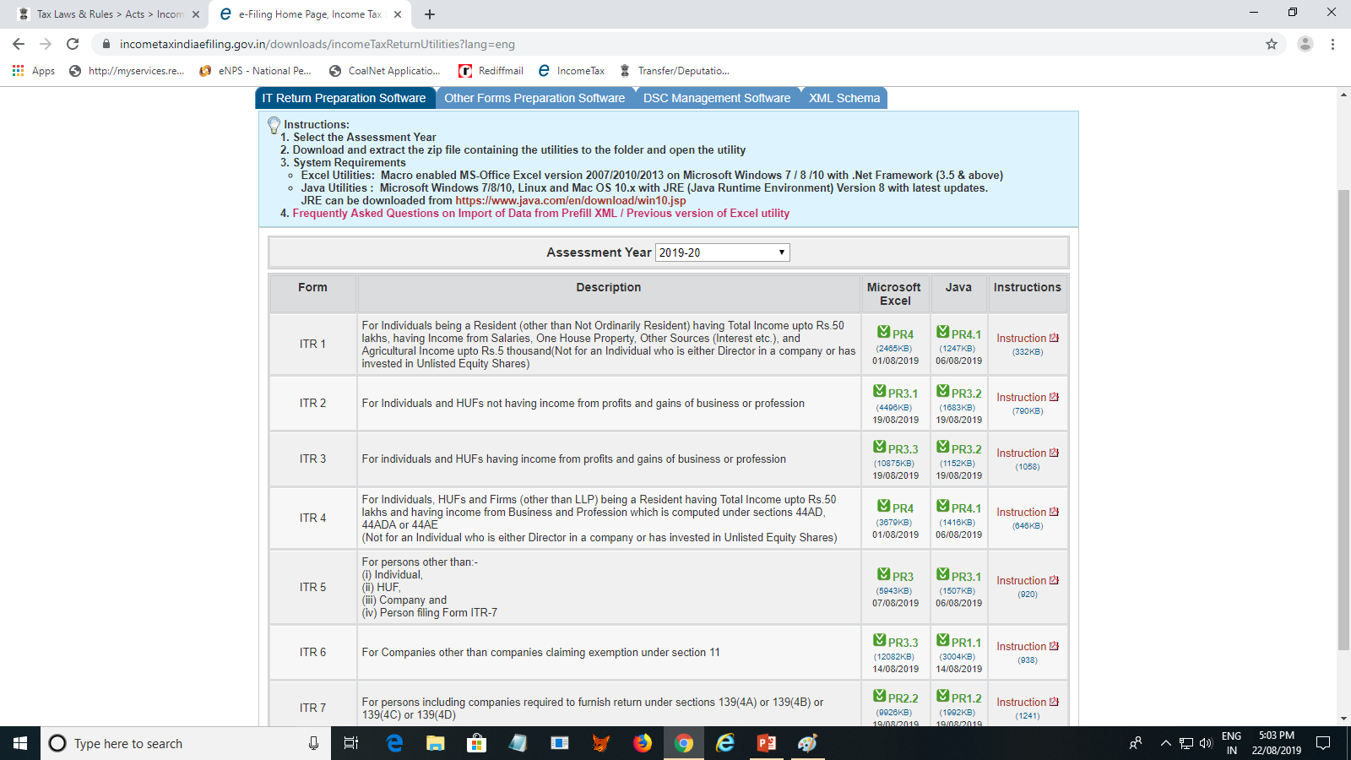
ITR FORMS

Slide 28
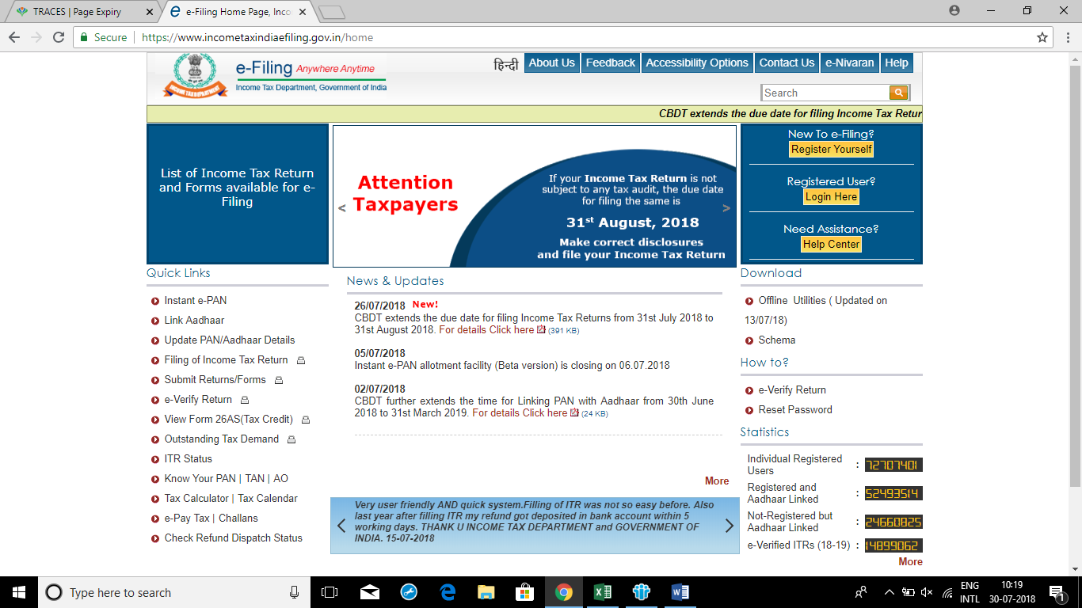
Income Tax E-Filing ( ITR-1)

Slide 29
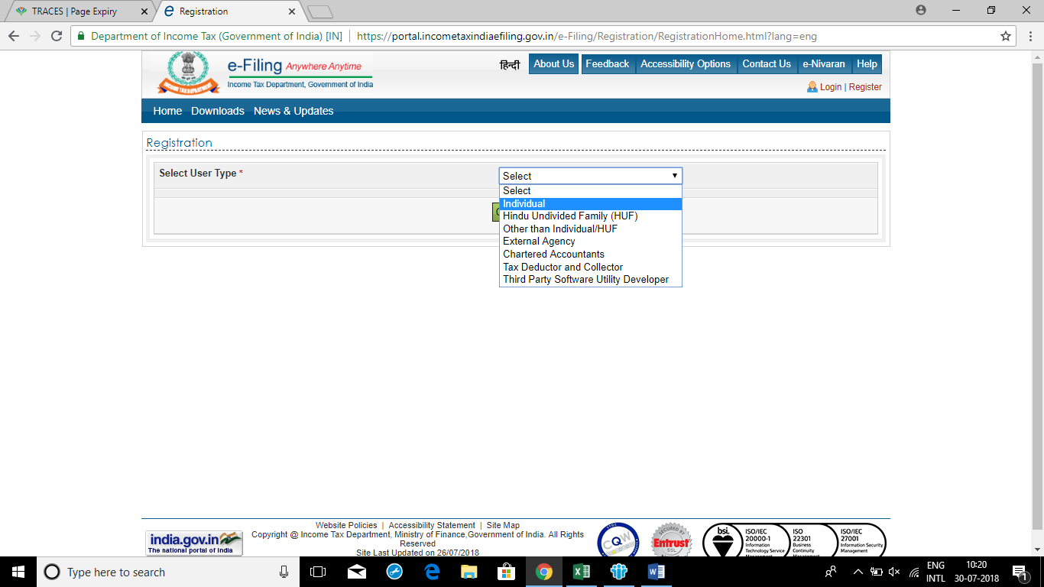
Income Tax E-Filing ( ITR-1)

Slide 30
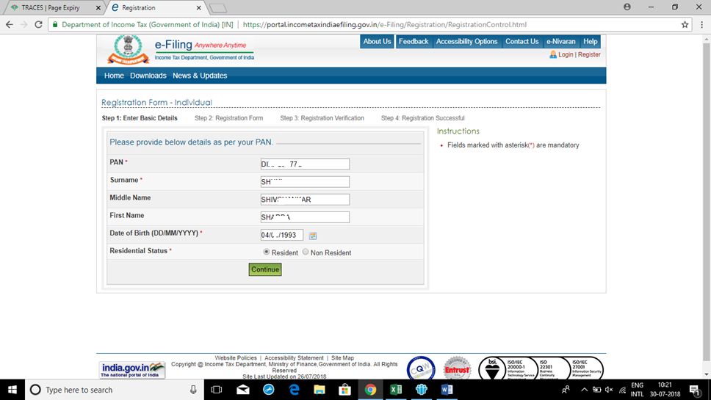
Income Tax E-Filing ( ITR-1)

Slide 31
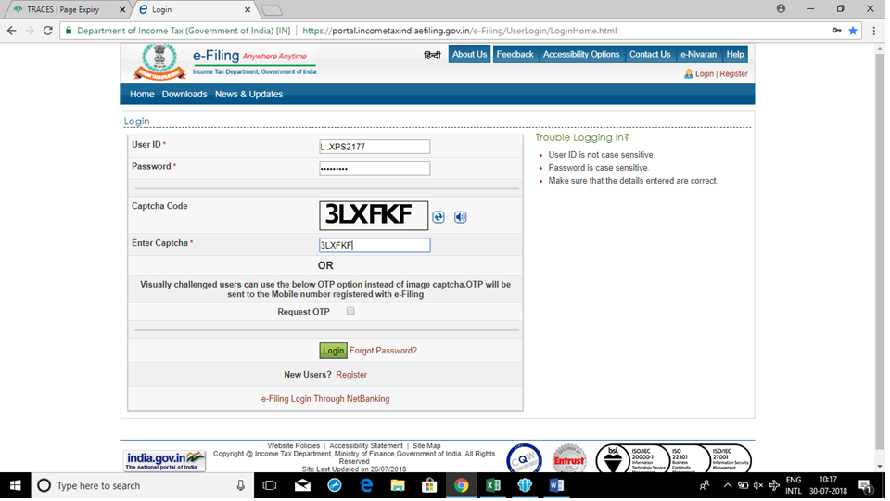
Income Tax E-Filing ( ITR-1)

Slide 32
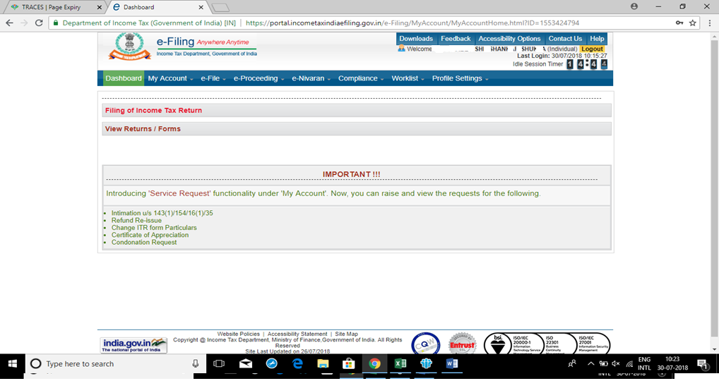
Income Tax E-Filing ( ITR-1)

