Slide 1
Half Wave & Full wave Rectifier

Slide 2
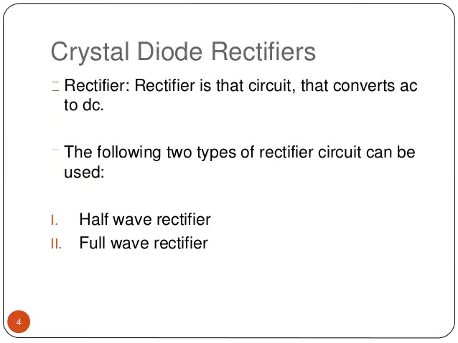

Slide 3
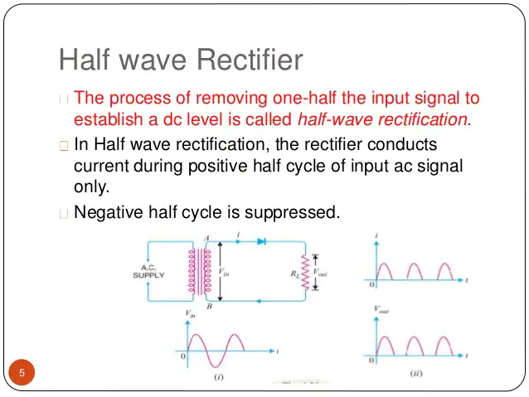

Slide 4
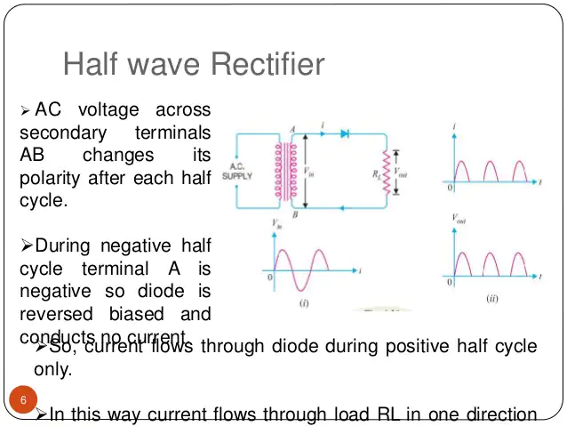

Slide 5
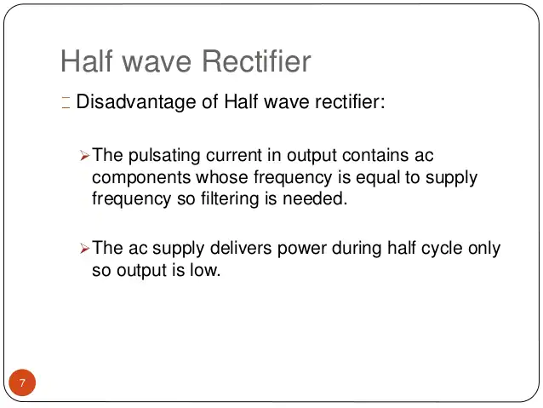

Slide 6
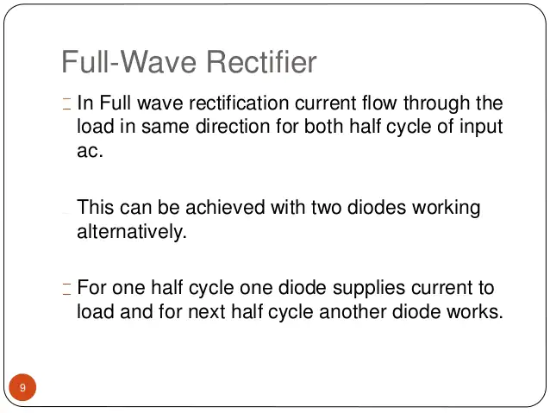

Slide 7
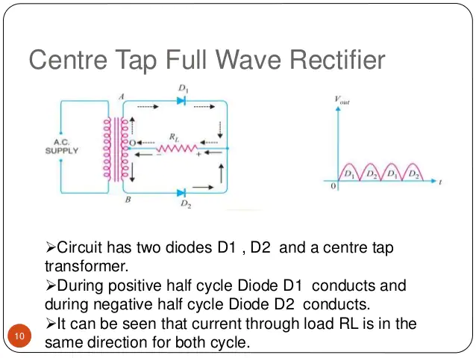

Slide 8
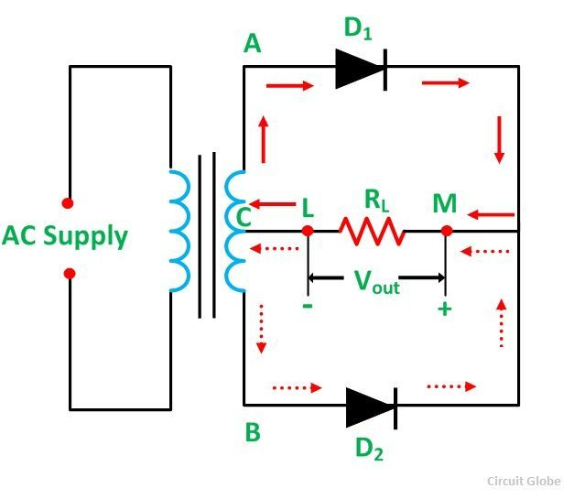

Slide 9
Full Wave Bridge Rectifier
In Full Wave Bridge Rectifier, an ordinary transformer is used in place of a center-tapped transformer. The circuit forms a bridge connecting the four diodes D1, D2, D3, and D4. The circuit diagram of the Full Wave Bridge Rectifier is shown below.
The AC supply which is to be rectified is applied diagonally to the opposite ends of the bridge. Whereas, the load resistor RL is connected across the remaining two diagonals of the opposite ends of the bridge.

Slide 10
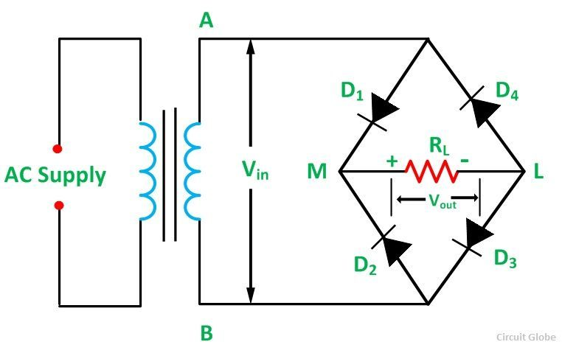
Full wave bridge rectifier

Slide 11
Operation of Full Wave Bridge Rectifier
When an AC supply is switched ON, the alternating voltage Vin appears across the terminals AB of the secondary winding of the transformer which needs rectification. During the positive half cycle of the secondary voltage, end A becomes positive, and end B becomes negative as shown in the figure below.

Slide 12
Full Wave Bridge Rectifier
The diodes D1 and D3 are forward biased and the diodes D2 and D4 are reversed biased. Therefore, diode D1 and D3 conduct, and diode D2 and D4 do not conduct. The current (i) flows through diode D1, load resistor RL (from M to L), diode D3, and the transformer secondary. The waveform of the full-wave bridge rectifier is shown below.

Slide 13
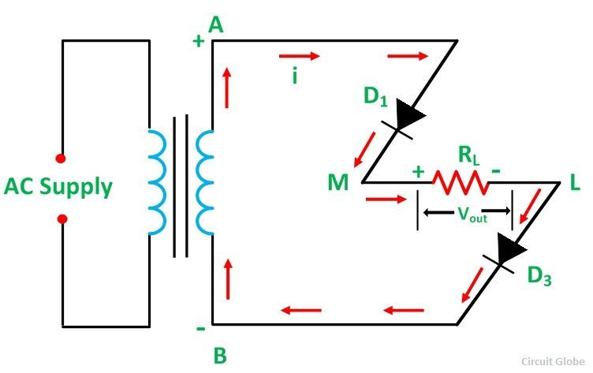
Full Wave Bridge Rectifier

Slide 14
Full Wave Bridge Rectifier
During the negative half-cycle, end A becomes negative and end B positive as shown in the figure below:
From the above diagram, it is seen that the diode D2 and D4 are under forward bias and the diodes D1 and D3 are reverse bias. Therefore, diode D2 and D4 conduct while diodes D1 and D3 do not conduct. Thus, current (i) flows through the diode D2, load resistor RL (from M to L), diode D4, and the transformer secondary.
The current flows through the load resistor RL in the same direction (M to L) during both the half cycles. Hence, a DC output voltage Vout is obtained across the load resistor.

Slide 15
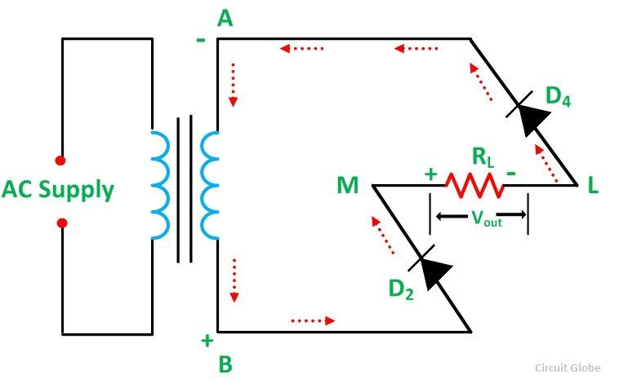
Full Wave Bridge Rectifier

Slide 16
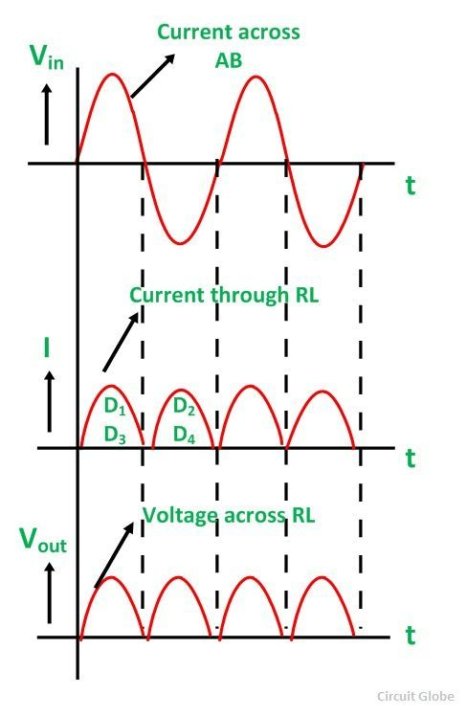
Full Wave Bridge Rectifier

