Slide 1
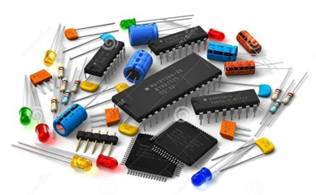
Basic Electronics Comonents

Slide 2
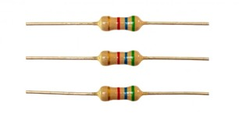
Resistor A component with 2 leads (connections)
Its function in a circuit is to control the electric current flow through the circuit
The greater the resistance value, the less will be the current flow
Resistor value is measured in Ohms (Ω)
Sometimes in a circuit the symbol for Ohms is not shown:
10 Ω may be written as 10R
0.1 Ω may be written as 0R1
1000 Ω may be written as 1k (1 kilo Ohms)
The value of the resistor is read using a colour coding scheme

Slide 3
Appearance & Schematic Symbol

Slide 4
Standard Resistor Values and Color
Resistor Color Coding uses colored bands to quickly identify a resistors resistive value and its percentage of tolerance with the physical size of the resistor indicating its wattage rating.
Generally, the resistance value, tolerance, and wattage rating are printed on the body of a resistor as numbers or letters when the resistors body is big enough to read the print, such as large power resistors.

Slide 5
Standard Resistor Values and Color

Slide 10
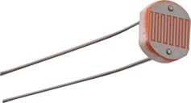
Light Dependent Resistor (L.D.R.)
A component with 2 leads (connections)
Its function in a circuit is to control the electric current flow through the circuit
The value of the resistor varies with light applied over it
Resistance decreases as light increases
Appearance
Schematic Symbol

Slide 11
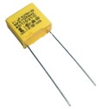
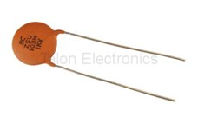
Capacitor A component with 2 leads (connections)
Its function in a circuit is to charge up to a voltage, hence storing electrical charge (energy)
Capacitor value is measured in Farads (F)
Capacitors usually have a very low capacitance value:
F is given as 1 µF (µ = micro = 1 x 106)
F is given as 1 nF (n = nano = 1 x 109)
F is given as 1 pF (p = pico = 1 x 1012)
The value of the capacitor is read using a number coding scheme
Appearance
Schematic Symbol

Slide 12
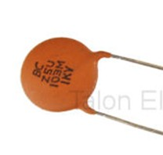
Reading Capacitor Value:
If the code ‘103’ is printed on the capacitor:
The first digit of the code is the first digit of the value
The second digit of the code is the second digit of the value
The third digit of the code is the number of zeros following the first 2 digits of the value
The resulting value is always in pico-farads
The value of the capacitor will therefore be:
10000 pF or 10 nF
The letter code 1KV means that the capacitor can be charged up to 1000V (1kV) maximum.

Slide 13
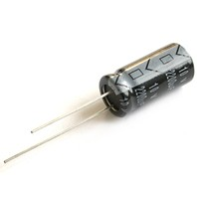
Polarized Capacitor
A capacitor whose leads are marked with (+) and (-)
They are designed for higher capacitance values (range of micro-farads)
It is important to properly connect in the circuit to avoid damage during operation
Used only on DC (values of voltage that do not change polarity)
Capacitor marking:
The longer lead is the (+)
(-) lead indicated on the capacitor body
The value and working voltage are written on the case (no number coding used)
Appearance
Schematic Symbols

Slide 14
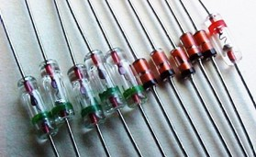
Diode A component with 2 leads (connections)
The connections are named ANODE and CATHODE
Its function in a circuit is to control the direction of electric current flow through the circuit
When a DC voltage is applied across a diode:
current will be allowed to pass if the (+) is connected to the anode, and the (-) is connected to the Cathode (DIODE IS FORWARD BIASED)
current will not be allowed to pass if the (+) is connected to the Cathode, and the (-) is connected to the Anode (DIODE IS REVERSED BIASED)
A ring printed on one side of the diode body indicates the Cathode Lead
Appearance
Schematic Symbol

Slide 15
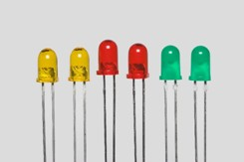
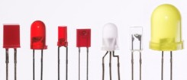
Light Emitting Diode (L.E.D.):
A component with 2 leads (connections)
Its function in a circuit is to indicate the presence of voltage, or to produce light.
When the LED is connected in FORWARD BIAS MODE, it will light up
IMPORTANT :
Never connect a LED in Reverse Bias
it will not light up ☹
It will be damaged with just 5V ☹
The maximum voltage to be applied in Forward Bias Mode is 5V, or the LED will be easily damaged.
Appearance
Schematic Symbol

Slide 16
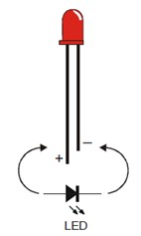
How to identify the Leads of a LED:

Slide 17
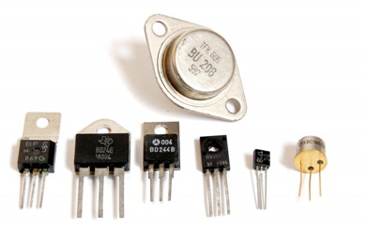
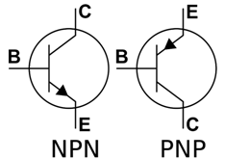
Transistor A component with 3 leads (connections)
Its function in a circuit is as an electronic switch, or as an amplifier
Two types of transistors are available:
NPN
PNP
The connections are named:
COLLECTOR (C)
BASE (B)
EMITTER (E)
Appearance
Schematic Symbols

Slide 18
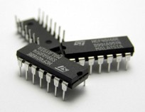
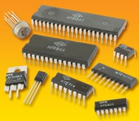
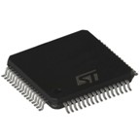
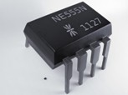
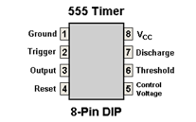
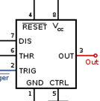
Integrated Circuits (IC)
A component with a number of pins ranging from 8 to 40 (and more)
A full electronic circuit is built inside the IC package, and connected to pins located around the IC
Each IC has its own functional circuit
Always read the data sheet of the IC in order to find out its function
Appearance
Schematic Symbol (example NE 555 timer IC)

Slide 19
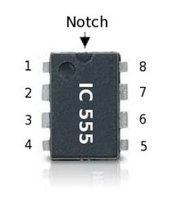
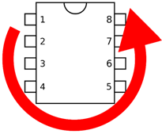
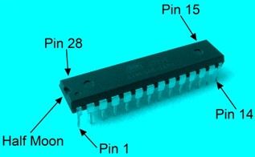
Identifying IC pin-outs

Slide 20
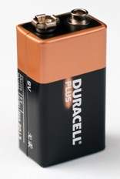
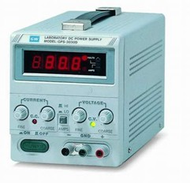
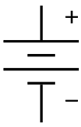
Variable output DC power supply
Battery (DC Power Supply)
A source of DC Power used to supply electronic components and circuits
Can be in the form of a battery
Can be in the form of a piece of electronic equipment which is plugged into the 230V AC mains supply
Called DC power supply
Converts AC 230V into DC
Steps down the DC into a low voltage suitable for electronics
9V DC Battery
Variable output DC power supply
Appearance
Schematic Symbols

Slide 21
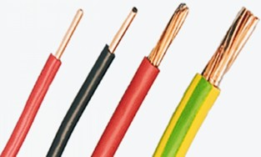
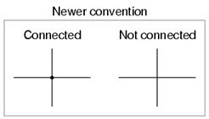
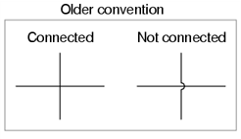
Wire (Conductor) Used to interconnect components to form a circuit
Must be insulated
Can be single stranded or multi-stranded
Single stranded used during experiments to insert into the prototyping (Breadboard) Board
Multi-stranded type used in practice for improved flexibility
In the circuit schematics, a wire is drawn as a LINE
Single stranded wire
Multi-stranded wire
Appearance
Schematic Symbols

Slide 22
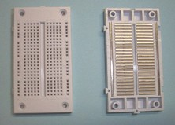
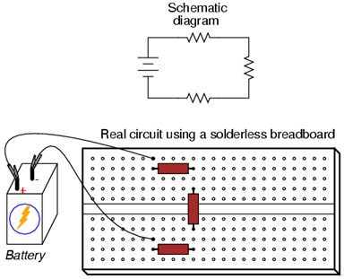
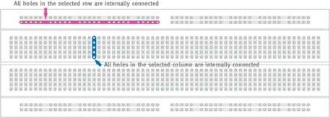
Prototyping Board (Breadboard)
Used to build electronic circuits for experimental purposes
Components easily inserted and removed
Internal links help construct the circuit very easily
Breadboard connections
Constructing a circuit on a Breadboard

Slide 23
Active and Passive Electronics Components

Slide 25
What are Active Electronic Components?
Those devices or components which require an external source to operate in a circuit are called Active Components.

Slide 26
What are Active Electronic Components?
For Example: Diode, Transistor, SCR etc…
Explanation: As we know that Diode is an active component. Therefore, it requires an external source to work and operate in a circuit.
This is because if we connect a Diode in a circuit which is further connected to the supply voltage, the diode will not conduct the current (either in forward or reverse bias) until the level of voltage reaches to 0.3V (In case of Germanium) or 0.7V (In case of Silicon).

Slide 27
Complete List of Active Electronic Components
Diodes (All)
Rectifier Diode
Schottky Diode
Zener Diode
Unipolar / Bipolar Diode
Varicap
Varactor
Light-Emitting Diode (LED)
Solar PV Cell, PV Panel
Transistors (All)
Photo Transistor
Darlington Transistor
Compound Transistor
Field-Effect Transistor (FET)
JFET (Junction Field-Effect Transistor)
MOSFET (Metal Oxide Semiconductor FET)
Thyristors
Composit Transistors

Slide 28
What are Passive Electronic Components?
Those devices or components which do not require an external source to operate in a circuit are called Passive Components.

Slide 29
What are Passive Electronic Components?
For Example: Resistor, Capacitor, Inductor etc…
Explanation: Passive Components (such as resistors. capacitors, inductors etc.) do not require an external source to their operation.
Like a Diode, Resistor does not require 0.3V or 0.7 V. i.e., when we connect a resistor to the supply voltage, it starts work and responds instantly in the circuit without using additional and conditional specific voltage like in case of diodes etc. Same is the case for inductors and capacitors etc.

Slide 30
Complete List of Passive Electronic Components
Resistors (All Types)
Capacitors (All Types)
Inductors / Coil
Memristor / Network
Sensors
Detectors
Transducers
Antennas
Assembly Modules
Piezoelectric devices
Crystals
Resonators
Terminals and Connectors
Cables
Switches
Circuit Protection Devices
PCB
Mechanical Devices such as a Fan, Lamp

Slide 31
In other words:
Active Components:
Those devices or components which produce energy in the form of Voltage or Current are called Active Components
Examples: Diodes, Transistors SCR etc…
Passive Components:
Those devices or components which store or maintain Energy in the form of Voltage or Current are known as Passive Component
Examples: Resistor, Capacitor, Inductor etc…
In very Simple words;
Active Components: Energy Donor
Passive Components: Energy Acceptor

Slide 34
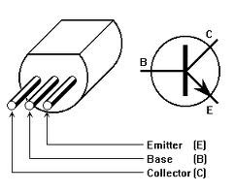
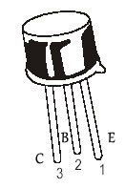
How to identify Terminal of Transistor

