Slide 1
Electronic Workshop Practices
Study of various active & passive electronic components.

Slide 2
What are Active Electronic Components?
Active electronic components are those that can control the flow of electricity. Different Types of Printed Circuit Boards have at least one active component. Some examples of active electronic components are transistor, vacuum tubes, silicon-controlled rectifiers (SCRs).

Slide 3
Active Electronic Components:
Definition 1 : Active components are those components which generate or supply energy to the circuit in some form. Components that can amplify power such as transistors also fall in this category since there is a net energy change in the circuit.
Definition 2 : Active components are the components connected to a source of energy and rely on it to amplify power (such as transistors).
Definition 3 : Active electronic components are those components that can control the flow of electricity (by either amplifying, attenuating, or generating.

Slide 4
List of Active Components

Slide 5
What are Passive Electronic Components?
Passive electronic components are those that don’t have the ability to control the flow of electric current by means of another electrical signal. Examples of passive electronic components are capacitors, resistors, inductors, transformers.

Slide 6
Passive Electronic Components
Definition 1 : A passive component is a component that cannot generate, supply or amplify energy/power.
Definition 2 : Passive components are the components that do not require being connected to an external supply to operate.
Definition 3 : Passive electronic component are those components who cannot control the flow of electricity by means of another electrical signal. For example, transformers cannot change the direction of electricity or have any control over it—they simply either increase voltage or current. The power remains constant.

Slide 8
List of Passive Components

Slide 14
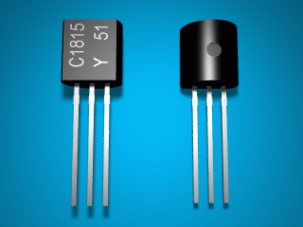
Transistors
Transistors may be packaged individually or they can be a part of an integrated circuit. Some of the ICs have billion of transistors in a very small area.

Slide 33
Electronic Component Description

