Slide 1
Strategic alliance Joint venture Leverage buyout

Slide 2
S
Strategic Alliance

Slide 3
Strategic Alliance
A strategic alliance is an arrangement between two companies to undertake a mutually beneficial project while each retains its independence.
A company may enter into a strategic alliance to expand into a new market, improve its product line, or develop an edge over a competitor.
The arrangement allows two businesses to work toward a common goal that will benefit both. The relationship may be short-term or long-term.
Strategic alliances diversify revenue streams, grant access to potentially difficult-to-obtain resources, and may improve a company's public image.
Strategic alliances may also cause companies to expend resources resolving conflict, not yield results as expected, or negatively impact a company's public image.

Slide 4
Types Of Strategic Alliance
Equity Strategic Alliance : An equity strategic alliance may have similar outcome goals as a joint venture; however, it is funded differently in that one company makes an equity investment into another.
Non-Equity Strategic Alliance: A non-equity strategic alliance forms when two entities realize mutual benefit exists and no equity transfusion is necessary. A more simple contractual obligation is agreed upon for the two entities to pool resources and capabilities together.

Slide 5
How Do Strategic Alliances Create Value?
Improving short-term finances.
Eliminating barriers to entry.
Gaining better business insights.
Sharing financial risk.
Innovating beyond current capabilities.

Slide 6
Joint Venture (JV)

Slide 7
Joint Venture (JV)
A joint venture (JV) is a business arrangement in which two or more parties agree to pool their resources for the purpose of accomplishing a specific task. This task can be a new project or any other business activity.
Each of the participants in a JV is responsible for profits, losses, and costs associated with it. However, the venture is its own entity, separate from the participants’ other business interests.
They are a partnership in the colloquial sense of the word but can take on any legal structure. A common use of JVs is to partner up with a local business to enter a foreign market.

Slide 8
Why companies form JV
To Leverage Resources
To Reduce Costs
To Combine Expertise
To Enter Foreign Markets

Slide 9
Examples of Joint Venture Companies
Tata Starbucks
Bharti-AXA General Insurance Co Ltd
Mahindra-Renault Ltd
AirAsia India
Bayer Zydus Pharma JV with Cadila Healthcare

Slide 10
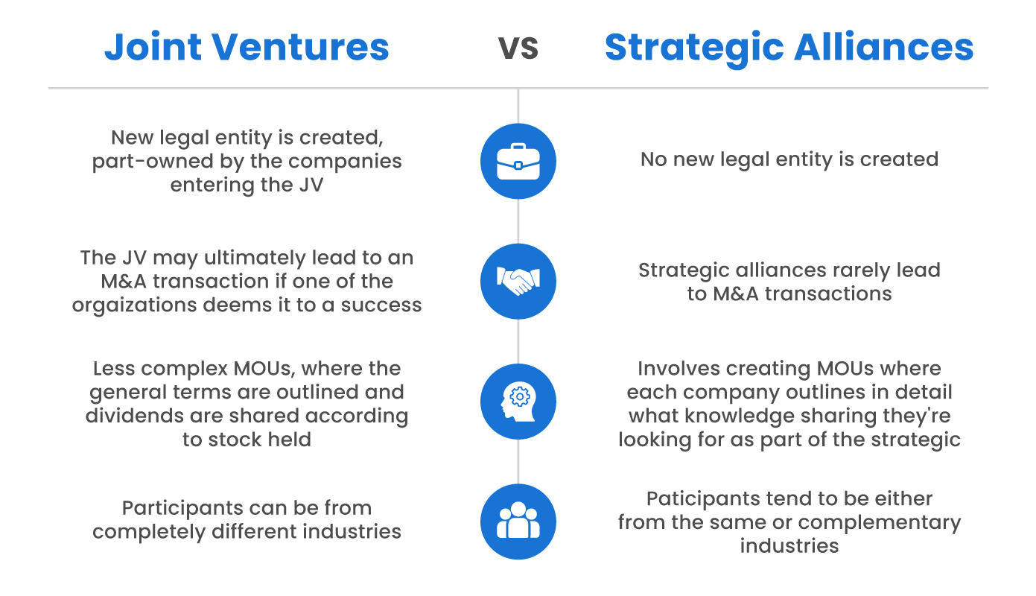

Slide 11
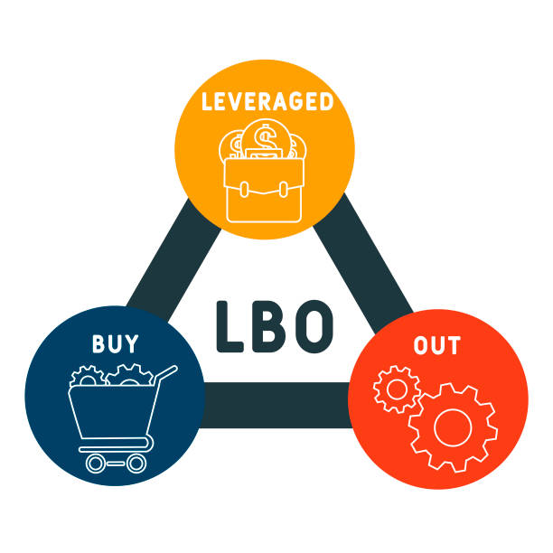

Slide 12
Leveraged Buyout
A leveraged buyout (LBO) is the acquisition of another company using a significant amount of borrowed money (bonds or loans) to meet the cost of acquisition. The assets of the company being acquired are often used as collateral for the loans, along with the assets of the acquiring company.
A leveraged buyout (LBO) occurs when the acquisition of another company is completed almost entirely with borrowed funds.
Leveraged buyouts declined in popularity after the 2008 financial crisis, but they are once again on the rise.
In an LBO, there is usually a ratio of 90% debt to 10% equity.

Slide 13
Characteristics of a LBO Candidate
Strong, predictable operating cash flows with which the leveraged company can service and pay down acquisition debt
Mature, steady (non-cyclical), and perhaps even boring
Well-established business and products and leading industry position
Moderate Capex and product development (R&D) requirements so that cash flows are not diverted from the principle goal of debt repayment
Limited working capital requirements
Strong tangible asset coverage
Undervalued or out-of-favor

