Slide 1
Seven Principles for Effective Energy Management

Slide 2
Seven Principles for Effective Energy Management
With the passage of time, the cost of energy has shot up to a great extent. This change has resulted in making energy management a priority for all the facility managers and commercial building owners.

Slide 3
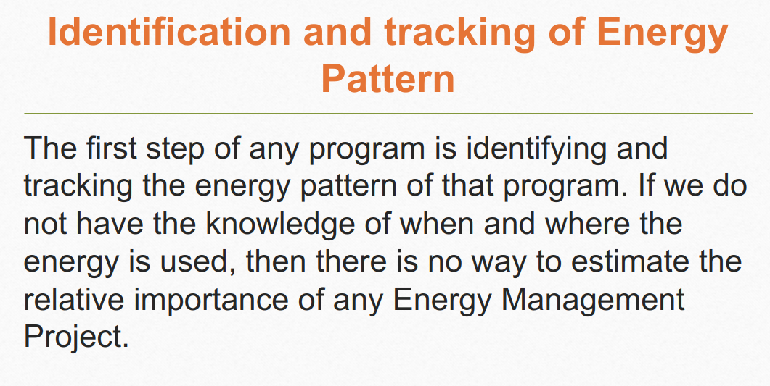

Slide 4
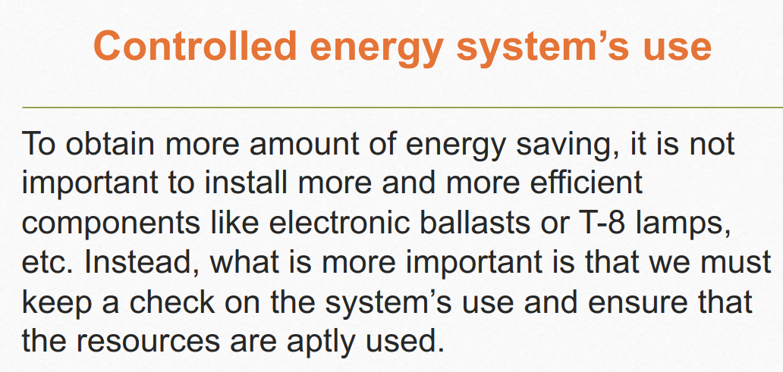

Slide 5
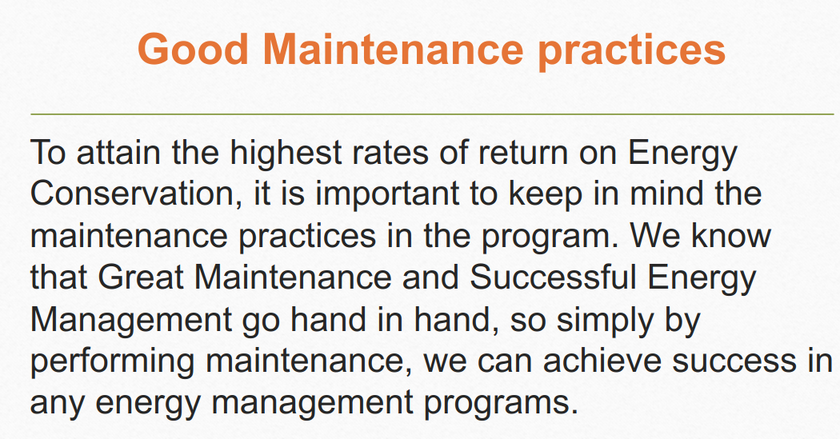

Slide 6
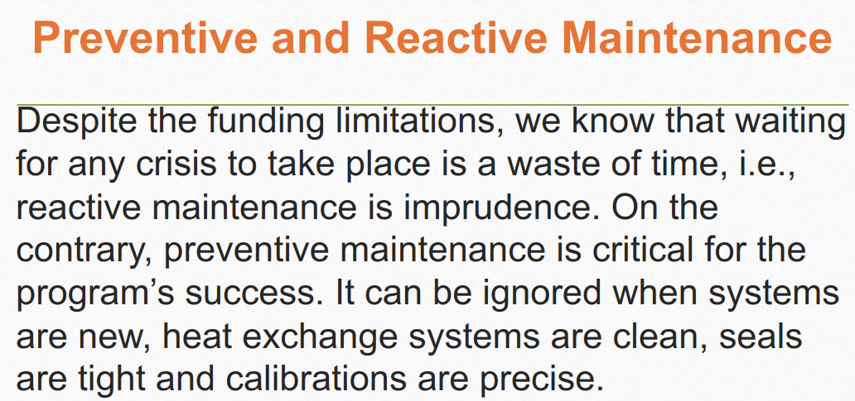

Slide 7
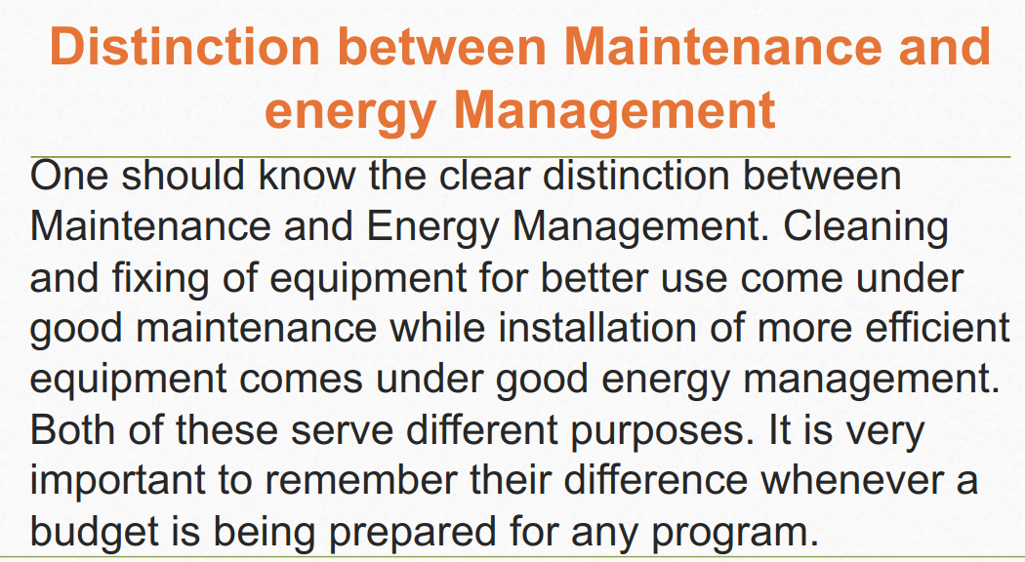

Slide 8
