Slide 1
Mergers and Acquisitions
The price is right, or is it?

Slide 2
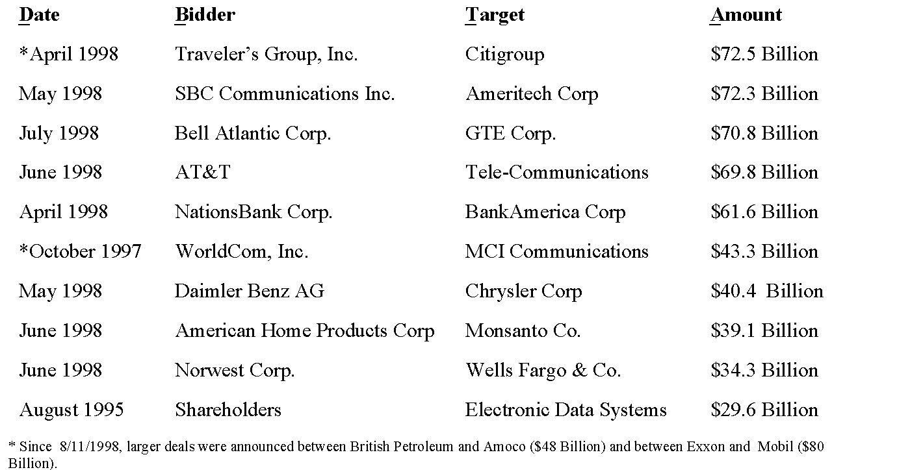
10 Largest Mergers & Acquisitions as of 8/11/1998 (Source: Dow Jones Newswire)

Slide 3
Mergers and Acquisitions: Some Definitions
Merger or Consolidation
Acquisition
Acquisition of Stock
Takeover
Proxy Contest
Acquisition of Assets
Going Private

Slide 4
Mergers and Acquisitions: Some Definitions
Horizontal Mergers
Vertical Mergers
Conglomerate Mergers

Slide 5
Mergers and Acquisitions: Tax Status
To qualify for tax-free status, the merger must
have a valid business purpose (not just to avoid taxes), and
continue the equity interest of the target shareholders in the bidder.
These conditions generally imply that the merger will be tax-free if the bidder offers shares of its firm for shares of the target firm in the transaction.
The tax implications for mergers show up in the
capital gains, if any, paid by the target firm’s shareholders, and
the “write-up” the bidding firm can use for depreciation purposes

Slide 6
Mergers and Acquisitions: Synergy
What is synergy?
The positive incremental net gain associated with the merger
Cash Flows =  EBIT - Taxes -  Capital Spending
=  Sales - Costs -  Taxes -  Capital Spending

Slide 7
Mergers and Acquisitions: Synergy
 Sales
Marketing Gains
Media Programming Enhancements -
Improved distribution Networks
More balanced Product Mixes
Strategic Benefits
Market Power

Slide 8
Mergers and Acquisitions: Synergy
Costs
Economies of Scale
Economies of Vertical Integration
Complementary Resources

Slide 9
Mergers and Acquisitions: Synergy
 Taxes
Net Operating Losses
Unused Debt Capacity
Surplus Funds
Asset Write-Ups
 Capital Spending

Slide 10
Mergers and Acquisitions: How to Value the Deal
Do not ignore available market values.
Estimate only incremental cash flows.
Use the correct discount rate.
Be aware of transactions costs.

Slide 11
Mergers and Acquisitions: Deterrents to Value
June 3, 1999
Wall Street Top Deal Makers
Aren't the Best Matchmakers
By ROBERT MCGOUGH
Staff Reporter of THE WALL STREET JOURNAL
Wall Street's top deal-making firms can boast about advising corporate
America on big tender offers and raking in huge merger fees.
So, they also can brag about putting together superior deals, right? Not
quite.
The stocks of acquirers whose tender offers were handled by top-tier
investment banks -- those doing the most merger-advisory business --
actually performed worse over the next three years than the stocks of
acquirers advised by less-active merger-advisory firms, according to
Raghavendra Rau, a Purdue University professor who studied the subject.

Slide 12
Mergers and Acquisitions: Deterrents to Value
After the Wedding
In the three years following tender offers, acquiring firms advised by top-tier
investment banks often fared worse in the stock market than clients advised by
lower-ranked investment banks.
Clients of: Return in Excess of Benchmark (In percentage points)
First-tier banks 0.63
Second-tier banks 6.19
Third-tier banks 20.16
Note: Investment-bank rankings are based on the banks' annual dollar amount of
advisory transactions for acquiring companies from 1980 through 1994. Returns
are measured from the deal's closing date.
Source: Raghavendra Rau, Krannert Graduate School of Management, Purdue
University

Slide 13
Mergers and Acquisitions: Deterrents to Value
Why the disparity among advisers?
A larger percentage of the fee of the top-tier investment banks was tied to completing the deal than for
lower-ranked rivals, the study found. First-tier banks got 73% of their pay in tender offers from contingency fees, compared with 61% for second-tier banks and 64% for third-tier banks. The higher a contingency fee paid by an acquirer in a tender offer, the worse its stock generally performed over the next 12 months.
Clients of first-tier investment banks also tended to pay a high premium over the stock-market price to acquire
their targets. For instance, in tender offers, the study found that clients of first-tier investment banks paid a median premium of 56% above the market price, compared with 38% for clients of third-tier banks.

Slide 14
Mergers and Acquisitions: Deterrents to Value
Citigroup: Is This Marriage Working? Business Week, June 7, 1999
The Citigroup merger is going reasonably well. But there are signs of tension between Weill and Reed
Ask John S. Reed about being co-CEO of Citigroup with Sanford I. Weill, and he volunteers a revealing story. It
concerns a Spanish bank created by a merger that, like Citigroup (C), was headed by co-CEOs. At first, the Spanish
bankers were ''good buddies,'' but they soon got into a power struggle. One CEO died, but another man replaced him
and the fighting continued. Finally, the board settled on one boss and the bank thrived.
The lesson for Citigroup, the Spanish CEO told Reed, was simple. Have the board flip a coin in public and let the
winner be CEO. That way there's no winner and no loser, just blind luck. Reed made a point of telling Weill this story.
Says Reed, with his characteristic candor: ''Sandy didn't like it.''
Reed is not suggesting a coin flip. But just in case anyone missed the message of the story, Reed leaves no doubt that
sharing the top job is tough. ''I don't think Sandy and I have yet created much of a problem,'' Reed says. ''But
co-CEO's are hard.''
One year after the integration of Citicorp and Travelers began in earnest, there's evidence that the relationship is
fraying. Saudi Prince Alwaleed bin Talal, whose 4.8% of Citigroup stock makes him the largest single shareholder,
says he learned three weeks ago that coordination between Weill and Reed has not been as close as it was when the
merger was announced. Says the Prince: ''I will try to see them both in July during my trip to the U.S., but I hope it will
be resolved by then one way or the other.'' Citigroup's next board meeting is the third week in July.

Slide 15
Mergers and Acquisitions: Defense Mechanisms
Major defense tactics against mergers include:
The corporate charter - super majority amendments
Standstill agreements - greenmail and targeted repurchases
Exclusionary self-tenders
Poison pills - share rights plans - flip-over provisions
Leveraged Buyouts
Other defense tactics
Golden parachutes
Poison puts
Crown jewels
White knights - white squires - whitemail
Lockups

Slide 16
Mergers and Acquisitions: Stockholders’ Abnormal Returns
Takeover Technique Target Bidder
Tender Offer 30% 4%
Merger 20% 0%
Proxy Contest 8% NA
(Source: Jensen and Ruback, JFE, 1983)

Slide 17
Mergers and Acquisitions: What do Stockholders’ Abnormal Returns Tell Us and How are they Measured?
Stockholders’ abnormal returns around mergers measure the firm-specific effects of the merger announcement(s) on the target and bidding firms.
One way to measure these abnormal returns is by

Slide 18
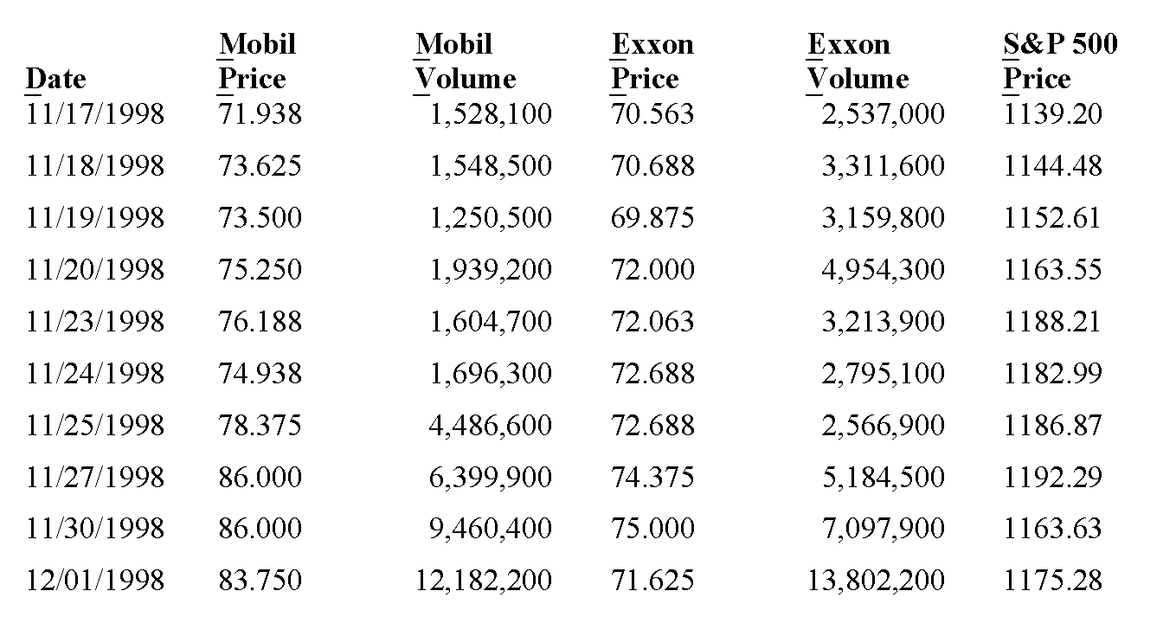
Mergers and Acquisitions: Abnormal Returns for Mobil and Exxon whose s are, respectively, 0.51 and 0.67

Slide 19
Mergers and Acquisitions: Abnormal Returns for Mobil and Exxon
Questions about abnormal returns:
The announcement of the merger was made on 12/01/1998, but was that the first information the market had about it?
Rumors of this merger?
Actual mergers or rumors of other mergers in this industry?
What do abnormal returns mean about synergy?
What do abnormal returns say about the likelihood of the success of the offer?

Slide 20
Mergers and Acquisitions: Abnormal Returns for Mobil and Exxon
Assuming rumors about the Exxon/Mobil merger surfaced on 11/25/1998, what are the abnormal returns for each company?
What is the aggregate dollar value change in firm value for each company? (Mobil has 787 million shares outstanding; Exxon has 2,478 million)

Slide 21
Mergers and Acquisitions: Abnormal Returns for Mobil and Exxon
What is the market’s assessment of the likelihood that this merger will be completed at the price Exxon is willing to pay? (1.32 shares of Exxon was offered for each share of Mobil.)

Slide 22
Mergers and Acquisitions: Value Creation for Mobil and Exxon
The companies projected an annual operating cost savings of $2.8 billion from the merger. At what rate should the savings be discounted? (Exxon had $6,912 million in long-term debt, and Mobil had $3,957 million. The rate on long-term government bonds at the time was about 5.20%)
If the savings is realized every year for the next 10 years, can the savings justify the premium Exxon is paying?

Slide 23
Mergers and Acquisitions: Value Creation for Mobil and Exxon
The companies also projected that capital spending would be cut by 10%. The projected combined capital budget for next year is $13 billion. If that expense is expected to be the same every year for the next 10 years and the savings will accrue every year over that period, can the savings in capital spending justify the premium Exxon is offering? (Assume depreciation is straight line over 10 years.)

Slide 24
Mergers and Acquisitions: Value Creation for Mobil and Exxon
To what do you attribute the price that Exxon is willing to pay for Mobil?

