Slide 1
Cross Border Merger & Acquisition

Slide 2
What are Merger & Acquisition?
Merger
A merger combines two companies in one. Such transactions take place between two businesses/ companies of the same size.
Additionally, the terms of the merger are amicable and also mutually agreed by the two companies to become equal partners in the new venture..
Acquisition
Acquisition occurs when a company buys another company. Sometimes, the purchase is friendly whereas sometimes it is hostile. Thus, a large company acquires a small company to diversify its business.

Slide 3
What is Cross Border Merger & Acquisition?
It’s cross border transaction where legal barriers are more complex and the business culture is wide.
For a basic concept:
Its an international “marriage” between two companies to form a “family” where the two parties will be equally responsible for the finance and the management strategies. The two parties will share the profits and losses accordingly.
Cross-border mergers and acquisitions involve assets and operations of firms belonging to two different countries.

Slide 4
What are the Factors to be Considered in Cross Border Mergers and Acquisitions?
The globalisation of financial markets.
Due to market pressure and the decreasing demand because of competition in the international market. To seek new market opportunities because of fast- growing technology.
Due to geographical diversification which would
provide opportunities in exploring the assets in other countries.
Increase the efficiency of companies’ in producing
goods and services.
Fulfilling the objective to increase profitability. To increase productivity or scale of production.
Sharing technology or any innovation which can help in
reducing the costs.

Slide 5
What are the Effects of Cross Border Merger and Acquisition?
Cross border merger and acquisitions are a reformation of industrial assets and production structures on a worldwide basis.
It empowers global transferring of technology, goods and services and integrates it for overall networking.
Cross border M&A’s leads to economies of scale and also scope, which helps in gaining expertise.

Slide 6
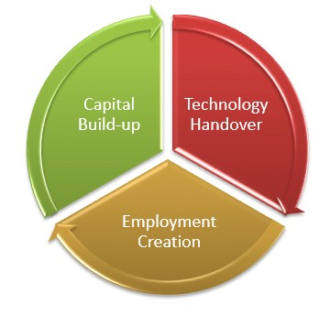
Benefits of Cross Border Merger & Acquisition:

Slide 7
Capital Build-up
Cross border M & A supports an increase in the capital on a long term basis. To expand their businesses, it not only undertakes investment in plants or buildings and equipment’s but also in the incorporeal assets such as technical skills rather than just the capital.

Slide 8
Employment creation
Mergers and acquisition that are undertaken to drive restructuring may lead to downscaling but would lead to employment gains in the long term. This downsize sometimes is essential for the continued existence of operations. In case the businesses expand and become successful, it would create new employment opportunities.

Slide 9
Technology Handover
When businesses across countries join together, it brings transfer of technology, sharing of best management skills and practices in the host country. This results in innovations and has a better influence on the operations of the company.

Slide 10
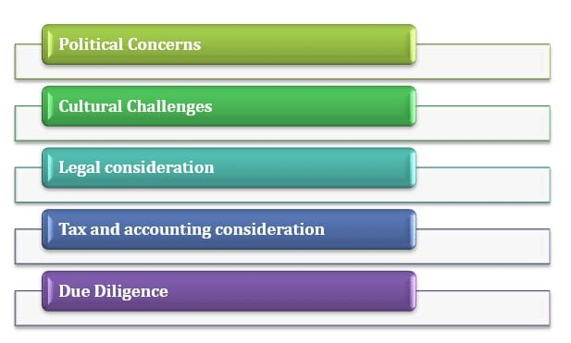
Issues and Challenges on Cross Border Merger & Acquisition

Slide 11
The political scenario plays a crucial role in cross border merger and acquisitions.
Basically, for industries which are politically sensitive such as defence, security etc.
Political concerns

Slide 12
Cultural Challenges
A cultural challenge can be a considerable threat to cross border M&A. To deal with this challenge, businesses need to spend the right amount of time to get knowledge of the local culture and also of the employees.

Slide 13
Legal considerations
The merging companies must look into the various legal and regulatory issues that they are likely to face. While going through the process of reviewing these concerns, it could indicate that the potential merger or acquisition would be incompatible. Hence, it is recommended to not go ahead with the deal.

Slide 14
Tax & Accounting Considerations
Tax-related matters are critical, particularly when it comes to structuring the transactions. Many countries are yet to implement International Financial Reporting Standards (IFRS).
The parties in the merger should be aware of the financial and accounting terms in the deal.

Slide 15
Due Diligence
Due diligence affects the terms and conditions under which the M&A transaction would take place, influence the deal structure affects the price of the deal. There are various other issues as every agreement has its favour and differences.

Slide 16
Conclusion
The corporate sector in India is moving towards the stage where globalisation and its principles are intended to be accepted by the state through favourable legislation but, due to existence of multiple technical legislation governing the concerned subject, it is almost impossible to attain the most desirable stage with one attempt. Though there is very little progress in the research literature to explore the role of culture in the success of these ventures of M&A. Cross-border M&A has added challenges of dealing with both national and organizational culture differences.

Slide 17
THANK YOU!

