Slide 1
Transmission Line

Slide 2
Field Theory | Circuit Theory
The dimensions are fraction of a wavelength or many wavelengths ,in size. | The physical dimensions of the network is very less comparatively with the wavelength.
Distributed parameter network, where the voltages & currents change with distance & time over the length of the circuit. (travelling waves) | Lumped parameter network, where voltages and currents are constant over the length of the circuit. They may be time harmonic but not distance dependant.
Analysis based on Maxwell’s equations. | Analysis based on Kirchoff’s laws and Ohm’s law.
Useful for RF and micorwave signals (range from MHz to GHz) | Useful for low frequency electrical signals (range up to few KHz)

Slide 3
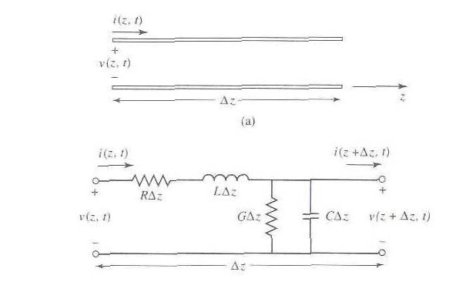
As shown in figure the transmission line is represented as a two-wire line, means it has at least two conductors. (for TEM wave propagation)
The transmission line equivalent to the circuit element is shown in figure for the small section of line of length Δz.
R, L, G and C line parameters are per unit length.

Slide 4
The series inductance L represents the total self-inductance of the two conductors, and the shunt capacitance C is due to the close proximity of the two conductors.
The series resistance R represents the resistance due to the finite conductivity of the conductors, and the shunt conductance G is due to dielectric loss in the material between conductors. R and G therefore, represent loss.
By KVL in the circuit

Slide 5
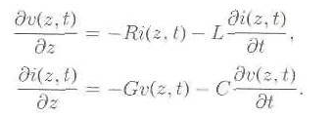
By KCL in the circuit,
By dividing the above two equations by Δz and taking Δz 0
These equations are the time domain form of the transmission line [Telegrapher’s Equations].

Slide 6
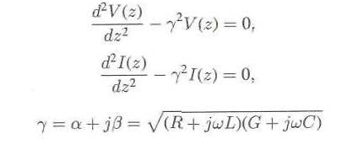
The wave equations for V(z) and I(z) can be written as,
Where, γ is the complex propagation constant.
The solution of the above equations are,

Slide 7
From the above equations, we get,
And the characteristic impedance is given by,
It relates the voltage and current on the line as,
The current on the line is given by,

Slide 8
For lossless, transmission line, setting R=0 and G =0,
The propagation constant is
The phase velocity is
The characteristic impedance is

Slide 9
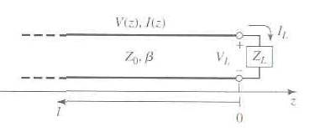
Transmission Line and Reflection Coefficient
A lossless transmission line terminated in an arbitrary load impedance ZL.
An incident wave of the form is generated from the source and the ratio of voltage to current for such a traveling wave is Z0.
But when the line is terminated in an arbitrary load ZL= Z0, the ratio of voltage to current at the load must be ZL.

Slide 10
Thus, a reflected wave must be excited with appropriate amplitude to satisfy this condition.
The total voltage on the line is sum of incident and reflected waves.
Similarly, the total current on the line is,
The total voltage and current at the load are related by the load impedance.
This gives,

Slide 11
The amplitude of the reflected voltage wave normalized to the amplitude of the incident voltage wave is defined as the voltage reflection coefficient Г.
The total voltage and current waves on the line are,
It is seen that the voltage and current on the line consist of a superposition of an incident and reflected wave; such wave are called standing waves.
Only when Г=0, there is no reflected wave.

Slide 12
To obtain Г=0, the load impedance must be equal to the characteristic impedance of the transmission line.
Such a load is then said to be matched load and there is no reflection of the incident wave.
The time average power flow along the line,
The middle two terms are of the form A-A =2j Im(A) means purely imaginary.
Which shows that the average power flow is constant at any point on the line.
*

Slide 13
The total power delivered to the load is equal to the incident power, minus the reflected power.
Г=0, the maximum power is delivered to the load, while no power is delivered for Г=-1 or 1.
When the load is mismatched, not all of the available power from the generator is delivered to the load. This “loss” is called return loss RL and it is given by,
The SWR is given by

Slide 14
Standing Wave
When the load Z_{L} is different from Z₀, then it is established along the line, a system of standing waves.
The two waves put one upon the other, the incident and the reflected wave propagating in opposite directions.
Antinodes, where the incident waves and the reflected waves will meet always in phase and so the total voltage is maximum
Nodes, where the two waves meet always in phase opposition and where the voltage has a minimum value

Slide 15
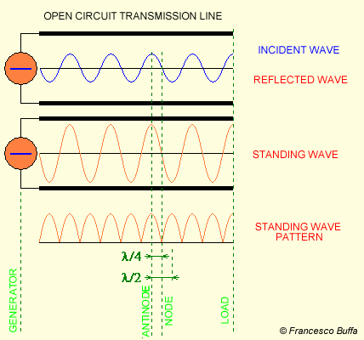
Standing Wave

Slide 16
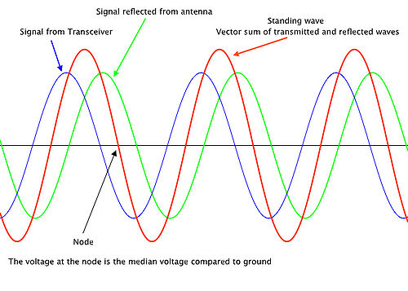

Slide 17
Standing Wave Ratio
Consider a lossless transmission line that is terminated with a load:
Z_{g}
I(z)
+
sinusoidal source
S
Z₀
V(z)
Z_{L}
-
z = 0
z

Slide 18
Standing Wave Ratio (cont.)
Denote
Then we have
The magnitude is
Maximum voltage:
Minimum voltage:

Slide 19
Standing Wave Ratio (cont.)
The voltage standing wave ratio is the ratio of V_{max} to V_{min} .
We then have
For the current we have

Slide 20
Standing Wave Ratio (cont.)
The voltage magnitude repeats in a distance Δz:
or
Note:
so
Note: The complex voltage repeats every λ.

Slide 21
Standing Wave Ratio (cont.)

Slide 22
Line Impedance(cont.)
If the line is matched, i.e. if the load impedance Z_{L} coincides with the characteristic impedance of the line Z₀, then there isn't reflection and the line runs at progressive regime, not more stationary.
In this case, the waves emitted by the generator never return to it because they are absorbed by the load where they turn into another form of energy or radiate into space as electromagnetic waves if the load is an antenna.
|V(z)|
Special cases:
+
ZL= Z0, Γ = 0
|V0|
|V(z)|
= |V0|
-λ
-3λ/4
-λ/2
-λ/4

Slide 23
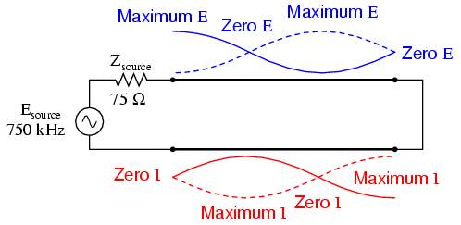
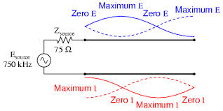
Short Circuit
Open Circuit

Slide 24
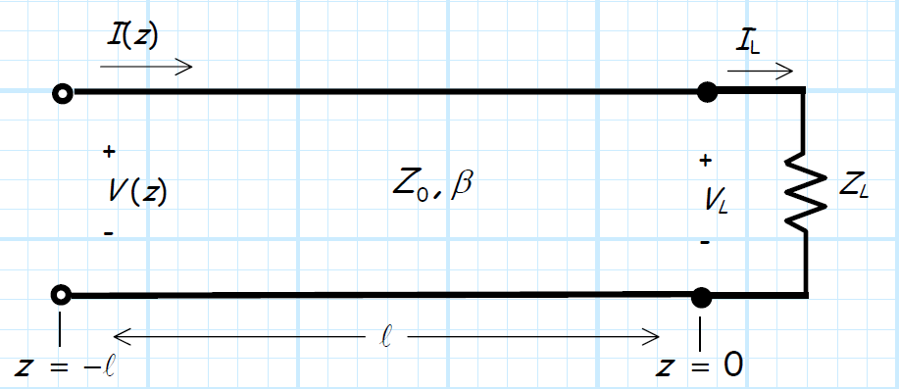
Line Impedance(cont.)
Consider a lossless line, length l, terminated with a load Z_{L}.
The input impedance is simply the line impedance seen at the beginning (z = −l) of the transmission line, i.e.:
Note Z_{in} equal to neither the load impedance Z_{L} nor the characteristic impedance Z₀.

Slide 25
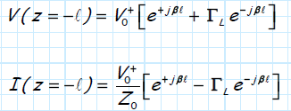
Line Impedance(cont.)
To determine exactly what Z_{in} is, we first must determine the voltage and current at the beginning of the transmission line (z = -l).
Combining these two expressions, we get:
By Eular’s equations:

Slide 26
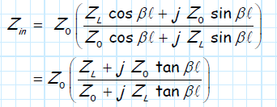
Line Impedance(cont.)
Using Euler’s relationships, we can likewise write the input
impedance without the complex exponentials:
Short-Circuit/Open-Circuit Case:
For a line of known length l, measurements of its input impedance, one when terminated in a short and another when terminated in an open, can be used to find its characteristic impedance Z₀ and electrical length βl,

Slide 27
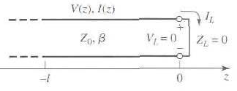
Short Circuited Load
As shown in figure the line is terminate in short circuit ZL=0.
The reflection coefficient for the short circuit is -1.
The voltage and current on the line are,
The input impedance is

Slide 28
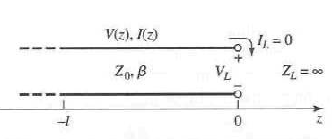
Open Circuited Load
As shown in figure the line is terminate in short circuit ZL=0.
The reflection coefficient for the short circuit is -1.
The voltage and current on the line are,

Slide 29
Line Impedance(cont.)
The characteristics of transmission line :
Special Cases
Now let’s look at the Z_{in} for some important load impedances and line lengths.
If the length of the transmission line is exactly one-half wavelength , we find that:
1.

Slide 30
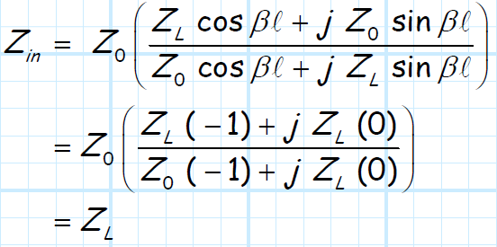
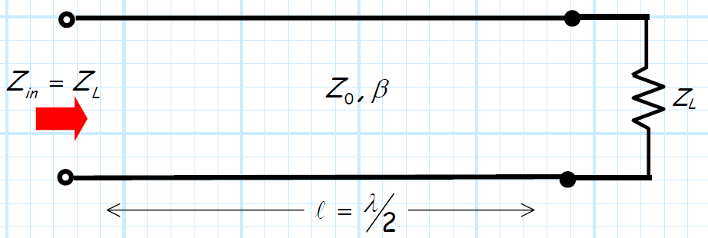
Line Impedance(cont.)
if the transmission line is precisely one-half wavelength long, the input impedance is equal to the load impedance

Slide 31
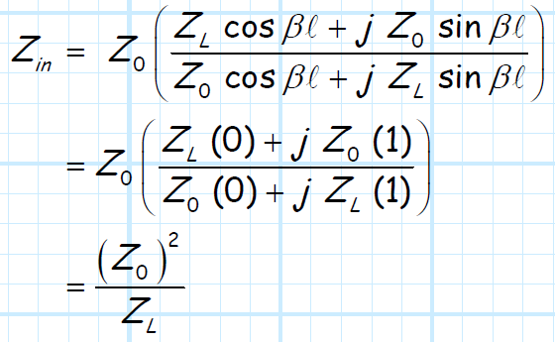
Line Impedance(cont.)
2.
If the transmission line is precisely one-quarter wavelength long, the input impedance is inversely proportional to the load impedance.

Slide 32
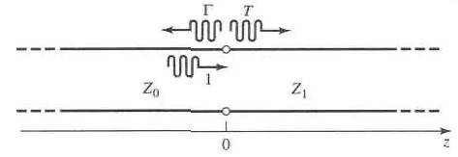
Reflection and Transmission Coefficient
A transmission line of characteristic impedance Z0 feeding a line of different characteristic impedance Z1.
The reflection coefficient is given by,
Not all of the incident wave is reflected; some of it is transmitted onto the second line with a voltage amplitude given by a transmission coefficient T.

Slide 33
The voltage wave for Z > 0, in the absence of reflections, is outgoing only, and can be written as,
The transmission coefficient T is,
The transmission coefficient between two points in a circuit is often know as, insertion loss, IL

Slide 34
Impedance Matching
For maximum power transfer from the source to load, the resistance of the load should be equal to that of the source.
The reactance of the load should be equal to that of the source but opposite in sign, RL=Rs and jX=-jX, means if load is inductive , the source must be capacitive.
Transmission line having a length λ/4 and λ/2 have special property that can be employed for impedance matching purposes.

Slide 35
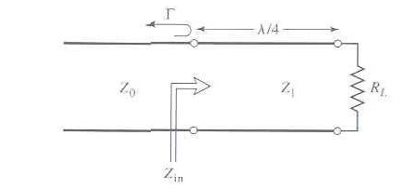
The Quarter-Wave Transformer
In the given figure, the load resistance RL and the feed line characteristic impedance Z0, are both real and assumed to be known.
These two components are connected with a lossless piece of transmission line of characteristic impedance of Z1 and length λ/4.

Slide 36
The load should match the Z0 line, by using λ/4 piece of line, and so reflection coefficient should be zero.
Here l=λ/4, so βl=π/2,
In order for ρ = 0, Zin=Z0, so the characteristic impedance Z1,
The above condition is also apply for the odd multiple (2n+1) of the λ/4 and perfect match may be achieved at one frequency, but mismatch will occur at other frequency.

