Slide 1
Shift Registers

Slide 2
SHIFT REGISTERS
Introduction :
Shift registers are a type of sequential logic circuit, mainly for storage of digital data. They are a group of flip-flops connected in a chain so that the output from one flip-flop becomes the input of the next flip-flop. Most of the registers possess no characteristic internal sequence of states. All the flip-flops are driven by a common clock, and all are set or reset simultaneously. In this chapter, the basic types of shift registers are studied, such as Serial In - Serial Out, Serial In - Parallel Out, Parallel In - Serial Out, Parallel In - Parallel Out, and bidirectional shift registers. A special form of counter - the shift register counter, is also introduced.

Slide 3
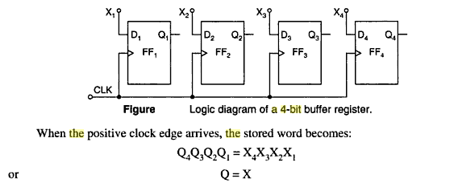
Buffer Register

Slide 4
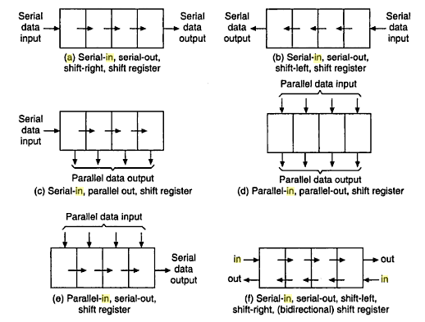

Slide 5
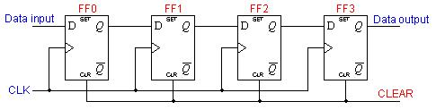

Serial In - Serial Out
Shift Registers
A basic four-bit shift register can be constructed using four D flip-flops, as shown below. The operation of the circuit is as follows. The register is first cleared, forcing all four outputs to zero. The input data is then applied sequentially to the D input of the first flip-flop on the left (FF0). During each clock pulse, one bit is transmitted from left to right. Assume a data word to be 1001. The least significant bit of the data has to be shifted through the register from FF0 to FF3.

Slide 6
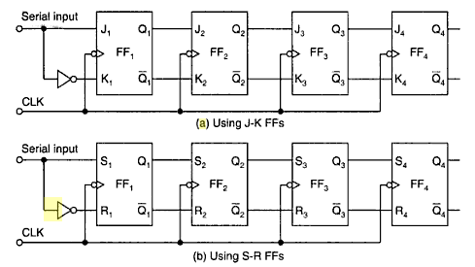

Slide 7
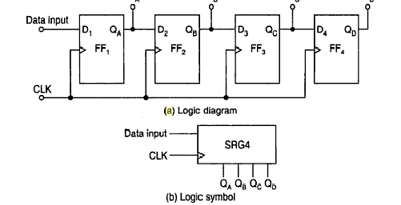
Serial in parallel shift register

Slide 8
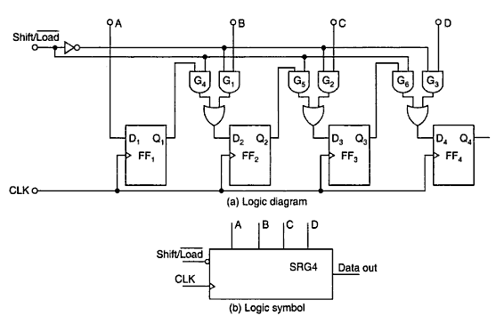
Parallel in serial out shift register

Slide 9
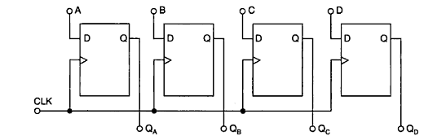
Parallel in parallel out shift register

