Slide 1
Binary codes

Slide 2
Binary Code
A binary code is just an assignment of information to bit patterns.

Slide 3
Binary Codes
Electronic digital systems use signals that have two distinct values and circuit elements that have two stable states.
Digital systems represent and manipulate not only binary numbers, but also many other discrete elements of information.
Any discrete element of information distinct among a group of quantities can be represented by a binary code.
Binary codes merely change the symbols, not the meaning of the elements of information that they represent.

Slide 4
Binary Codes
To represent a group of 2^{n} distinct elements in a binary code requires a minimum of n bits.
There is no maximum number of bits that may be used for a binary code.

Slide 5
Binary Codes for Decimal Numbers
A set of n-bit string in which different bit strings represent different numbers or other things is called a code.
A particular combination of n bit values is called a code word.

Slide 6
Classification of binary code
Binary code
Non weighted code
Reflective code
Sequential code
Error detecting and correcting code
Example: Gray Excess-3 Five bit BCD
Example: 5211 2421 Excess-3
Example: Hamming Parity
Example: 8421 Excess-3
Weighted code
Binary Ex: 0s1
BCD Ex: 8421 2421 5211 4221

Slide 7
Weighted code
Each decimal digit can be obtained from its code word by assigning a fixed weight to each code-word bit.
BCD (8,4,2,1)
2421 (self-complementing: code word for the 9’s complement of any digit may be obtained by complementing the individual bits of the digit’s code word)

Slide 8
Excess-3 code
Self-complementing code
Not weighted
Corresponding BCD code + 0011₂
Binary counters

Slide 9
BCD codes

Slide 10
Binary code decimal (BCD)
8421 (BCD) | Decimal
0000 | 0
0001 | 1
0010 | 2
0011 | 3
0100 | 4
0101 | 5
0110 | 6
0111 | 7
1000 | 8
1001 | 9

Slide 11
Gray code
It is called cyclic or reflected code.
In this code each code group does not differ from its neighbor in more than one bit.
This code is used for input and output devices in digital system.

Slide 12
Table of gray code
Decimal number | Gray code
0 | 0 0 0 0
1 | 0 0 0 1
2 | 0 0 1 1
3 | 0 0 1 0
4 | 0 1 1 0
5 | 0 1 1 1
6 | 0 1 0 1
7 | 0 1 0 0
8 | 1 1 0 0
9 | 1 1 0 1
10 | 1 1 1 1
11 | 1 1 1 0
12 | 1 0 1 0

Slide 13
Conversion from binary to gray code
This conversion method strongly follows the EX-OR gate operation between binary bits . The below steps & solved example may useful to know how to perform binary to grey code conversion. 1. To convert binary to grey code, bring down the most significant digit of the given binary number, because, the first digit or most significant digit of the grey code number is same as the binary number.
2. To obtain the successive grey coded bits to produce the equivalent grey coded number for the given binary, add the first bit or the most significant digit of binary to the second one and write down the result next to the first bit of grey code, add the second binary bit to third one and write down the result next to the second bit of grey code, follow this operation until the last binary bit and write down the results based on EX-OR logic to produce the equivalent grey coded binary.

Slide 14
Conversion from binary to gray code

Slide 15
Conversion from grey code to binary code
This conversion method also follows the EX-OR gate operation between grey & binary bits. The below steps & solved example may useful to know how to perform grey code to binary conversion. 1. To convert grey code to binary, bring down the most significant digit of the given grey code number, because, the first digit or the most significant digit of the grey code number is same as the binary number. 2. To obtain the successive second binary bit, perform the EX-OR operation between the first bit or most significant digit of binary to the second bit of the given grey code. 3. To obtain the successive third binary bit, perform the EX-OR operation between the second bit or most significant digit of binary to the third MSD (most significant digit) of grey code and so on for the next successive binary bits conversion to find the equivalent.

Slide 16
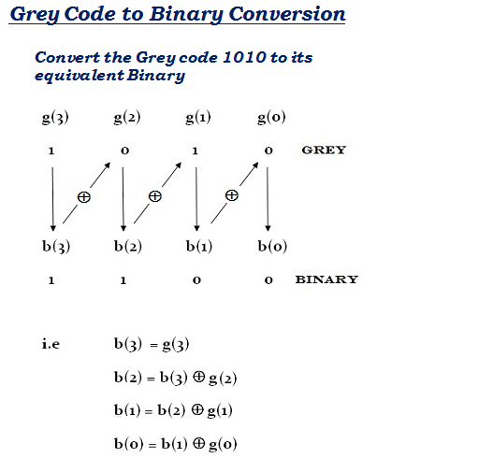
Conversion from grey code to binary code

Slide 17
Gray Code
Decimal
8,4,2,1
Gray
0
0000
0000
1
0001
0100
2
0010
0101
3
0011
0111
4
0100
0110
5
0101
0010
6
0110
0011
7
0111
0001
8
1000
1001
9
1001
1000
What special property does the Gray code have in relation to adjacent decimal digits?
Only one bit position changes with each increment
Notes:
Answer: As we “counts” up or down in decimal, the code word for the Gray code changes in only one bit position as we go from decimal digit to digit including from 9 to 0.

Slide 18
Codes for detecting and correcting errors
An error in a digital system is the corruption of data from its correct value to some other value.
i.e., a change of some bits from 0 to 1 or vice versa.
During the processing or transmission of digital data a noise may change some bits from 0 to 1 or vice versa.
A short duration noise can affect only a single bit causes a single-bit error.
A long duration noise can affect two or more bits causes a multi-bit error.

Slide 19
Codes for detecting and correcting errors
Error-detecting codes normally add extra information to the data.
In general, error-detecting codes contains redundant code.
That is a code that uses n-bit strings need not contain 2^{n} valid code words.
An error-detecting code has the property that corrupting or garbling a code word will likely produce a bit string that is not a code word.
Thus errors in a bit string can be detected by a simple rule - if it is not a code word it contains an error.

Slide 20
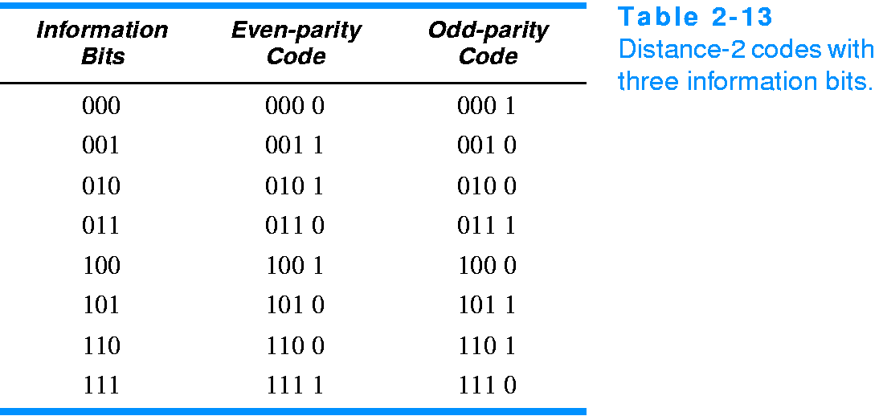
Parity check
One of the most common ways to achieve error detection is by means of a parity bit.
A parity bit is an extra bit included with a message to make the total number of 1’s transmitted either odd or even.
If an odd parity is adopted, the P bit is chosen such that the total number of 1’s is odd.

Slide 21
4-Bit Parity Code Example
Even Parity
Odd Parity
Message
-
Parity
Message
-
Parity
000
-
0
000
-
1
001
-
1
001
-
0
010
-
1
010
-
0
011
-
0
011
-
1
100
-
1
100
-
0
101
-
0
101
-
1
110
-
0
110
-
1
111
-
1
111
-
0
The codeword "1111" has even parity and the codeword "1110" has odd parity. Both can be used to represent 3-bit data.
Notes:
Even Parity Bits: 0, 1, 1, 0, 1, 0, 0, 1
Odd Parity Bits: 1, 0, 0, 1, 0, 1, 1, 0

Slide 28
