Slide 1
Topics
  Programmable Logic Devices (PLDs)
    PLAs
    PALs Positive and Mixed Logic

Slide 2
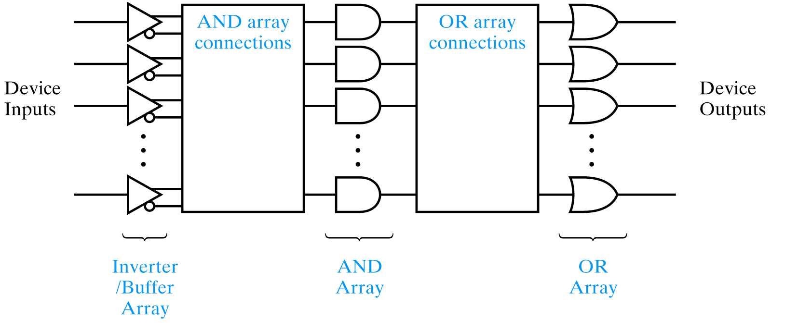
AND/OR Array Architecture
Device type AND array OR array Product term sharing
PLA Programmable Programmable Yes
PAL Programmable Fixed No

Slide 3
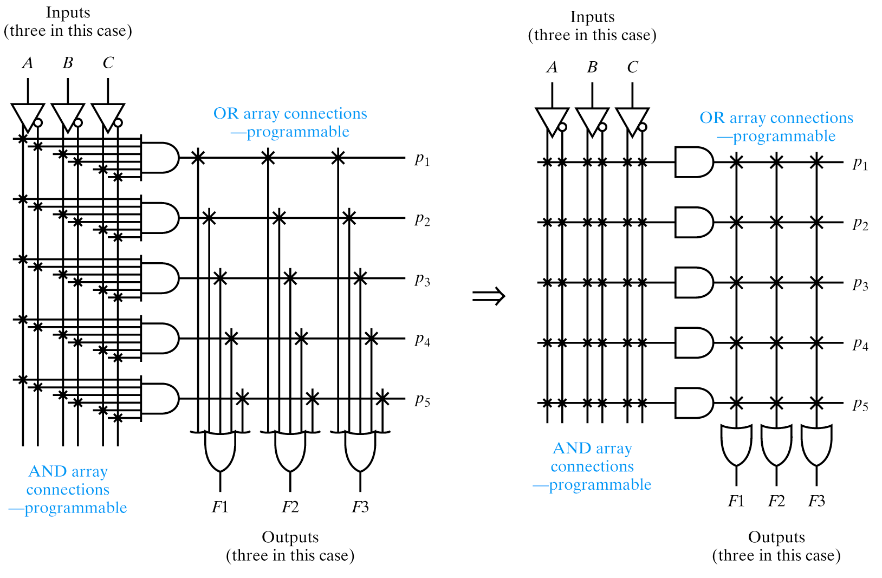
PLAs
Product term sharing

Slide 4
Design for PLA:
Example
  Implement the following functions using PLA
F0 = A + B' C'
F1 = A C' + A B
F2 = B' C' + A B
F3 = B' C + A
Input Side:
1 = asserted in term
0 = negated in term
- = does not participate
Personality Matrix
Product
Inputs
Outputs
t
Output Side:
erm
A
B
C
F
F
F
F
0
1
2
3
1 = term connected to output
0 = no connection to output
A B
1
1
-
0
1
1
0
B C
-
0
1
0
0
0
1
Reuse
A C
1
-
0
0
1
0
0
of
t
1
0
1
0
erms
B C
-
0
0
A
1
-
-
1
0
0
1

Slide 5
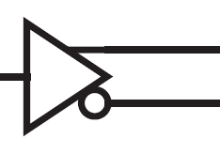
Example: Continued
A
B
C
F0 = A + B' C'
F1 = A C' + A B
F2 = B' C' + A B
F3 = B' C + A
AB
B’C
AC’
B’C’
Personality Matrix
A
F0
F1
F2
F3

Slide 6
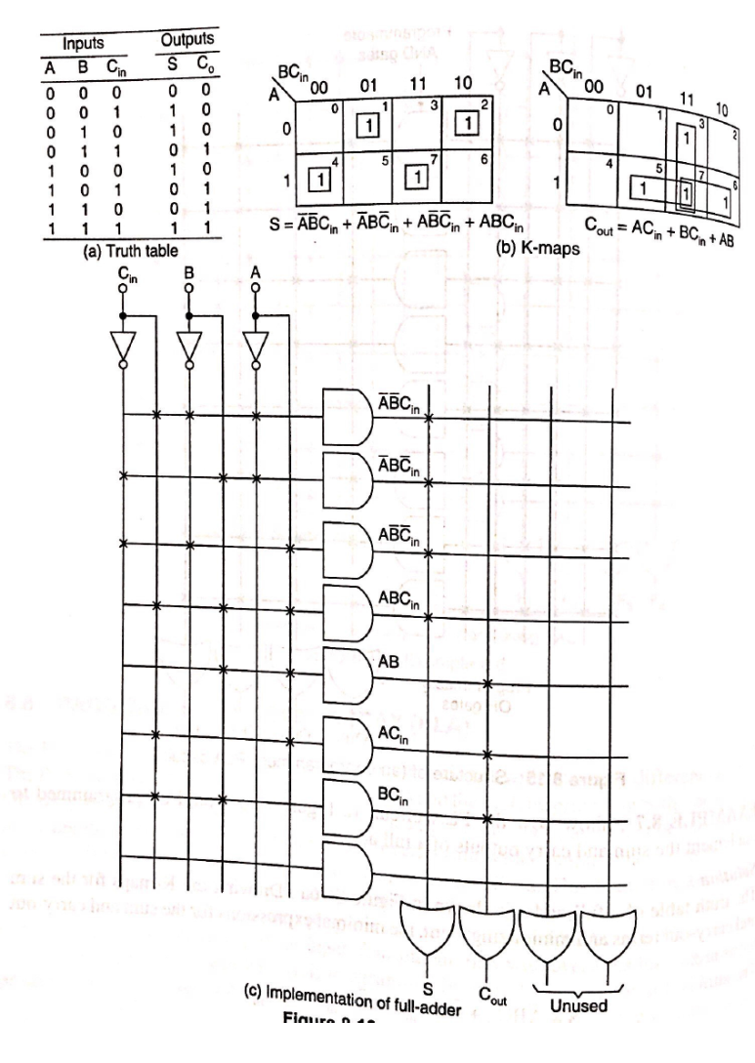
Design of Full adder using PLA

Slide 7
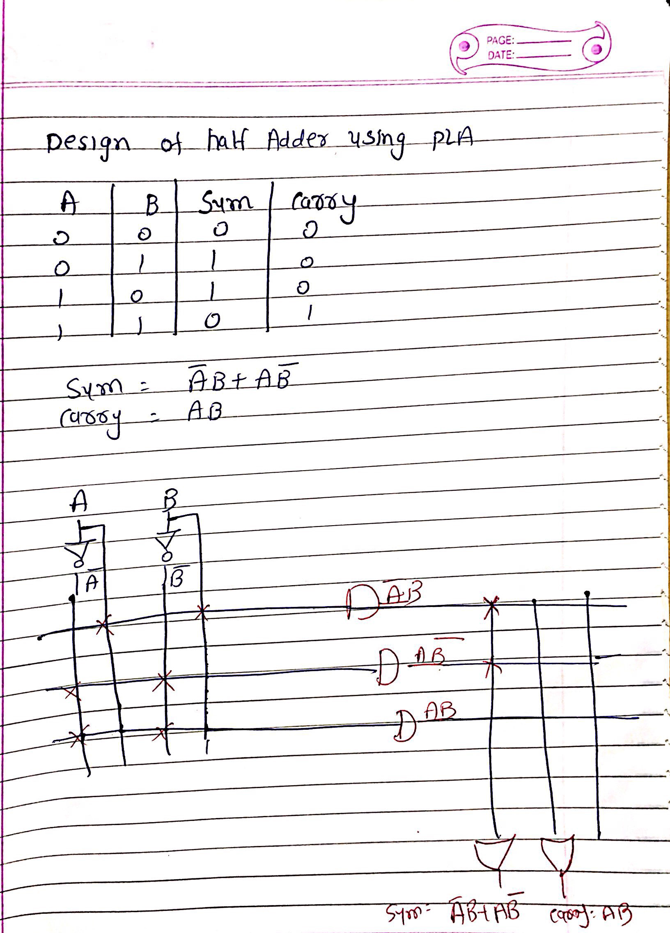
Design of Half adder using PLA

Slide 8
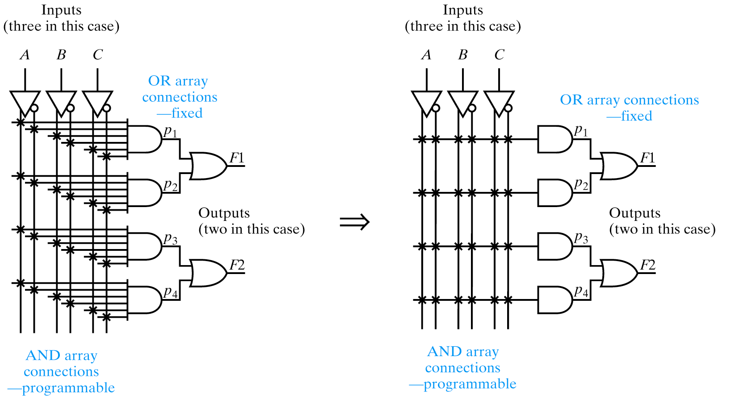
PALs
No product term sharing
This example shows a PAL that doesn’t permit product term sharing

Slide 9
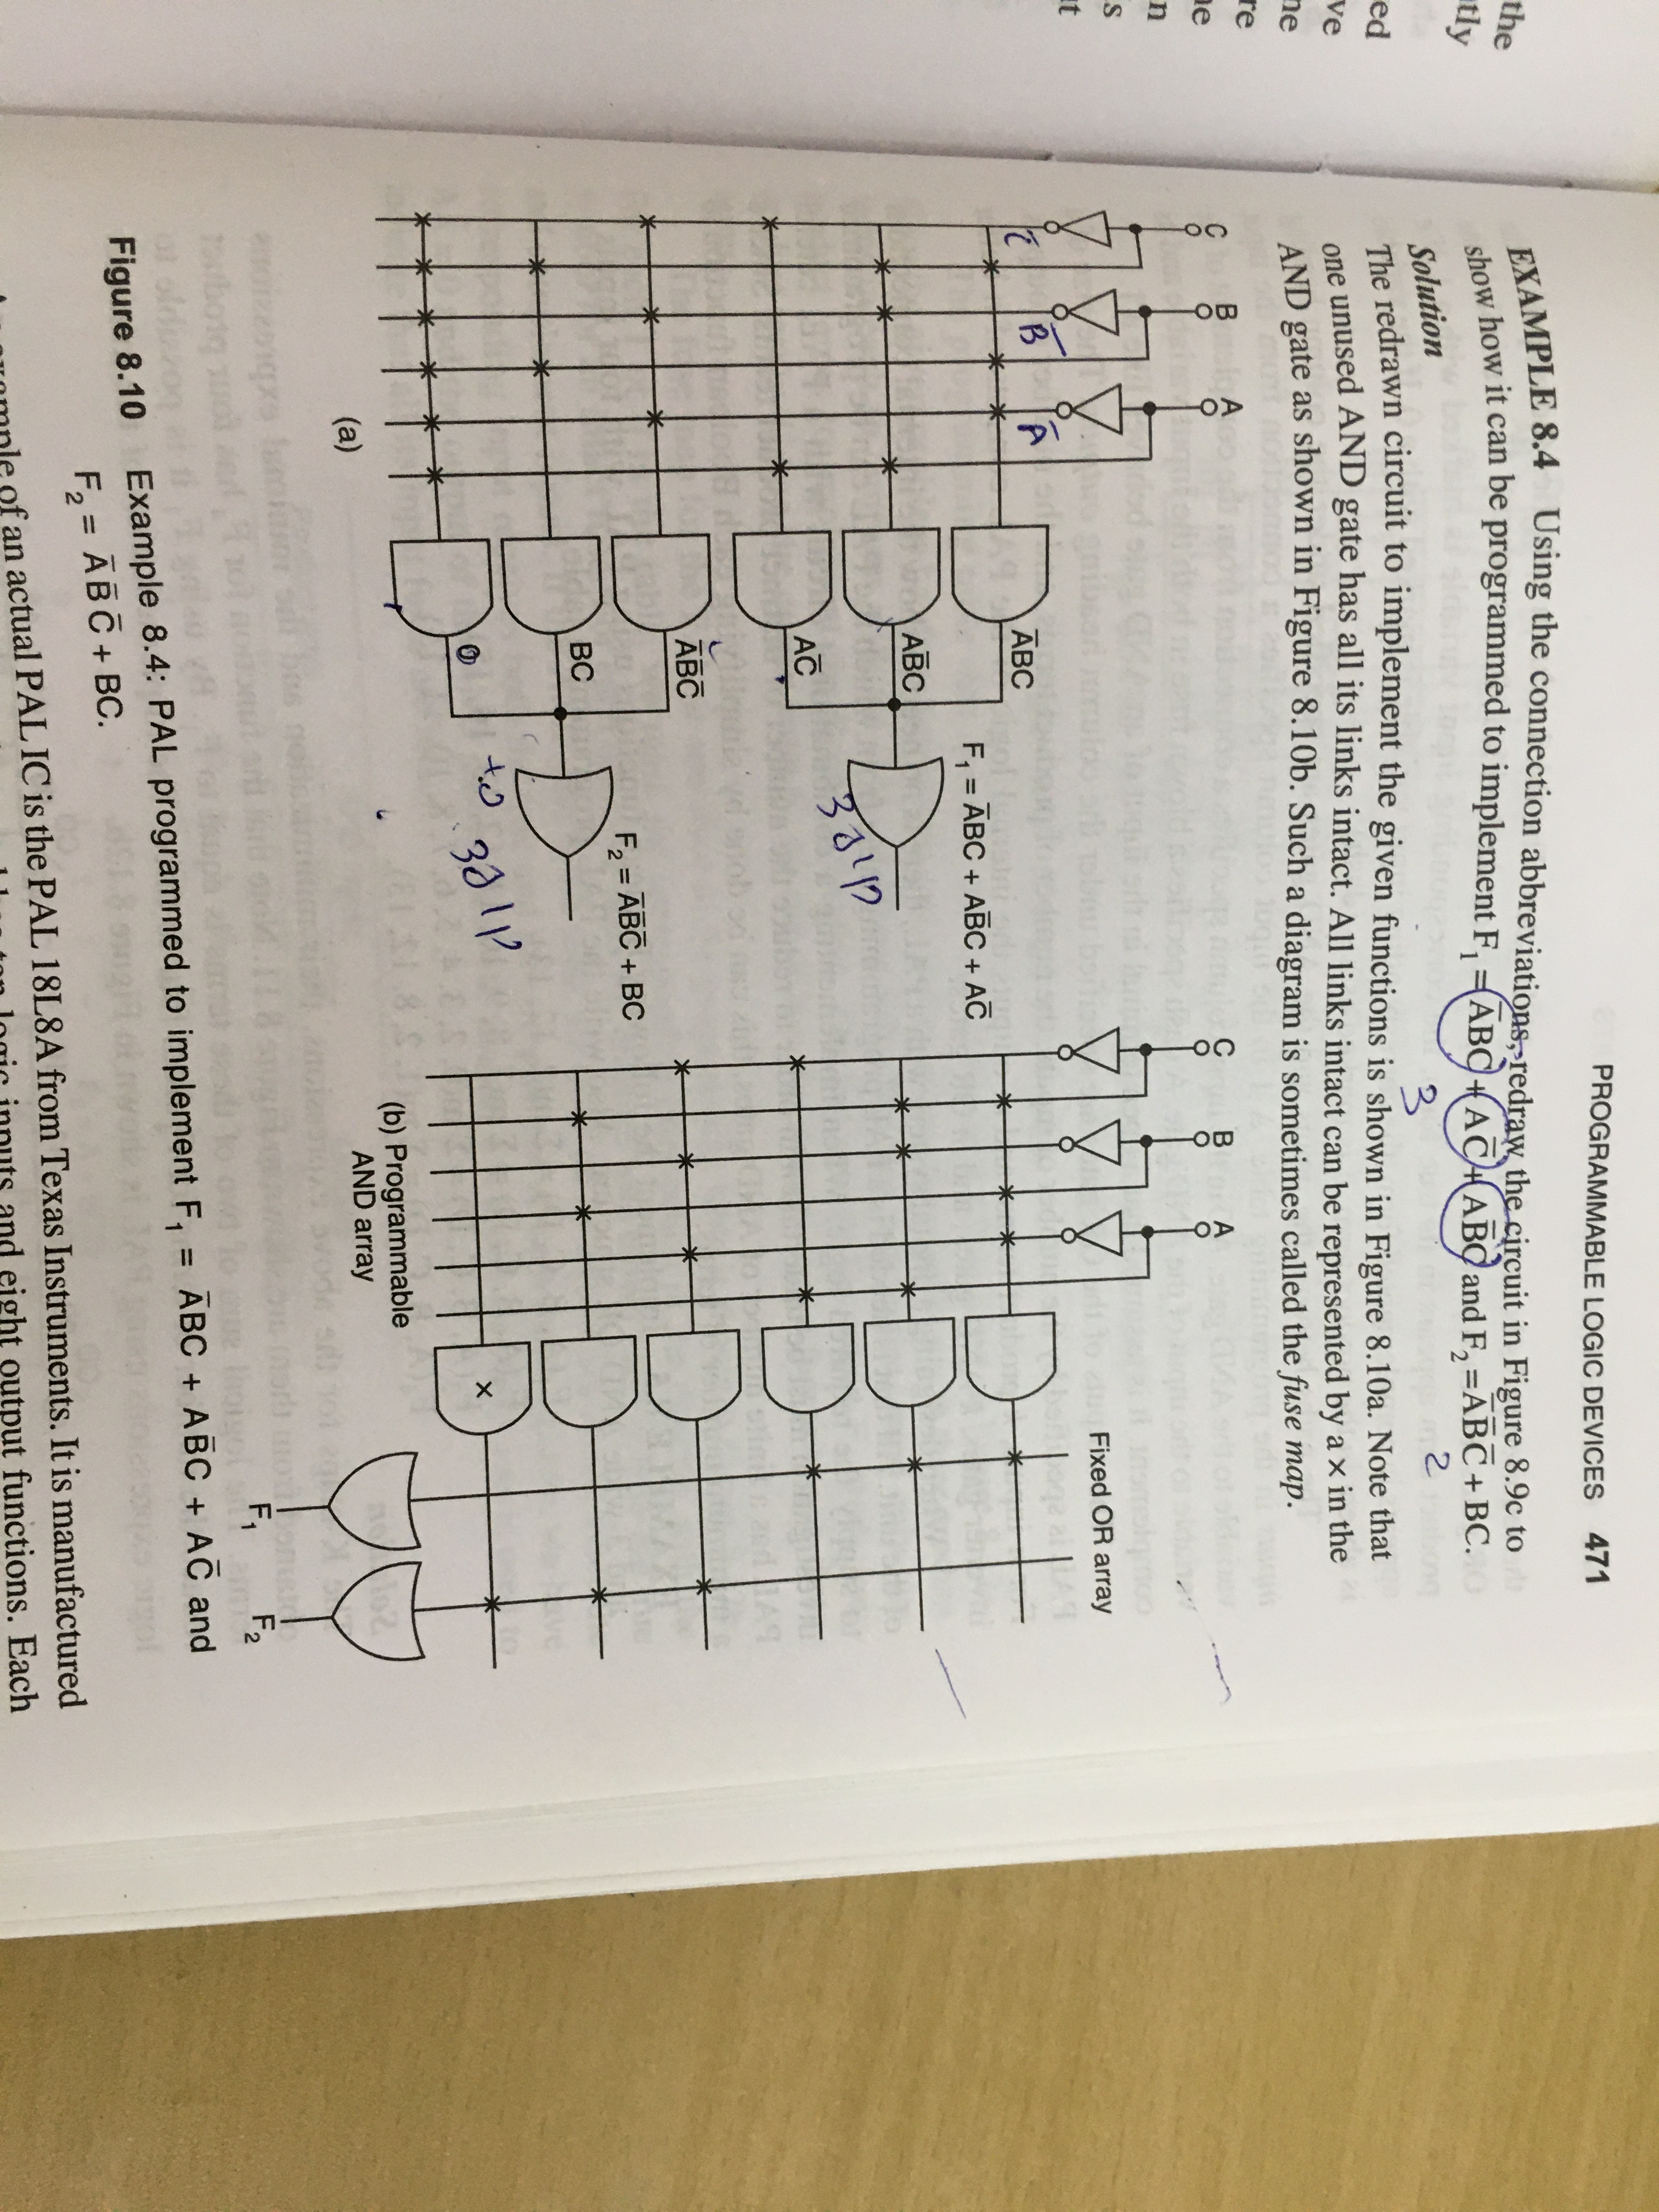

Slide 10
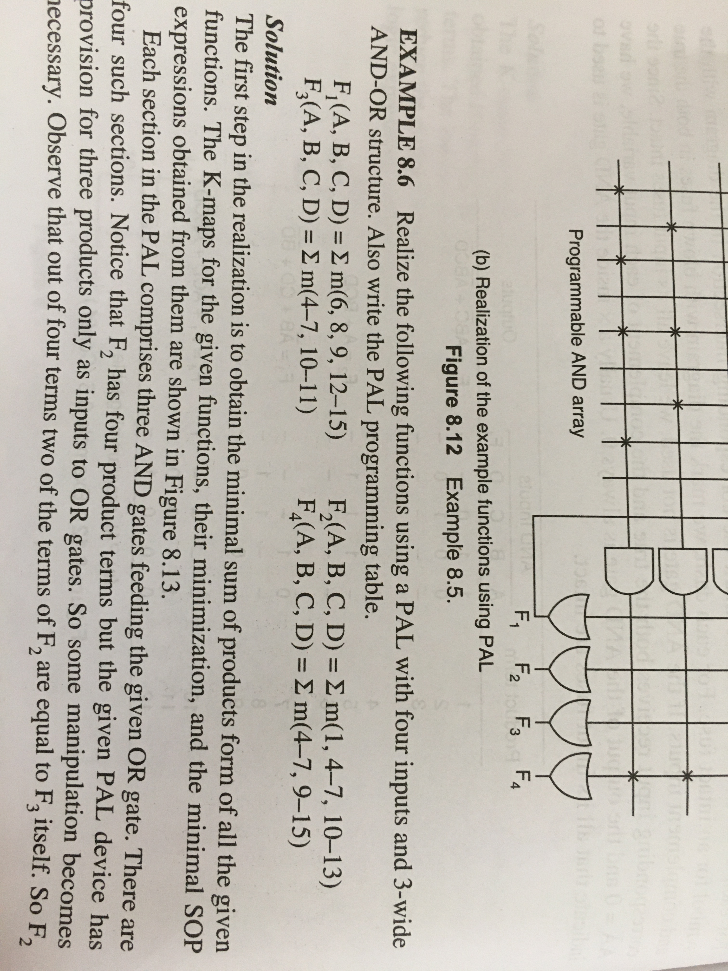

Slide 11
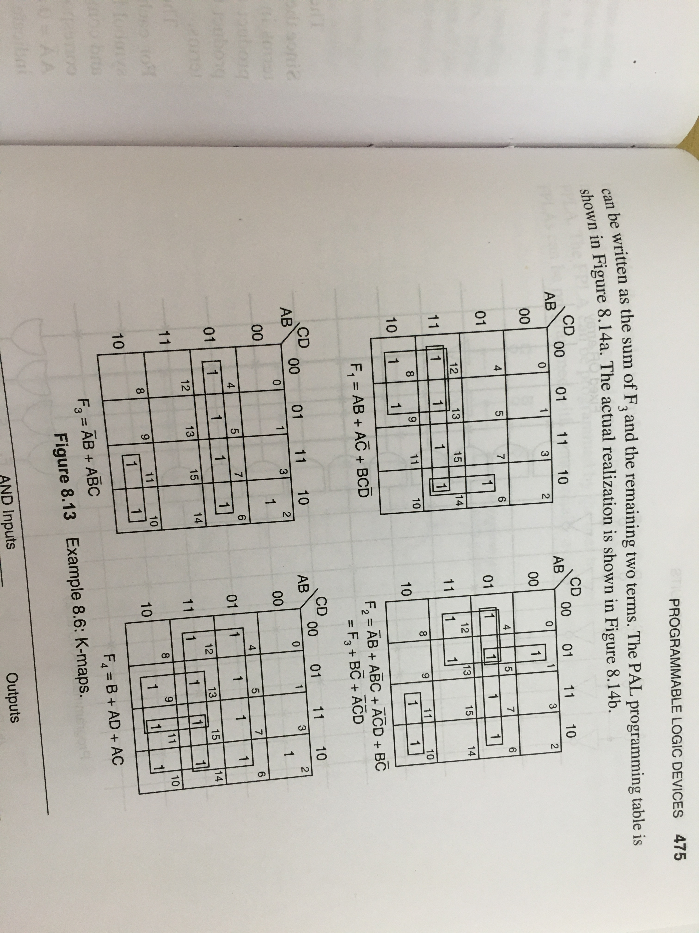

Slide 12
