Slide 1
Electromagnetic Theory
It is a discipline concerned with the study of charges at steady and in motion.
Some of the branches of study where electromagnetic principles find application are:
RF communication
Microwave Engineering
Antennas
Satellite Communication
Radar Technology
Remote sensing

Slide 2
What is Electromagnetic?
Electric charges create an electric field, if they are moving they also generate a magnetic field. [Maxwell's Equations]
The combination of the electric and magnetic field is called the electromagnetic field.

Slide 3
Electrostatic
Electric charge is a fundamental property of matter and charge exist in integral multiple of electronic charge. (1.6×10⁻¹⁹ Coloumb)
Electrostatics can be defined as the study of electric charges at rest. (static charges)
Electric fields have their sources in electric charges.

Slide 4
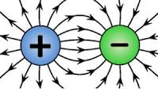
Electrostatic
Electrostatic phenomena arise from the forces that electric charges exert on each other.
Such forces are described by Coulomb's law.
Electric field is defined as the electric force per unit charge.
The electric field is radially outward from a positive charge and radially in toward a negative point charge.

Slide 5
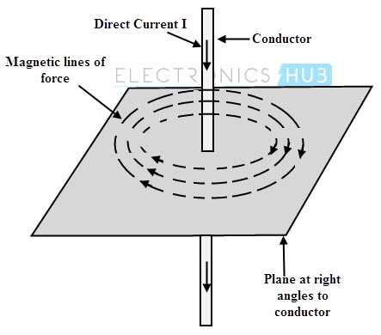
Magnetostatic
In contrast to the electrostatics, which deals with static electric charges , magnetostatics deals with stationary electric currents.
Oersted stated that the charges are surrounded by a magnetic field when charges are in motion. Hence, the current carrying conductor is always surrounded by a magnetic field. (Ampere’s Law)

Slide 6
Maxwell’s Equations
Guass law : staedy electric field
Ampere’s law: steady magnetic field
Faraday’s law: time varying EM field
Maxwell has theoretically proven the EM wave motion in free space. (possiblity of wirless communication)

