Slide 7
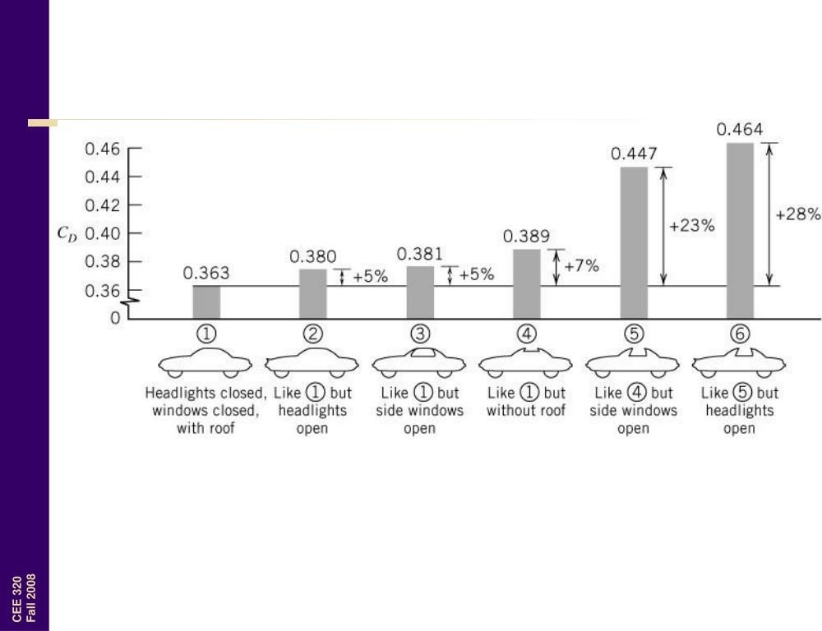

Slide 19
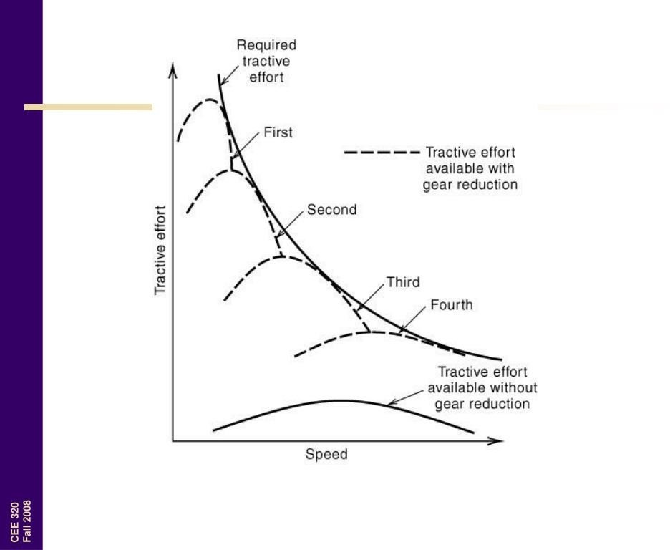

Slide 31
Reference Link
(1) https://www.youtube.com/watch?v=jHgHEjDEDvM
(2) https://www.youtube.com/watch?v=DLTwL6kYkCk

