Slide 1
Chassis Frame and Body

Slide 2
Frame
Supporting component of automobile.
Foundation for carrying engine, transmission & steering system by means of spring, axle, rubber pads etc.
Frames are made of box, tubular channel or U-shaped section welded or riveted together.
When engine, transmission, steering system and wheels are fitted on the frames the assembly is known as Chassis.

Slide 3
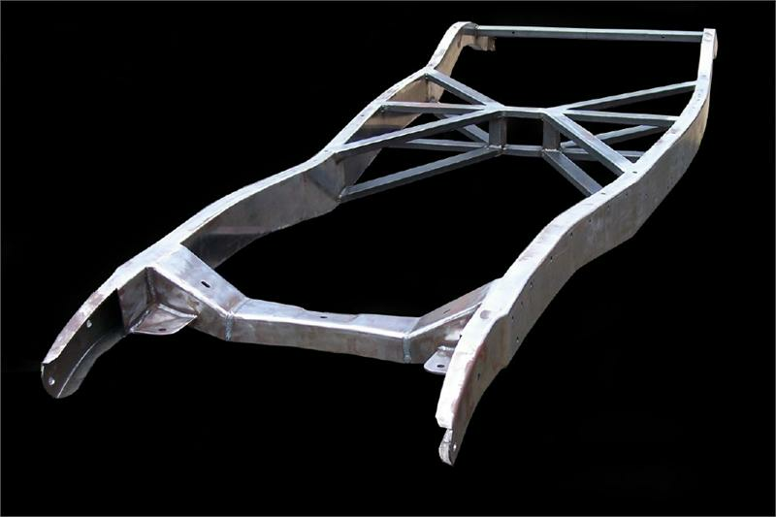
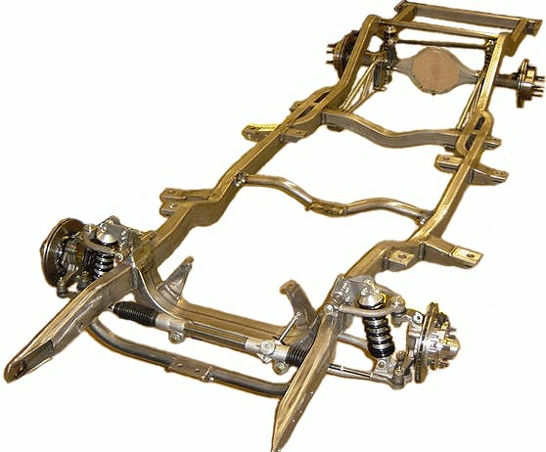

Slide 4
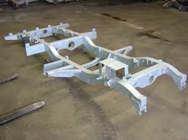

Slide 5
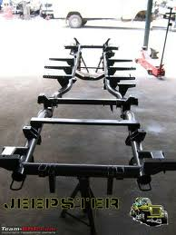
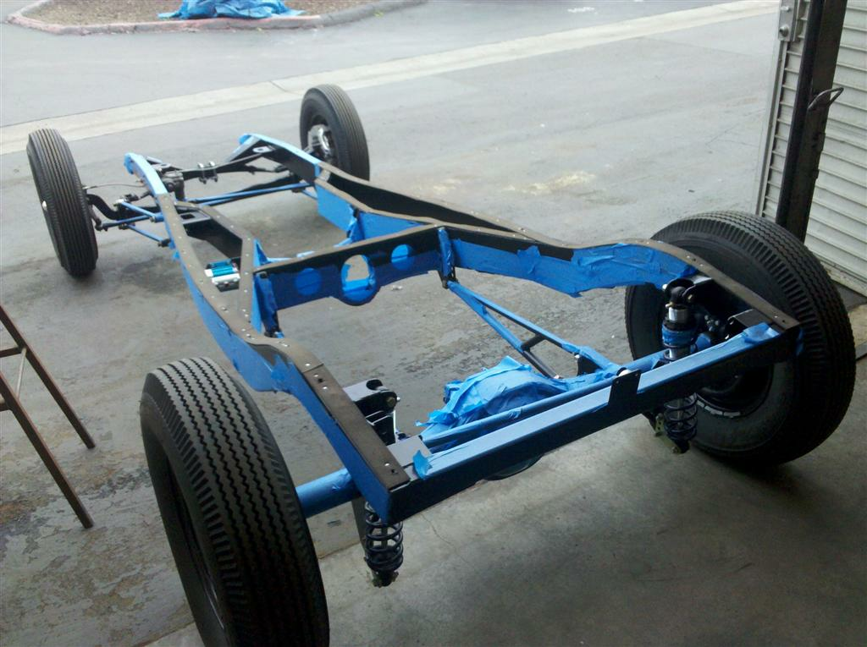

Slide 6
Chassis
Backbone of the Vehicle/ vehicle without body.
Its contain all major units necessary to propel the vehicle.
Automobile Chassis consists of
  Engine Wheels
  Radiator Transmission system
  Suspension system Steering system
  Brakes Fuel Tank

Slide 7
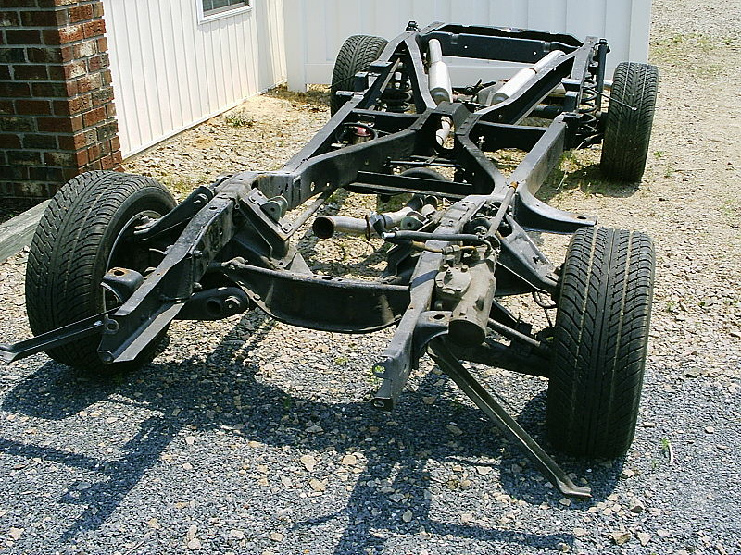

Slide 8
Body
Body is superstructure of the vehicle.
Chassis and body makes complete vehicle.
For Small & light car body and chassis are made as single unit.
For Large & heavy vehicle chassis and body are made as separate unit and then bolted together.
Body is made of sheet metal or fiber glass.
Main purpose of body is to provide comfort & protection to passenger besides having good look.

Slide 9
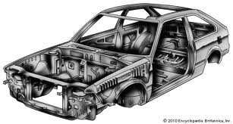

Slide 10
Function of Frame
To support the chassis components and the body.
To withstand static & dynamic load of different components of chassis.
To carry load of passenger or goods carried in the body.
To withstand the force caused due to turning of vehicle & sudden braking or acceleration.
To with stand stresses caused due to uneven conditions.
To withstand impact load due to collision of the vehicle with another object.

Slide 11
Types of Frames
Conventional Frame.
Integral or unit Construction or Frameless Chassis.
Half integral & half frame chassis.

Slide 12
Conventional Frame
Use on most of heavy vehicle.
Chassis frame made of steel section
  Strong enough to withstand load
  Light in weight to hence reduce dead weight of vehicle
This type of frame has two long members & 5 to 6 cross member joined together with the help of rivets or bolts.
Cross members is used to increase the strength of frame.
Frames are narrowing (inswept) at front & wider (upswept) at rear.

Slide 13
Conventional Frame

Slide 14
Conventional Frame
Frames is narrowed @ front
  For better steering lock
  Smaller turning radius
Upswept @ rear
  Gives room for vertical movement of rear axle as travel over road bumps
Body brackets are provided to support the body of vehicle.
Spring brackets are provided for mounting springs.

Slide 15
Conventional Frame
Extension of chassis frame ahead of front axle is known as front overhang & extension beyond rear axle is called rear overhang.
Section used for long side & cross member are channel section, box section, I-section, hat section and tubular section.
Channel section and box section have higher bending stiffness therefore both used for side long members.
I- section, hat section tabular section are used for cross section.
Side and cross members are joined by riveting or welding or bolted.

Slide 16
Integrated Frame Chassis/ Frameless
Frameless or Chassisless or Unit Construction now a days used in most of motor car.
Floor assembly & part of frame form one integral unit.
Heavy side member used in conventional frame construction are eliminated & floor strengthened by cross member and body.

Slide 17
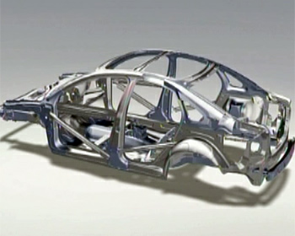
Integrated Frame Chassis/ Frameless

Slide 18
Integrated Frame Chassis/ Frameless
In some case, sub frames are also used on various chassis components are mounted.
Sub frames are provided for isolation, flexibility and simplified production.
Normally structure includes floor structure having light side member, cross member, floor and other components.
Press steel body shell is attached to chassis frame by welding or bolting.

Slide 19

Conventional Frame Construction | Frameless Construction
Used for commercial Heavy Vehicle | Used for Light vehicle & mostly for cars
Frame & body are separate parts. Chassis component and body are fitted on frame. | Body and frame are integral parts & on it different components are fitted.
Heavy side members are used. | Light side members are used.
Suitable for low volume produced vehicle. | Suitable for light mass produced vehicles.
Flexibility for fitting a variety of bodies to same chassis | No flexibility to change body design for same chassis
Accident damage is easy to repair. | Accident damage is difficult to repair.

Slide 20
Conventional Frame Construction | Frameless Construction
Height of chassis is increase or decreased depending upon the mounting chassis frame to axle. | Height of chassis does not change once it designed.
Dead weight of vehicle is grater as frame required long and heavy side members. | Dead weight of vehicle is less as body floor work as chassis and extra members are eliminated.
Due to heavy frame C.G of vehicle is higher. Stability is reduced. | Due to elimination of frames C.G of vehicle is lowered which giver more stability.
Cost of vehicle is increased due to heavy frame. | Cost of vehicle is less as body floor works as long side & cross members.S

Slide 21
Classification of Chassis
According to its control
  Full forward chassis
  Semi forward chassis
  Bus chassis
According to location of engine
  Engine fitted @ front
  Engine fitted @ rear
According to drive
  Front wheel drive
  Rear wheel drive
  All drive wheel
  Left hand drive
  Right hand drive
According to no of wheels and no of driving wheels
  4 x 2 drive chassis
  4 x 4 drive chassis
  6 x 2drive chassis

Slide 22
Front Engine – Rear Wheel Drive

Slide 23
Front Engine – Rear Wheel Drive
Advantages
Weight distribution is reasonably balanced between front and rear wheels which gives good handling characteristics.
Engine & radiator @ front : natural air stream & reduce power losses for a large fan.
Weight of vehicle is shifted to rear wheel during hence less chance of wheel sleeping.
Front wheel used only for steer the vehicle, hence steering mechanism becomes simple in design.
Large luggage space available @ back of vehicle increase carrying capacity.

Slide 24
Front Engine – Rear Wheel Drive
Disadvantage
During breaking weight of vehicle is shifted to front wheels and weight on rear wheels decreased, results in decreased breaking effort.
It require long propeller shaft and differential at rear, therefore height of floor area is increased.
Due to Long propeller shaft transmission problems and weight are increased.
Less weight on rear wheels, less adhesion on road & results in less holding capacity.

Slide 25
Front Engine – Front Wheel Drive
Advantages
More weight placed on driving front wheel, vehicle has more adhesion on road. Hence good road holding capacity even on curved and slippery roads.
Low floor area, since no propeller shaft and differential placed at front instead of rear.
Clutch, gear box, final drive usually made as one unit hence cost of vehicle is reduced.
Wheels does not get turn too sharply into curve due to tendency of understeering.
Engine mounted either transverse or longitudinal. In transverse mounted engine, crankshaft and wheels already in parallel plans. 90 degree turned not required.

Slide 26
Front Engine – Front Wheel Drive
Disadvantages
Weight on driving front wheel is reduced during acceleration and climbing of gradient due to weight of the vehicle shifting to rear wheels. Hence decreased tractive effort.
Steering mechanism becomes more complicated due to accommodation of engine clutch, gearbox, final drive all are at front of vehicle.

Slide 27
Four Wheel Drive
Engine is fitted at front or center of chassis & drive given to all four wheels.
All the four wheels getting driven, whole of the weight of the vehicle is available for traction.
There is optional arrangement to disconnect rear or front wheel from engine to make two wheel drive for good road surfaces.
This arrangement is used in jeeps and some other defence services vehicle which are known as 4 x 4 wheel drive vehicle.

Slide 28
Four Wheel Drive
Advantages
Increase traction at four wheels useful on soft or slippery ground.
Balanced load distribution hence even tyre wear.
Better acceleration available in low gear.
If front wheel drop into slippery ground, than traction is not available at front wheel and front wheel tend to climb out, but in rear wheel drive they tend to forced downwards, that case only two wheels drive traction is ofcource available.

Slide 29
Four Wheel Drive
Disadvantages
Weight of Vehicle is increased
Cost of vehicle is increased.
Maximum speed of the engine is reduced.

