Slide 1
Automatic Transmission

Slide 2
Automatic Transmission
An automatic transmission, also called auto, self-shifting transmission.
It is a type of transmission that can automatically change gear ratios as the vehicle moves, freeing the driver from having to shift gears manually.

Slide 3
Devices Used in Automatic Transmission
Torque converter
Epicyclic gear box
Transmission Oil Pump
Clutch packs & Brake bands
Freewheel or Overrunning clutch
Hydraulic service and Control valves
Manual or Electronic Operated Shift Control

Slide 4
Epicyclic gear train
Gear Ratio = T(Driven)/T(Driver)
Ring Gear Stationary
Sun Gear : Driver
Planet Gear : Driven
Sun Gear Stationary
Ring Gear : Driver
Planet Gear : Driven

Slide 5
Epicyclic gear train
Ring Gear Stationary
Planet Driver & Sun Driven
GR = 30/120 = 0.25:1
Sun Driver & Planet Driven
GR = 120/30 = 4:1
Planet Gear Stationary
Sun Driver & Ring Driven
GR = 90/30 = 3:1
(Opposite Rotation)
Ring Driver & Sun Driven
GR = 30/90 = 0.66:1
Sun Gear : 30
Ring Gear : 90
Planet : 120

Slide 6
Automatic Transmission

Slide 7
Automatic Transmission
2 Input &1 Output
Input 1 = Ring Gear
Input 2 = Sun Gear
Output = Planet
Ring Gear Stationary (Input 1= 0)
Rotation is given to Input 2 (Sun Gear)
Rotation is obtained at Output (Planet Gear)
Ring Gear starts rotate (Input 1= Increases)
Output Speed Increases
Input 1 = Input 2 (Planet does not Spin)
Input Speed = Output Speed
Ring Gear Speed increases further
Input 1 > Input 2
Output Increases

Slide 8
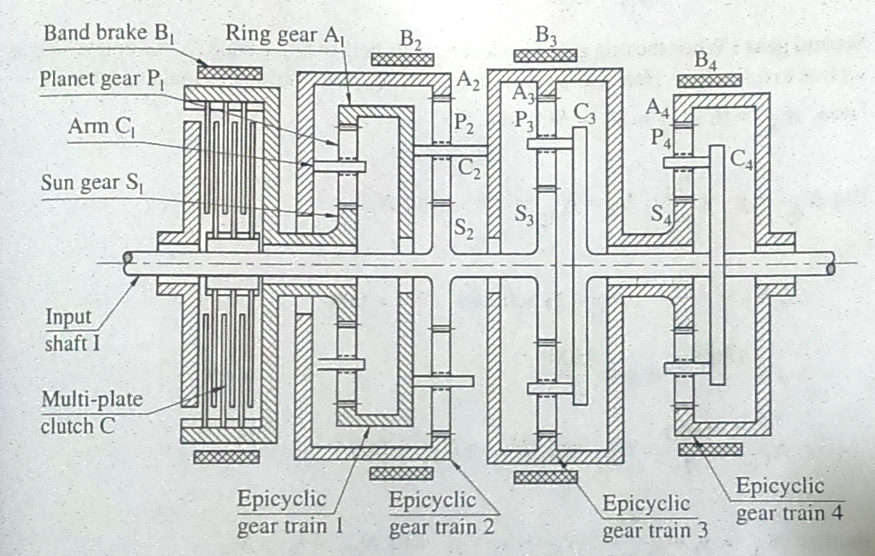
Wilson Gear Box
1st Gear : A3 is Locked with B3 cause C2 & A1 stationary (Large gear reduction takes place)
2nd Gear : A2 is locked with B2 (less gear reduction takes place)
3rd Gear : S1 held stationary by brake B1
Direct (Top) Gear : S1 locked to input shaft by applying clutch.
Reverse Gear : A4 is locked with B4.

Slide 9
Torque Converter

Slide 10
Torque Converter
Turbine blade angle is such that it changes the direction of oil flow (Reverse direction).
If this reverse direction is not changed
Oil leaving the turbine will enters in opposite direction of pump rotation & slow down its speed.
Reverse direction changed by Stator
Oil returns from turbine to pump in favorable direction (same in which pump is rotating).
Again pump throw the oil back to turbine & this goes continuous.
Repeated pushing of turbine blade cause the torque on turbine to increase, its called torque multiplication. (torque multiplication = 2.1 to 2.6)
If turbine is stationary & pump rotating fast than maximum torque multiplication occurs, its called Stall.

Slide 11
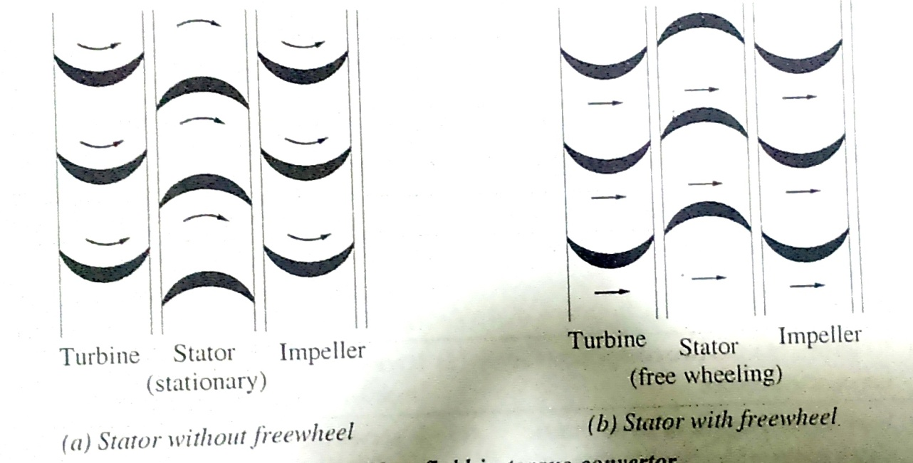
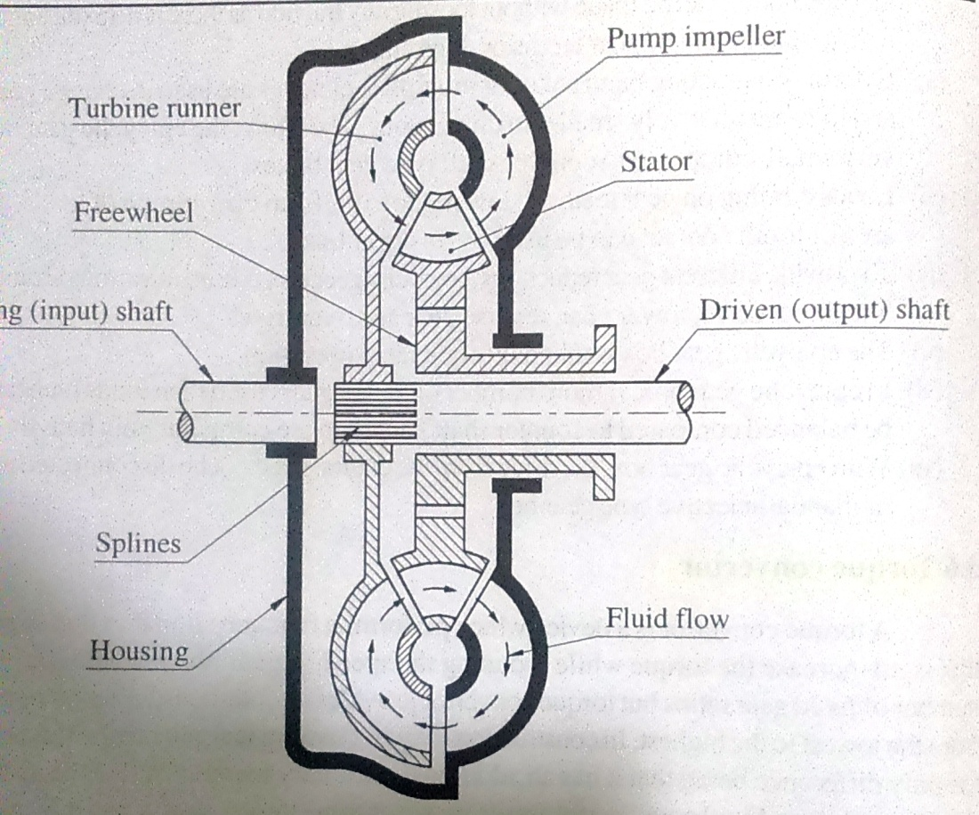

Slide 12
Torque Converter
When vehicle moves turbine speed increases & torque multiplication decreases.
Torque multiplication becomes unity when turbine speed = pump speed. (direct drive)
When turbine speed = 80 to 90% of pump speed
Oil leaves turbine in forward direction & hitting back of stator blade.
This delay the smooth flow of oil from turbine to pump.
This unwanted situation can be avoid by mounting stator on freewheel.
Freewheel allows stator to rotate in the direction of turbine & impeller. Also restrict the rotation in opposite direction.

Slide 13
Freewheel (Overrunning Clutch)

Slide 14
Overdrive

Slide 15
Continuous Variable Transmission

