Slide 1
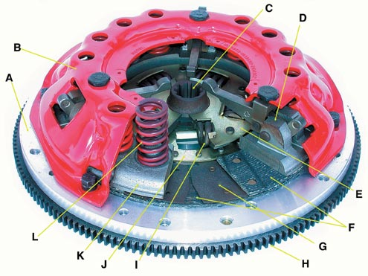
Clutch

Slide 2
Elements of Transmission System
Clutch
Gear box
Propeller shaft and Universal joint
Final Drive & Differential
Wheels & tyre

Slide 3
Function of Transmission System
It provides connection and disconnection between engine and rest of power train component without shock.
It provide variable speed or torque to road wheel.
It also provide power to road wheel in opposite direction.
It can transmit power at varied angle and length.
It divert the power at right angle towards the driving wheel.
It provides different speed/torque to driving wheels while taking turn.

Slide 4
Clutch
tight grip / grip something tightly
A clutch is a mechanical device that engages and disengages the power transmission, especially from driving shaft to driven shaft.
Clutch is a machine member used to connect a driving shaft to a driven shaft so that the driven shaft may be started or stopped without stopping the driving shaft.

Slide 5
Requirement of Good Clutch
Gradual engagement : smooth power transmission, increases driving comfort, increase life.
Torque transmission : able to transmit 100 % torque, not slip during engagement.
Inertia & mass : Rotating parts should have minimum inertia, cause hard shifing.
Effortless operation :driver should not feel tired.
Heat dissipatation : proper ventilation & sufficient surface area.
Friction facing material : high coefficient of friction, strength against mechanical & thermal loading.
Vibration damping : eliminate the noise produce in clutch.
Dynamic balancing : clutch should be in exact dynamic balance particularly at high speed.
Size : smallest , occupy less space.

Slide 6
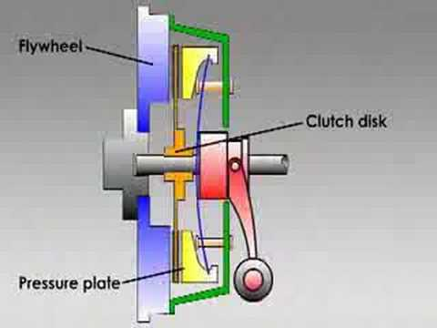
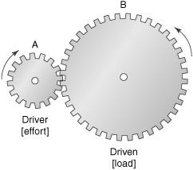

Slide 7
Classification of Clutch
According to method of transmitting torque.
Positive clutch (Dog Clutch)
Gradual engagement (friction clutch)
Single plate
Multi plate
Cone clutch
Diaphragm
Hydraulic (Fluid) Clutch
Fluid Flywheel
According to method of engaging force.
Spring type
Centrifugal
Semi-centrifugal
Electro-magnetic
According to method of control.
Automatic
Manually

Slide 8
Coupling, Clutch & Brakes
Coupling & Clutch
Coupling is the permanent connection between driver and driven shaft.
Clutch can connect or disconnect driver and driven shaft depending upon the requirement.
Clutch & Brakes
Clutch
Initial: driving member is rotating & driven is at rest
Final: Both member rotate with same speed & have a relative motion.
Brakes
Initial: brake drum is rotating & shoe is at rest.
Final: Both member is at rest & have no relative motion.

Slide 9
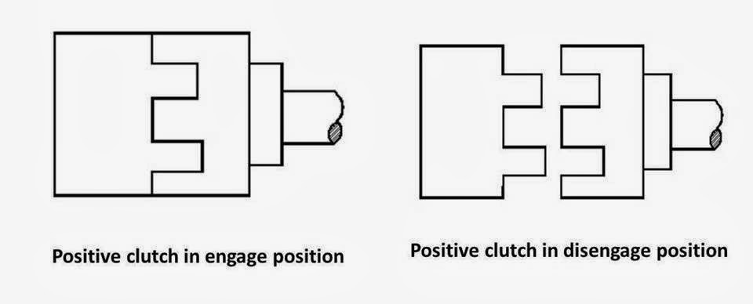
Classification of Clutch
Positive Clutch
Power transmission is achieved by means of interlocking of Jaw or Teeth
Positive engagement
Transmit large torque without slip
https://www.youtube.com/watch?v=5-edXs_OTPo

Slide 10
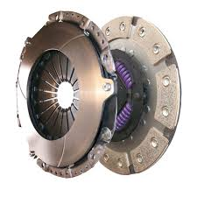
Classification of Clutch
Friction Clutch
Power transmission is achieved by means of friction between contacting surfaces.
Single & Multi Plate Clutch
Cone Clutch
Centrifugal Clutch
https://www.youtube.com/watch?v=HY_PjmHRxuE

Slide 11
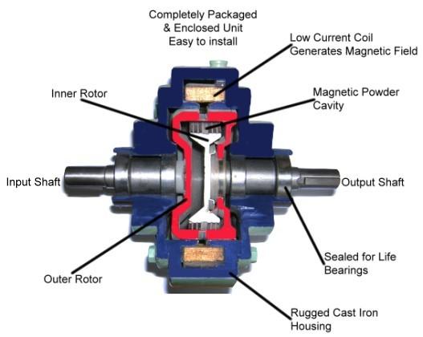
Classification of Clutch
Electromagnetic Clutch
Power transmission is achieved by means of magnetic field.
Rapid response time
Better control
https://www.youtube.com/watch?v=W4EylNDo9RI

Slide 12
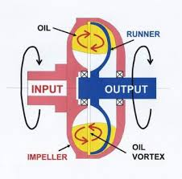
Classification of Clutch
Fluid Clutch
Power transmission is achieved by means of fluid pressure.
Extremely smooth start & absorb shock.
https://www.youtube.com/watch?v=O2HRp3k8lzs

Slide 13
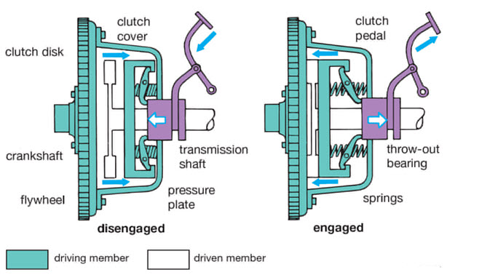
Single Disc or Plate Clutch

Slide 14
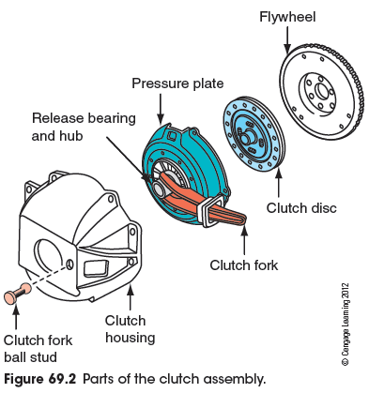
Single Disc or Plate Clutch

Slide 15
Main Component of Friction Clutch
Flywheel
Clutch plate
Clutch facing
Pressure plate
Springs
Throw out bearing
Cover
Linkages to operate clutch

Slide 16
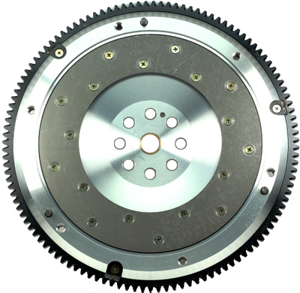
Main Component of Friction Clutch
Flywheel
Store the energy during expansion stroke & release during remaining stroke.
To provide base for starter ring gear.
To provide foundation on which entire clutch assembly is mounted.
To provide clutch friction surface.

Slide 17
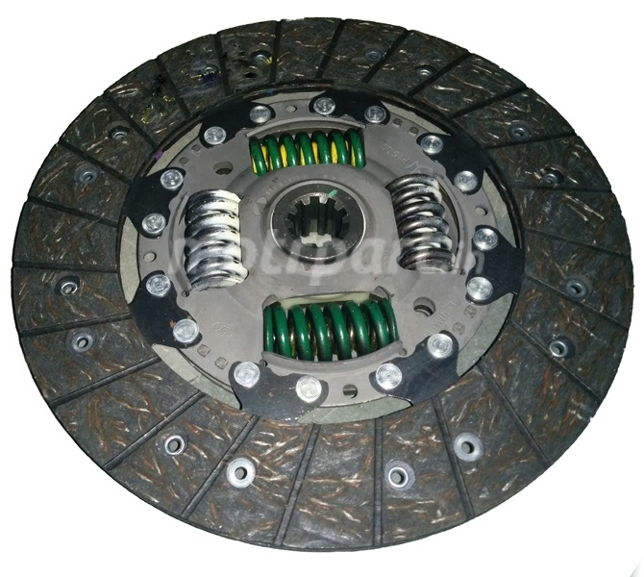
Main Component of Friction Clutch
Clutch plate
To provide friction surface on both side of clutch plate
To provide damping action against the torsional vibration.
To ensure engagement of clutch without any jerk.
To provide to and fro motion on driven shaft.

Slide 18
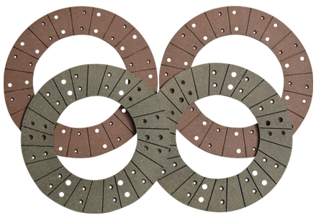
Main Component of Friction Clutch
Clutch Facing
Good wear resistance against high rubbing speed and large intensity of pressure.
High heat resistance to withstand high temperature.
High coefficient of friction.
Should be easy to manufacture.
Should has long life.
Asbestos, leather, fabric, reybestos, metal-ceramic, organic fiber composite, etc.

Slide 19
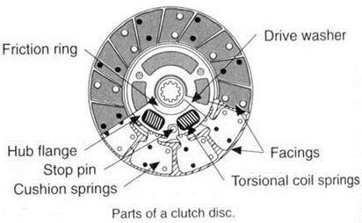
Main Component of Friction Clutch
Cushioning Spring
Clutch plate is made in two parts, central hub & outer facing.
In between these two units cushioning springs are fitted.
Cushioning effect helps in smoother engagement of clutch.
To reduce torsional vibration , cushioned plate provided with torsional spring.

Slide 20
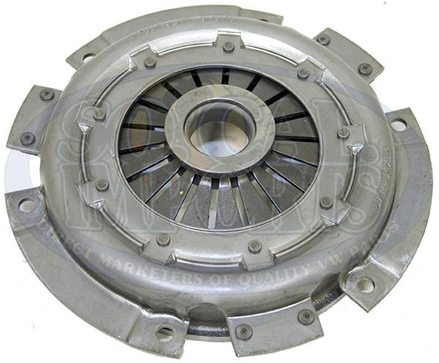
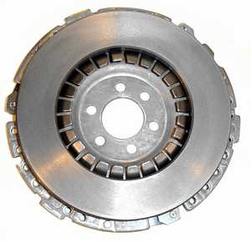
Main Component of Friction Clutch
Pressure Plate
It provide uniform pressure to pressure plate.
Material :High tensile gray cast iron
Good thermal conductivity to absorb and conduct away the heat generated during engagement.
It should be rigid so do not gets destroyed against pressure of clutch plate.

Slide 21
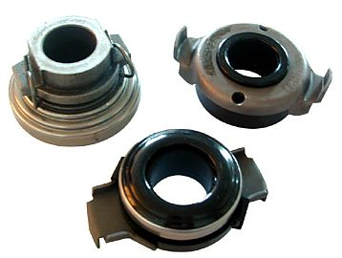
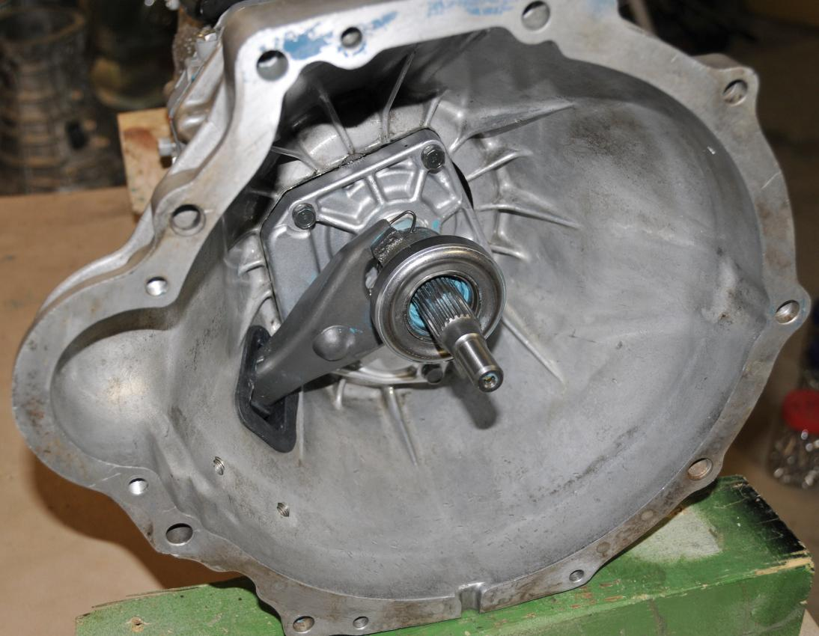
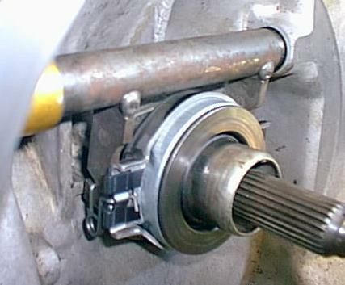
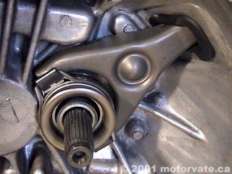
Main Component of Friction Clutch
Throw Out Bearing
Transfer pedal force to pressure plate.
Thrust ball bearing require grease for lubrication.
Graphite impregnated bearing does not require lubrication.

Slide 22
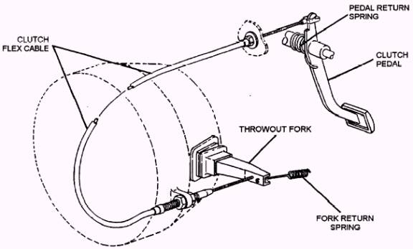
Main Component of Friction Clutch
Clutch Operating Linkage
It transmit the force applied at clutch pedal to throw out bearing.
It provide mechanical advantage to make clutch operation possible with reasonable amount of foot pressure.

Slide 23
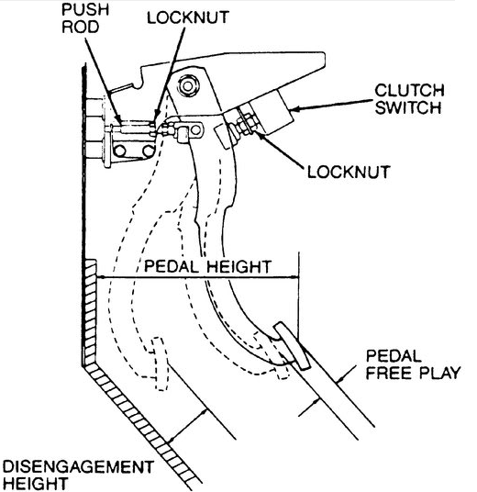
Main Component of Friction Clutch
Free Pedal Play
When clutch pedal is pressed, throw out bearing does not moves immediately.
A part of pedal movement is desirable to kept idle. To prevent rapid war of clutch plate, thrust bearing and other linkage component.
Normally free play provided about 25 mm at the clutch pedal.

Slide 24
Material for Friction Surfaces
1. It should have a high and uniform coefficient of friction.
2. It should not be affected by moisture and oil.
3. It should have the ability to withstand high temperatures caused by slippage.
4. It should have high heat conductivity.
5. It should have high resistance to wear.

Slide 25
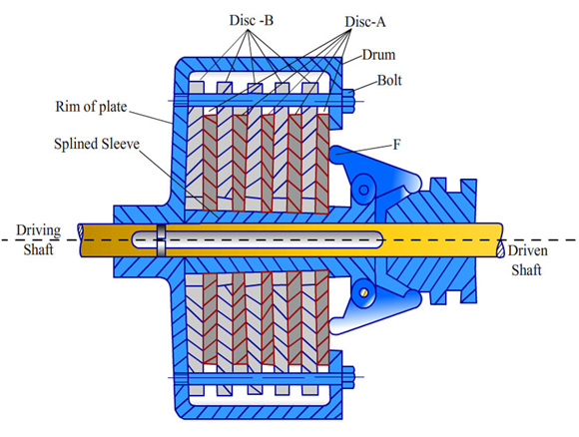
Multi Plate Clutch

Slide 26
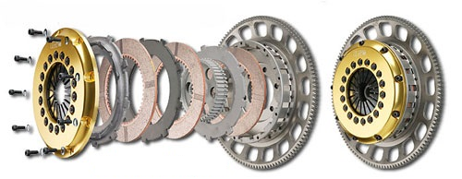
Multi Plate Clutch
Working of Clutch: (1) https://www.youtube.com/watch?v=devo3kdSPQY (2) youtube.com/watch?v=DIlCxj3-LhU

Slide 27
Multi Plate Clutch Vs Single Plate Clutch
Multi Plate Clutch | Single Plate Clutch
Number of friction clutch plates. | Only one single frictional clutch plate.
Increase torque carrying capacity hence suitable for heavy vehicle. Special purpose military and articulated vehicle. | Less torque carrying capacity hence used in light vehicle.
Smoother in operation . | Less smooth in operation.
For same torque transmission diameter of clutch plate is reduce. Hence useful where less space available. | For same torque transmission diameter of clutch plate is larger. Hence it requires more space.

Slide 28
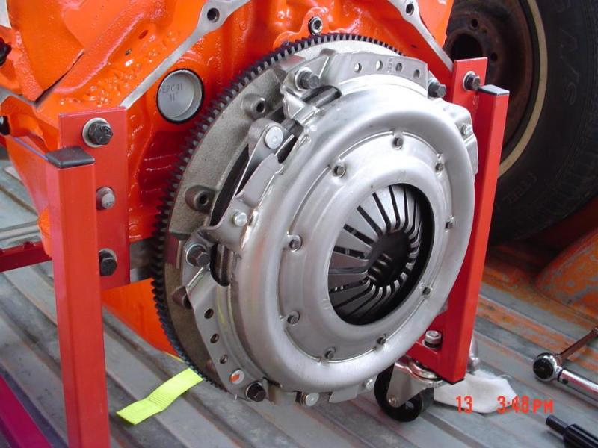
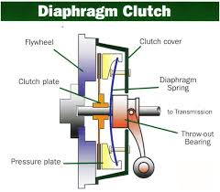
Diaphragm Clutch

Slide 29
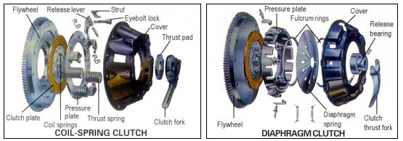

Slide 30
Difference between Helical Spring plate clutch & Diaphragm Spring plate clutch
Helical Spring | Diaphragm Spring
Coil spring provide sufficient clamping force hence suitable for heavy vehicle. | Diaphragm Spring provide less clamping force hence not suitable for heavy vehicle.
Less pedal movement is required hence easy gear shifting possible. | Large pedal movement is required. Clutch may stick. More impact load during gear changing.
Less compact. | More compact.
Affected by centrifugal force at high speed. | Less affected by centrifugal force at high speed.
Spring force on clutch plate is reduce with wear of clutch facing. | Spring force gradually increase with wear of clutch facing.
Large and complex construction as compared to diaphragm clutch | Compact and simple construction.

Slide 31
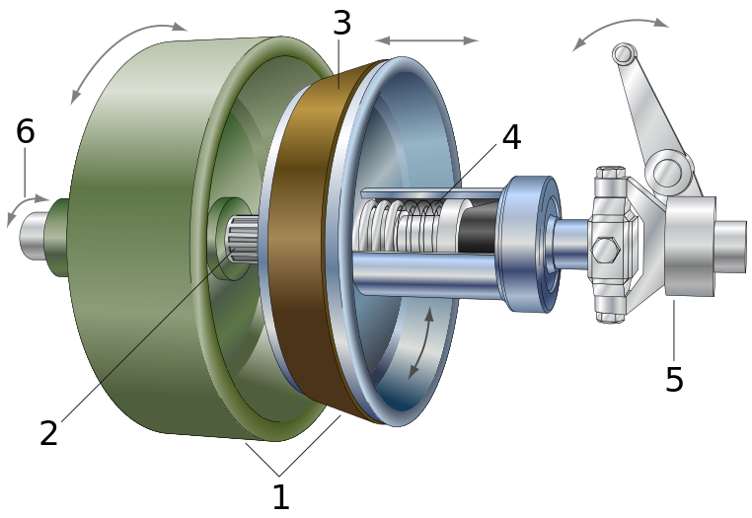
Cone Clutch
Cones: female cone (green), male cone(blue)
Shaft: male cone is sliding on splines
Friction material: usually on female cone, here on male cone
Spring: brings the male cone back after using the clutch control
Clutch control: separating both cones by pressing
Rotating direction: both direction of the axis are possible

Slide 32
Single Plate Clutch Vs Cone Clutch
Single Plate Clutch | Cone Clutch
Normal force acting on contact surface is equal to axial force hence large axial force is required. More stiff spring is required. | Normal force acting on contact surface is grater than axial force. Hence less effort is required to operate.
Due to slip between mating surface, less torque is transmitted. | Less chance of slip between mating surfaces hence almost 100% torque is transmitted.
Since surfaces of clutch plate is flat. So no problem during disengagement. | Disengagement of clutch become difficult if cone angle is less than 20 degree.
It does not suffer from disadvantage of cone clutch (biding of cones). | Small wear on cone surface results in considerable movement of male cone which affect the functioning of clutch.

Slide 33
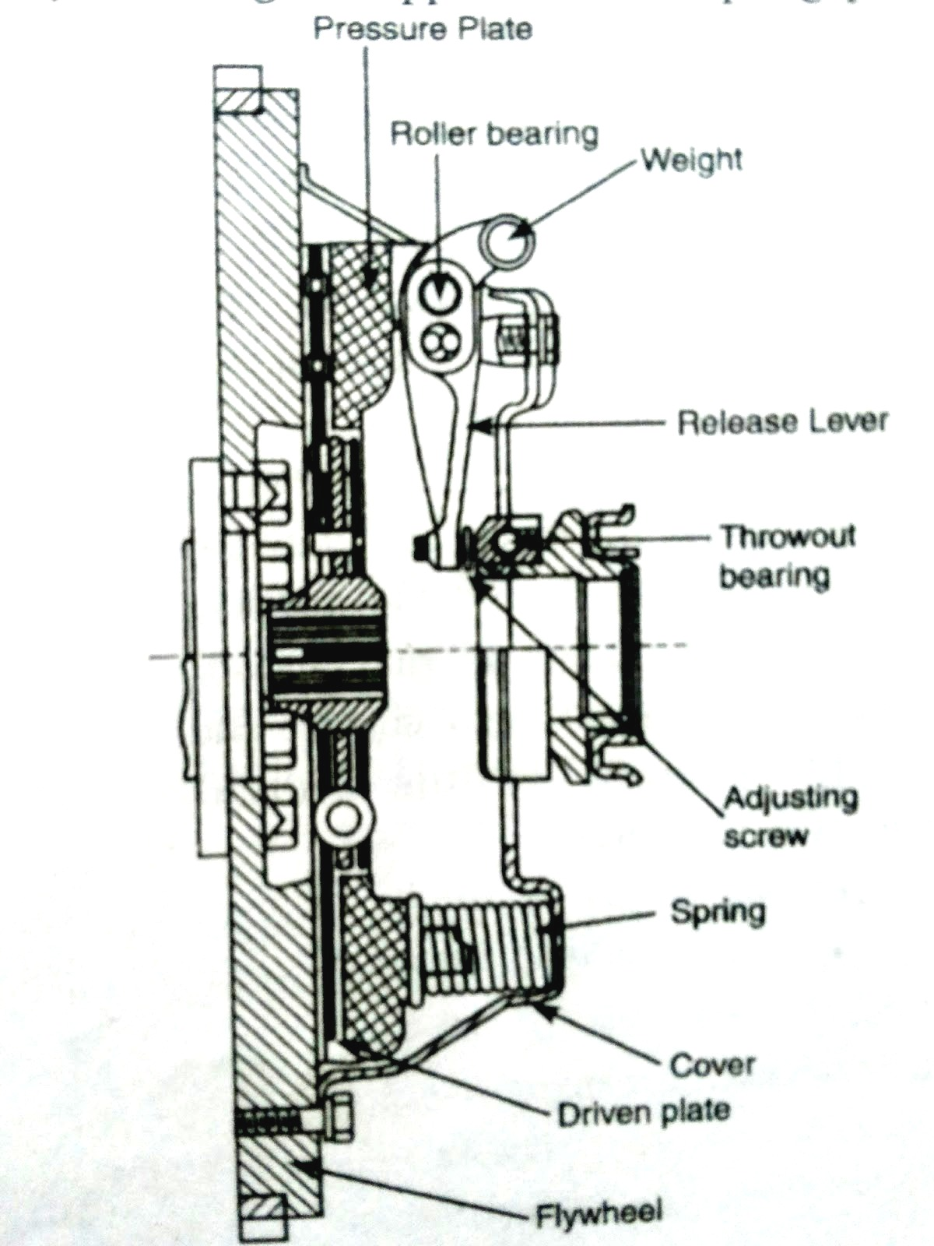
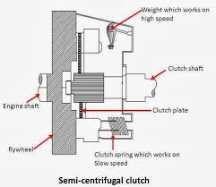
Semi Centrifugal Clutch

Slide 34
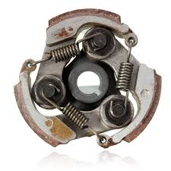
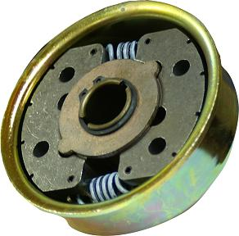
Centrifugal Clutch

Slide 35
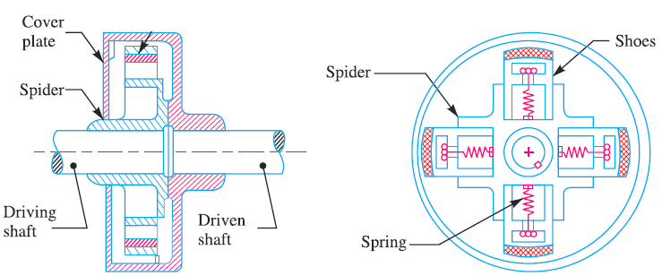
Centrifugal Clutch

Slide 36
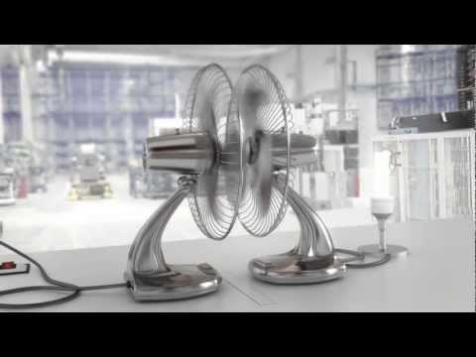
Fluid Flywheel

Slide 37
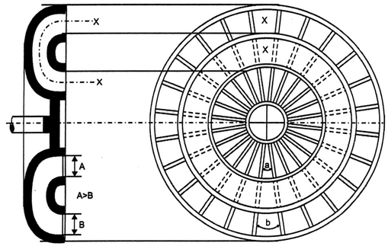
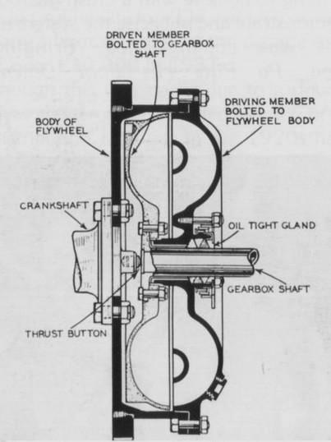
Fluid Flywheel

Slide 38
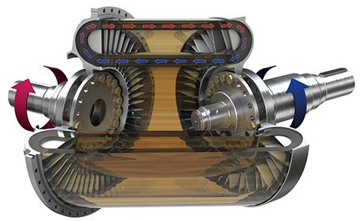
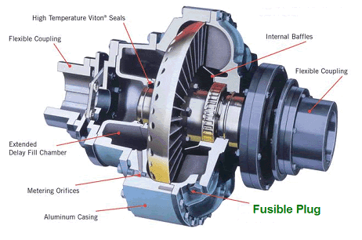
Fluid Flywheel

Slide 39
Advantage and Disadvantage of Fluid Flywheel
Advantage
No wear on moving parts.
No maintenance necessary except oil level.
No jerk on transmission when gear engages.
Damps all shocks and strain during power transmission.
No skill required for operating it.
Disadvantage
Gear changing is difficult with ordinary crash type gear box. Hence fluid flywheel is generally mounted with epicyclic gearbox.
Slip is grater at lower speed (engine not to run between 500 to 1000 rpm).
Oil has to be topped in regular interval.

Slide 40
Wet Clutch Vs Dry Clutch
Wet Clutch | Dry Clutch
Heat transfer is much batter since metal to oil heat transfer is very efficient. | Heat transfer is not batter since metal to air heat transfer is less efficient.
Longer life then dry type clutch. | Smaller life than wet clutch.
Due to less co-efficient of friction, the torque transmission capacity is lower. | High co-efficient of friction, the torque transmission capacity is higher.
Clutch Plate is perforated. | Clutch Plate is not perforated.
High operating and design cost. | Low operating and design cost.
Generally multiplate wet clutch is used. | Generally single plate dry clutch is used.

Slide 41
Type of Clutch in Automobile
Single plate – helical spring | Swaraj Mazda, Ashok Layland, Jeep, Ambassador.
Single plate – diaphragm spring | Tata-sumo, Sierra
Multi plate (Dry) | LML make scooter, Royal Enfield bullet.
Multi plate (Wet) | Bajaj Super, Bajaj Chetak, Hero Honda CBZ
Cone Clutch | Earlier motorcycles
Semi centrifugal clutch | Chrysler Imperial
Centrifugal clutch | TVS scotty, TVS champ, Bajaj Luna
Fluid Flywheel | Audi- A4

Slide 42
Trouble Shooting in Clutch
Symptom | Cause | Remedy
Clutch Slip Lack of contact between flywheel and pressure plate. Engine will unable to move vehicle. | Facing of clutch worn out. | New facing or clutch plate install.
 | Pressure spring may be broken or weak. | Replace
 | Pressure plate binding in cover plate. | Free up and lubricate.
 | Clutch pate or Pressure plate worn out or damaged | Replace or repair.
 | Worn splines on clutch shaft. | Replace shaft.
 | Dirt or dust on clutch facing. | Clean
 | No free play in pedal. | Adjust free travel.
 | Clutch adjustment may be faulty. | Re-adjust.

Slide 43
Trouble Shooting in Clutch
Symptom | Cause | Remedy
Clutch Drag Driven plate may not stop rotating while disengaging clutch. Difficult to shift gear | Wrapped or damaged pressure plate | Replace
 | Clutch shaft is not align with engine. | Adjust or replace pilot bearing.
 | Clutch adjustment is too tight. | Loosen
 | Excessive free pedal play | Adjusted properly
 | Oil or grease on clutch plate. | clean
Clutch Judder While engaging clutch vibration is produced instead of smooth gradual engagement. | Misalignment of pressure plate | Correct
 | Flywheel loosen on crankshaft flange. | Tighten
 | Clutch shaft bent. | Replace
 | Loose rivets. | Tight or replace
 | Destroyed clutch plate | Replace

Slide 44
Trouble Shooting in Clutch
Symptom | Cause | Remedy
Clutch Rattle During idling noise is produced. | Clutch assembly or flywheel improper balanced. | Replace
 | Clutch shaft bent. | Replace
 | Clutch plate do not engage with flywheel properly | Replace clutch plate
 | Worn or loose release bearing. | Replace
 | Misalignment between clutch and transmission. | Make proper alignment
Pulsation of clutch pedal | Unbalance flywheel. | Check dynamic balancing.
 | Wobbling flywheel. | Mount properly
 | Misalignment between clutch and transmission. | Make proper alignment

Slide 45
Trouble Shooting in Clutch
Symptom | Cause | Remedy
Knock or Tick When engine is idling and clutch is engaged. | Worn out bearing. | Replace
 | Worn out splines of clutch hub or shaft. | Replace
Clutch Grabs Hub of friction plate bins on clutch shaft. | Wraped friction plate. | Straighten or replace
 | Wraped pressure plate. | Straighten or replace
 | Release lever is not properly mounted. | Adjust properly

Slide 46
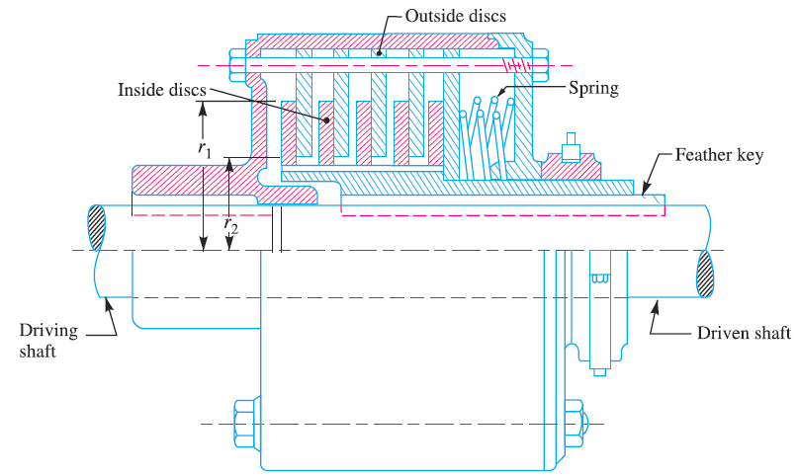
Multiple Disc Clutch

Slide 47
Considerations in Designing a Friction Clutch
Suitable frictional material @ contacting surface.
Designing the clutch for sufficient torque.
Engagement & disengagement should be without shock and jerk.
Contacting surface need to be hold together by itself & without any external assistance.
Low weight of rotating parts to reduce inertia forces.
Provision for carrying away the heat generated at the rubbing surfaces.

Slide 48
Design of a Disc or Plate Clutch
Axial force
δW = Pressure × Area = p × 2π r.dr
frictional force @ r,
Fr = μ × δW = μ.p × 2π r.dr
Frictional torque,
Tr = Fr × r = μ.p × 2π r.dr × r = 2 π μ p.(r)^2.dr

Slide 49
Considering uniform pressure
Intensity of pressure
Total frictional torque

Slide 50
Considering uniform axial wear
p.r = C (a constant) or p = C / r
Total frictional torque

Slide 51
Automatic Transmission
Working of Automatic Power Transmission:
https://www.youtube.com/watch?v=u_y1S8C0Hmc
Comparison of Manual and Automatic Transmission system:
https://www.youtube.com/watch?v=auQgOtveQi0
Torque Converter, How does it work?
https://www.youtube.com/watch?v=bRcDvCj_JPs

