Slide 1
Unit – 12 Couplings, Clutches And Brakes
By: Mudit M. Saxena
Dept. of Mechanical Engineering

Slide 2
Concept of Shaft and Coupling

Slide 3
Coupling
What is coupling ?
Coupling Diagram
The elements which join two shafts are known as couplings.
Couplings can form permanent connections between two shafts used for transmission of power from one shaft to another.

Slide 4
Coupling
Need of coupling
Coupling Diagram
Commercial shafts are limited in length by manufacturing and shipping requirements. Couplings are used to join sections of long transmission shafts.
Couplings are also used to connect the shaft of a driving machine to the shaft of a separately built machine so as to give an effect of continuous shaft.

Slide 5
Coupling
Sleeve or Box or Muff Coupling
Diagram of Muff Coupling
The coupling consists of a sleeve normally made of cast iron, in the form of hollow cylinder which receives end of two shafts made to butt together inside the sleeve.
The shafts are secured by means of a taper sunk key extending for the whole length of sleeve. The torque is transmitted from one shaft to the sleeve and then from the sleeve to the other shaft.

Slide 6
Sleeve or Box or Muff Coupling
Sleeve coupler
Muff Coupling

Slide 7
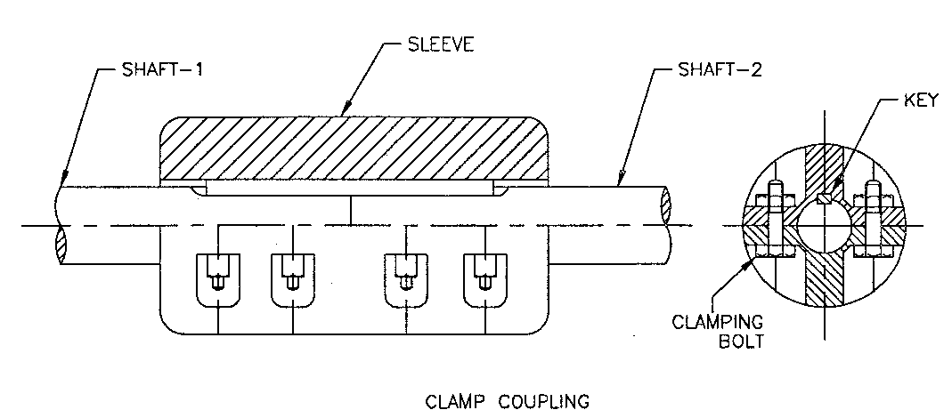
Coupling
Split muff or Clamp Coupling
The sleeve is split in two approximate halves which are connected by through bolts which are housed in recesses formed in the sleeve. The shafts are keyed together by using parallel key in the common key way. This type of coupling is used for heavy duty work.

Slide 8
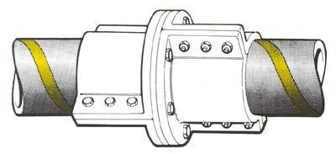
Split muff or Clamp Coupling
muff

Slide 9
Couplings
Flange-Couplings
It is most widely used coupling from medium to heavy duty transmission. The flange coupling consists of two
coupling halves keyed to the
two shafts. These two halves are coupled together by means of suitable number of bolts fitted in the holes through
halves.

Slide 10
Coupling
Bush pin type Flange Coupling:
This type of coupling has a cushioning effect due to flexible elements inserted in one of the flanges. The pins are rigidly fastened by nuts to one of the flanges and the enlarged diameters of the pin are covered with flexible material like leather or rubber bushings. The other flange has the holes corresponding to the size of bushings.
The couplings are commonly used for directly connecting electric motor to a machine. The couplings permits axial movement and takes care of shocks or slight misalignment.

Slide 11
FLANGE COUPLING
Flange
Flange Coupling

Slide 12
Coupling
Oldham coupling:
Oldham's coupling is used in connecting two parallel shafts whose axes are at small distance apart. The shafts to be connected have flanges rigidly fastened at their ends. The flanges have diametral slots at right angle to each other.
The intermediate piece a circular disc has diametral projections on either side at right angle to each other and closely fit into the slots in the two flanges. The rotation of drive shafts causes the rotation and sliding of circular disc which transmits motion and power to the driven shaft.

Slide 13
Oldham coupling
Odham Coupling Joint

Slide 14
Coupling
Universal Coupling
This coupling is used to connect two shafts whose axes will intersect. The angle between the shaft axes ray vary slightly during operation.
The coupling consists of forks keyed to the ends of either shaft and they are pin joined to a centre block which has two arms at right angles to each other. This type of coupling is widely used in automobiles to connect propeller shaft and also in machine tools.

Slide 15
Coupling
Universal Coupling
Universal Coupling

Slide 16
Clutches
What is a clutch ?
Clutch is a form of coupling which is used to transmit the power from driver shaft or an input shaft to driven shaft of machine which may be required to start or stop frequently.

Slide 17
Clutch

Slide 18
Classification of Clutches

Slide 19
Jaw and Toothed type clutches
JAW CLUTCH
JAW CLUTCH DIAGRAM
These types of clutches ensure a positive engagement without any slippage.
The jaw clutch consists of segmental projections or dogs on one side flange and corresponding recesses on other side flange on the driven shaft.
Driving flange is rigidly attached to the end of driving shaft while the other flange is keyed to the other shaft by feather key so that it can slide on that shaft.
The shifting device is accommodated on the hub of the sliding flange which makes it possible to engage with the driven flange to transmit the motion and power to the driven shaft.

Slide 20
Clutches
Friction Clutches
Principle of friction Clutches
Friction clutches transmit power by virtue of a friction force developed between the contact surfaces.
The clutch can slip under certain conditions and can be used as a safety device also.
They are used when sudden and complete disconnection of two rotating shafts is neces­sary.
The friction surfaces may be flat, conical or cylindrical.

Slide 21
Clutches
Disc clutch:
There are two flanges, A and B One (A) keyed rigidly to the driving shaft and other (B) fitted to the driven shaft by feather key or splines so that it may be moved along the shaft.
Driven flange (B) may be pressed against the driving flange (A) by a suitable mechanism.
The torque is transmitted by friction between the flanges with friction disc. The amount of torque transmitted depends upon axial pressure, radius of the friction surfaces and coefficient of friction.
Single disc clutches are used in automobiles.

Slide 22
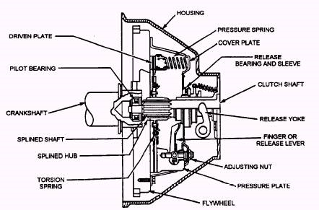
Disc clutch:

Slide 23
Clutches
Cone clutch
The clutch consists of an internal cone fixed to the driving member and a movable cone free to slide axially is keyed to the driven member. The Slope a of the cone is from 8° to 15°. The clutch parts (Cones) are held together by springs producing the required axial force. Cone clutch is relatively simple device for coupling two shafts by friction without use of much excessive axial pressure.

Slide 24
Clutches
Centrifugal clutch
It is a sort of coupling by which the engagement and dis­engagement takes place at a certain fraction of the running speed of the driving shaft.
Here, the shoes move radially. The shoes are held against the hub or spider on the driving shaft by means of suitable springs.

Slide 25
Clutches
Centrifugal clutch
The driven member consist of a cylindrical drum in which shoes slide to make the contact through friction surfaces with the inner linings of drum due to centrifugal force on the shoes. The engagement of the shoes will take place when the centrifugal force on shoe increases and become greater than spring force.
The engagement will cause the transmission of torque from driving to driven member.

Slide 26
BRAKES
What is a brake ?
BRAKE
Brake is a device by means of which frictional resistance is applied to a moving machine member in order to retard or stop the motion of a machine.
The brakes absorb the kinetic energy and also many a time potential energy (In case of Hoists, Elevators etc.) which appears as heat energy. This heat is to be dissipated in sur^{r}ounding to prevent excessive heating of brake lining.
Brakes are used in automobiles, trains, vehicles, hoists, elevators, presses and similar ma­chines

Slide 27
Classification of Brakes

Slide 28
Brakes
Block Brake
The block brake consists of blocks which are pressed against the rim of revolving brake wheel or drum.
The blocks are made of a softer material than that of rim or some times faced with a friction material.
The friction between the wheel and the blocks tends to prevent the rotation of the wheel. This type of brake is commonly used on railway train wheels and tram cars.

Slide 29
Brakes
Electric Hydraulic Block Brake

Slide 30
Brakes
Band Brake :
A band brake consists of a flexible band of leather of steel lined with friction material which embraces a part of the circumference of the brake drum.
In simple band brake one end of the band is attached to a fixed pin or fulcrum of the lever while other at a distance from the fulcrum.
In getting braking action, the band is tightened around the wheel by applying effort at the end of the lever. The friction between the band and the wheel surface provides the braking force to decrease or stop the motion of the wheel.

Slide 31
Brakes
Band and Block Brake
The band and block brake is modified type of the band brake which consists of a number of wooden blocks fixed to a steel band. For braking, the effort is applied at the end of the lever.

Slide 32
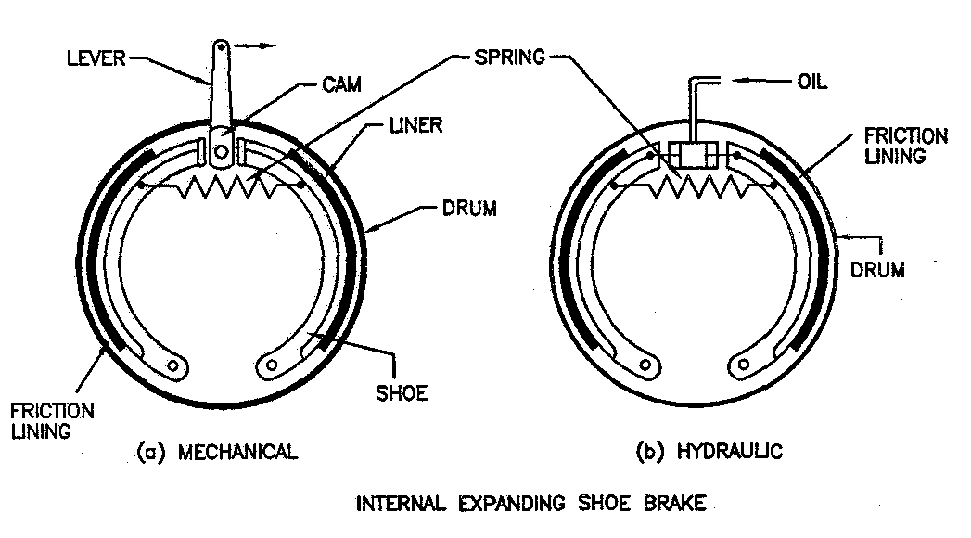
Internal Expanding shoe Brake :
This type of brake is widely used in automobiles. The brake may be operated mechanically or hydraulically. The brake consists of two shoes lined with some friction material pivoted at one end about a fixed fulcrum. The shoes are housed inside the rotating drum. Under released condition, sufficient gap between shoes and inner surface of drum is maintained.

Slide 33
Brakes
In mechanically applied brakes, a cam is placed between free ends of the shoes The cam is fixed over a shaft which is rotated by operating suitable linkages. The rotation of cam tends to expand the shoes out-wards eliminating gap and making contact between the shoes and inner surface of the rotating drum. Due to frictional resistance between contact surfaces, the rotation of the drum is decreased or stopped. When the cam is not operated, the shoes come to original position due to spring force provided by retracting spring connected between free ends of the two shoes.
In Hydraulically operated brake during braking, the fluid at high pressure enters into cylinder fitted with two pistons which move outwards pushing free ends of the shoes similar to the action of a cam causing the braking of the drum.

Slide 34
Brakes ( Internally Expanding )
By: Mudit M. Saxena, Dept. of Mech. Engg.

Slide 35
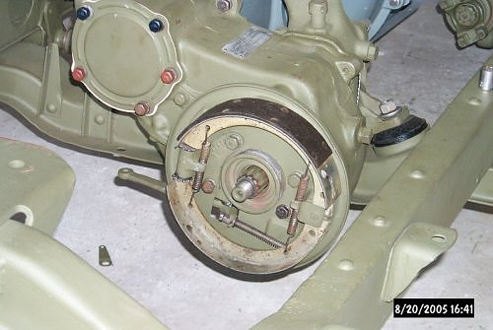
Internally Expanding Shoe Brakes

Slide 36
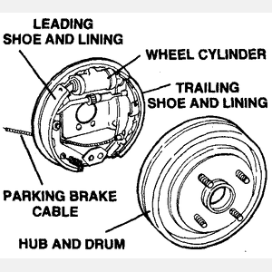
Internally Expanding Shoe Brakes

