Slide 1
Refrigeration & Air Conditioning
By: Mudit M. Saxena,
Dept. of mech. Engg.
Notes:
TO THE TRAINER
This PowerPoint presentation can be used to train people about the basics of refrigeration and air condonditioning. The information on the slides is the minimum information that should be explained. The trainer notes for each slide provide more detailed information, but it is up to the trainer to decide if and how much of this information is presented also.
Additional materials that can be used for the training session are available on www.energyefficiencyasia.org under “Energy Equipment” and include:
Textbook chapter on this energy equipment that forms the basis of this PowerPoint presentation but has more detailed information
Quiz – ten multiple choice questions that trainees can answer after the training session
Option checklist – a list of the most important options to improve energy efficiency of this equipment

Slide 2
Introduction
How does it work?
High Temperature Reservoir
Heat Rejected
R
Work Input
Heat Absorbed
Low Temperature Reservoir
Notes:
Refrigeration and air conditioning is used to cool products or a building environment.
The refrigeration or air conditioning system (R) transfers heat from a cooler low-energy reservoir to a warmer high-energy reservoir

Slide 3
Coefficient of Performance (CoP)
Coefficient of Performance (CoP) is very important in determining a system's overall efficiency.
It is defined as refrigeration capacity in kW divided by the energy input in kW. While CoP is a very simple measure, like the kW.

Slide 4
Units of refrigeration
The units of refrigeration are always a unit of power. Domestic and commercial refrigerators may be rated in kJ/s, or Btu/h of cooling.
For commercial and industrial refrigeration systems most of the world uses the kilowatt (kW) as the basic unit refrigeration.

Slide 5
Ton of Refrigeration (TR).
One Ton of Refrigeration was defined as the energy removal rate that will freeze one ton of water at 0 °C (32 °F) in one day(24 Hrs).
One Ton’s value as historically defined is approximately 11,958 BTU/hr (3.505 kW) has been redefined to be exactly 12,000 BTU/hr (3.517 kW).

Slide 6
Introduction
AC Systems
AC options / combinations:
Air Conditioning (for comfort / machine)
Split air conditioners
Fan coil units in a larger system
Air handling units in a larger system
Notes:
Depending on applications, there are several options / combinations of air conditioning, which are available for use:
Air conditioning (for space or machines)
Split air conditioners
Fan coil units in a larger system
Air handling units in a larger system

Slide 7
Types of Refrigeration
Refrigeration systems
Vapour Compression Refrigeration (VCR): uses mechanical energy
Vapour Absorption Refrigeration (VAR): uses thermal energy
Notes:
The two principle types of refrigeration plants found in industrial use are: Vapour compression refrigeration (VCR) and vapour absorption refrigeration (VAR). VCR uses mechanical energy as the driving force for refrigeration, while VAR uses thermal energy as the driving force for refrigeration.

Slide 8
Type of Refrigeration
Vapour Compression Refrigeration
Highly compressed fluids tend to get colder when allowed to expand
If pressure high enough
Compressed air hotter than source of cooling
Expanded gas cooler than desired cold temperature
Notes:
Compression refrigeration cycles take advantage of the fact that highly compressed fluids at a certain temperature tend to get colder when they are allowed to expand.
If the pressure change is high enough, then the compressed gas will be hotter than our source of cooling (outside air, for instance) and the expanded gas will be cooler than our desired cold temperature. In this case, fluid is used to cool a low temperature environment and reject the heat to a high temperature environment.

Slide 9
VAPOUR COMPRESSION REFRIGERATION CYCLE ( T-S diagram )
1-2 Isentropic compression
2-3 Constant pressure heat rejection in the condenser
3-4 Throttling in an expansion valve
4-1 Constant pressure heat addition in the evaporator

Slide 10
VAPOUR COMPRESSION REFRIGERATION CYCLE ( p-h diagram )
1-2 Isentropic compression
2-3 Constant pressure heat rejection in the condenser
3-4 Throttling in an expansion valve
4-1 Constant pressure heat addition in the evaporator

Slide 11
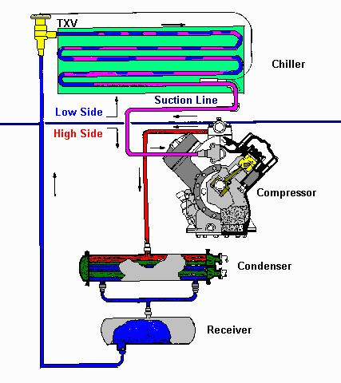
Typical Refrigeration Cycle

Slide 12
Components
Refrigerant
Evaporator/Chiller
Compressor
Condenser
Receiver
Thermostatic expansion valve (TXV)

Slide 13
Vapour Compression Refrigeration
Two advantages
Lot of heat can be removed (lot of thermal energy to change liquid to vapour)
Heat transfer rate remains high (temperature of working fluid much lower than what is being cooled)
Notes:
Vapour compression refrigeration cycles have two advantages.
First, a large amount of thermal energy is required to change a liquid to a vapor, and therefore a lot of heat can be removed from the air-conditioned space.
Second, the isothermal nature of the vaporization allows extraction of heat without raising the temperature of the working fluid to the temperature of whatever is being cooled. This means that the heat transfer rate remains high, because the closer the working fluid temperature approaches that of the surroundings, the lower the rate of heat transfer.

Slide 14
Vapour Compression Refrigeration
Refrigeration cycle
Condenser
3
High Pressure Side
4
Expansion Device
Compressor
1
2
Low Pressure Side
Evaporator
Notes:
The refrigeration cycle is shown in the Figure and can be broken down into the following stages (note to the trainer: the next slides will explain what is happening between 1 to 4)

Slide 15
Vapour Compression Refrigeration
Low pressure liquid refrigerant in evaporator absorbs heat and changes to a gas
Refrigeration cycle
Condenser
3
High Pressure Side
4
Expansion Device
Compressor
1
2
Low Pressure Side
Evaporator
Notes:
The refrigeration cycle is shown in the Figure and can be broken down into the following stages (note to the trainer: the numbers 1-4 are shown in the figure):
1 – 2. Low-pressure liquid refrigerant in the evaporator absorbs heat from its surroundings, usually air, water or some other process liquid. During this process it changes its state from a liquid to a gas, and at the evaporator exit is slightly superheated.

Slide 16
Vapour Compression Refrigeration
The superheated vapour enters the compressor where its pressure is raised
Refrigeration cycle
Condenser
3
High Pressure Side
4
Expansion Device
Compressor
1
2
Low Pressure Side
Evaporator
Notes:
The refrigeration cycle is shown in the Figure and can be broken down into the following stages (note to the trainer: the numbers 1-4 are shown in the figure):
2 – 3. The superheated vapour enters the compressor where its pressure is raised. The temperature will also increase, because a proportion of the energy put into the compression process is transferred to the refrigerant.

Slide 17
Vapour Compression Refrigeration
The high pressure superheated gas is cooled in several stages in the condenser
Refrigeration cycle
Condenser
3
High Pressure Side
4
Expansion Device
Compressor
1
2
Low Pressure Side
Evaporator
Notes:
The refrigeration cycle is shown in the Figure and can be broken down into the following stages (note to the trainer: the numbers 1-4 are shown in the figure):
3 – 4. The high pressure superheated gas passes from the compressor into the condenser. The initial part of the cooling process (3-3a) de-superheats the gas before it is then turned back into liquid (3a-3b). The cooling for this process is usually achieved by using air or water. A further reduction in temperature happens in the pipe work and liquid receiver (3b - 4), so that the refrigerant liquid is sub-cooled as it enters the expansion device

Slide 18
Vapour Compression Refrigeration
Liquid passes through expansion device, which reduces its pressure and controls the flow into the evaporator
Refrigeration cycle
Condenser
3
High Pressure Side
4
Expansion Device
Compressor
1
2
Low Pressure Side
Evaporator
Notes:
The refrigeration cycle is shown in the Figure and can be broken down into the following stages (note to the trainer: the numbers 1-4 are shown in the figure):
1 – 2. Low-pressure liquid refrigerant in the evaporator absorbs heat from its surroundings, usually air, water or some other process liquid. During this process it changes its state from a liquid to a gas, and at the evaporator exit is slightly superheated.
2 – 3. The superheated vapour enters the compressor where its pressure is raised. The temperature will also increase, because a proportion of the energy put into the compression process is transferred to the refrigerant.
3 – 4. The high pressure superheated gas passes from the compressor into the condenser. The initial part of the cooling process (3-3a) de-superheats the gas before it is then turned back into liquid (3a-3b). The cooling for this process is usually achieved by using air or water. A further reduction in temperature happens in the pipe work and liquid receiver (3b - 4), so that the refrigerant liquid is sub-cooled as it enters the expansion device.CondenserEvaporatorHigh Pressure SideLow Pressure SideCompressorExpansion Device1234
4 - 1 The high-pressure sub-cooled liquid passes through the expansion device, which both reduces its pressure and controls the flow into the evaporator

Slide 19
Vapour Compression Refrigeration
Type of refrigerant
Refrigerant determined by the required cooling temperature
Chlorinated fluorocarbons (CFCs) or freons: R-11, R-12, R-21, R-22 and R-502
Notes:
A variety of refrigerants are used in vapor compression systems. The choice of fluid is determined largely by the cooling temperature required.
Commonly used refrigerants are in the family of chlorinated fluorocarbons, CFCs, also known as freons: R-11, R-12, R-21, R-22 and R-502.

Slide 20
Vapour Compression Refrigeration
Choice of compressor, design of condenser, evaporator determined by
Refrigerant
Required cooling
Load
Ease of maintenance
Physical space requirements
Availability of utilities (water, power)
Notes:
The choice of refrigerant and the required cooling temperature and load determine the choice of compressor, as well as the design of the condenser, evaporator, and other auxiliaries.
Additional factors such as ease of maintenance, physical space requirements and availability of utilities for auxiliaries (water, power, etc.) also influence component selection.

Slide 21
DOMESTIC REFRIGERATOR

Slide 22
WINDOW AIR CONDITIONER

Slide 23
WINDOW AIR CONDITIONER

Slide 24
A thermostatic expansion valve system,
In a thermostatic expansion valve system, the components necessary for system operation are:
the condenser, the evaporator, the compressor, the receiver drier, the thermostatic expansion valve, connecting pipes and hoses, a thermostat, blower fans and pressure switches.
The thermostatic expansion valve, also called a TX valve, is located at the entry to the evaporator and provides a throttling or restricting function to control the quantity of refrigerant entering the evaporator. At the same time it must provide for complete vaporization of all the liquid refrigerant which enters the evaporator.
The system is charged with refrigerant and a quantity of lubricating oil which circulates with the refrigerant at all times.

Slide 25
Thermostatic expansion valve

Slide 26
SPLIT AIR CONDITIONING SYSTEM

Slide 27
SPLIT – AIR CONDITIONER SCHAMATIC

Slide 28
Vapour Absorption Refrigeration
It uses heat energy instead of mechanical work. It eliminates compressor.
The vapours are absorbed in the liquid which are pumped into generator where heat energy is supplied to generate vapours of high pressure.
Pump needs a small amount of work for circulating the liquid.

Slide 29
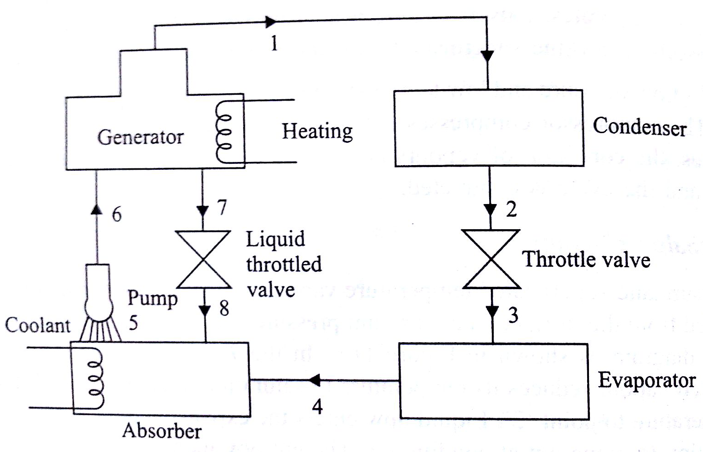
Vapour Absorption Refrigeration
Two widely used absorbent and refrigeration pairs are:
Ammonia Water system
Ammonia – refrigerant;
Water – Absorbent
Water lithium bromide system –
Water – Refrigerant ;
Lithium bromide- absorbent
The function of compressor in vapour compression is replaced by absorber, generator, throttle valve and pump.
The remaining component namely components condenser, throttle valve, and evaporator are same.

Slide 30
Vapour Absorption Refrigeration
Working:
Ammonia water solution is kept in the generator, where heat energy is supplied from an external source. Ammonia vapours are generated at point 1 and flow through the pipe to the condenser.
These vapours get codensed and reject heat externally and flow through the throttle valve (Point 2).
Liquid ammonia is throttled through the expansion valve where both temperature and pressure fall.(Point 3)
Liquid now enters the evaporator . Here ammonia evaporates by absorbing latent heat of evaporation to produce refrigeration effect.
After absorbing heat the liquid converts into vapours and enters the absorber. (Point 4) .In the absorber weak solution (Ammonia+Water) also enters through throttling valve point (8).

Slide 31
Vapour Absorption Refrigeration
It absorbs ammonia to become strong solution which is pumped ( Point 5) with the help of a pump to the generator (Point 6). Thus cycle is completed.
The pump work is considered negligible in comparison to heat supplied in the generator and refrigeration effect is obtained in the evaporator.
The coefficient of performance ( COP ) is expressed as the ratio of refrigeration effect ( in evaporator ) to heat supplied ( in generator ). The value of COP is only 20 to 30 % of the COP of vapour compression system at the same refrigeration temperature.

