Slide 1
ELEMENTS OF MECHANICAL ENGINEERING
By: Mudit M. Saxena, Dept. of Mech. Engg

Slide 2
ELEMENTS OF MECHANICAL ENGINEERING
UNIT – 1
INTRODUCTION
PROPERIES OF GASES

Slide 3
BASIC UNITS AND DIMENSION ANALYSIS
MEASUREMENT OF
FORCE
MASS
PRESSURE
WORK
POWER
ENERGY
HEAT
TEMPERATURE
SPECIFIC HEAT CAPACITY

Slide 4
MASS
MASS
The mass of an object is a fundamental property of the object; a numerical measure of its inertia; a fundamental measure of the amount of matter in the object.
It is a fundamental quantity that it is hard to define in terms of something else.
All mechanical quantities can be defined in terms of mass, length, and time. The usual symbol for mass is m and its SI unit is the kilogram.
Mass is normally considered to be an unchanging property of an object but at speeds approaching the speed of light one must consider the increase in the relativistic mass.

Slide 5
Weight
Weight
The weight of an object is defined as the force of gravity on the object and may be calculated as the mass times the acceleration of gravity, w = mg.
Since the weight is a force, its SI unit is the Newton.
Dimensional Formula: [M¹L¹T⁻²]

Slide 6
FORCE
FORCE
A force can cause an object with mass to change its velocity (which includes to begin moving from a state of rest), i.e., to accelerate, or a flexible object to deform, or both.
Force can also be described as a push or a pull.
A force has both magnitude and direction, making it a vector quantity.
It is measured in the SI unit of Newtons and represented by the symbol F.
Dimensional Formula: [M¹L¹T⁻²]

Slide 8
Newton's second law
Newton's second law
Rate of change of momentum is equal to applied external force.
F = ( mv - mu) / t or F = ma

Slide 9
Pressure
Pressure:
Pressure (symbol: P or p) is the ratio of force to the area over which that force is distributed.
Pressure is force per unit area applied in a direction perpendicular to the surface of an object.
Pressure is measured in any unit of force divided by any unit of area.
The SI unit of pressure is the newton per square metre, which is called the pascal (Pa)

Slide 10
PRESSURE
UNITS OF PRESSURE:
1 Pascal = 1 N/m² (The SI unit)
1 Bar = 10⁵ Pa = 10⁵ N/m² = 100 kPa
1 Tor = 1 mm Hg = 133.3 Pa
1 atm = 1.01325 x 10⁵ Pa = 101.3 kPa = 760 mm Hg

Slide 11
PRESSURE
Gauge pressure (also spelled gage pressure) is the pressure relative to the local atmospheric or ambient pressure.
Absolute pressure is zero-referenced against a perfect vacuum, so it is equal to gauge pressure plus atmospheric pressure.
Gauge pressure is zero-referenced against ambient air pressure, so it is equal to absolute pressure minus atmospheric pressure.
Differential pressure is the difference in pressure between two points.

Slide 12
Work
Work
It refers to an activity involving a force and movement in the directon of the force.
A force of 20 newtons pushing an object 5 meters in the direction of the force does 100 joules of work.
S.I. unit of work is Joule and c.g.s unit is erg.
1 Joule = 10⁷ Ergs Dimensions: [M¹L²T⁻²]

Slide 13
Power
Power
It is the rate of doing work or the rate of using energy, which are numerically the same.
If you do 100 joules of work in one second (using 100 joules of energy), the power is 100 watts.
P = dw/dt Joule/sec or Watt
Dimensions: [M¹L²T⁻³]

Slide 14
Energy
Energy
It is the capacity for doing work.
You must have energy to accomplish work
It is like the "currency" for performing work.
To do 100 joules of work, you must expend 100 joules of energy.
S.I. Unit: Joule Dimensions: [M¹L²T⁻²]

Slide 15
Heat
Heat:
Heat is a form of energy which flows from higher temperature to lower temperature.
Unit : Joule or Calorie
One calorie = 4.18 joules
One kilocalorie = 4.18 kilojoules
Hence Calorie is a bigger unit.
S.I. Unit: Joule Dimensions: [M¹L²T⁻²]

Slide 16
TEMPERATURE
TEMPERATURE:
A temperature is a numerical measure of hot or cold.
Its measurement is by detection of heat radiation or particle velocity or kinetic energy, or by the bulk behavior of a thermometric material.
It may be calibrated in any of various temperature scales, Celsius, Fahrenheit, Kelvin, etc.
The fundamental physical definition of temperature is provided by thermodynamics.

Slide 17
Various Temperature Scales
SCALE | Water Boils | Water Freezes | Room Temp. | Absolute Zero
F ° | 212 ° | 32 ° | 72 ° | - 460 °
C ° | 100 ° | 0 ° | 22 ° | - 273 °
K | 373 | 273 | 295 | 0

Slide 18
Absolute temperature scale
Absolute temperature scale, any thermometric scale on which a reading of zero coincides with the theoretical absolute zero of temperature—i.e., the thermodynamic equilibrium state of minimum energy.
The standard measure of temperature in the International System of Units is the Kelvin (K) scale, on which the only point established by arbitrary definition is the unique temperature at which the liquid, solid, and vapour forms of water can be maintained simultaneously.
The interval between this temperature and absolute zero is defined as 273.16 kelvins, and the temperature of this “triple point” is designated 273.16 K.
In essence, the Kelvin scale is the Celsius (°C) temperature scale shifted by 273.15 degrees (because the triple point of water is actually 0.01 °C), with the same size unit of temperature.

Slide 19
Specific Heat
Specific Heat:
The specific heat is the amount of heat per unit mass required to raise the temperature by one degree Celsius.
The relationship between heat and temperature change is usually expressed in the form shown below where c is the specific heat.
Q = m c Δ t ; c = Q / m Δ t
The relationship does not apply if a phase change is encountered, because the heat added or removed during a phase change does not change the temperature.
The specific heat of water is 1 calorie/gram °C = 4.186 joule/gram °C which is higher than any other common substance. As a result, water plays a very important role in temperature regulation.

Slide 20
BASIC UNITS AND DIMENSION ANALYSIS
Change of state
Mechanical equivalent of Heat
Internal energy
Enthalpy
Entropy
Efficiency

Slide 21
CHANGE OF STATE AND LATENT HEAT
CHANGE OF STATE AND LATENT HEAT
When a substance changes from one state to another energy is either absorbed or liberated. This heat energy is called the latent heat, and part of it is the energy used to overcome the forces of attraction between the molecules. It is clearly useful to know the energy required to change the state of unit mass of the substance. This is known as the specific latent heat and is defined as follows:
The specific latent heat is the energy required to change the state of 1 kg of the substance Any material has two specific latent heats: The specific latent heat of fusion is the heat energy needed to change 1 kg of the material in its solid state at its melting point to 1 kg of the material in its liquid state, and that released when 1 kg of the liquid changes to 1 kg of solid
The specific latent heat of vaporisation of a liquid is the heat energy needed to change 1 kg of the material in its liquid state at its boiling point to 1 kg of the material in its gaseous state, and that released when 1 kg of vapour changes to 1 kg of liquid

Slide 22
Change of State

Slide 23
The mechanical equivalent of heat
The mechanical equivalent of heat is that amount of work required to raise the temperature of a substance of unit mass by 1 deg / 1K In modern terms, the mechanical equivalent of heat, symbol J (in honor of James Joule), is the ratio of a unit of mechanical energy to the equivalent unit of thermal energy (W/Q), when a system of units is used in which then differ. The modern formulaic relationship is: W = J·Q where J is a constant known as the mechanical equivalent of heat The value of J is 4.186 Joule per calorie.

Slide 24
INTERNAL ENERGY
INTERNAL ENERGY
It is defined as the sum of the random distribution of kinetic and potential energies associated with the molecules of a system.
It is the energy of the particles inside the object and is not affected by the objects kinetic or potential energy but by the energy of these particles inside it.
If the temperature of a system rises, the molecules will travel quicker, therefore have more kinetic energy and so the Internal Energy will increase.

Slide 25
Enthalpy
Enthalpy:
A thermodynamic function of a system, equivalent to the sum of the internal energy of the system plus the product of its volume multiplied by the pressure exerted on it by its surroundings.
Enthalpy = u + pv

Slide 26
Entropy
Entropy:
A measure of the amount of energy in a physical system not available to do work.
As a physical system becomes more disordered, and its energy becomes more evenly distributed, that energy becomes less able to do work.
For example, a car rolling along a road has kinetic energy that could do work (by carrying or colliding with something, for example); as friction slows it down and its energy is distributed to its surroundings as heat, it loses this ability.
The amount of entropy is often thought of as the amount of disorder in a system.

Slide 27
Entropy
In thermodynamics, entropy (usual symbol S) is a measure of the number of specific ways in which a thermodynamic system may be arranged, often taken to be a measure of disorder, or a measure of progressing towards thermodynamic equilibrium.
The entropy of an isolated system never decreases, because isolated systems spontaneously evolve towards thermodynamic equilibrium, which is the state of maximum entropy.
The change in entropy (ΔS) was originally defined for a thermodynamically reversible process as

Slide 28
LAWS OF THERMODYNAMICS
Statement of:
Zeroth law of thermodynamics
First Law of thermodynamics
Second law of thermodynamics

Slide 29
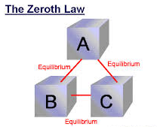
Zeroth law of thermodynamics
Zeroth law of thermodynamics: If two systems are in thermal equilibrium with a third system, they must be in thermal equilibrium with each other.
This law helps define the notion of temperature.

Slide 30
First law of thermodynamics
First law of thermodynamics:
This states that energy can be neither created nor destroyed. However, energy can change forms, and energy can flow from one place to another. The total energy of an isolated system remains the same.
Heat is a form of energy. Because energy is conserved, the internal energy of a system changes as heat flows in or out of it.
Equivalently, perpetual motion machines of the first kind are impossible.
The increase in internal energy of a body is equal to the heat supplied to the body minus work done by the body.
dU = dQ – dW or dQ = dU + dW

Slide 31
Second Law of Thermodynamics
Second Law of Thermodynamics:
It is not possible for heat to flow from a colder body to a warmer body without any work having been done to accomplish this flow.
Energy will not flow spontaneously from a low temperature object to a higher temperature object.

Slide 32
Second Law of Thermodynamics
Clausius statement:
Clausius statement states “it is impossible for a self acting machine working in a cyclic process without any external force, to transfer heat from a body at a lower temperature to a body at a higher temperature. It considers transformation of heat between two heat reservoirs.
Kelvin – Planck statement:
Kelvin – Planck statement states “it is impossible to construct an engine, which is operating in a cycle produces no other effect except to external heat from a single reservoir and do equivalent amount of work.

Slide 33
Ideal Gas
An ideal gas is defined as one in which all collisions between atoms or molecules are perfectly elastic and in which there are no intermolecular attractive forces.
In such a gas, all the internal energy is in the form of kinetic energy and any change in internal energy is accompanied by a change in temperature.
An ideal gas can be characterized by three state variables: absolute pressure (P), volume (V), and absolute temperature (T). The relationship between them may be deduced from kinetic theory and is called the
Ideal gas relation: PV = nRT = N kT
n = number of moles
R = universal gas constant = 8.3145 J/mol K
N = number of molecules
k = Boltzmann constant = 1.38066 x 10⁻²³ J/K = 8.617385 x 10⁻⁵ eV/K
k = R/N_{A}
N_{A} = Avogadro's number = 6.0221 x 10²³ /mol
One mole of an ideal gas at STP occupies 22.4 liters.

Slide 34
Properties of Gases
Gas Laws
Boyle’s Law
Combined Gas Law
Gas Constant
Internal Energy
Relation between Cp and Cv

Slide 35
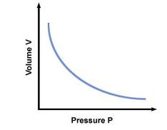
Boyle’s Law
Boyle's law is:
The volume of a given mass of gas is inversely proportional to its pressure, if the temperature remains constant. Mathematically this is:
P α 1 / V ; P₁V₁ = P₂V₂
where k is a constant (NOT Boltzmann's constant or Coulomb’s constant).

Slide 36
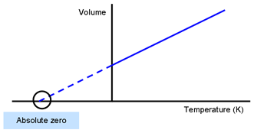
Charles’ Law
Charles’ law states that if a given quantity of gas is held at a constant pressure, its volume is directly proportional to the absolute temperature.
As the temperature of the gas increases, the gas molecules will begin to move around more quickly and hit the walls of their container with more force—thus the volume will increase.
You must use only the Kelvin temperature scale when working with temperature in all gas law formulas!

Slide 37
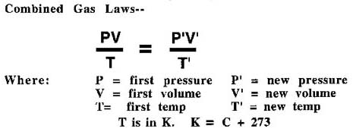
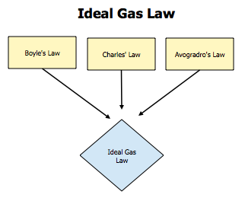
Combined Gas Law

Slide 38
GAS CONSTANT
R is the gas constant in the ideal gas equation pV = nRT
R is related to the Boltzmann constant, K ,
By R = k N_{A}
where
k = 1.3806 x 10⁻²³ J K⁻¹, and
N_{A} = 6.022 x 10²³ mol⁻¹
R with different units
R = 8.31451 J K⁻¹mol⁻¹
R = 1.98722 cal K⁻¹mol⁻¹

Slide 39
Relation between Cp and Cv
The specific heat of a gas is the heat energy added to the gas per degree of temperature rise.
The value of the specific heat depends on the condition under which the heat is added.
If the heat is added at constant volume the heat energy goes entirely into increasing the internal kinetic energy of the particles.
If the heat is added at constant pressure, the gas can expand while the heat is added and the gas does work on the expanding walls of the container. Consequently, the specific heat at constant pressure (Cp) is greater than the specific heat at constant volume (Cv)
The two are related by
Cp = Cv + R

Slide 40
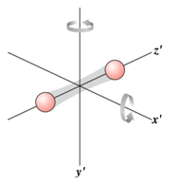
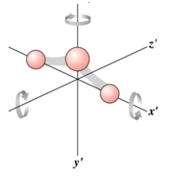
Specific Heats of an Ideal Gas
Ideal gas:
→
→
Experimental values ( room T ):
For monatomic gases, γ ≈ 5/3, e.g., He, Ne, Ar, ….
For diatomic gases, γ ≈ 7/5 = 1.4, C_{V} = 5R/2, e.g., H₂ , O₂ , N₂ , ….
For tri-atomic gases, γ ≈ 1.3, C_{V} = 3.4R, e.g., SO₂ , NO₂ , ….
Degrees of freedom (DoF) = number of independent coordinates required to describe the system
Single atom: DoF = 3 (transl)
For low T ( vib modes not active ) :
Rigid diatomic molecule : DoF = 5 (3 transl + 2 rot)
Rigid triatomic molecule : DoF = 6 (3 transl + 3 rot)

Slide 41
Processes
Flow process:
It is one in which fluid enters the system and leaves it after work interaction, which means that such processes occur in the systems having open boundary permitting mass interaction across the system boundary.
Non flow process:
It is the one in which there is no mass interaction across the system boundaries during the occurrence of process. Different type of non-flow process of perfect gas are given: (1) constant volume process (2) constant pressure process (3) Isothermal process(4) adiabatic process(5) polytropic process
Steady-Flow Process:
It is a process during which a fluid flows through a control volume steadily. That is, the fluid properties can change from point to point within the control volume, but at any fixed point they remain the same during the entire process.

Slide 42
Non – flow process
Constant volume process
Constant pressure process
Isothermal Process
Poly-tropic Process
Adiabatic Process

Slide 43
Constant-Volume Processes & Specific Heat
Constant-volume process ( isometric, isochoric, isovolumic ) :
V = constant
→
C_{V} = molar specific heat at constant volume
→
isometric processes
Ideal gas: U = U(T)
→
for all processes
Non-ideal gas:
only for isometric processes

Slide 44
Isobaric Processes & Specific Heat
Isobaric Process : constant P
C_{P} = molar specific heat at constant pressure
isobaric processes
Ideal gas, isobaric :
→
Ideal gas

Slide 45
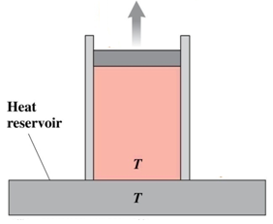
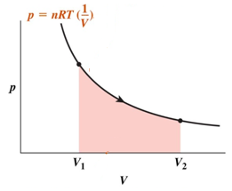
Isothermal Processes
Isothermal process: T = constant.
→
Isothermal processes on ideal gas

Slide 46
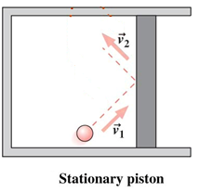
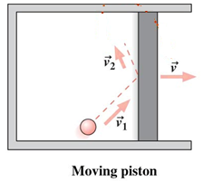
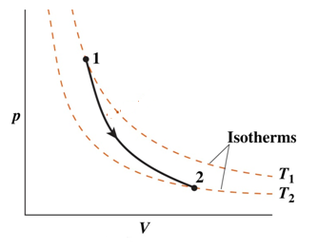
Adiabatic Processes
Adiabatic process: Q = constant
e.g., insulated system, quick changes like combustion, …
adiabat, ideal gas
Tactics 18.1. →
Prob. 66
Adiabatic: larger Δp
Prob. 62

Slide 47
Adiabatic Equation
Ideal gas, any process:
Adiabatic process:
→
∴
→

Slide 48
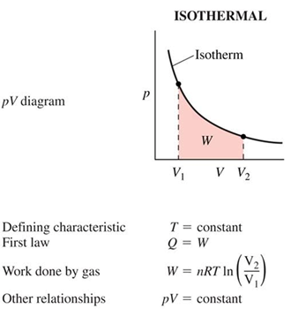
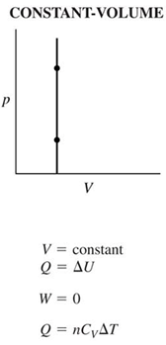
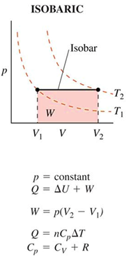
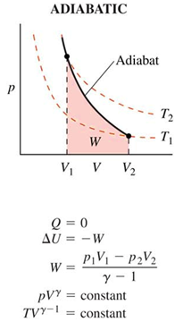
Ideal Gas Processes

Slide 49
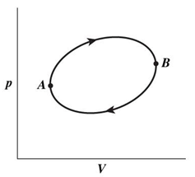
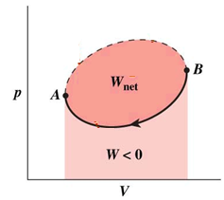
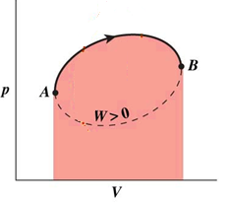
Cyclic Processes
Cyclic Process : system returns to same thermodynamic state periodically.

Slide 50
Polytropic process
A polytropic process is a thermodynamic process that obeys the relation:
where p is the pressure, v is specific volume, n, the polytropic index, is any real number, and C is a constant.
This equation can accurately characterize a very wide range of thermodynamic processes, that range from n<0 to n= which covers,
n=0 (isobaric),
n=1 (isothermal),
n=γ (isentropic),
n= (isochoric) processes
Hence the equation is polytropic in the sense that it describes many lines or many processes.

Slide 51
Polytropic process

Slide 52
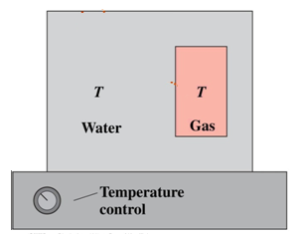
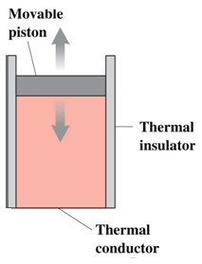
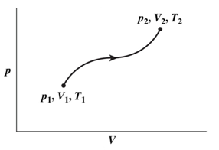
Thermodynamic Processes
Quasi-static process: ( Infinitely slow process )
Arbitrarily slow process such that system always stays arbitrarily close to thermodynamic equilibrium.
Reversible process:
Any changes induced by the process in the universe (system + environment) can be removed by retracing its path.
T_{water} = T_{gas} & rises slowly
Reversible processes must be quasi-static.
Irreversible process:
Part or whole of process is not reversible.
e.g., any processes involving friction, free expansion of gas ….
system always in thermodynamic equilibrium

Slide 53
Assignment
Q 1. Write the units and dimensions of:
Force
Mass
Pressure
Work
Power
Energy
Heat
Temperature
Specific heat capacity
Latent heat
Q 2. Define and explain (a) Zeroth Law (b) First Law (c) Second law of thermodynamics
Q 3. Explain all the three Newton’s Laws of motions.
Q 4. What is the difference between Heat and Temperature.

Slide 54
Assignment
5. Explain the following.
Mechanical equivalent of Heat
Internal energy
Enthalpy
Entropy
Efficiency
6. Derive combined gas equation with the help of Boyle’s Law and Charle’s Law.
7. What is the difference between extensive and intensive properties explain with examples.

Slide 55
Assignment
8. Derive the relations:
C_{p} – C_{v} = R
C_{v} = R / γ - 1
Cp = γ R / γ - 1
9. What is equation of Isothermal Process. Derive an expression for work done in Isothermal process.
What is equation of Adiabatic Process. Derive an expression for work done in Adiabatic process.
Show the P-V diagram for (a) Isochoric Process (b) Isobaric Process (c ) Isothermal process (d) Adiabatic Process
Explain Poly-tropic process. Show various processes derived from poly-tropic process by a P-V diagram.
Explain (a) Cyclic Process (b) Reversible Process (c ) Quasi-static process (d) Flow and Non-flow process

Slide 56
14. Explain guage pressure, absolute pressure and vacuum pressure.
15. What are open system, close system and Isolated system?

