Slide 1
BIODEGRADABLE WASTE MANAGEMENT
STABILIZATION:
  LESS IN WEIGHT
  LESS IN VOLUME
  ODORLESS
  DOESN,T ATTRACT VECTORS
  HYGIENICALLY SAFE
  NUTRIENT VALUE (REUSE QUALITY)
STABILIZATION-AEROBIC or ANAEROBIC

Slide 2
Composting
Complex organics + O₂ ---------CO₂ + H₂O + NO₃- + SO₄⁻⁻ +
Less complex organics + heat

Slide 3
Phases of Composting

Slide 4
S.No. | Organisms | Time and Temperature for destruction
1. | S. typhosa | No growth beyond 46ºC, death in 30 minutes at 55-60ºC and 20 minutes at 60ºC, destroyed in a short time in compost environment.
2. | Salmonella sp. | In 1 hour at 55ºC and in 15-20 minutes at 60ºC
3. | Shigella sp. | In 1 hour at 55ºC
4. | E. Coli | In 1 hour at 55ºC and in 15-20 minutes at 60ºC
5. | E. histolytica cysts | In few minutes at 45ºC and in a few seconds at 55ºC
6. | Taenia saginata | In a few minutes at 55ºC.
7. | Trichinella spiralis larvae | Quickly killed at 55ºC, instantly at 60ºC.
8. | Br. Abotus or Br. suis | In 3 minutes at 62-63ºC and in 1 hour at 55ºC
9. | Micrococcus pyogenes | In 10 minutes at 54ºC
10. | Streptococcus pyogenes | In 10 minutes at 54ºC
11. | Mycobactercum tuberculosis var. hominis | In 15-20 minutes at 66ºC or after momentary heating at 67ºC.
12. | Corynebacterium diptheriae | In 45 minutes at 55ºC.
13. | Necator americanus | In 50 minutes at 45ºC
14. | A. lumbricoides eggs | In 1 hour at 50ºC

Slide 5

MSW Generation (0.5 kg/Cap.d)
0.05
Source Separation
0.45
Street Sweepings, C&D, Drains (0.05)
Wet Waste (0.3)
Dry Waste(0.1)
C&D Waste Reuse
Mech/Manual Sorting, Extrusion Press
0.05 Recycleable
Mech/Manual Sorting,
0.05
0.2
CO2 & Moisture
Composting
0.05
Waste to Energy/RDF
0.12
Inert to Landfill 0.02
Raw Compost
Inert to Landfill 0.05
Energy
0.02 Ash Landfill
Screened Compost 0.1

Slide 6
What really COMPOSTING is ?-
Speeding up the natural decay process
By Maintaining optimum:
  Water/Moisture contents of the waste
  Shredding- Optimum particle sizes
  Ingredient (Carbon and Nitrogen) in the waste, & decomposers (Bacteria, Fungi etc., )
  Air /oxygen transfer (turning) or by diffused aeration to the waste.
  Temperature of the waste

Slide 7
Moisture
Rapid decomposition requires optimum water content- 60-70 % by weight.
If too dry (30-40 %), bacterial activity will slow or cease
If too wet (>70 %), air cannot transfer to microorganisms due to clogging of pores and will lead to anaerobic conditions.
If too dry, add water as you turn the pile, not the case
If too wet, add browns and/or turn the pile

Slide 8
Moisture Contents
Moisture content of mixed material

Slide 9


Q. Ten tons of a mixture of paper and other compostable materials has a moisture content of 7%.
The intent is to make a mixture for composting of 50% moisture.
How many tons of water or sludge must be added to the solids to achieve this moisture concentration in the compost pile?
W2 = 8.6 tons of water or sludge.

Slide 10
Calculate the Moisture Content ?
Components | (%) by mass as discarded | Moisture content (%)
Food waste | 15 | 70
Paper | 45 | 42.3
Cardboard | 10 | 5
Plastics | 10 | 2
Garden trimming | 10 | 60
Wood | 5 | 20
Tin cans | 5 | 3

Slide 11
Based on100-kg sample of waste.
=3738.5/100 = 37.85 %

Slide 12
Particle Size-Shredding- 1-5 cm
Have greater surface area per unit volume
Allows microbes to get at more of the food
Smaller particles decompose faster
but…
  Smaller particles will also decrease airflow into the pile
  May lead to anaerobic conditions
  Pile may need to be turned more often

Slide 13
Ingredient (Carbon and Nitrogen) in the waste
C:N ratio
Should be 24-30 parts carbon to 1 part nitrogen by weight
  Grass Clippings 19:1
  Leaves 40:1
Equal weight of each would gives approximately 30:1 ratio for pile
If high, degradation slow due to the limitation of N
If low- fast degradation----- Ammonia Formation----- Increase pH----Ammonia volatilization ---- Nitrogen Loss

Slide 14
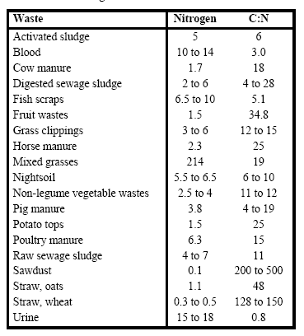
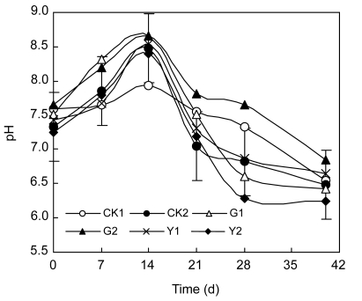
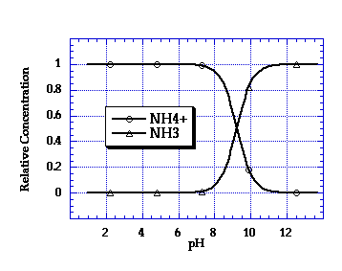
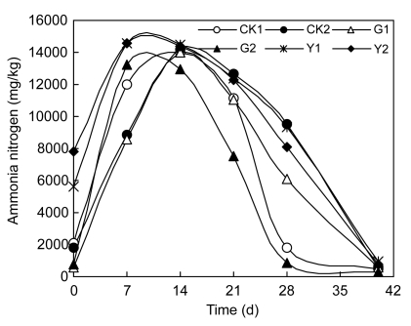
C/N Ratio

Slide 15
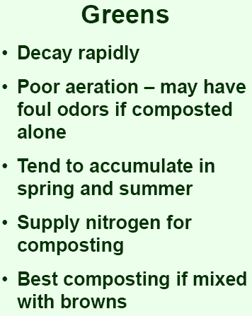
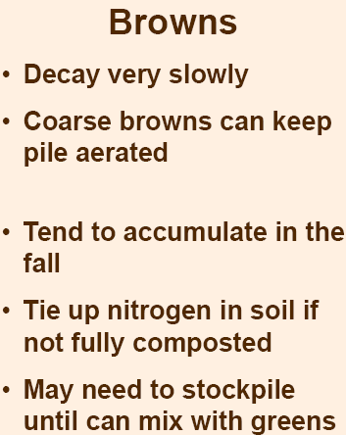
What’s what
Green (Nitrogen)
  Grass clippings
  Plant clippings
  Fertilizer
  Coffee grounds
  Fresh cowdung, cow urine
Brown (Carbon)
  Dry Leaves
  Sawdust
  Rice Husk
  Agricultural waste

Slide 16
C/N Ratio
R = C/N ratio
Qn = mass of material n ("as is", or "wet weight")
Cn = carbon (%)
Nn = nitrogen (%)
Mn = moisture content (%) of material n

Slide 17

C/N
Component | Moisture content (%) | Carbon (%) | Nitrogen (%) | Weight(kg)
Food waste | 70 | 48 | 2.6 | 50
Paper | 6 | 48 | 0.3 | 5
Garden trimmings | 60 | 48 | 3.4 | 10
Q1 = 50kg, Q2 = 5kg, Q3 = 10kg
N1 = 2.6 (%), N2 = 0.3 (%), N3 = 3.4 (%)
C1 = 48 (%), C2 = 48 (%), C3 = 48 (%)
M1 = 70 (%), M2 = 6, (%), M3 = 60 (%),

Slide 18
C: Carbon
Biomass : C₅H₇NO₂, , Bacteria C/Total Mass = 0.53 or 1/1.8

Slide 19
pH: If reduces-Aeration Mixing, If very high- Acidifying agent (Sulphur compounds)

Slide 20
Air-Oxygen Transfer, Mixing/Turning
Porosity is the air filled space between particles "Browns” help to maintain good porosity in the pile. A compacted pile has lost porosity, can be increased by turning
Aeration can be increased by inserting sticks, cornstalks, or perforated pipes into or under the pile.

Slide 21
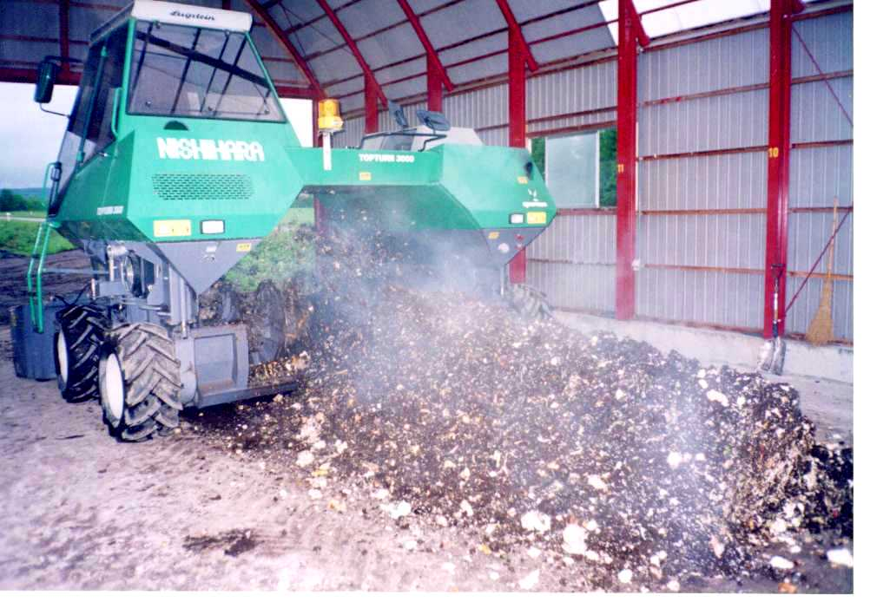
Turning & Mixing
To force fresh breathable air into all the material.
Enhance process uniformity by disrupting and reshaping the pile
To break up clumps to improve product consistency.
Notes:
Turning and mixing provides
force fresh breathable air into all the material.
Enhance process uniformity by disrupting and reshaping the pile
break up clumps to improve product consistency.

Slide 22
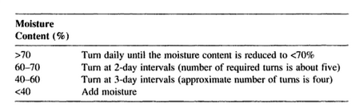
Compost Turning

Slide 23
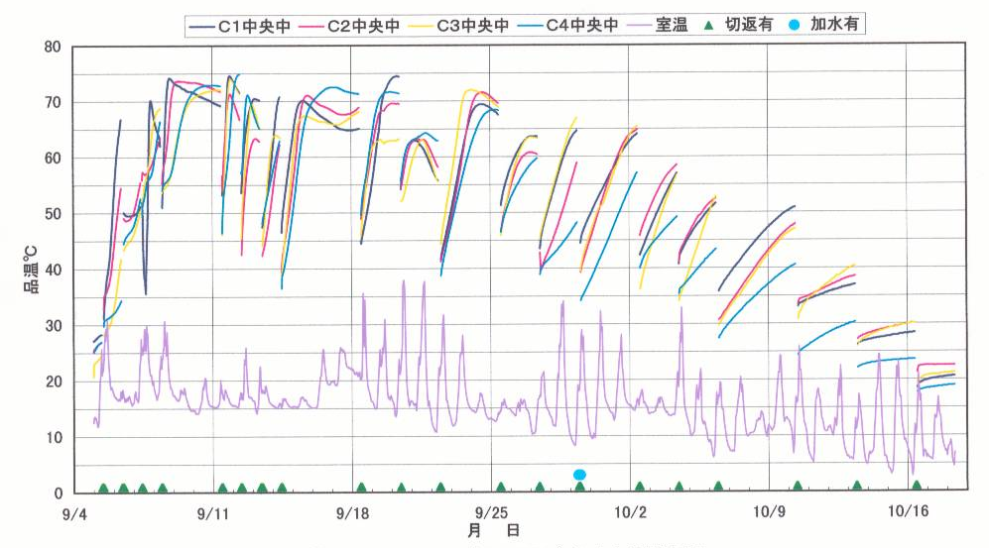
Experimental Results
Temp of pile ºC
Ambient Temperatures
Dayss
Turning
Notes:
This is the typical temperature vatiation graphs in the piles.
Turning and mixing lowers down the temperature, otherwise beneficial microbes will be killed under high temperature.
After 1-1.5 month, the biological activity became lower and the stabilized and hygeinically safe organic matter (Compost) is produced

Slide 24
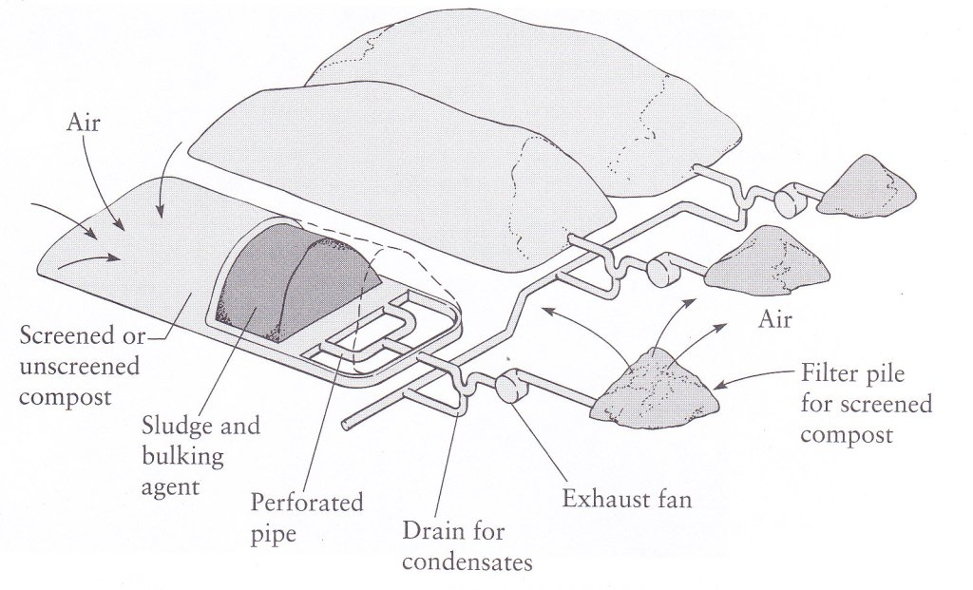
Aeration- Active or Passive

Slide 25
Q : Determine the amount of air required to oxidize completely 1 tonne of waste having the chemical equation C₅₀H₁₀₀O₄₀N.

Slide 26
Determine the amount of air required to compost one ton of solid wastes using an in-vessel composting system with forced aeration. Assume that the composition of the dry organic fraction of the MSW to be composted is given by C_{60.0}H_{94.3}O_{37.8}N. Assume that the following conditions and data apply.
1. Moisture content of organic fraction of MSW=65%
3. Volatile solids, VS= 0.8 TS
4. Expected VS conversion efficiency = 60 %
5. Composting time= 5d
6. Oxygen demand is 20, 35, 25, 15, 5% for the successive days of the 5-day composting
8. Air contains 23% O₂ by mass, and the specific weight of air is equal 1.29 kg/m3
9. A factor of 2 times the equal air supplied will be needed to be assumed that the oxygen content of air does not drop below 50% of its original value.

Slide 27
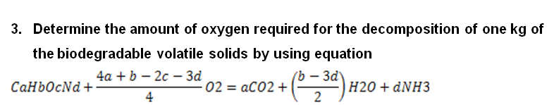
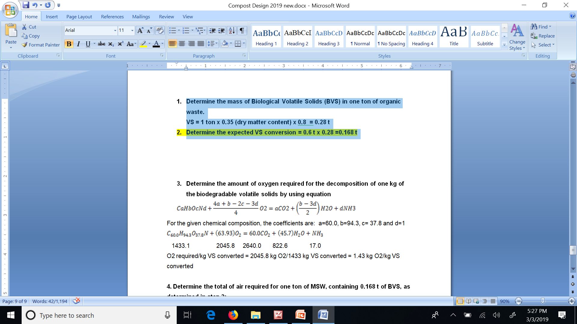
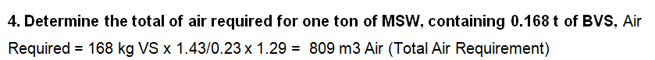
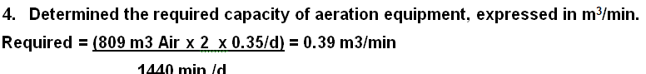
Determine the mass of Biological Volatile Solids (BVS) in one ton of organic waste.
VS = 1 ton x 0.35 (dry matter content) x 0.8 = 0.28 t
Determine the expected VS conversion = 0.6 t x 0.28 =0.168 t

Slide 28
Screenings
Pre-Processing-
  100 mm trommel with feed and reject conveyor
  Screened material-Compost Pile
  Reject- Manual Sorting, landfilling
  Coarse Segregation
  50, 35 and 14 mm trommel- feeder, hopper conveyor
  Screened material-Curing
  Reject for landfilling
  Coarse Segregation
  Refinement Section
  6, 5 and 3 mm trommel screen for cured, reject, glass, metal other material
  Vibrating sand separator

Slide 29
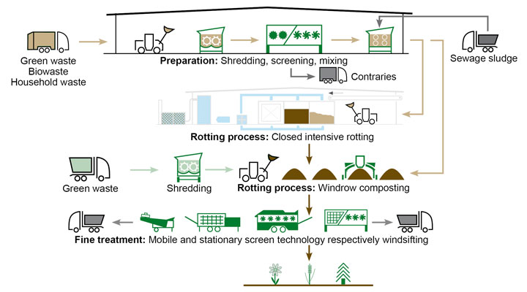
Technologies

Slide 31
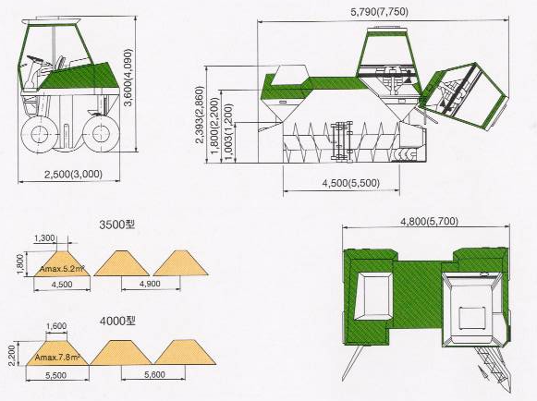
TOPTURN MIXING
Notes:
Here you can see the different photographs of topturn mixng machine for compost production. You can see the mixing blades and the height of operators seat. This condition help in optimum mixing condition of the compost pile.

Slide 32
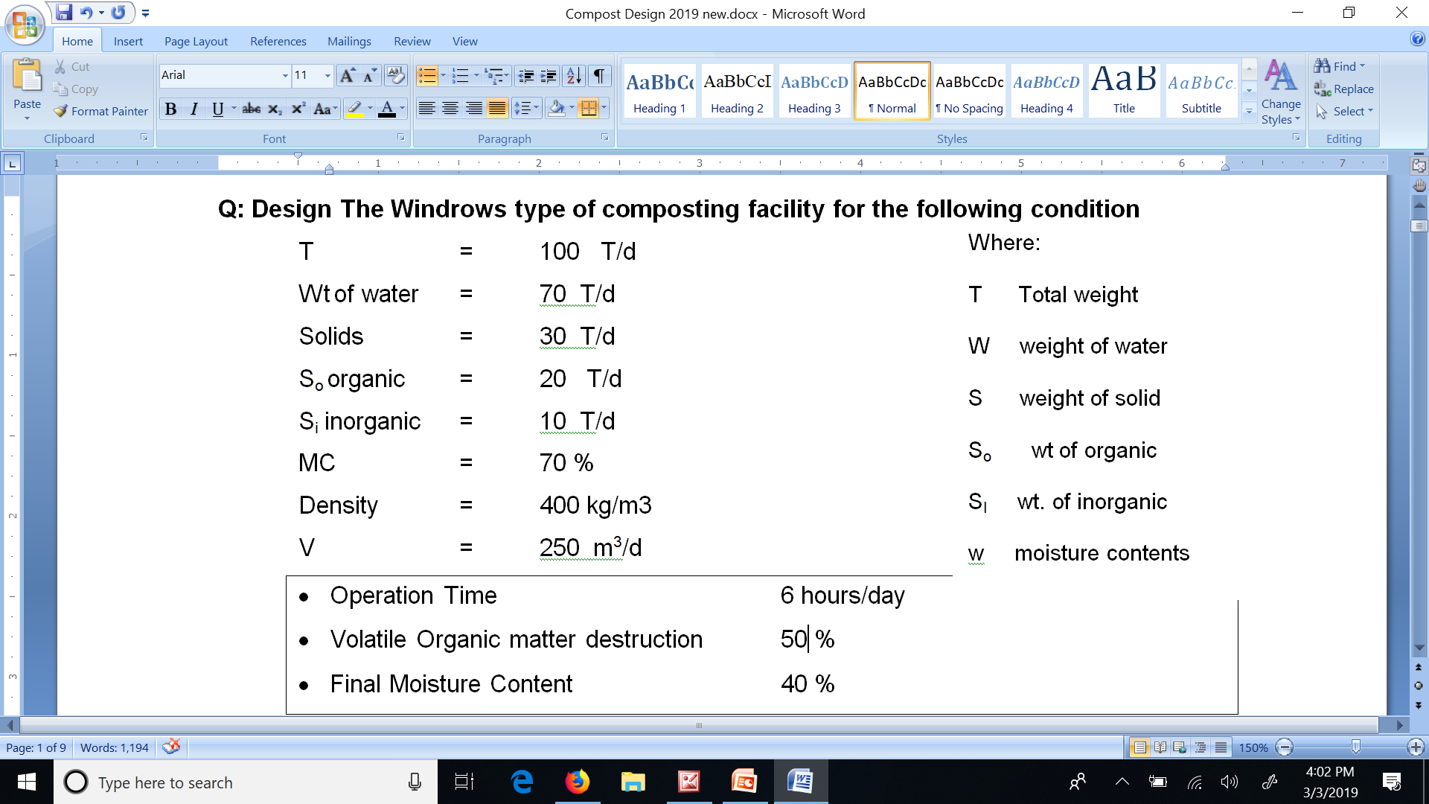
Design of Composting Facility
Notes

Slide 33
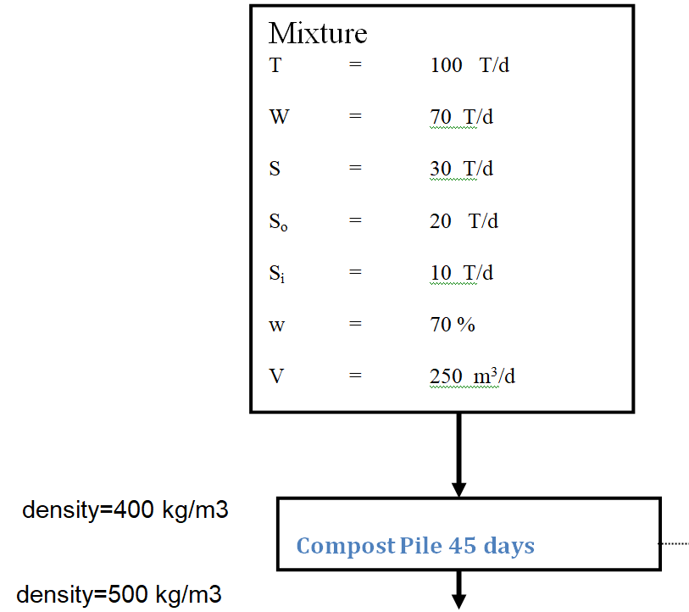
Mass Balance
???

Slide 34
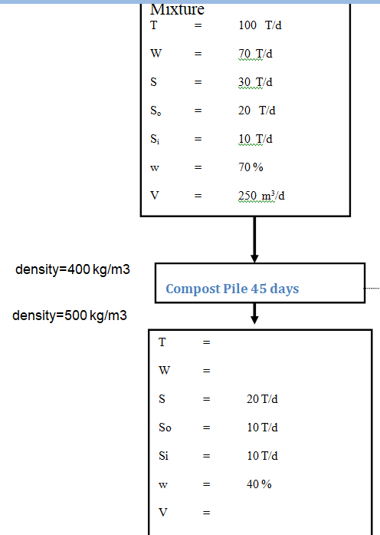
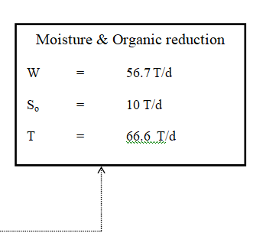
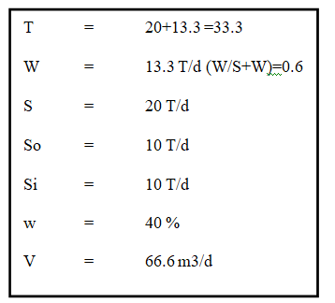

Slide 35
MSW Yard
MSW keeping time – 4 days
Volume required = 250 m³/d × 4 d
= 1000 m³
Dimensions : 20.0 m × 10 m × 2.5 m H × 2

Slide 36
Composting Area
Composting Time – 45 days
Pile Volume required = 250 m³/d × 45 d = 11250 m³
Area of the Pile = 5.2 m²
Length of pile
L = 11250 m³/ 5.2 m² = 2163 m
Size : 220 m × 10
Topturn 400 x 2

Slide 37
Finished Compost Area
Maturation & storage time – 45 days
Volume required = 66.6 m³/d × 45 d = 2997 m³
Area required:
2997 m³/2.5 = 1120 m²
30 % excess = 1120 x 1.3 = 1456 m²

Slide 38
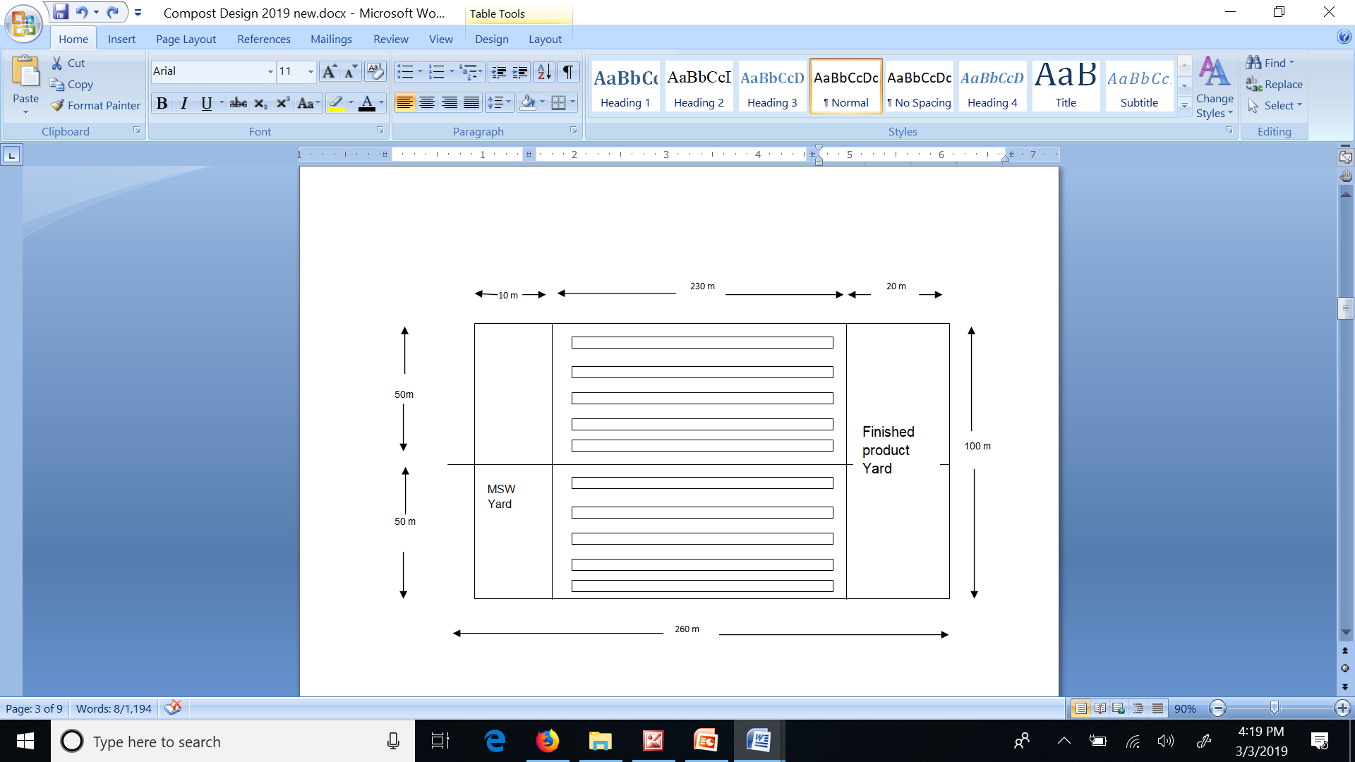
Layout

Slide 39
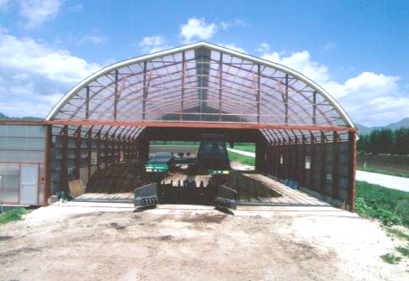
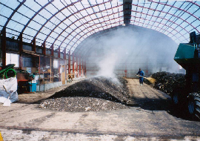
Composting Yard
Notes:
Here is the picture of typical compost yard.

Slide 40
Space Requirements (43 t/d)
120m
Finished Product Room
Inflow & Storage Yard
Compost Piles
Finished Compost
32 m
Electricity Room
Deodor Room
Control Room
6.2 m
Notes:
The figure shows the typical space or yard requiremnt for 30 t/day of composting facility. The yard typicaly consists of :
Inflow and storage space, fermentation piles. Finished product space. Finished produect packing room.
As well as Electicity room, deodorization room (if required) and control room (if required)

Slide 41
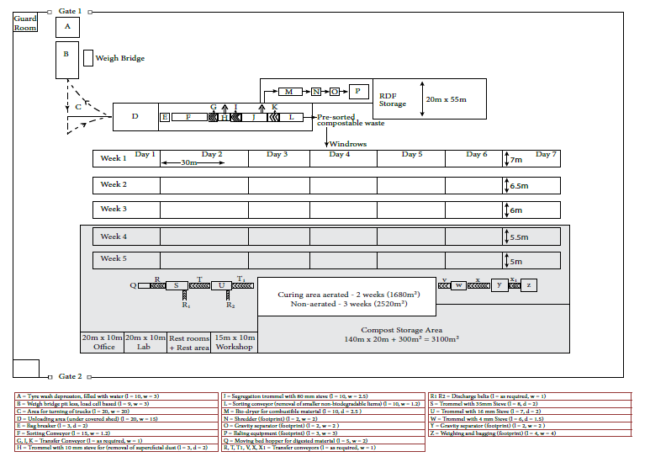

Slide 42
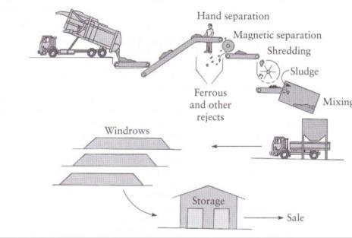
Supply to Receiving Pit → Belt Conveyer (Manual sorting + Magnetic separation ) → Shredding → Addition of Bulking Material → Rotary Drum composting (Primary composting) → Maturation in Composting Yard

Slide 43
Supply of Wet Solid Waste
Garbage is collected by a collection vehicle exclusively for this purpose and deposited into Receiving Pit.
Garbage collected from the city market was primarily composed of vegetable and fruit waste.

Slide 44
Manual Sorting
Plastic, cans newspaper and other dry matter contained with the fruit/vegetable waste is removed as it moved along the belt conveyer.

Slide 45
Shredding
After sorting, the garbage is finely chopped by a shredder equipped with a high speed rotating blade.

Slide 46
Addition -Sawdust/Finished compost
After shredding, commercial compost and bulking material for moisture adjustment (dried, dead leaves) sprinkled onto conveyer and mixed together by a mixing machine.

Slide 47
Mixing
The mixing machine is a continuous feed screw.

Slide 48
Rotary Drum Composter
Rotary Drum Specifications
Diameter：2.5 m
Length：10.5 m
Effective Capacity：25.8 m³
(No. of retention days：7 days minimum）
Driving Power：11kW (380V)

Slide 49
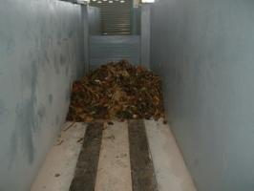
Maturation
Maturation: Further air supply from floor; allotted space has retention capacity of approximately 20 days.

Slide 50
Design of Rotary Drum Composting Facility (Dia 3 m x Length 36 m)
Notes
Drum Detention Time 6 days
Volatile Organic matter destruction 40 %
Moisture Content of Rotary Drum output 55 %
Maturation & Storage Time 21 days
Volatile Organic matter destruction 20 %
Final Compost Moisture Content 40 %

Slide 51
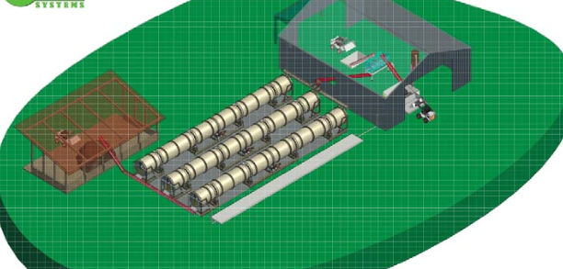
Layout

Slide 52
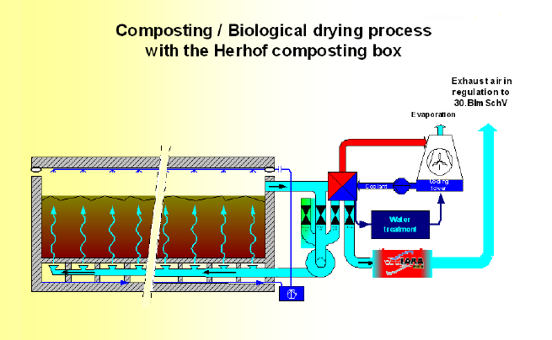
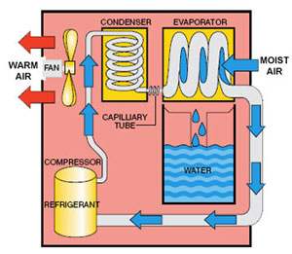

Slide 53
Parameters | Windrow | Aerated Static Pile | In-Vessel | Vermi-Composting
General | Simple Technology for large scale-application | Effective for farm and municipal use | Large-scale systems for commercial applications | Small-scale
Ainput Waste/day | 1-500 tonnes | 1-500 tonnes | 1-300 tonnes | Upto 50 tonnes
Land Requirement | 8 ha for 500 tpd incl. buffer zone | 5 Ha for 500 TPD | 4 Ha for 500 TPD | 2 Ha for 50 TPD
Time | 8 weeks | 6 weeks | 4 weeks (1 week + 3 week) | 8-10 weeks
Ambient temperature | Not temperature sensitive | Not temperature sensitive | Not temperature sensitive | 20 oC – 40 oC ideal range
Energy input | Moderate | Moderate 2-3 h aeration | High | Low
Financial implications | Moderate | Costly | Very costly | Moderate but exotic earthworms are expensive
Odor and aesthetic issues | Odour is an issue if turning is inadequate | Moderate but controls can be used such as pile insulation and filters on air system | Minimum due to equipment failure or system design failure | None

Slide 54
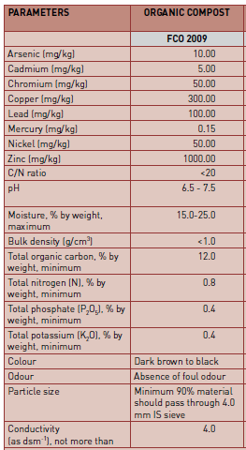
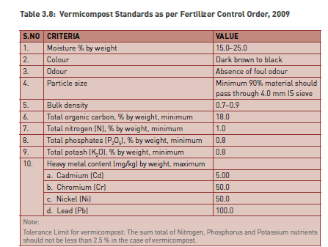

Slide 55
Summary

