Slide 1
SOLID WASTE SEPARATION AND PROCESSING

Slide 2
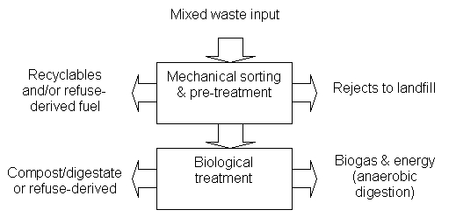
Flowsheet-1 (Typical Ongoing Projects)
Manual/Mechanical Sorting- Pretreatment
Or Incineration
To Landfill

Slide 3
Flowsheet-2 – Jindal Plant, Okhla, Jabalpur etc.,)
Mixed Waste
Heat/Electrical Energy
Incineration
Ash to Landfill

Slide 4
Flowsheet-3
Mixed Waste
Heat/Electrical Energy
Bioreactor Landfill
Leachate
recirculation

Slide 5
Flowsheet-4
Mixed Waste
Biogas-Flare
Landfill
Leachate Treatment

Slide 6
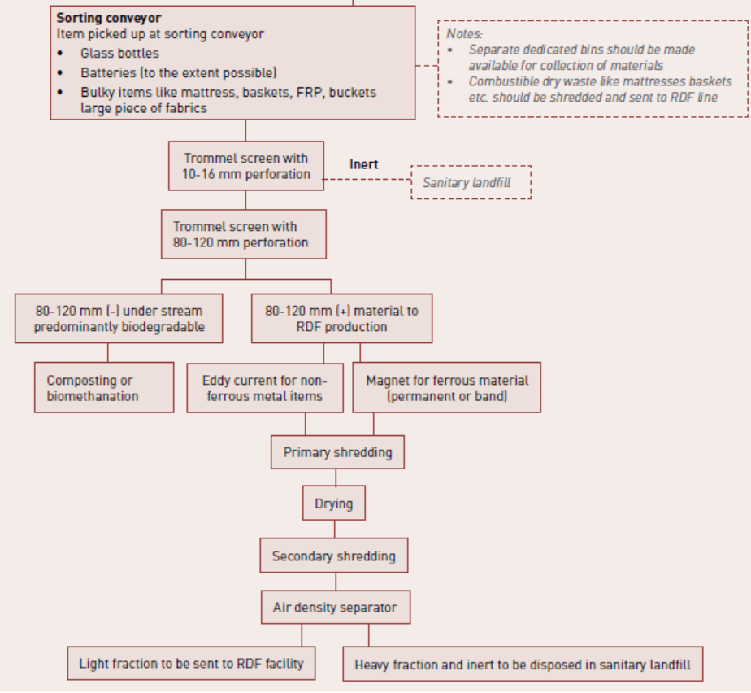
DETAILED FLOWSHEET MIXED WASTE

Slide 7
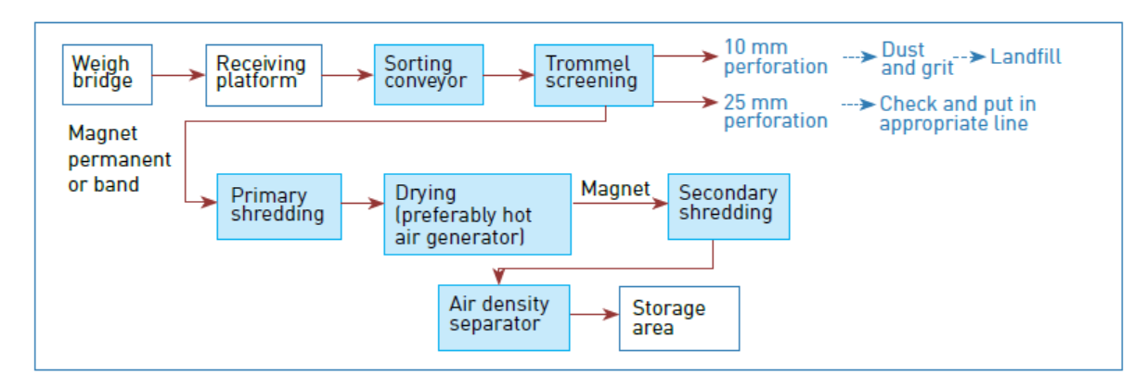
Dry Waste (SWM 2016)

Slide 8
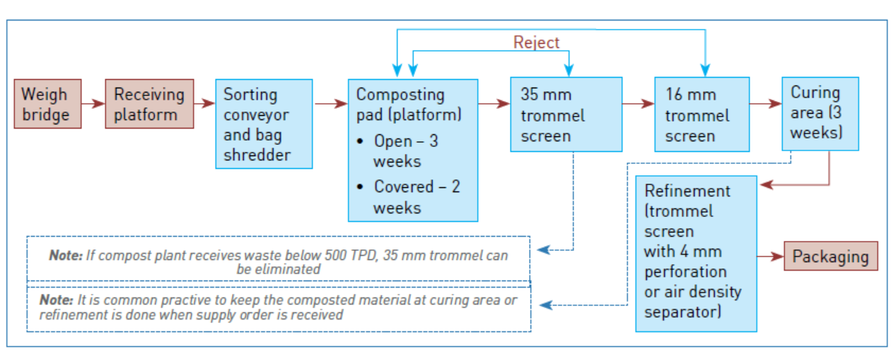
Wet Waste (SWM 2016)

Slide 9
Typical Flowsheet SWM Rules 2016
MSW Generation (0.5 kg/Cap.d)
0.05
Source Separation
0.45
Street Sweepings,, Drains (0.05)
Wet Waste (0.3)
Dry Waste(0.1)
0.05 Recycleable & Inert
0.05 Landfill
Mech/Manual Sorting, Extrusion Press
Mech/Manual Sorting,
0.05
0.2
Biogas
Anaerobic Digestion
0.05
Waste to Energy/RDF
0.15
Energy
0.05 Inert to Landfill
Energy
Digestate Composting
0.02 Ash Landfill
CO2
Compost 0.12
Inert to Landfill 0.04
Compost Product 0.08

Slide 10
PART A- PROCESSING OF SOLID WASTE

Slide 11
1: RECEIVING AREA
(STORAGE AREA)
(TIPPING FLOOR)
Store material in sufficient quantities to cope up the fluctuations in supply due to
Weekends,
Festivals
Holidays

Slide 12
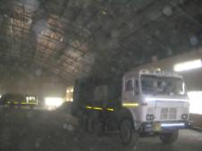
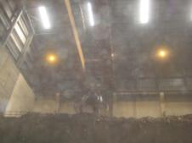
Type-1: MSW pit with an overhead bridge crane: Common in Incinerator facilities
Garbage and transfer trucks back up to the pit and discharge solid waste directly into it.
An overhead crane, with an operator either directly on the crane or centred over the pit, is used to both spread the load in the pit and retrieve the solid waste.
The crane can drop the solid waste into a feed chute, onto a conveyor belt.

Slide 13
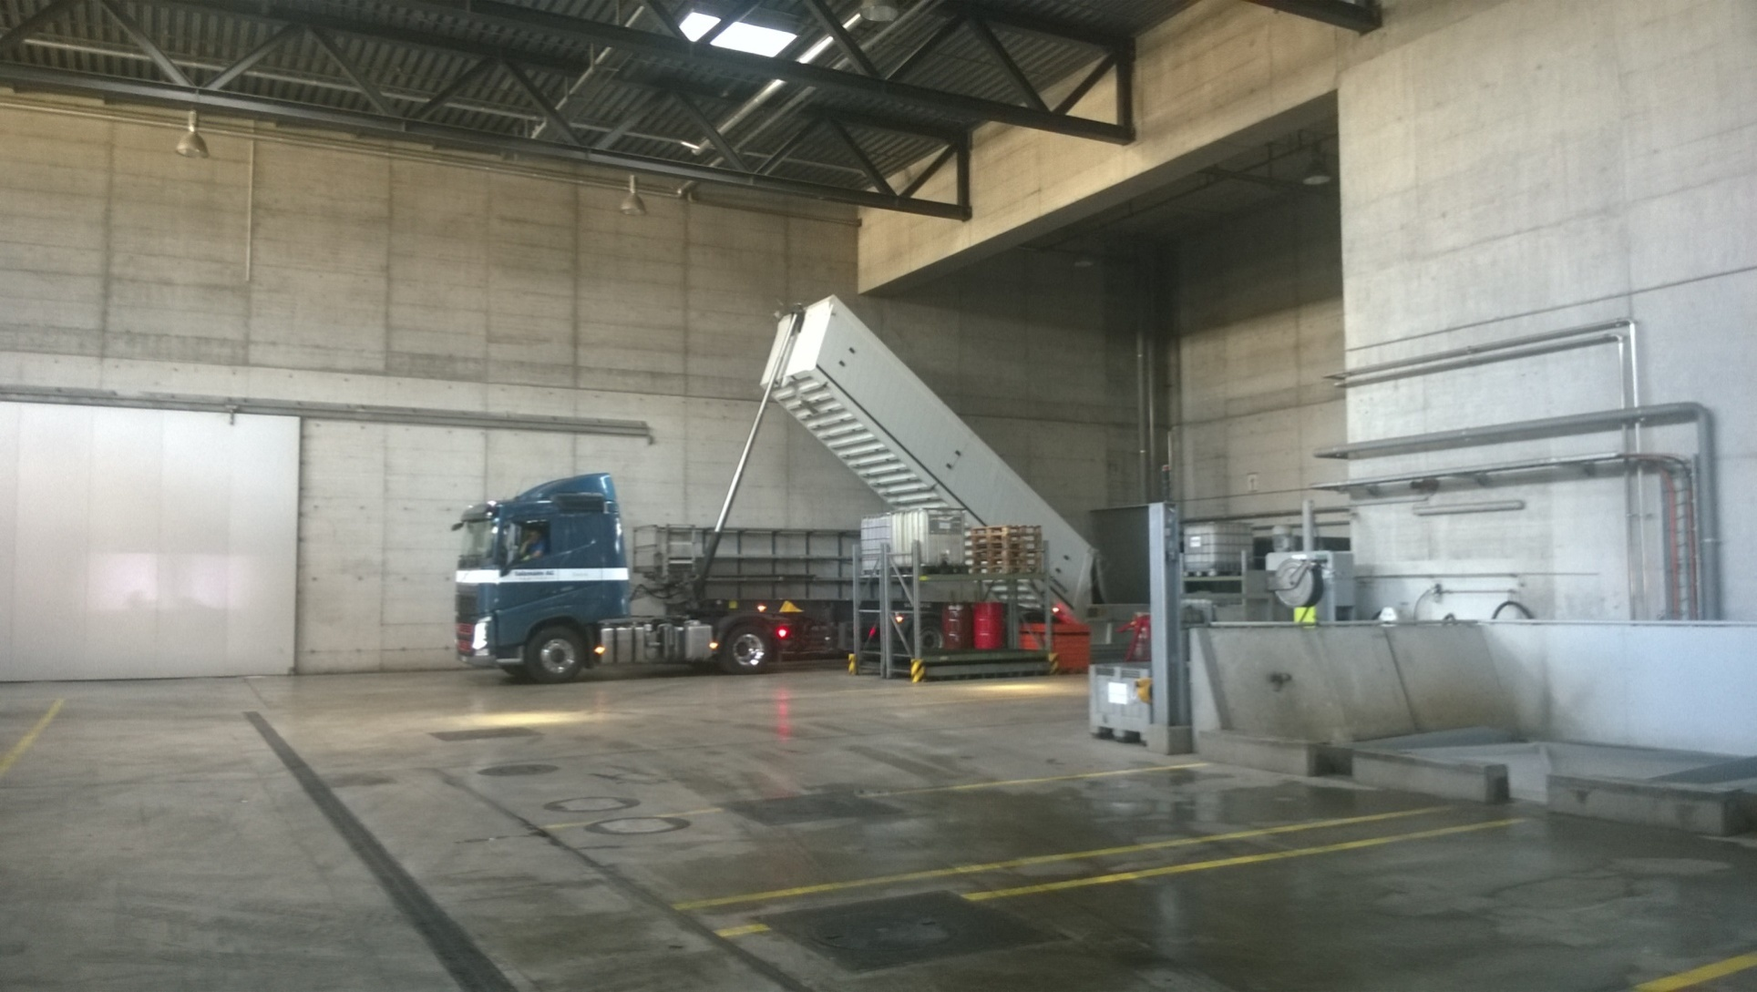
Tipping Floor & Pit

Slide 14
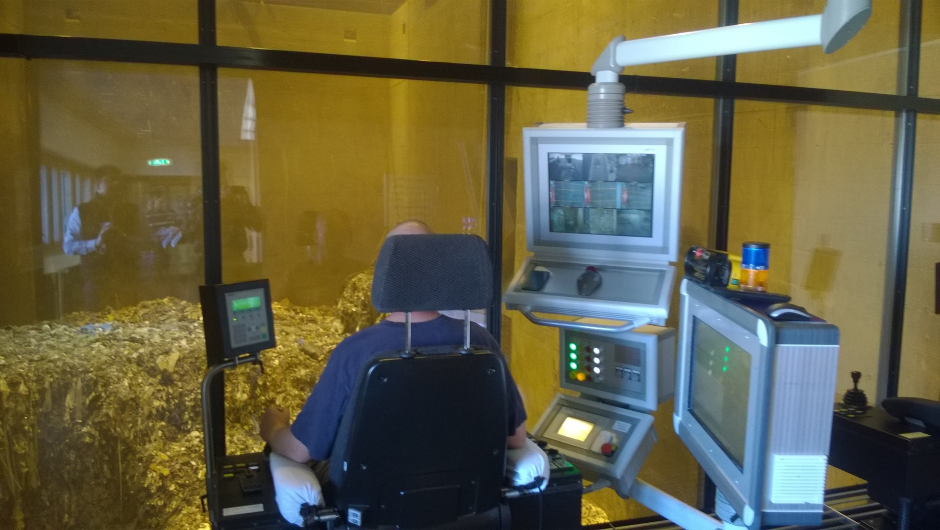
MSW Pit with Overhead Crane

Slide 15
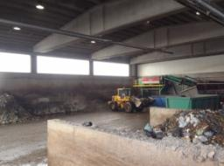
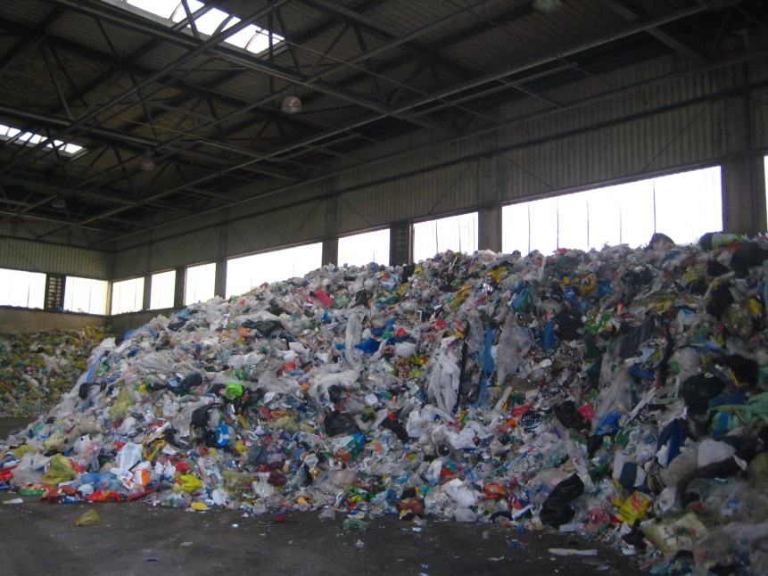
Type-2: Large Tipping Floor- Most Common
Solid waste is deposited onto the floor and is then stacked as high as 20 ft ( 7m) by a front end loader.
A concrete or steel push wall is incorporated into the design.

Slide 16
Design the Receiving Area/tipping floor for 100 TPD Dry Waste facility of solid waste management.
Assume the following data:
Storage period – 3 days
Density of MSW – 200 kg/m³
No of days of effective operation – 320 Days
Height of Waste – 3 m
30% additional Space for Vehicular Movement.
Step 1: Design capacity of Receiving Area
Design Capacity = Total Waste to be handled per annum / No. of days of effective operation = (100 x 365) / 320 = 114 TPD
Tipping floor is designed for its design capacity i.e. 114 TPD
Step 2: Storage Volume
Max. Waste that can be stored in 3 days = 114 x 3 = 342 Tonnes or 342000 kg
Volume of this quantity = 342000 /200 = 1711 m³

Slide 17
Contd….
Step 2: Calculation of area requirement.
Assume height of waste collected = 3 m (Max. 7m)
Area requirement = 1711 / 3 = 570 m²
Additional Space for Vehicular Movement = 30%.
Therefore total area requirement = 1.3 x 570 = 741m²
Provide length as 30m.
Width = 741/30 = 24.7m (Provide 25 m)
Therefore Tipping floor dimensions are 25m x 30m.

Slide 18
2: Conveying Municipal Solid Waste
A conveyer is an endless belt, supported by antifriction ideal bearing and driven from one end by a drive roller.
Belts can be made from rubber, canvas or synthetic materials for handling relatively light weight recycle material.
For heavy duty applications such as un separated commingled MSW and recovered metals, hinged steel belts are used.

Slide 19
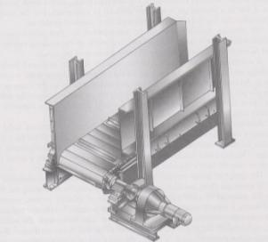
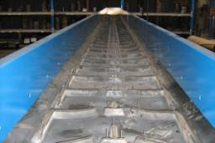
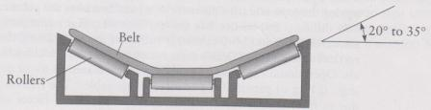
Conveyors: Skirts (sides) are sometimes used for bulky materials

Slide 20
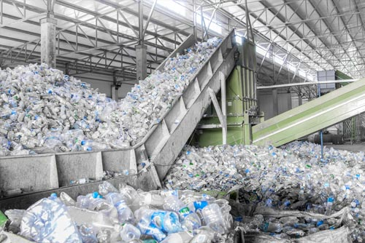

Slide 21
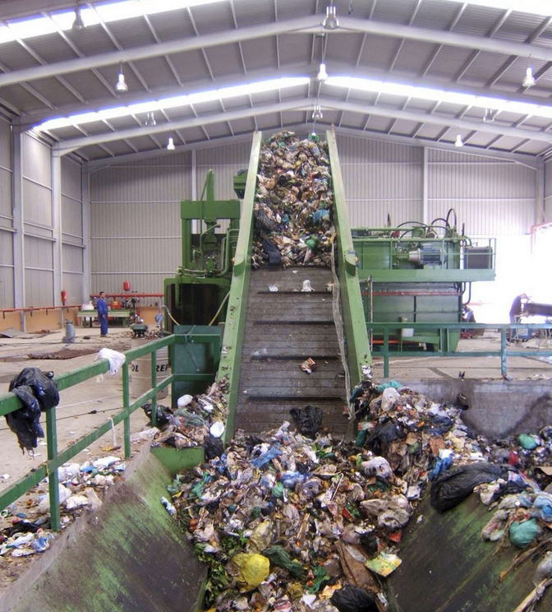

Slide 22
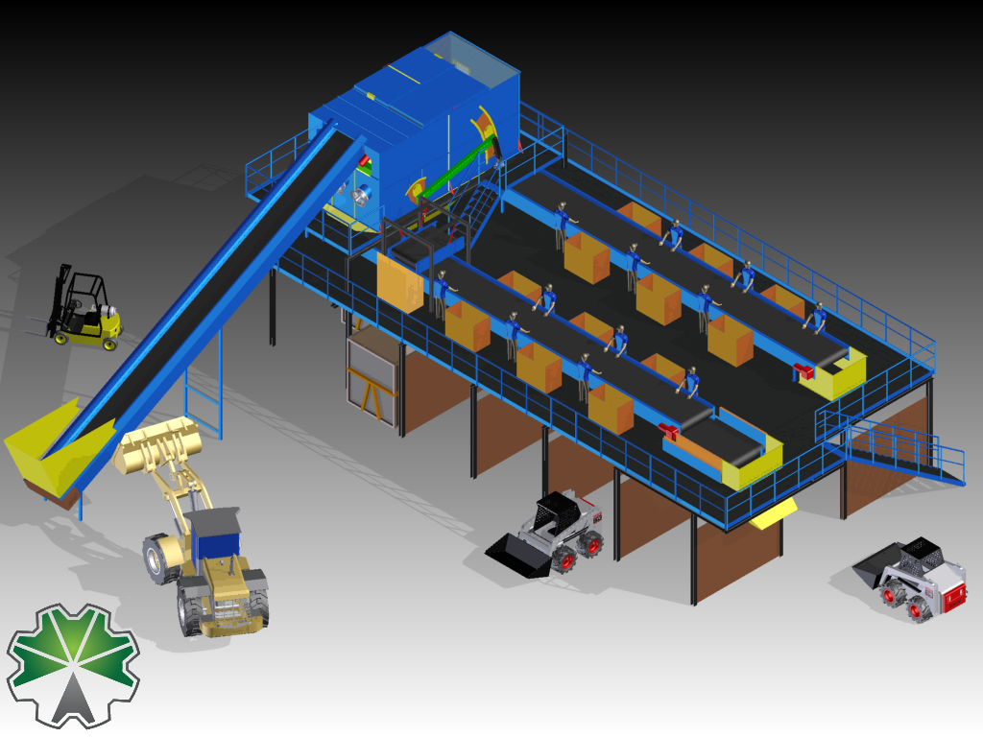

Slide 23
Design Considerations
Belt Size
Belt Speed-3-30 m/min for metal belt and 10-50 m/min for flexible belt
Throughput
Power
Material | Belt width (inches) 18 36 60 Capacity, tonnes/hour
Glass bottles | 6.0 | 28.3 | 83.4
Plastic bottles | 0.8 | 3.7 | 10.8
MSW from truck | 8.7 | 40.0 | 117
Select the belt size for conveying MSW in Previous Problem

Slide 24
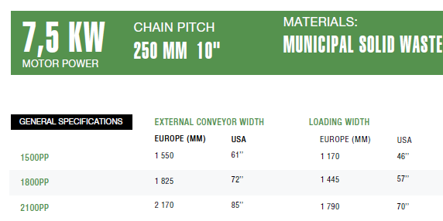

Slide 25
Power Requirement
Power for Empty Conveyor --- Speed
Power for Conveying Material--- Tonnage
Power for Lifting---Lift

Slide 26
Power Requirement
HP required for Empty Conveyor
HP_{empty} = horsepower to drive empty conveyor
A, B = empirical constants (see Table)
L = conveyor length, ft
Empirical constants for belt conveyors
Conveyor belt width, Empirical constants
In A B
14 0.20 0.00140
16 0.25 0.00140
18 0.30 0.00162
20 0.30 0.00187
24 0.36 0.00224
30 0.48 0.00298
36 0.64 0.00396
42 0.72 0.00458
48 0.88 0.00538
54 1.00 0.00620
60 1.05 0.00765

Slide 27
Power Requirement

Slide 28
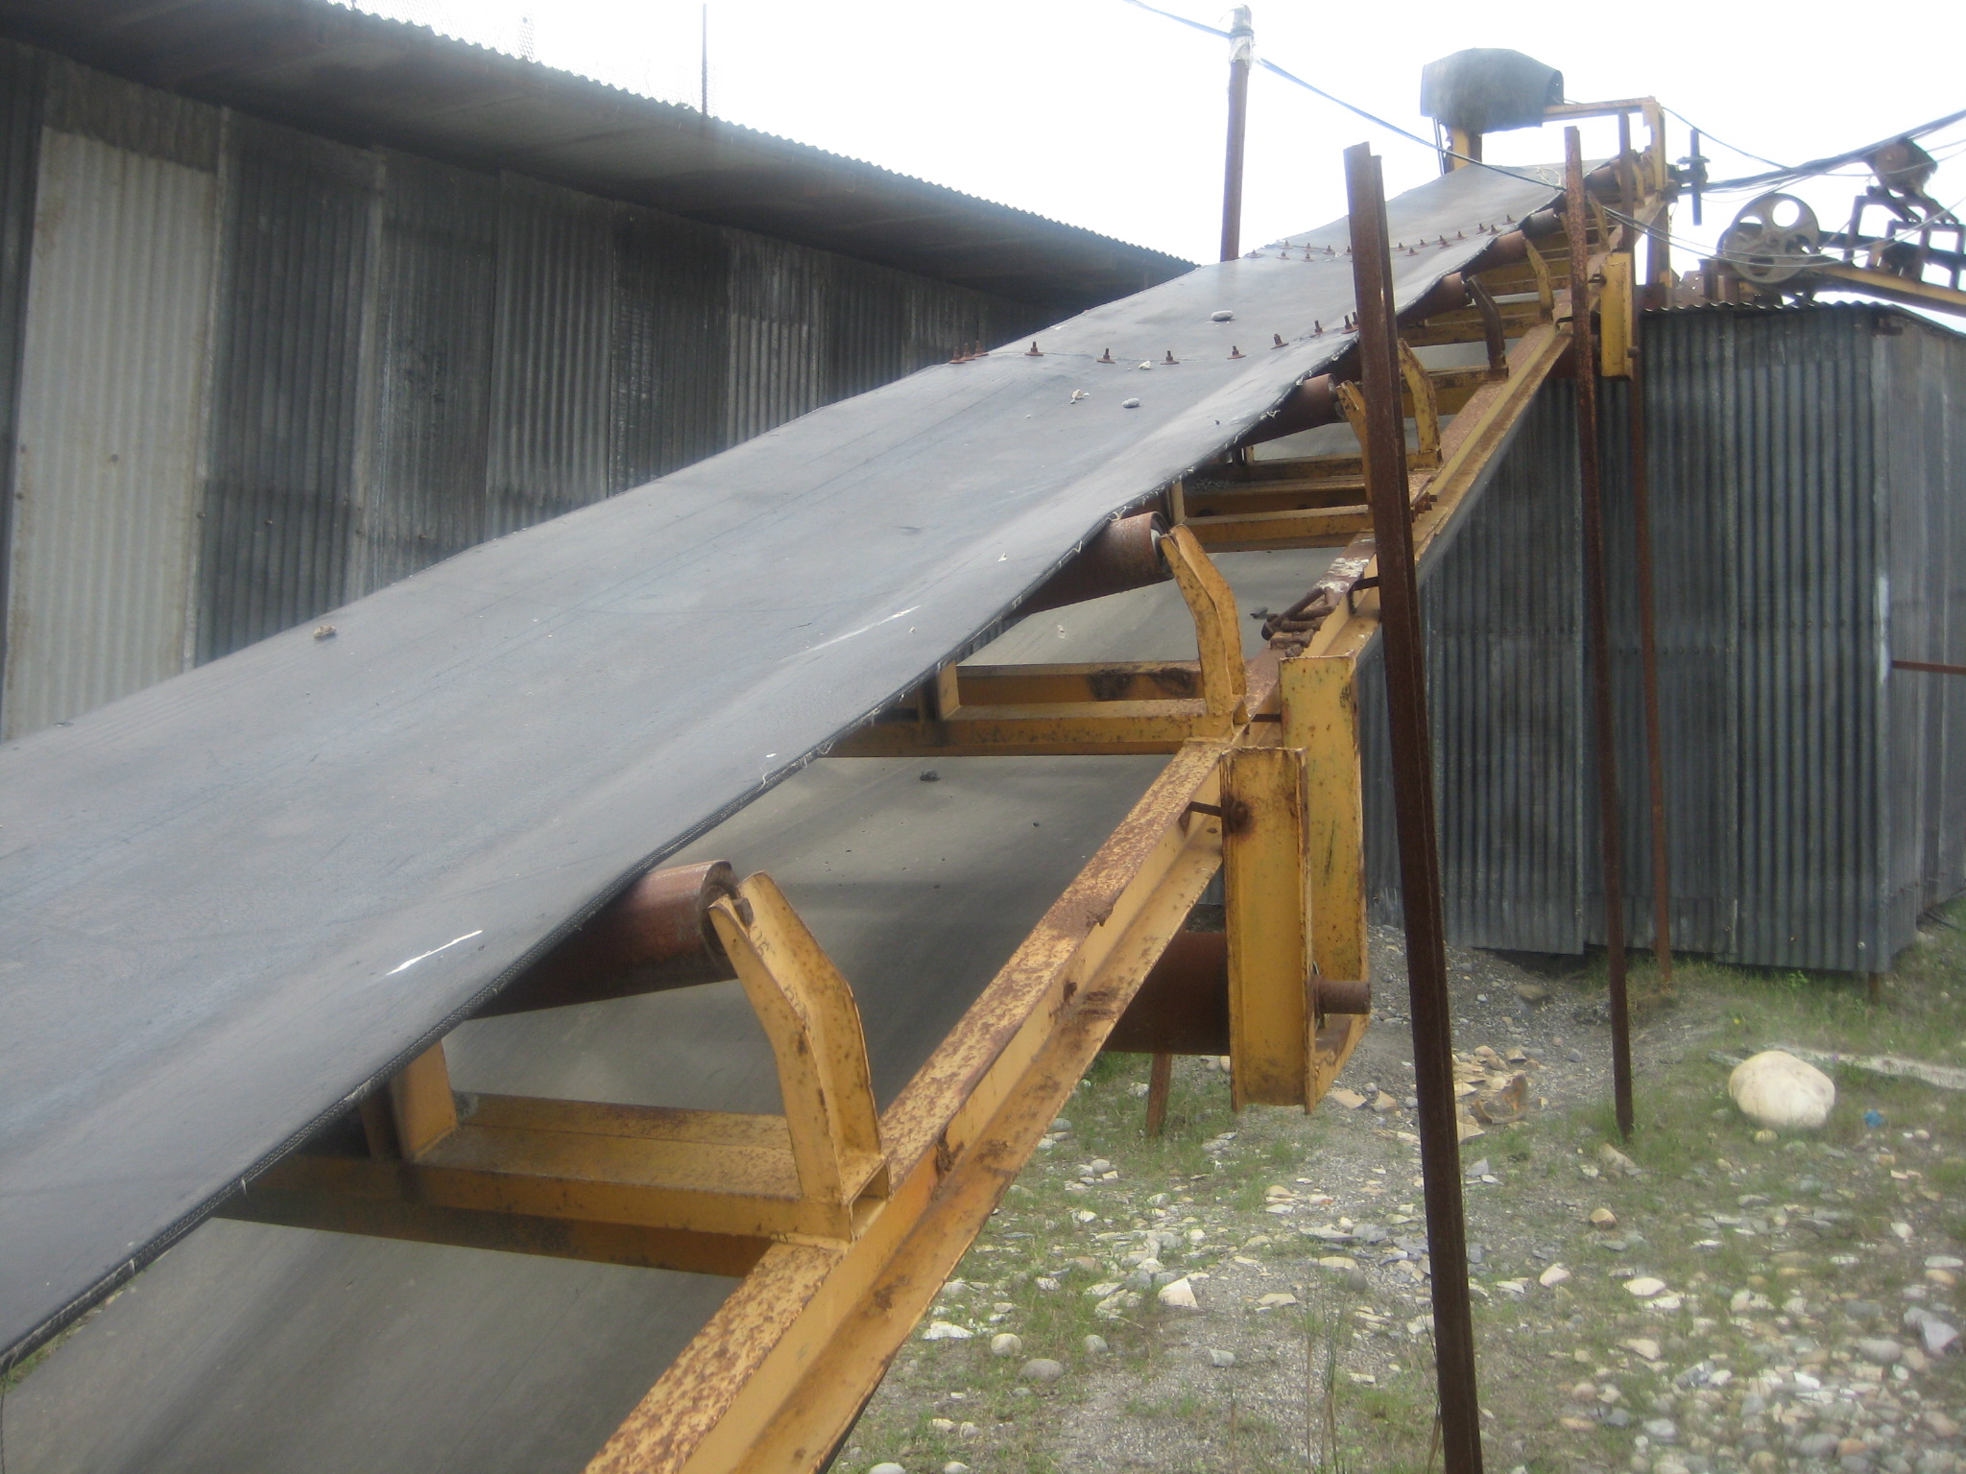

Slide 29
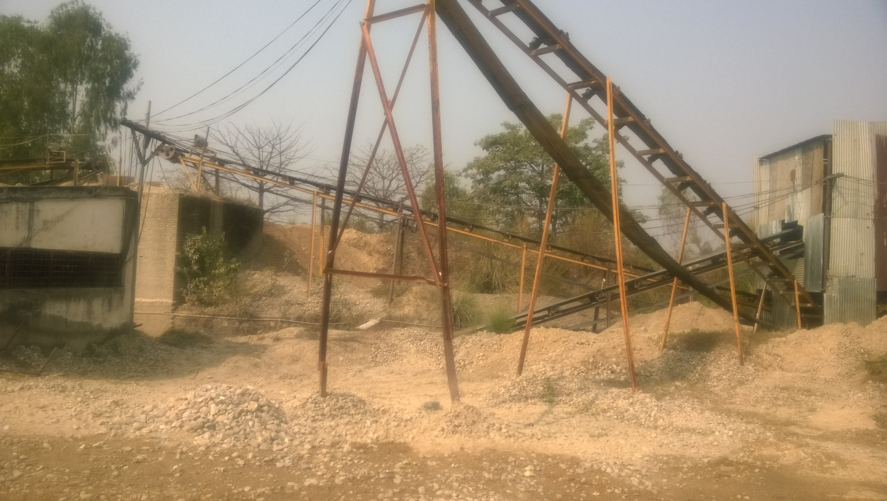

Slide 30
Calculate the HP requirement of a belt conveyor for the following conditions;
Throughput 45 t/h
Length- 400 ft
Speed- 400 ft/min
Angle of inclination -15º
From equation (1) the power required to drive the empty conveyor is
400(0.72 + 0.00458 x 400) / 100 = 10.28 hp
From equation (2) horsepower required For conveying is : 45 (0.48 +0.00302 x 400) /100 = 0.76
The lift is 400 sin 15º = 104 ft. The power required to elevate the material is determined thus from equation (3 ):
104 x 1.015 x 45/1000 = 4.75 hp
Therefore, the total horsepower requirement is
10.28 + 4.75 + 0.76 = 15.71 hp

Slide 31
Calculate the HP requirement of a belt conveyor for the following conditions;
Throughput 45 t/h
Length- 40 ft
Speed- 30 ft/min
Angle of inclination -15º

Slide 32
3.0 Shredding of Municipal Solid Waste
The operation reduces bulky items to particles, the sizes of which are compatible with the processing equipment.
It brings degree of uniformity in terms of the maximum particle size of the diverse components
Advantages:
  More homogenous
  Compacted easily
  Require lesser landfill volume
  Elimination of earth cover in landfill: As odorless due to well mixed, drier, no large food particles etc.,
  Material recovery

Slide 33
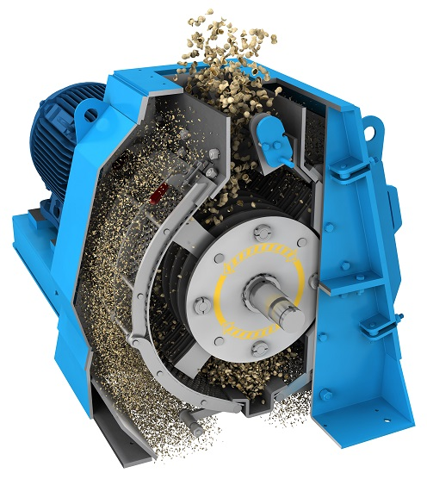
Shredder (Hammer mill)
Objects to be size reduced are introduced into the infeed opening of the machine.
They then interact with the hammers and each other until at least one of their dimensions reaches a size small enough for the particle to fall through the grates at the bottom of the machine.

Slide 34
Hammer Mill
Characterize by high speed 140-1500 rpm.
For mixed waste processing applications, the rotational speed of the rotor is usually in the range of 1,000 to 1,500 rpm.
Residence time of the material in the mill and the size distribution of the size-reduced product are largely determined by grate spacing.
Other factors that affect product size distribution are feed rate, moisture content, and hammer speed (i.e., velocity of the tip of the hammer).

Slide 35
Shear Shredders
The unit consists of two horizontal, counter-rotating shafts. Each shaft contains cutters to tear and shear the material.
It is characterized by its high torque and low rpm. of 20 to 70 rpm.
Shear and deformation are the primary mechanisms of particle size reduction.
Commonly used to size reduce items that are difficult to shred, such as tires.
They generally perform poorly when fed long, stringy materials, which tend to wrap around the cutter shafts.

Slide 36
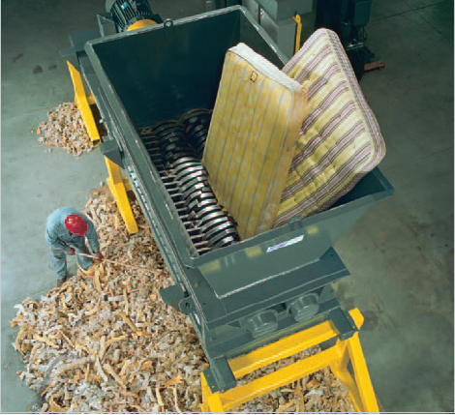

Slide 37


Power Requirement
Energy (dE) required to achieve small size change dL in a unit mass of material is inversely proportional to the size of article L.
n and C are constants
If n =1, the equation can be integrated from size L₁ to L₂to yield
Physically, this expression states that the work done is proportional to the number of smaller particles created from the larger ones. This is widely known as Kick,s Law

Slide 38

If n =2, the integrated form of the equation yields
Which is known as Rittinger,s Law, physically represents the assumption that the energy required is proportional to the amount of new surface formed by the size reduction process.
Riitinger,s law seems to agree better with the results of rough grinding operations, whereas the Kicks law is a better approximation of fine grinding.

Slide 39


For n = 1.5, Bond (1952) proposed the ‘Third Law’ of grinding. The Third Law states that the net energy required in comminution is proportional to the total length of the new cracks formed.
X_{f} and x_{p} are the feed and product size indices respectively and K₃ is constant
The general form of Bond’s equation is as follows:
Where;
W = work input (kWh/t);
W_{i}= work index (kWh/t) which expresses the resistance of the material to crushing and grinding;
F₈₀ and P₈₀ = 80% passing size of the feed and the product (micro-m), respectively.

Slide 40
TYPICAL BOND WORK INDICES OF SHREDDERS
Location | Material shredded | W_{i} (kWh/ton)
Charleston, SC | MSW | 400
St. Louis, MO | MSW | 400
Washington, DC | Aluminium cans | 650
Washington, DC | Glass | 8
Washington, DC | MSW | 470
Wilmington, DE | MSW | 450
Washington, DC | Paper | 200
Washington, DC | Steel cans | 260
Pompano Beach, FL | MSW | 400

Slide 41

Determine the power requirement to shred 100 tonnes/day of solid waste having an 80 th percentile size of 30 cm to a product having an 80 th percentile size of 1.7 cm. Assume that W_{i}=434
W= Wi
W= 10(434)
=25.36 kWh/ton
Power=25.36(100) =2536 kWh/day=105 kW=105/0.75 =140.0 hp (If operate for 24h)

Slide 42
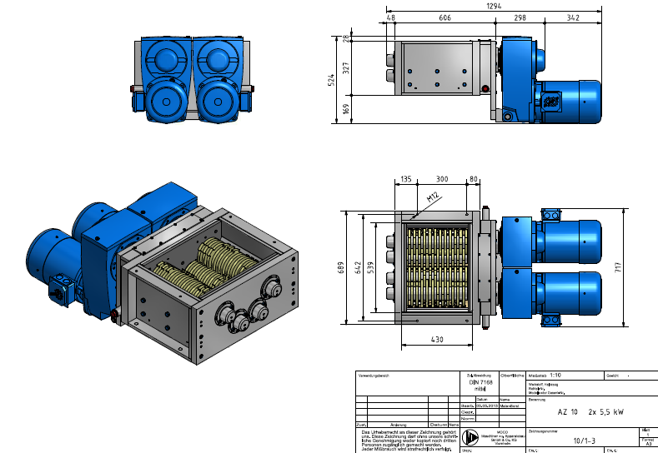

Slide 43
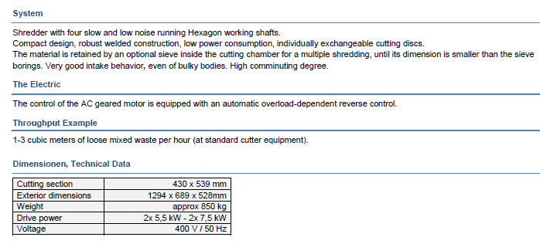

Slide 44
Application of Shredder for Indian MSW
Hammer Mills can be used for crushing aggregates as daily landfill cover.
Generally shear shredders can be used for:
  Shredding cardboard
  Paper
  Garden Trimmings for composting

Slide 45
PART B- MATERIAL SEPARATION FROM SOLID WASTE

Slide 46
Binary Separation: Effectiveness (Recovery & Purity) of Separation
If the input to a binary separation device is denoted as X_{o} + Y_{o}, then after separation, two waste streams result, 1 and 2, each containing a mixture of X and Y denoted as X₁ + Y₁ and X₂ + Y₂
1
X1+ Y1
(Want X here)
Xo + Yo
Binary separator
40 kg plastic + 5 kg paper
50 kg plastic + 50 kg paper
2
X2 + Y2
(Want Y here)
10 kg plastic + 45 kg paper
Recovery of component X = Recovery (X) = R_{(x1)} = (X₁/X_{o}) x 100%
Recovery of component Y = Recovery (Y) = R_{(y2)} = (Y₂/Y_{o}) x 100%

Slide 47
A second parameter, purity, must also be used to describe the performance of a separation device. The purity function represents the quality of the material separated in terms of its contamination by the other material. The percentage of purity of the recovered material can be defined as follows:
Purity of component X = Purity (X) = P_{(x1)} = (X1)/(X1 + Y1) x 100%
Purity of component Y = Purity (Y) = P_{(y2)} = (Y2)/(X2 + Y2) x 100%
An ideal device would have both high recovery and high purity. A single parameter, efficiency, can be used to describe both recovery and purity:
Efficiency = E_{(x, y)} = [(X1/Xo)-(Y1/Yo)] x 100%
= [(X2/Xo)-(Y2/Yo)] x 100%

Slide 48
Problem : Given that 100 t/h of commingled MSW with 8 % Glass is applied to a trommel screen for the removal of glass prior to shredding, determine and recovery, purity, and efficiency of the screen based on the following experimental data.
Weight of underflow = 10 t/h
Weight of glass in screen underflow = 7.2 t/h
The MSW into the screen is defined as Xo +Yo, the underflow as X1 + Y1 and overflow is denoted as X1 + X2.
Others- Xo - 92
X1 – 89.2
90 t/h
100 t/h
Glass- Yo - 8
Y1 – 0.8
X2 – 2.8
Y2 – 7.2

Slide 49
Find the recovery of glass in the underflow, using
Recovery (Y) = R_{(y2)} = (Y₂/Yo) x 100%
= (7.2/8.0)x 100% = 90%
Find the purity of the overflow and of the recovered glass.
find the purity of overflow:
Purity (X) = P_{(x1)} = (X1/X1+Y1) x 100%
P_{(x1)} = (89.2/89.2+0.8) x 100% = 99%
find the purity of recovered glass:
Purity (Y) = P_{(y2)} = (Y2/X2+Y2) x 100%
P_{(y2)} = (7.2/2.8 + 7.2) x 100% = 72%
Find the efficiency of the trommel screen
Efficiency = E_{(x, y)} = [(X1/Xo)-(Y1/Yo)] x 100% = [(X2/Xo)-(Y2/Yo)] x 100%
Efficiency = E_{(x, y)} = [(89.2/92.0)-(0.8/8.0)] x 100% = 87%
Comment: The trommel screen in this example appears to have a good recovery rate for glass (90%); however, note that while the purity of the overflow material is high (99%), the purity of the glass in the underflow is an unacceptable 72%. Without additional processing, it would be unmarketable as mixed glass. The overflow material would probably be acceptable, with further processing, as a feed stock for refuse-derived fuel (RDF).

Slide 50
Unit Processes:
Manual Separation

Slide 51
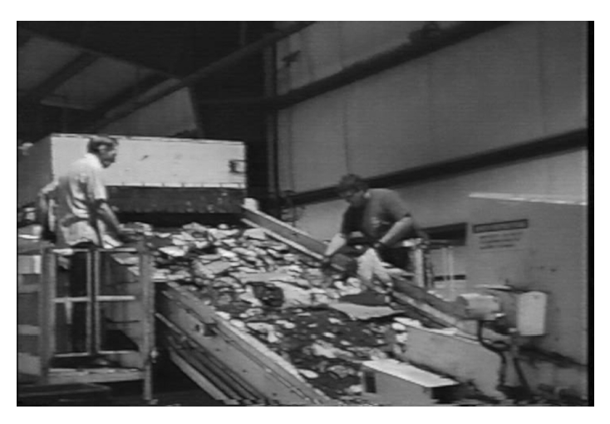
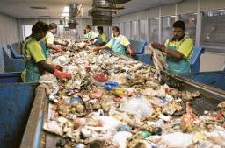
Manual Separation

Slide 52
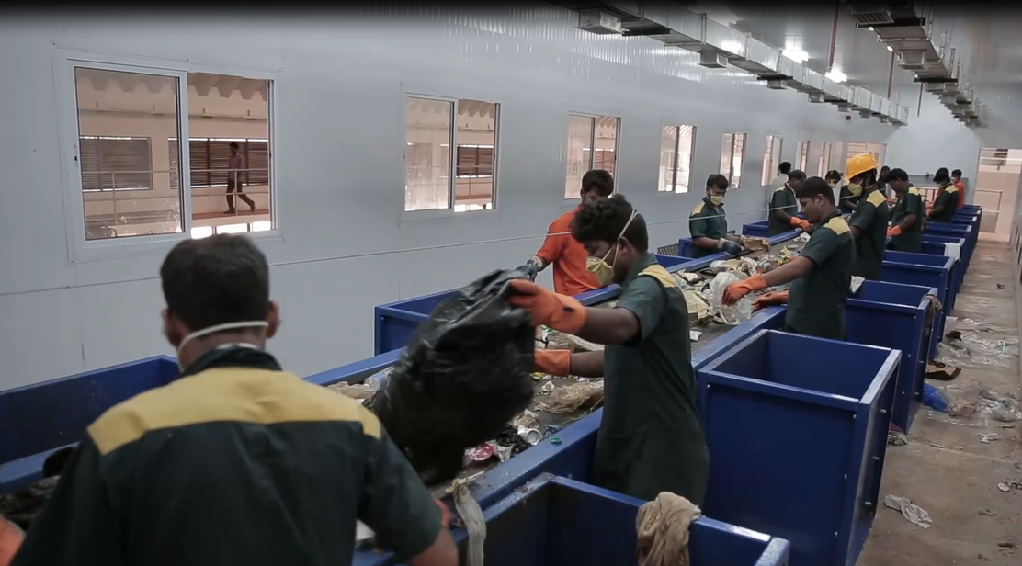

Slide 53
Pickers (hand sorters) have two major functions: Positive sorting and negative sorting;
Positive Sorting: Recover items that doesn’t need to be further processed : cardboard, Newspapers, metal bars
Negative Sorting: Remove items that cause damage to equipments.

Slide 54
Manual Sorting Station with bunkers to sort 15 fractions
Ventilation system
Lighting
Safety switches

Slide 55
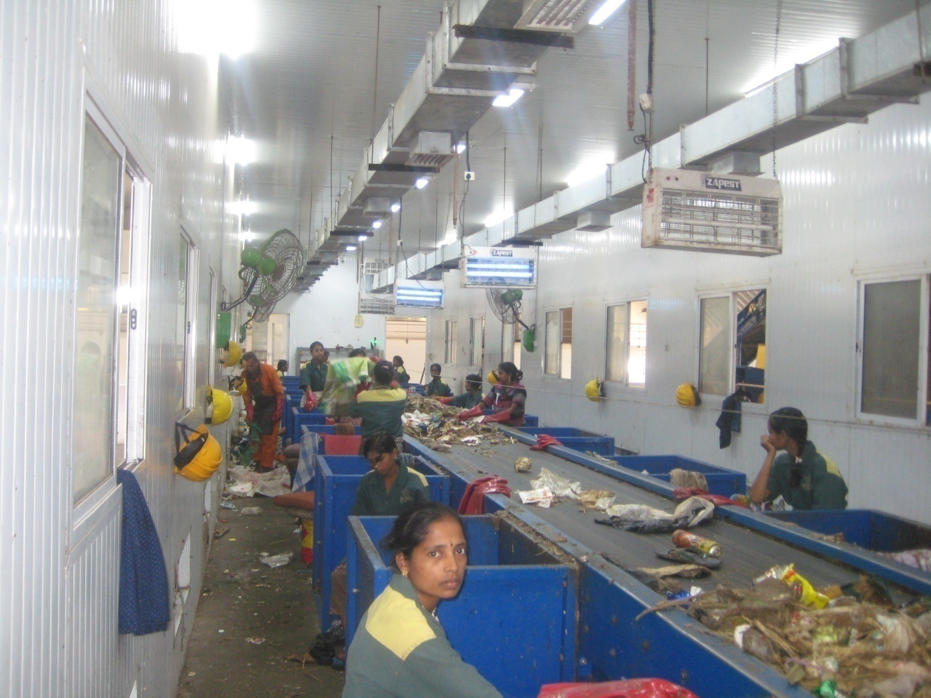
Manual Sorting Station

Slide 56
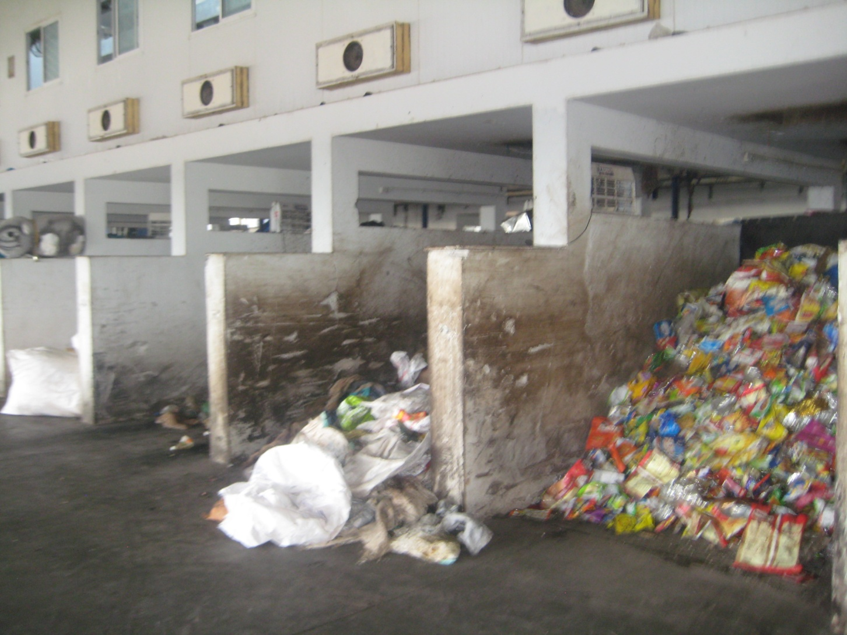
Manual Sorting Station-Bottom

Slide 57
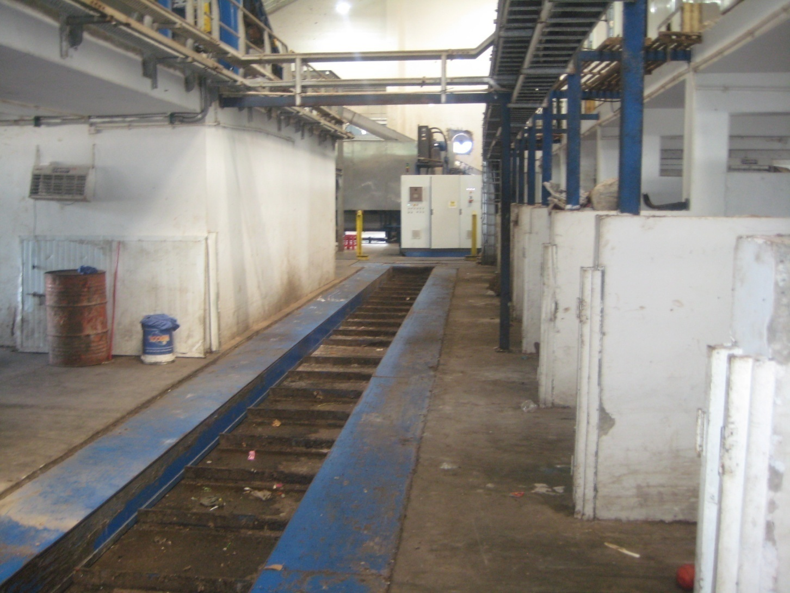
Conveying Recyclables

Slide 58
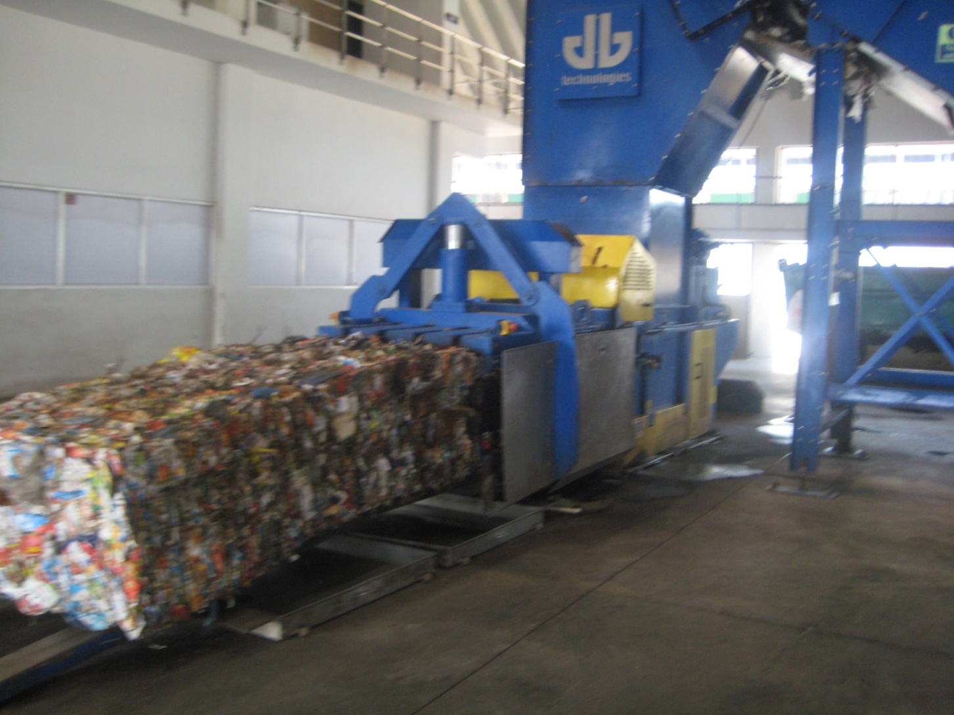
Recyclables

Slide 59
Manual Separation
The Picking Belt should be < 60 cm for one side picking
<90-120 cm for both side picking
Speed 9-15 m/min.
Material | Sorting Rate (kg/hr/sorter) | Recovery Efficiency (%)
Newspaperª | 700 – 4500 | 60 - 95
Corrugatedª | 700 – 4500 | 60 - 95
Glass containers^{b}(mixed colour) | 400 - 800 | 70 - 95
Glass containers^{b}(by colour) | 200 - 400 | 80 - 95
Plastic containers^{b}(PET,HDPE) | 140 - 280 | 80 - 95
Aluminium cans^{b} | 45 - 55 | 80 - 95

Slide 60
Design the manual sorting facility for 100 tpd of solid waste. Assume the maximum pick capacity of a person 250 kg/h.
No. of days of effective operation considered in a year = 320 days
No. of operating hours considered in a day = 16 hrs.
Space provided per Person =1.50 m
No. of units and belt provided = 1.
Solution:
Step 1: Capacity (Throughput Rate) of the Manual Sorting Conveyor Belt.
Total Quantity of Input MSW to be treated in a year = 100 x 365 = 36500 tons/annum.
Capacity (Throughput Rate) = Total Qty. / Effective operation hours = 36500 / (320 x 16) = 7.13 tons/hr
Therefore, Capacity (Throughput Rate) of each Unit required = 7.13 tons/hr.
Provide 8 ton/hr (With 10% safety factor).

Slide 61
Step 2: Personnel Requirement.
Person Requirement = Throughput rate / maximum pick capacity of a person
= 8 t/h x 1000 kg/t / 250 kg/person = 32 person
Considering two rows of Pickers, one at each side of Manual Sorting Conveyor Belt,
No. of Pickers required at each side of Conveyor Belt. = 16 No.
Step 3: Length of Conveyor Belt.
Assume minimum Space provided per Person =1.50m.
Length of Conveyor Belt required = 16 x 1.5 = 24 m.
Provide 1 conveyor belt with length 24.00m.

Slide 62
SCREENING OF SOLID WASTE
In solid waste processing, three types of screening machines are most commonly encountered:
The trommel,
The disk screen,
The vibrating screen.

Slide 63
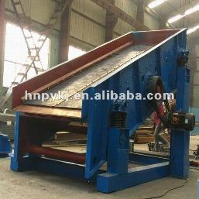
VIBRATING SCREEN
The vibrating screen, consists primarily of a screen panel mounted in a box. Screens are either punched plate or wire mesh.
A drive imparts either a vibratory or rotary motion to the box. The feed material is agitated, allowing fine material to pass through the screen.
Work best with relatively dry, granular mixtures such as grit,
Performs poorly when the amount of undersize is a small fraction of the feed stream.

Slide 64
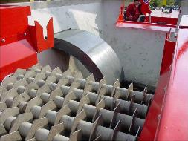
DISK SCREEN
The disk screen, consists of a series of shaft-mounted disks.
The screen opening is defined by the distance between the disks in one direction, and the distance between the shafts in the other.
The shafts rotate, transporting the feed along the length of the machine and presenting the material to the screen openings.

Slide 65
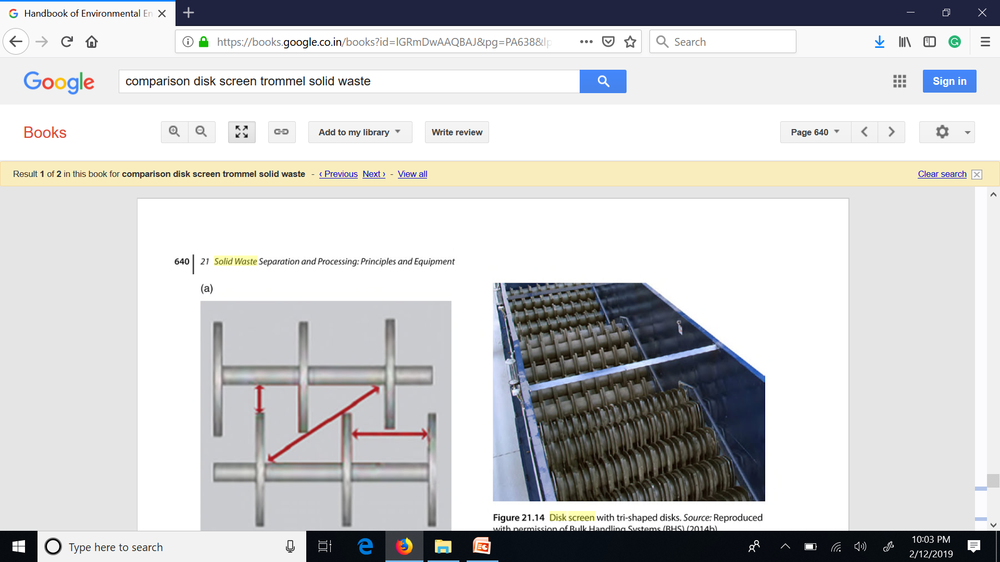
Disk Screen

Slide 66
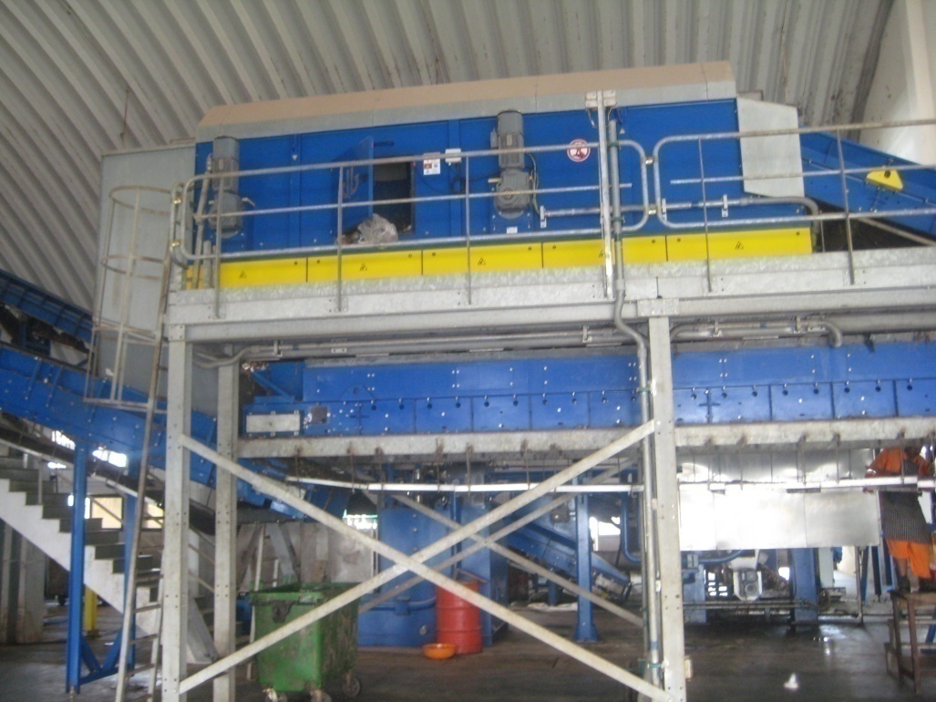
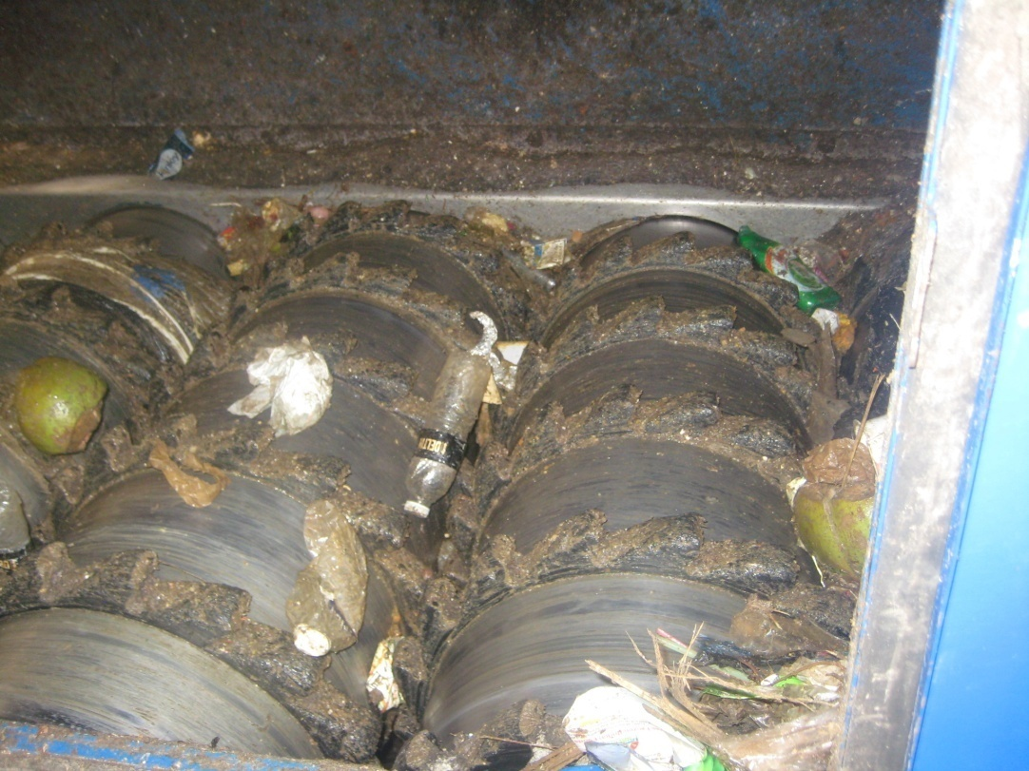
Disk/Roller Screens

Slide 67

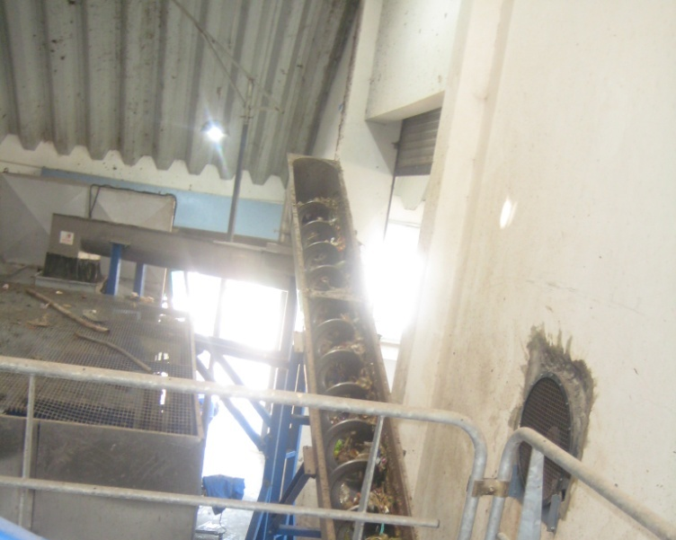
Overflow and Underflow
OVERFLOW (Paper, Plastic, Garden trimmings, coconut.,)
UNDERFLOW (Food, kitchen waste, inerts, small paper, plastics)

Slide 68
DISK SCREEN
ADVANTAGES
Distance between disk can be adjusted according to the size of material
Prevent clogging of apertures, Self cleaned by rotation
Disk screens may offer some advantage over trommels in terms of cost and space requirements.
Disadvantages:
The disk screen's inability to turn material over strongly limits its usefulness in solid waste processing.
It is prone to the undersize carry-over
It doesn't break open plastic bags.

Slide 69
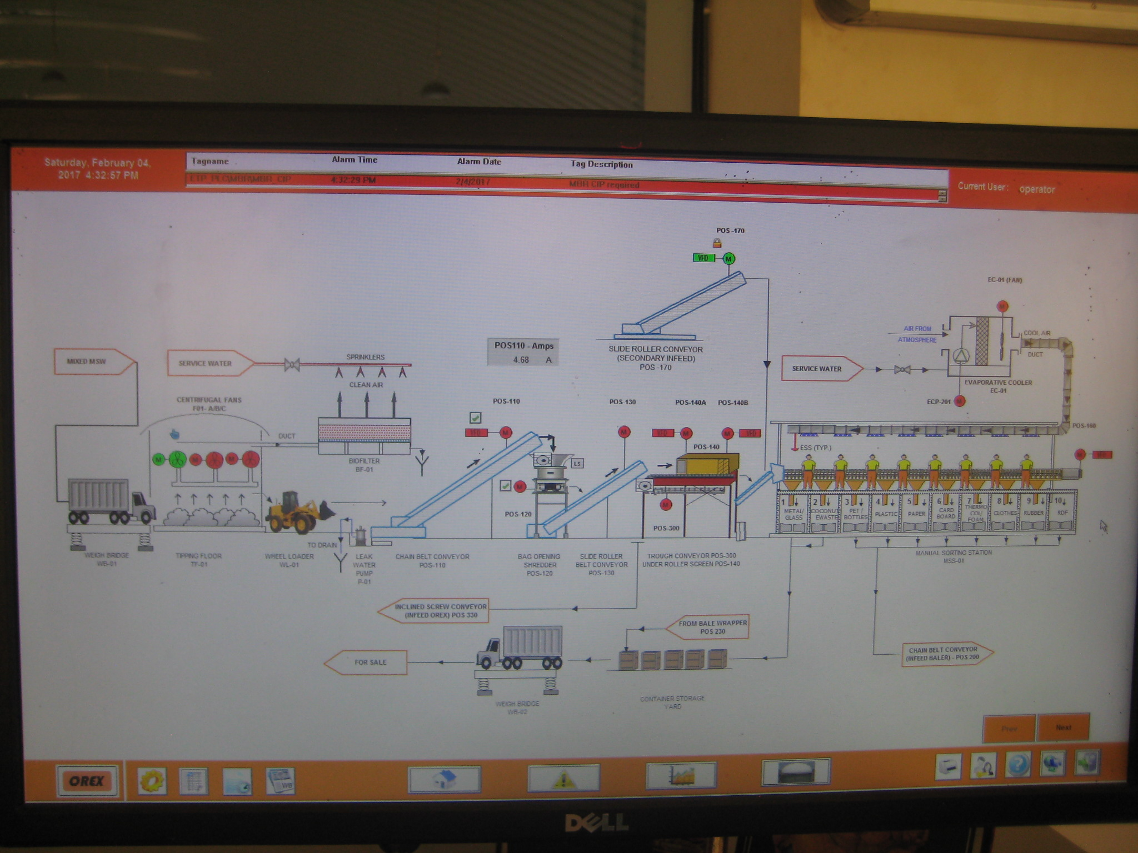

Slide 72
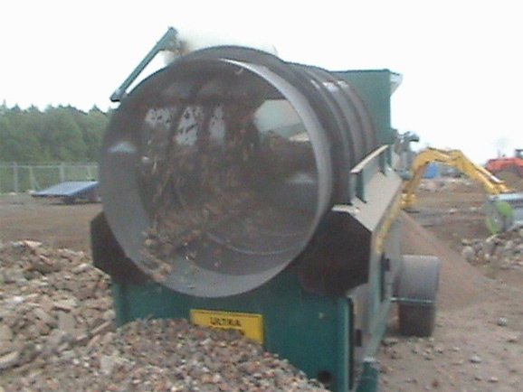
Trommel Screen
The trommel is a sloped, rotating, screen-covered drum.
The screen surface may be either a wire mesh or punched plate; punched plate is used much more commonly.
The feed advances through the drum by virtue of both the slope and the rotation. The rotation continually turns the material, ensuring that all of the feed is presented to the screen apertures.
.

Slide 73
Trommel Screen
In order to effectively separate such streams, the feed must be tumbled to prevent these large oversize items from shielding the undersize from the screen. This shielding occurs when undersize material rides across the screen on top of the oversize, never being exposed to a screen aperture.
The drum rolls at slow speed of 10 to 15 rpm, thus using very little power.
The main advantage of trommel screen is its resistance to clogging.
Efficiency of trommel is dependent on: angle of inclination, screen sizes or slots. feed rate, rotational speed, diameter, and length, particle shape, particle distribution,

Slide 74
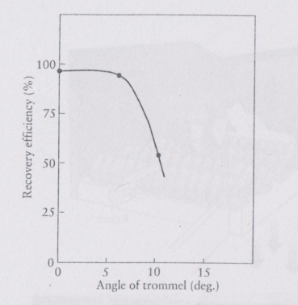
Trommel Screen: Inclination and Slot sizes
The angle of inclination affects the residence time of material in the trommel. Angles of 2 to 5° have been reported in operating MSW systems.
Screen Size and Slot: Tradeoff between the size of the trommel, the efficiency of removing certain components, and the tolerance for passage of items larger than those whose removal is desired.
For processing raw MSW, hole sizes from 1 in. (25 mm) to 2 in. (51 mm) are used to remove grit consisting of dirt, broken glass, small rocks, and organic fines.

Slide 75
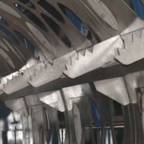
Trommel: Additional Use- Bag Opening
For primary screening (i.e., screening prior to any other operation such as shredding),
Break the plastic bags in order to liberate the material for screening.

Slide 76
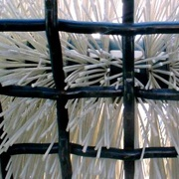
Screening of Compost
Precompost Screening: Screening prior to composting removes plastic sheeting and other no compostable oversize, and typically uses a hole size of 3-4 in. (76-102 mm).
Post-composting screening, using screen openings 10-19 mm, typically is done to remove plastic film, or any bulking agent such as wood chips.
Cleaning Device: Some trommel used for finished compost have been equipped with cleaning devices like rotating brushes in order to reduce blinding; at a minimum.

Slide 77
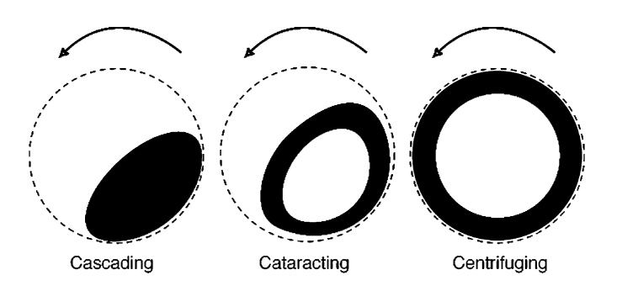
Rotation of Trommel:
Tumbling Motion
Cascading : Rotating very slowly within the cylinder will travel only slightly up the sides and will immediately slide back, thus missing most openings.
Cataracting : Waste that is rotated more rapidly within the cylinder will rise up farther, and then tumble and slide back. This cataracting motion causes substantial turbulence of the waste.
Centrifuging : At even higher speeds the material may adhere to the inside of the trommel and will not effectively tumble or fall by gravity through the screens, i.e., it tends to centrifuge.

Slide 78
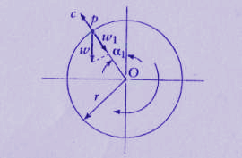
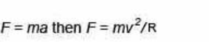
The forces acting on the particle are
Centrifugal force, C;
Weight of the particle, W,
The opposing forces are W1 = W cos α
If C > W1 centrifuging, solid adheres
If C < W1 particle will fall off, cascading or cataracting
If C = W1 then separation occurs and the particle will leave the surface of the trommel at a given velocity – cataracting
Therefore C = W cos α
C = W (r ω²)/g [r ω²is Acceleration]
r = radius (m)
ω = rotational velocity (rad/s)
g = acceleration due to gravity (m/s²)
W cos α = W (r ω²)/g or
Cosα = (r ω²)/g
Substitute ω = 2 π n
Where n is the speed of the screen in rev/s
Cos α = 4 π² n² r /g

Slide 79
Critical point or last chance for the particle to separate and float in the air is when α = 0 or cos α = 1
Then 1 = 4 π² n² r /g
Or
n_{c} = ( g/(4π²r)^{1/2} = (1/2π )(g/r)^{1/2}
This is the critical speed, n_{c}.
At the critical speed, material would in essence remain stuck to the screen surface, and the trommel would plug.
At about 75% of critical speed, violent agitation ends to keep material in the air and away from the holes.
At very low speeds, tumbling action is poor limiting efficiency, and the drop height is low, limiting total throughput. Normally, drum speed is specified as 50% of critical.

Slide 80
Calculate the critical speed of a 3-m-diameter trommel.

Slide 81
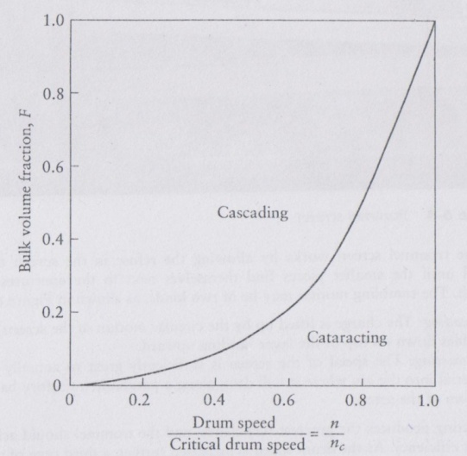
Effect of Refuse Fraction

Slide 82
Analysis of Trommel Screen
Diameter and length
for given Throughput
Maximum material advance/revolution
Where
D = Diameter of Trommel
α = Slope of Trommel
Since this advance occurs once with each revolution, the maximum material velocity through the drum running at N rpm is given by
Maximum material velocity = V_{est} = N_{x} = ND tan α (3)
Where;
N = RPM of Drum

Slide 83
Maximum material velocity = V_{est} =NDK_{v} tan α
Where K_{v} is an empirical factor based on slope
that adjusts the velocity.
Slope | K_{v}
3º | 1.35
5º | 1.85
The volumetric flow (Q_{v}) through the drum is
Q_{v} = VAf ``````````````````````(6)
Where;
V is actual velocity of the material through the drum.
Assume V = 50% of the critical rotational speed is the value given by Eq. (4),
Generally, the total throughput determines the diameter of the trommel. While occasionally the maximum particle size in the feed dictates the drum diameter required. Normally the drum is sized to be between 25% and 33% full of material.
The effective flow area in the trommel is
A_{f} = F(π D² /4) (5)
Where; F= fraction of the volume of the trommel that is filled with material.

Slide 84

then the volumetric capacity is given by
Q_{v} = 0.088 FD^{2.5}g^{0.5}
Multiply by K_{v} to adjust velocity effect and tan α to adjust slope of drum.
Therefore Q_{v} = 0.088 FD^{2.5}g^{0.5}K_{v}tan α (7)
N = 0.5 Nc
The throughput based on weight (Q_{m}) is related to the volumetric throughput (Q_{v} ) by
Q_{m} = d_{b}Q_{v} (8)
Where d_{b} = Density of material.
Combining Eqs. (7) and (8) yields a formula for the diameter in terms of the tonnage, bulk density, and drum slope.

Slide 85
Throughput by Trommel Screen
where D is the trommel diameter (m),
Qm the trommel throughput, (kg/s),
d_{b} the bulk specific weight of MSW (kg/m3),
α the angle of trommel from base frame (deg),
Kv the velocicorrection
ty factor (Kv1.35 when α 3°, and Kv1.85 when α 5°),
F the fillage factor (a typical range is between 0.25 and 0.33),
and g 9.81 m/s2.

Slide 86
Problem:
Calculate the diameter and operating speed of the trommel screen for the following data.
Qm = 2.5 kg/s
db- density of MSW 400 kg/m3
F – 0.25
Kv = 1.85
Alpha – 5 degrees

Slide 87
Drum Length
Residence Time T = L/V
L = V x T
Assume V = 50% of critical speed (n_{c}= (1/2π)(g/r)^{1/2)}) and multiply by K_{v} tanα to adjust speed and slope.
L = 0.113 T D^{0.5} g^{0.5} K_{v} tanα (11)
Problem: Calculate the length of drum required for residence time of 5 minutes and diameter of 10 ft. Assume K_{v} tanα = 0.071 ?
Solution:
L = 0.113 x 5 x 60sec/min x 10^{0.5} x (3.28 ft/m x 9.81)^{0.5} x .071 = 43 ft

Slide 88
Trommel: Specs
Model | Diameter (m) | Length (m) | Power (kW) | Capacity (m3/hr ) | Capacity (t/hr)
BT10/2.5 | 2.5 | 10 | 15 | 61 | 30
BT8/2.5 | 2.5 | 8 | 10 | 61 | 30
BT10/2 | 2 | 10 | 10 | 48 | 24
BT8/2 | 2 | 8 | 7.5 | 48 | 24
BT6/2 | 2 | 6 | 5.5 | 48 | 24
BT10/1.5 | 1.5 | 10 | 7.5 | 34 | 17
BT8/1.5 | 1.5 | 8 | 5.5 | 34 | 17
BT6/1.5 | 1.5 | 6 | 5.5 | 34 | 17

Slide 89
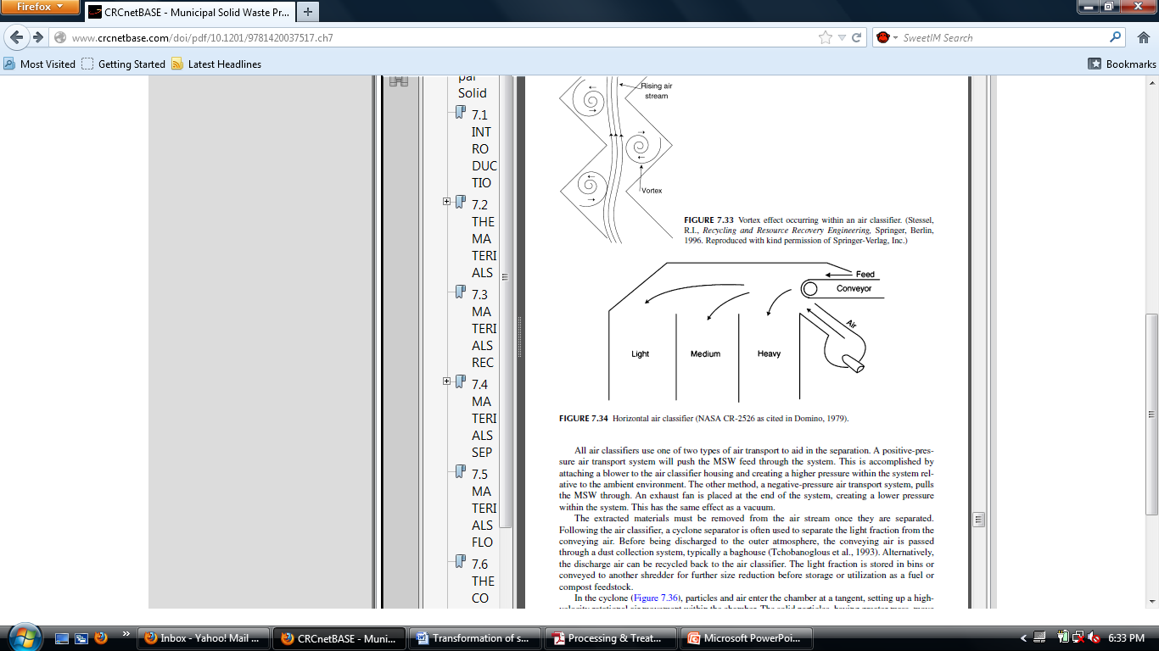
Air Classifiers
Process of separating categories of materials by way of differences in their respective aerodynamic characteristics.
Aerodynamic characteristics = f(Size, geometry, and density)
Interaction of a
  moving stream of air,s
  shredded waste material,
  and the gravitational force within a confined volume.

Slide 90
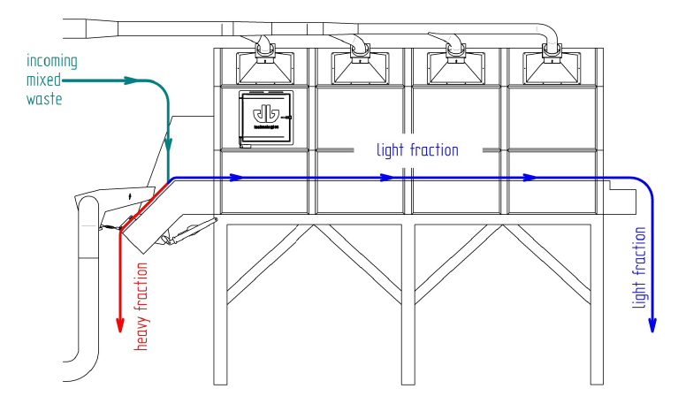
Air Classifier

Slide 91
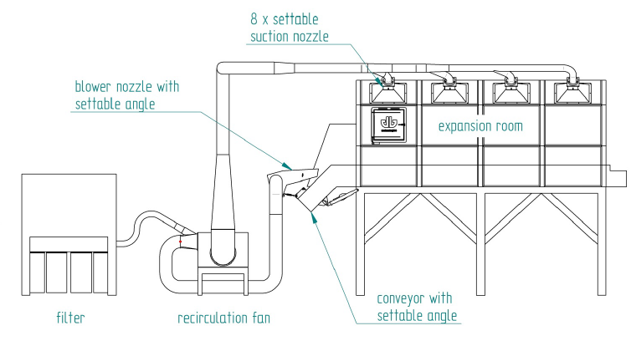
Air Classifier

Slide 92
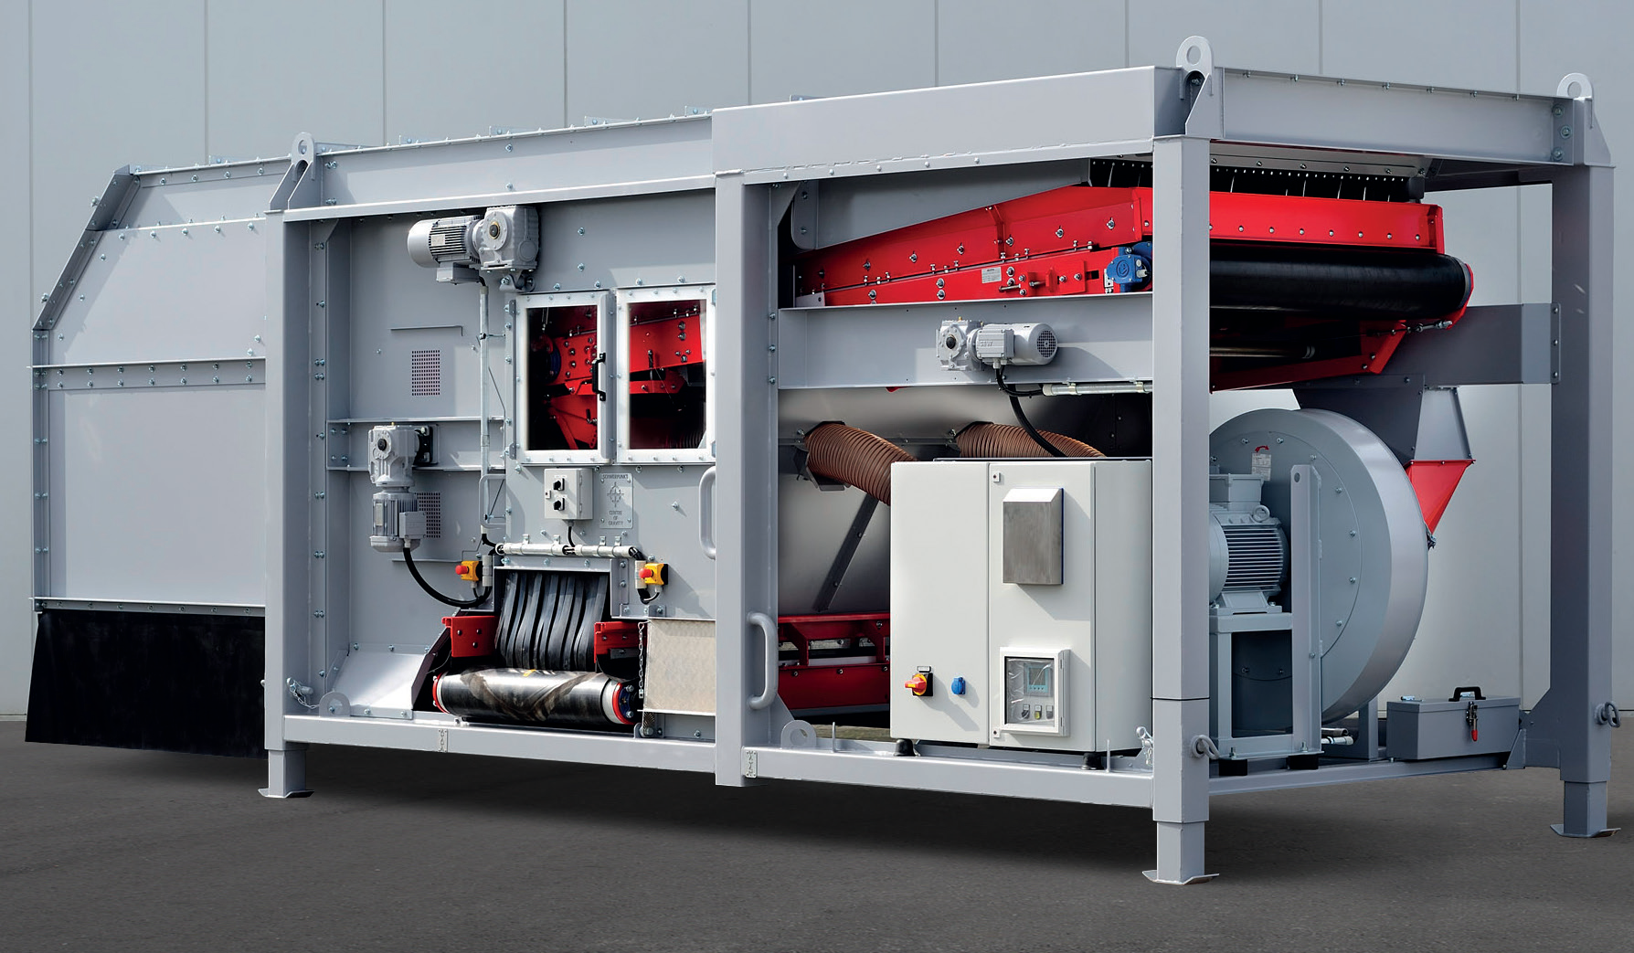
Air Classifier
Input
Fines
Heavy

Slide 93
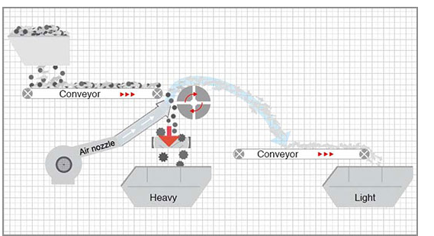
Air Classifier

Slide 94
Specifications
Sr. No. | Particular | Detail
A | General:
1 | Tag No. | Pos. 660
2 | No. of Units | 1 No.
3 | Location | MSRC Shed
4 | Service | To separate light and heavy fractions from the waste coming from Wave Screen
5 | Capacity | 1.00 ton/hr
B | Electrical:
1 | Type of Starter | DOL
2 | Location of Starter | MCC Panel
3 | Type of Drive | Motor
4 | Rating of Drive | Vibratory Feeder: 2 x 0.60kW Air Fan: 1 x 5.50 kW Separator Drum – 1 KW

Slide 95
Air Classifiers
The drag force and the gravitational force are exerted in different directions upon the particles.
Waste particles that have a large drag-to-weight ratio are suspended in the air stream, whereas components that have a small ratio tend to settle out of the air stream.
The suspended fraction conventionally is referred to as the “air-classified light fraction” and the settled fraction is termed “air-classified heavy fraction”.
Paper and plastic materials tend to be concentrated in the light fraction, and metals and glass are the principal components of the heavy fraction.

Slide 96
Theoretical Efficiency

Slide 97


Slide 98
Maximum permissible Al and Steel for RDF
Air Speed:
Assume 12 % Al and 5 % Fe
Video De-Stoner® Air Classifier for MSW

Slide 99




MSW containing equal amounts of paper, plastics, Aluminum & Steel is fed into an air classifier operating with an air velocity of 175 cm/sec. Calculate the recovery of the organic product and the purity of the product.

Slide 100
Binary Separation: Effectiveness (Recovery & Purity) of Separation
If the input to a binary separation device is denoted as X_{o} + Y_{o}, then after separation, two waste streams result, 1 and 2, each containing a mixture of X and Y denoted as X₁ + Y₁ and X₂ + Y₂
1
X1+ Y1
(Want X here)
Xo + Yo
Binary separator
40 kg plastic + 5 kg paper
50 kg plastic + 50 kg paper
2
X2 + Y2
(Want Y here)
10 kg plastic + 45 kg paper
Recovery of component X = Recovery (X) = R_{(x1)} = (X₁/X_{o}) x 100%
Recovery of component Y = Recovery (Y) = R_{(y2)} = (Y₂/Y_{o}) x 100%
Purity (X) = P_{(x1)} = (X1/X1+Y1) x 100%

Slide 101

Magnetic Separation
Material to be sorted passes over the magnetic pulley.
Magnetic particles are pulled part way around the rotating pulley while the non-magnetic particles follow a separate unrestrained ballistic path.
Video
MSW Plant Trommel magnetic, vib screen YouTube

Slide 102


Magnetic Separator

Slide 103

Magnetic Separation
The effectiveness of magnetic conveyor depends on several variables;
Height of Magnet above the conveyor: The closer the magnet is to the refuse, the better the effectiveness of ferrous metal removal
Speed of the Conveyor: The higher the speed showing reduced recovery.
Burden Depth: The greater the burden depth, the lower the recovery

Slide 104

Eddy Current Separator: Separate aluminum & other non-ferrous metals from process stream, municipal recycling facility (MRF)

Slide 105

Eddy Current Separator
The Eddy Current Separator (ECS) is an advanced metal sorting unit that is capable of separating non-ferrous metals such as aluminium and copper from domestic and industrial waste.
Short belt conveyor that has its drive located at the return end and a high speed magnetic rotor system installed at the discharge end
As the rotor spins at these high speeds, an electric current is induced into conducting metals. The induced electric current produces a magnetic field, which opposes the field created by the rotor, repelling the conducting metals over a pre-positioned splitter plate.
While other materials drop off at the end of the conveyor, the non-ferrous metals are propelled forward over a splitter for separation.

Slide 106


Eddy Current Separator

