Slide 1
Timing Diagram is a graphical representation. It represents the execution time taken by each instruction in a graphical format. The execution time is represented in T-states.
Instruction Cycle:
The time required to execute an instruction .
Machine Cycle:
The time required to access the memory or input/output devices .
T-State:
The machine cycle and instruction cycle takes multiple clock periods.
A portion of an operation carried out in one system clock period is called as T-state.

Slide 3
Timing diagrams
The 8085 microprocessor has 7 basic machine cycle. They are
Op-code Fetch cycle(4T or 6T).
Memory read cycle (3T)
Memory write cycle(3T)
I/O read cycle(3T)
I/O write cycle(3T)
Interrupt Acknowledge cycle(6T or 12T)
Bus idle cycle

Slide 4
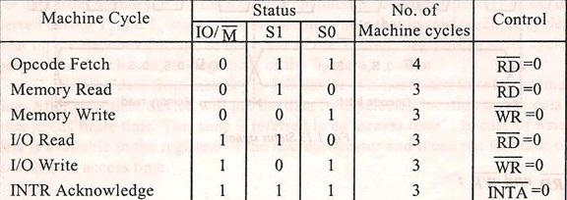

Slide 5
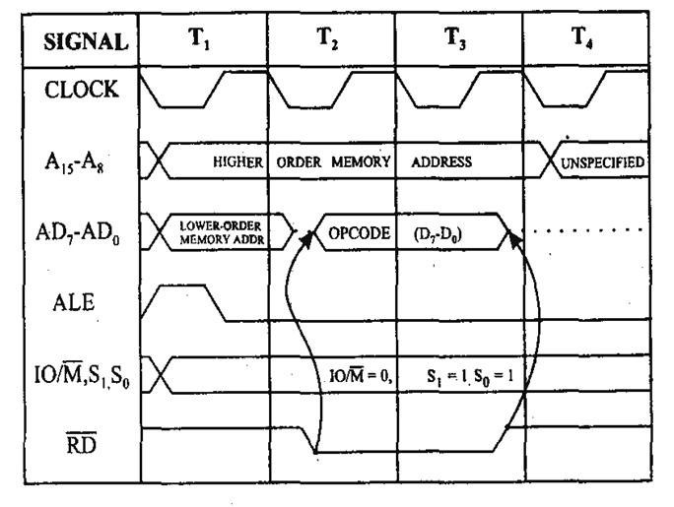
1.Opcode fetch cycle(4T or 6T)

Slide 6
OPCODE FETCH
•
The Opcode fetch cycle, fetches the instructions from memory and delivers it to the instruction register of the microprocessor
Opcode fetch machine cycle consists of 4 T-states.
T1 State:
During the T1 state, the contents of the program counter are placed on the 16 bit address bus. The higher order 8 bits are transferred to address bus (A8-A15) and lower order 8 bits are transferred to multiplexed A/D (AD0-AD7) bus.
ALE (address latch enable) signal goes high. As soon as ALE goes high, the memory latches the AD0-AD7 bus. At the middle of the T state the ALE goes low

Slide 7
T2 State:
During the beginning of this state, the RD’ signal goes low to enable memory. It is during this state, the selected memory location is placed on D0-D7 of the Address/Data multiplexed bus.
T3 State:
In the previous state the Opcode is placed in D0-D7 of the A/D bus. In this state of the cycle, the Opcode of the A/D bus is transferred to the instruction register of the microprocessor. Now the RD’ goes high after this action and thus disables the memory from A/D bus.
T4 State:
In this state the Opcode which was fetched from the memory is decoded.

Slide 8
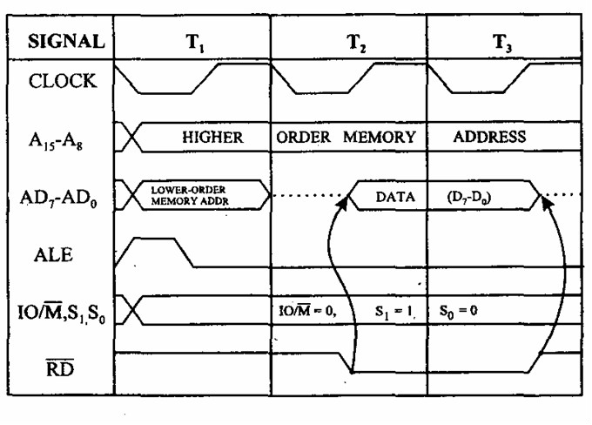
2. Memory read cycle (3T)

Slide 9
These machine cycles have 3 T-states.
•
T1 state:
The higher order address bus (A8-A15) and lower order address and data multiplexed (AD0-AD7) bus. ALE goes high so that the memory latches the (AD0-AD7) so that complete 16-bit address are available.
The mp identifies the memory read machine cycle from the status signals IO/M’=0, S1=1, S0=0. This condition indicates the memory read cycle.
T2 state:
Selected memory location is placed on the (D0-D7) of the A/D multiplexed bus. RD’ goes LOW
T3 State:
The data which was loaded on the previous state is transferred to the microprocessor. In the middle of the T3 state RD’ goes high and disables the memory read operation. The data which was obtained from the memory is then decoded.
•
•
•

Slide 10
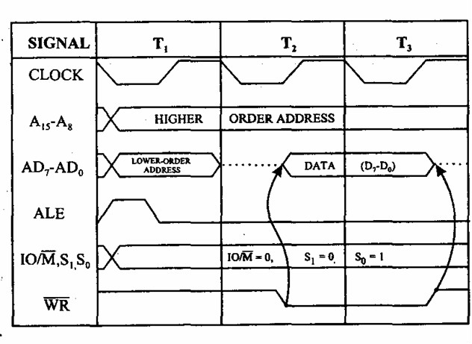
3. Memory write cycle (3T)

Slide 11
These machine cycles have 3 T-states.
T1 state:
The higher order address bus (A8-A15) and lower order address and data multiplexed (AD0-AD7) bus. ALE goes high so that the memory latches the (AD0-AD7) so that complete 16-bit address are available.
The mp identifies the memory read machine cycle from the status signals IO/M’=0, S1=0, S0=1. This condition indicates the memory read cycle.
T2 state:
Selected memory location is placed on the (D0-D7) of the A/D multiplexed bus. WR’ goes LOW
T3 State:
In the middle of the T3 state WR’ goes high and disables the memory write operation. The data which was obtained from the memory is then decoded.
•

Slide 12
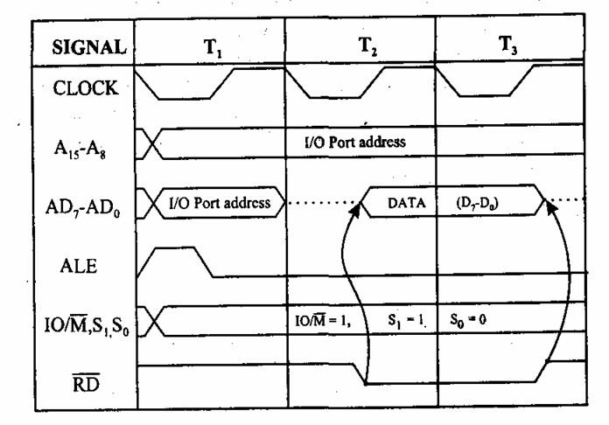
4.I/O read cycle(3T)

Slide 13
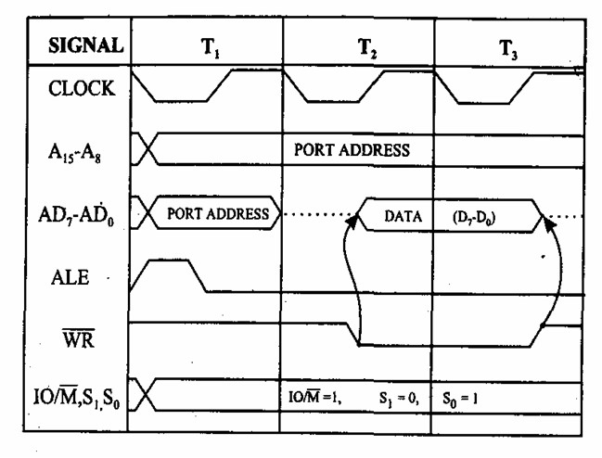
5.I/O write cycle(3T)

Slide 14
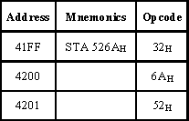
STA instruction
ex: STA 526A

Slide 15
It require 4 m/c cycles 13 T states
1.opcode fetch(4T) 2.memory read(3T) 3.memory read(3T) 4.Memory write(3T)

Slide 16
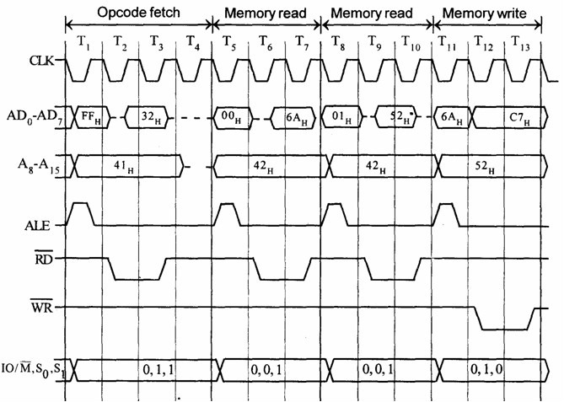

Slide 17
Timing diagram for IN C0H
Fetching the Opcode DBH from the memory 4125H.
Read the port address C0H from 4126H.
Read the content of port C0H and send it to the accumulator.
Let the content of port is 5EH.

Slide 18
It require 3 m/c cycles 10 T states
opcode fetch(4T) memory read(3T) I/O read(3T)

Slide 19
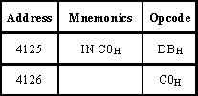

Slide 21
OUT
instruction Machines Cycles(10T):
1.instruction fetch(4T) 2.memory read (3T) 3.IO write (3T)

Slide 22
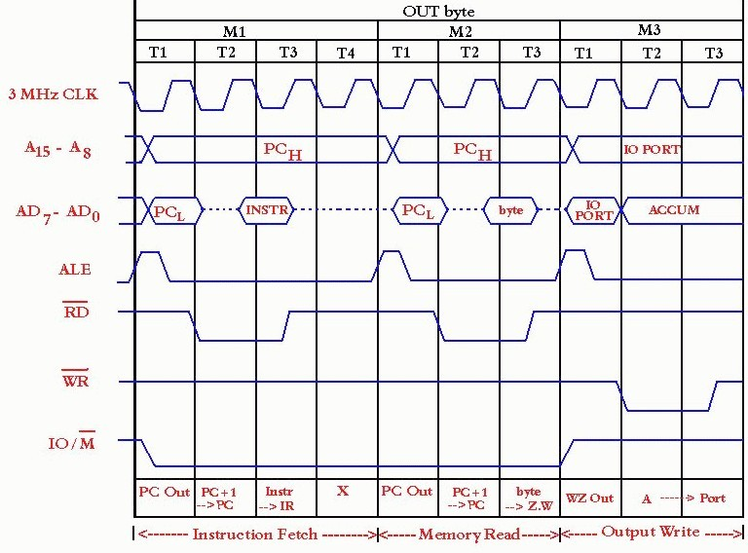

Slide 23
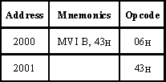
Timing diagram for MVI B, 43h
Fetching the Opcode 06H from the memory 2000H. (OF machine cycle)
Read (move) the data 43H from memory 2001H. (memory read)

Slide 24
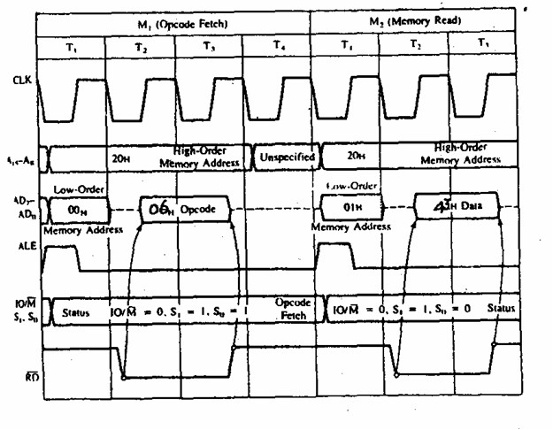

Slide 25
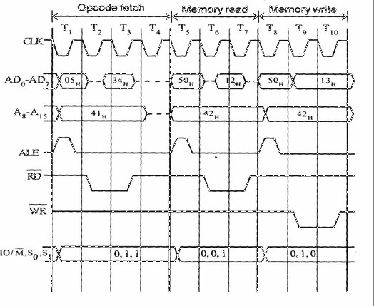
INR M

Slide 26
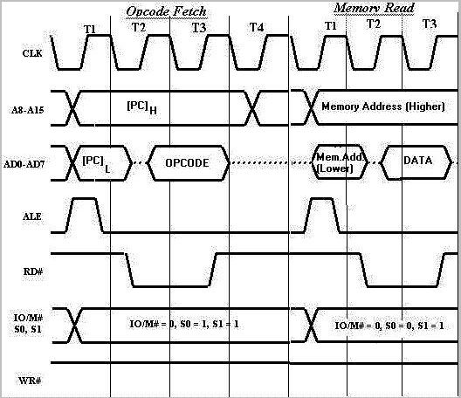
ADD M

Slide 27
references
•
8085 microprocessor by Sajid Akram, researcher/lecturer at c.abdul hakeem college of engineering and technology
Timingdiagram by puja00 (slideshare.net)
Microprocessor 8086 by Gopikrishna Madanan, Assistant Professor of Physics at Collegiate Education, Kerala, India
•
•

