Slide 1
Topic:
Pipelining

Slide 2
A Pipelining is a series of stages, where some work is done at each stage in parallel.
The stages are connected one to the next to form a pipe - instructions enter at one end, progress through the stages, and exit at the other end.

Slide 3
Pipelining Case: Laundry
4 loads of laundry that need to washed, dried, and folded.
30 minutes to wash, 40 min. to dry, and 20 min. to fold.
We have 1 washer, 1 dryer, and 1 folding station.
What’s the most efficient way to get the 4 loads of laundry done?

Slide 4
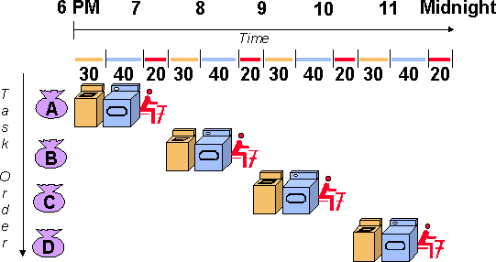
Non Pipelined Laundry
Takes a total of 6 hours; nothing is done in parallel

Slide 5
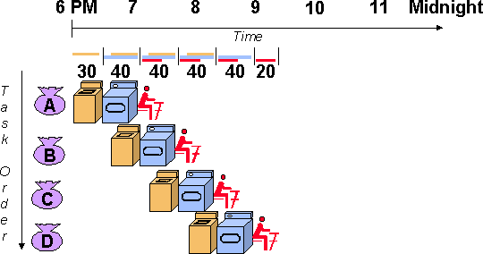
Pipelined Laundry
Using this method, the laundry would be done at 9:30.

Slide 6
Definition:
Pipelining is an speed up technique where multiple instructions are overlapped in execution on a processor.

Slide 7
Pipelining: Processors
Computers, like laundry, typically perform the exact same
steps for every instruction:
Fetch an instruction from memory
Decode the instruction
Execute the instruction
Read memory to get input
Write the result back to memory

Slide 8
Instruction Pipeline
Instruction execution process lends itself naturally to pipelining
– overlap the subtasks of instruction fetch, decode and execute
Instruction pipeline has six operations,
Fetch instruction (FI)
Decode instruction (DI)
Calculate operands (CO)
Fetch operands (FO)
Execute instructions (EI)
Write result (WR)
Overlap these operations
CS211 8

Slide 9
Instructions Fetch
The IF stage is responsible for obtaining the requested instruction from memory. The instruction and the program counter are stored in the register as temporary storage.
CS211 9

Slide 10
Decode Instruction
The DI stage is responsible for decoding the instruction and sending out the various control lines to the other parts of the processor.
CS211 10

Slide 11
Calculate Operands
The CO stage is where any calculations are performed. The main component in this stage is the ALU. The ALU is made up of arithmetic, logic and capabilities.
CS211 11

Slide 12
Fetch Operands and Execute Instruction
The FO and EI stages are responsible for storing and loading values to and from memory. They also responsible for input and output from the processor respectively.
CS211 12

Slide 13
Write Operands
The WO stage is responsible for writing the result of a calculation, memory access or input into the register file.
CS211 13

Slide 14
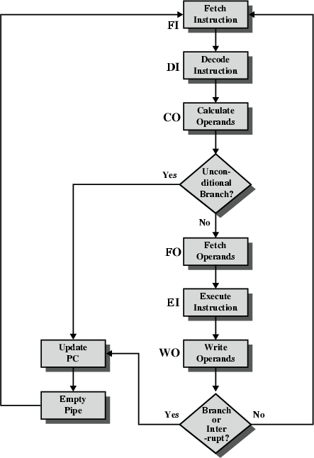
Six Stage Instruction Pipeline

Slide 15
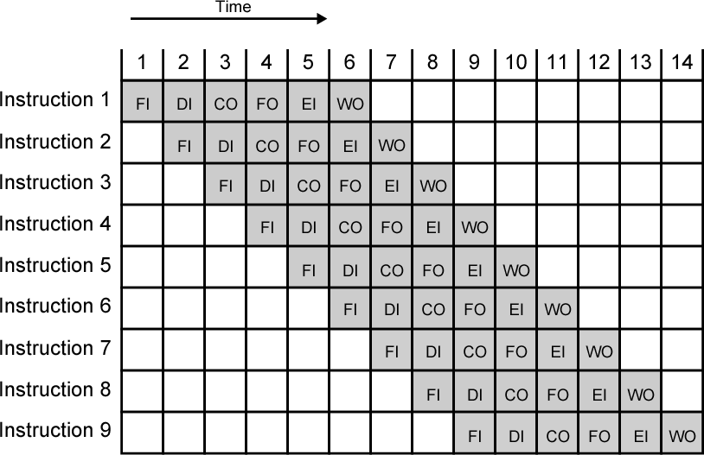
Timing Diagram for Instruction Pipeline Operation

Slide 16
Pipeline Performance: Clock & Timing
6
S_{i}
^{S}i+1
τ
τ_{m}
d
Clock cycle of the pipeline : τ
Latch delay : d
τ = max {τ_{m} } + d
Pipeline frequency : f
f = 1 / τ
CS211 16

Slide 17
Pipeline Performance: Speedup & Efficiency
7
k-stage pipeline processes n tasks in k + (n-1) clock cycles:
k cycles for the first task and n-1 cycles for the remaining n-1 tasks
Total time to process n tasks
T_{k} = [ k + (n-1)] τ
For the non-pipelined processor
T₁ = n k τ
Speedup factor
T₁
n k τ [ k + (n-1)] τ
n k
k + (n-1)
S =
=
=
k
T
k
CS211 17

Slide 18
Advantages
Pipelining makes efficient use of resources.
Quicker time of execution of large number of instructions
The parallelism is invisible to the programmer.

Slide 19
Can Pipelining Get Us Into Trouble?
Yes: Pipeline Hazards
structural hazards: attempt to use the same resource by two different instructions at the same time
data hazards: attempt to use data before it is ready
An instruction’s source operand(s) are produced by a prior
instruction still in the pipeline
control hazards: attempt to make a decision about program control flow before the condition has been evaluated and the new PC target address calculated
branch instructions
Can always resolve hazards by waiting
pipeline control must detect the hazard
and take action to resolve hazards
CSE431 L06 Basic MIPS Pipelining.19 Irwin, PSU, 2005

