Slide 2
Pipeline Hazards
There are situations, called hazards, that prevent the next instruction in the instruction stream from executing during its designated cycle
There are three classes of hazards
Structural hazard
Data hazard
Branch hazard
Structural Hazards. They arise from resource conflicts when the hardware cannot support all
possible combinations of instructions in simultaneous overlapped execution.
Data Hazards. They arise when an instruction depends on the result of a previous instruction in a way that is exposed by the overlapping of instructions in the pipeline.
Control Hazards.They arise from the pipelining of branches and other instructions that change the PC.

Slide 3
What Makes Pipelining Hard?
Power failing,
Arithmetic overflow,
I/O device request,
OS call,
Page fault

Slide 4
Pipeline Hazards
Structural hazard
Resource conflicts when the hardware cannot support all possible combination of instructions simultaneously
Data hazard
An instruction depends on the results of a previous instruction
Branch hazard
Instructions that change the PC

Slide 5
Structural hazard
Some pipeline processors have shared a single- memory pipeline for data and instructions

Slide 6
Single Memory is a Structural Hazard
Time (clock cycles)
I
n s t r.
Load Instr 1
M
ALU
Reg M
Reg
M
Reg
ALU
M
Reg
Instr 2
Instr 3
Instr 4
M
Reg
ALU
M
Reg
O
r d e
Reg
ALU
M
Reg
M
M
Reg
ALU
M
Reg
•^{r}Can’t read same memory twice in same clock cycle

Slide 7
Structural hazard
Memory data fetch requires on FI and FO
S1 S2 S3 S4
S5
Fetch
Instruction (FI)
Decode
Instruction (DI)
Fetch
Operand
(FO)
Execution
Instruction
(EI)
Write
Operand (WO)
Time
S1 1 2 3 S2
S3 S4 S5
4
5
1 2 3 4 5
1 2 3 4 5
1 2 3 4 5
1 2 3 4 5

Slide 8
Structural hazard
To solve this hazard, we “stall” the pipeline until the resource is feed
A stall is commonly called pipeline bubble, since it floats through the pipeline taking space but carry no useful work

Slide 9
Structural Hazards limit performance
◻ Example: if 1.3 memory accesses per instruction (30% of instructions execute loads and stores)
and only one memory access per cycle then
◉
◉
Average CPI  1.3
Otherwise datapath resource is more than 100% utilized
Structural Hazard Solution: Add more Hardware

Slide 10
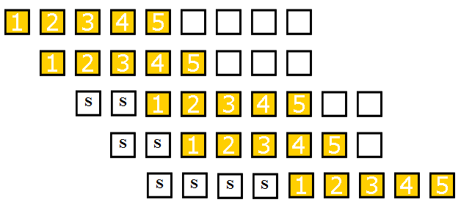
Structural hazard
Fetch
Instruction (FI)
Decode
Instruction (DI)
Fetch
Operand
(FO)
Execution
Instruction
(EI)
Write
Operand (WO)
Time

Slide 11
Data hazard
Example:
ADD R1 R2+R3
SUB R4 R1-R5
AND R6 R1 AND R7
OR R8 R1 OR R9
XOR R10 R1 XOR R11

Slide 12
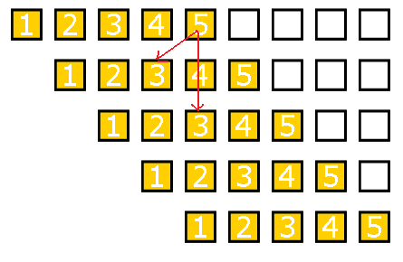
Data hazard
FO: fetch data value WO: store the executed value
S1 S2 S3 S4 S5
Fetch
Instruction (FI)
Decode
Instruction (DI)
Fetch
Operand
(FO)
Execution
Instruction
(EI)
Write
Operand (WO)
Time

Slide 13
Data hazard
Delay load approach inserts a no-operation instruction to avoid the data conflict
ADD
No-op No-op SUB AND OR XOR
R1 R2+R3
R4 R1-R5
R6 R1 AND R7 R8 R1 OR R9 R10 R1 XOR R11

Slide 14
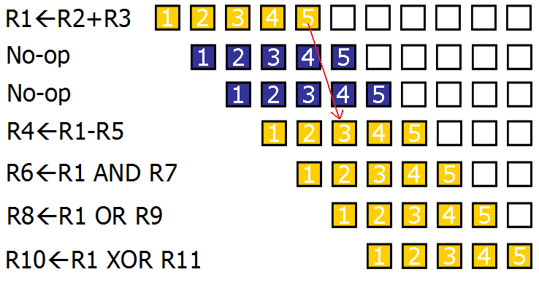
Data hazard

Slide 15
Data hazard
It can be further solved by a simple hardware technique called
forwarding (also called bypassing or short-circuiting)
The insight in forwarding is that the result is not really needed by SUB until the ADD execute completely
If the forwarding hardware detects that the previous ALU operation has written the register corresponding to a source for the current ALU operation, control logic selects the results in ALU instead of from memory

Slide 16
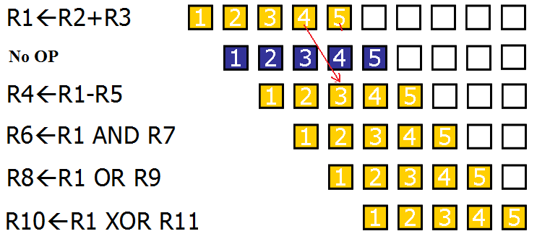
Data hazard

Slide 17
Data Hazard Classification
Three types of data hazards
RAW : Read After Write
WAW : Write After Write
WAR : Write After Read
RAR : Read After Read
– Is this a hazard?

Slide 18
Read After Write (RAW)
A read after write (RAW) data hazard refers to a situation where an instruction refers to a result that has not yet been calculated or retrieved.
This can occur because even though an instruction is executed after a previous instruction, the previous instruction has not been completely processed through the pipeline.
example:
i1. | R2 | <- | R1 + R3
i2. | R4 | <- | R2 + R3

Slide 19
Write After Read (WAR)
A write after read (WAR) data hazard represents a problem with concurrent execution.
For example:
i1.
i2.
R4 <- R1 + R5 R5 <- R1 + R2

Slide 20
Write After Write (WAW)
A write after write (WAW) data hazard may occur in a concurrent execution environment.
example:
i1. R2 <- R4 + R7 i2. R2 <- R1 + R3
We must delay the WB (Write Back) of i2 until the execution of i1

Slide 21
Branch hazards
Branch hazards can cause a greater performance loss for pipelines
When a branch instruction is executed, it may or may not change the PC
If a branch changes the PC to its target address, it is a taken branch Otherwise, it is untaken

Slide 22
Branch hazards
There are FOUR schemes to handle branch hazards
Freeze scheme
Predict-untaken scheme
Predict-taken scheme
Delayed branch

Slide 23
5-Stage Pipelining
Fetch
Instruction (FI)
Decode
Instruction (DI)
Fetch
Operand
(FO)
Execution
Instruction
(EI)
Write
Operand (WO)
Time
S1 1 2 3 S2
S3 S4 S5
4
5
1 2 3 4 5
1 2 3 4 5
1 2 3 4 5
1 2 3 4 5

Slide 24
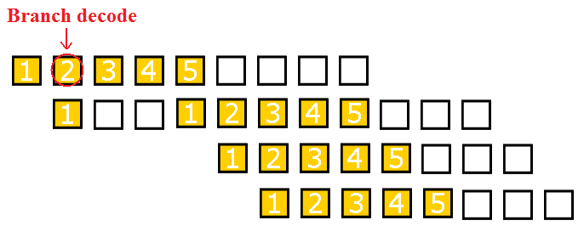
Branch Untaken
(Freeze approach)
The simplest method of dealing with branches is to redo the fetch following a branch
Fetch
Instruction (FI)
Decode
Instruction (DI)
Fetch
Operand
(FO)
Execution
Instruction
(EI)
Write
Operand (WO)

Slide 25
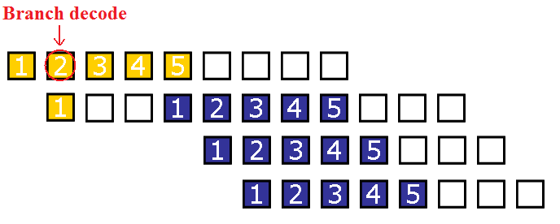
Branch Taken
(Freeze approach)
The simplest method of dealing with branches is to redo the fetch following a branch
Fetch
Instruction (FI)
Decode
Instruction (DI)
Fetch
Operand
(FO)
Execution
Instruction
(EI)
Write
Operand (WO)

Slide 26
Branch Taken
(Freeze approach)
The simplest scheme to handle branches is to freeze the pipeline holding or deleting any instructions after the branch until the branch destination is known
The attractiveness of this solution lies primarily in its simplicity both for hardware and software

Slide 27
Branch Hazards
(Predicted-untaken)
A higher performance, and only slightly more complex, scheme is to treat every branch as not taken
It is implemented by continuing to fetch instructions as if the branch were normal instruction
The pipeline looks the same if the branch is not taken
If the branch is taken, we need to redo the fetch instruction

Slide 28
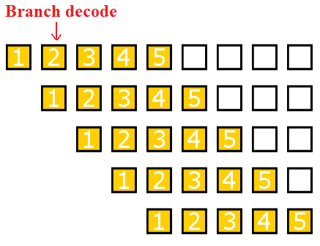
Branch Untaken
(Predicted-untaken)
Fetch
Instruction (FI)
Decode
Instruction (DI)
Fetch
Operand
(FO)
Execution
Instruction
(EI)
Write
Operand (WO)
Time

Slide 29
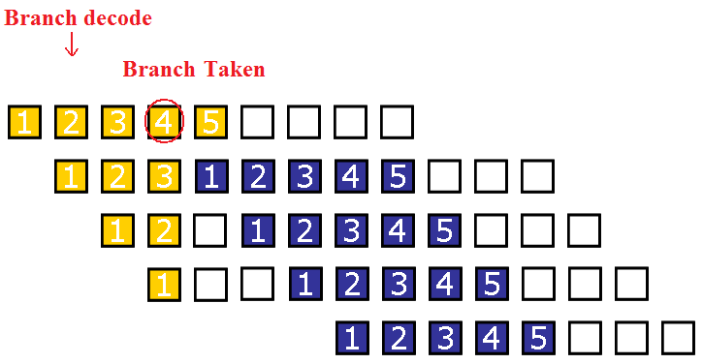
Branch Taken
(Predicted-untaken)
Fetch
Instruction (FI)
Decode
Instruction (DI)
Fetch
Operand
(FO)
Execution
Instruction
(EI)
Write
Operand (WO)

Slide 30
Branch Taken
(Predicted-taken)
An alternative scheme is to treat every branch as taken
As soon as the branch is decoded and the target address is computed, we assume the branch to be taken and begin fetching and executing the target

Slide 31
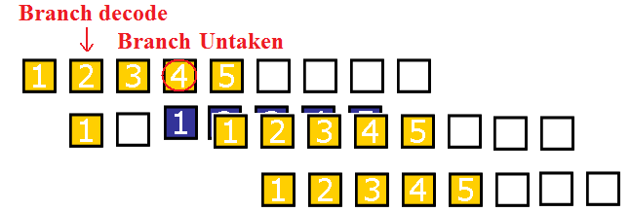
Branch Untaken
(Predicted-taken)
Fetch
Instruction (FI)
Decode
Instruction (DI)
Fetch
Operand
(FO)
Execution
Instruction
(EI)
Write
Operand (WO)

Slide 32
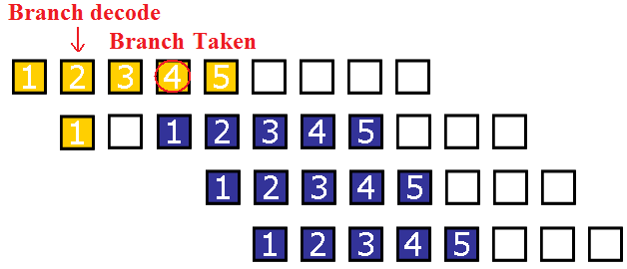
Branch taken
(Predicted-taken)
Fetch
Instruction (FI)
Decode
Instruction (DI)
Fetch
Operand
(FO)
Execution
Instruction
(EI)
Write
Operand (WO)

Slide 33
Delayed Branch
A fourth scheme in use in some processors is called delayed branch
It is done in compiler time. It modifies the code
The general format is: branch instruction
Delay slot
branch target if taken

Slide 34
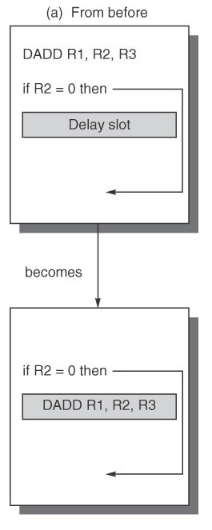
Delayed Branch
Optimal

Slide 35
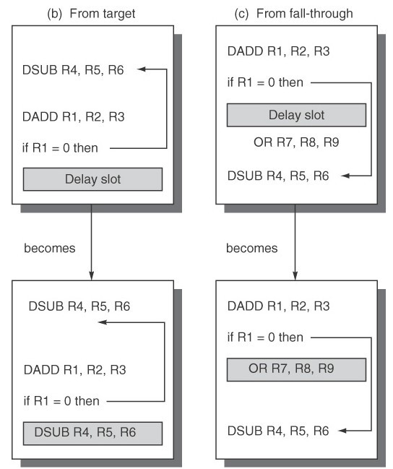
Delayed
Branch
If the optimal is not available:
Act like predict-taken
(in complier way)
Act like predict-untaken (in complier way)

Slide 36
Delayed Branch
Delayed Branch is limited by
the restrictions on the instructions that are scheduled into the delay slots (for example: another branch cannot be scheduled)
our ability to predict at compile time whether a branch is likely to be taken or not

Slide 37
Branch Prediction
A pipeline with branch prediction uses some additional logic to guess the outcome of a conditional branch instruction before it is executed

Slide 38
Branch Prediction
Various techniques can be used to predict whether a branch will be taken or not:
Prediction never taken
Prediction always taken
Prediction by opcode
Branch history table
The first three approaches are static: they do not depend on the execution history up to the time of the conditional branch instruction. The last approach is dynamic: they depend on the execution history.

Slide 39
Important Pipeline Characteristics
58
◻ Latency
◉
Time required for an instruction to propagate through the pipeline
Based on the Number of Stages * Cycle Time Dominant if there are lots of exceptions / hazards, i.e.
◉
◉
we have to constantly be re-filling the pipeline
◻ Throughput
◉
◉
The rate at which instructions can start and finish Dominant if there are few exceptions and hazards, i.e.
the pipeline stays mostly full
◻ Note we need an increased memory bandwidth over the non-pipelined processor

Slide 40
Exceptions
59
◻ An exception is when the normal execution order of instructions is changed. This has many names:
◉
◉
◉
Interrupt Fault Exception
◻ Examples:
◉
◉
◉
◉
◉
◉
◉
I/O device request Invoking OS service Page Fault Malfunction Undefined instruction
Overflow/Arithmetic Anomaly Etc!

Slide 41
Eliminating hazards- Pipeline
bubbling
Bub b ling the p ip e line , also known as
a p ip e line b re a k or a p ip e line s ta ll, is a method for preventing data, structural, and branch hazards from occurring.
instructions are fetched, control logic determines whether a hazard could/will occur. If this is true, then the control logic inserts NOPs into the pipeline. Thus, before the next instruction (which would cause the hazard) is executed, the previous one will have had sufficient time to complete and prevent the hazard.

Slide 42
No: of NOPs = stages in pipeline
◻ If the number of NOPs is equal to the number of stages in the pipeline, the processor has been cleared of all instructions and can proceed free from hazards. All forms of stalling introduce a delay before the processor can resume execution.

