Slide 1





DESIGN & ENGINEERING
BE-102

Slide 2





























































DESIGN ENGINEERING
Engineering design is a systematic, intelligent process in which engineers generate, evaluate, and specify solutions for devices, systems, or processes whose form(s) and function(s) achieve clients’ objectives and users’ needs while satisfying a specified set of constraints.
OR
In other words, engineering design is a thoughtful process for generating plans or schemes for devices, systems, or processes that attain given objectives while adhering to specified constraints.

Slide 3

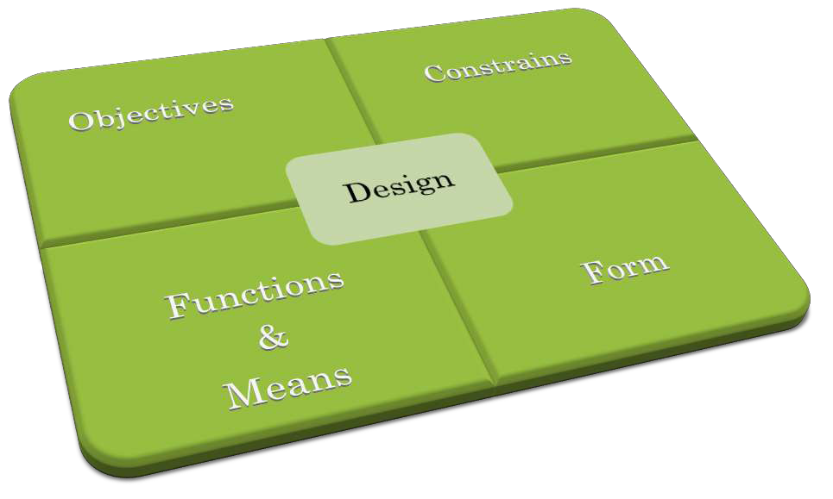
ASPECTS OF DESIGN

Slide 4

DESIGN OBJECTIVES
A feature or behaviour that we whish the design to have or exhibit
It defining the requirements of a design
Objectives, or design goals, are the desired attributes of the design, what the design will "be" and what qualities it will have.
Objectives allow exploration of the design space to select amongst alternatives that are at least acceptable or satisfice

Slide 5
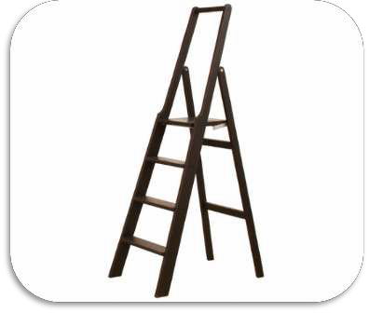

OBJECTIVES OF DESIGNING A PORTABLE
LADDER
❖Ladder should be compact and portable
❖It should be stable on smooth surfaces
❖Should stand safely without a support
❖Can be used for house hold requirements
❖Should be reasonably stiff and comfortable for users
❖Must be safe and durable
❖Should be relatively economical
❖Should be reduce space requirements while packing by means of detachable parts
❖The ladder should be marketable
❖Useful for electrical and maintenance work

Slide 6


































































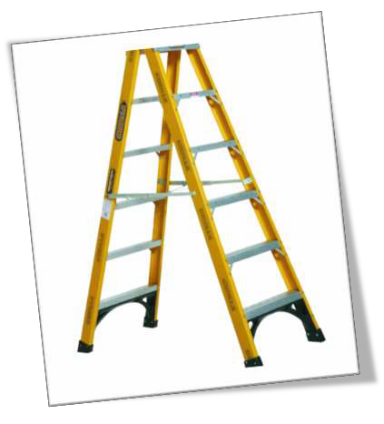
Objectives are normally expressed as adjectives that capture what the design should be, as opposed to what the design should do. For example, saying that a ladder should be portable or lightweight expresses an attribute that the client wants the ladder to have.
These features and behaviours, expressed in the natural languages of the client and of potential users, make the object “look good” in the eyes of the client or user.

Slide 7

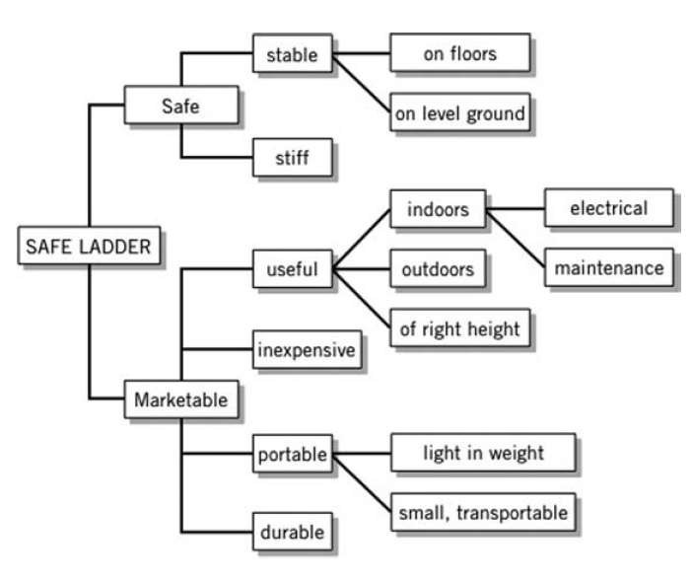
OBJECTIVE TREE
Objectives are depended and interconnected hence it can be arranged in an hierarchy with parent node followed by second stage objectives

Slide 8
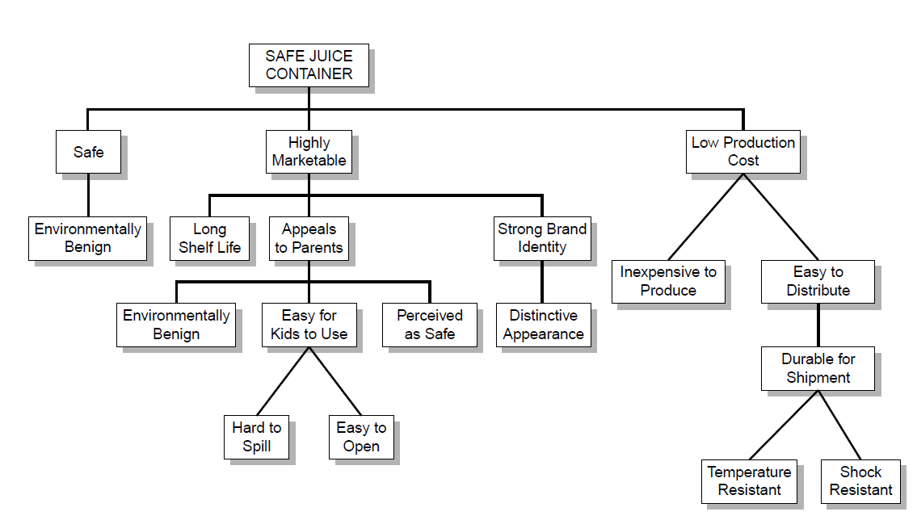
Objective tree to design a juice container

Slide 9

















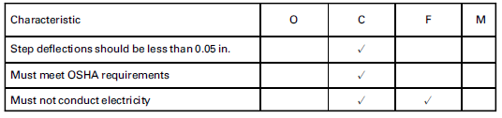
DESIGN CONSTRAINS
a limit or restriction on the design’s behaviours or attributes
Constraints are typically framed as a binary yes-or-no choice
Constraints are important to the design process because they limit the size of a design space by forcing the designer to meet a well defined set of requirements
Constraints enable us to reject unacceptable alternatives, while objectives enable
us to select among design alternatives that are at least acceptable

Slide 10
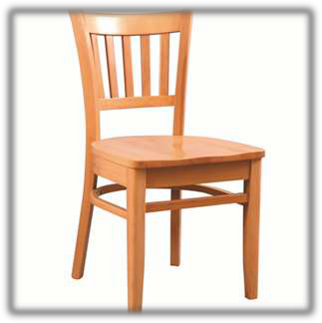

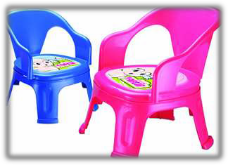




Constrains establish the Design
Space
Develop a accounting software which executable on Microsoft Windows with hardware support of 2GB RAM, 32 bit &
1.7 GHz Clock speed
Design a 1-BHK apartment within 50 m²
Designed for babies constrained to support load up to 15 kg
Design a DC motor which able to runs at 100 rpm along 1kg loading
Designed for adults constrained to support up to 150 kg
Design a resistor which offer a resistance of 100 Ω and capacitor which produce a capacitance of 50 𝜇𝐹
Constrains are fixed under the consideration of factor of safety (FOS), Standardisation, Customer requirements, Cost, Market etc.

Slide 11




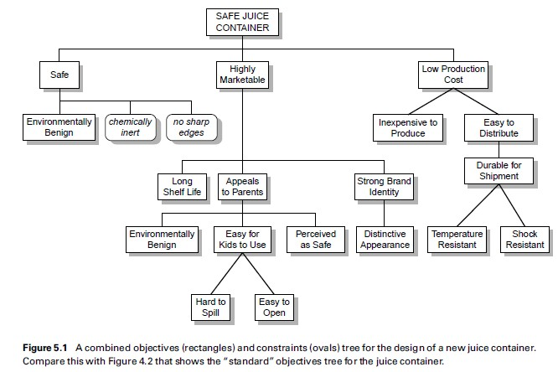
OBJECTIVE-CONSTRAIN TREE

Slide 12



DESIGN FUNCTIONS
Those things a designed device or system is supposed to do
Functions are the behaviours that expected from the design
A design should perform certain functions for convert given input to required output
Functions are often expressed as verb-object pairs.
They describe what the design (or, more likely, an object within the design) will "do" or
accomplish, with an emphasis on input-output transformations
The statement of a function typically couples an action verb to a noun or object:
Eg: lift a book, support a shelf, transmit a current, measure a temperature, or
switch on a light

Slide 13
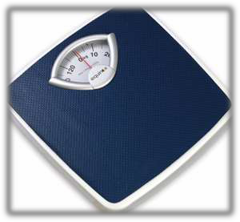
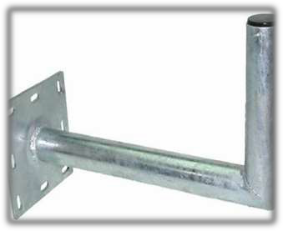

Measure weight of objects up to 120 kg
Support weight up to 70 kg Hold on wall without failure
Control pointer on a computer

Slide 14




Function s
Primary Functions
Secondary Functions
Desirable
Undesirable

Slide 15





Project Images
(Primary/Basic Function)
Converting Energy
(Secondary function)
Secondary functions are prerequisites
Generation of Light
(Desirable)
Generation of Heat
(Undesirable)

Slide 16

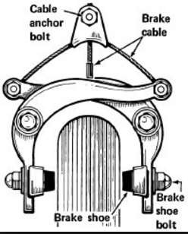
DESIGN MEANS
It is the way in which a design executes a desired function
Eg:
The function of a bicycle brake is stop the wheel when applying the brake lever by means of frictional force between rim and brake pad

Slide 17

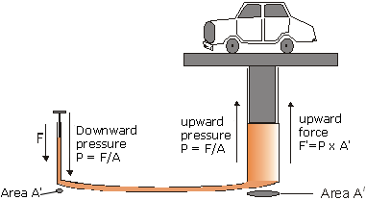
The function of a speaker is to produce sound by means of electro magnetic induction
The function of a hydraulic lift is to elevate heavy weight by means of pascals law

Slide 18


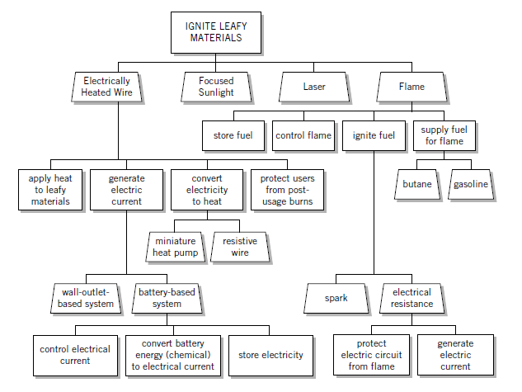
FUNCTION-MEAN TREE
Design Functions
Design Means

Slide 19
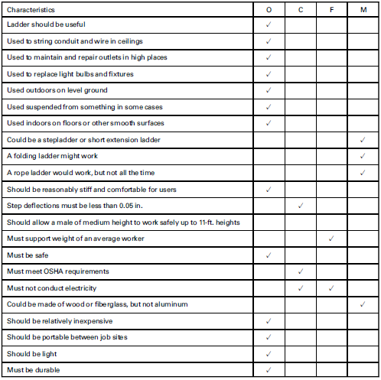
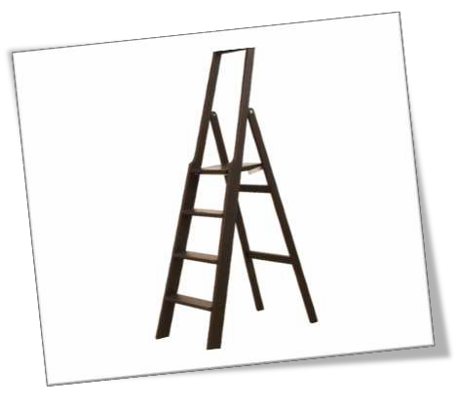
Design aspects of a ladder

Slide 20

Objectives ? Constrains ? Functions ?
Means ?

Slide 21
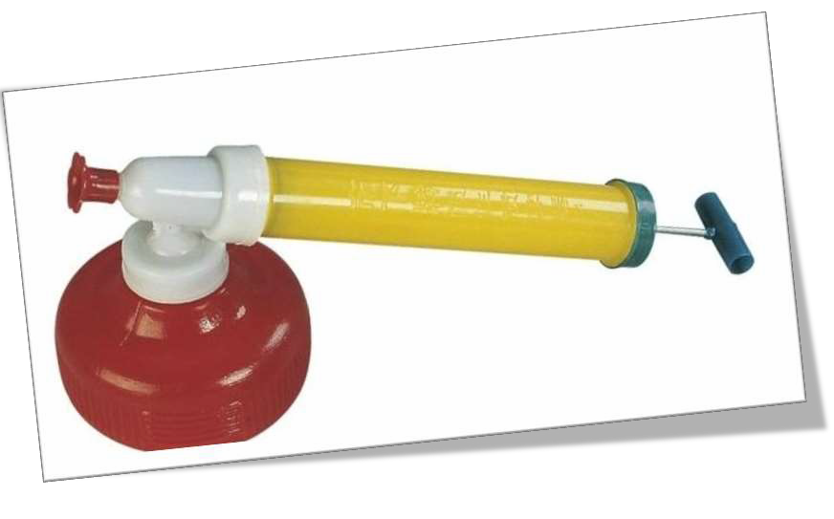
Objectives ? Constrains ? Functions ?
Means ?

Slide 22
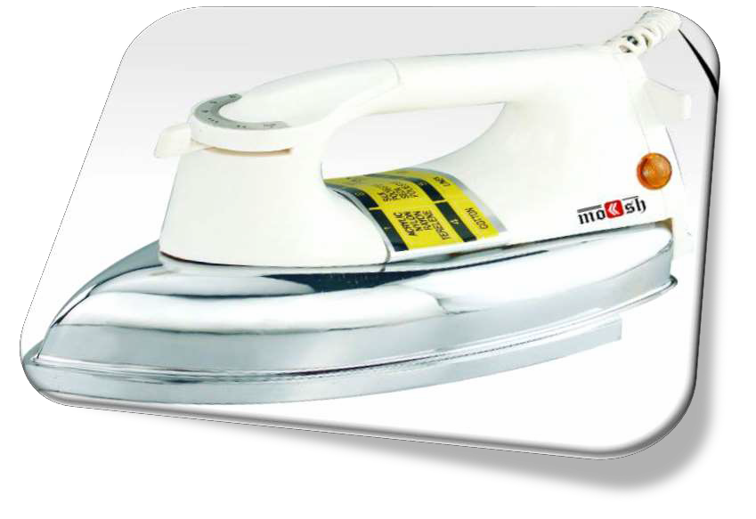
Objectives ? Constrains ? Functions ?
Means ?

Slide 23











DESIGN FORM
Form is the shape of a design
The design procedure starts from its form
This has not much to do with the function
Most of the time Form determines the aesthetics and ergonomics of
a product
For the same function the shape could be different.

Slide 24

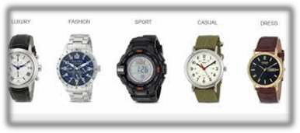
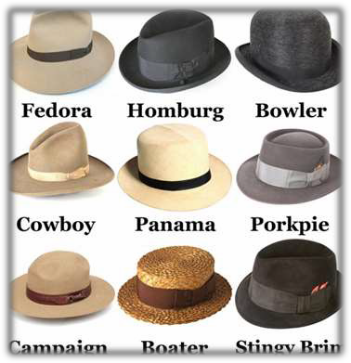
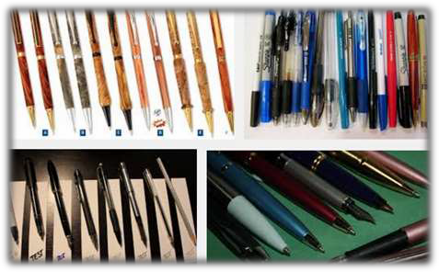
Designs with same Functions but
different Form

Slide 25
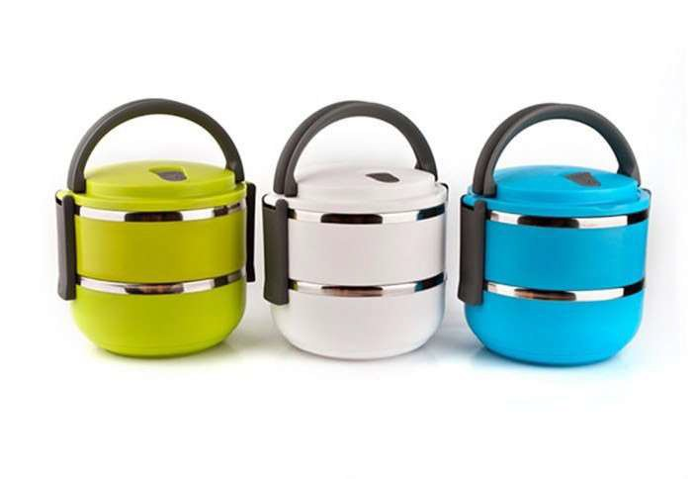
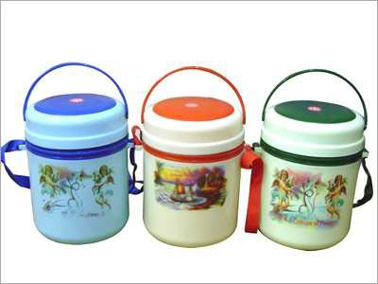

Form determines the Aesthetics

Slide 26
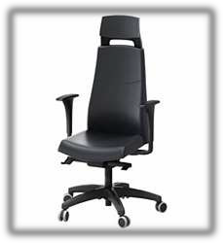

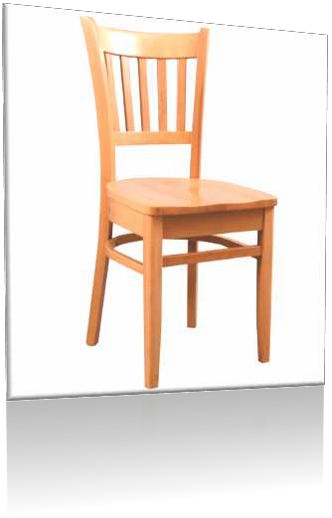


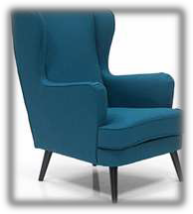
Form determines Ergonomics

Slide 27

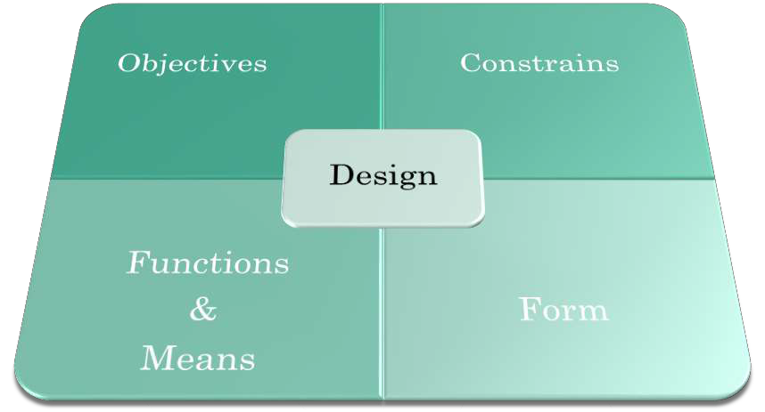
ASPECTS OF DESIGN

Slide 28


STRENGTH DESIGN
quality or state of being physically strong
In strength based designs ‘STRENGTH’ has higher priority than any other desig considerations…..

Slide 29






STRENGTH BASED DESIGNS
Strength is the quality or state of being physically strong
In Design theories strength usually deals with capacity to bear load
In general strength of a design is the capacity to full fill its functions
A designed member usually undergoes varieties of loading conditions as per the
requirements, hence to sustain these designs the member has to be strong enough
The importance of strength become crucial in designs which deals with high loading conditions
In order to prevent failure, the strength of a member has to be greater than the induced stress
on that member
Strength of a design depends up on the material properties, size, geometry, design
refinement, design pattern etc.

Slide 30
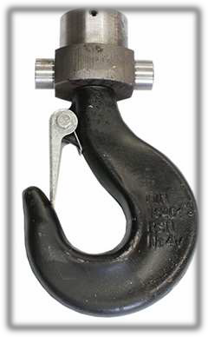
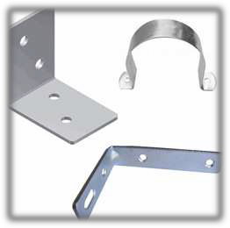

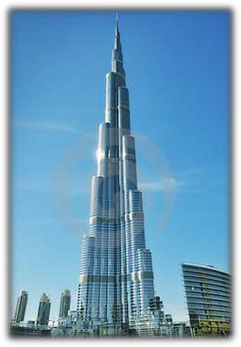

Strength priority designs

Slide 31
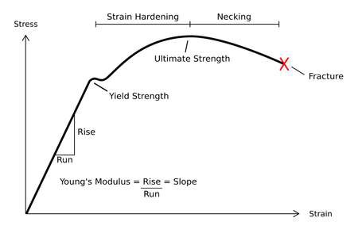
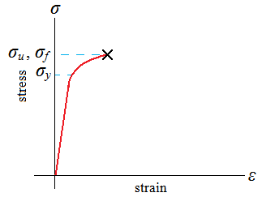
Stress &
Strain
Ductile Material Brittle Material
Stress-Strain diagrams used to determine the strength of materials

Slide 32
Factor of Safety (FOS)
Structural capacity of a system beyond the expected loads or actual loads
�𝒂����𝒂𝒍 𝑺�������
𝑭𝑶𝑺 =
𝑫����� ��𝒂�
Design load being the maximum load the part should ever see in service
By this definition, a structure with a FOS =1 will support only the design load and no more
Any additional load will cause the structure to fail. A structure with a FOS=2 will fail at twice the design load
Hence FOS fixed based on the safety requirements

Slide 33


DOWNLOAD SLIDES
www.slideshare.net/naseelazeeniya

Slide 34


