Slide 1
Introduction to Computer Organization

Slide 2
Chapter Outline
System Organization
CPU Organization
Memory Organization and Interfacing
I/O Organization and Interfacing
Relatively Simple Computer
8085-based Computer

Slide 3
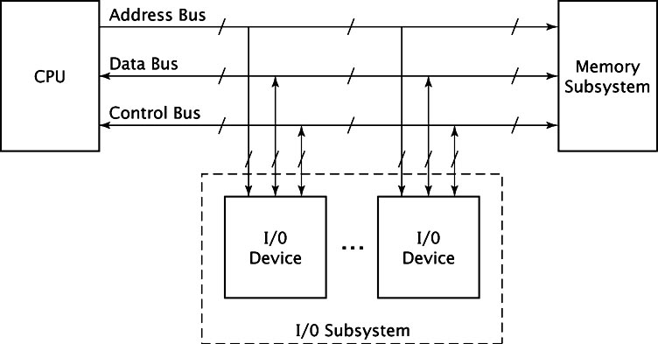
Basic Computer Organization

Slide 4
System Components
CPU/Microprocessor
Memory Subsystem
I/O Subsystem

Slide 5
System Buses
Address Bus
Data Bus
Control Bus

Slide 6
Instruction Cycle
Fetch
Decode
Execute

Slide 7
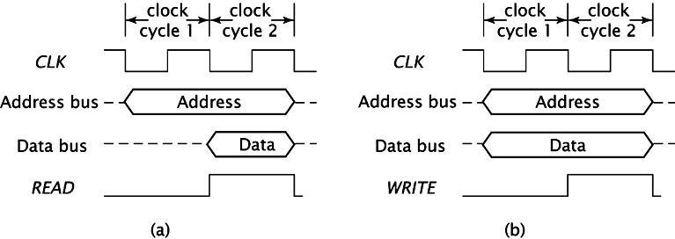
Instruction Fetch

Slide 8
Types of I/O Organization
Isolated I/O
Memory-mapped I/O

Slide 9
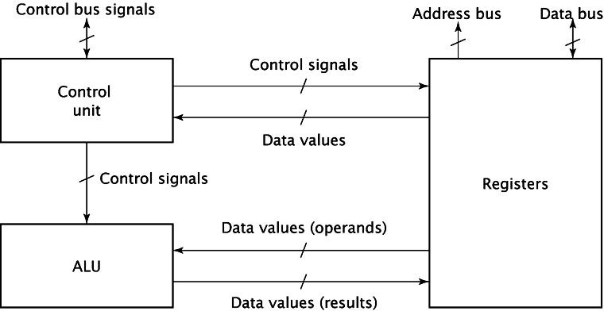
CPU Organization

Slide 10
Types of Memory
Static RAM
Dynamic RAM
ROM
PROM
EPROM
EEPROM

Slide 11
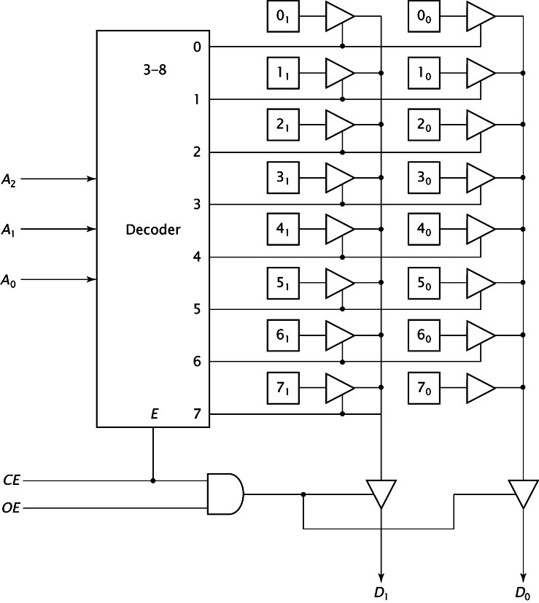
Memory Chip Organization - Linear

Slide 12
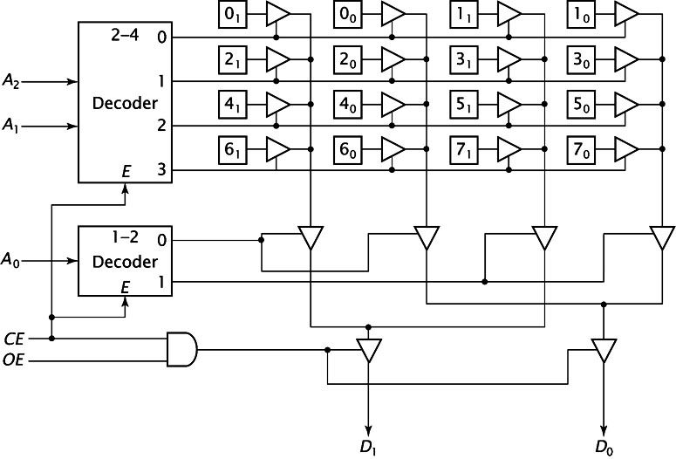
Memory Chip Organization - Two Dimensional

Slide 13
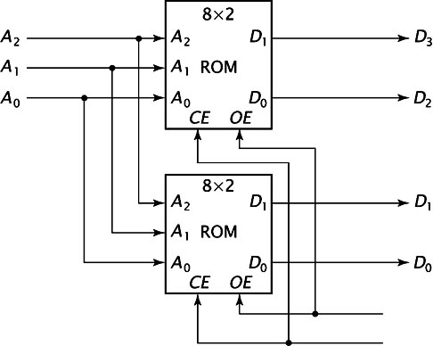
Combining Memory Chips to Increase Word Size

Slide 14
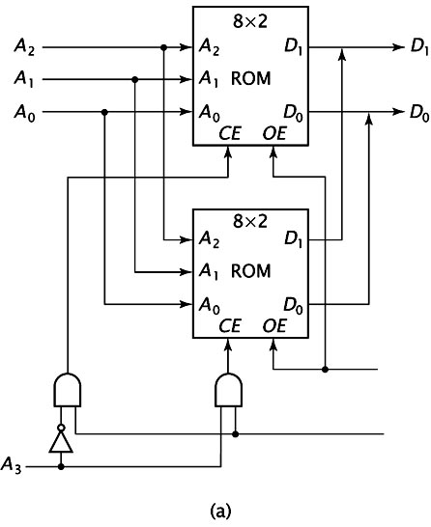
Combining Memory Chips to Increase Address Space

Slide 15
Low-order Interleaving

Slide 16
von Neumann Architecture
Instructions and data mixed
Used in modern computers

Slide 17
Harvard Architecture
Instructions and data separate
Used in low-level cache memory design

Slide 18
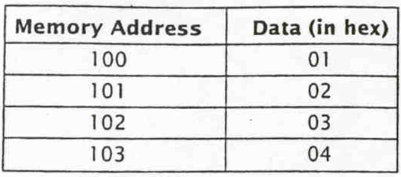
Big Endian Data Organization
Most significant byte first

Slide 19
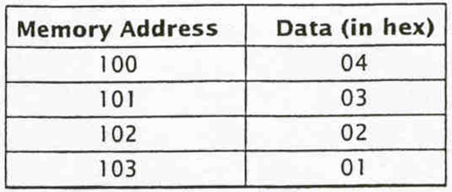
Little Endian Data Organization
Least significant byte first

Slide 20
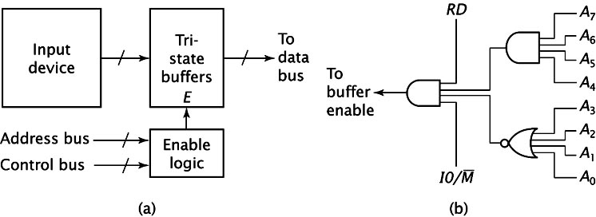
Input Device Organization

Slide 21
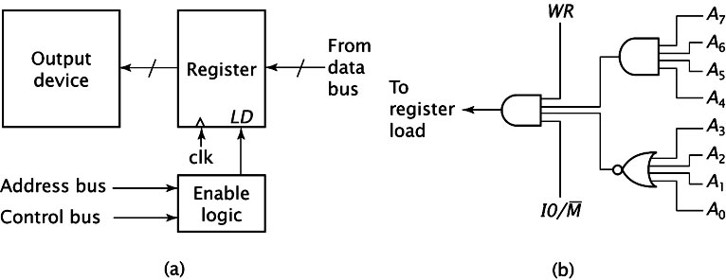
Output Device Organization

Slide 22
Bidirectional I/O Device Organization

Slide 23
I/O Interface Enhancements
READY signal
Interrupts
DMA

Slide 24
Relatively Simple Computer Specifications
Relatively Simple CPU
8K ROM starting at 0000H
8K RAM starting at 2000H
Memory-mapped, bidirectional I/O port at 8000H

Slide 25
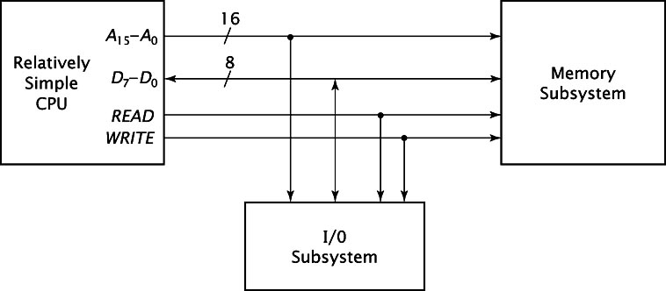
Relatively Simple Computer Organization - CPU Details

Slide 26
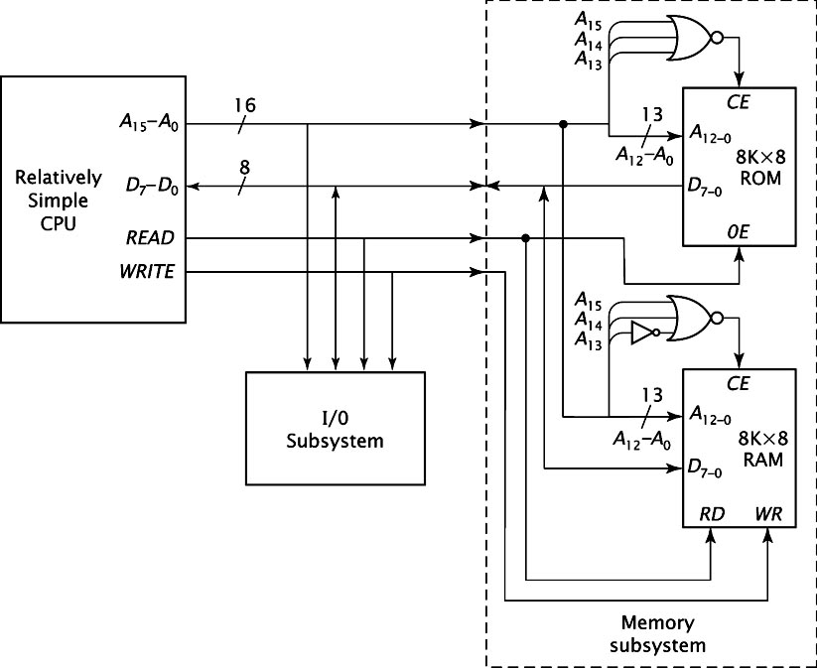
Relatively Simple Computer Organization - Memory Details

Slide 27
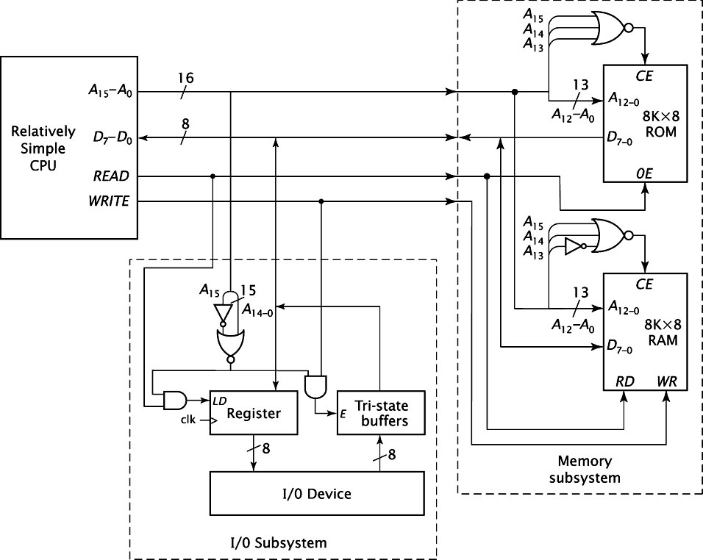
Relatively Simple Computer Organization - Final Design

Slide 28
INCLUDE EXTERNAL ANIMATION FROM JAVA SIMULATOR HERE

Slide 29
8085-based Computer Specifications
2K EPROM starting at 0000H
256 bytes RAM starting at 2000H
Four 8-bit I/O ports at 00H, 01H, 19H, and 1AH
One 6-bit I/O port at 1BH

Slide 30
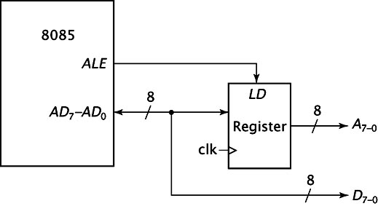
Demultiplexing the AD signals

Slide 31
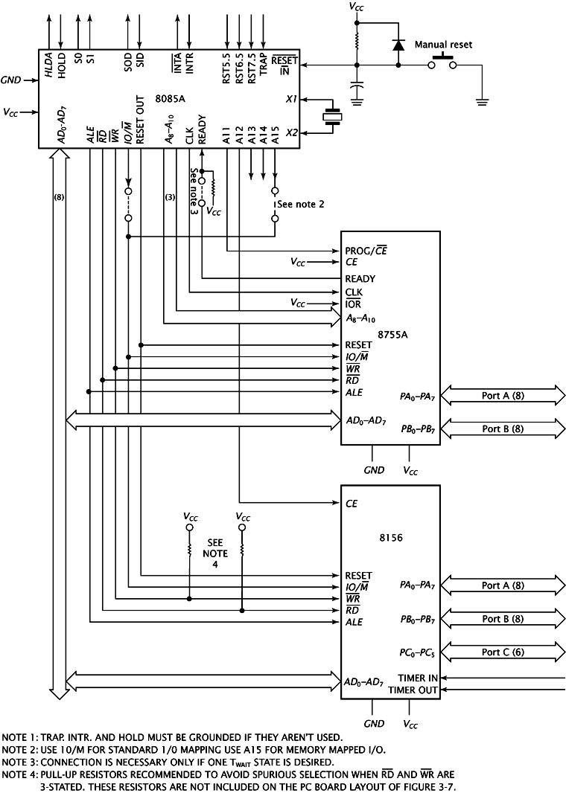
8085-based Computer Organization

Slide 32
Summary
Basic Computer Organization
CPU Organization
Memory Chip Internal Organization
Memory Subsystem Organization
I/O Port Organization and Interfacing

