Slide 1
Flynn’s Classification Of Computer
Architectures
■
In 1966, Michael Flynn proposed a classification for computer architectures based on the number of instruction steams and data streams (Flynn’s Taxonomy).
■
Flynn uses the stream concept for describing a machine's structure
■
A stream simply means a sequence of items (data or instructions).
■
The classification of computer architectures based on the number of instruction steams and data streams (Flynn’s Taxonomy).

Slide 2
Flynn Classification Of
Computer architectures
Flynn’s Taxonomy
■
SISD: Single instruction single data
– Classical von Neumann architecture
SIMD: Single instruction multiple data
MISD: Multiple instructions single data– Non existent, just listed for completeness
MIMD: Multiple instructions multiple data – Most common and general parallel machine
■
■
■

Slide 3
SISD
■
SISD (Singe-Instruction stream, Singe-Data stream)
■
SISD corresponds to the traditional mono- processor ( von Neumann computer). A single data stream is being processed by one
instruction stream
OR
■
A single-processor computer (uni-processor) in which a single stream of instructions is generated from the program.

Slide 4
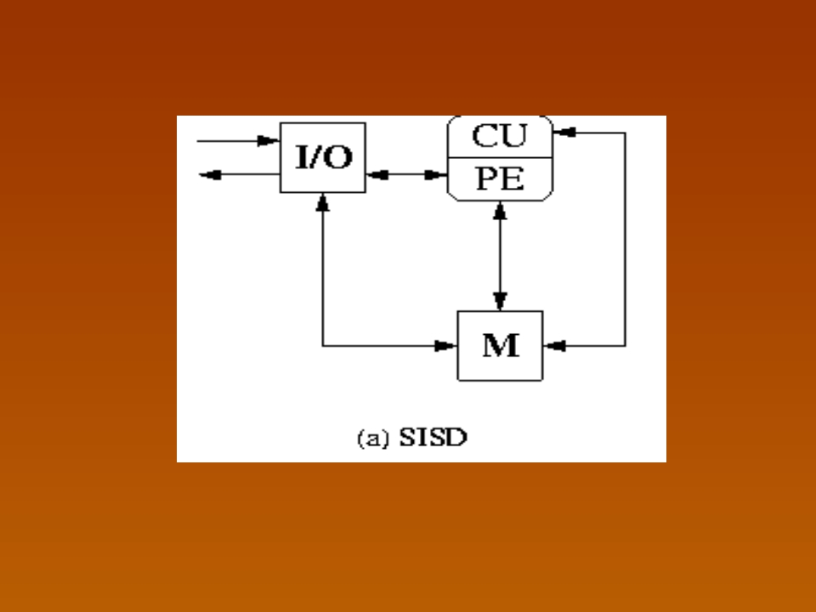
SISD
where CU= Control Unit, PE= Processing Element, M= Memory

Slide 5
SIMD
■
SIMD (Single-Instruction stream, Multiple- Data streams)
■
Each instruction is executed on a different set of data by different processors i.e multiple processing units of the same type process on multiple-data streams.
■
This group is dedicated to array processing machines.
■
Sometimes, vector processors can also be seen as a part of this group.

Slide 6
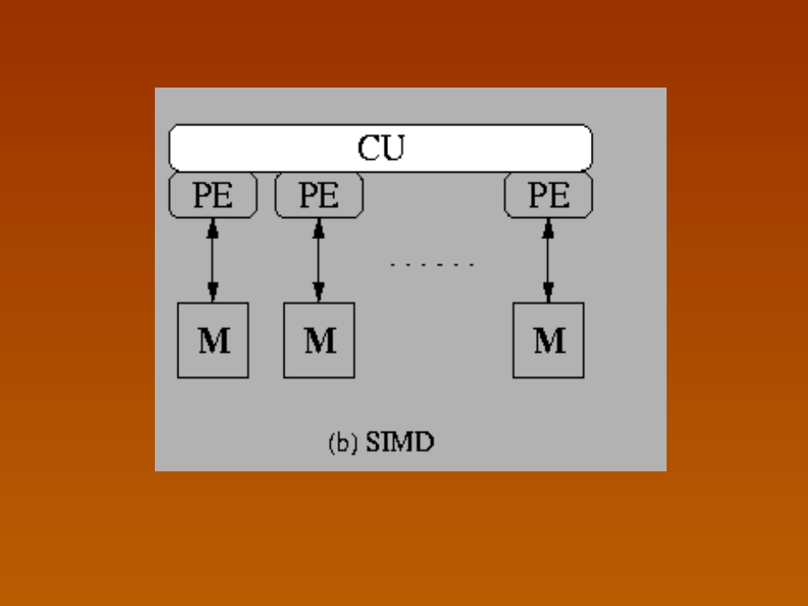
SIMD
where CU= Control Unit, PE= Processing Element, M= Memory

Slide 7
MISD
■
MISD (Multiple-Instruction streams, Singe- Data stream)
■
Each processor executes a different sequence of instructions.
■
In case of MISD computers, multiple processing units operate on one single-data stream .
■
In practice, this kind of organization has never been used

Slide 8
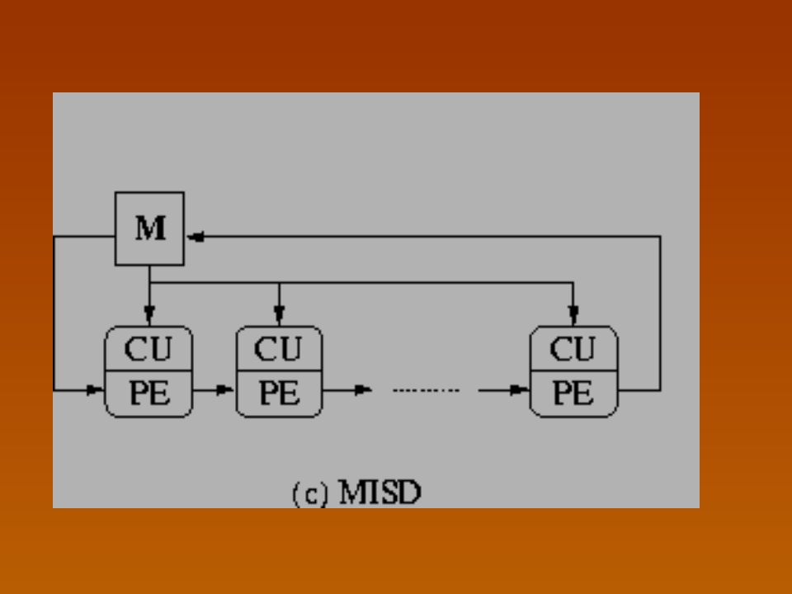
MISD
where CU= Control Unit, PE= Processing Element, M= Memory

Slide 9
MIMD
■
MIMD (Multiple-Instruction streams,
Multiple- Data streams)
■
Each processor has a separate program.
■
An instruction stream is generated from each program.
■
Each instruction operates on different data. This last machine type builds the group for the traditional multi-processors. Several processing units operate on multiple-data streams.
■

Slide 10
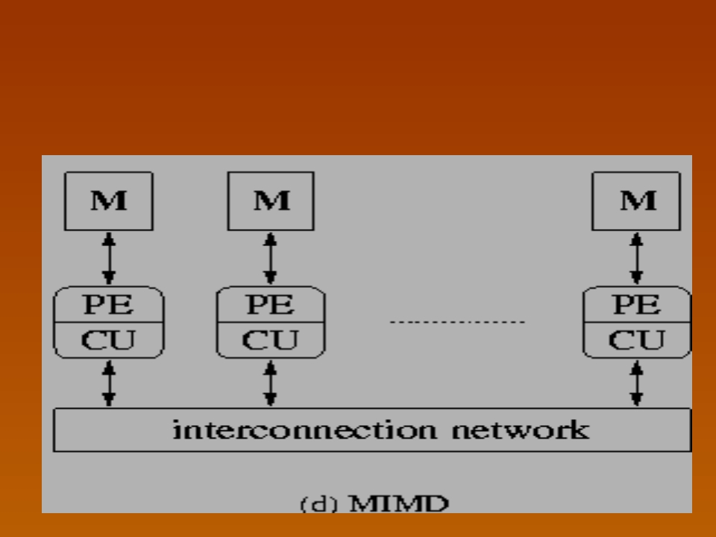
MIMD Diagram

