Slide 1
Paging

Slide 2
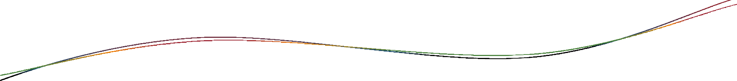



Virtual Memory
Background
Demand Paging
Copy-on-Write
Page Replacement
Allocation of Frames
Thrashing
Operating-System Examples

Slide 3

Objectives
To describe the benefits of a virtual memory system
To explain the concepts of demand paging, page-replacement algorithms, and allocation of page frames
To discuss the principle of the working-set model

Slide 4
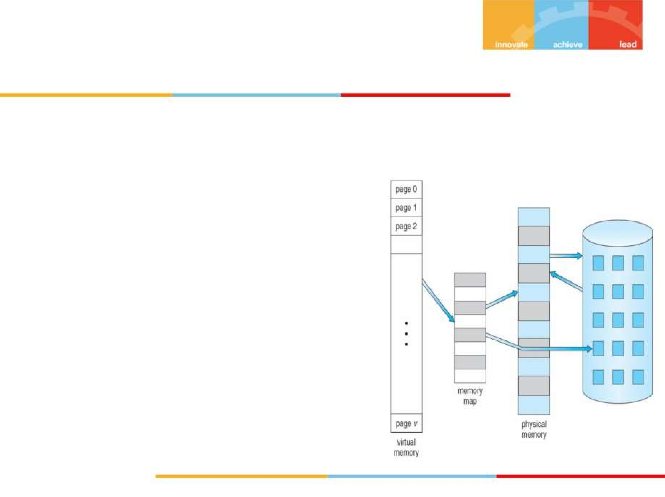

Background
Virtual memory - separation of user logical memory from physical memory.
  Only part of the program needs to be in
memory for execution
  Logical address space can therefore be
much larger than physical address space
  Allows address spaces to be shared by several processes
Virtual memory can be implemented via:
  Demand paging
  Demand segmentation

Slide 5
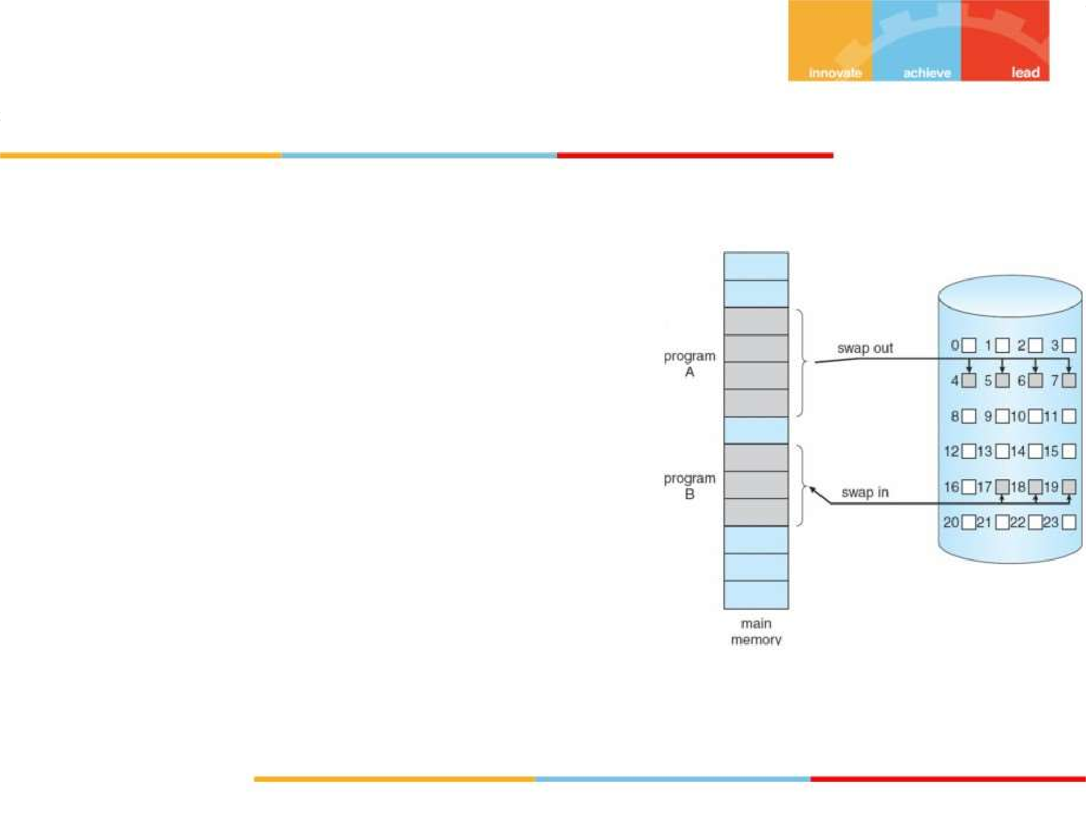

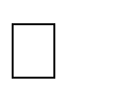
Demand Paging
Bring a page into memory only when it is needed
  Less I/O needed
  Less memory needed
  Faster response
  More users
Page is needed reference to it
Invalid reference
Not-in-memory
abort
bring to memory
Lazy swapper -never swaps a page into memory unless page will be needed- Swapper that deals with pages is a pager

Slide 6
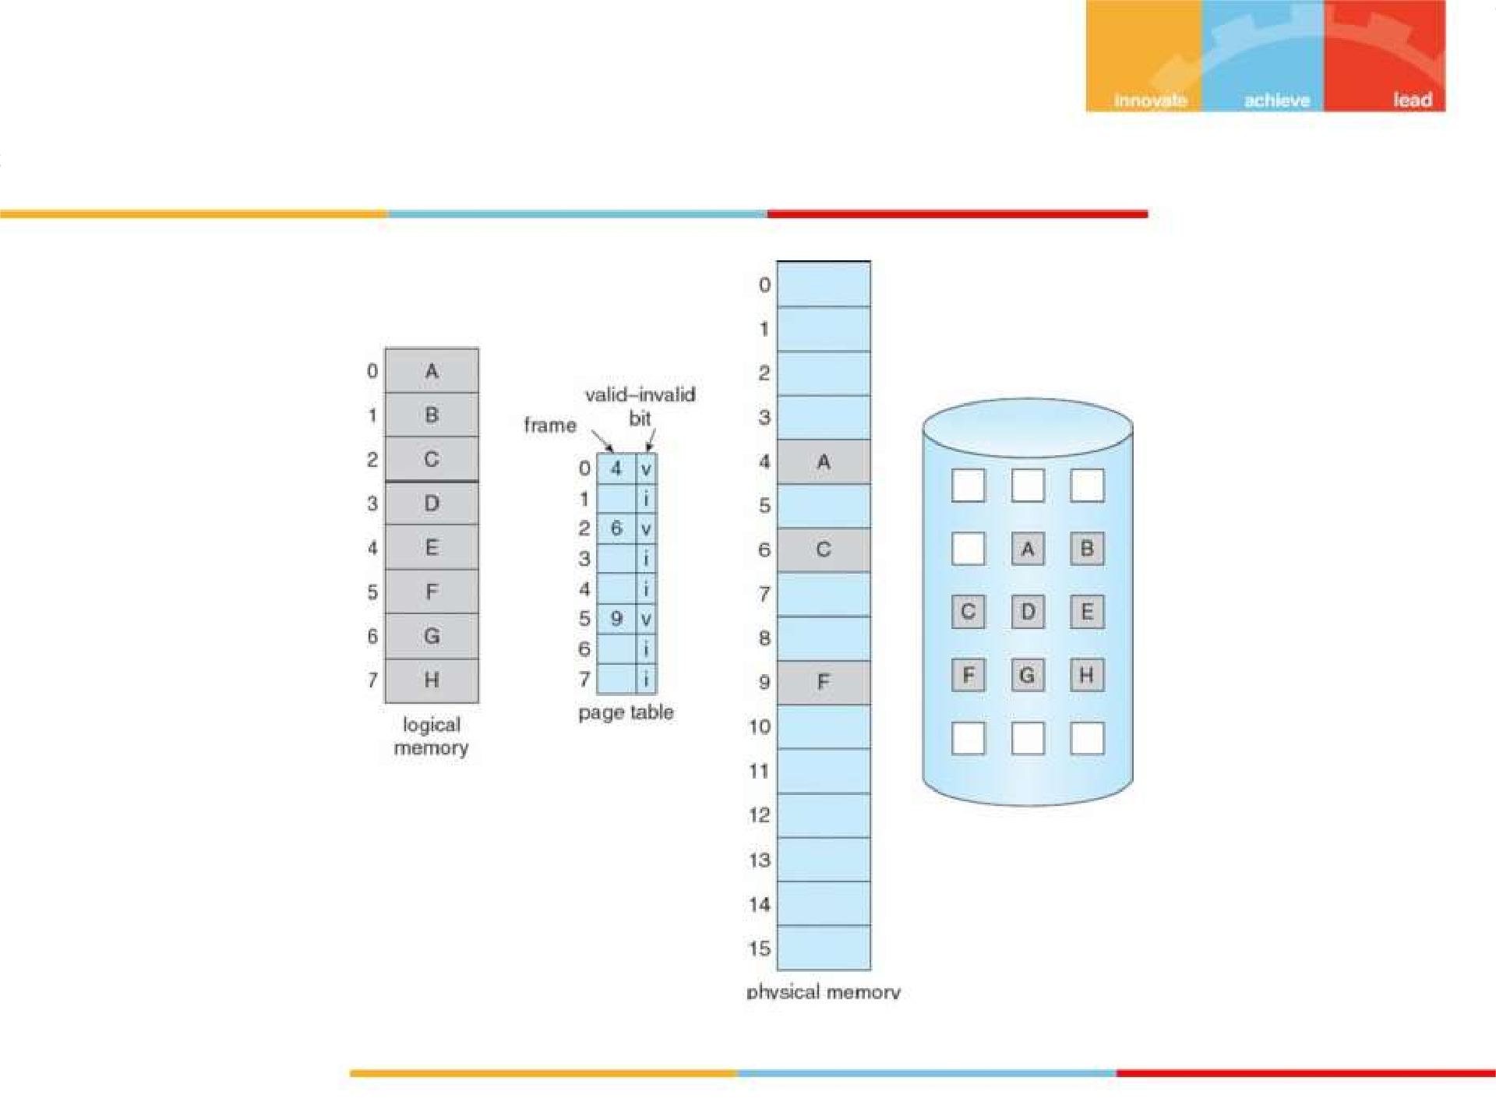

Page Table When Some Pages Are Not in Main Memory

Slide 7

Page Fault
If there is a reference to a page, first reference to that page will trap to operating system:
page fault
1. Operating system looks at another table to decide:
Get empty frame
Swap page into frame
Reset tables
Set validation bit = v
Restart the instruction that caused the page fault

Slide 8
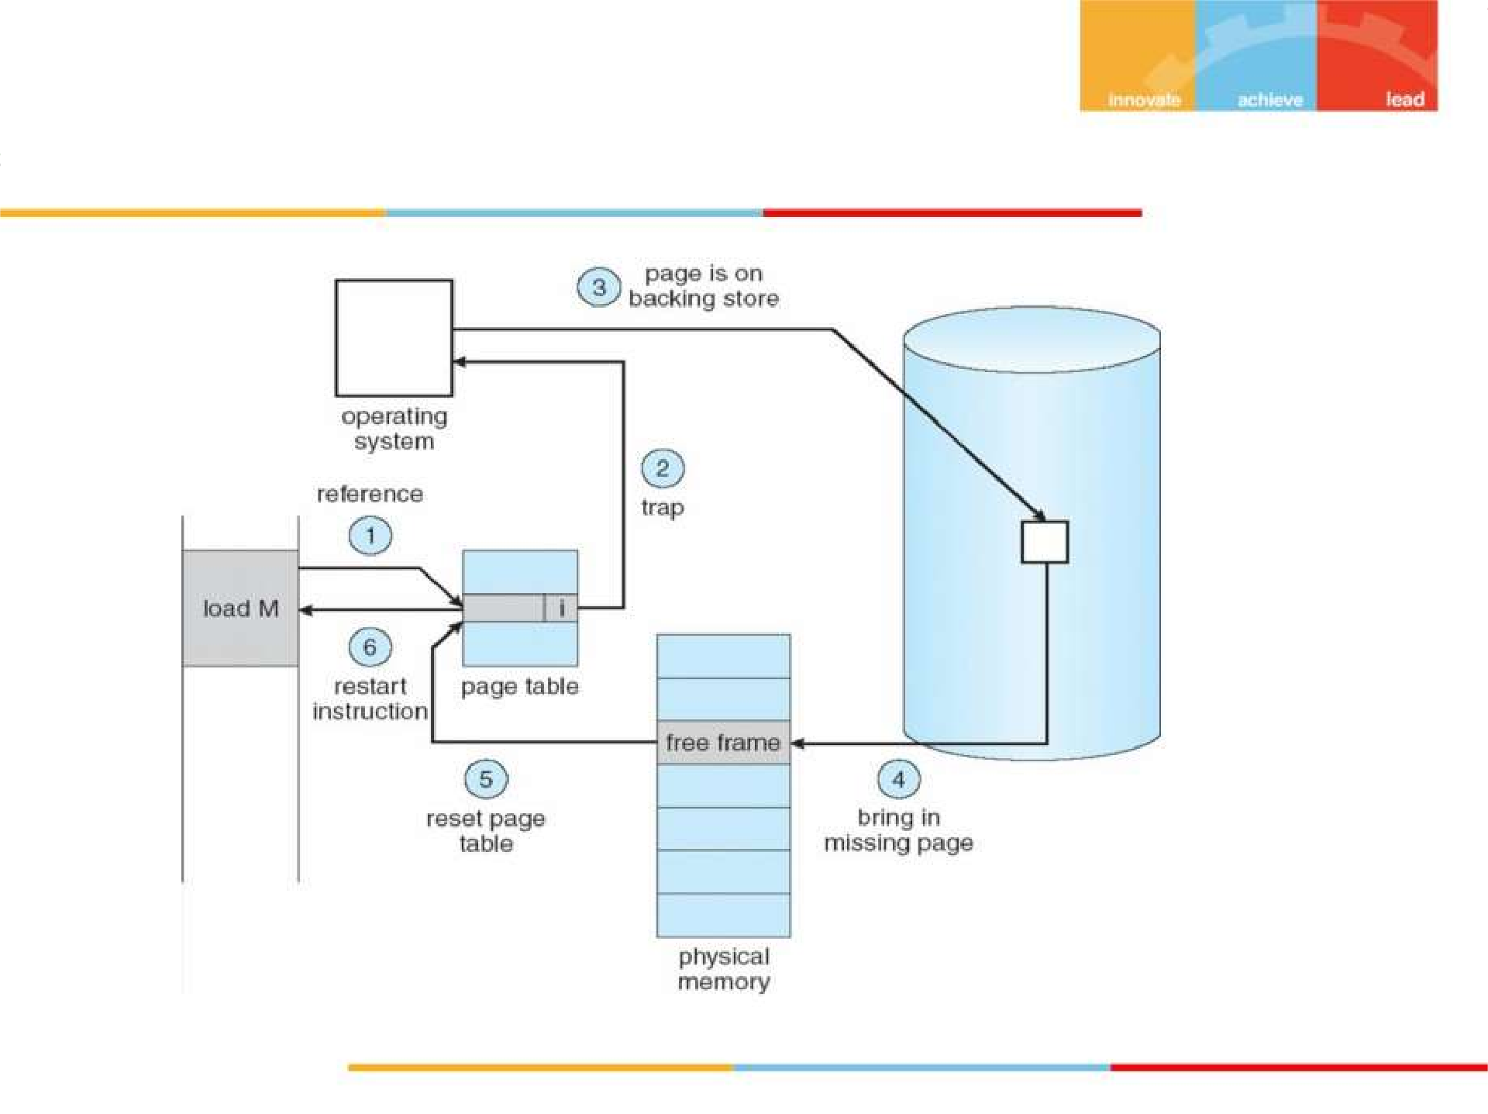



Slide 9




PURE DEMAND PAGING
We start executing a process with no pages in the memory. When the Operating System sets the instruction pointer to the first pointer instruction of the process, which is on a non memory resident page, the process immediately faults for the process. After this page is brought into the memory, the process continues to execute, faulting as necessary until every page that it needs is in memory.
At this point, it can execute with no more faults. This is Pure Demand Paging.

Slide 10












HARDWARE SUPPORT
The hardware to support demand paging is the same as the hardware for paging and swapping:
PAGE TABLE : This table has the ability to mark an entry invalid through a valid invalid bit or a special value of protection bits.
SECONDARY MEMORY : The memory holds those pages that are not present in the main memory. The secondary memory is usually a high speed disk.
It is known as Swap Device and the section of the disk used for this purpose is known as the Swap Space.

Slide 11

Performance of Demand Paging
Page Fault Rate 0 < p < 1.0
  if p = 0 no page faults
  if p = 1, every reference is a fault
Effective Access Time (EAT)
EAT = (1 - p) x memory access
+ p (page fault overhead
+ swap page out
+ swap page in
+ restart overhead)

Slide 12

Demand Paging Example
Memory access time = 200 nanoseconds
Average page-fault service time = 8 milliseconds
EAT = (1 - p) x 200 + p (8 milliseconds)
= (1 - p x 200 + p x 8,000,000
= 200 + p x 7,999,800
EAT is directly proportional to the page fault rate.

Slide 13

What happens if there is no free frame?
Page replacement - find some page in memory, but not really in use, swap it out
  Algorithm
  Performance - want an algorithm which will result in minimum number of page faults
Same page may be brought into memory several times

Slide 14

Page Replacement
Basic to demand paging
  When a user process executes and page fault occurs and there are no free frames in memory
    One choice for OS is to terminate the process
    Another choice is to swap out one process
    One frame is freed that is not currently being used… called Page Replacement
Page replacement completes separation between logical memory and physical memory - large virtual memory can be provided on a smaller physical memory

Slide 15






STEPS IN PAGE REPLACEMENT :
Find the location of the desired page on the disk.
Find a free frame :
If there is a free frame, use it.
If there is no free frame, use a page replacement algorithm to select a victim frame.
Write the victim frame to the disk, change the page and frame tables accordingly.
Read the desired page into the newly freed frame, change the page and frame tables.
Restart the user process.

Slide 16
Use modify (dirty) bit to reduce overhead of page transfers - only modified pages are written to disk

Slide 17
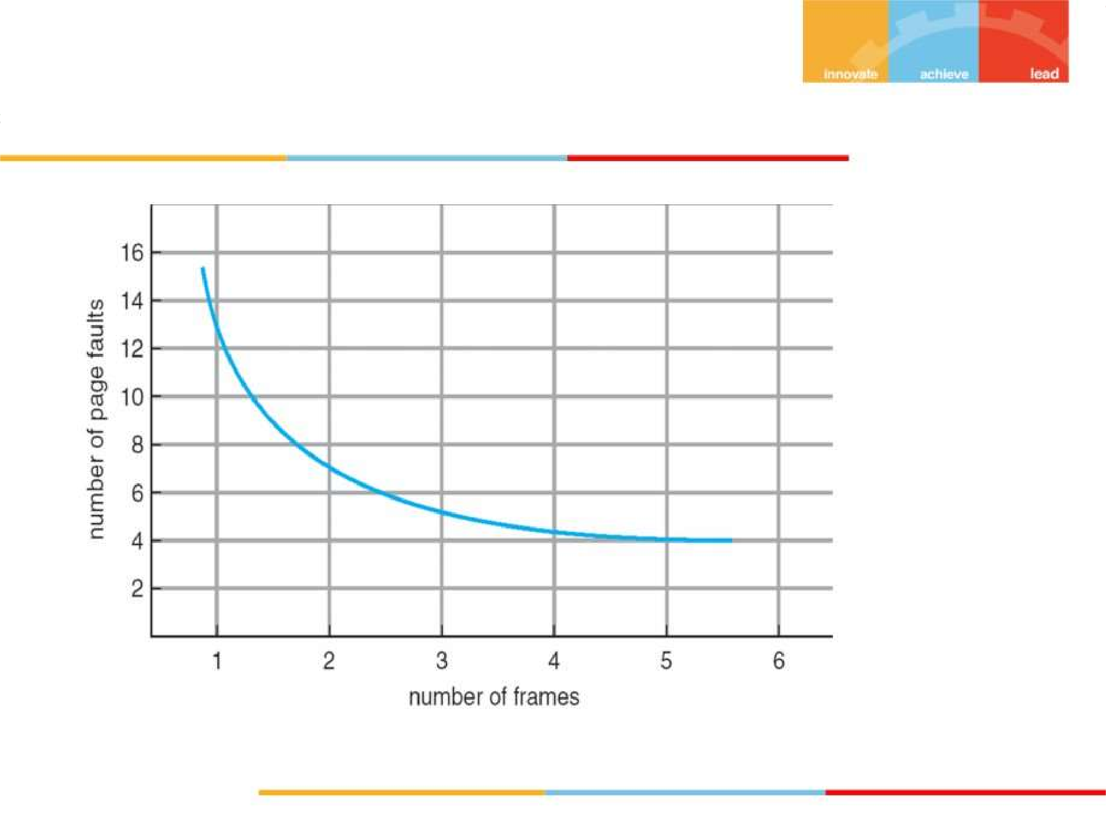




Slide 18


Want lowest page-fault rate
Evaluate algorithm by running it on a particular string of memory references (reference string) and computing the number of page faults on
that string
In all our examples, the reference string is
7,0,1,2,0,3,0,4,2,3,0,3,2,1,2,0,1,7,0,1

Slide 19
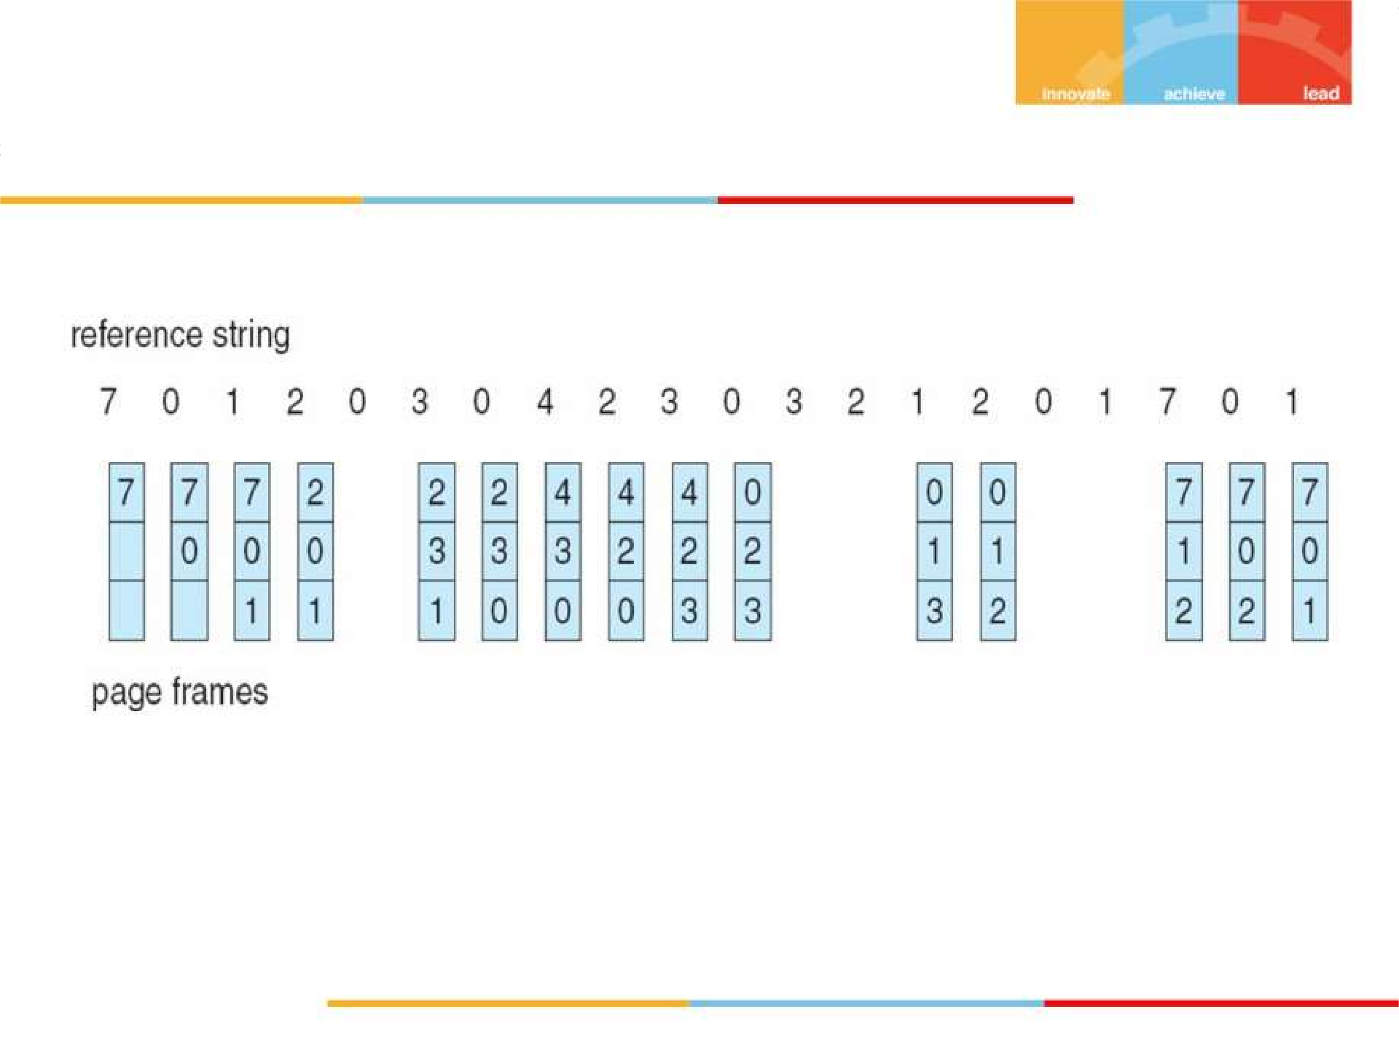



Slide 20
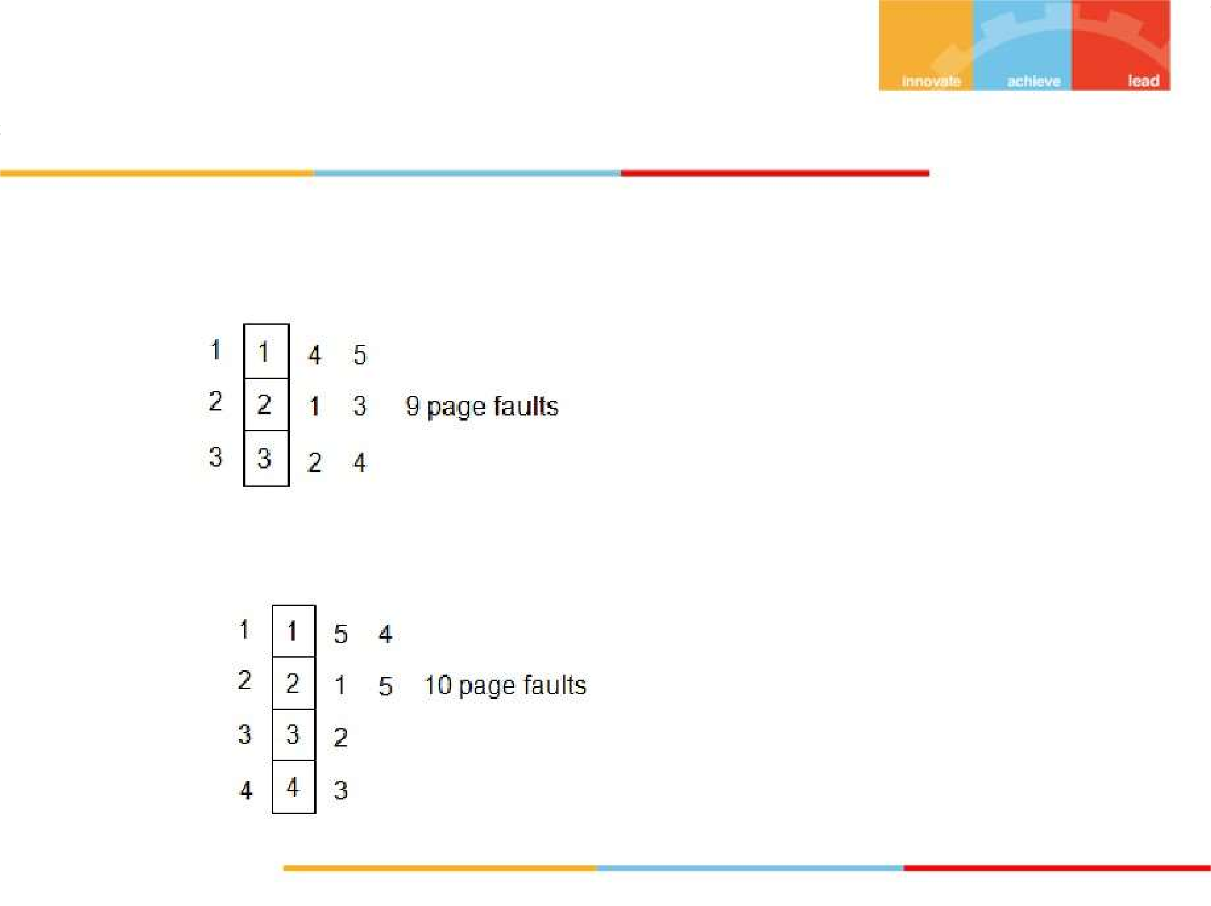






Reference string: 1, 2, 3, 4, 1, 2, 5, 1, 2, 3, 4, 5
3 frames (3 pages can be in memory at a time per process)
4 frames

Slide 21
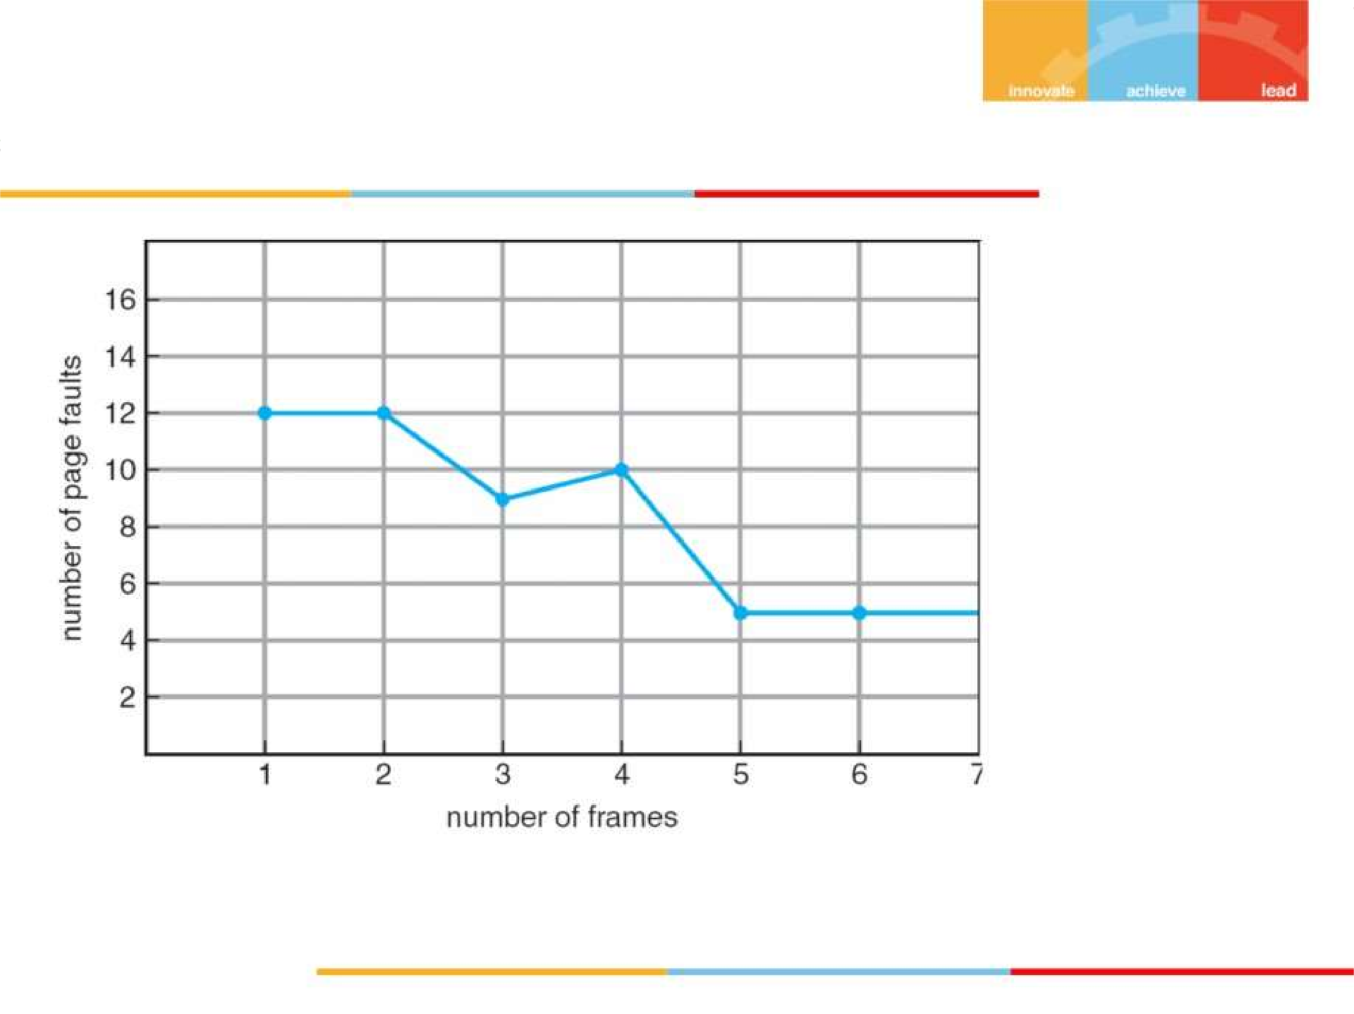





Slide 22
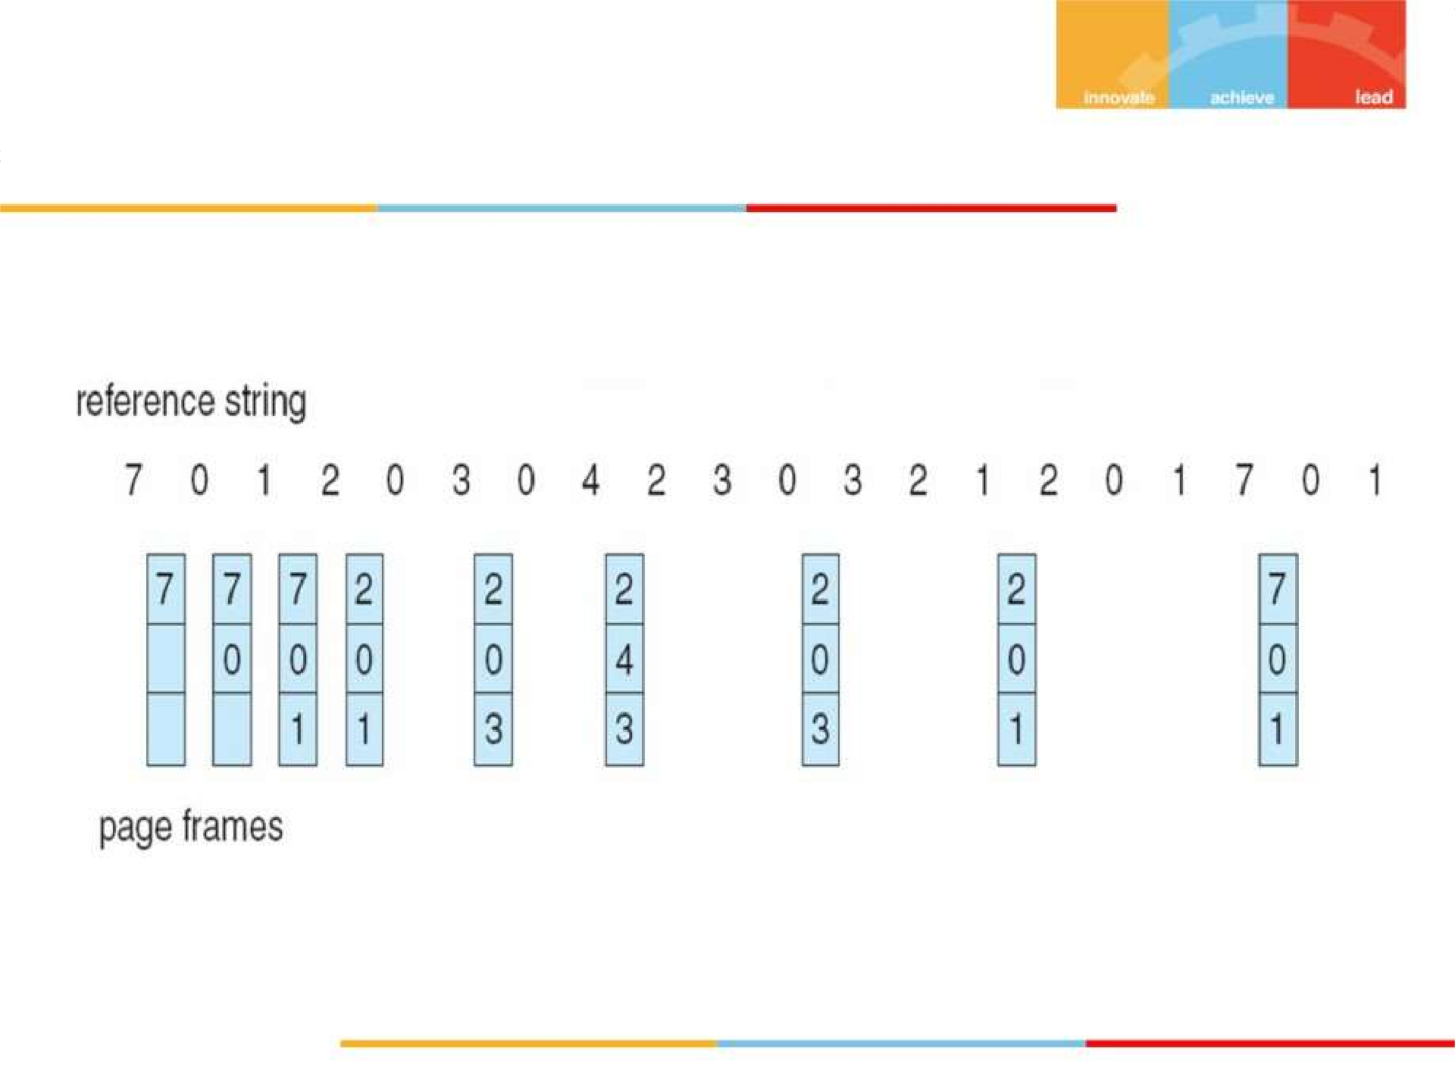

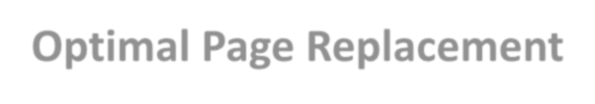
Replace page that will not be used for longest period of time
Unfortunately, the optimal page-replacement is difficult to implement, because it requires future knowledge of the reference string

Slide 23



LRU replacement associates with each page the time of that page’s last use
When a page must be replaced, LRU chooses the page that has not been used for the
longest period of time

Slide 24



Reference string: 1, 2, 3, 4, 1, 2, 5, 1, 2, 3, 4, 5
1
2
3
4
1
2
5
4
1
2
5
3
1 5
2 2
4 4
3 3

Slide 25


The major problem is how to implement LRU replacement:
  Counter: whenever a reference to a page is made, the content of the clock register are copied to the time-of-use field in the page table entry for the page. We replace the page with the smallest time value
  Stack: Whenever a page is referenced, it is
removed from the stack and put on the top. In this way, the most recently used page is always at the top of the stack

Slide 26
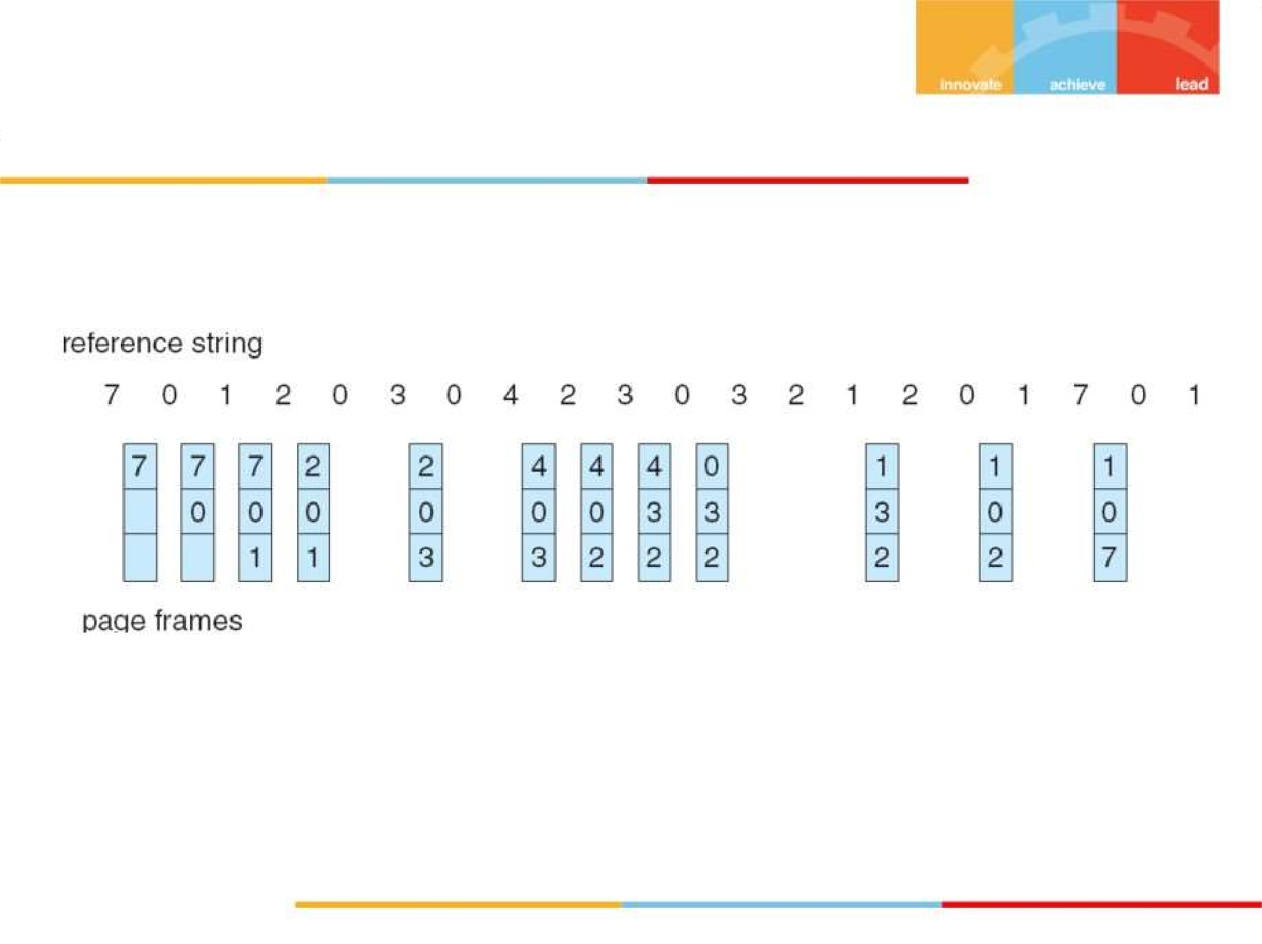



Slide 27


Second-Chance algorithm is actually a FIFO replacement algorithm with a small modification that causes it to
approximate LRU.
When a page is selected according to a FIFO order, we check its reference bit.
- If it is set (the page was referenced), we clear it and look for another page.
Also called the clock algorithm.
In the worst case, when all bits are set, the pointer cycles through all of the pages, giving each page a
second chance and clearing its bit.
Requires hardware support for reference bit.

Slide 28
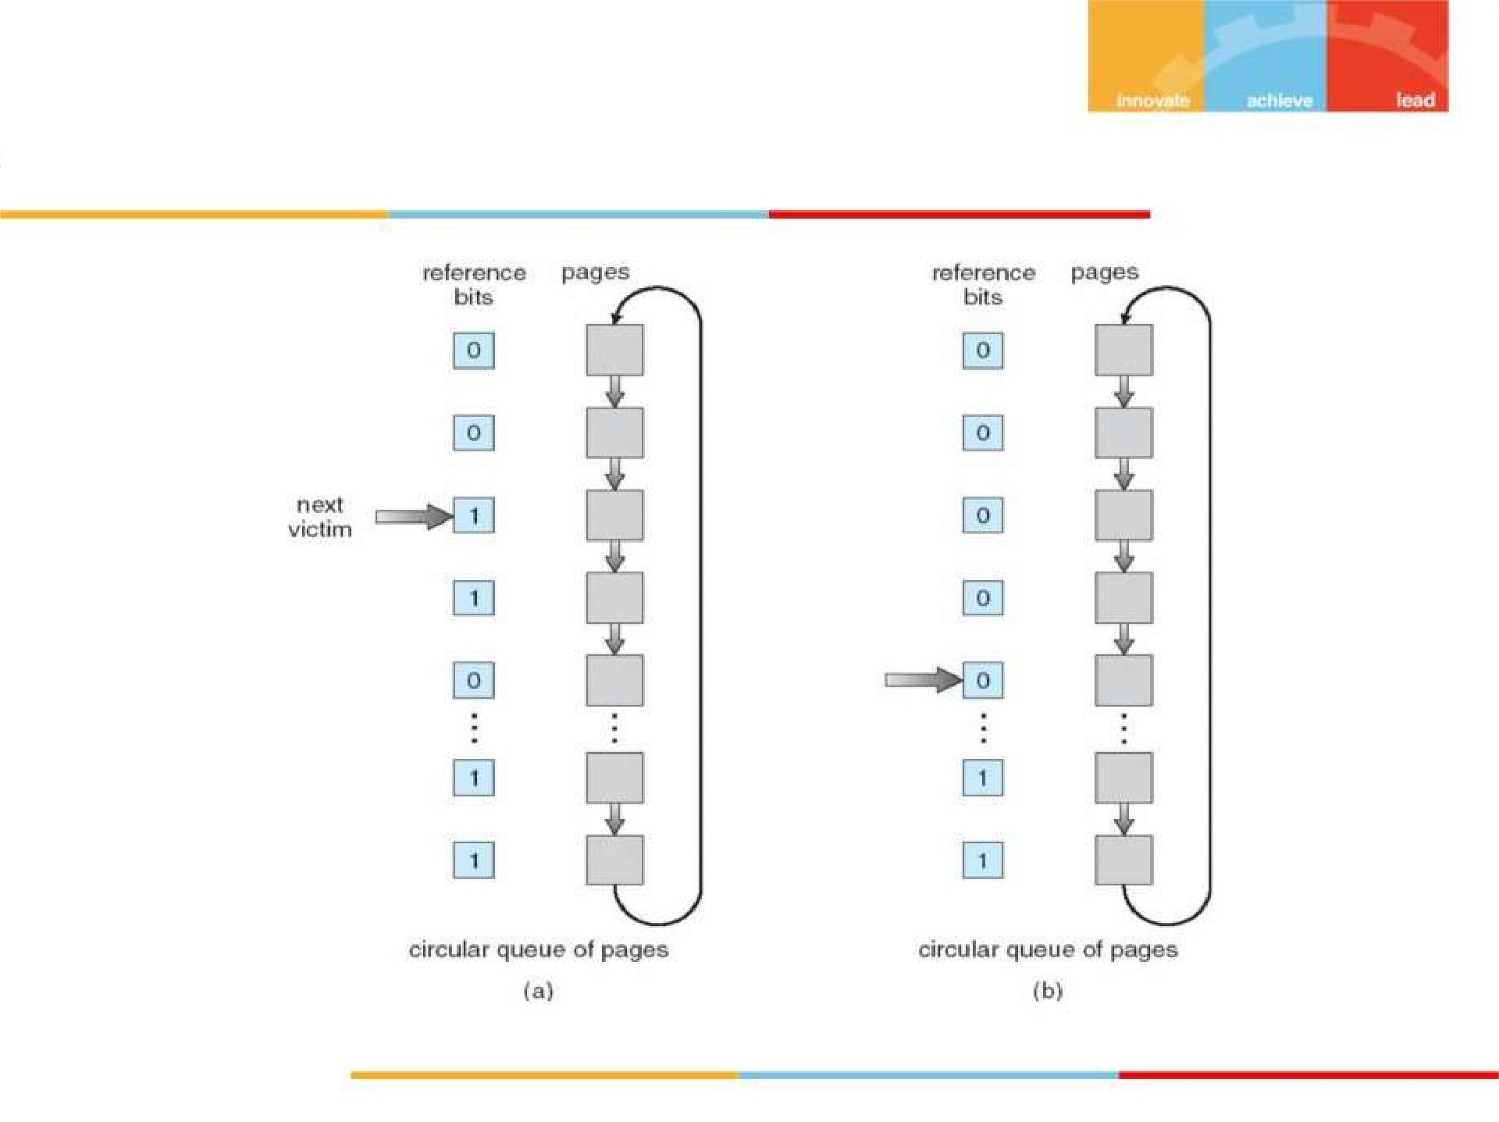





Slide 29


Keep a counter of the number of references that have been made to each page
LFU Algorithm: replaces page with smallest count
MFU Algorithm: based on the argument that the page with the smallest count was probably just brought in and has yet to be used

Slide 30


Each process needs minimum number of pages
The minimum no. of frames per process is defined by the architecture, the maximum no. is defined by the amount of physical memory.
  Two major allocation schemes :-
    fixed allocation
    priority allocation

Slide 31




Equal allocation - For example, if there are 100 frames and 5 processes, give each process 20 frames.
Proportional allocation - Allocate according to the size of process
m= 64
s _{i}
S
s =10
size of process p _{i}
is sum of all the process
1
s
=127
2
m is total number of free frames
a₁ = (10/137) * 64 = 4
a _{i}
allocation for pi ( s_{i} / S )* m
a2 = (127/137) * 64 = 57

Slide 32


Use a proportional allocation scheme using priorities rather than size
If process Pi generates a page fault,
  select for replacement one of its frames
  select for replacement a frame from a process with lower priority number

Slide 33


Global replacement - process selects a replacement frame from the set of all frames; one process can take a frame from another
Local replacement - each process selects from only its own set of allocated frames

Slide 34


If a process does not have “enough” pages, the page-fault rate is very high. This leads to:
  low CPU utilization
  operating system thinks that it needs to increase the degree of multiprogramming
  another process added to the system
Thrashing a process is busy swapping pages in and out

Slide 35
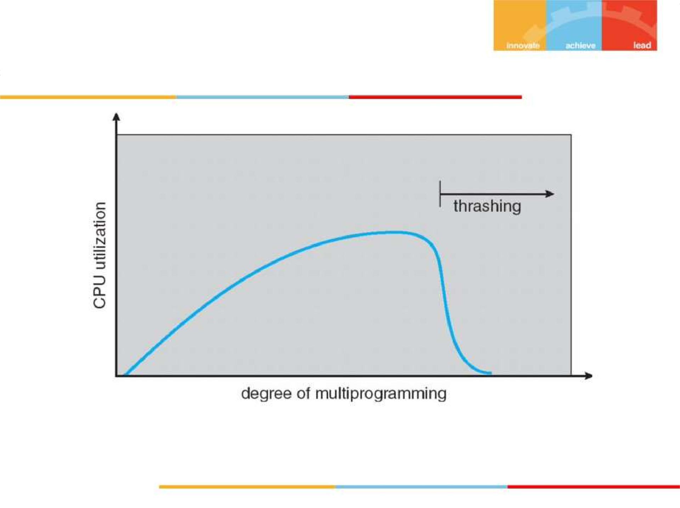



Slide 36




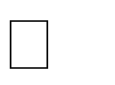
•
working-set window = a fixed number of page references
Example: 10,000 instruction
WSSi (working set of Process Pi) =
total number of pages referenced in the most recent (varies in time)
  if too small will not encompass entire locality
  if too large will encompass several localities
  If is equal will encompass entire program
D = ∑WSSi , D= total demand frames, m= available frames
if D > m Thrashing
Policy if D > m, then suspend one of the processes

Slide 37
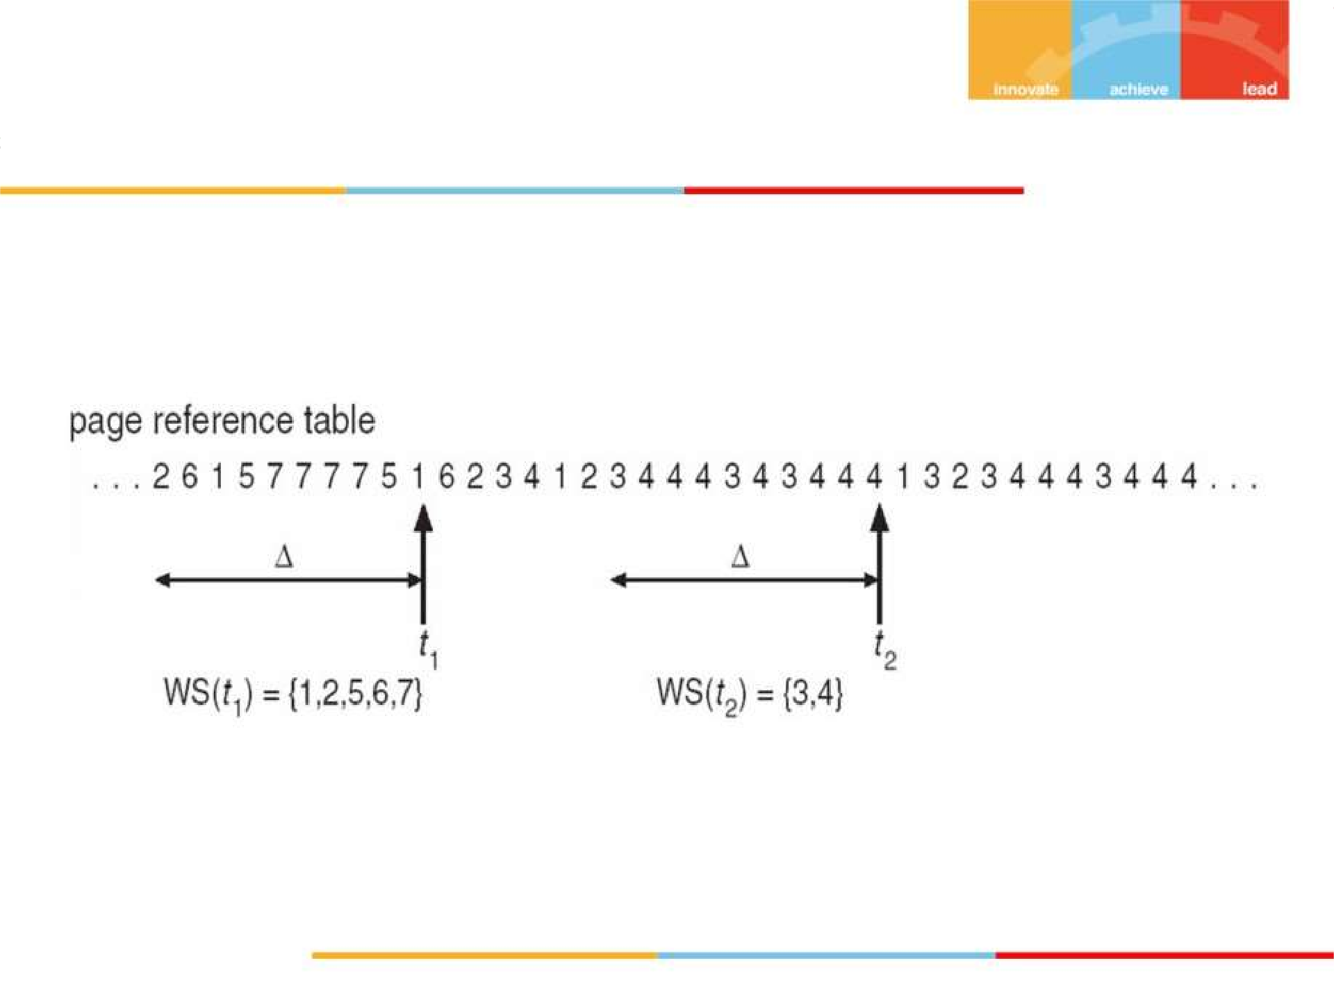



Slide 38

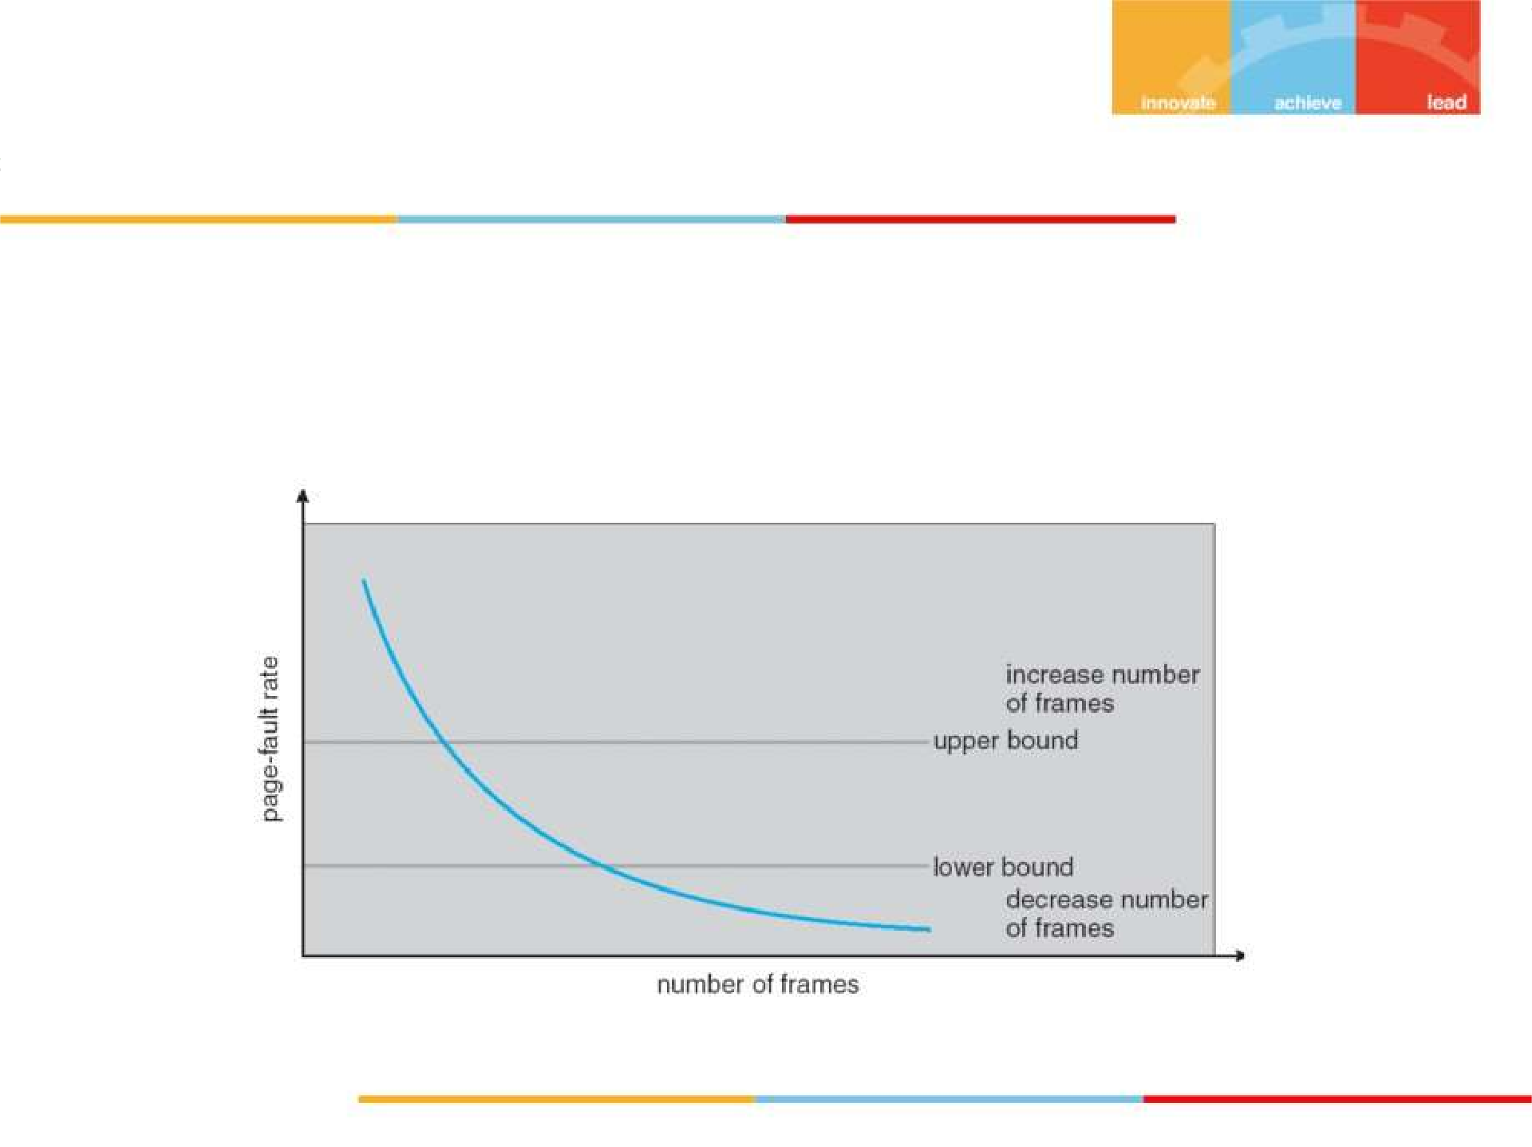



Establish “acceptable” page-fault rate
  If actual rate too low, process loses frame
  If actual rate too high, process gains frame

