Slide 1





DESIGN & ENGINEERING
Creativity: Initiating Creative Design Brainstorming

Slide 2

Creativity

Slide 3

Creativity is the act of turning new and imaginative ideas into reality. Creativity is characterised by the ability to perceive the world in new ways, to find hidden patterns, to make connections between seemingly unrelated phenomena, and to generate solutions.

Slide 4
Logic
1-'ersona 1 y
Math
anguage Reading
Writing
An alvsis
Creativity
Intuition Music
Art
Spatial abiIitie

Slide 5
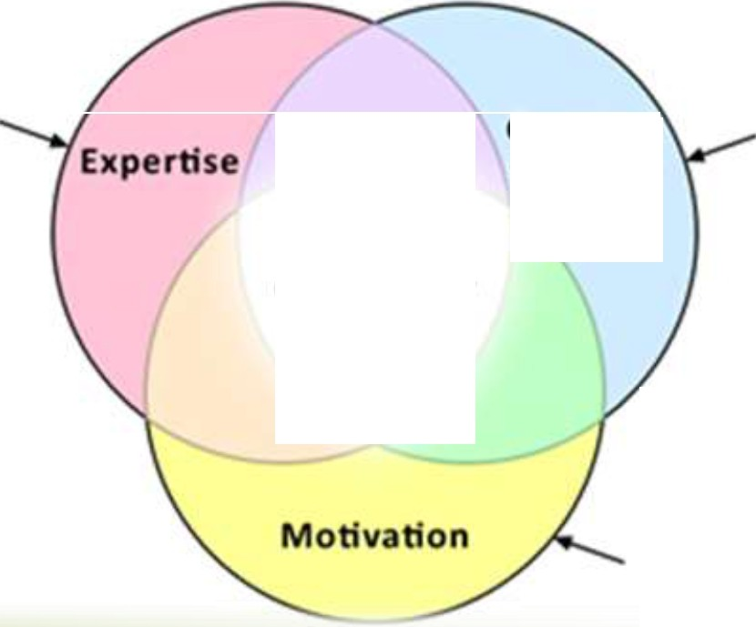









Three Components of Creativity
technical,procedural, and intellectual
knowledge
how flexibly and
imaginatively people approach problems
Creative­ thinki ng Skills
Creativity
mtrinsk is more effective than extrinsic
l \ l ' "J V'

Slide 6
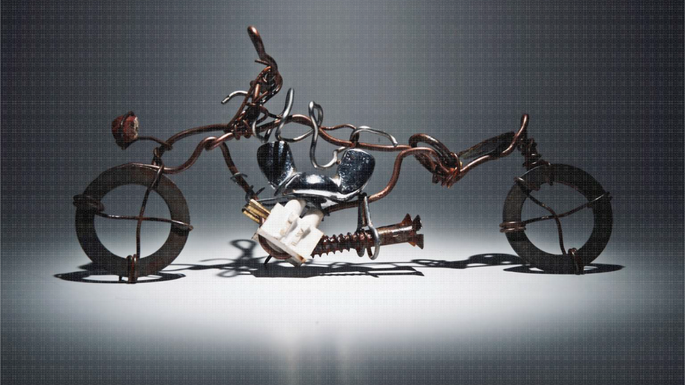
Enhance Creative Thinking
Creative cognition is the use of regular cognitive operations to solve problems in novel ways.
Following are some positive steps you can take to enhance your creative thinking

Slide 7

Develop a creative attitude :
It is essential to develop confidence that you can provide a creative solution to a problem. Although you may not visualize the complete path through to the final solution at the time you first tackle a problem, you must have self-confidence ; you must believe that a solution will develop before you are finished. Of course, confidence comes with success, so
start small and build your confidence up with small successes

Slide 8

Unlock your imagination :
You must rekindle the vivid imagination you had as a child. One way to do so is to begin to question again. Ask “why” and “what if,” “Why Not” “How”

Slide 9

Be persistent :
We already have dispelled the myth that creativity occurs with a lightning strike. On the contrary, it often requires hard work. Most problems will not succumb to the first attack.

Slide 10

Develop an open mind :
Having an open mind means being receptive to ideas from any and all sources. The solutions to problems are not the property of a particular discipline, nor is there any rule that solutions
can come only from persons with college degrees.

Slide 11

Suspend your judgment :
We have seen that creative ideas develop slowly, but nothing inhibits the creative process more than critical judgment of an emerging idea. Engineers, by nature, tend toward critical
attitudes, so special forbearance is required to avoid judgment at an early stage of conceptual design.

Slide 12

Set problem boundaries :
We place great emphasis on proper problem definition
as a step toward problem solution. Establishing the
of
boundaries of the problem is an essential part
problem definition. Experience shows that setting problem boundaries appropriately, not too tight or not too open, is critical to achieving a creative solution.

Slide 13

How to
Initiate Creative
Thinking ?

Slide 14


Sit somewhere with no distractions,
think again what
you have already done and
start jotting down ideas

Slide 15

Start sketching
whatever in your
mind or visualizing

Slide 16

Now start putting things haphazardly.
Pick out
things that
catch your eye
& put them
all together.

Slide 17

Then start again over.
You should continue this process a few times until
you run out of ideas.

Slide 18

See what idea or scheme catches your eye.
Ask yourself, What caught your eye and
why ?

Slide 19

should this be
the focal point?
Will it work
correctly ?

Slide 20

Basically it is like a flow chart.
If yes, then keep working on it.

Slide 21

You should look for
other items
and accessories
also that coordinate with it.

Slide 22

If no, then go back and
find another
idea and start working
with that.

Slide 23

You may have come up
with an even
better
idea
of your own for
brainstorming

Slide 24

The fact is you have to
VISUALIZE what things will look like
when the
project become
completed

Slide 25
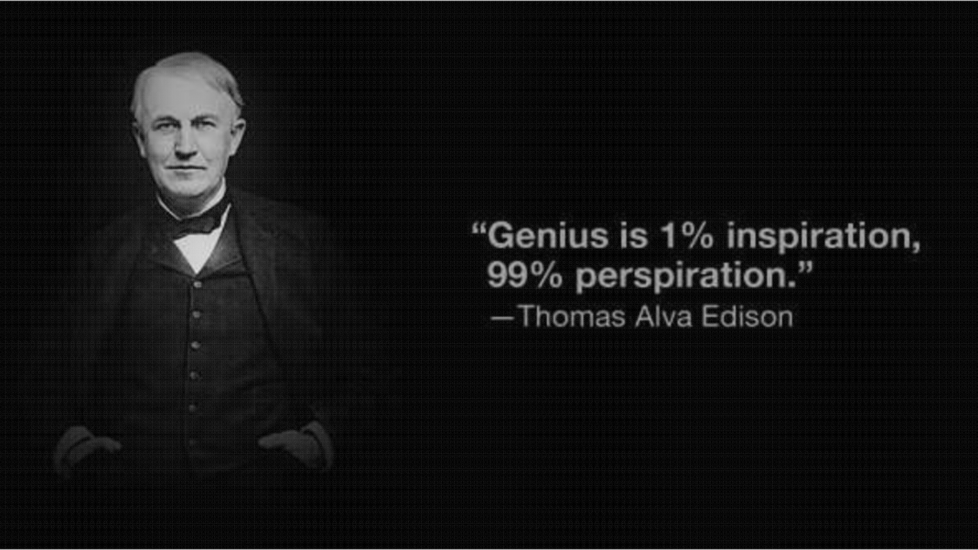

Slide 26

Brainstorming

Slide 27

Brainstorming is a group creativity technique by which efforts are made to find a conclusion for a specific problem by gathering a list of ideas spontaneously contributed by its members.
Collaboration is key! As you can see, all group participants are actively involved in an effective brainstorming session. You'll also notice that this group is getting really creative by brainstorming visually with paints. Brainstorming can take many different forms. Your group should choose to brainstorm ideas in a format that works the best for you.

Slide 28

Tips for Effective Brainstorming

Slide 29
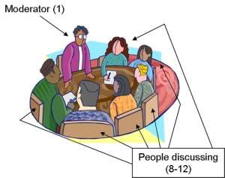
#1 Assign a Moderator
Assigning someone to guide the brainstorming session into a productive direction is an absolute must. Though the entire point involves the free flow of ideas, this can quickly get completely off track and out of control if not kept in check.

Slide 30


#2 Identify Goals
It’s best to begin a brainstorming session by briefly stating an overview of the project. Even if everyone present is familiar with it, the refresher is a good way to get their brains in the right place. After stating what the project entails, clearly state the goal of the brainstorming session. Never go into a brainstorming session without a clear idea of what you want out of it, otherwise you’re setting yourself up for a phenomenal waste of time.

Slide 31

#3 Set a Time Limit
Obviously, you’ll have to end the brainstorming at some point. However, it may not always be the best idea to ideate until people simply stop talking. Try setting and announcing a firm time limit at the beginning of the session. The significance of the announcement is that it ensures everyone knows that the agreed upon goals must be met by a certain time. If you’ve got a strong team, this will encourage them to stay on track and really crank out as many ideas as possible within the allotted timeframe.

Slide 32

#4 Write Down and/or Sketch Everything
Be prepared at the start of the meeting with sketchpads, stickie's, or a large amount of whiteboard space for everyone involved. Remember that every idea, good or bad should be briefly written or sketched out. Never imagine that you’ll simply remember the important things that were said. Otherwise, three days later you’ll be scratching your head trying to figure out how you could forget all those great ideas.

Slide 33

#5 Don’t Judge
This concept might be a bit overstated but it is absolutely essential to effective brainstorming. At the beginning of the process you want to shoot for quantity over quality. Rather than taking five minutes to discuss reasons why a particular idea is bad or good, just take every idea and move along.

Slide 34

#6 Embrace the Ridiculous
If you really want to see the value of brainstorming, don’t simply avoid judging unrealistic ideas, actually encourage them. As strange as it sounds, the very best ideas are often born from the very worst. Ask questions like, “what if money were no option?” or “what if our time table were three times as long?”

Slide 35

#7 Start General, End Specific
If you’re the moderator of the brainstorming session, your job is to gently steer the conversation towards a productive output.

Slide 36

#8 Look for Synergy Potential
As you begin to trim your selection of ideas in the step above, beware of viewing the possibilities in black and white terms. It’s not always the case that the furthering of one idea must mean the death of another. There is often potential for creating synergy among originally separate suggestions.

Slide 37

#9 Avoid Group Think
There’s a fine line between a team that
productively too much intently for
cooperates and one that cooperation. The moderator signs of group think and accordingly.
suffers should steer
from watch the
conversation

Slide 38

#10 Include an Outsider
final suggestion for effective brainstorming is to include at least one person in the group who doesn’t belong. For instance, if you’re working with a team of designers, try throwing in a developer to add some diversity to the mix. Or better yet, grab someone who knows absolutely nothing about creating websites or developing attractive user interfaces.

Slide 39

Reference
 George E Dieter, Linda C. Schmidt- Engineering Design
 Dym, C. L., Little, P. and Orwin, E. J., Engineering Design - A Project based
introduction-Wiley
 Haik, Y. And Shahin, M. T., Engineering Design Process, Cengage Learning
 Balmer, R. T., Keat, W. D., Wise, G., and Kosky, P., Exploring Engineering, Third Edition: An Introduction to Engineering and Design
 V.B Bhandari- Design of Machine Elements
 Donald A Norman- Living With Complexity
 Jorma Tuomaala- Creative Engineering Design
www.slideshare.net/naseelazeeniya
Email Your feedbacks to naseel@live.com

