Slide 1


COMPUTER ARCHITECTURE

Slide 2
OUTLINE
Introduction
Classes of Computers
Computer Architecture
Trends in Technology
Trends in Cost
Dependability
Measuring, Reporting and Summarizing Performance
Quantitative Principles of Computer Design

Slide 3
WHAT IS ARCHITECTURE?
Original sense:
  Taking a range of building materials, putting together in desirable ways to achieve a building suited to its purpose
In Computer Science:
  Similar: how parts are put together to achieve some overall goal
  Examples: the architecture of a chip, of the Internet, of an enterprise database system, an email system, a cable TV distribution system
Adapted from David Clark’s, What is “Architecture”?

Slide 4
WHY COMPUTER ARCHITECTURE?
 Exploit advances in technology
 Make things Faster, Smaller, Cheaper, …
 Which enables new applications
 Shrek 20 years ago?
 Make new things possible
 Accurate one-month weather forecasts? Cure for cancer? Life-like virtual reality?
The advancement of computer architecture is vital for the advancement of all other areas of computing!

Slide 5
MOORE’S LAW (1965)
Transistors per inch square
  Twice as many after ~1.5-2 years
Related trends
  Processor performance
Twice as fast after ~18 months
  Memory capacity
Twice as much in <2 years

Slide 6
₁G₀₀R₀O₀ WTH IN PROCESSOR PERFORMANCE
From Hennessy and Patterson, Computer Architecture: A Quantitative Approach, 4th edition, October, 2006
Performance (vs. VAX-11/780)
20%/year
1000
52%/year
100
10
25%/year
1
1978 1980 1982 1984 1986 1988 1990 1992 1994 1996 1998 2000 2002 2004 2006
VAX : 25%/year 1978 to 1986
RISC + x86: 52%/year 1986 to 2002
RISC + x86: 20%/year 2002 to 2006

Slide 7
OUTLINE
Introduction
Classes of Computers
Computer Architecture
Trends in Technology
Trends in Cost
Dependability
Measuring, Reporting and Summarizing Performance
Quantitative Principles of Computer Design

Slide 8
CHANGING FACE OF COMPUTING
In the 1960s mainframes roamed the planet
 Very expensive, operators oversaw operations
 Applications: business data processing, large scale scientific computing
In the 1970s, minicomputers emerged
 Less expensive, time sharing
In the 1990s, Internet and WWW, handheld devices (PDA), high-performance consumer electronics for video games have emerged
Dramatic changes have led to 3 different computing markets
 Servers, Desktop computing, Embedded Computers

Slide 9
DEPENDS ON THE CLASS OF PROCESSOR
Feature | Desktop | Server | Embedded
Price of system (USD) | $500-$5K | $5K - $5M | $10 - $100K (ex. high-end network routers)
Price of CPU (per processor) | $50 - $500 | $200 - $10K | $0.01 - $100
Critical design issues | Price- performance, graphics performance | Throughput, availability, scalability | Price, power, application- specific performance

Slide 10

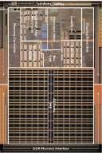
DESKTOP SYSTEMS
Examples
  Intel Core 2 Duo
  AMD Opteron
Applications: everything (general purpose)
  Office, Internet, Multi-media, Video Games…
Goals
  performance, price/performance
  power → affects cost, size

Slide 11
SERVERS
Examples
IBM Power
 Sun Niagara (T1)
Intel Xeon
Applications
infrastructure: file server, email server, …
 business: web, e-commerce, databases
Goals
 Throughput (transactions/second)
Availability (reliability, dependability, fault tolerance …)
 Cost not a major issue

Slide 12
EMBEDDED
Examples
  Xscale, ARM, MIPS, x86, … (many varieties)
Applications
  cell phones, mp3 players, game consoles, consumer electronics (refrigerator,
microwave), automobiles, … (many varieties)
Goals
  Cost, Power
  Sufficient performance, real-time performance
  Size (CPU size, memory footprint, chip count…)

Slide 13
OUTLINE
Introduction
Classes of Computers
Computer Architecture
Trends in Technology
Trends in Cost
Dependability
Measuring, Reporting and Summarizing Performance
Quantitative Principles of Computer Design

Slide 14
TASK OF COMPUTER DESIGNER
“Determine what attributes are important for a new machine; then design a machine to maximize performance while staying within cost, power, and availability constraints.”
Aspects of this task
  Instruction set design
  Functional organization
  Logic design and implementation
(IC design, packaging, power, cooling...)

Slide 15
WHAT IS COMPUTER ARCHITECTURE?
Computer Architecture covers all three aspects of computer design
Instruction Set Architecture
  the computer visible to the assembly language programmer or compiler writer (registers, data types, instruction set, instruction formats, addressing modes)
Organization
  high level aspects of computer’s design such as the memory system, the bus structure, and the internal CPU (data path + control) design
Hardware
  detailed logic design, interconnection and packing technology, external connections

Slide 16

INSTRUCTION SET ARCHITECTURE: CRITICAL INTERFACE
software
instruction set
hardware
Properties of a good abstraction
Lasts through many generations (portability)
Used in many different ways (generality)
Provides convenient functionality to higher levels
Permits an efficient implementation at lower levels

Slide 17
OUTLINE
Introduction
Classes of Computers
Computer Architecture
Trends in Technology
Trends in Cost
Dependability
Measuring, Reporting and Summarizing Performance
Quantitative Principles of Computer Design

Slide 18
TECHNOLOGY TRENDS
Integrated circuit technology – 55% /year
 Transistor density – 35% per year
 Die size – 10-20% per year
Semiconductor DRAM
 Density – 40-60% per year (4x in 3-4 years)
 Cycle time – 33% in 10 years
 Bandwidth – 66% in 10 years
Magnetic disk technology
 Density – 100% per year
 Access time – 33% in 10 years
Network technology (depends on switches and transmission technology)
 10Mb-100Mb (10years)
 Bandwidth – doubles every year (for USA)

Slide 19

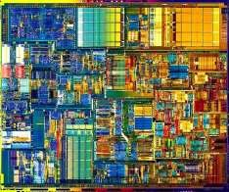
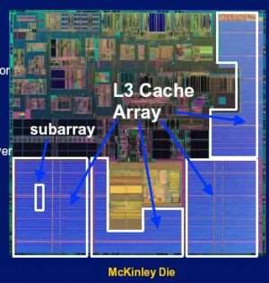
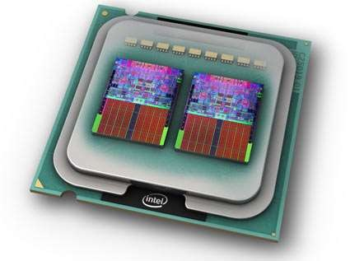
PROCESSOR TRANSISTOR COUNT
Intel 4004,
2300tr
(1971)
Intel McKinley – 221M tr. (2001)
Intel P4 – 55M tr
(2001)
Intel Core 2 Extreme Quad-core 2x291M tr. (2006)

Slide 20
OUTLINE
Introduction
Classes of Computers
Computer Architecture
Trends in Technology
Trends in Cost
Dependability
Measuring, Reporting and Summarizing Performance
Quantitative Principles of Computer Design

Slide 21
WHY DO YOU CARE ABOUT PRICES?
Target market, target prices place a limit on the cost of my processor
  price = what I sell the part for
  cost = what it costs me
Design decisions affect the cost (and price)
  Ex. adding more cache may improve performance, but increase cost
Price-performance is often what we’re trying to balance
So what determines price/cost?

Slide 22
COST, PRICE, AND THEIR TRENDS
Price – what you sell a good for
Cost – what you spent to produce it
Understanding cost
Learning curve principle – manufacturing costs decrease over time (even without major improvements in implementation technology)
 Best measured by change in yield – the percentage of manufactured devices that survives the testing procedure
Volume (number of products manufactured)
 decreases the time needed to get down the learning curve
 decreases cost since it increases purchasing and
manufacturing efficiency
Commodities – products sold by multiple vendors in large volumes which are essentially identical
 Competition among suppliers lower cost

Slide 23
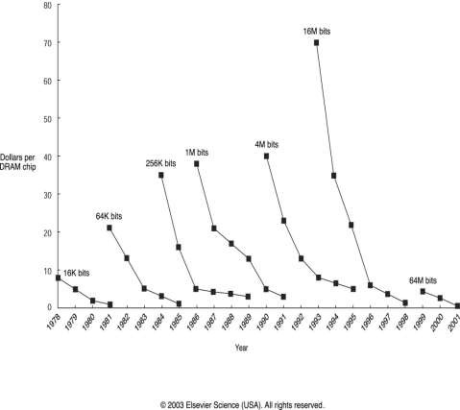
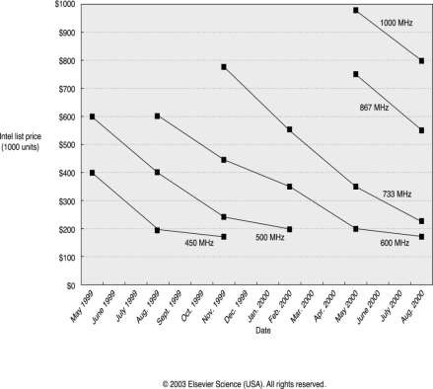
TRENDS IN COST:
THE PRICE OF DRAM AND INTEL PENTIUM III

Slide 24
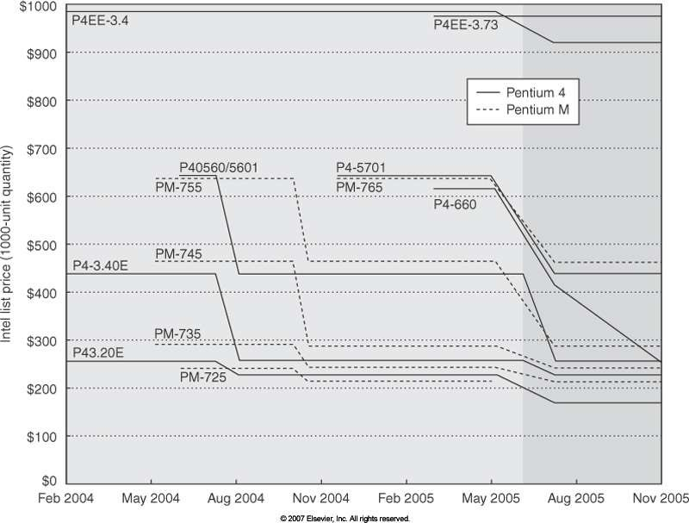
TRENDS IN COST:
THE PRICE OF PENTIUM4 AND PENTIUMM

Slide 25
COST OF AN INTEGRATED CIRCUIT
CPU (die) size greatly affects cost of all systems (desktop/server/embedded)
  Current CPUs 1-2 cm²
  Embedded much smaller
    cost and footprint really matters in cell phone or iPod
Die
Silicon Wafer

Slide 26

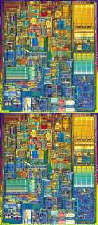
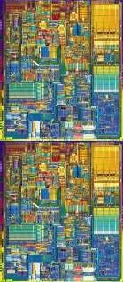
YIELD
Manufacturing Defects
✗
✗
✗
✗
✗
✗
✗
✗
13/16 working chips 81.25% yield
1/4 working chips 25.0% yield

Slide 27







YIELD (2)
Assuming $250 per wafer:
$5.92 per die
$58.82 per die
52 die, 81.25% yield →
42.25 working parts / wafer
17 die, 25.0% yield →
4.25 working parts / wafer

Slide 28
COST OF AN INTEGRATED CIRCUIT
(Cost of die + cost of testing die + cost of packaging and final test)
final test yield
Cost of integrated circuit =

Slide 29
COST/YIELD EQUATIONS (APPROXIMATIONS)
Cost of wafer
Cost of Die =
Dies per wafer × Die yield
Dies per wafer =
π × (Wafer diameter / 2)²
π × Wafer diameter
Die area
sqrt(2 × Die area)
Wafer yield × (1 +
Defects per unit area × Die area
α
)
−α
Die yield =
Number of completely bad wafers
Typical: 0.4 defects per cm² in 90nm, but improves with time
Parameter related to complexity of manufacturing, typical α = 0.4

Slide 30
OUTLINE
Introduction
Classes of Computers
Computer Architecture
Trends in Technology
Trends in Cost
Dependability
Measuring, Reporting and Summarizing Performance
Quantitative Principles of Computer Design

Slide 31
DEPENDABILITY: SOME DEFINITIONS
Computer system dependability is the quality of delivered service
The service delivered by a system is its observed actual behavior
Each module has an ideal specified behavior, where a service
specification is an agreed description of the expected behavior
A failure occurs when the actual behavior deviated from the specified behavior
The failure occurred because of an error
The cause of an error is a fault

Slide 32
DEPENDABILITY: MEASURES
Service accomplishment vs. service interruption (transitions: failures vs. restorations)
Module reliability: a measure of the continuous service accomplishment
A measure of reliability: MTTF – Mean Time To Failure
(1/[rate of failure]) reported in [failure/1billion hours of operation)
MTTR – Mean time to repair (a measure for service interruption)
MTBF – Mean time between failures (MTTF+MTTR)
Module availability – a measure of the service accomplishment; = MTTF/(MTTF+MTTR)

Slide 33
OUTLINE
Introduction
Classes of Computers
Computer Architecture
Trends in Technology
Trends in Cost
Dependability
Measuring, Reporting and Summarizing Performance
Quantitative Principles of Computer Design

Slide 34
COST-PERFORMANCE
Purchasing perspective: from a collection of machines, choose one which has
 best performance?
least cost?
 best performance/cost?
Computer designer perspective:
faced with design options, select one which has
 best performance improvement?
least cost?
 best performance/cost?
Both require: basis for comparison and metric for evaluation

Slide 35
TWO “NOTIONS” OF PERFORMANCE
Which computer has better performance?
User: one which runs a program in less time
 Computer centre manager:
one which completes more jobs in a given time
Users are interested in reducing Response time or Execution time
the time between the start and the completion of an event
Managers are interested in increasing Throughput or Bandwidth
total amount of work done in a given time

Slide 36
DEFINITION OF PERFORMANCE
We are primarily concerned with Response Time
Performance [things/sec]
1
Performance(x) =
Execution _ time(x)
“X is n times faster than Y”
_{n =} Execution _ time( y) ₌ Performance(x) Execution _ time(x) Performance( y)
As faster means both increased performance and decreased execution time, to reduce confusion
will use “improve performance” or “improve execution time”

Slide 37
EXECUTION TIME AND ITS COMPONENTS
Wall-clock time, response time, elapsed time
the latency to complete a task, including disk accesses, memory accesses, input/output activities,
operating system overhead,...
CPU time
the time the CPU is computing, excluding I/O or running other programs with multiprogramming
often further divided into user and system CPU times
User CPU time
the CPU time spent in the program
System CPU time
the CPU time spent in the operating system

Slide 38
CPU EXECUTION TIME
CPU time = CPU clock cycles for a program × Clock cycle time
_{CPUtime =} CPU clock cycles for a program
Clock rate
Instruction count (IC) = Number of instructions executed
Clock _{C}cy_{P}c_{I}les₌p^{C}e^{P}r i^{U}nst^{c}r^{l}uºc^{c}t^{k}io^{c}n^{y}(^{c}C^{le}P^{s}I) ^{for a program}
IC
CPI - one way to compare two machines with same instruction set, since Instruction Count would be the same

Slide 39
CPU EXECUTION TIME (CONT’D)
CPU time = IC × CPI × Clock cycle time
CPU time = ^{IC × CPI}
Clock rate
_{CPU time =} Instructions × Clock cycles × Seconds Program Instruction Clock cycle
₌ Seconds
Program
 | IC | CPI | Clock rate
Program | X
Compiler | X | (X)
ISA | X | X
Organisation |  | X | X
Technology |  |  | X

Slide 40
HOW TO CALCULATE CPI
First calculate CPI for each individual instruction (add, sub, and,
etc.): CPI_{i}
Next calculate frequency of each individual instr.: Freq_{i} = IC_{i}/IC
Finally multiply these two for each instruction and add them up to get final CPI
Op ALU |  | Freq_{i} 50% |  | CPI_{i} 1 |  | Prod 0..5 |  | % Time 23%
Load |  | 20% |  | 5 |  | 1.0 |  | 45%
Store |  | 10% |  | 3 |  | 0.3 |  | 14%
Bran. |  | 20% |  | 2 |  | 0.4 |  | 18%
 |  |  |  |  |  | 2.2
IC_{i}
n
CPI = ∑ ×CPI
i =1
IC
i

Slide 41
OUTLINE
Introduction
Classes of Computers
Computer Architecture
Trends in Technology
Trends in Cost
Dependability
Measuring, Reporting and Summarizing Performance
Quantitative Principles of Computer Design

Slide 42
QUANTITATIVE PRINCIPLES OF DESIGN
Where to spend time making improvements?
⇒ Make the Common Case Fast
  Most important principle of computer design: Spend your time on improvements where those improvements will do the most good
  Example
    Instruction A represents 5% of execution
    Instruction B represents 20% of execution
    Even if you can drive the time for A to 0, the CPU will only be 5% faster
Key questions
  What the frequent case is?
  How much performance can be improved by making that case faster?

