Slide 1
Computer Number Systems and Data Representation.

Slide 2
Lecture Outline
Number Systems
Binary, Octal, Hexadecimal
Representation of characters using codes
Representation of Numbers
Integer, Floating Point, Binary Coded Decimal
Program Language and Data Types
2

Slide 3
Data Representation?
Representation = Measurement
Most things in the “Real World” actually exist as a single, continuously varying quantity Mass, Volume, Speed, Pressure, Temperature
Easy to measure by “representing” it using a different thing that varies in the same way Eg. Pressure as the height of column of mercury or as voltage produced by a pressure transducer
These are ANALOG measurements
3

Slide 4
Digital Representation
Convert ANALOG to DIGITAL measurement by using a scale of units
DIGITAL measurements
In units – a set of symbolic values - digits
Values larger than any symbol in the set use sequence of digits – Units, Tens, Hundreds…
Measured in discrete or whole units
Difficult to measure something that is not a multiple of units in size. Eg Fractions
4

Slide 5
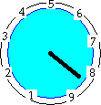
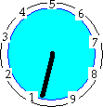
Analog vs. Digital representation
5

Slide 6
Data Representation
Computers use digital representation
Based on a binary system
(uses on/off states to represent 2 digits).
Many different types of data.
– Examples?
ALL data (no matter how complex)
must be represented in memory as binary digits (bits).
6

Slide 7
Number systems and computers
Computers store all data as binary digits, but we may need to convert this to a number system we are familiar with.
Computer programs and data are often represented (outside the computer) using octal and hexadecimal number systems because they are a short hand way of representing binary numbers.
7

Slide 8
Common Number Systems
System | Base | Symbols | Used by humans? | Used in computers?
Decimal | 10 | 0, 1, … 9 | Yes | No
Binary | 2 | 0, 1 | No | Yes
Octal | 8 | 0, 1, … 7 | No | No
Hexa- decimal | 16 | 0, 1, … 9, A, B, … F | No | No

Slide 9
Quantities/Counting (1 of 3)
Decimal | Binary | Octal | Hexa- decimal
0 | 0 | 0 | 0
1 | 1 | 1 | 1
2 | 10 | 2 | 2
3 | 11 | 3 | 3
4 | 100 | 4 | 4
5 | 101 | 5 | 5
6 | 110 | 6 | 6
7 | 111 | 7 | 7
p. 33

Slide 10
Quantities/Counting (2 of 3)
Decimal | Binary | Octal | Hexa- decimal
8 | 1000 | 10 | 8
9 | 1001 | 11 | 9
10 | 1010 | 12 | A
11 | 1011 | 13 | B
12 | 1100 | 14 | C
13 | 1101 | 15 | D
14 | 1110 | 16 | E
15 | 1111 | 17 | F

Slide 11
Quantities/Counting (3 of 3)
Decimal | Binary | Octal | Hexa- decimal
16 | 10000 | 20 | 10
17 | 10001 | 21 | 11
18 | 10010 | 22 | 12
19 | 10011 | 23 | 13
20 | 10100 | 24 | 14
21 | 10101 | 25 | 15
22 | 10110 | 26 | 16
23 | 10111 | 27 | 17
Etc.

Slide 12
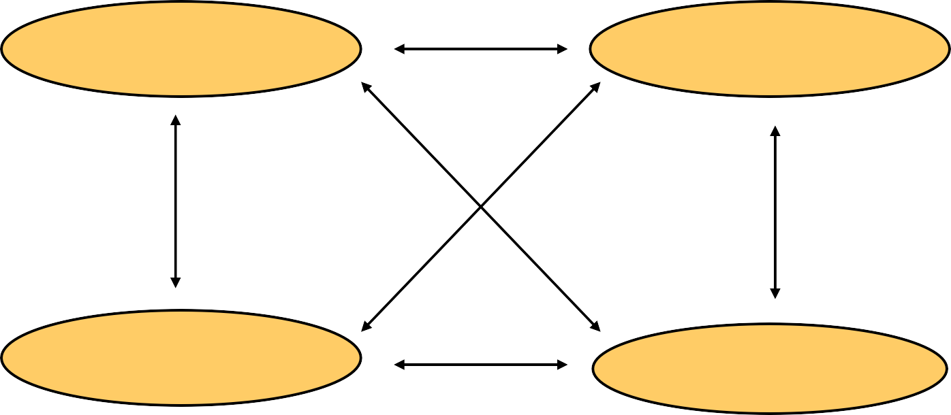
Conversion Among Bases
The possibilities:
Decimal
Octal
Binary
Hexadecimal

Slide 13
Quick Example
25₁₀ = 11001₂ = 31₈ = 19₁₆
Base

Slide 14
Decimal to Decimal (just for fun)
Decimal
Octal
Binary
Hexadecimal
Next slide…

Slide 15
Weight
125₁₀ | => | 5 | x | 10⁰ | = | 5
 |  | 2 | x | 10¹ | = | 20
1 |  |  | x | 10² | = 100
 |  |  |  |  | 125
Base

Slide 16
Binary to Decimal
Decimal
Octal
Binary
Hexadecimal

Slide 17
Binary to Decimal
Technique
Multiply each bit by 2^{n}, where n is the “weight” of the bit
The weight is the position of the bit, starting from 0 on the right
Add the results

Slide 18
Example
Bit “0”
101011₂ | => | 1 | x
 |  | 1 | x
 |  | 0 | x
 |  | 1 | x
 |  | 0 | x
 |  | 1 | x
₂0
₂1
₂2
₂3
₂4
₂5
= | 1
= | 2
= | 0
= | 8
= | 0
= | 32
 | 43₁₀

Slide 19
Octal to Decimal
Decimal
Octal
Binary
Hexadecimal

Slide 20
Octal to Decimal
Technique
Multiply each bit by 8^{n}, where n is the “weight” of the bit
The weight is the position of the bit, starting from 0 on the right
Add the results

Slide 21
Example
₈0
₈1
₈2
= 4
= 16
= 448
468₁₀
724₈ | => | 4 | x
 |  | 2 | x
 |  | 7 | x

Slide 22
Hexadecimal to Decimal
Decimal
Octal
Binary
Hexadecimal

Slide 23
Hexadecimal to Decimal
Technique
Multiply each bit by 16^{n}, where n is the “weight” of the bit
The weight is the position of the bit, starting from 0 on the right
Add the results

Slide 24
Example
ABC₁₆ | => | C | x | 16⁰ | = | 12 | x | 1 | = | 12
 |  | B | x | 16¹ | = | 11 | x | 16 | = | 176
 |  | A | x | 16² | = | 10 | x | 256 | = | 2560
2748₁₀

Slide 25
Decimal to Binary
Decimal
Octal
Binary
Hexadecimal

Slide 26
Decimal to Binary
Technique
Divide by two, keep track of the remainder
First remainder is bit 0 (LSB, least-significant bit)
Second remainder is bit 1
Etc.

Slide 27
Example
125₁₀ = ?₂
2 125
2 62 1
2 31 0
2 15 1
2 7 1
2 3 1
2 1 1
0 1
125₁₀ = 1111101₂

Slide 28
Octal to Binary
Decimal
Octal
Binary
Hexadecimal

Slide 29
Octal to Binary
Technique
– Convert each octal digit to a 3-bit equivalent binary representation

Slide 30
Example
705₈ = ?₂
7 0 5
111 000 101
705₈ = 111000101₂

Slide 31
Hexadecimal to Binary
Decimal
Octal
Binary
Hexadecimal

Slide 32
Hexadecimal to Binary
Technique
– Convert each hexadecimal digit to a 4-bit equivalent binary representation

Slide 33
Example
10AF₁₆ = ?₂
1
0
A
F
0001 0000 1010 1111
10AF₁₆ = 0001000010101111₂

Slide 34
Decimal to Octal
Decimal
Octal
Binary
Hexadecimal

Slide 35
Decimal to Octal
Technique
Divide by 8
Keep track of the remainder

Slide 36
Example
1234₁₀ = ?₈
8 1234
8 154 2
8 19 2
8 2 3
0 2
1234₁₀ = 2322₈

Slide 37
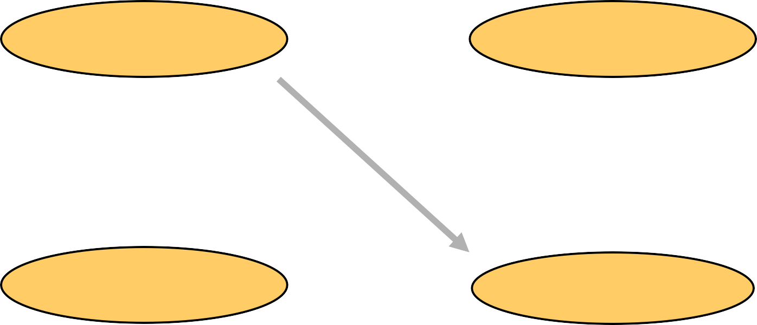
Decimal to Hexadecimal
Decimal
Octal
Binary
Hexadecimal

Slide 38
Decimal to Hexadecimal
Technique
Divide by 16
Keep track of the remainder

Slide 39
Example
1234₁₀ = ?₁₆
 | 16 | 1234
 | 16 | 77 | 2
 | 16 | 4 | 13 | = | D
 |  | 0 | 4
1234₁₀ = 4D2₁₆

Slide 40
Binary to Octal
Decimal
Octal
Binary
Hexadecimal

Slide 41
Binary to Octal
Technique
Group bits in threes, starting on right
Convert to octal digits

Slide 42
Example
1011010111₂ | = | ?₈
 |  | 1 | 011 | 010 | 111
 |  | 1 | 3 | 2 | 7
1011010111₂ = 1327₈

Slide 43
Binary to Hexadecimal
Decimal
Octal
Binary
Hexadecimal

Slide 44
Binary to Hexadecimal
Technique
Group bits in fours, starting on right
Convert to hexadecimal digits

Slide 45
Example
1010111011₂ = ?₁₆
10 1011 1011
2
B
B
1010111011₂ = 2BB₁₆

Slide 46
Octal to Hexadecimal
Decimal
Octal
Binary
Hexadecimal

Slide 47
Octal to Hexadecimal
Technique
– Use binary as an intermediary

Slide 48
Example
1076₈ = ?₁₆
1
0
7
6
001 000 111 110
2
3
E
1076₈ = 23E₁₆

Slide 49
Hexadecimal to Octal
Decimal
Octal
Binary
Hexadecimal

Slide 50
Hexadecimal to Octal
Technique
– Use binary as an intermediary

Slide 51
Example
1F0C₁₆ = ?₈
1
F
0
C
0001 1111 0000 1100
1 7 4
1
4
1F0C₁₆ = 17414₈

Slide 52
Exercise – Convert ...
Decimal | Binary | Octal | Hexa- decimal
33
 | 1110101
 |  | 703
 |  |  | 1AF
Don’t use a calculator!
Skip answer
Answer

Slide 53
Exercise – Convert …
Answer
Decimal | Binary | Octal | Hexa- decimal
33 | 100001 | 41 | 21
117 | 1110101 | 165 | 75
451 | 111000011 | 703 | 1C3
431 | 110101111 | 657 | 1AF

Slide 54
Common Powers (1 of 2)
Base 10
Power | Preface | Symbol | Value
₁₀-12 | pico | p | .000000000001
₁₀-9 | nano | n | .000000001
₁₀-6 | micro |  | .000001
₁₀-3 | milli | m | .001
10³ | kilo | k | 1000
10⁶ | mega | M | 1000000
10⁹ | giga | G | 1000000000
₁₀12 | tera | T | 1000000000000

Slide 55
Common Powers (2 of 2)
Base 2
Power | Preface | Symbol | Value
₂10 | kilo | k | 1024
₂20 | mega | M | 1048576
₂30 | Giga | G | 1073741824
What is the value of “k”, “M”, and “G”?
In computing, particularly w.r.t. memory, the base-2 interpretation generally applies

Slide 56
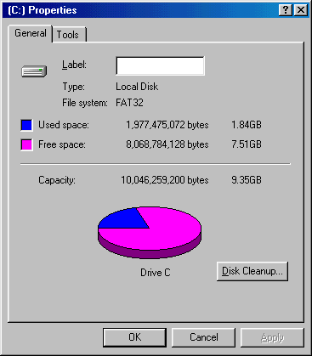
Example
In the lab…
Double click on My Computer
Right click on C:
Click on Properties
_{/ 2}30
=

Slide 57
Exercise – Free Space
Determine the “free space” on all drives on a machine in the lab
Drive | Free space
 | Bytes | GB
A:
C:
D:
E:
etc.

Slide 58
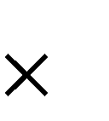
Review – multiplying powers
For common bases, add powers
_{a}b _{a}c _{= a}b+c
₂6 ₂10 ₌ ₂16
or…
= 65,536
₂6 ₂10
= 64
₂10
= 64k

Slide 59
Binary Addition (1 of 2)
Two 1-bit values
A | B | A + B
0 | 0 | 0
0 | 1 | 1
1 | 0 | 1
1 | 1 | 10
“two”

Slide 60
Binary Addition (2 of 2)
Two n-bit values
Add individual bits
Propagate carries
– E.g.,
1
1
10101
21
+ 11001 + 25
46
101110

Slide 61
Multiplication (1 of 3)
Decimal (just for fun)
35 x 105
175
000
35
3675

Slide 62
Multiplication (2 of 3)
Binary, two 1-bit values
A | B | A B
0 | 0 | 0
0 | 1 | 0
1 | 0 | 0
1 | 1 | 1

Slide 63
Multiplication (3 of 3)
Binary, two n-bit values
– As with decimal values
– E.g.,
1110
x 1011
1110
1110
0000
1110
10011010

Slide 64
Fractions
Decimal to decimal (just for fun)
3.14 =>
4 x 10⁻²
1 x 10⁻¹
3 x 10⁰
= 0.04
= 0.1
= 3
3.14

Slide 65
Fractions
Binary to decimal
₂-4
₂-3
₂-2
₂-1
₂0
₂1
10.1011 | => | 1 | x
 |  | 1 | x
 |  | 0 | x
 |  | 1 | x
 |  | 0 | x
 |  | 1 | x
= | 0.0625
= | 0.125
= | 0.0
= | 0.5
= | 0.0
= 2.0
2.6875

Slide 66
Fractions
Decimal to binary
.14579
x 2
3.14579
0.29158
x 2
0.58316
x 2
1.16632
x 2
0.33264
x 2
0.66528
x 2
1.33056
etc.
11.001001...

Slide 67
Exercise – Convert ...
Decimal | Binary | Octal | Hexa- decimal
29.8
 | 101.1101
 |  | 3.07
 |  |  | C.82
Don’t use a calculator!
Skip answer
Answer

Slide 68
Exercise – Convert …
Answer
Decimal | Binary | Octal | Hexa- decimal
29.8 | 11101.110011… | 35.63… | 1D.CC…
5.8125 | 101.1101 | 5.64 | 5.D
3.109375 | 11.000111 | 3.07 | 3.1C
12.5078125 | 1100.10000010 | 14.404 | C.82

