Slide 1
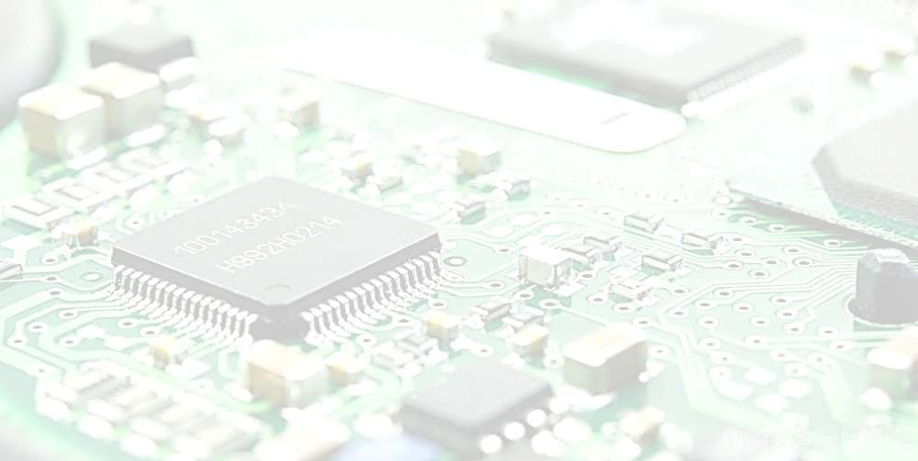



Slide 2

Cache memory
is a small-sized type of volatile
computer memory that provides high-speed data access to a processor and stores frequently used computer programs, applications and data. It stores and retains data only until a computer is powered up.

Slide 3







Slide 4









Small amount of fast memory
Sits between normal main memory and CPU
May be located on CPU chip or module

Slide 5















Address
Address buffer
Control
Control
System bus
Data buffer
Data

Slide 6








The CPU initially looks in the Cache for the data it needs
If the data is there, it will retrieve it and process it
If the data is not there, then the CPU accesses the system memory and then puts a copy of the new data in the cache before processing it
Next time if the CPU needs to access the same data again, it will just retrieve the data from the Cache instead of going through the whole loading process again

Slide 7

Level 1(L1) Cache:
L1-cache is the fastest cache and it usually comes within the processor
chip itself.
The L1 cache typically ranges in size from 8KB to 64KB and uses the high-speed SRAM (static RAM) instead of the slower and cheaper DRAM (dynamic RAM) used for main memory.
It is referred to as internal cache or primary cache.
Level 2(L2) Cache:
The L2 cache is larger but slower in speed than L1 cache.
store recently accessed information. Also known as secondary cache, it is designed to reduce the time needed to access data in cases where data has already been accessed previously.
L2 cache comes between L1 and RAM(processor-L1-L2-RAM) and is bigger than the primary cache (typically 64KB to 4MB).

Slide 8
Level 3(L3) Cache:
L3 Cache memory is an enhanced form of memory present on the motherboard of the computer.
L3, cache is a memory cache that is built into the motherboard. It is used to feed the L2 cache, and is typically faster than the system’s main memory, but still slower than the L2 cache, having more than 3 MB of storage in it.

Slide 9


Commonly used methods:
Direct-Mapped Cache
Associative Mapped Cache
Set-Associative Mapped Cache

Slide 10










Slide 11


Each block of main memory maps to only one cache line
  i.e. if a block is in cache, it must be in one specific place
Address is in two parts
Least Significant w bits identify unique word
Most Significant s bits specify one memory block
The MSBs are split into a cache line field r and a tag of
s-r (most significant)

Slide 12


Tag s-r
Line or Slot r
Word w
2
8
14
24 bit address
2 bit word identifier (4 byte block)
22 bit block identifier
  8 bit tag (=22-14)
  14 bit slot or line
No two blocks in the same line have the same Tag field
Check contents of cache by finding line and checking Tag

Slide 13

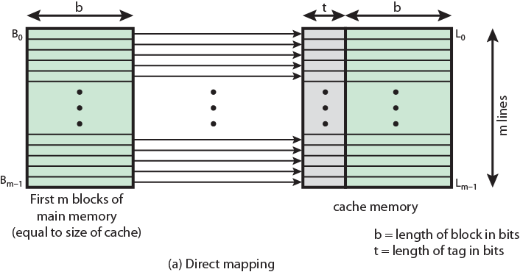

Slide 14
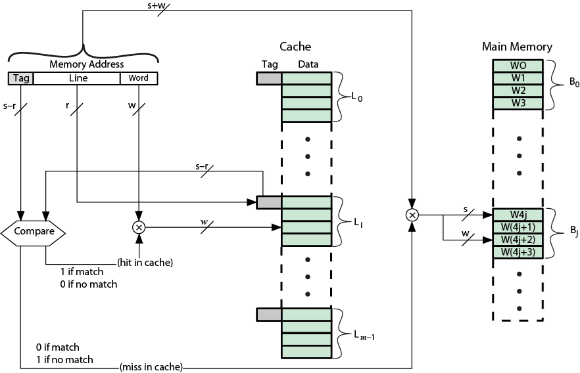

Slide 15




Advantages
The tag memory is much smaller than in associative mapped cache.
No need for an associative search, since the slot field is used to direct the comparison to a single field.

Slide 16

Disadvantages
Consider what happens when a program references locations that are 219 words apart, which is the size of the cache. Every memory reference will result in a miss, which will cause an entire block to be read into the cache even though only a single word is used.

Slide 17
Address length = (s + w) bits
Number of addressable units = 2s+w words or bytes
Block size = line size = 2w words or bytes
Number of lines in cache = m = 2r
Size of tag = (s – r) bits

Slide 18











Slide 19

A main memory block can load into any line of cache
Memory address is interpreted as tag and word
Tag uniquely identifies block of memory
Every line’s tag is examined for a match
Cache searching gets expensive

Slide 20
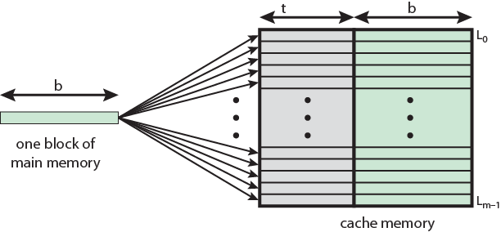

Slide 21
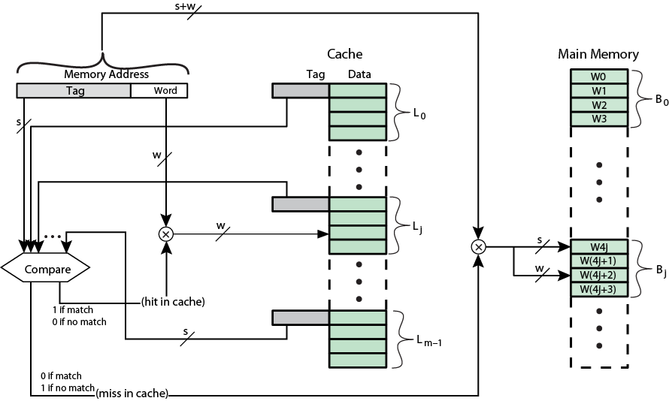

Slide 22




Word
2 bit
Tag 22 bit
22 bit tag stored with each 32 bit block of data
Compare tag field with tag entry in cache to check for hit
Least significant 2 bits of address identify which 16 bit word is required from 32 bit data block
e.g.
Address | Tag | Data | Cache line
FFFFFC | FFFFFC | 24682468 | 3FFF

Slide 23
Advantages
Any main memory block can be placed into any cache slot.
Regardless of how irregular the data and program references are, if a slot is available for the block, it can be stored in the cache.

Slide 24
Disadvantages
Considerable hardware overhead needed for cache bookkeeping.
There must be a mechanism for searching the tag memory in parallel.

Slide 25
Address length = (s + w) bits
Number of addressable units = 2s+w words or bytes
Block size = line size = 2w words or bytes
Number of lines in cache = undetermined
Size of tag = s bits

Slide 26












Slide 27
Cache is divided into a number of sets
Each set contains a number of lines
A given block maps to any line in a given set
e.g. Block B can be in any line of set i
2 way associative mapping
A given block can be in one of 2 lines in only one set

Slide 28
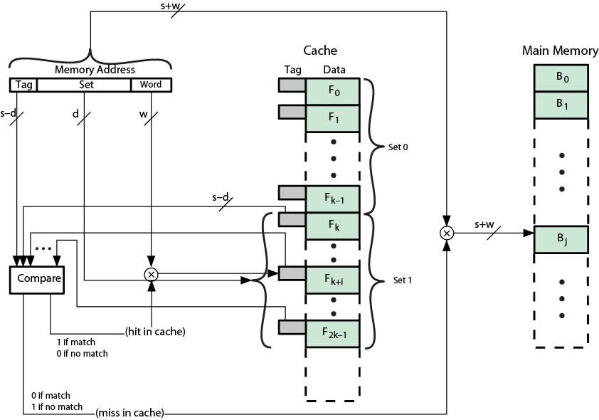

Slide 29

Advantages
In our example the tag memory increases only slightly from the direct mapping and only two tags need to be searched for each memory reference.
The set-associative cache is widely used in today’s microprocessors.

Slide 30
Address length = (s + w) bits
Number of addressable units = 2s+w words or bytes
Block size = line size = 2w words or bytes
Number of blocks in main memory = 2d
Number of lines in set = k
Number of sets = v = 2d
Size of tag = (s – d) bits

Slide 31
The synchronization of data in multiple caches such that reading a memory location via any cache will return the most recent data written to that location via any (other) cache.
Some parallel processors do not provide cache accesses to shared memory to avoid the issue of cache coherency.

Slide 32
If caches are used with shared memory then some system is required to detect, when data in one processor's cache should be discarded or replaced, because another processor has updated that memory location. Several such schemes have been devised.

