Slide 1
Arithmetic Pipeline

Slide 2
Main topics in Pipeline processing is
Arithmetic pipeline :
fixed Arithmetic pipeline
floating point
Vector processing : adder/multiplier pipeline
Array processing : array processor
Attached array processor
SIMD Array Processor

Slide 3
Parallel Processing
Adder-subtractor
Integer multiply
Simultaneous data processing tasks for the purpose of increasing the computational speed
Perform concurrent data processing to achieve faster execution time
Multiple Functional Unit :
Separate the execution unit into eight functional units operating in parallel.
Logic unit
Shift unit
To Memory
Processor registers
Incrementer
Floatint-point add-subtract
Floatint-point multiply
Floatint-point divide

Slide 4
Pipelining: Laundry Example
A B C D
Small laundry has one washer, one dryer and one operator, it takes 90 minutes to finish one load:
Washer takes 30 minutes
Dryer takes 40 minutes
“operator folding” takes 20 minutes

Slide 5
Sequential Laundry
6 PM
7 8
9
Time
10
11
Midnight •
This operator scheduled his loads to be delivered to the laundry every 90 minutes which is the time required to finish one load.
30 40 20 30 40 20 30 40 20 30 40 20
T
a s k
A
In other words he will not start a new task unless he is already done with the previous task
B
O
r d e r
C
The process is sequential. Sequential laundry takes 6 hours for 4 loads
90 min
D

Slide 6
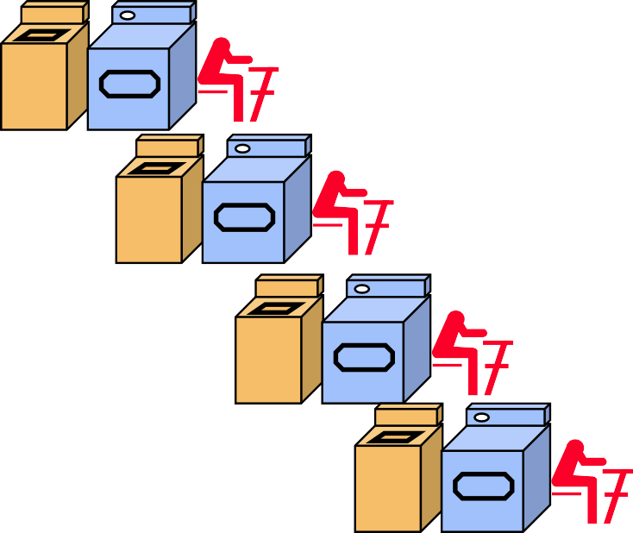
Efficiently scheduled laundry: Pipelined Laundry Operator
6 PM
7 8
9 10 11
Time
Another operator asks for the delivery of loads to the laundry every 40 minutes!?.
30 40 40 40 40 20
T
a s k
40 40 40
A
B
Pipelined laundry takes 3.5 hours for 4 loads
O
r d e r
C
D

Slide 7
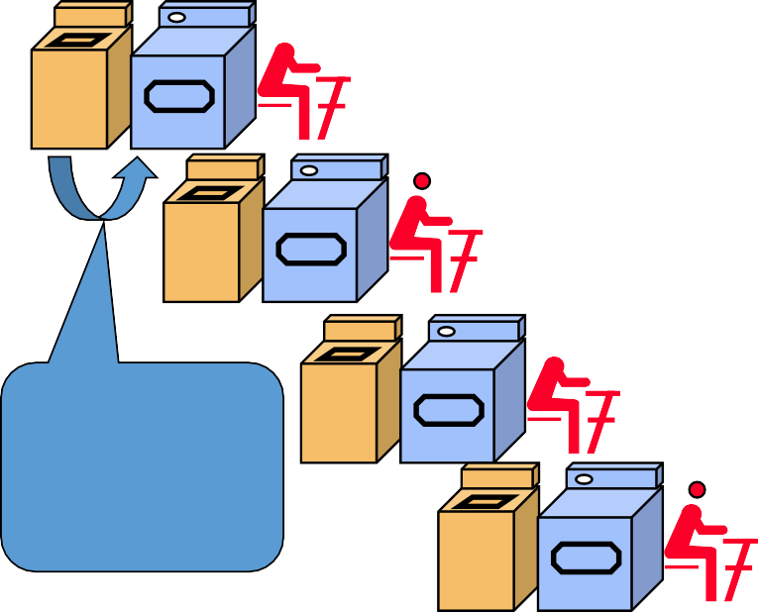
Pipelining Facts
Multiple tasks operating simultaneously
6 PM | 7 |  | 8 | 9
 |  |  |  | Time
30 | 40 | 40 | 40 | 40 20
Pipelining doesn’t help latency (response time) of single task, it helps throughput of entire workload
T
a s k
A
Pipeline rate limited by slowest pipeline stage
O
r d e r
B
Potential speedup = Number of
pipe stages
Unbalanced lengths of pipe stages reduces speedup
C
The washer waits for the dryer for 10 minutes
D

Slide 8
Pipelining
Decomposing a sequential process into suboperations
Each subprocess is executed in a special dedicated segment concurrently
Instruction execution is divided into k segments or stages
Instruction exits pipe stage k-1 and proceeds into pipe stage k
All pipe stages take the same amount of time; called one processor cycle
Length of the processor cycle is determined by the slowest pipe stage
k segments

Slide 9
Pipelining
Suppose we want to perform the combined multiply and add operations with a stream of numbers:
Ai * Bi + Ci for i =1,2,3,…,7
The sub operations performed in each segment of the pipeline are as follows:
R1 ← Ai ,
R2 ← Bi
R3 ← R1 * R2 R4 ← Ci
R5 ← R3 + R4

Slide 10
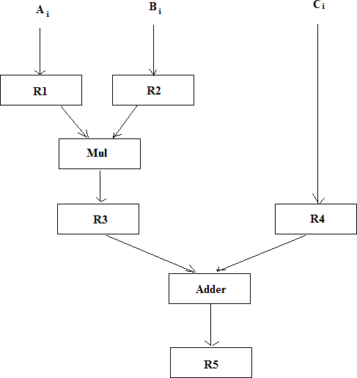
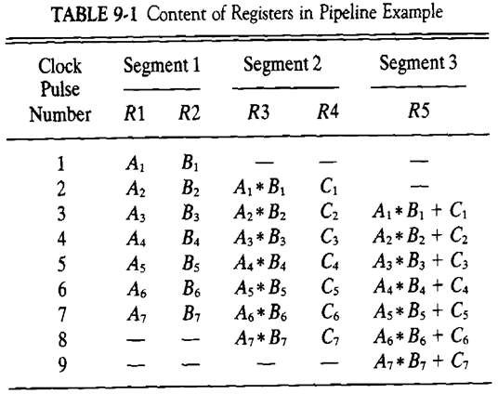

Slide 11
Arithmetic Pipeline
Pipeline arithmetic units are usually found in very high speed computers.
Arithmetic pipelines are constructed for : simple fixed-point
floating-point arithmetic operations.
For implementing the arithmetic pipelines we generally use following two types of adder:
i) Carry propagation adder (CPA): It adds two numbers such that carries generated in successive digits are propagated.
ii) Carry save adder (CSA): It adds two numbers such that carries generated are
not propagated rather these are saved in a carry vector.

Slide 12
Fixed Arithmetic pipeline
We take the example of multiplication of fixed numbers.
Two fixed-point numbers are added by the ALU using add and shift operations.
This sequential execution makes the multiplication a slow process.
Observe that this is the process of adding the multiple copies of shifted multiplicands as show below:

Slide 13
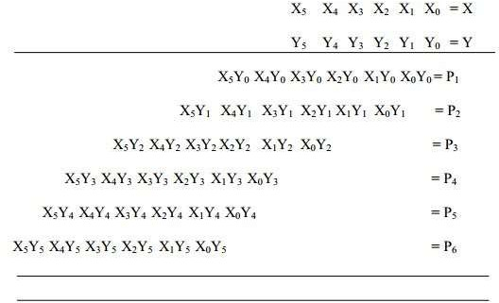
Fixed Arithmetic pipeline

Slide 14
Now, we can identify the following stages for the pipeline:
The first stage generates the partial product of the numbers, which form the six rows of shifted multiplicands.
In the second stage, the six numbers are given to the two CSAs merging into four numbers.
In the third stage, there is a single CSA merging the numbers into 3numbers.
In the fourth stage, there is a single number merging three numbers into
2numbers.
In the fifth stage, the last two numbers are added through a CPA to get the final product.

Slide 15
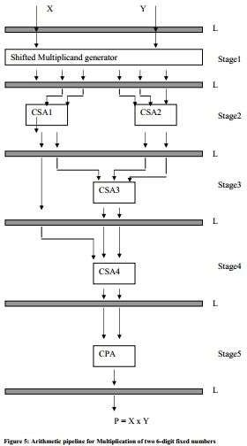

Slide 16
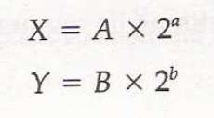
Floating point operations.
The inputs to floating point adder pipeline are two normalized floating point numbers.
Mantissa
Exponent
A and B are mantissas and a and b are the exponents.
The floating point addition and subtraction can be performed in four segments.

Slide 17
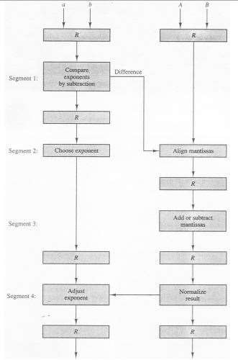
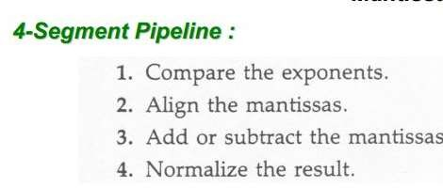
Floating-Point Add/Subtraction Pipeline:
Mantissa
Exponent

Slide 20
Vector Processing
Science and Engineering Applications
Long-range weather forecasting,
Petroleum explorations,
Seismic data analysis
Medical diagnosis ,
Aerodynamics and space flight simulators,
Artificial intelligence and expert systems,
Mapping the human genome, Image processing

Slide 21
Vector Processing

Slide 22
Vector Instruction Format :
Operation code | Base address source 1 | Base address source 2 | Base address destination | Vector length
ADD A B C
Matrix Multiplication
3 x 3 matrices multiplication : n² = 9 inner product
100
⎡ª11 ª12 ª13 ⎤ ⎡^{b}11
^{b}12 ^{b}13 ⎤ ⎡^{c}11
22
^{b}32
^{c}12 ^{c}13 ⎤
21 22 23 ⎥
^{c}32 ^{c}33 ⎥⎦
⎢_{a}
a a
⎥ × ⎢_{b}
b
23 ⎥
^{b}33 ⎥⎦ ⎢⎣^{c}31
⎥
21 22 23 ⎥
b ⎥ = ⎢c
c c
⎢ ⎢
21
⎢
⎢⎣ª31 ª32 ª33 ⎥⎦ ⎢⎣^{b}31
^{c}11 ^{= a}11 ^{b}11 ^{+ a}12 ^{b}21 ^{+ a}13 ^{b}31
: inner product 9
Cumulative multiply-add operation : n³ = 27 multiply-add
c = c + a × b
: Three such multiply-add
^{c}11 ^{= c}11 ^{+ a}11 ^{b}11 ^{+ a}12 ^{b}21 ^{+ a}13 ^{b}31
① ① ② ② ③ ③
therefore 9 X 3 multiply-add = 27
C₁₁ initial value = 0

Slide 23
Pipeline for calculating an inner product :
Floating point multiplier pipeline : 4 segment
Floating point adder pipeline : 4 segment
Example:
C = A₁B₁ + A₂ B₂ + A₃B₃ +Λ + A_{k} B_{k}
after 1st clock input
after 4th clock input
Source A
Source A
A
1^{B}1
A₄B₄
A₃B₃
A₂B
₂ A₁B
1
Source B
Multiplier
Adder
Source B
Multiplier
Adder
pipeline
pipeline
pipeline pipeline
after 8th clock input
after 9th, 10th, 11th ,...
Source A
Source A
₆ A₅B
A₄B₄
A₃B
3 ^{A}2
B₂ A₁B₁
A₈B₈
A₇B₇
A₆B
₆ A₅B
5
A₄B₄
A₃B₃
A₂B
₂ A₁B
1
A A₇B₇ A₆B
8^{B}8
5
Source B
Multiplier
Adder
Source B
Multiplier
Adder
pipeline
pipeline
pipeline
pipeline
C = A₁B₁ + A₅B₅ + A₉ B₉ + A₁₃B₁₃ +Λ
A₂ B₂ + A₆B₆
A₁B₁ + A₅B₅
The four partial sum are added to form the final sum
+ A₂ B₂ + A₆ B₆ + A₁₀B₁₀ + A₁₄B₁₄ +Λ
, , , ⑩ ⑨
+ A₃B₃ + A₇ B₇ + A₁₁B₁₁ + A₁₅B₁₅ +Λ
+ A₄ B₄ + A₈ B₈ + A₁₂B₁₂ + A₁₆B₁₆ +Λ

Slide 24
Memory Interleaving
Memory Interleaving :
Simultaneous access to memory from two or more source using one memory bus system.
Select one of 4 memory modules using lower 2 bits of AR
Example) Even / Odd Address Memory Access
Address bus
AR AR AR AR Memory Memory Memory Memory array array array array DR DR DR DR
Data bus

Slide 25
Array Processor
Processor that performs the computations on large arrays of data.
Vector processing : Adder/Multiplier pipeline use Array processing: using a separate array processor
There are two different types of (array processor) :
Attached Array Processor
SIMD Array Processor

Slide 26
Attached Array Processor
It is designed as a peripheral for a conventional host computer.
Its purpose is to enhance the performance of the computer by providing vector processing.
It achieves high performance by means of parallel processing with multiple functional units.
General-purpose computer
Input-Output interface
Attached array Processor
High-speed memory to- memory bus
Main memory
Local memory

Slide 27
SIMD Array Processor
It is processor which consists of multiple processing unit operating in parallel.
The processing units are synchronized to perform the same task under control of common control unit.
Each processor elements(PE) includes an ALU , a floating point arithmetic unit and working register.
PE 1
M1
Master control unit
PE 2
M2
PE 3
M3
Main memory
PE n
Mn

