Slide 1
Criteria for waste to energy process.-
Non recyclable waste having calorific value of 1500 KCal/kg or more shall not be disposed of on landfills and shall only be utilised for generating energy either or through refuse derived fuel or by giving away as feed stock for preparing refuse derived fuel.
High calorific wastes shall be used for co-processing in cement or thermal power plants.
The local body or an operator of facility or an agency designated by them proposing to set up waste to energy plant of more than five tones per day processing capacity shall submit an application in Form-I to the State Pollution Control Board or Pollution Control Committee, as the case may be, for authorization.
The State Pollution Control Board or Pollution Control Committee, on receiving such application for setting up waste to energy facility, shall examine the same and grant permission within sixty days.

Slide 2
Chemical Transformation of Solid Waste
1. Combustion (or chemical oxidation)
Combustion is carried out in the presence of enough air to oxidize the organic matter
Key products are N₂, CO₂, H₂O, O₂, Ash, and
Heat is generated (exothermic reactions)
Used for waste to energy plants
2. Pyrolysis
Thermal reactions in absence of oxygen
Endothermic reactions (heat is taken by the reaction)
Organic fraction transforms into H₂, CH₄, CO₂, trace gases, tar/oil, acetic acid, acetone, and char (carbon)

Slide 3
3. Gasification
Partial combustion of carbonaceous fuel to generate combustible fuel gas rich in CO, H₂, saturated hydrocarbons (CH₄)
Internal combustion engine can be used to burn the combustible fuel gas to generate energy

Slide 4
Combustion of Solid Waste
The principal elements of solid waste are carbon, hydrogen, oxygen, nitrogen and sulfur.
Under ideal conditions, when solid-waste materials are combusted (burned) the gaseous end product include CO₂ (carbon dioxide), H₂O (water), N₂ (nitrogen), and SO₂ (sulfur dioxide).

Slide 5
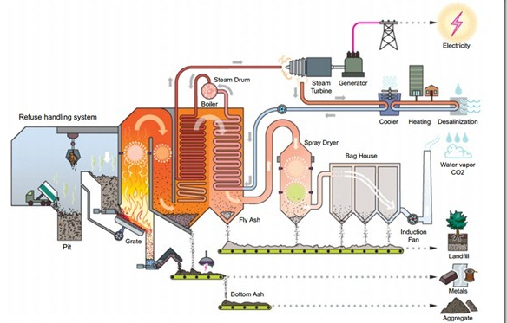

Slide 6
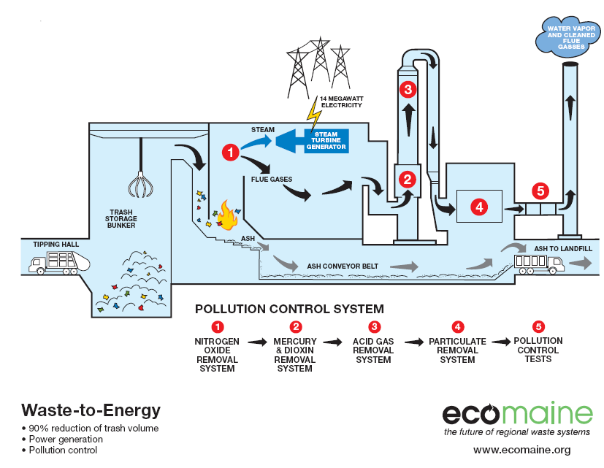
Air

Slide 7
Types of Combustion Systems
Mass-Fired (commingled solid waste is
used as fuel)
RDF-Fired (processed solid waste is used as fuel – more efficient system than mass-fire and less toxic emissions)
Fluidized Bed (sand or limestone bed is heated using coal, natural gas, or RDF) limestone reduces SO₂ emissions.

Slide 8
Power Plant Process Flow
RDF
Ash Handling System
Flue Gas Treatment System
Chimney
Primary Air
SCAPH
Boiler
CEMS
Secondary Air
Deaaerator
Makeup
Water
Instrument
Air
Service
Air
Turbine Generator
Condenser
RO
Compressor
Switchyard
Process
Water
Water Treatment Plant
Internal Consumption
Export to grid
(Green Power)
1.1 MLD Treated Sewage Water

Slide 9
Air Requirements for Combustion
For carbon: - C + O₂ → CO₂
(12) (32) (44)
For hydrogen: - 2H₂ + O₂ → 2H₂O
(4) (32) (36)
For sulfur: - S + O₂ → SO₂
(32) (32) (64)
If it is assumed that air contains 23.15 percent oxygen by mass, then the amount of air required for the complete oxidation of 1 kg of carbon would be equal to [(32/12)(1/0.2315)] =11.52 kg
The corresponding amount for hydrogen and sulfur are 34.56 and 4.31 kg, respectively.
In combustions, the oxygen requirements for the combustion of hydrogen usually are based on the net value of hydrogen available. The net value of hydrogen is computed by subtracting one-eighth of the percent oxygen from the total percentage of hydrogen present initially.
This computation is based on the assumption that the oxygen in the sample will combine with the hydrogen in the waste to form water.

Slide 10
Determining Air Requirement for combustion Determine the air requirement expressed in kilograms per tonne of waste for the complete oxidation of a waste
Element | Percent by mass
Carbon | 44.3*
Hydrogen | 7.4
Oxygen | 47.3
Nitrogen | 1.0
Compute the net available hydrogen not bound as water.
Net available hydrogen = 7.4% - 47.3%/8 = 1.49%

Slide 11
Compute the air required per tonne of waste.
Using the air requirements developed for carbon (11.52 kg/kg)
and hydrogen (34.56 kg/kg), the required air is computed as follow:
Element | Kg/tonne
Carbon (0.443 × 1000)11.52 | 5103
Hydrogen (0.0149 × 1000)34.56 | 515
Total | 5618

Slide 12
Electrical Energy Recovery
MSW has a heating value ranging from 9300 to 12,800 kJ/kg or 3000 Kcal//kg (Developed Countries).
It is possible to recover this energy by using MSW to fire boilers in orders to produce steam
Steam can be used to drive a steam turbine.
The turbine then turns a generator producing electricity.

Slide 13
Efficiencies and Losses
Heat losses:
Due to the sensible heat content of the ash and gases (the specific heat is normally taken as 1047 J/kg. ºC)
The unburned carbon remaining in the ash (The heating value of carbon is 32,851 kJ/kg),
Heat loss due to radiation (0.003 to 0.005 kJ/kg of fuel).
Water losses: Since the actual furnace combustion suspends all the combustion water in gaseous form, energy of vaporization is needed for this suspension. The latent or vaporization of water is equal to 2420 kJ/kg. It Includes
Loss due to the moisture content,
Loss due to combined water,
Loss due to the net hydrogen water.

Slide 14
Heat losses in combustion of solid waste
Types of losses | Remarks
Sensible heat Sensible heat in residue & Stack gases | Specific heat of residue is taken as 1047 J/kg. K
Reactor Unburned carbon 2. Radiation | Typically, the grate residue is assumed to contain from 4 to 8 percent carbon. The heating value of carbon is about 32,789 kJ/kg Heat lost through the reactor walls and other appurtenances to surroundings is estimated as 0.003-0.005 kJ/kg of furnace input.

Slide 15
Types of losses | Remarks
Latent heat Inherent moisture. Moisture in bound water Moisture from oxidation of net hydrogen | Water content of waste. The latent heat of vaporization for water is approximately 2420 kJ/kg.

Slide 16
Determining combustion heat balance: Determine the heat available in the exhaust gases from the combustion of 100 tonnes/d of RDF with an energy content or 10,500 kJ/kg (HHV, As Received) and the following composition. Assume the incinerator residue contain 5 percent carbon and that the temperatures of the entering air and residue from the grate are 25 and 425 ºC, respectively.
Element | Percent by mass
Carbon Hydrogen Oxygen Nitrogen Sulfur Water Inerts | 28 5 22 4 1 20 20

Slide 17
Compute carbon in residue.
Inerts = 20 tonnes/d
Total residue = 20/0.95 = 21.1 (Including 1.1 tonne of unburnt carbon)
Carbon in residue (5 %) = 1.1 tonnes/d
Compute net available hydrogen.
Net available hydrogen = 5% - 22%/8 = 2.25 %
Amount of water produced from combustion of hydrogen
Compute bound water.
Hydrogen in bound water = 5% - 2.25% = 2.75%
Bound water H₂O = (2.75 x 8) + 2.75% = 24.75%

Slide 18
Item | 10⁶ kJ/d
Gross heat input 10⁵ kg/d × 10.500 kJ/kg Heat lost in unburned carbon 0.011 × 10⁵ kg/d × 32,789 kJ/kg Inherent moisture 0.2 × 10⁵ kg/d × 2420 kJ/kg Moisture in bound water 0.2475 × 10⁵ kg/d × 2420 kJ/kg Moisture from oxidation of hydrogen 0.2025 × 10⁵ kg/d × 2420 kJ/kg Radiation loss 10⁵ kg/d × 0.005 kJ/kg Sensible heat in residue/Ash 0.211 × 10⁵ kg/d × 1.047 kJ/kg K × (698 – 298 K) Sensible heat in hot gases | 1050 -36 -48 -60 -49 - -9 848

Slide 19
Assuming a boiler efficiency of 80%
Steam energy available = 0.8(848) (10⁶) = 6.78(10⁸) kJ/day
Efficiency of Steam Engine 30 %
Energy Produced 2.5 x 10⁸ kJ/day or 50,000 kW-h

Slide 20
Flue Gas Pollutants
Particulates
Acid Gases
SOx
NO_{x}
CO
Organic Hazardous Air Pollutants
Metal Hazardous Air Pollutants

Slide 21
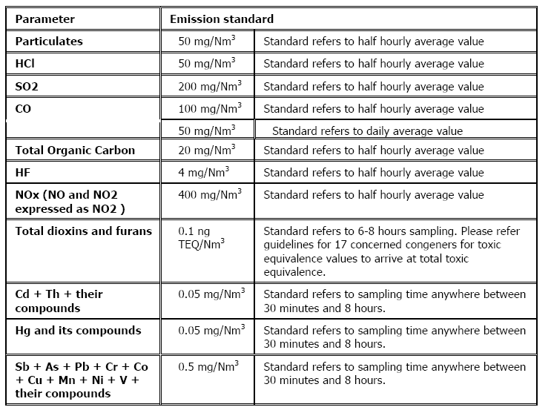

Slide 22
Note:
(i) Suitably designed pollution control devices shall be installed or retrofitted with the incinerator to achieve the above emission limits, if necessary.
(ii) Waste to be incinerated shall not be chemically treated with any chlorinated disinfectants.
(iii) Chlorinated plastics shall not be incinerated. ????
(iv) Toxic metals in incineration ash shall be limited within the regulatory quantities as specified in the Hazardous Waste (Management, Handling and Trans boundary Movement) Rules, 2008, as amended from time to time.
(v) Only low sulphur fuel like LDO or LSHS or Diesel shall be used as fuel in the incinerator.
(vi) The CO₂ concentration in tail gas shall not be less than 7%.
(vii) All the facilities in twin chamber incinerators shall be designed to achieve a minimum temperature of 950ºC in secondary combustion chamber and with a gas residence time in secondary combustion chamber not less than 2 (two) seconds.
(viii) Incineration plants shall be operated (combustion chambers) with such temperature, retention time and turbulence, as to achieve total Organic Carbon (TOC) content in the slag and bottom ashes less than 3%, or their loss on ignition is less than 5% of the dry weight.

Slide 23
Particulates
Solid
Condensable
Causes
Too low of a combustion T (incomplete combustion)
Insufficient oxygen (too high T)
Insufficient mixing or residence time
Too much turbulence, entrainment of particulates
Control
Cyclones - not effective for removal of small particulates
Electrostatic precipitator
Fabric Filters (baghouses)

Slide 24
Acid Gases
From Cl, S, N, Fl in refuse (in plastics, textiles, rubber, yd waste, paper)
Acid gas scrubber (SO₂, HCl, HF)
Wet scrubber
Spray dryer
Dry scrubber injectors

Slide 25
Metals
Removed with particulates
Mercury remains volatilized
Tough to remove from flue gas
Remove source or use activated carbon (along with dioxins)

Slide 26
NITROGEN REMOVAL
Source removal to avoid fuel NO_{x} production
T < 1500 ºF to avoid thermal NO_{x}
Selective catalytic reaction via injection of ammonia.
Selective Non-Catalytic Reduction

Slide 27
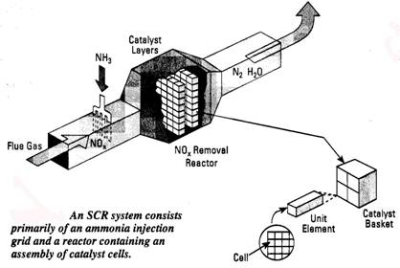
Selective catalytic reduction
Employs ammonia injection into the flue gas, followed by gas passage over a catalyst bed. The following reaction occurs in the temperature range of 530 to 800 ºF:
NO + NH₃ + 1/4 O₂ → N₂ + 3/2 H₂O

Slide 28
Selective-Non Catalytic Reduction (High Temperature)
Ammonia in gaseous form is directly injected into the furnace at 950 ºC
NO + NH₃ + O₂ + H₂O + H₂ → N₂ +H₂O

Slide 29
Control of Dioxins, Furans
Minimum temperatures in thermal processing systems of 950 ºC with a minimum residence time of 2 seconds to minimize the generation of CO also minimize generations of dioxins and furans.
Providing Dioxin Filters- Activated Carbon etc.,

Slide 30
Prevention of Dioxin, CO Formation
High Temperature Combustion
Mixing Gas and Air
Long Holding Time at High Temperature

Slide 31
Air Pollution Control-Summary
First Step: Cooling of Flue Gas
Second Step- Add Slaked Lime and Activated Carbon- Adsorption of Dioxins and Mercury
Third Step- Collection of Particulate matter and adsorbed Pollutants

Slide 32
Wet Scrubber- SO₂, HCl, HF

Slide 33
Second Stage Adsorption and Nitrogen Removal

Slide 34
Air Pollution Control

Slide 35
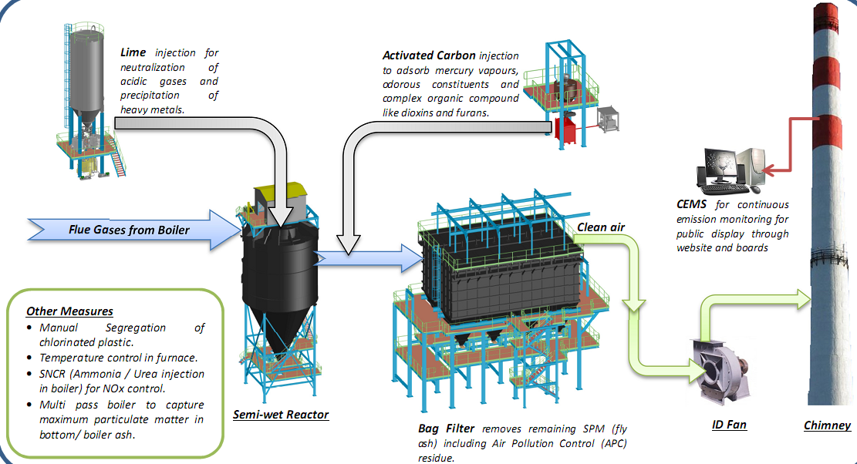
Flue Gas Treatment System- Delhi

Slide 36
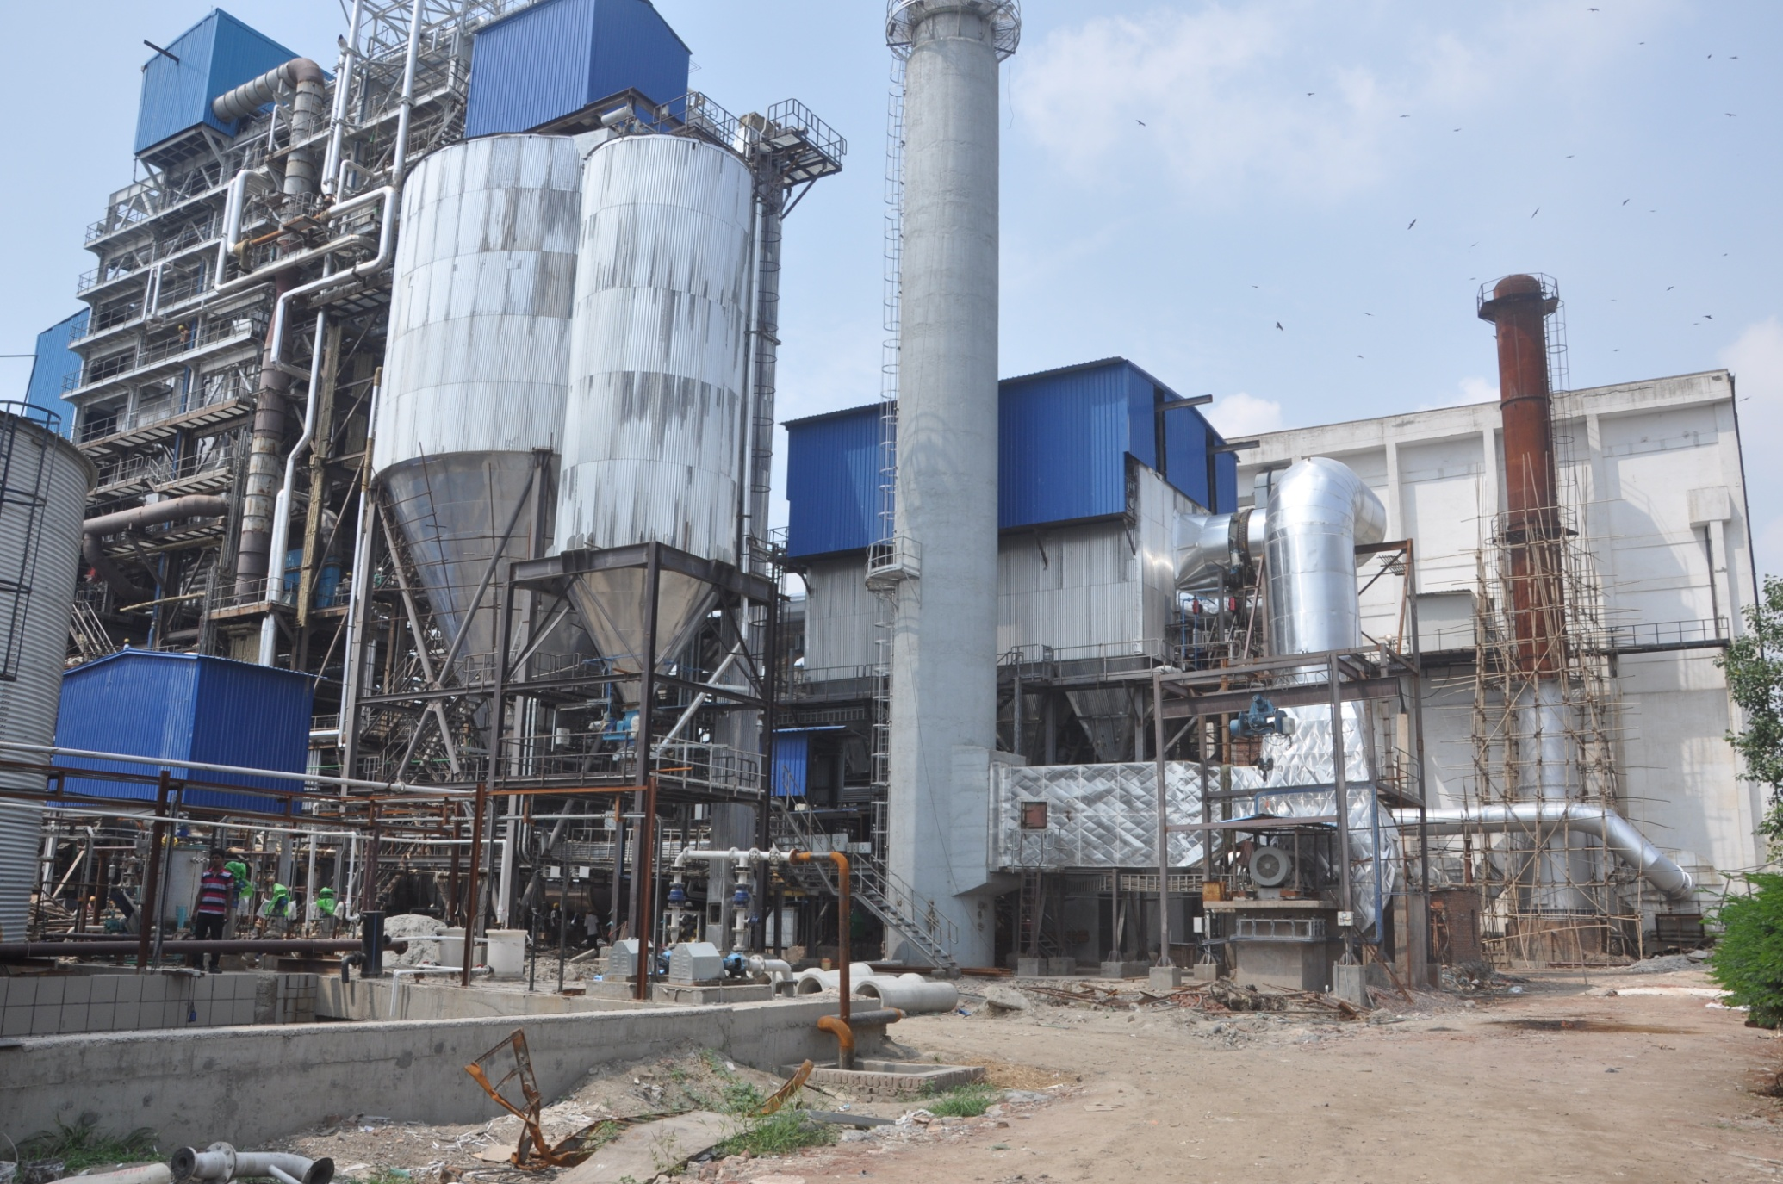
FLUE GAS TREATMENT SYSTEM

Slide 37
Ash
Bottom Ash – recovered from combustion chamber
Heat Recovery Ash – collected in the heat recovery system (boiler, economizer, superheater)
Fly Ash – Particulate matter removed prior to sorbents
Air Pollution Control Residues – usually combined with fly ash

Slide 38
Schematic Presentation of Bottom Ash Treatment

Slide 39
Utilization
Bottom ash : Use
Making hollow block for construction work
Raw material for cement production
Can be mixed with RMC
Can be used as filling material
Fly ash & APC residue
Depending upon the characteristics, can be used for cement blocks and asphaltic mixtures
To be disposed at secured landfills after testing its leachability

Slide 40
Ash Reuse Options
Construction fill
Road construction
Landfill daily cover
Cement block production
Treatment of acid mine drainage

Slide 41
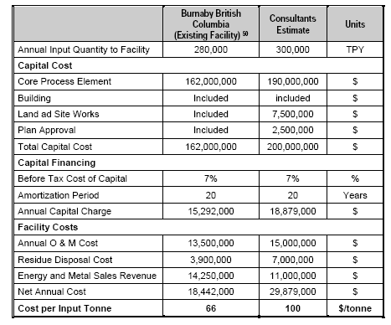
annual finance rate of 7%; and
• inflation rate of 3%.

