Slide 1
INDUS UNIVERSITY
Subject: Energy Conservation and Management (DE-II)
Subject Code: ME0709
Unit No. 4
Topic 7 : Energy Efficiency in Thermal Devices-II
Heating, Ventilation, Air Conditioning (HVAC) and Refrigeration System
Topic 8 : Energy, Environment and Climate Change

Slide 2
Topic 7: Energy Efficiency in Thermal Devices-II
- Heating, Ventilation, Air Conditioning (HVAC) and Refrigeration System

Slide 3




INTRODUCTION
Refrigeration deals with the transfer of heat from a low temperature level at the heat source to a high temperature level at the heat sink.
Air conditioning for comfort Refrigeration for process

Slide 4
PERFORMANCE ASSESSMENT
The specific power consumption kW/TR is a useful indicator of the performance of refrigeration system. By messing refrigeration duty performed in TR and the Kilo Watt inputs measured, kW/TR is used as a reference energy performance indicator.
The refrigeration TR is assessed as TR
= Q ⋅C ⋅ (T – T ) / 3024
p i o
Where TR is cooling TR duty
Q is mass flow rate of coolant in kg/hr
C is coolant specific heat in kCal /kg / C
0
p
T is inlet. Temperature of coolant to evaporator (chiller) in C.
0
i
T is outlet temperature of coolant from evaporator (chiller) in C.
0
o

Slide 5
OVERALL ENERGY CONSUMPTION
Compressor kW Chilled water pump kW
Condenser water pump kW Cooling tower fan kW
Overall kW/TR = sum of all above kW/ TR

Slide 6
EFFECT OF VARIATION
IN EVAPORATOR
TEMPERATURE
ON COMPRESSOR
POWER
CONSUMPTION
Evaporator Temperature (⁰C) | Refrigeration Capacity (tons) | Specific Power Consumption | Increase in kW/ton (%)
5.0 | 67.58 | 0.81 | -
0.0 | 56.07 | 0.94 | 16.0
-5.0 | 45.98 | 1.08 | 33.0
-10.0 | 37.20 | 1.25 | 54.0
-20.0 | 23.12 | 1.67 | 106.0
A 1⁰C raise in evaporator temperature can help to save almost 3 % on power consumption.

Slide 7
EFFECT
OF VARIATION IN
CONDENSER
TEMPERATURE ON COMPRESSOR
POWER
CONSUMPTION
Condensing Temperature (⁰C) | Refrigeration Capacity (tons) | Specific Power Consumption | Increase in kW/TR (%)
26.7 | 31.5 | 1.17 | -
35.0 | 21.4 | 1.27 | 8.5
40.0 | 20.0 | 1.41 | 20.5

Slide 8
EFFECT OF POOR
MAINTENANCE
ON COMPRESSOR
POWER
CONSUMPTION
Condition | Evap. Temp (⁰C) | Cond. Temp (⁰C) | Refrigeration Capacity (tons) | Specific Power Consumption (kW/ton) | Increase in kW/Ton (%)
Normal | 7.2 | 40.5 | 17.0 | 0.69 | -
Dirty | 7.2 | 46.1 | 15.6 | 0.84 | 20.4
condenser
Dirty | 1.7 | 40.5 | 13.8 | 0.82 | 18.3
evaporator
Dirty | 1.7 | 46.1 | 12.7 | 0.96 | 38.7
condenser
and
evaporator

Slide 9
ENERGY
SAVINGS
OPPORTUNITIES
Cold Insulation
Process Heat Loads Minimisation
Flow optimization and Heat transfer area increase to accept higher temperature coolant
Avoiding wastages like heat gains, loss of chilled water, idle flows
Frequent cleaning / de-scaling of all heat exchangers

Slide 10
AT THE REFRIGERATION PLANT AREA
Ensure adequacy of chilled water and cooling water flows, avoidance of bypass flows by valving off the idle equipment.
Minimize part load operations by matching loads and plant capacity on line, adopting variable speed drives for varying process load.
Ensure efforts to continuously optimize condenser and evaporator parameters for minimizing specific energy consumption and maximizing capacity.
Adopt VAR system where economics permit as a non CFC solution

Slide 11
SELECT THE
RIGHT
COOLING MEDIUM
Power Consumption
Type of cooling
Cooling tower water
Chilled water System at 10ºC
Brine System at -20ºC
0.1 KW/TR
0.7 KW/TR
1.8 KW/TR
Order of preference Cooling water
ChilledWater
Brine

Slide 12
ENERGY
SAVINGS
IN REFRIGERATION
SYSTEMS
There are two broad ways by which energy can be conserved
By decreasing the load
By optimising the refrigeration system

Slide 13

CALCULATING
THE OPERATING
LOAD OF A
CHILLER
PLANT
Refrigeration plant
Hot well
plant
Process
Cold well 8^{O}C
Chilled water flow – 100 m³/hr
m
C_{p}
DT
Refrigeration TR -
100,000 kg/hr x 1 x 4
3000
- 133.33 TR
Power drawn by compressor, kW
Efficiency-
TR
120
-
= 0.9
133.33

Slide 14
EFFICIENT OPERATION & MAINTENANCE
The suction temperature, pressure delivery pressure of compressors should be kept at optimum level
Ensure all indicators are working properly Keep record of oil consumption
Condensers
Remove scale and algae and adopt suitable water treatment Give periodic purging of non-condensable gases
Lesser the water temperature more the COP Routine defrosting of Cooling coils
Stop condenser water pump when compressor not working
5^{O}C rise in condensing temperature increases 10 % power consumption 5^{O}C rise in evaporating temperature increases 10 % power consumption

Slide 15
ENERGY SAVING MEASURES IN REFRIGERATION
Look for process modifications to reduce the cooling load
Use cooling water to remove the maximum heat before using chilled water Provide VSD for condenser water pumps
to vary the cooling water flow to maintain 4ºC difference across the condensers
Avoid primary pump operation
Normally two pumps are operation
(Chilled water supply pump from cold well and return water pump from hot well)
Modify to operate only return water pump Provide VSD for efficient part load operation
Explore ‘Ice-bank’ system for Maximum demand reduction Explore application of vapour absorption with cost economics Replace old systems with modern energy efficient systems

Slide 16
COLD INSULATION
Difference in temperature between
Heat ingress k Cal/m² /hr
Exposed area per tonne of
ambient | and | surface |  | refrigeration
 | 5 |  | 35 | 86
 | 10 |  | 73 | 41
 | 15 |  | 113 | 27
 | 20 |  | 154 | 19
Basis:
Ambient temperature - 35^{O}C, emissivity – 0.8, still air conditions Allowable heat ingress – 10 –15 Kcal/m²/hr
Thumb rules for cold Insulation
Chilled water pipe insulation (Provide 2 to 3 inch thickness) Duct insulation (Provide 1 to 2 inch thickness)
Suction line refrigerant pipe insulation(Provide 2 to3 inch thickness)

Slide 17
ENERGY EFFICIENT HVAC

Slide 18
HVAC is typically responsible for around 40% of the energy consumption in a building. Frequently, this is the largest energy consuming type of equipment on a site and can therefore provide significant scope for saving energy and money. This fact sheet covers common types of HVAC and will guide you in the right direction to identify energy efficient HVAC initiatives.

Slide 19
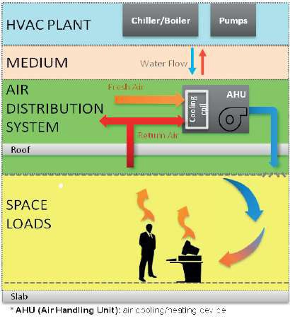
WHAT IS HVAC?
HVAC is an acronym for heating, ventilation and air conditioning.
It refers to all the different systems, machines and technologies that are used to regulate the temperature and air quality in an indoor environment.
Also filter and recirculate air to remove odour, dust and other particulates to provide acceptable standards in air quality
A Building Management System (BMS) controls operation of HVAC system components: fans, pumps, chiller heater (boiler) and cooling tower

Slide 20
Heating can be accomplished by heating the air within a space (e.g. supply air systems, perimeter fin-tube "radiators"), or by heating the occupants directly by radiation (e.g. floor/ceiling/wall radiation or radiant panels).
Ventilating maintains an adequate mixture of gases in the air we breath (e.g. not too much CO₂), controls odors, and removes contaminants from occupied spaces. "Clean" air helps keep occupants healthy and productive. Ventilation can be accomplished passively through natural ventilation, or actively through mechanical distribution systems powered by fans.
Air-conditioning refers to the sensible and latent cooling of air. Sensible cooling involves the control of air temperature while latent cooling involves the control of air humidity.
Controls ensure occupant comfort, provide safe operation of the equipment, and in a modern HVAC control system enable judicious use of energy resources.

Slide 21
WHY HVAC MATTERS?
Efficient HVAC systems do more than just make an area comfortable; they can help to reduce running costs, improve the working environment, increase productivity and safety, improve aesthetics and reduce greenhouse gas emissions.
Increasing the efficiency of your HVAC system is an effective way to cut energy consumption, generate financial savings and reduce your organisation’s environmental footprint – whether you are in an office, church, school or even a sporting facilities.

Slide 22
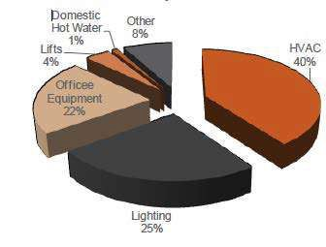
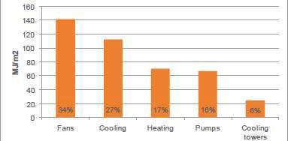
ENERGY CONSUMPTION OF HVAC SYSTEMS
In many buildings HVAC is the largest energy consumer.
Figure 1. Energy breakdown for a typical office space
Figure 2. HVAC energy breakdown (%)

Slide 23
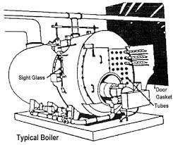
TYPES OF HVAC SYSTEMS
HEATING SYSTEMS
Boiler: Boilers are used to generate steam or hot water and can be fired by natural gas, fuel oil, or coal.
Furnace: Furnaces can be used for residential and small commercial heating systems. Furnaces use natural gas, fuel oil, and electricity for the heat source
Heat pump: Heat pumps are devices that add heat to or extract heat from a conditioned space. Both refrigerators and air conditioners are types of heat pumps that extract heat from a cooler, conditioned space and reject it to a warmer space (i.e., the outdoors). Heating can be obtained if this cycle is reversed: heat is moved from the outdoors to the conditioned space indoors. Heat pumps are available in two major types: conventional packaged (air- source) and water-source (conventional or geothermal).
HEATING CONTROLS
Modulating flame
Step-fired
Modular boilers
Oxygen trim

Slide 24
➢VENTILATION SYSTEMS
Constant air volume (CAV): systems deliver a constant rate of air while varying the temperature of the supply air.
Variable air volume (VAV): systems vary the amount of air supplied to a zone while holding the supply air temperature constant. This strategy saves fan energy and uses less reheat than in a CAV system.
Low-flow air diffuser in VAV systems help maintain uniform air distribution in a space at low airflows. These devices can be passive or active. Passive low flow diffusers are designed to mix the supply air with the room air efficiently at low flow. Active diffusers actually move the outlet vanes of the diffuser to maintain good mixing at low flow. Active diffusers can also be used as VAV terminal units.
Fan-powered VAV terminal units provide another method to improve air distribution at low load conditions. These units combine the benefits of a VAV system, by reducing central fan energy and reheat energy, with the benefits of a CAV system, by maintaining good airflow.

Slide 25
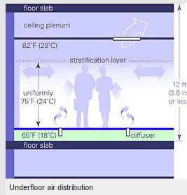
5. Raised floor air distribution delivers air low in the space, at low velocity and relatively high temperature compared to traditional plenum mounted distribution systems. Delivering air through a series of adjustable floor- mounted registers permits room air to be stratified with lower temperatures in the bottom portion of the room where people are located and high temperatures towards the ceiling. This system type is attracting increasing
interest because it has the potential to save energy and to provide a high degree of individual comfort control. These systems have historically used constant-volume air delivery.
Manufacturers are now beginning to offer VAV systems that are more easily designed, installed, and operated with
raised floor plenum systems.

Slide 26
➢VENTILATION SYSTEM CONTROLS
Direct digital control (DDC) systems using digital-logic controllers and electrically-operated actuators are replacing traditional pneumatic controls.
CAV systems have controls to reset the supply air temperature at the cooling coil to provide the warmest air possible to the space with the highest cooling load.
VAV systems now be designed to serve areas with as little as six tons of cooling load. Inlet vanes or, better yet, variable speed fans should be used to control air volume.
CO₂-based control systems control the amount of outside air required for ventilation. These systems monitor the CO₂ in the return air and modulate the outside air damper to provide only the amount of outside air required to maintain desired levels. Since CO₂ does not account for contaminants released by the building materials, there must be a minimum amount of outside air even when the spaces are unoccupied.

Slide 27
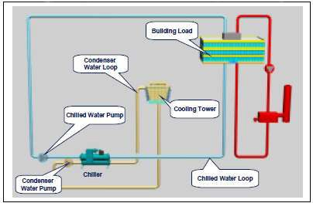
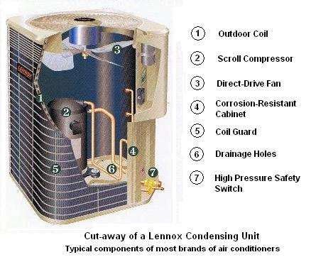
➢AIR-CONDITIONING EQUIPMENT
Chillers: In large commercial and institutional buildings, devices used to produce cool water are called chillers. The water is pumped to air handling units to cool the air. They use either mechanical refrigeration processes or absorption processes.
Condensers: are heat exchangers that are required for chillers to reject heat that has been removed from the conditioned spaces. Condensers can be either air-cooled or water-cooled. Water-cooled condensers often rely on rooftop cooling towers for rejecting heat into the environment; however, it is possible to reject the heat to the ground or river water.

Slide 28
➢AIR-CONDITIONING EQUIPMENT CONTROLS
Controls that significantly affect the energy efficiency of chillers include:
  Variable speed drives achieve good part-load performance by matching the motor output to the chiller load, and by cycling off at a lower fraction of capacity than constant-speed chillers.
  Multiple compressor achieves a closer match of the load than single- compressor chillers by sequencing the compressors as needed.
  Water temperature reset controls raise the water temperature as the demand decreases, allowing for more efficient chiller operation.
Strategies that significantly affect the energy efficiency of cooling towers
include the use of:
  Variable-speed or multiple-speed fans
  Wet-bulb reset strategies, where the temperature of the cooling water is adjusted according to the temperature and humidity of outside air (instead of maintaining it constant)
  Fans and pumps that use variable frequency drive (VFD) controls to reduce energy use at part-load

Slide 29
HOW HVAC WORKS?
Central cooling system
The central cooling system is in essence a split system, meaning that it is comprised of an outdoor cabinet with condenser and compressor units built in. While the compressor and condenser are stored outside, the evaporator coil is housed inside. This is where the separate systems are brought together, installed in conjunction with both the air handler and the furnace.
The air exchange
Your unit first takes warm air from inside the structure and blows it across the evaporator coil. The heat energy then transfers the air to the refrigerant that is already inside the coil. The transfer is what allows the unit to cool the air. The refrigerant then is pumped back into the compressor and the whole cycle starts all over again.
Central heating system
For your central heating system, this has a primary heating source such as a furnace. A furnace will usually be located in the basement, garage, or even the attic of your home or structure. Quite simply, the furnace feeds an energy source into the unit (usually natural gas or electricity) at the same time it brings in air. Burners in the furnace then heat up the air and deliver it into your structure by way of the air ducts.
While this is a very simplified version of how your HVAC central cooling and heating system works, still it gives you the basic idea.

Slide 30
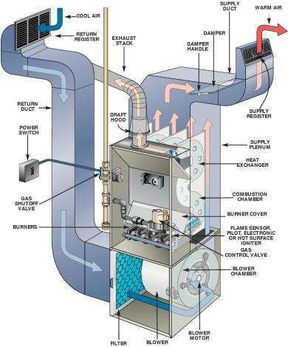

Slide 31
THREE MAIN FACTORS THAT AFFECT THE DEMAND ON A HVAC SYSTEM TO ACHIEVE ENERGY SAVINGS:
The design, layout and operation of the building affect how the external environment impacts on internal temperatures.
The heat generated internally by lighting, equipment and people, or removed by refrigeration equipment or fans, all have an impact on how warm or cool your building is.
The amount of temperature difference between a conditioned space and its environment (temperature set points).

Slide 32
ENERGY SAVINGS THROUGH HVAC
There are two key areas where savings can be made:
1. Quick wins – areas that can be addressed at no or low cost almost straight away
Turn HVAC units off
Optimise temperature/humidity settings in each area
Minimise heat gain (in summer)
Minimise ventilation rates
2. Strategic – those areas which are more complex, or require more capital investment
Maintenance
Insulation/draught-proofing/shading
Variable Speed Drives (VSDs)
Economy cycle
Upgrade cooling & heating systems
Cogeneration/Trigeneration
Energy recovery ventilation systems
Ground-Source Heat Pumps

Slide 33
ENERGY CONSERVATION STRATEGIES FOR HVAC
SYSTEMS
Heating ventilation and air-conditioning systems consumes nearly 50 to 60% of the total power consumption in any building and thus, offers huge potential and challenge to reduce the energy consumption by employing various innovative systems designs.
No-cost measures for reducing the energy bills. For air-conditioning systems, the measures include selecting the right temperature [no overcooling or overheating], minimizing the space for air-conditioning and closing of dampers/ grills for areas where air-conditioning is not required.
INNOVATIVE STRATEGIES:
  Building Orientation/ Architectural features
  Establishing Baseline Performance Indices.
  Automation and Building management system.
  Variable Voltage and Variable Frequency Drives [VVVD].
  Heat recovery wheel / desiccant cooling system for fresh air.
  Vapour Absorption Machines [VAM]
  Roof Top Chillers.
  Geothermal System.

Slide 34
DESIGN RECOMMENDATIONS
In skin-load dominated structures, employ passive heating or cooling strategies (e.g., sun control and shading devices, thermal mass).
In internal-load dominated structures, include glazing that has a high cooling
index.
Specify exterior wall constructions that avoid thermal bridging.
Detail the exterior wall constructions with air retarder systems.
Incorporate the highest R-value wall and roof construction that is cost- effective.
Design efficient lighting systems.
Use daylight dimming controls whenever possible.
Specify efficient office equipment.
Accept life-cycle horizons of 20 to 25 years for equipment and 50 to 75 years
for walls and glazing

Slide 35
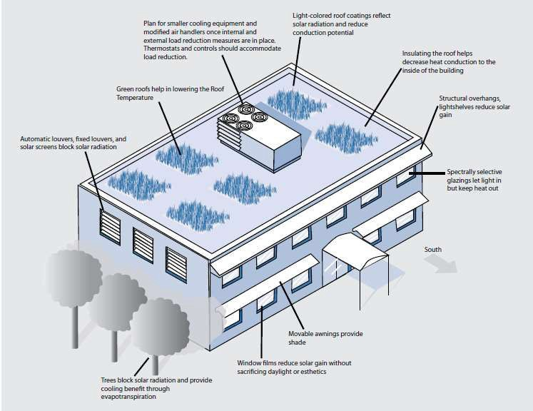
COOLING LOAD REDUCTION MEASURES

Slide 36
HEAT RECOVERY
Air is blown across copper coils to reject heat from this residential air-cooled condenser. Heat Recovery is an important component of many energy efficient HVAC systems.
Types of heat recovery include:
a)
Air-to-air heat exchangers transfer heat or "coolth" from one air stream to another. They are usually classified as one of the following:
Plate heat exchangers, with 60%-75% efficiencies
Glycol loop heat exchangers, with 50%-70% efficiencies (including pump energy use)
Heat pipe heat exchangers, with efficiencies as high as 80%
Other forms of heat exchange include:
Indirect evaporative cooling (IDEC) uses water-to-air heat exchange to precool air.
Electric heat recovery chillers receive up to 50% of rejected heat, usually though split or multiple condensers.
Absorption chiller/heaters can use a fraction (typically 50%) of the heat input
for cooling and the rest for heating.
Gas-fired, engine driven chillers retrieve much of the heat rejected (usually 20% - 50%).
b)

Slide 37
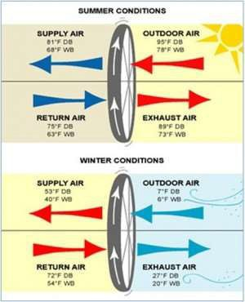
ENERGY RECOVERY WHEEL

Slide 38
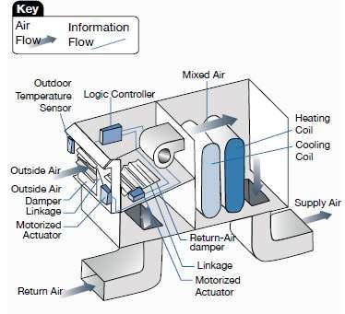
ECONOMIZER
An economizer is simply a collection of dampers, sensors, actuators, and logic devices that together decide how much outside air to bring into a building.
When the outdoor temperature and humidity are mild, economizers save energy by cooling buildings with outside air instead of by using refrigeration equipment to cool recirculated air.
A properly operating economizer can cut energy costs by as much as 10 percent of a building’s total energy consumption, depending mostly on local climate and internal cooling loads.
The ECBC requires an economizer for cooling systems over 1,200 liters/sec (2,500 cfm) and with a cooling capacity > 22 kW [ECBC 5.3.1.1].
The Components of an Economizer

Slide 39
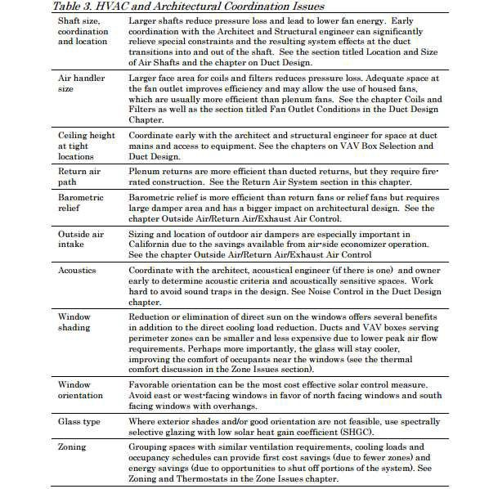

Slide 40
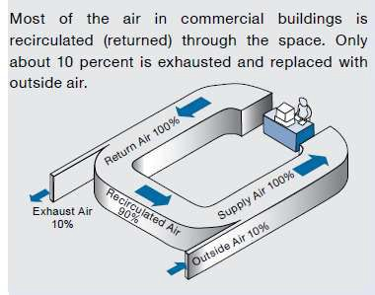
AIR HANDLING UNIT CONCEPTS
Air-handling systems deliver fresh outside air to disperse contaminants and provide free cooling, transport heat generated or removed by space conditioning equipment, and create air movement in the space also being served, deliver heated or cooled air to conditioned air to conditioned spaces.
Air Flow and its Make Up

Slide 41
Pressure: The pressure a fan must work against depends on two primary factors: the flow and duct design features such as diameter, length, surface treatment, and impediments such as elbows, filters, and coils. Typical pressure losses are on the order of 2 to 6 inches water gauge (wg); an efficient system operates at less than 1.5” wg.
Duty factor: Using simple or complex controls, duty factors can often be reduced to about 3,000 hours per year or less by limiting fan operation to occupied periods.
Efficiency: The mechanical efficiency of the fan and its drive system, can
typically be raised from the 40 to 60% range to the mid-80 % range.
Fan power increases at the square of air speed, delivering a large mass of air at low velocity is a far more efficient design strategy than pushing air through small ducts at high velocity.
Supplying only as much air as is needed to condition or ventilate a space through the use of variable-air-volume systems is more efficient than supplying a constant volume of air at all times.
The largest gains in efficiency for air distribution systems are realized in the
system design phase during new construction or major retrofits.

Slide 42
DISTRIBUTION SYSTEM
The ECBC requires insulating ducts and pipelines to reduce energy losses in heating and cooling distribution systems. Insulation exposed to weather is required to be protected by aluminium sheet metal, painted canvas, or plastic cover. Cellular foam insulation needs to be protected as described above, or be painted with water retardant paint.
Duct sealing: Proper duct sealing ensures that correct quantities of heated or cooled air will be delivered to the space, and not be lost to unconditioned spaces or the outdoors through leaks in the ducts.
Pipe insulation: Insulating pipelines reduces energy losses in heating and cooling systems. Besides insulating pipes to save energy, wrapping exposed cold water lines prevents them from sweating and collecting moisture in warmer climates.
Duct layout HVAC duct layout must have a good design that is planned early in the construction process and understood by the designer and HVAC contractor. Every joint and bend in the duct system affects the efficiency of the system. The duct system must be properly installed with the correct amount of airflow. The duct system must be air sealed, insulated and appropriately sized.

Slide 43
CONCLUSION
Regularly scheduled maintenance of HVAC systems can increase the energy efficiency. While the initial data is encouraging, more quantification of the energy savings will lead more building owners to become interested in regular maintenance for their HVAC systems. More studies are needed to accurately quantify the energy savings from varying maintenance strategies, as well as the return on investment from maintenance activities. The HVAC industry can develop better tools to help building owners and facility managers evaluate the relationship between maintenance costs and energy costs and support investment in the appropriate maintenance approach.

Slide 44
Question Bank
Explain with a sketch the working principle of a vapor compression refrigeration plant.
Explain the working principle of vapor absorption refrigeration system.
List a few energy efficiency improvement options in a refrigeration plant
List a few types of air conditioning systems in use.
2. 1 TR of refrigeration is
a) 50 kCal/hour b) 3024 kCal/hour c) 1000 kCal/hour d) 100 kCal/hour
Explain with a sketch the working principle of a vapor compression refrigeration plant .
Explain the working principle of vapor absorption refrigeration system.
Of the following, which has zero ozone depletion potential?
a) R11 b) R22 c) HFC 134a d) HCFC22
List a few energy efficiency improvement options in a refrigeration plant.
Name different types of compressors used in refrigeration system.
Throttling as a means of capacity control applies to
(a) Reciprocating compressor b) Screw compressor c) Scroll Compressor d) Centrifugal compressor
Explain the phenomenon of surge in a centrifugal compressor.
What is the refrigeration load in TR when 15 m3 /hr of water is cooled from 21°C to 15°C? If the compressor motor draws 29 kW, chilled water pump draws 4.6 kW, condenser water pump draws 6.1 kW and Cooling Tower fan draws 2.7 kW, what is overall kW/TR?
Explain the term Integrated Part Load Value (IPLV).
Explain the impact of condensing and evaporation temperatures on compressor power consumption.
Briefly list various energy conservation opportunities in a refrigeration plant

Slide 45
References
Technology Menu on Energy Efficiency (NPC)
ASHRAE Hand Book
NPC Case Studies
Vendor Information

Slide 46
Topic 8
Energy, Environment and Climate Change
-

Slide 47

Climate Changes in India
Increase in surface temperature by 0.4 degree C over the past century.
Warming trend along the west coast, in central India, the interior peninsula, and northeastern India.

Slide 48

Climate Changes in India
Cooling trend in northwest India and parts of South India.
Regional monsoon variations: increased monsoon seasonal rainfall along the west coast, northern Andhra Pradesh and North-western India, decreased monsoon seasonal rainfall over eastern Madhya Pradesh, North-eastern India, and parts of Gujarat and Kerala.

Slide 49

Climate Changes in India
Observed trends of multi- decadal periods of more frequent droughts, followed by less severe droughts.
Studies have shown a rising trend in the frequency of heavy rain events and decrease in frequency of moderate events over central India from 1951 to 2000.
5

Slide 50

Climate Changes in India
Records of coastal tide gauges in the north Indian ocean for the last 40 years has revealed an estimated sea level rise between 1.06-1.75 mm per year.
The available monitoring data on Himalayan glaciers indicates recession of some glaciers.
6

Slide 51

Per-capita Carbon –dioxide emission (Metric Tons)
25
20.01
20
15
11.71
9.4
9.87
10
5
3.6
4.25
1.02
0
USA
Europe
Japan
China
Russia
India
World
average

Slide 52
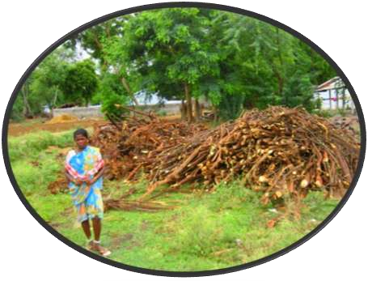
Impacts of Climate Changes
Water resources
Agriculture and food production
Health
Forests
Coastal areas
Vulnerability to extreme events
Bioenergy
Livelihoods
Environment
Economy
Ecology
8

Slide 53

National Action Plan for Climate Change (NAPCC)
Protecting the poor and vulnerable sections of society through sustainable development sensitive to climate change
Achieving national growth objectives through a qualitative change in direction, ecological sustainability, mitigation of greenhouse gas emissions.
9

Slide 54

National Action Plan for Climate Change (NAPCC)
Efficient and cost effective strategies for end use Demand side Management.
Technologies for adaptation and mitigation of greenhouse gases emissions.
Promote sustainable development - Regulatory and voluntary mechanisms
10

Slide 55


Core of NAPCC - National Missions
National Solar Mission:The NAPCC aims to promote the development and use of solar energy for power generation and other uses with the ultimate objective of making solar competitive with fossil- based energy options.
National Mission for Enhanced Energy Efficiency: Current initiatives are expected to yield savings of 10,000 MW by 2012.
These National Missions are being institutionalized by the respective Ministries/ Departments.

Slide 56

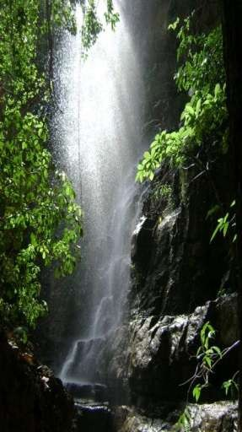
Core of NAPCC - National Missions
National Mission on Sustainable Habitat: To promote energy efficiency as a core component of urban planning.
National Water Mission: With water scarcity projected to worsen as a result of climate change, the plan sets a goal of a 20% improvement in water use efficiency through pricing and other measures.

Slide 57


Core of NAPCC - National Missions
National Mission for Sustaining the Himalayan Ecosystem: The plan aims to conserve biodiversity, forest cover, and other ecological values in the Himalayan region, where glaciers that are a major source of India’s water supply are projected to recede as a result of global warming.
National Mission for a “Green India”: Goals include the afforestation of 6 million hectares of degraded forest lands and expanding forest cover from 23% to 33% of India’s territory.

Slide 58
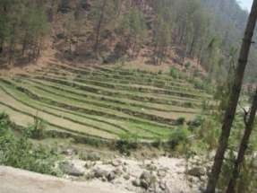

Core of NAPCC - National Missions
National Mission for Sustainable Agriculture: The plan aims to support climate adaptation in agriculture through the development of climate-resilient crops, expansion of weather insurance mechanisms, and agricultural practices.
National Mission on Strategic Knowledge for Climate Change: To gain a better understanding of climate science, impacts and challenges, the plan envisions a new Climate Science Research Fund, improved climate modeling, and increased international collaboration. It also encourage private sector initiatives to develop adaptation and mitigation technologies through venture capital funds.

Slide 59




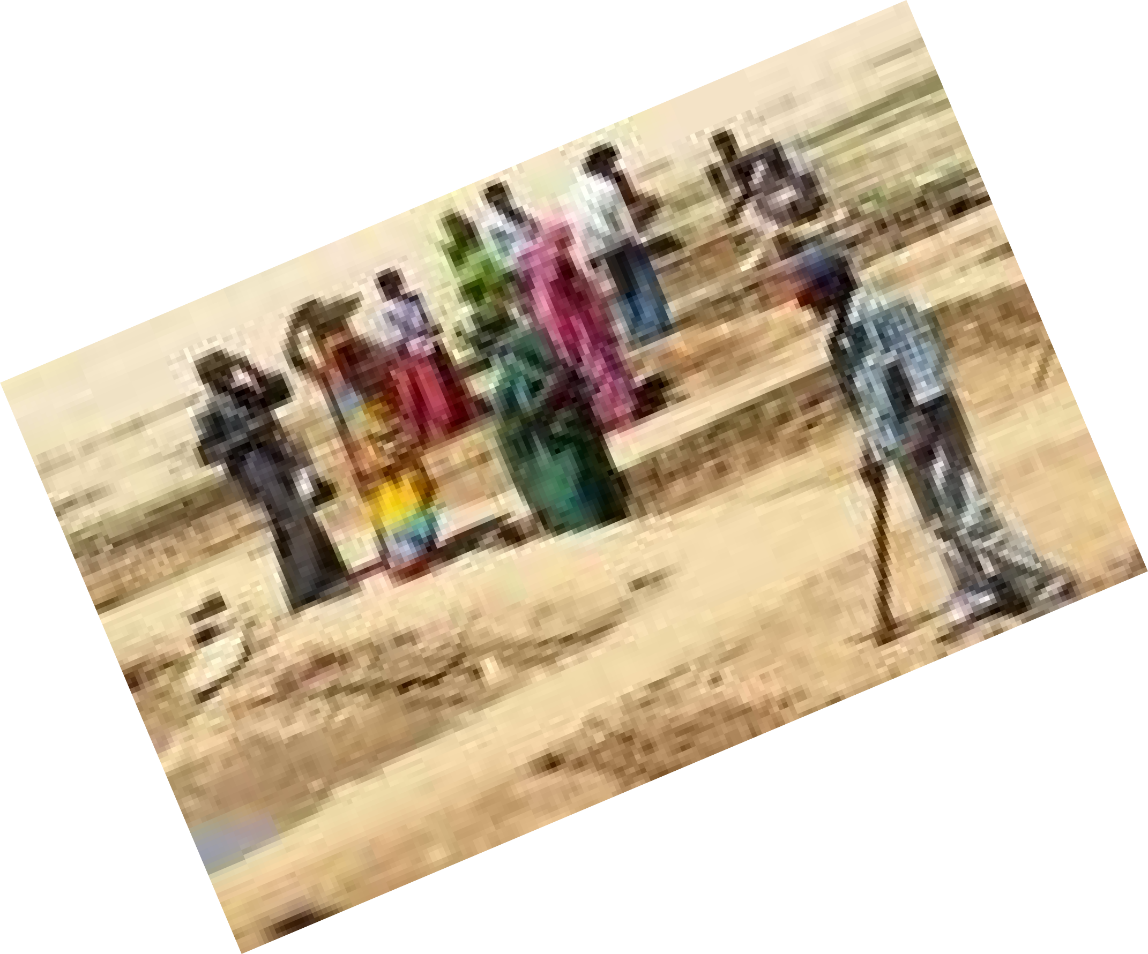

Slide 60
Rural Livlihoods - Resources
The livelihoods of the rural poor are directly dependent on environmental resources.
land
Water
Forests
Energy
water stress increases
groundwater levels recede
soil fertility declines
forest habitats disappear.
Are vulnerable to weather and climate variability

Slide 61
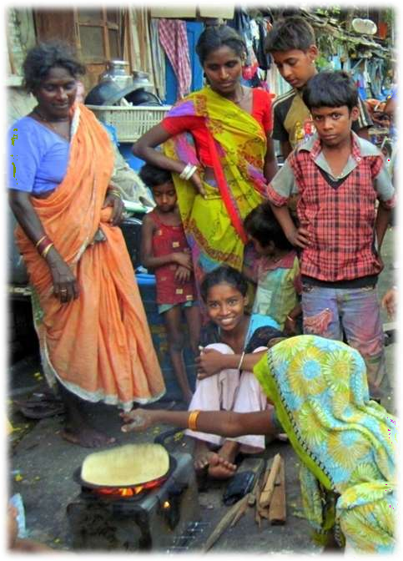
Rural Poor Paying the most
Climate change will only exacerbate
the vulnerabilities of the rural poor.
As climate- sensitive, natural ecosystems deteriorate, subsist ence will slip further out of reach.

Slide 62
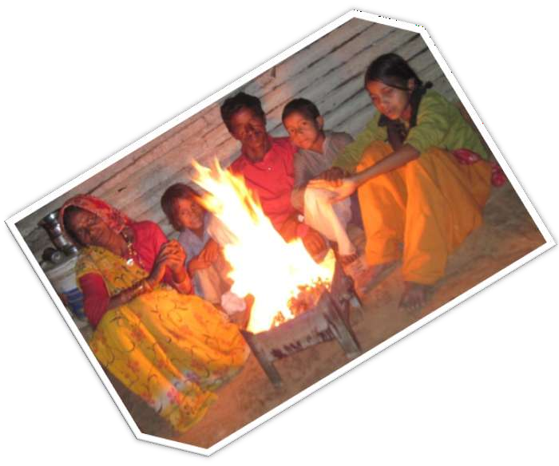
India’s rural poor, who have least contributed to Climate Change, will pay some of the problem’s heaviest tolls.

Slide 63
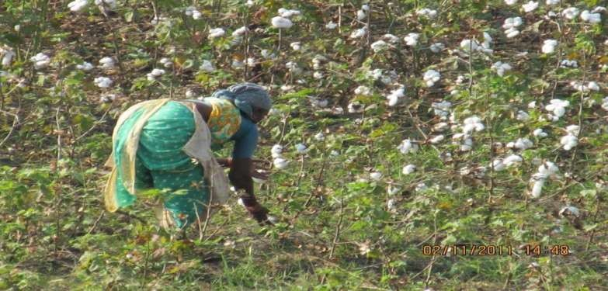
Climate Change vulnerability
Vulnerability to climate change is the risk of adverse things happening
Vulnerability is a function of three factors:
  Exposure
  Sensitivity
  Adaptive capacity

Slide 64
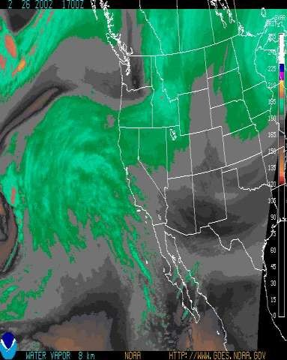
Exposure
Exposure is what is at risk from climate change, e.g.,
  Population
  Resources
  Property
It is also the climate change that an affected system will face, e.g.,
  Sea level
  Temperature
  Precipitation
  Extreme events

Slide 65
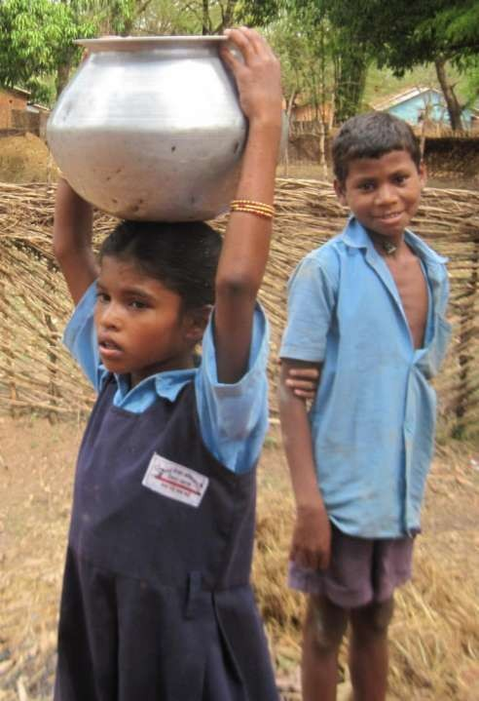
Sensitivity
Biophysical effect of climate change
– Change in crop
yield, runoff, energy demand
It considers the socioeconomic
context, e.g., the agriculture
system
Grain crops typically are sensitive
Manufacturing typically is
much less sensitive

Slide 66
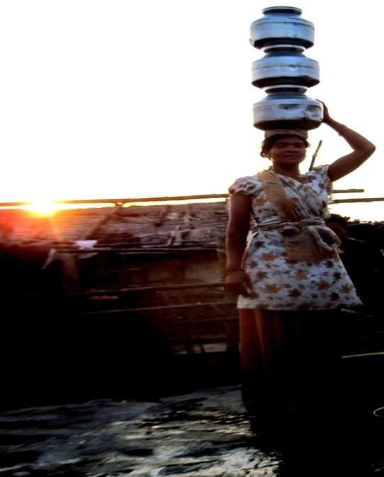
Adaptive Capability
ity
Capability to adapt
Function of:
  Wealth
  Technology
  Education
  Institutions
  Information
  Infrastructure
  “Social capital”
Having adaptive capacity does not mean it is used effectively

Slide 67
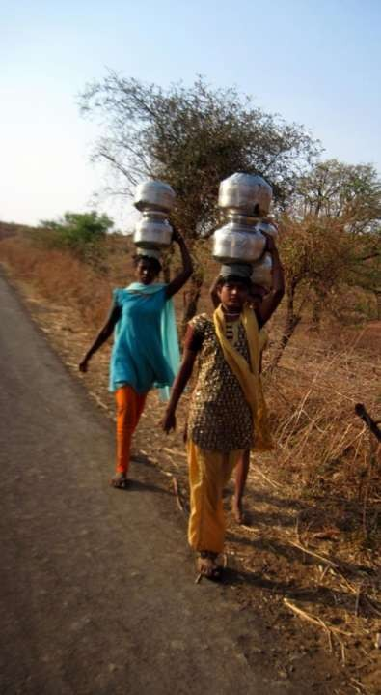
Vulnerability is a Function of …
More exposure and sensitivity increase vulnerability
More adaptive capacity decreases vulnerability
An assessment of vulnerability should consider all three factors

Slide 68

Adaptation
“adjustment in natural or human systems in response to actual or expected climatic stimuli or their effects, which moderates harm of exploits beneficial opportunities”
(Third Assessment Report, Working Group II)
Includes “actual” (realized) or “expected” (future) changes in climate

Slide 69
Adaptation (continued)
Two types of adaptation
Autonomous adaptation or reactive adaptation tends to be what people and systems do as impacts of climate change become apparent
Anticipatory or proactive adaptation are measures taken to reduce potential risks of future climate change

Slide 70










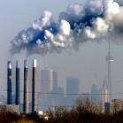
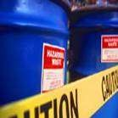
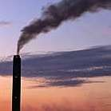

Slide 71


UNFCCC
Overview of UNFCCC
United Nations Framework Convention on Climate Change
A global legal instrument (international agreement) on the control and management of greenhouse gases (GHG).
Adopted in 1992, entered into force in 1994.
Status of participation: 189 Parties. Contains 2 annexes:
Annex 1: countries with obligations to take measures to mitigate the
effects of climate change
Annex 2: countries with obligations to provide financing to developing countries for their obligations under UNFCC
Affiliated instruments: Kyoto Protocol.

Slide 72
UNFCCC
Overall goal and objectives
What is the overall goal?
“ to protect the climate system for the benefit of present and future generations of mankind. ”
What are the further objectives?
“ to achieve stabilisation of greenhouse gas concentrations in the atmosphere at a level that would prevent dangerous anthropogenic interference with the climate system. ”

Slide 73
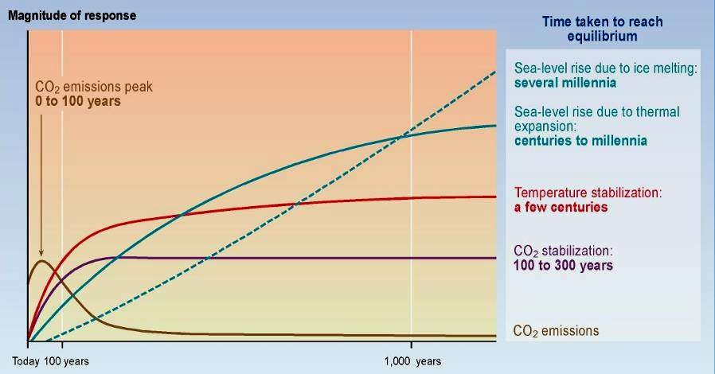
UNFCCC
Time taken to reach equilibrium
CO2 concentration, temperature, and sea level continue to rise long after emissions are reduced !

Slide 74
UNFCCC
Means to achieve the objectives
What can be done to protect the climate system?
Enhancement of energy efficiency in relevant sectors and development of new and renewable energy forms/sources.
Protection of sinks and reservoirs of GHGs.
Limitation and reduction of transport and waste management- related emissions.
Policy changes toward elimination of market imperfections and implementation of market-based instruments, and policy reform to support GHG limits and reductions.

Slide 75
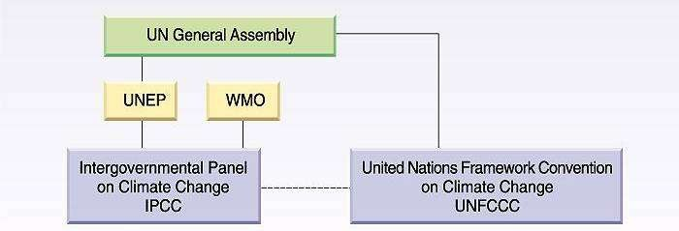
UNFCCC
Institutional framework

Slide 76
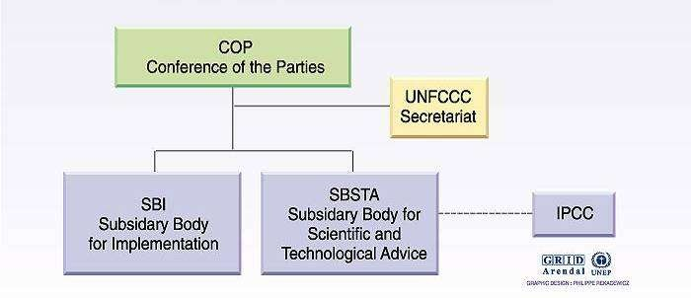
UNFCCC
Organisation of the Convention

Slide 77
UNFCCC
National level actors
National UNFCCC focal points
Responsible for the Government’s interaction and communication with UNFCCC.
Usually a specific ministry / department.
Usually interacting with a wide range of other organizations / stakeholders at the national level.
National CDM or JI organizations (DNA)
Specific organization (authority) that is responsible for approving CDM and JI activities at the national level.
Often, but not always, the same as the National Focal Point.

Slide 78
KYOTO PROTOCOL
Bringing UNFCCC into action
The Kyoto Protocol
An addition to UNFCCC that requires developed countries to limit their GHG emissions in 2012, as compared to their emissions in 1990.
Provides detailed methods and mechanisms for how the emission reductions can be achieved, measured and verified.
All members in UNFCCC have not agreed to sign the Kyoto Protocol!
A long process of ratification
Adopted in 1997, but required the ratification of more than 55 countries representing more than 55% of GHG emissions.
Entered into force on February 16th, 2005 after ratification of the Russian Federation (now 163 countries covering 61.6% of global emissions have ratified the protocol).

Slide 79
KYOTO PROTOCOL
A market-based instrument
Kyoto Protocol characteristics
Commits Annex 1 countries to reduce GHG emissions by 5.2% by 2012 compared to 1990.
Actual commitment period: 2008 - 2012.
Individual goals for each country.
3 mechanisms to help countries to reach their commitments
ETS - Emissions Trading System
CDM - Clean Development Mechanism (session 5)
JI - Join Implementation (session 6)
6 greenhouse gases: CO₂, CH₄, N₂O, PFCs, HFCs, SF₆.

Slide 80
Kyoto Protocol
Developed Countries Signed:
  Greenhouse Gases ↓ by 5% by 2012
  Reduce or Offset
  National Targets, Government’s responsible
Mechanisms:
  Clean Development Mechanism
  Emissions Trading
Runs out in 2012 – new agreement needed

Slide 81
Policies to mitigate impact of climate change
Pricing the externality:
  Carbon tax
  Carbon trading
  Implicit pricing through regulation / legislation
Bringing forward lower carbon technology- research, development and deployment
  Which policies provide the best incentive for this?
Income payments for environmental husbandry e.g. to combat deforestation
Overcoming information barriers
Promoting a shared understanding of responsible behaviour across all societies

Slide 82
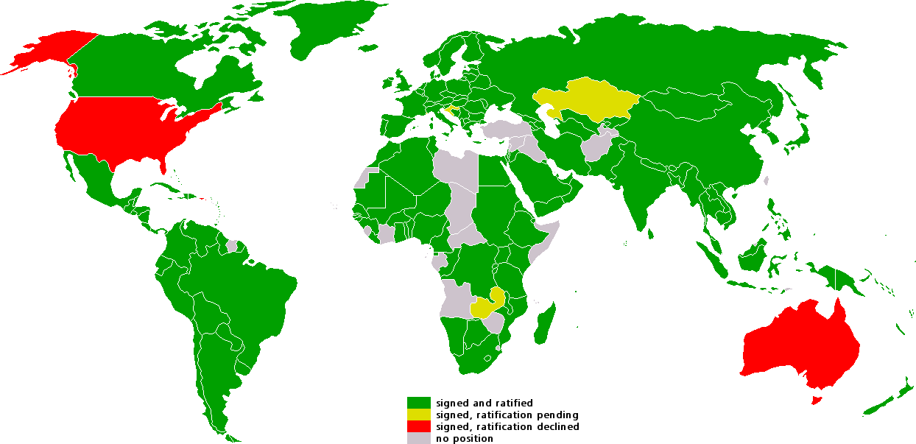
UNFCCC
Ratification of the Kyoto protocol
Signed and ratified
Signed, ratification pending Signed, ratification declined No position

Slide 83
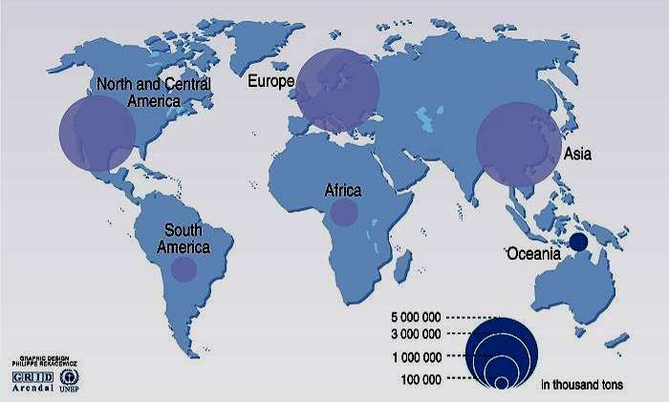
CO₂ emissions from industrial process

Slide 84
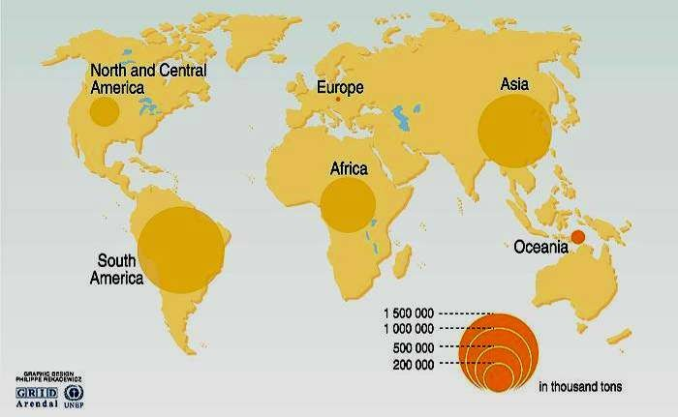
CO₂ emissions from land use change

Slide 85
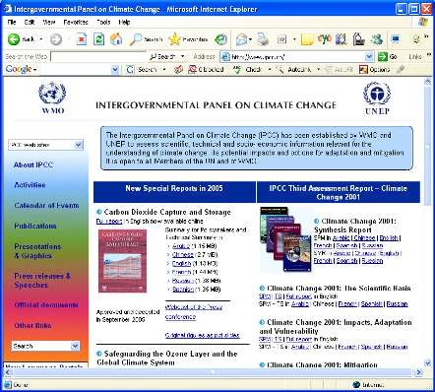
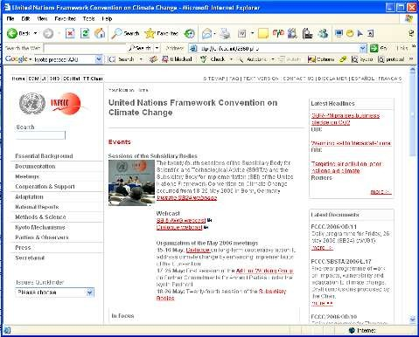
INFORMATIONS & TOOLS
Official websites
UNFCCC, site of the Convention http://unfccc.int
IPCC, Intergovernmental Panel
on Climate Change http://www.ipcc.ch

Slide 86
UNDP – GEF Project
Government of India, with UNDP as the lead agency, is implementing a Global Environment Facility (GEF) supported project - “Mainstreaming Coastal and Marine Biodiversity Conservation into Production Sectors in the Godavari River Estuarine Ecosystem, Andhra Pradesh”.

Slide 87
COUNTRY: India
PROJECT TITLE: Mainstreaming Coastal and Marine Biodiversity Conservation into Production Sectors in the East Godavari River Estuarine Ecosystem (EGREE)
GEF AGENCY: UNDP
OTHER EXECUTING PARTNER: Ministry of Environment & Forests
(MoEF), Government of India / Wildlife
Wing, Environment, Forests, Science & Technology Department, State Government of Andhra Pradesh
GEF FOCAL AREA: Biodiversity

Slide 88
The project will focus specifically on removing the key barriers to mainstreaming environmental management considerations into major production activities that are impacting the Godavari region, with special focus on Coringa Wildlife Sanctuary.

Slide 89
The main components of the project include
Sectoral mainstreaming including knowledge management for coastal and marine biodiversity conservation;
Institutional Capacity Development; and
Sustainable Community Livelihoods and Natural Resource Use in the Godavari River Estuary.

Slide 90
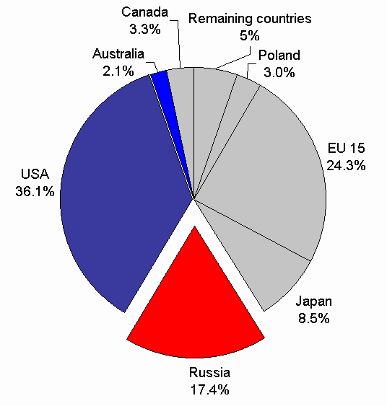

Carbon Credit
DID YOU KNOW????
WHY

Slide 91


Concept of Carbon Credit
Birth of Carbon Credit
Growth of Carbon Credit & India’s Position
Concern for Chartered Accountants

Slide 92
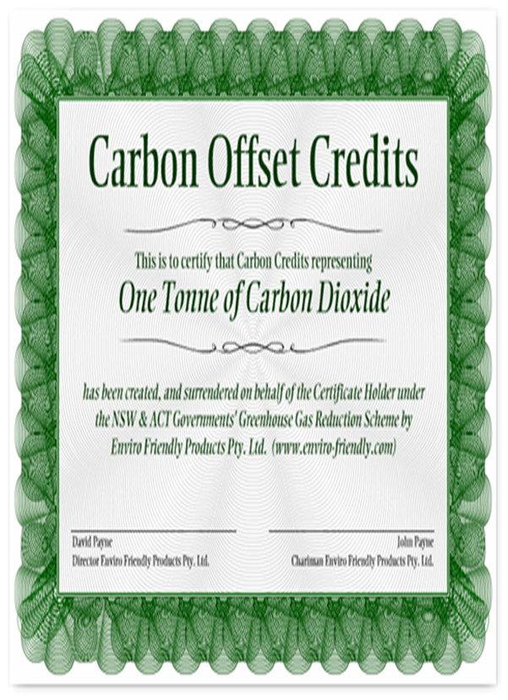

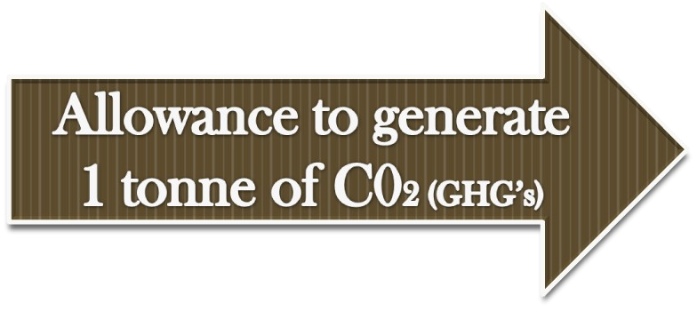
What is Carbon Credit under the KYOTO Protocol…
A credit for reducing 1 ton of CO2 (Green House Gases) from the atmosphere

Slide 93

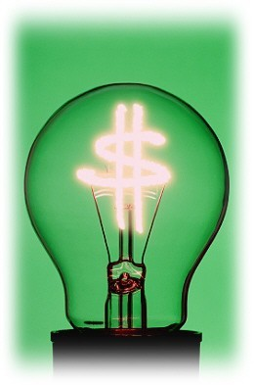

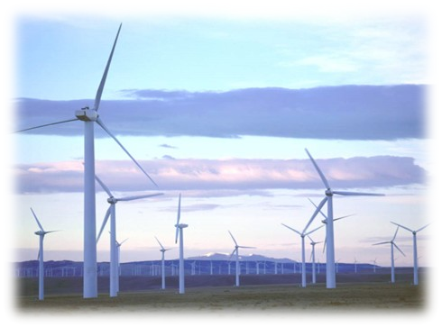
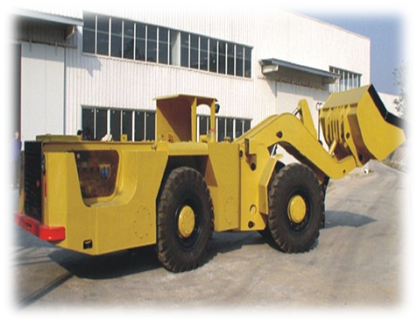
How to generate Carbon Credits???
CARBON CREDITS

Slide 94
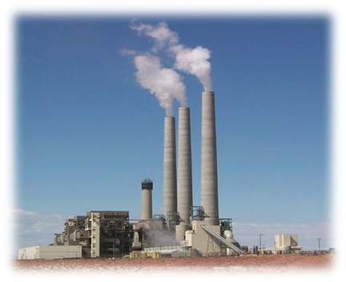
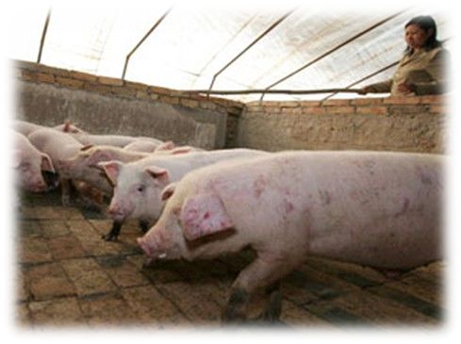
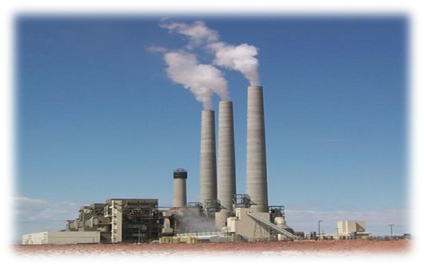
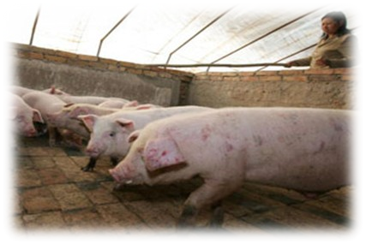

METHANE
CO2
METHANE
EARN CARBON CREDIT
CO2
METHANE

Slide 95
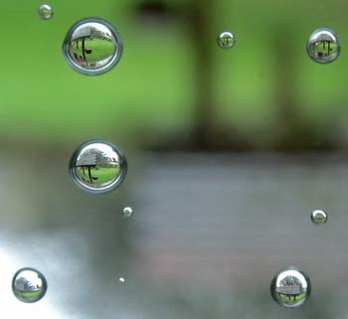
USE OF CARBON CREDITS IN
EMISSION REDUCTION

Slide 96






REDUCTION
ADDITIONAL MEASURES
NATIONAL MEASURES
THE FLEXIBILITY MECHANISM

Slide 97








FLEXIBILITY MECHANISM
Joint
implementation
Clean development Mechanism
Emission trading
Project based

Slide 98
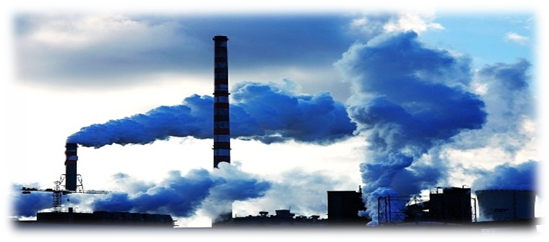
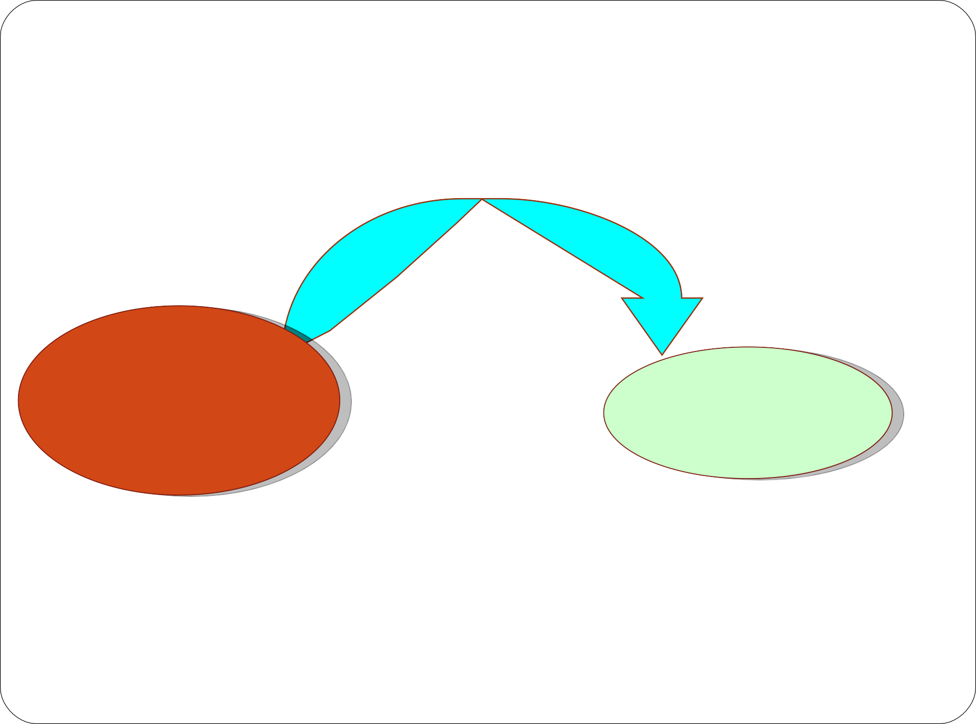


Emission Trading
Payment for CC
Developed country A (needs CC)
Developed country B
Earns carbon credits called Assigned Amount Units
Sell these carbon credits

Slide 99
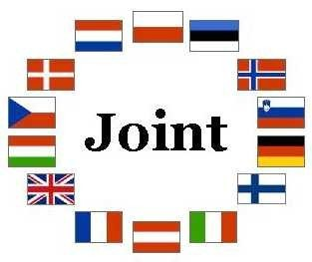
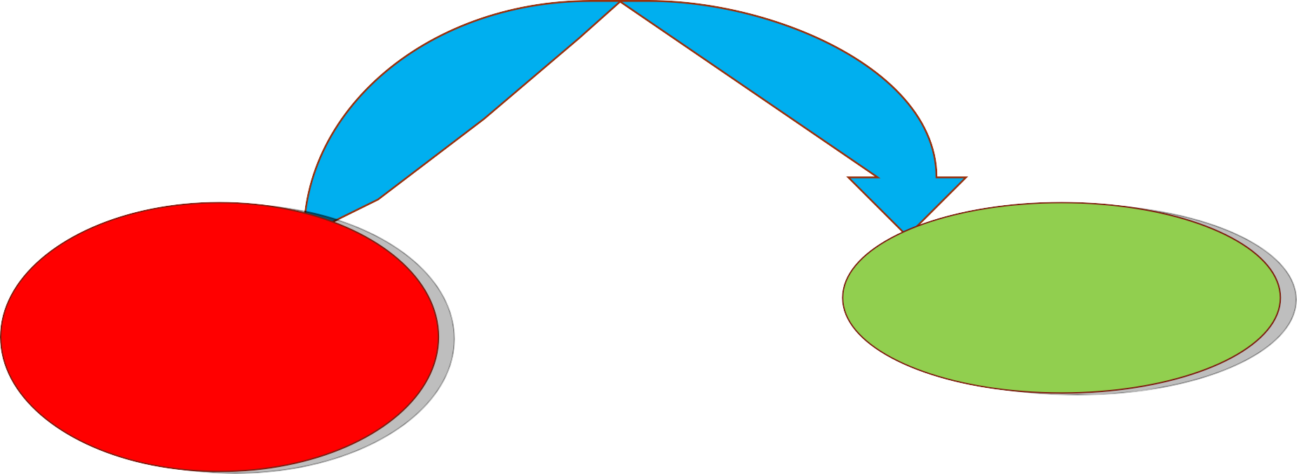

Joint Implementation
Sets a project
Developed country A (needs CC)
Developed country B
Earns carbon credits called Emission Reduction Units
Sell carbon credits

Slide 100



Clean Development Mechanism (CDM)
Sets a project
Developed country (needs CC)
Developin g Country
Earns carbon credits called Certified
Emission Reduction
Sells carbon credits

Slide 101





Concept of VER’s
Countries not committed to the protocol
Voluntary Emission Reduction
OR
Verified Emission reduction
VER

Slide 102

What should be the price of carbon????
At present, price of 1 carbon credit is 10 Euro to 15 Euro

Slide 103

Concept of Carbon Credit
Birth of Carbon Credit
Growth of Carbon Credit & India’s Position
Concern for Chartered Accountants

Slide 104





Market for Carbon Trading……
Currently there are 5 Environmental Exchanges, trading in Carbon Credits
EUROPEAN CLIMATE EXCHANGE
POWER NEXT

Slide 105

India’s Stance in Carbon Credits

Slide 106


India along with China, lead countries in earning Carbon Credit

Slide 107


India pocketed Rs 1,500 crores in the year 2005 just by selling carbon credits to developed-
country clients.
India has generated 30 million Carbon credits & 140 million are in pipeline

Slide 108




Some of the Leading companies of India using & selling Carbon Credits…
GUJARAT FLOUROCARBONS Ltd

Slide 109


SRF….
The major beneficiary of reducing GHG gases

Slide 110
Concept of Carbon Credit
Birth of Carbon Credit
Growth of Carbon Credit & India’s Position
Concern for Chartered Accountants

Slide 111


Concern for
The Chartered Accountants

Slide 112

ACCOUNTING TREATMENT

Slide 113









Present Accounting treatment…..
Treatment under IFRS
Treatment under US GAAPS
Treatment under AS
currently no
accounting standard available
IAS 20
(Government grants)
currently no guidance note available

Slide 114

Tax Treatments
Will there be any tax on Carbon Credits ??????
If there is income there will be tax…

Slide 115

















TAX TREATMENT
DIRECT TAX
Income from CER’s
INDIRECT TAX
Goods
Services
VAT, etc
Servic e tax
Busines s Income
Other Income
OR CER
Transaction Tax

Slide 116



However, NO set Accounting or Tax
Treatment has yet been decided

Slide 117




Scope for
Chartered Accountants

Slide 118






Other opportunities…..
As an auditor….
In audit of Carbon Trading
As a Carbon Trading Consultant
Carbon Trading Broker

Slide 119
Question Bank
Explain effect of climate change due to conventional energy utilization.
Role of United Nations Framework Convention on Climate change (UNFCC) in climate change policy forming.
Explain in detail Kyoto Protocol.
Explain concept of carbon credit in detail.
Explain following terms in detail.
(a) Conference of Parties (COP), (b) Clean Development Mechanism (c) Prototype Carbon Fund
What are the national action plans for climate change?
Write procedures case of CDM.
Write short note on ECBC code for Building construction

Slide 120
Thanks

