Slide 1
Anaerobic Digestion of Solid Waste
Also bio-methanation: the organic fraction of wastes is segregated and fed to a closed container (biogas digester) where, under anaerobic conditions, the organic wastes undergo bio-degradation producing methane-rich biogas and effluent/sludge.
The biogas production ranges from 50-150m³/tonne of wastes, depending upon the composition of waste.
The biogas can be utilized either for cooking/heating application, or through dual fuel or gas engines or gas/ steam turbines for generating motive power or electricity.
The residual sludge from anaerobic digestion, after stabilisation, can ne used as a soil conditioner, or even sold as manure depending upon its composition, which is determined mainly by the composition of the input waste.

Slide 2
Steps of AD of Solid Waste
Pre-treatment: To remove inerts and non-biodegradable materials, upgrade and homogenize the feedstock for digestion and to promote downstream treatment processes.
Anaerobic Digestion: To produce biogas for energy to de-odorise, stabilize and disinfect the feed stock.
Post – Treatment: To complete the stabilisation of the digested material and to produce a refined product of suitable moisture content, particle size and physical structure for the proposed end-use as organic manure.
Supernatant or Effluent Treatment: To treat the liquid effluent to specified standards before final disposal.

Slide 3
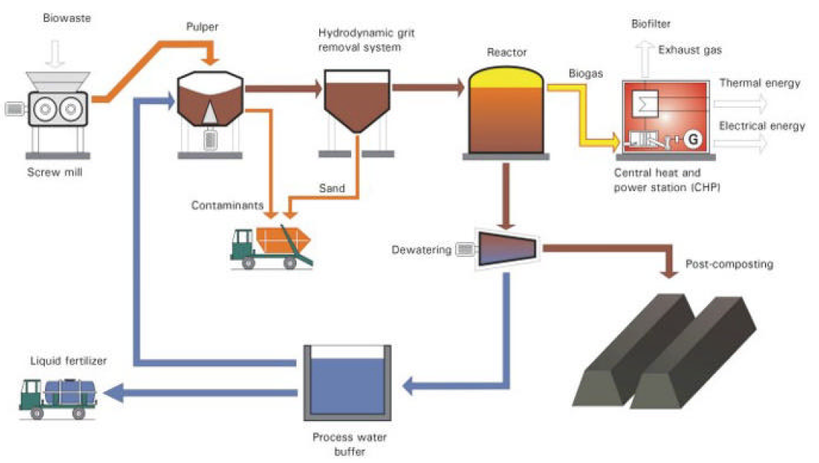
Process Flowsheet
Shredding, Pulping, Grit Removal, Magnetic Separation, Trommel separation- Pretreatment
H2S, Moisture, Siloxane Removal
Dewatering of digestate, Composting and treatment of Dewatering Supernatant- Residual Treatment

Slide 4
Pretreatment
Shredding: Optional
Trommel : Separating Inert, grit, coarse sand etc.,
Manual Separation: Inert, Plastic and cardboard
Magnetic Separation and Eddy Current Separation- Optional
Shredding and Pulping- Addition of Water
Hydrocyclone- Separation of Sand and Heavier Particles from Slurry for Anaerobic Digestion

Slide 5
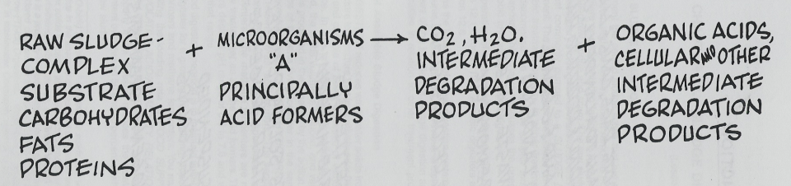
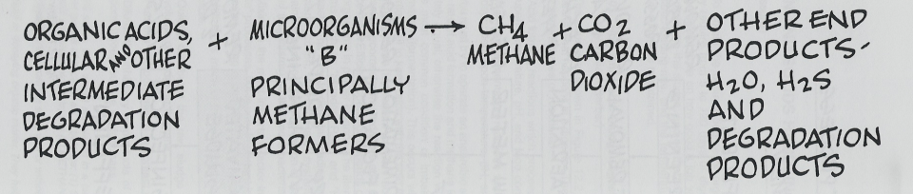
How AD of MSW is Accomplished ?
waste

Slide 6
Anaerobic Digestion
1. Fermentative organisms (50% of viable organisms in anaerobic digester)
Cellulose Acetate, alcohols, Strepto cocci
Lipids other organic acids, Enterobacteria
Proteins H₂, CO₂, NH₃, HS⁻ Chlostridia
2. Acetogenic bacteria
Simple organics (except acetate)
(fatty acids, sol. organics)
3. Methanogenic bacteria (produce methane)
Get energy from forming CH₄
Need low redox potential
O₂ toxic
Need temp.↑
}→
→ Acetate

Slide 7
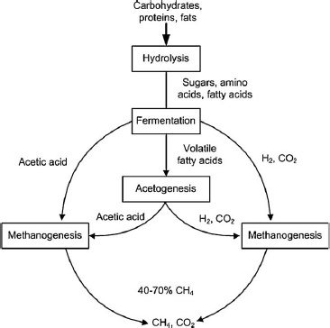
Rate limiting step
Conversion of propionic and acetic acid to CH₄ (McCarty, 1964)
Hydrolysis of organic solids (cellulose) (Pfeffer, 1979)
All efforts focused to these

Slide 8
Biogas Yield
C₃₁H₄₇O₂₂N --------15.5 CH₄ + 15.5 CO₂
785 g VSS -------------248 g CH4 + 682 g CO2
1 g VSS --------0.31 g CH4
Density of Methane is 0.66 g/L
1 g VSS -------- 0.31 g /0.66 = 0.47 L
1 g VSS-----------0.87 g CO2
Density of CO2 = 2 g/L
1 g VSS --------0.87/2 = 0.44 L CO2

Slide 9
Specific Gas Production
SGP = Q_{biogas}
Q × S
SPG = specific gas production [m³ biogas/kg as solid waste, VSS or organic matter feed]
Q_{biogas} = biogas flow rate [m³/day]
Q = inlet flow rate [m³/day]
S = substrate concentration (VSS) in the influent [kg substrate/ m³]

Slide 10
Biogas/kg of MSW

Slide 11
Design Criteria
OLR = organic loading rate [kg substrate/m³ reactor day]
OLR= Q× S
V
Where
S – Volatile Solids or Degradable Solids (kg/m3)
Q is the flowrate and (m3/d)
V is the volume of the anaerobic digester

Slide 12
OLR

Slide 13
HRT
HRT = V
Q
HRT = hydraulic retention time [days]
V = reactor volume [m³]
Q = flow rate [m³/day]
Under Indian Condition HRT= 20-25 days

Slide 14
Design of System
Solid Waste Generated in Roorkee – 50 t/day
After Pretreatment – 0.5 x 50 = 25 tpd (As discarded Wet)
% VSS in Pretreated Waste = 25 % (70 % Moisture and 5 % Inert)
% VSS Load t/day = 25 tpd x 25 % SS/OFMSW = 6.25 t/d
Moisture content -70 %
Dilute to 95 % moisture content slurry
95 = 25 x 70 + X x 100
25 + X
X (kg of Water needed) = 125 t/day or 125 m3/d
Total Weight = 125 + 25 = 150 t/day or 150 m3/day (Assuming density 1000 kg/m3)

Slide 15
Contd
HRT – 20 days
Volume = 20 x 150 m3/day = 3000 m3
Assuming 30 % headspace and free board
Volume = 1.3 x 3000 m3 = 3900 m3 (Approx)
Check OLR = 6250 kg VSS/d /3000 m3= 2.08 kg VS/m3.day < 4 kg VS/m3.day
Mixing Power requirement = 7 W/m3
Mixing Power = 7 x 3000 m3 = 21.0 kW

Slide 16
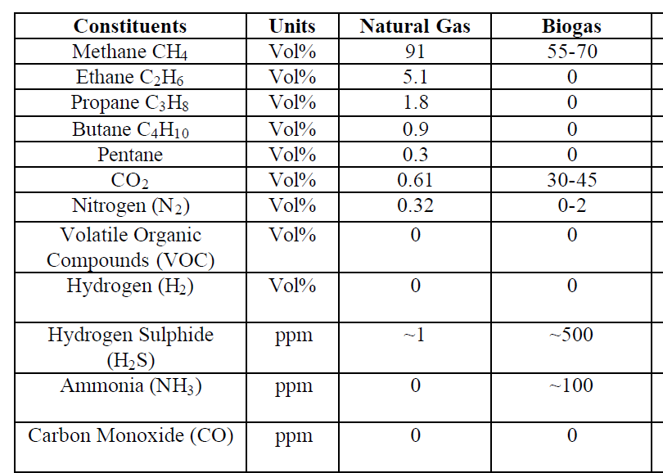
Comparison of Biogas

Slide 17
Biogas Contaminants Removal
CO2
  Removal- Water Scrubbing- CO2 absorb in water-But it generates lot of wastewater
H2S
  Addition air to Headspace of biogas digester- H2S converted to elemental S- Care to be taken in overdosing of air.
  FeCl3 addition in digester- Forms iron sulphide.
  Iron Oxide in digester- Iron sulphide.
  Pass Biogas thru Iron Oxide (rusty steel wool, iron oxide pellets or wood pellets coated with iron oxide).

Slide 18
Digestate DEWATERING

Slide 19
Dewatering Methods
Centrifuge
Belt Press
Screw Press
Filter Press
Sludge Drying Beds

Slide 20
How Centrifuge works?
Rotating bowl
Sludge &
Chemicals
Centrate
Sludge cake
Rotating conveyer
Cover

Slide 21
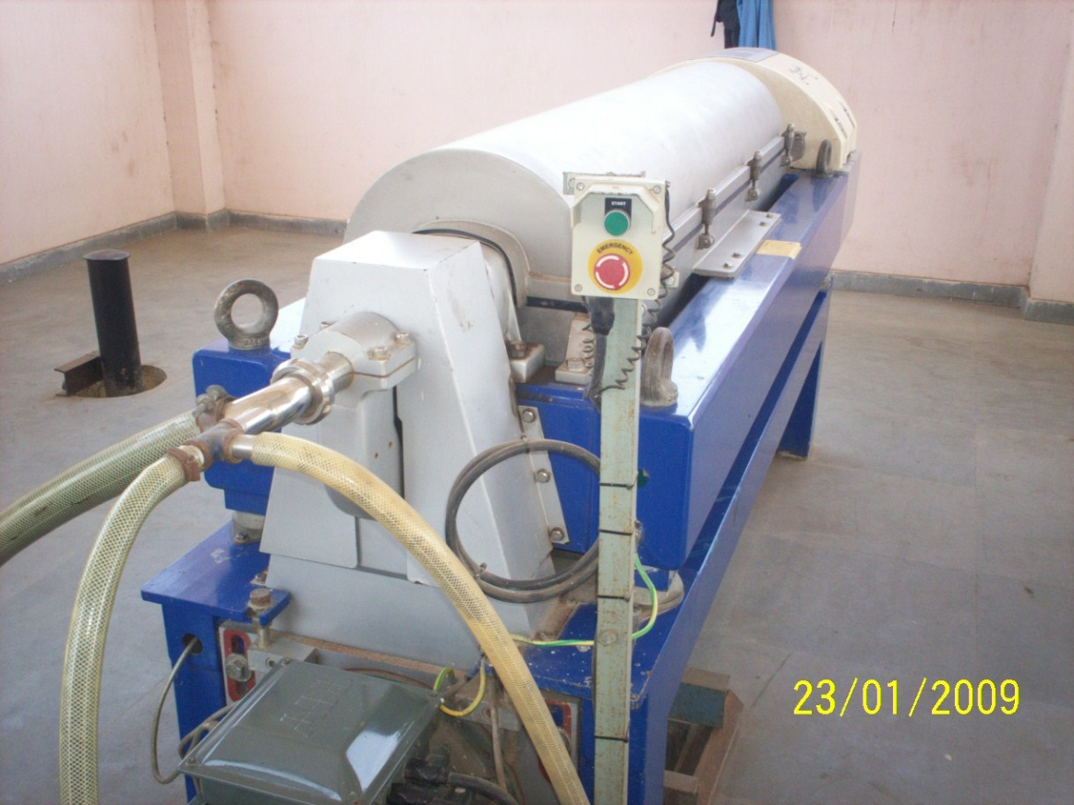
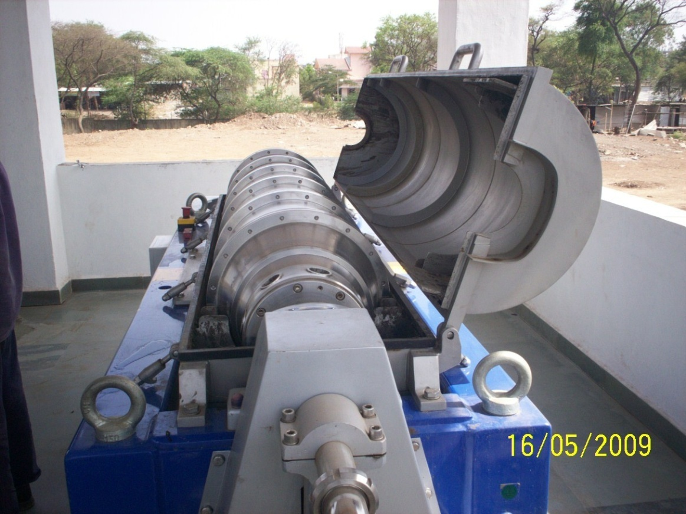

Slide 22
Digestate Dewatering
B
P
Digestate
tank
Polymer
Centrate
Dewatered
cake
P
Polymer tank unit

Slide 23
What is to be designed ?
Capacity of Centrifuge
Capacity of Centrifuge Feed pump
Working Hours
Polyelectrolyte consumption (kg/d)
Size of PE dosing tank
PE Dosing Pump
Mass Balance: Dewatered Sludge in kg/day or m³/day and supernatant in m3/d

Slide 24
Why Polyelectrolyte Conditioning ?
Coagulation of Solids & Releasing of absorb water. Improved production rate, cake solids contents and solid capture
Solid capture or SS recovery with chemicals-90-95%
Solids capture without chemical-80%
Dewatered Solids Conc. with chemicals- 20-30 %
Dewatered Solids Conc. Without chemicals- 15-18%

Slide 25
Design the Centrifuge for the digestate, if 90 % solid capture efficiency and 20 % dewatered sludge concentration

Slide 26
Design of Dewatering System
Digestate Flow- 150 m3/day
Operating hours- 12 h/day
Capacity of centrifuge – 12.5 or 15 m3/h
Polymer dosing – 5 kg Polymer/1t dry Solids (0.5 %)
Left Dry solids = (7.5-6.25)t/d + 50 % of 6.25 tpd = 4.375 t/d
Concentration of Slurry = 4375 kg/day /150 m3/day = 29 kg/m3
Daily polymer requirement – 5 x 4.375 = 21.87 kg/day
If Polyelectrolyte Concentration = 0.2 % or 2000 mg/L = 2 kg/m³
Polymer solution in m³/day
= 21.87kg/2kg/m³ = 10.93 m³/day
Storage Period of Polyelectrolyte- 24 h or 1 days
Volume of PE Tank
= 10.93 m3
Polyelectrolyte Dosing Pump = 7.59 LPM
Actual operation is 12 h
Polyelectrolyte Pump required = 7.59 x 24/12 = 15.18 LPM
Capacity of Centrifuge
Capacity of Centrifuge Feed pump
Working Hours
Polyelectrolyte consumption (kg/d)
Size of PE dosing tank
PE Dosing Pump
Mass Balance: Dewatered Sludge in kg/day or m³/day and supernatant in m3/d

Slide 27
Mass = 4375 kg/day
Q = 150 m3/day
Conc. = 29 kg/m3
90 % solid capture- Centrate
Centrate
Dewatered Sludge
Conc. = 200 kg/m3

Slide 28
Mass = 4375 kg/day
Q = 150 m3/day
Conc. = 29 kg/m3
90 % solid capture
Centrate
Mass = 437.5 kg/day
Dewatered Sludge
Mass = 3937.5 kg/day
Conc. = 200 kg/m3

Slide 29
Mass = 4375 kg/day
Q = 150 m3/day
Conc. = 29 kg/m3
90 % solid capture
Centrate
Mass = 437.5 kg/day
Dewatered Sludge
Mass = 3937.5 kg/day
Conc. = 200 kg/m3
Q = 19.68 m3/day

Slide 30
Mass = 4375 kg/day
Q = 150 m3/day
Conc. = 29 kg/m3
90 % solid capture
Centrate
Mass = 437.5 kg/day
Q= 150-19.68=130.31 m3/d
Conc= 437/130.31=3.36 kg/m3
Dewatered Sludge
Mass = 3937.5 kg/day
Conc. = 200 kg/m3
Q = 19.68 m3/day

Slide 31
Biogas Generation
Volatile solids destroyed = 3.125 tpd or 3125 kg/day
0.47 m3 Methane per kg VSS destroyed
Methane Generation/day= 0.47 x 3125 = 1468 m3
Energy in KJ/day = 1468 m3/day x 38,800 kJ/m3 = 659 KJ/s- 0.68 MW
Biogas Engine Efficiency = 20 % = 0.131 MW
Or 3144 units of electricity/day

Slide 32
Final Product
3144 units of electricity/day
Final Reduction in Volume from 150 m3 to 19.68 m3 dewatered cakes
Wastewater = 130.31 m3/d

Slide 33

Raw Wet Solid Waste
Raw Waste Slurry
Digestate
Dewatered Digestate
Centrate 130.32 tpd
Water
142.5 t/d
Water
145.615 t/d
150 tpd
150 tpd
Water
17.5 t/d
Water
15.75 t/d
25 tpd
19.6
tpd
Inert 1.25 tpd
Inert 1.25 tpd
Inert 1.25 tpd
VS 6.25 tpd
VS 6.25 tpd
TS 3.93 tpd
VS 3.125 tpd
Solids 30 %
Solids 5 %
Solids 2.9 %
Solids 20 %

Slide 34
Single Stage and Two-stage Digestion

Slide 35
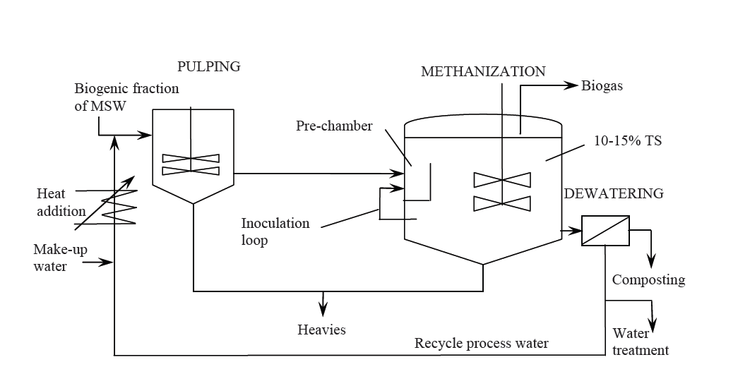
Single Stage Digesters
5 % TS

Slide 36
Single Stage- Wet Systems
Advantages
  Derived from well developed anaerobic sludge digestion technology
  Simplified material Handling and mixing
  Dilution of inhibitors with Fresh water
  Less expensive material handling equipments
  Well established theory for process control, no patents

Slide 37
Single Stage- Wet Systems- Disadvantages
Complicated pre-treatment
Abrasion with sand
Sink and float phases
Short circuiting. Advanced mixers are required
Sensitive to shock as inhibitors spread immediately in reactor- Highly degradable kitchen waste without cellulose- Degrade fast-Accumulation of Acid and Lowers the pH
VS lost with removal of inert fraction in pretreatment
High consumption of water
Larger tanks required
Costly digestate treatment
Costly wastewater treatment

Slide 38
Two-Stage Digesters
Stage I: two-stage processes attempt to optimize the hydrolysis and fermentative acidification reactions in the first stage where the rate is limited by hydrolysis of complex carbohydrates – HRT- 3 days
Stage II: The second stage is optimized for methanogenesis where the rate in this stage is limited by microbial growth kinetics.
Since methanogenic archaea prefer pH in the range of 7–8.5 while acidogenic bacteria prefer lower pH, the organic acids are diluted into the second stage at a controlled rate – HRT- 15 days

Slide 39
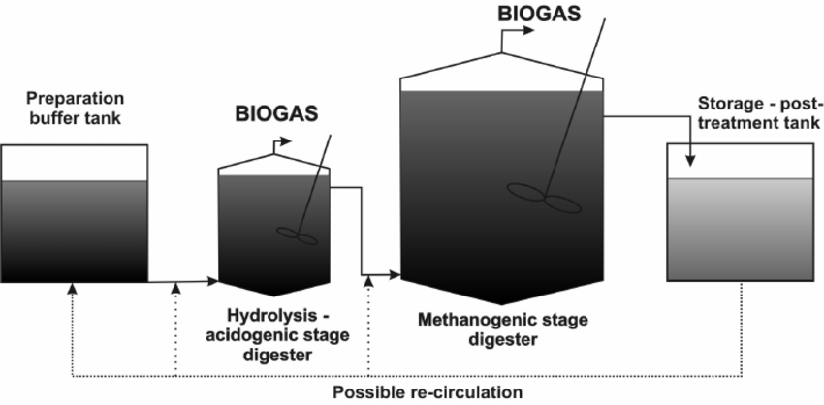
Two-Stage Digesters

Slide 40
Two-Stage Digesters
Advantages
  Higher Loading Rate-
  Tolerate fluctuation in Loading
  Higher throughput
  Smaller footprint
Disadvantages
  Complex design and material handling
  Difficult to achieve true e separation from hydrolysis and methanogenesis
  Larger capita investment

Slide 41
Thermophilic- Digestion
Higher Temperature Digestion by Thermophilic Bacteria- 55º C- Higher Methane production- HRT reduced to 12-14 days

Slide 42
Dry Digesters
(<5% TS = wet, >20% TS = dry)
Dry systems have become prevalent in Europe , making up 60-70 percent of the single-stage digester capacity installed to date .
Dry digesters treat waste streams with 20-40 % total solids without adding dilution water.
These systems may retain some process water or add some water either as liquid or in the form of steam used to heat the incoming feedstock.
HRT – 15-20 Days

Slide 43
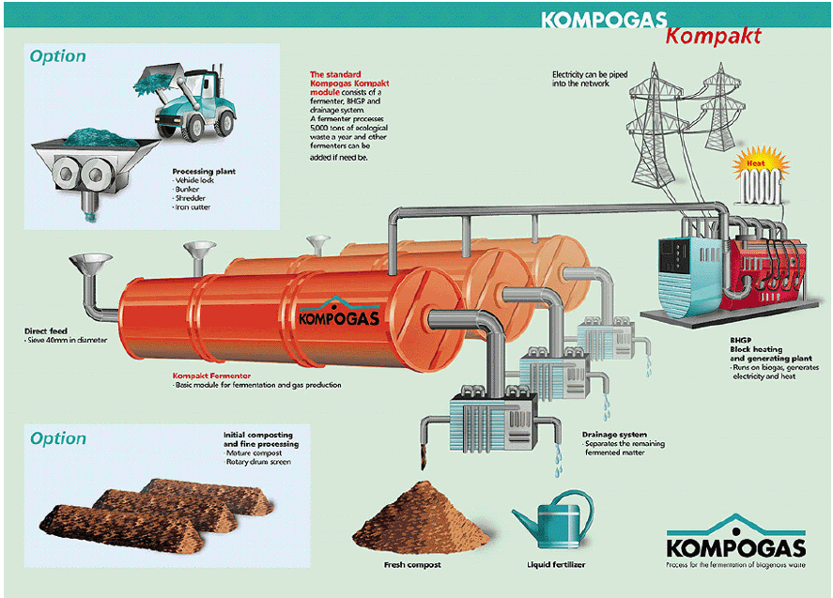

Slide 44
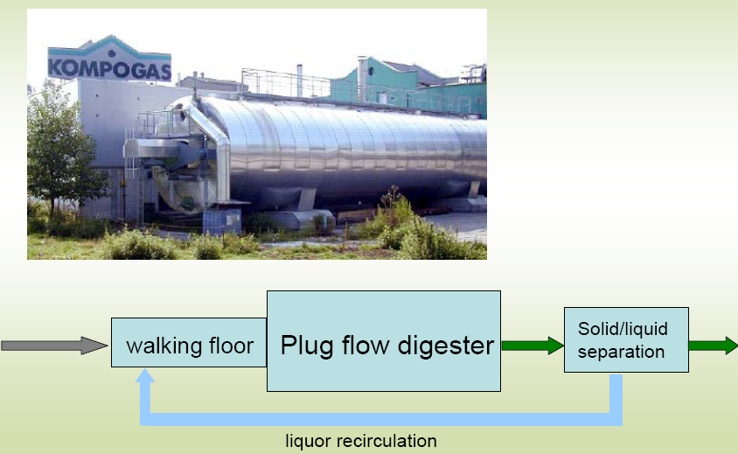
Kompogas Dry Digester

Slide 45
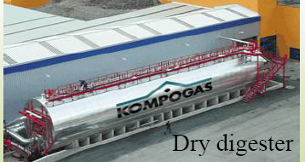
Kompogas Dry Digester

Slide 46
Important Considerations
MSW slurry behaves differently than wastewater sludge.
Because of the heterogeneous nature of MSW, the slurry tends to separate and form a scum layer which prevents the bacteria from degrading these organics .
The scum layer tends to evade the pump outlets and can clog pumps and pipes when it is removed from the reactors.
To prevent this, pretreatment to remove inert solids and homogenize the waste is required.
Solids can also short circuit to the effluent pipe before they have broken down completely, therefore design modifications were made to allow longer contact time between bacteria and dense, recalcitrant material.
MSW tends to contain a higher percentage of toxic and inhibitory compounds than wastewater. In diluted slurry, these compounds diffuse quickly and evenly throughout the reactor. In high enough concentrations, this can shock the microorganisms

