Slide 1

Operations Management
By: Mudit M. Saxena
Dept. of Mech. Engineering, ITE, Indus University

Slide 2
Contents
1- What is Operations Management (OM)?
2-Importance of OM .
3-OM decisions.
4-OM's contributions to society.
5-OM of service & manufacturing organizations 6-The ever-changing world of OM
7-Make or buy decision

Slide 3
What is operations management (OM)?
OM definition
Responsibilities of operations managers Difference between OM and PM

Slide 4
What is operations management ?
Finished goods and services: The collection of people, technology, and systems within a company that has primary responsibility for providing the organization’s products or services.
The management of the direct recourses that are required to produce and deliver an organization's goods and services .
A discipline and profession that studies and practices the process of planning, designing, and operating production systems and subsystems to achieve the goals of the organization.
The business function responsible for planning, coordinating, and controlling the resources needed to produce a company’s products and services.
The management of the conversion process that transforms inputs into outputs in the form of

Slide 5
Operations as a transformation process
INPUTS
Material
Machines
Labor
Management
Capital
- Customer
OUTPUTS
Goods
Services
TRANSFORMATION PROCESS
Feedbac k

Slide 6
Inputs and Outputs of a production system
Inputs
External:
Legal, Economic, Social, Technological
ν
Market:
ν
Competition, Customer Desires, Product Info.
Primary Resources:
ν
Materials, Personnel, Capital, Utilities
Outputs
Direct
ν
ν
Products Services
Indirect
ν
ν
ν
Waste
Pollution
Technological Advances

Slide 7
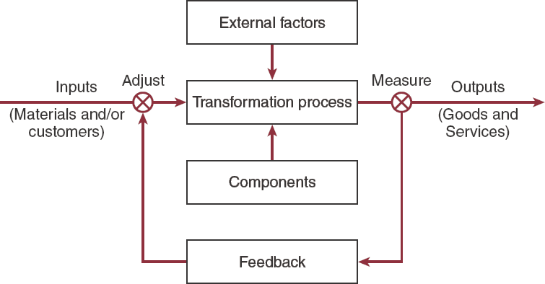
The transformation process within OM

Slide 8
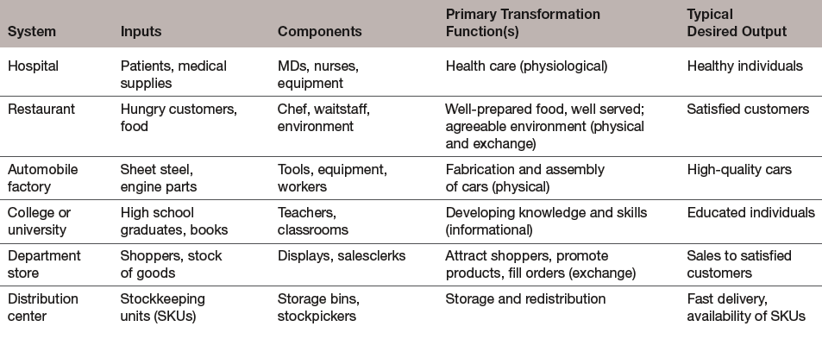
Input- transformation- output relationships for typical systems

Slide 9
What is operations management ?
Operations management is the set of activities that create value inthe form of goods and services by transforming inputs into outputs.
Value added is the net increase between output product value and
Input material value (The value of the outputs is greater than the value of the inputs, resulting in the profit or the benefit for government or non-profit organizations)
All types of organizations, manufacturing or service, large or small, transform inputs into outputs.
Every organization has OM function, since all organizations
provide products or services, but the function may be formal or informal (In many smaller organizations operations management may be done by people who perform many other types of task such as marketing and accounting)

Slide 10
What's the difference between PM and OM?
If services concept added to the production management it can be called operations management.
ν

Slide 11
Direct Responsibilities :
What responsibilities do operations managers have ?
The activities which are directly related to
producing and delivering products and services.
Indirect responsibilities :
the activities involved in interfacing with other
a wider set of tasks that involve scanning the
parts of the organisation.
Broad responsibilities :
business, social and political environment in which the organisation exists in order to understand its context.

Slide 12
Responsibilities of OM
Planning Organizing
Degree of centralization
Process selection
Staffing
– Capacity
Inventory
Quality
Costs
Productivity
Hiring/laying off
Use of Overtime
Directing
Location
Products & services
Make or buy
Layout
Projects
Scheduling
Controlling/Improving
Incentive plans
Issuance of work orders
Job assignments

Slide 13
Importance of OM

Slide 14
Importance of OM
We should know how goods and services are produced (All managers should have an understanding the main principles and tools of OM)
It is responsible for the customer fulfillment aspects of an organization. Thus, it manages customer satisfaction.
OM is such a costly part of an organization. (For most organizations it absorbs a huge percentage of required capital ) Companies need to have efficient operations to survive. To succeed, a firm must have a strong operations function teaming with the other organization functions.
OM responsible to increase productivity and profitability .
Increasing overall productivity leads to economic growth and a higher standard of living.
Operational decision-making requires a long- term perspective and requires inputs from all business functions .OM Decisions tend to be costly and difficult to reverse

Slide 15
Some definitions
Productivity:
The ration of what is produced by an operation or process to what is required to produced it, that is ,the output from the operations divided by the input to the input operation (ratio of output to input)
Efficiency:
producing something at the lowest possible cost
Effectiveness:
doing the right things to create the most value for the firm
Value :
quality divided by price
Competitive advantage:
competitive advantage is an advantage over competitors gained by offering consumers greater value, either by means of lower prices or by providing greater benefits and service that justifies higher prices

Slide 16
OM decisions
Strategic Tactical operational

Slide 17
Main operational decisions
Where should we locate our facility
How much capacity do we need
What should we make, what should we buy
What technology should we use
How do we insure appropriate quality
Who should we use as vendors
How much inventory do we need
How should we schedule our resources

Slide 18
Critical decisions of OM
Product & service design.
Quality management.
Process design.
Capacity & location of facilities. Layout of facilities.
Human resource & Job design. Supply-chain management.
Inventory management. Scheduling.
Maintenance.

Slide 19
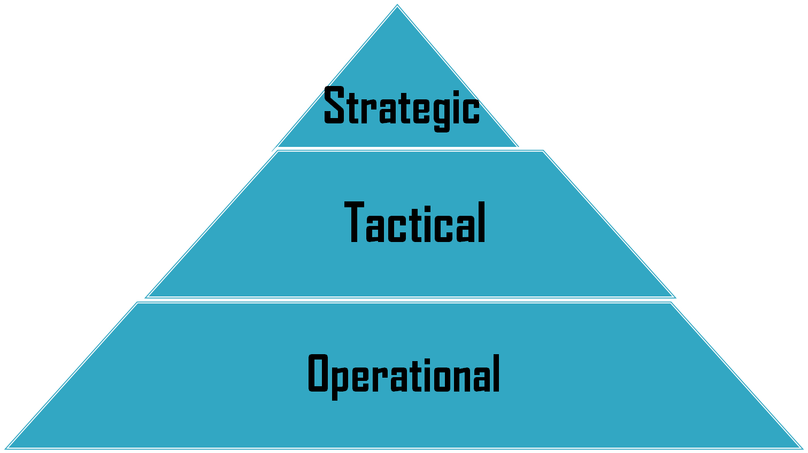
OM decisions
Operations managers must make decisions on three levels:

Slide 20
Strategic decisions
Senior management responsibility More broad in nature
Determine the success of an organization's strategy,
ν
ν
ν
ν
ν
ν
Very risky and hard to reverse
Have significant long - term impact, ,and less frequent.
^{ν} Examples:
How will we make the product? Where do we locate the facility? How much capacity do we need? When should we add more capacity?
ν
ν
ν
ν

Slide 21
Tactical decisions
Medium- range decisions focus on resource needs, schedules, & quantities to produce
Tactical decisions are frequent, must align with strategic decisions.
Involves resource allocation and utilization. Involves a moderate degree of uncertainty and risk..
They are the link between lower and high level management
Examples:
ν
ν
ν
ν
ν
ν
ν
ν
ν
ν
ν
How many workers do we need? When do we need them?
Should we work overtime or put on a second sift?
When should we have material delivered?
Should we have a finished goods inventory?

Slide 22
Operational decisions
What jobs do we work on today or this week? To whom do we assign what task?
What jobs have priority?
Involves a short time horizon.
Involves very little uncertainty and risk.
θ
θ

Slide 23
OM decisions
Strategic
Longer term decisions
Responsibility of the senior management
Tactical
Medium term decisions
Responsibility of middle and senior managers
Operating
Shorter term decisions
Responsibility of middle and lower management levels
Characteristics
High capital investment
Broad in nature
Narrow in scope
These decisions concern the day-to- day activities of workers

Slide 24
OM's contributions to society
Higher Standard of Living
Better Quality Goods and Services Concern for the Environment Improved Working Conditions

Slide 25
Operations management's contributions to society
OM's contributions to society:-
(A)- Higher Standard of Living
(B)- Better Quality Goods and Services
(C)- Concern for the Environment
(D)-Improved Working Conditions

Slide 26
(A)- Higher standard of living
A major factor in raising the standard of living in a society is the
ability to increase its productivity.
ν
Higher productivity is the result of increased efficiency in
operations, which in turn translates into lower cost goods and services.
ν
ν
consumers with more discretionary income, which contributes to their higher standard of living.

Slide 27
Higher standard of living
1-Improve productivity
5-Higher standard of living
2- Result of increased efficiency in operations
4- More income
3- Lower cost of goods & services

Slide 28
(B) - Better quality of goods and services
One of the many consumer benefits of increased competition is the higher-quality products that are available today.
Quality standards are continually increasing.
Many companies today have established Six-Sigma quality standards pioneered by Motorola in the late 1980s), resulting in no more than 3.4 defects per million opportunities.
Such high quality standards were once considered not only prohibitively expensive but also virtually impossible to achieve even if cost wasn't a consideration.
Today we know that such high quality is not only very possible, but also results in lower costs, because firms can reduce their waste and rework.

Slide 29
(C)- Concern for the environment
Many companies today are taking up the challenge to produce environmentally friendly products with environmentally friendly processes, all of which falls under the purview of operations management.
■ Recycling and concern for air and water quality

Slide 30
(D)-Improved working conditions
Managers recognize the benefits of providing workers with
ν
better working conditions.
This includes not only the work environment but also the design of the jobs themselves.
ν
Workers are now encouraged to participate in improving operations through suggestions.
ν
After all, who would know better how to do a particular operation than that person who does it every day.
ν
Managers also have learned that there is a very clear
ν
relationship between satisfied workers and satisfied customers, especially in service operations.
ν
(Empowerment :The concept of encouraging and authorizing
workers to take the initiative to improve operations, reduce costs, and improve product quality and customer service.)

Slide 31
OM of service and manufacturing organizations
Importance of service now Service nature
The affect of service nature on OM activities

Slide 32
OM of service and manufacturing organizations
^{ν} Initially, operations management concepts
focused almost entirely on manufacturing.
As countries become more developed,
ν
services continue to represent a larger percentage of their economies.
Now Less than 20% of all jobs are in manufacturing (and they are declining)
Almost 80% of jobs are in the service sector
(and they are increasing)
Nearly half of all jobs are in POM

Slide 33
Services as a percent of Gross Domestic Product (GDP) for different countries

Slide 34
Service and manufacturing similarities
All use technology
Both have quality, productivity, & response issues
All must forecast demand
Each will have capacity, layout, and location issues
All have customers and suppliers
All have scheduling and staffing issues

Slide 35
Manufacturing vs. service
Characteristic Manufacturing Service
Output
Customer contact Uniformity of input Labor content Uniformity of output
Measurement of productivity
Opportunity to correct quality problems
High
Tangible Low High Low High Easy High
Intangible High Low High Low Difficult Low

Slide 36
Manufacturing vs. service
Customer contact:
Service, by nature, involves a much high degree of customer contact than manufacturing.
The performance of service often occurs at the point of consumption. Manufacturing allows a separation between production and consumption, so that manufacturing can occur away from the consumer.
Customer are sometimes apart of the system (self-service operations-shopping
+gas stations) so tight control on process is impossible
Uniformity of input:
ν
Service operations are subject to greater variability of input than typical
manufacturing operations.
ν
Eachpresents a specific problem that often must be diagnosed before it patient, each client and each auto repair can be remedied
ν
Manufacturing operations often have the ability to carefully control the amount of variability of input and thus achieve low variability in outputs.
ν
Job requirements for manufacturing are generally more uniform than those for service

Slide 37
Manufacturing vs. service
Labor content of jobs:
Many services involve a higher labor content than manufacturing operations
Uniformity of output
Because high mechanization generates products with low variability , manufacturing tends to be smooth and efficient , service activities sometimes appear to be slow and awkward and output is more variable. Automated services are exception to this
Measurement of productivity
Measurement of productivity is more straightforward in manufacturing due to the high degree of uniformity of most manufacturing items.
In service operations , variations in demand intensity and in requirements from job to job make productivity measurement more difficult

Slide 38
Goods vs. services
Attributes of
goods
Attributes of services
- Product can be inventoried.
Intangible Products
Many services cannot be inventoried.
Many aspects of quality are difficult to measure.
Selling is often a part of the service.
- Some aspect of quality are measurable.
Selling is distinct from production.
Site of facility is important for
Provider, not product, is often transportable.
Site of facility is important for customer
cost.
- Often easy to automate.
contact.
- Revenue is generated primarily from the tangible
Service is often difficult to automate.
Revenue is generated primarily from the intangible service.
product.
Capital intensive
Labor intensive

Slide 39
The ever – changing world of OM
Increased global competition Advances in technology
Linking OM to customers and suppliers

Slide 40
The ever-changing world of OM
Operations management is continuously changing to meet the new and exciting challenges of today's business world.
This ever-changing world is characterized by increasing global competition and advances in technology. Emphasis is also shifting within the operations function to link it more closely with both customers and suppliers.

Slide 41
(A)- Increased global competition
The world is rapidly transforming itself into a single global economy, which referred to as a global village or global landscape.
Markets once dominated by local or national companies are now vulnerable to competition from literally all corners of the world. For example, in the 1960s, only 7 percent of the firms in the United
ν
ν
States exposed to foreign competition; by the late 1980s,
This figure exceeded 70 percent, and that percentage has
ν
continued to grow.
Consequently, as companies expand their business to include
ν
foreign markets, so too must the operations management function take a more global perspective in order for companies to remain competitive.
ν
To s prosper in such a global marketplace companies must excel in more than one dimension, which previously was the norm.
ν

Slide 42
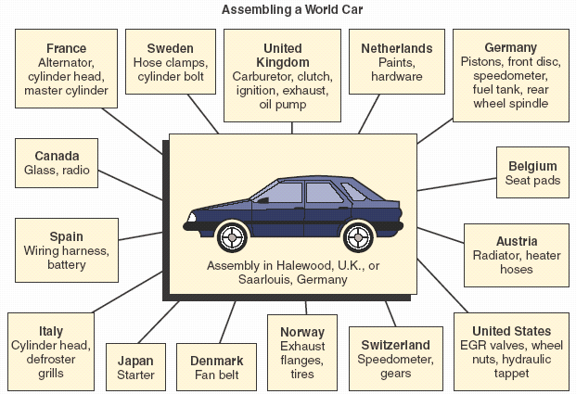
Ford’s Global Network to Support the Manufacturing of the Escort

Slide 43
(B)- Advances in technology
ν
Advance in technology in recent years have had a significant effect on the OM function:
IT+ automation + Internet Competition
Product life cycle
New jobs Robots
E-???
ν
ν
ν
ν
ν
ν

Slide 44
( C )- Linking OM to customers and suppliers
In the past, most manufacturing organizations viewed operations strictly as an internal function that had to be buffered from
ν
materials were obtained through the purchasing function; capital for equipment purchases came from the finance function; the labor force was obtained through the human resources function; and the product was delivered by the distribution function
the external environment by other organizational functions.
ν
Orders were generated by the marketing function; supplies and raw
Now more and more firms are recognizing the competitive advantage achieved when the transformation process is not isolated, as when
ν
customers are invited to view their operating facilities firsthand

Slide 45
(C )- Linking OM to customers and suppliers
Companies are working more closely with suppliers.
The relationship between the transformation processes of suppliers and customer often referred to as a product's value chain.
( steps an organization requires to produce a good or service, regardless of where the are performed)
A value chain consists of all the steps actually add value to the product. This concept helps managers to eliminate all non
Firms like Toyota, have suppliers deliver product directly to the factory floor, eliminating need for a stockroom.
ν
ν
ν
ν
added steps (such as inspections and inventory ) and
consequently results in a higher of dependence among the value- added functions within the chain.
This integration of both suppliers and customers into the transformation process to blur the boundaries between what were previously totally independent organizations (Virtual enterprises)
ν
ν
(company whose boundaries are not clearly defined due to the integration of customers and suppliers)

Slide 46
7- Make or buy?
Capacity Expertise Quality Demand Cost Risk

Slide 47
Make or buy?
Make or Buy Decision:
For a variety of reasons. Among those factors are:
1- Available capacity:
ν
Many organizations buy parts or contract out services,
ν
If an organization has available the equipment, necessary skills, and time, it often make sense to produce an item or perform a service in-house.
The additional costs would be relatively small compared
ν
with required to buy items or subcontract services.
2- Expertise:
ν
If a firm lacks the expertise to do a job satisfactorily,
buying might be a reasonable alternative.

Slide 48
Make or buy?
3. Quality consideration:
Firms that specialize can usually offer high quality than an organization can attain itself.
Conversely, unique quality requirements or the desire to closely monitor quality may cause an organization to perform a job itself.
4. The nature of demand:
When demand for an item is high and steady, the organization is often better off doing the work itself.
However, wide fluctuations in demand or small orders are usually better handled by specializations who are able to combine orders from multiple sources, which results in a higher volume and tends to offset individual buyer fluctuations.

Slide 49
Make or buy?
5- Cost:
Any cost savings achieved from buying or making must be weighted against the preceding factors .
Cost saving might come from the item itself or from transportation cost savings.
If there are fixed costs associated with making an item that cannot be reallocated if the service or product is outsourced , that has to be recognized in the analysis. Conversely, outsourcing may help a firm avoid incurring fixed costs.
6- Risk:
Outsourcing may involve certain risks. one is loss of control operations.
Another is the need to disclose propriety information.
In some cases , a firm might choose to perform part of the job itself and let others handle the rest in order to maintain flexibility and to hedge against loss of a subcontractor . If part or all the work will be done “ in-house”, capacity alternatives will need to developed

