Slide 1
Solar Applications

Slide 2
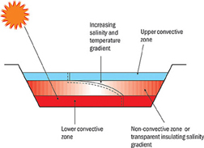
SOLAR POND
Solar pond have three layers and can attain 90 C at the bottom layer and 30 C at the top layer.
1) The top layer-Surface convection zone: thickness of 0.3 to o.5m. low, uniform concentration(low salinity<5%) temp. Close to atm.

Slide 3
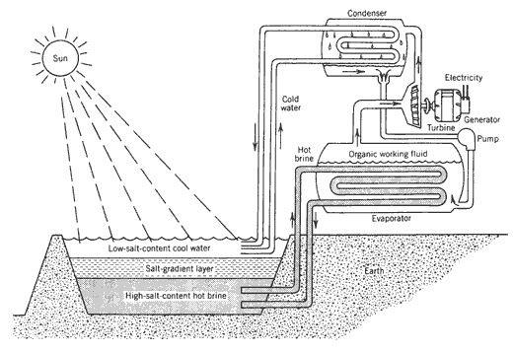
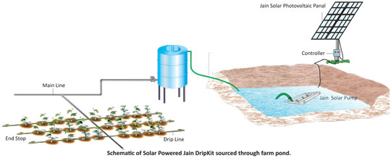
2) Intermediate insulating layer with a salt gradient- Non-convective zone: thicker up to 1 to 1.5m concentration and temp. increase with depth. Due to density gradient prevent heat exchange by nature convection.
3) Lower convective or storage zone: thicker about 0.5 to 1m and high salinity about 20%. Serves as main heat collection as well as thermal storage medium

Slide 4
Solar energy applications and type of collectors used
Application | System | Collector
Solar water heating Thermosyphon systems Integrated collector storage Direct circulation Indirect water heating systems Air systems | Passive Passive Active Active Active | FPC CPC FPC, CPC ETC FPC, CPC ETC FPC
Space heating and cooling Space heating and service hot water Air systems Water systems Heat pump systems Absorption systems Adsorption (desiccant) cooling Mechanical systems | Active Active Active Active Active Active Active | FPC, CPC ETC FPC FPC, CPC ETC FPC, CPC ETC FPC, CPC ETC FPC, CPC ETC PDR
Solar refrigeration Adsorption units Absorption units | Active Active | FPC, CPC ETC FPC, CPC ETC

Slide 5
Solar energy applications and type of collectors used
Application | System | Collector
Industrial process heat Industrial air and water systems Steam generation systems | Active Active | FPC, CPC ETC PTC, LFR
Solar desalination Solar stills Multi-stage flash (MSF) Multiple effect boiling (MEB) Vapour compression (VC) | Passive Active Active Active | - FPC, CPC ETC FPC, CPC ETC FPC, CPC ETC
Solar thermal power systems Parabolic trough collector systems Parabolic tower systems Parabolic dish systems Solar furnaces Solar chemistry systems | Active Active Active Active Active | PTC HFC PDR HFC, PDR CPC, PTC, LFR

Slide 6
Solar Water Heating Systems
Thermosyphon systems
Integrated collector storage systems
Direct circulation systems
Indirect water heating systems
Air systems

Slide 7
Thermosyphon systems (passive)
Thermosyphon systems heat potable water or heat transfer fluid and use natural convection to transport it from the collector to storage.
The water in the collector expands becoming less dense as the sun heats it and rises through the collector into the top of the storage tank.
There it is replaced by the cooler water that has sunk to the bottom of the tank, from which it flows down the collector.
The circulation continuous as long as there is sunshine.
Since the driving force is only a small density difference larger than normal pipe sizes must be used to minimise pipe friction.
Connecting lines must be well insulated to prevent heat losses and sloped to prevent formation of air pockets which would stop circulation.

Slide 8
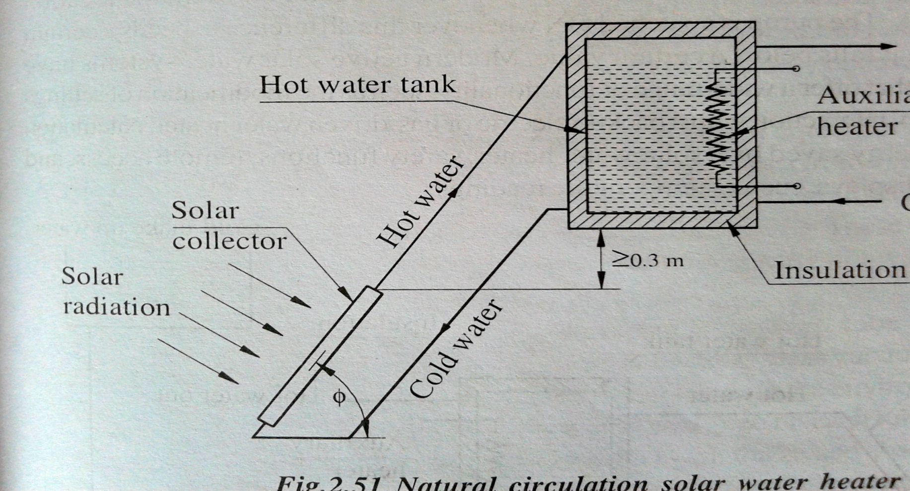
Schematic diagram of a thermosyphon solar water heater
Storage tank is located above level of collector, at least 0.3m above the top edge of collector.

Slide 9
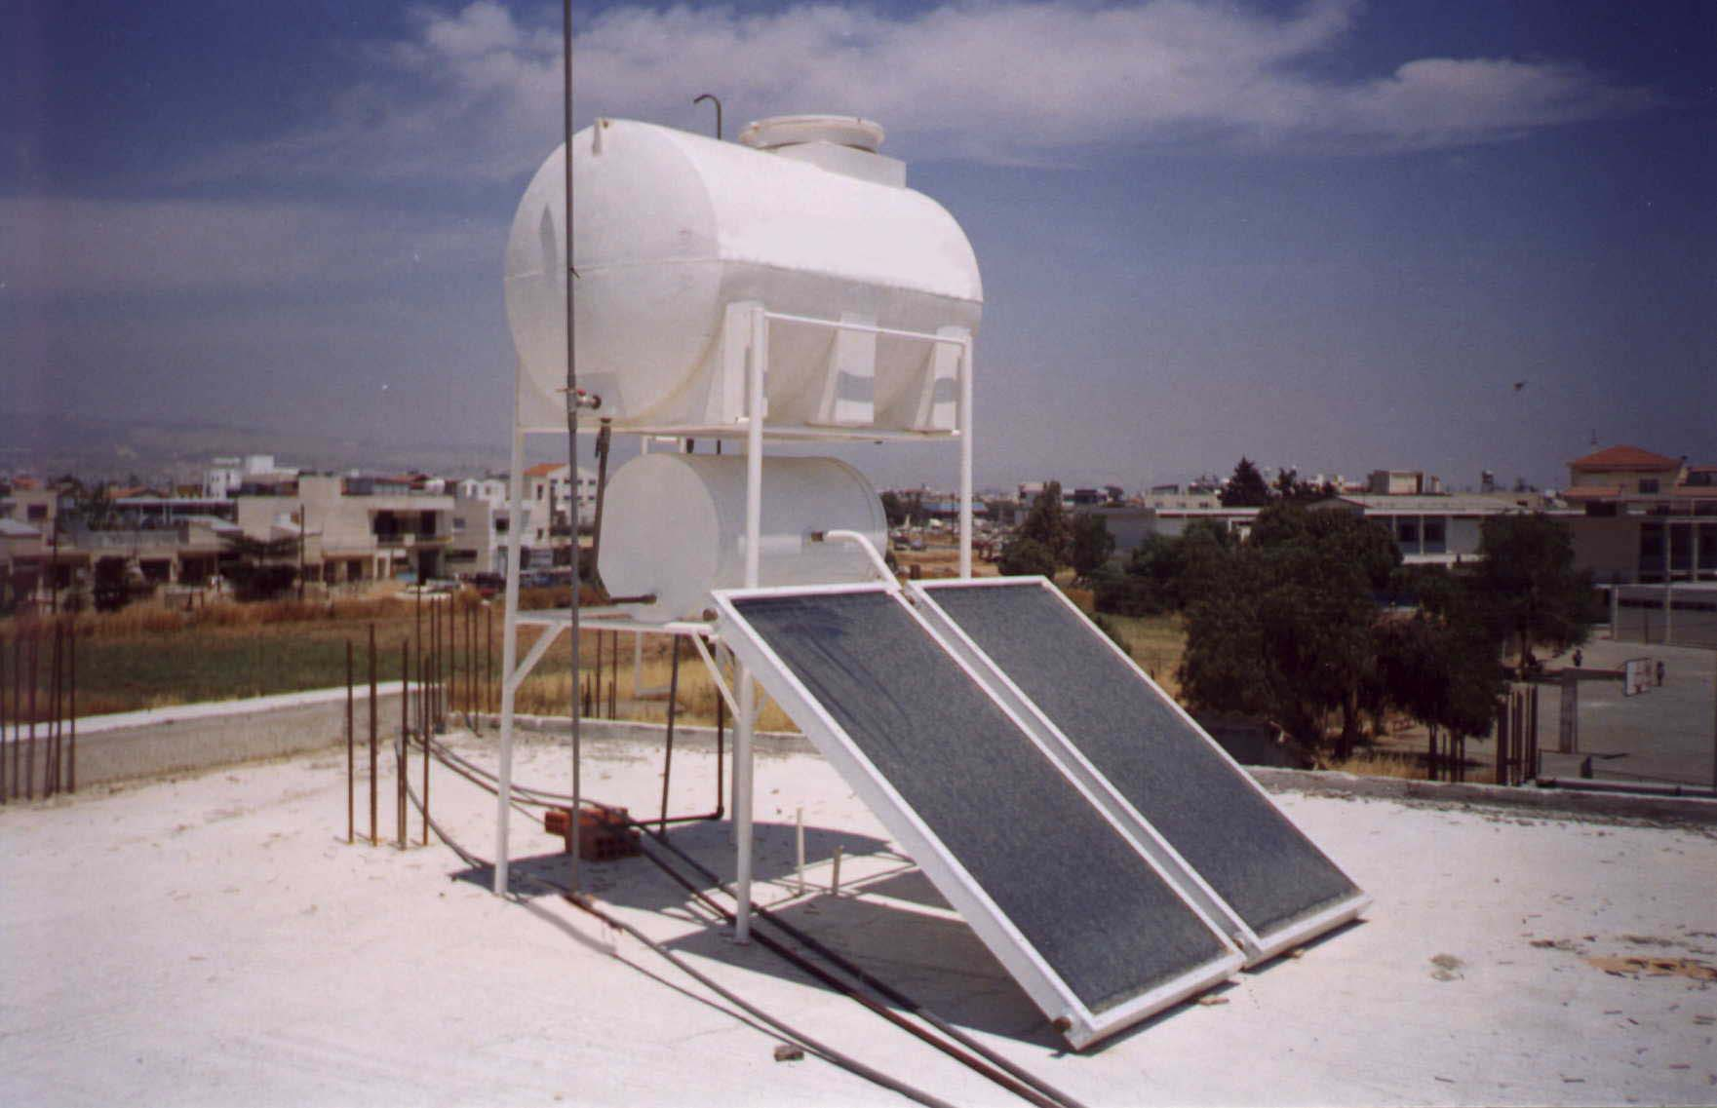
Typical thermosyphon solar water heater

Slide 10
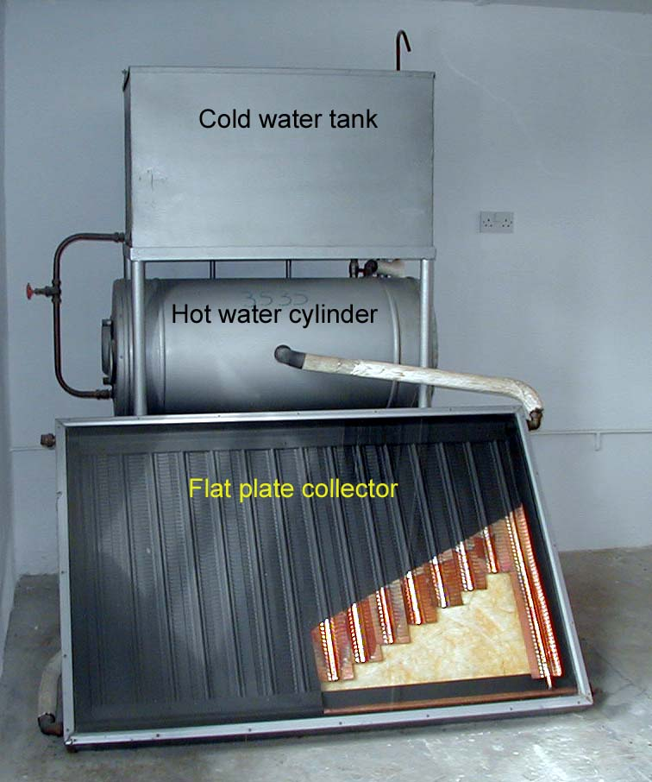
Laboratory model

Slide 11
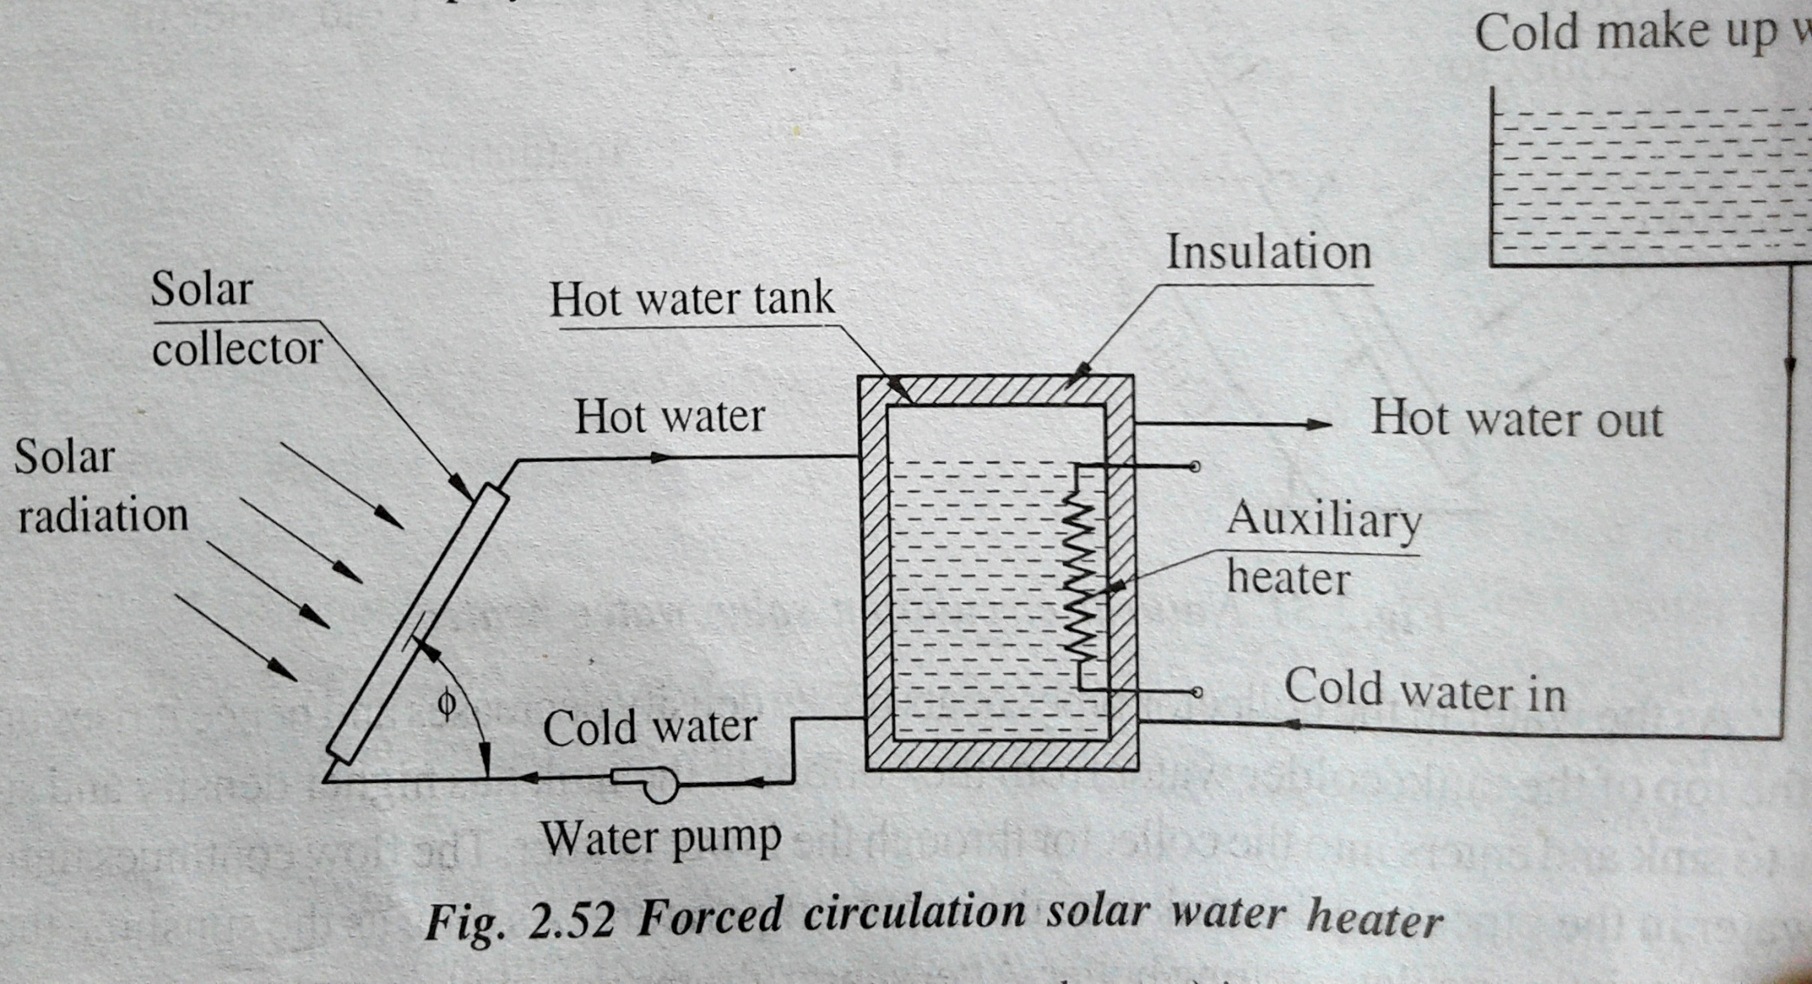
Force circulation SWH or active heating system

Slide 12
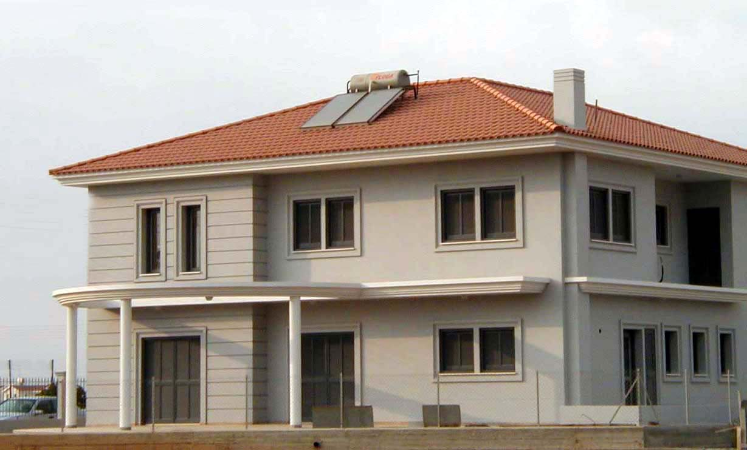
Pressurized system on inclined roof

Slide 13
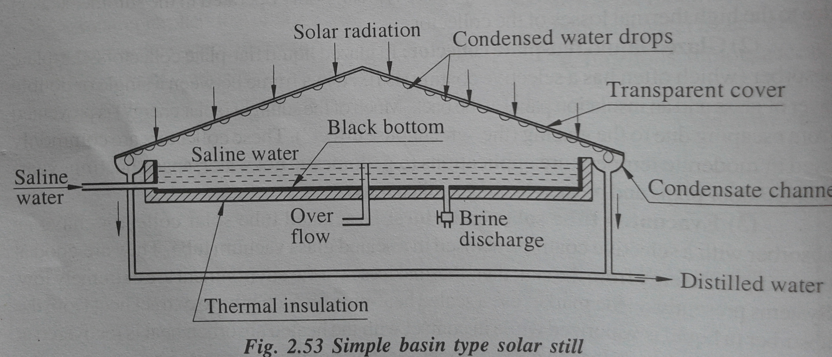
Solar distillation or solar still

Slide 14
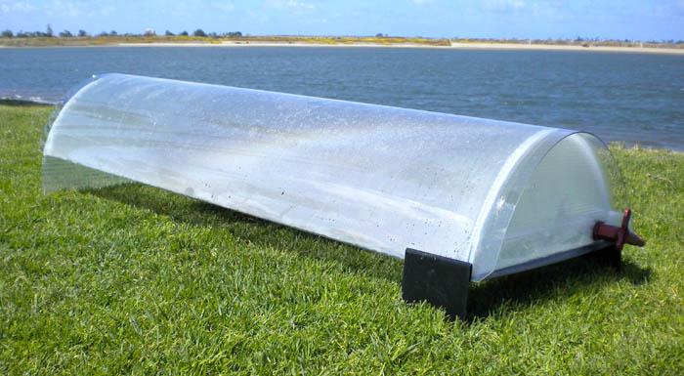
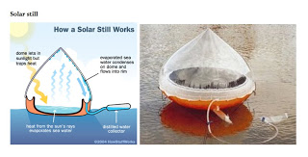
Solar still
The depth of water is kept about 5-10cm.
Output about 3 liter/m2 with efficiency of 30-35% in sunny day.

Slide 15
Solar Stills

Slide 16
Comparison of passive and active system
System operates without pumps, blower, or other mechanical devise.
Special building design is necessary.
The various elements of the buildings like wall, roof, windows, partitions etc., are so selected and so selected and so architecturally integrated that they participate in the collector, storage, transportation and distribution of thermal energy.
Less expensive than active system to construct and operate.
System require pumps, blower, or other mechanical devise for circulate the working fluid for transportation of heat
Special building design is not necessary.
Solar radiation may be stored in sensible heat storage materials, or in latent heat storage material and the energy is redistributed in the building space using pumps, blowing, fans etc.
More expensive

Slide 17
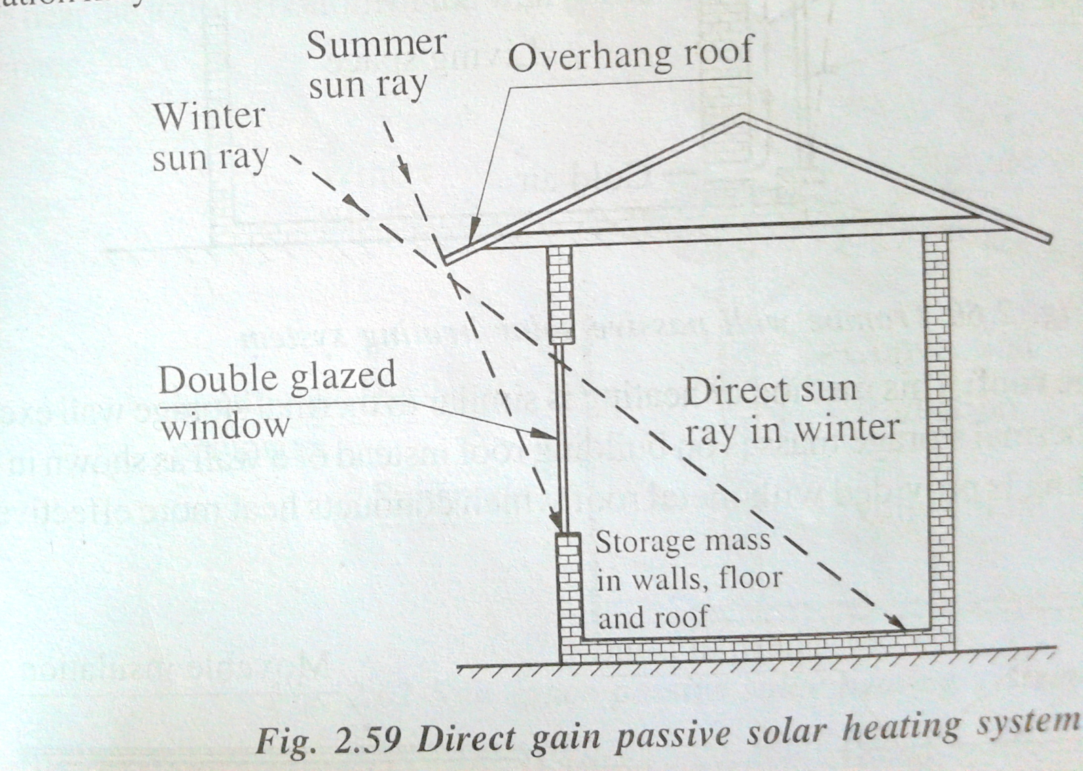
Passive solar space heating system
Direct gain

Slide 18
Thermal storage wall

Slide 19
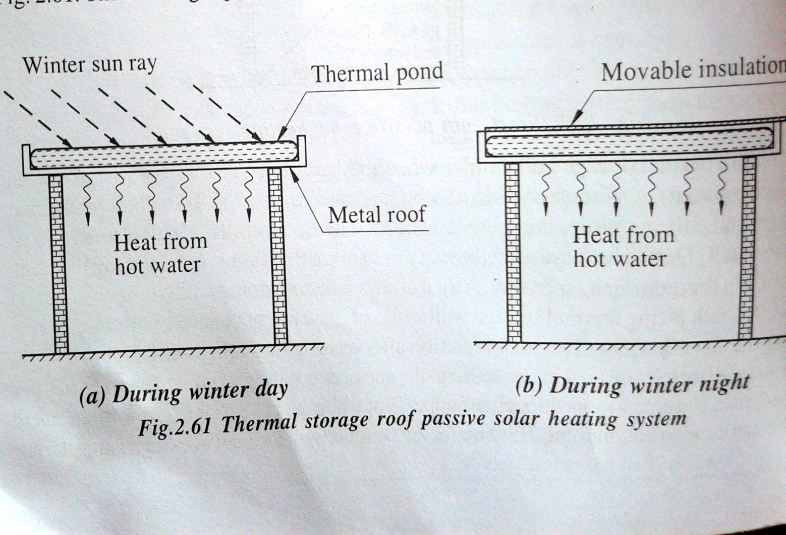
Thermal storage roof:

Slide 20
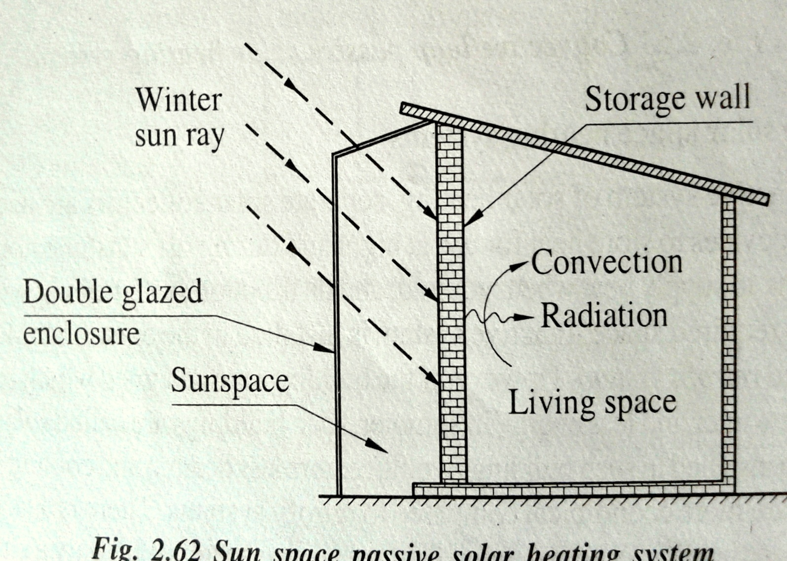
Attached sun space (green house):

Slide 21
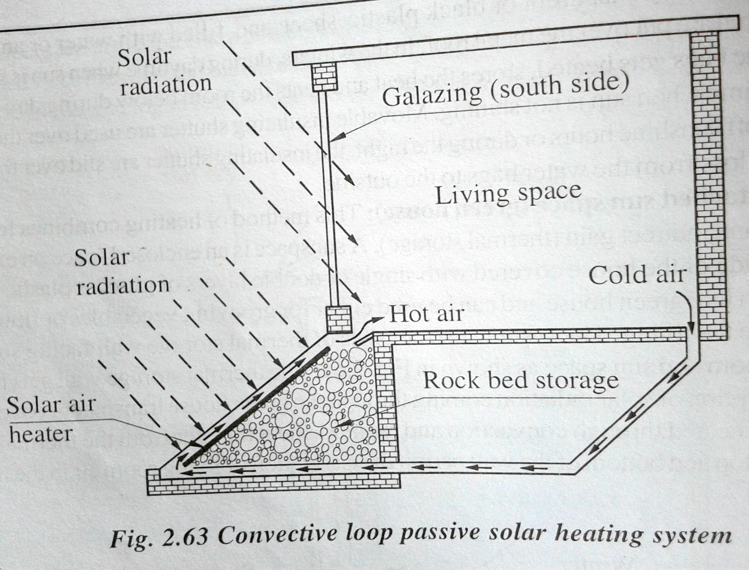
Convective loop: thermo-syphon principle

Slide 22
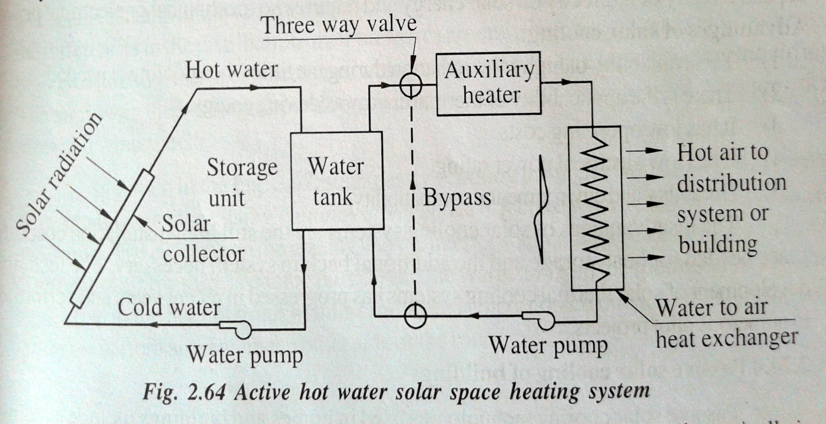
Active solar space heating system
Solar water collectors
Heat storage device
Pumping device or distribution system
Auxiliary heating system
Control system

Slide 23
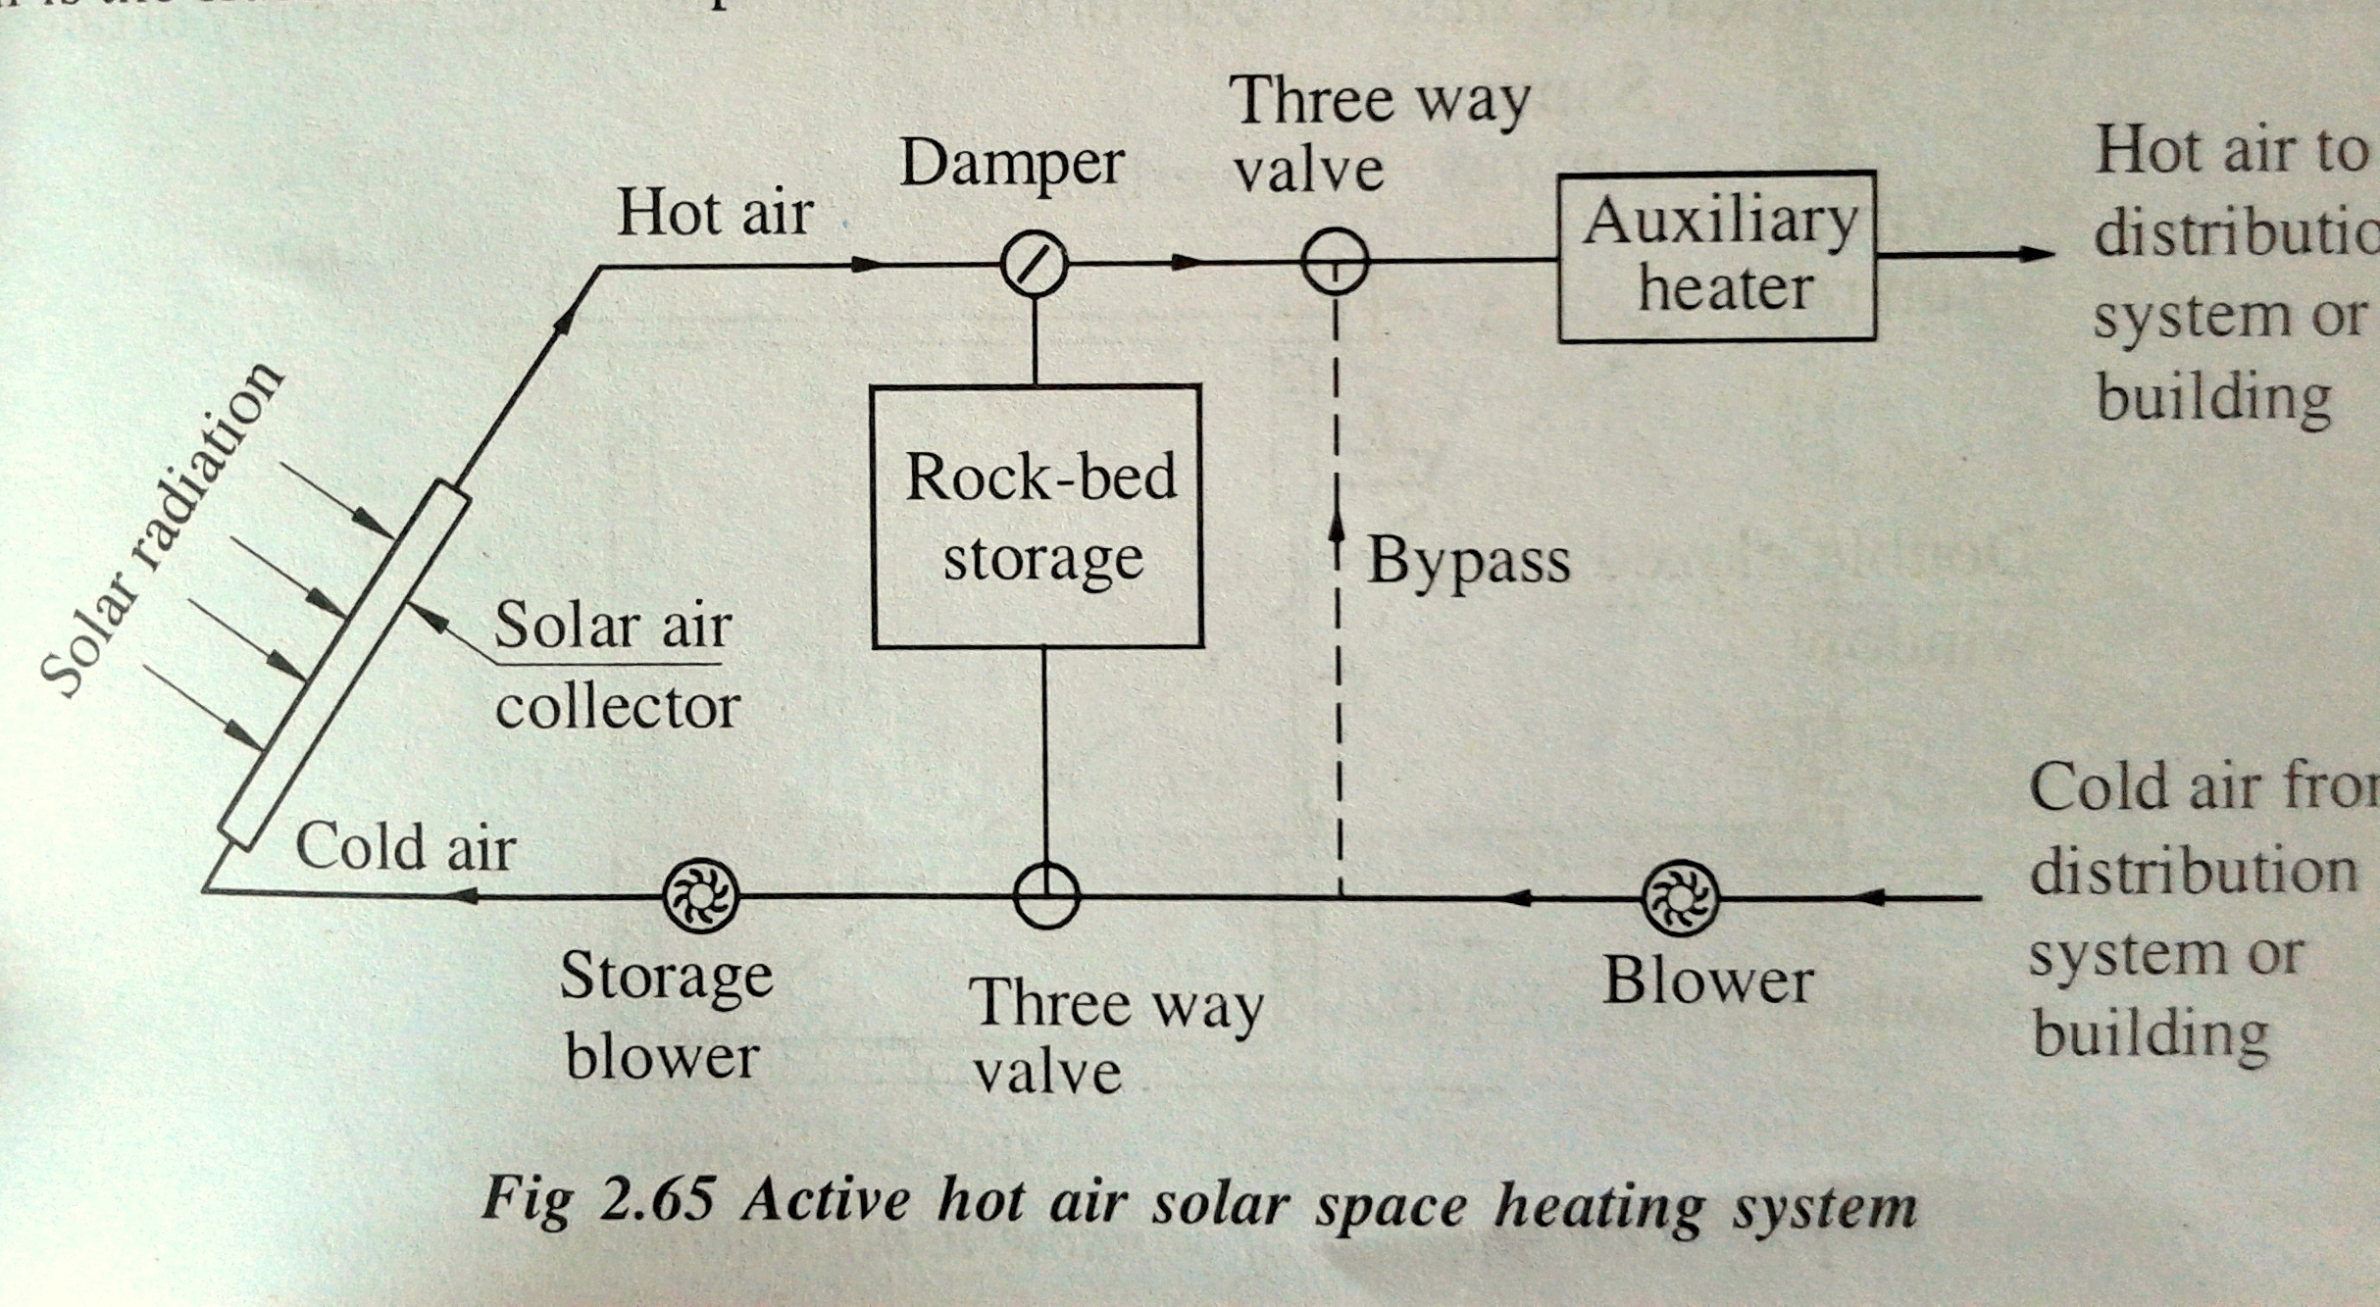

Slide 24
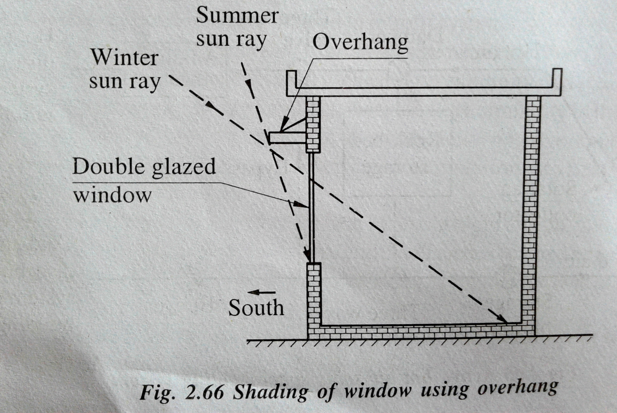
Passive solar cooling of building
Shading

Slide 25
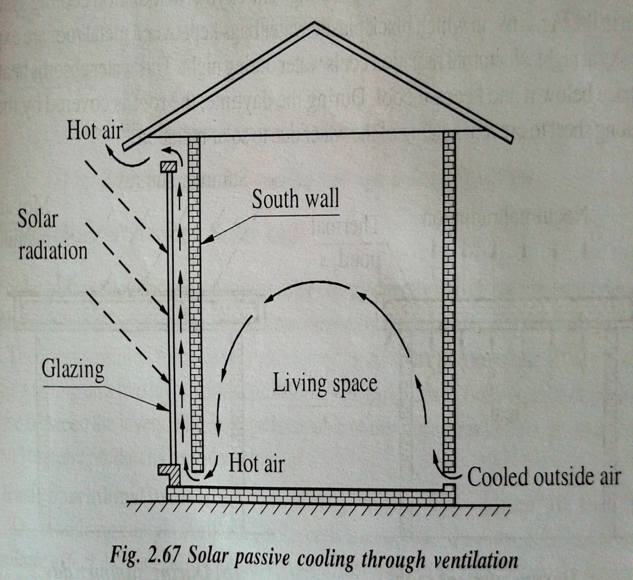
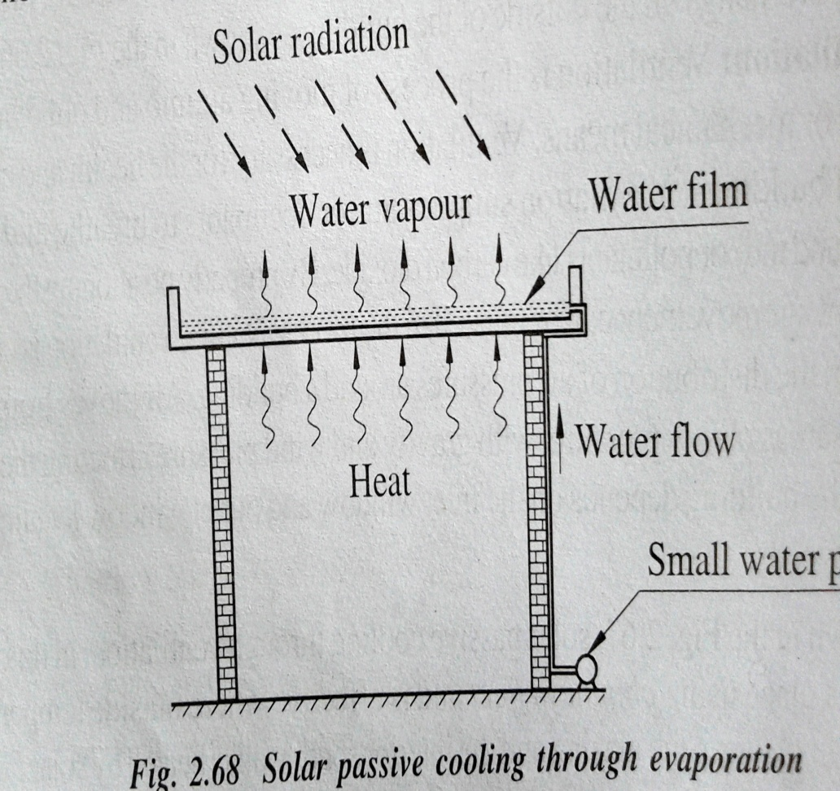
Ventilation
Evaporation

Slide 26
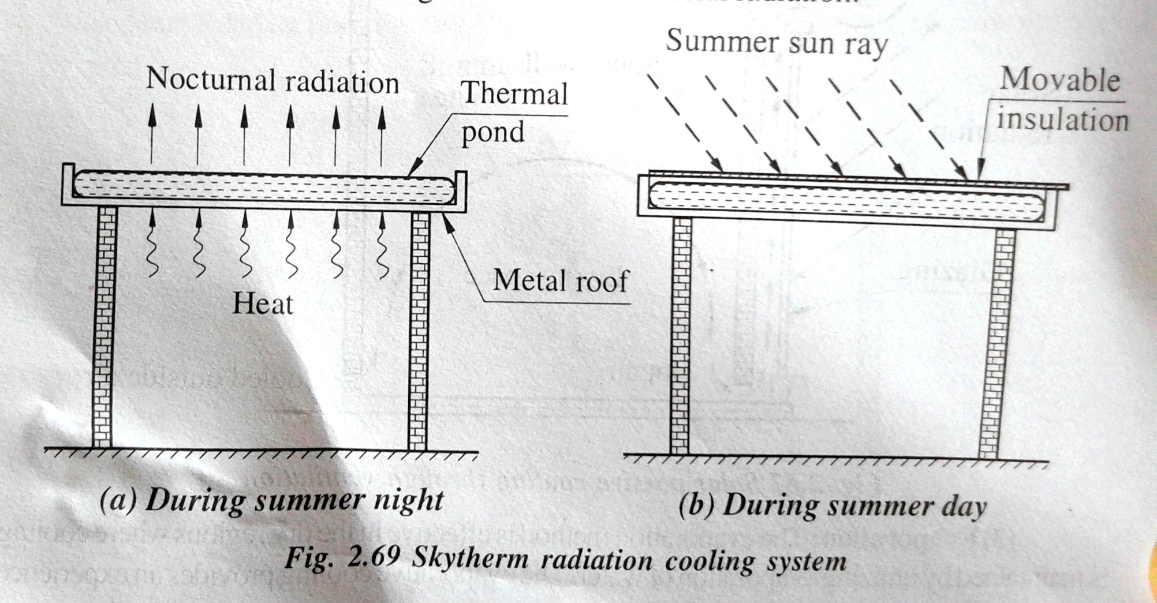
Radiation cooling

Slide 27
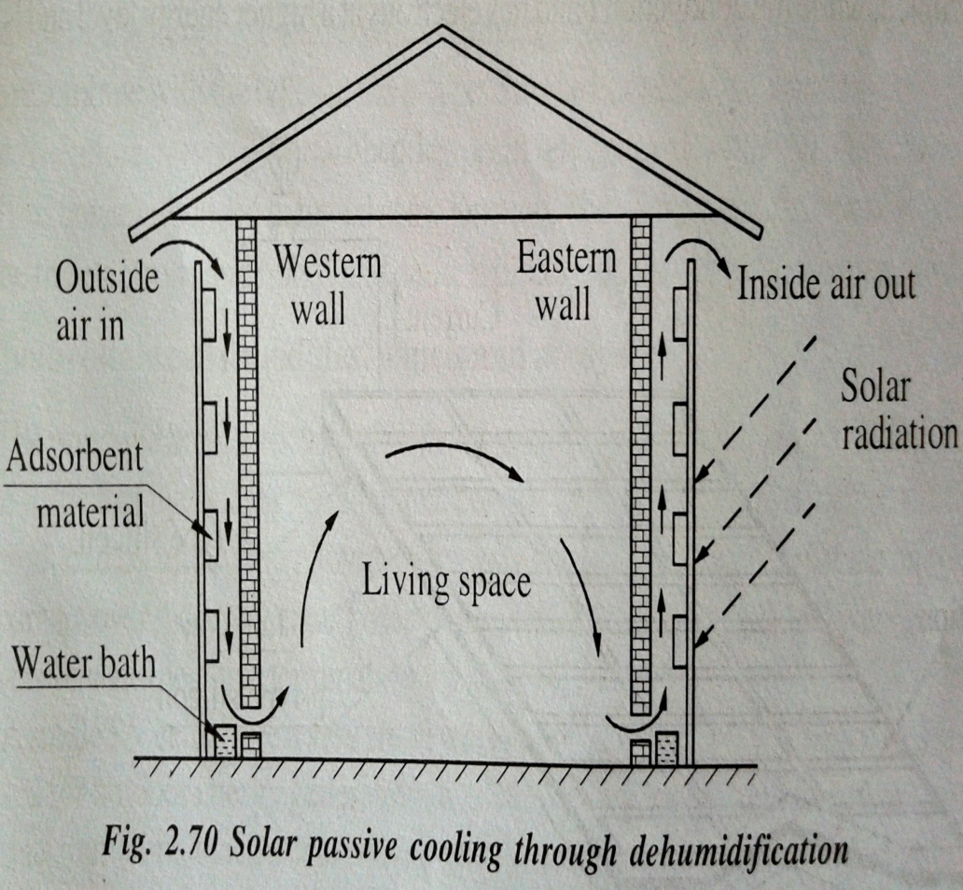
Ground coupling
Dehumidification
The ground temp. is always lower than the air temp. Lower temp. ground can be used for cooling the building by partially sinking it into the ground.

Slide 28
How can this energy be captured ?
Radiated energy from sun has to be captured
Then converted into electricity by the Photovoltaic effect
Use special panels called Photovoltaic (PV) Cells
These cells make up Solar Panels

Slide 29
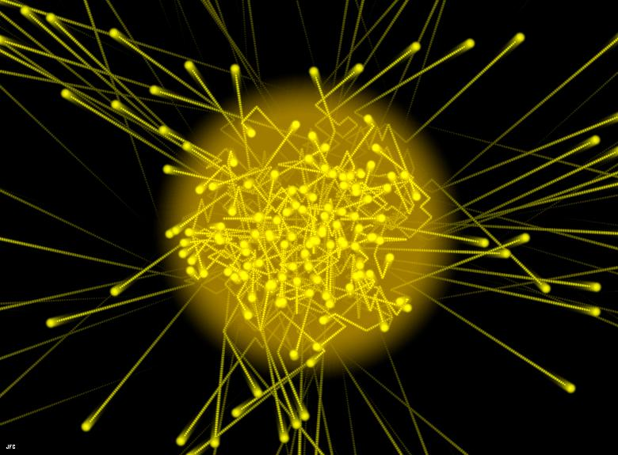
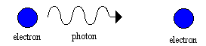

Photons and Semiconductors
Energy from the sun hits the surface of the cell, in the form of Photons
Photons :Energy in the form of light and electromagnetic radiation , no charge and no mass.
PV cell is a semiconductor made from a crystalline silicon (Si) material.
Semiconductor materials (Si and Ge) have a conductivity in-between conductors and insulators

Slide 30
PV Cell construction
Low Iron Glass
Polymer layer (EVA)
Anti-reflective coating
PV Cell consisting of
  Contact for electricity
  Emitter (n-type Si)
  Base (p-type Si)
  Contact
Back polymer layer
1
2
3
a
n-type Silicon
b
- - - - - - - - - - - -
+ + + + + + + + + + + +
p-type Silicon
c
d
5

Slide 31

Converting Light into Electricity
Photons reach emitter layer
Energy releases electrons from silicon
Electrons (-) are attracted to base region (+)
Holes (+) in the base are then attracted to emitter region
This is a flow of electricity
Electricity will flow through the two contacts
Same principle as a diode
n-type Silicon
- - - - - - - - - - - -
+ + + + + + + + + + + +
p-type Silicon

Slide 32
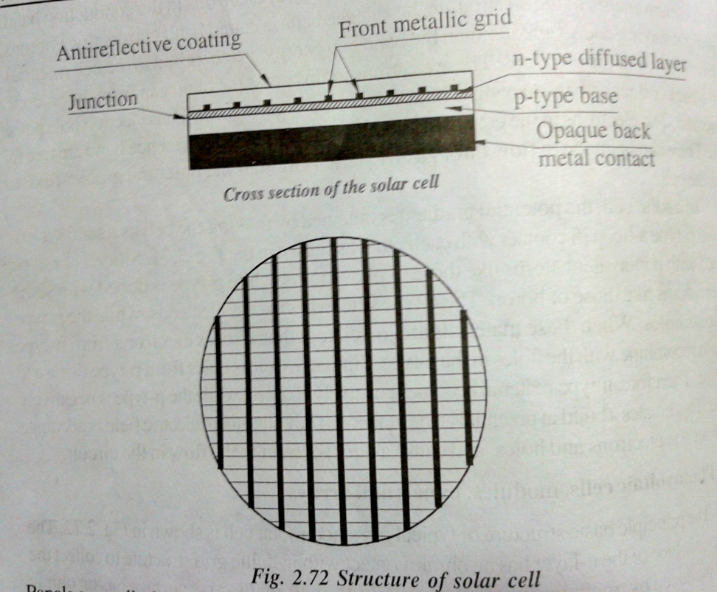
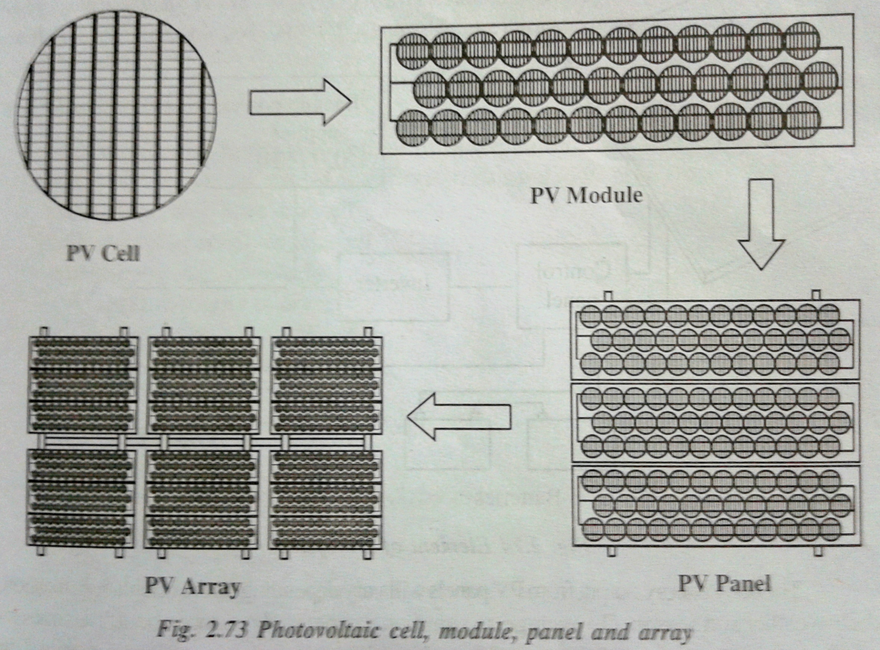
Photovoltaic cell, module, panel and array
Pv cell have very small voltage about 0.5V. The most common connection of 32 or 36 silicon cell to produce and capable of charging a 12V storage battery.
When series or parallel to increase the voltage or current rating called solar PV panel.
When large number of panels are interconnected and installed in an array field, are called solar PV array.

Slide 33
Panel categories
Low voltage/low power panels connecting 3 to 12 small segments of amorphous silicon PV voltage between 1.5 and 6V and outputs of a few mill-watts. Used for watches, clocks and calculators, cameras and devices for sensing light and dark, such as night light.
Small panels of 1-10 watts and 3-12V, with area from 100cm2 to 1000cm2. uses for radios, toys, small pumps, electric fences and trickle charging of batteries.
Large panels, ranging from 10 to 60 watts and generally either 6 or 12 volts, area of 1000cm2 to 5000cm2 are usually made by connecting from 10 to 36 full sized cells in series. Used for small pumps and caravan power or in arrays to provide power for houses, communications pumping and remote area power supplies.

Slide 34
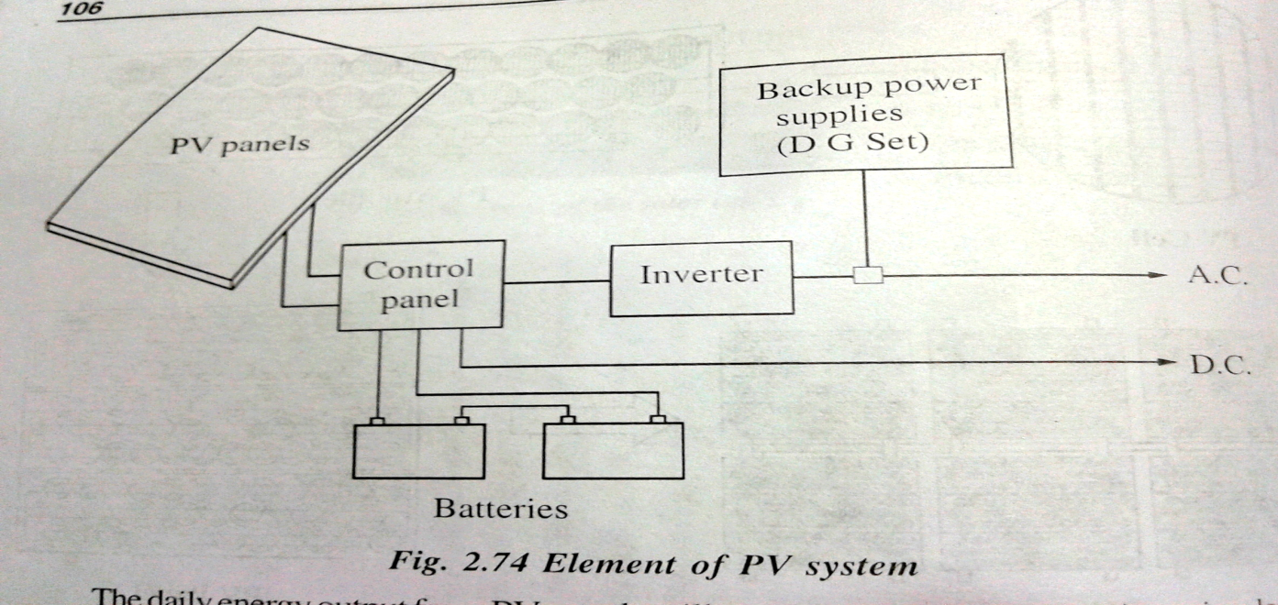
Photovoltaic system for power generation
A PV panel array ranging from to two to many hundreds of panels
Control panel: regulate power from the panels.
Power storage system: contains number of designed batteries.
Inverter: converting the DC to AC power(eg 240 V AC)
A backup power supplies such as diesel start up generators.

Slide 35
PV Technology Classification
Silicon Crystalline Technology Thin Film Technology
Mono Crystalline PV Cells Amorphous Silicon PV Cells
Multi Crystalline PV Cells Poly Crystalline PV Cells
(Non-Silicon based)

Slide 36
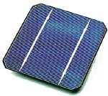
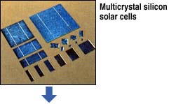
Silicon Crystalline Technology
Currently makes up 86% of PV market
Very stable with module efficiencies 10-16%
Mono crystalline PV Cells
Made using saw-cut from single cylindrical crystal of Si
Operating efficiency up to 15%
Multi Crystalline PV Cells
Caste from ingot of melted and recrystallised silicon
Cell efficiency ~12%
Accounts for 90% of crystalline Si market

Slide 37
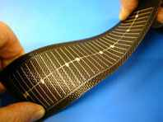
Thin Film Technology
Silicon deposited in a continuous on a base material such as glass, metal or polymers
Thin-film crystalline solar cell consists of layers about 10μm thick compared with 200-300μm layers for crystalline silicon cells
PROS
Low cost substrate and fabrication process
CONS
Not very stable

Slide 38
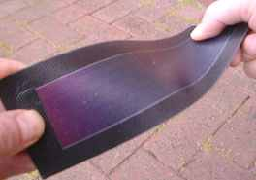
Amorphous Silicon PV Cells
The most advanced of thin film technologies
Operating efficiency ~6%
Makes up about 13% of PV market
PROS
Mature manufacturing technologies available
CONS
Initial 20-40% loss in efficiency

Slide 39
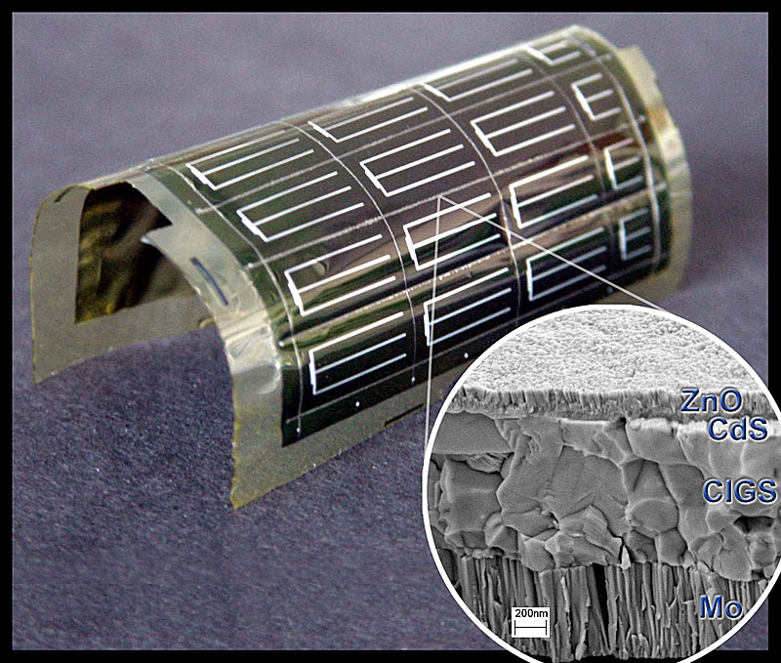
Poly Crystalline PV Cells
Non – Silicon Based Technology
Copper Indium Diselinide
CIS with band gap 1eV, high absorption coefficient 10⁵cm⁻¹
High efficiency levels
PROS
18% laboratory efficiency
>11% module efficiency
CONS
Immature manufacturing process
Slow vacuum process

Slide 40
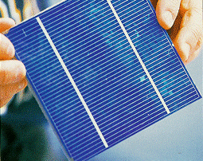
Poly Crystalline PV Cells
Non – Silicon Based Technology
Cadmium Telluride ( CdTe)
Unlike most other II/IV material CdTe exhibits direct band gap of 1.4eV and high absorption coefficient
PROS
16% laboratory efficiency
6-9% module efficiency
CONS
Immature manufacturing process

Slide 41
Semiconductor Material Efficiencies

Slide 42
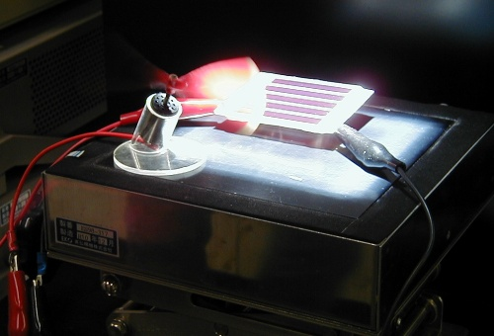
Emerging Technologies
‘ Discovering new realms of Photovoltaic Technologies ‘
Electrochemical solar cells have their active component in liquid phase
Dye sensitizers are used to absorb lig`ht and create electron-hole pairs in nanocrystalline titanium dioxide semiconductor layer
Cell efficiency ~ 7%
Electrochemical solar cells

Slide 43
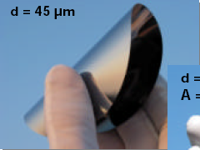
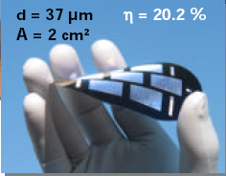
Emerging Technologies
Ultra Thin Wafer Solar Cells
Thickness ~ 45μm
Cell Efficiency as high as 20.3%
Anti- Reflection Coating
Low cost deposition techniques use a metalorganic titanium or tantanum mixed with suitable organic additives

Slide 44
PV’nomics
PV unit : Price per peak watt (Wp)
( Peak watt is the amount of power output a PV module produces at Standard Test Conditions (STC) of a module operating temperature of 25°C in full noontime sunshine (irradiance) of 1,000 Watts per square meter )
A typical 1kWp System produces approximately
1600-2000 kWh energy in India and Australia
A typical 2000 watt peak (2KWp) solar energy system costing $8000 (including installation) will correspond to a price of $4/Wp

Slide 45
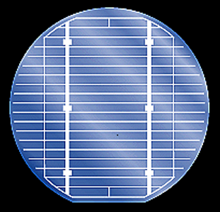
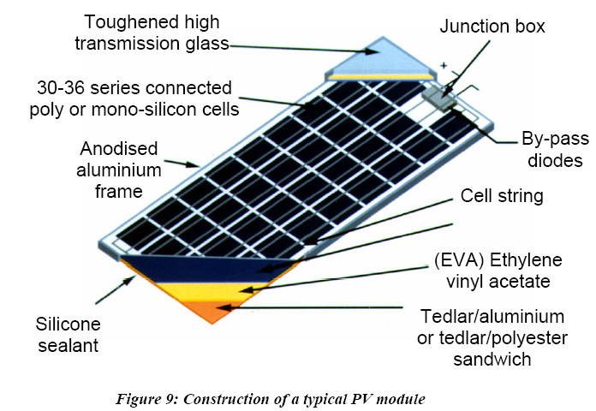
Solar Panel Construction
One PV Cell is approx 150mm in diameter
In bright sunshine it produces 0.4V d.c.
One Module is an array of approx 30 cells
Connected together in series/parallel for desired voltage
Life span is about 25 yrs
Cost varies
€300 - €600 per m²

Slide 46
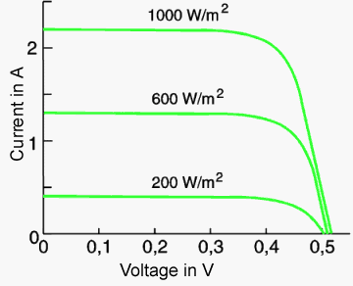
Solar Panel Ratings
Max voltage in single PV Cell is approx 0.4V (D.C.)
Current depends on sun intensity
Max of 2.5A
Average voltage from a module is 20V (D.C.)

Slide 47
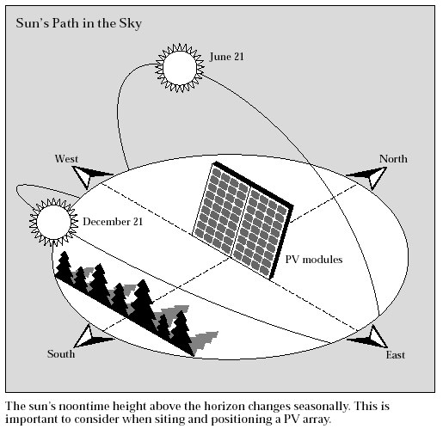
Performance of Solar Panels
Various factors effect power o/p from panels
Shade or Clouds
Panel position or angle
Active panels can track the sun
Temperature and solar irradiance variations
Air gap required for cooling
Partial shading will reduce performance and can cause damage

Slide 48
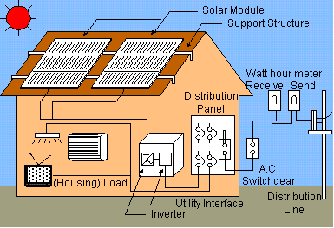
Domestic Solar Panels
Panels connected to inverter
This changes DC to AC
Fed into Distribution Board
Can supply domestic needs (e.g. hot water)
Or feed into main grid

Slide 49
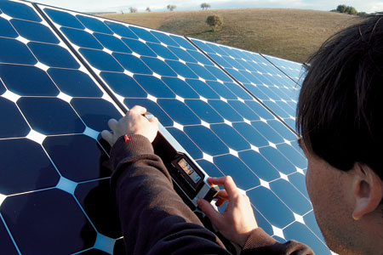
Types of Solar Panels
Monocrystalline
Uniform Blue Colour
Oldest and most efficient PV cell
Production process is slow and expensive
20 Year guarantee (usually for 80% rated Watts)
BP Solar, Siemens

Slide 50
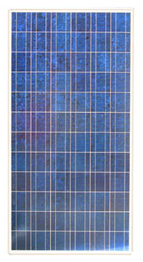
2/ Polycrystalline
Module efficiency ~ 9 - 13%
Irregular blue colour
Less expensive to produce due to simpler manufacturing process
Advantage over monocrystalline is that it is less likely to be damaged when it is partly shaded
20 Year guarantee (usually for 80% rated Watts)
Solarex, Kyocera

Slide 51
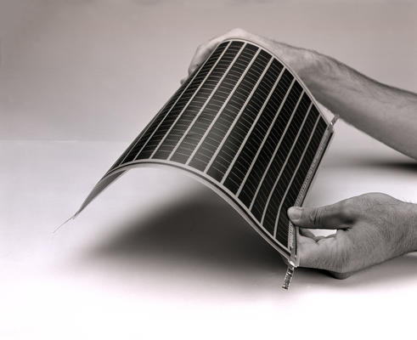
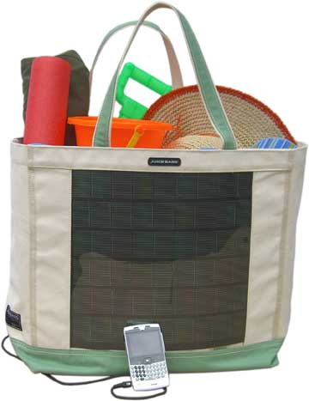
3/ Amorphous Silicon
Low Module efficiencies
Only 3 - 10%
Production process considerably less expensive than crystalline cells
Light and flexible, so can meet a range of applications
10 year guarantee
Unisolar, Intersolar

Slide 52
Application of solar cells
Catholic protection system
Electric fences
Remote lighting systems
Telecommunications and remote monitoring system
Solar powered water pumping
Rural electrification
Water treatment system
Miscellaneous application…..

