Slide 1


Design & Engineering
Material Selection
&
Design Standards

Slide 2

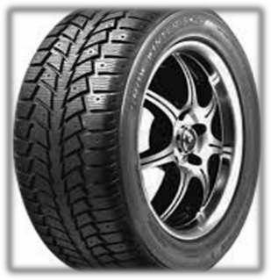

Material Selection
There are over 100,000 engineering materials to choose from. The typical design engineer should have ready access to information on 30 to 60 materials, depending on the range of applications he or she deals with.

Slide 3

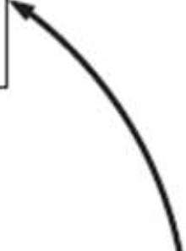


Design
Service conditions Function
Cost
Materials Properties
Availability
Cost
Processing Equipment sejection
Influence on properties
Cost

Slide 4
Material Selection Process

Slide 5
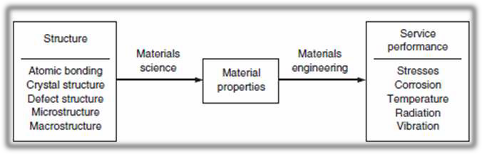
Material Selection Criteria
Materials are selected on the basis of four general criteria:
Performance characteristics (properties)
Processing (manufacturing) characteristics
Environmental profile
Business considerations

Slide 6


KINGDOM OF ENGINEERING MATERlALS
FAMILY
METALS
CERAMJCS
COMPOSITES
CLASS SUBCLASS MEMBER
Steels
Plain ca..rbon stee AISf 102G
t 1o.c.c
Allrn • stee _
A:SI 4-1.4G A!St 434.0 A!Sl 862C
.......ClClt st.e-'bi
01 Oil dening
H o work tool stee
Comrnoarty Thermoplastics
Poe'E!th • ene fPE} Polystyn:me (PS
Polyvin)'J chloriae (PVC'
Engineering ThennopJa!ilics
Nylon 6.'6
A.BS
Polycerbona.m PC Polyr..r.rethane·PUt
ThensuJset:e-highJy c.oss
Carbides. Oxides., Nitrides
Wood
Fibew--Relnfoceed Carbon -pol Glass ber-pol Jr.
Alun: •a.
3
Sffioo:r: carbi<:Je_ SiC Silialr.i rutnde.Si:J :4
Ta ened zirconia. Zr02
Cement.ad Carbides
c- eo
Cashon
CaJtXJn 1bera
Graphes
BuiJd.ing alleria.Js Bf"iclr..s
Ca-x:f"e:e
Glass
sr..a1rix matrix
P\iU2 nigh-·speed s::ee
c
Gi-a • ,..a1. da..ss. 20
D ule ca.st iron
S - ess st
A..51 30..1.
A..Sl 316
A St 440C
AtlDftinUJD Alloys
3003
6061
7075
sao
Epoxtes.
enollCIS
Polye'Sf.Era
Ela&tonters
Rubbers
eoppe.- oys
ETP copper-C11CC
Ye nra.ss-C" OOO
High-Perlonnance Nonf.enousAlk>ys f""">Conel600 -
suite - Co-Cr-Y '
J-OAS-4V

Slide 7
A bort Li t of
aterial Propertie
truct u re-In en itive Propertie
tructu re- en itiv Propertie
Strength.. a₁ where f denotes a failure n1ode Ductilit y
Fractu re toughness, K 1c
Fatigue propert ies Dan1ping capacity, TJ Creep
I1npact or hock loading resistance Hardness
Melting point t T,,,
Glass transition temperat ure Density, p
Porosjty
Modulus of elasticity, E
for po1ytners, Tl)
Coefficient of linear thermal expan ion .. a
Thern1al conductivity.. k
Sp cific heat. c"
Corrosion rate
Wear rate or corrosion rate

Slide 8
Material Selection Criteria's
1.Availability
Are there multiple sources of supply?
What is the likelihood of availability in the future?
Is the material available in the forms needed (tubes, wide sheet, etc.)?
2. Size limitations and tolerances on available material shapes and forms,
e.g., sheet thickness or tube wall concentricity
Excessive variability in properties
Environmental impact, including ability to recycle the material
Cost. Materials selection comes down to buying properties at the best available
price

Slide 9
Material Selection Example
Consider the question of materials selection for an automotive exhaust system. The product design specification states that it must provide the following functions:
Conduct engine exhaust gases away from the engine
Prevent noxious fumes from entering the car
Cool the exhaust gases
Reduce the engine noise
Reduce the exposure of automobile body parts to exhaust gases
Affect the engine performance as little as possible
Help control unwanted exhaust emissions
Have an acceptably long service life
Have a reasonable cost, both as original equipment and as a replacement part

Slide 10
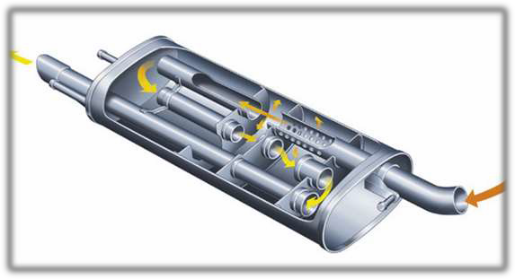
Material Requirements for an Automotive Exhaust System
Mechanical property requirements not overly severe.
Suitable rigidity to prevent excessive vibration
Moderate fatigue resistance
Good creep resistance in hot parts
Limiting property:
corrosion resistance , especially in the cold end where gases condense to form corrosive liquids.
Properties of unique interest:
The requirements are so special that only a few materials meet them regardless of cost.
Pt-base catalysts in catalytic converter
Special ceramic carrier that supports the catalyst

Slide 11

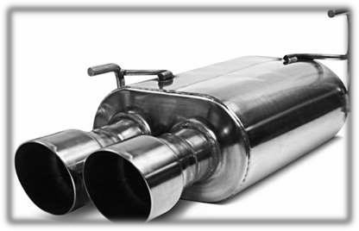
Previous materials used:
Low-carbon steel with corrosion-resistant coatings.
Material is relatively inexpensive, readily formed and welded. Life of tailpipe and muffler is limited.
Newer materials used:
With greater emphasis on automotive quality, many producers have moved to specially developed stainless steels with improved corrosion and creep properties. Ferritic 11% Cr alloys are used in the cold end components and 17 to 20% Cr ferritic alloys and austenitic Cr-Ni alloys in the hot end of the system.

Slide 12
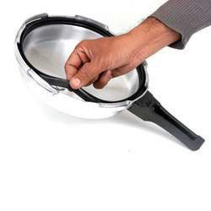
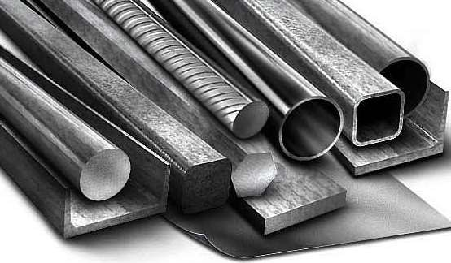

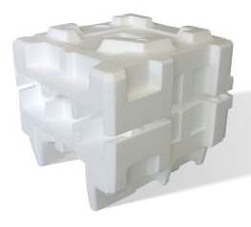

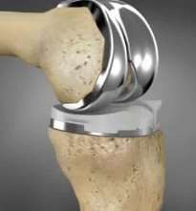
Why these materials are suitable for particular applications as mentioned bellow
Rubber as Washer
Steel as structure support
Polythene as bag
Thermocol for packing
Leather as Belt
Titanium alloy for Medical Implants

Slide 13
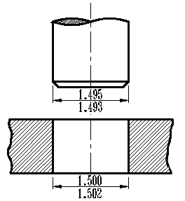



Tolerance
🠶 A tolerance is the permissible variation from the specified dimension
🠶 The designer must decide how much variation is allowable from the basic dimension of the component to accomplish the desired function.
🠶 The tolerance on a part is the difference between the upper and lower allowable limits of a
basic size dimension
Each manufacturing process has an inherent ability to maintain a certain range of tolerances, and to produce a certain surface roughness (finish).To
achieve tolerances outside of
the normal range requires special in an exponential increase in the
processing that typically results manufacturing cost.

Slide 14

Types of Tolerance
Bilateral tolerance
The variation occurs in both directions from the basic dimension. exceeds the basic value and the lower limit falls below it. | That | is, | the | upper | limit
2.500 ± 0.005 (This is the most common way of specifying tolerances)
Unilateral tolerance:
The basic dimension is taken as one of the limits, and variation is in only one direction

Slide 15
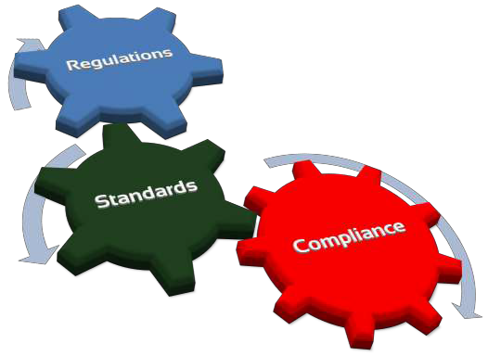
Standards & Codes in Design
Code is a collection of laws and rules that assists a government agency in meeting its obligation to protect the general welfare by preventing damage to property or injury or loss of life to persons.
Standard is a generally agreed-upon set of procedures, criteria, dimensions, materials, or parts. Engineering standards may describe the dimensions and sizes of small parts like screws and bearings, the minimum properties of materials, or an agreed-upon procedure to measure a property like fracture toughness.

Slide 16

Some Background:
🠶 The U.S. federal government is the largest single creator and user of standards: more than 45,000 (by current estimates)!
🠶 About 210 organization are designated Standard Development Organizations (SDO’s)
🠶 Most Standards (about 90%) come from about 20 of these SDO’s
🠶 ASTM, ASME, IEEE, AISI (ASM), ASCE, MilStd (Mil Specs), are
some of the most important SDO’s

Slide 17

Taking them Global!
🠶 ANSI and (U.S. National Committee (USNC)) are the U.S.
clearing house for Standards and a founding member of ISO!
🠶 Internationally we see Standard Organization in each of the major Industrial Nations and several Umbrella Groups:
🠶 International Organization for Standardization (ISO)
🠶 International Electro-technical Commission (IEC)
🠶 International Telecommunication Union (ITU)

Slide 18

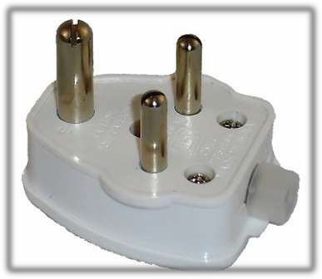
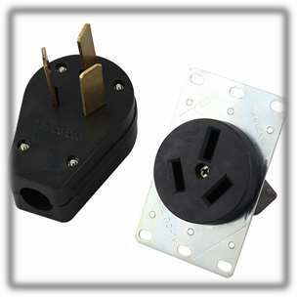
Why Standards & Codes ?
it makes the best practice available to everyone, thereby ensuring efficiency and safety.
it promotes interchangeability and compatibility. With respect to the second point, anyone who has traveled widely in other countries will understand the compatibility problems with connecting plugs and electrical voltage and frequency when trying to use small appliances

Slide 19

How they’re used:
🠶 Standards are a “COMMUNICATION” tool that allows all users to speak the same language when reacting to products or processes
🠶 They provide a “Legal,” or at least enforceable, means to evaluate acceptability and sale- ability of products and/or services
🠶 They can be taught and applied globally!
🠶 They, ultimately, are designed to protect the public from questionable designs, products and practices
🠶 They teach us, as engineers, how we can best meet environmental, health, safety and societal responsibilities

Slide 20









Org:anization
I
Initials
Country
Bureau of Indian standards
BIS
India
Badan standardisasi Nasional
BSN
Indonesia
Brazilian Nationa l Standa rds Organization
ABNT
Bra
zil
-
Spanish Association for Standarization and Certification
AENOR
Spain
IEEE
French association for Standardization
AFNOR
France
American Nationa l Standards Institute
ANSI
U.S
.
⁻ -
British standards Institution Direcci6n General de Normas
BSI DGN
U.
K
-
-
Mexico
Deutsches lnstitut tor Normung
DIN
Germany
Institute Argentina de Normalizaci6n y Certificaci6n
IRAM
Argentina
Bureau of Standards of Jamaica
BSJ
Jam
aica
-
-
Euro-Asian Councilfor Standardization, Metrology and Certification
GOST
Ru
ssia (Soviet Union)
Bureau of Indian Standards
-
-
Colombian Institute of Technical standards and Certification
ICONTEC
Colombia
Luxembourg Institute for Standardization,Accreditation, Security, and Quality of Products and Services
ILNAS
Luxembourg
Japanese Industrial Standards Committee
JISC
Japan
Korean Agency for Technology and standards Nederlandse Norm
KATS NEN
Kor
ea (Republic) herlands
INTERNATIONAL
Strind.-:J rds Worldwide
⁻ -
-
Net
-
South African Bureau of standards
SABS
South Africa
Standardization Administration of China
SAC
China
Standards Council of Canada
sec
Canada
Swed ish standards Institute Finnish Standards Association
SIS SFS
Sw
eden
S E T T I N G T H E S T A N D A R D
- -
Finland

Slide 21


