Slide 1
Introduction to Data Communication & Networking
1

Slide 2
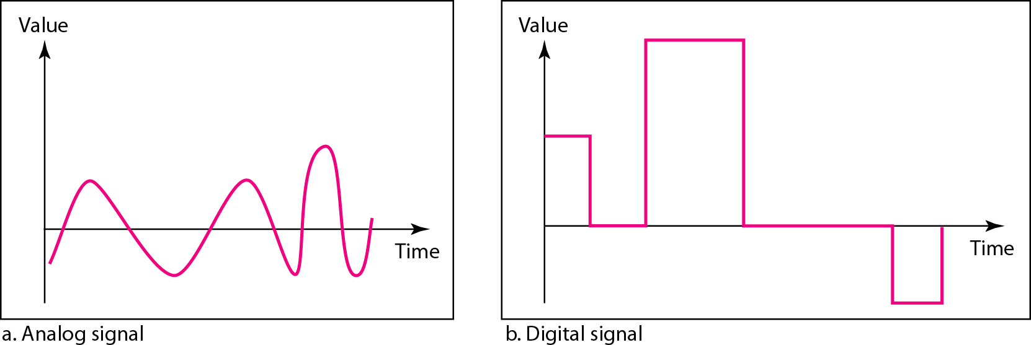
Data & Signals
2

Slide 3
Data Communication
Data Communications is the transfer of data or information between a source and a receiver.
The source transmits the data and the receiver receives it.
The purpose of data communications is to provide the rules and regulations that allow computers with different disk operating systems, languages, cabling and locations to share resources.
The rules and regulations are called protocols and standards in data communications.
3

Slide 4
Data Communication
4

Slide 5
Data Flow
Data flow is the flow of data between two points.
The direction of the data flow can be described as:
1. Simplex:
data flows in only one direction on the data communication line (medium). Examples are radio and television broadcasts.
5

Slide 6
2. Half-Duplex
data flows in both directions but only one direction at a time on the data communication line.
For example, a conversation on walkie-talkies
is a half-duplex data flow.
Each person takes turns talking. If both talk at once - nothing occurs!
6

Slide 7
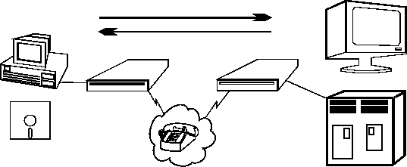
3. Full Duplex
Data flows in both directions simultaneously.
Modems are configured to flow data in both directions.
Bi-directional both directions simultaneously!
7

Slide 8
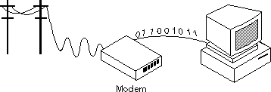
Modems
A modem (MOdulator/DEModulator) is a device that enables a computer to transmit data over, for example, telephone or cable lines. Computer information is stored digitally, whereas information transmitted over telephone lines is transmitted in the form
of analog waves.
8

Slide 9
How fast the modem can
transmit and receive data?
At slow rates, modems are measured in terms
of baud rates
The slowest rate is 300 baud
At higher speeds, modems are measured in terms of bits per second (bps)
The fastest modems run at 57,600 bps
The faster the transmission rate, the faster you can send and receive data
For example, if the device sending data to your computer is sending it at 2,400 bps, you must receive it at 2,400 bps
9

Slide 10
About Voice/Data
Many modems support a switch to change
between voice and data modes
In data mode, the modem acts like a regular modem
In voice mode, the modem acts like a regular
telephone
Modems that support a voice/data switch have a built-in loudspeaker and microphone for voice communication

Slide 11
Auto-answer modem
An auto-answer modem enables your computer to receive calls in your absence.

Slide 12
Data Compression modem
Some modems perform data compression, which enables them to send data at faster rates
However, the modem at the receiving end must be able to decompress the data using the same compression technique.

Slide 13
Fax Capability modem
Most modern modems are fax modems, which
means that they can send and receive faxes.

Slide 14
Digital Connection
The connection between the modem and
terminal/computer is a digital connection.
A basic connection consists of a Transmit Data (TXD) line, a Receive Data (RXD) line and many hardware handshaking control lines.
The control lines determine whose turn it is to talk (modem or terminal), if the terminal/computer is turned on, if the modem is turned on, if there is a connection to
another modem, etc.

Slide 15
Analog Connection
The connection between the modem and the outside world (the phone line) is an analog connection.
The voice channel has a bandwidth of 0-4 kHz but only 300 - 3400 Hz is usable for data communications.
The modem converts digital information into tones (frequencies) for transmitting through the phone lines. The tones are in the 300-3400 Hz Voice Band.

Slide 16
Types of Modems
External Modem
External modems sit next to the computer and connect to the serial port using a straight-through serial cable.
Internal Modem
An internal modems is a plug-in circuit board that sits inside the computer. It incorporates the serial port on-board.
They are less expensive than external modems because they do not require a case, power supply and serial cable.

Slide 17
Telecommunications
Telephones and networking work hand in hand.
The common goal is to join distantly located Local Area Networks into Metropolitan and Wide Area Networks (MANs and WANs).
Talking to someone on the phone uses voice channels.
We use voice channels for modem communications to connect to the Internet.
Due to the bandwidth limits on voice channels, the data transfer rate is relatively slow.

Slide 18
Voice Channels
Voice Channel: Dial-up connection through a
modem using standard telephone lines.
Typical voice channel communication rates are: 300, 1200, 2400, 9600, 14.4k, 19.2k, 28.8k,
33.6k and 56 kbps (bits per second).

Slide 19
Data Channels
Data channels are dedicated lines for communicating digitized voice and data.
At the end of 1996, there was a major milestone when more data was communicated in North America's telecommunications system than voice.
Data Channels are special communications channels provided by "common carriers" such as Telus, Sprint, Bell Canada, AT&T, etc. for transferring digital data.
Data Channels are also called "Leased Lines".

Slide 20
Data Channels(Contd.)
They are "directly" connected: you don't have to dial a connection number.
The connections are up and running 24 hours per day.
They appear to work as if there were a wire running directly between the source and the destination.
Typical transfer rates for data channels are: 56
k, 128k, 1.544 M, 2.08 M, 45M and 155 Mbps.

Slide 21
Data Channels(Contd.)
Common carriers charge for data connections by:
– The amount of data transferred (megabytes per month)
– The transfer rate (bits per second)
– The amount of use (time per month)

Slide 22
What is a network?
A network can consist of two computers connected together on a desk or it can consist of many Local Area Networks (LANs) connected together to form a Wide Area Network (WAN) across a continent.
The key is that two or more computers are connected together by a medium and are sharing resource.
These resources can be files, printers, hard•drives, or CPU number-crunching power.

Slide 23
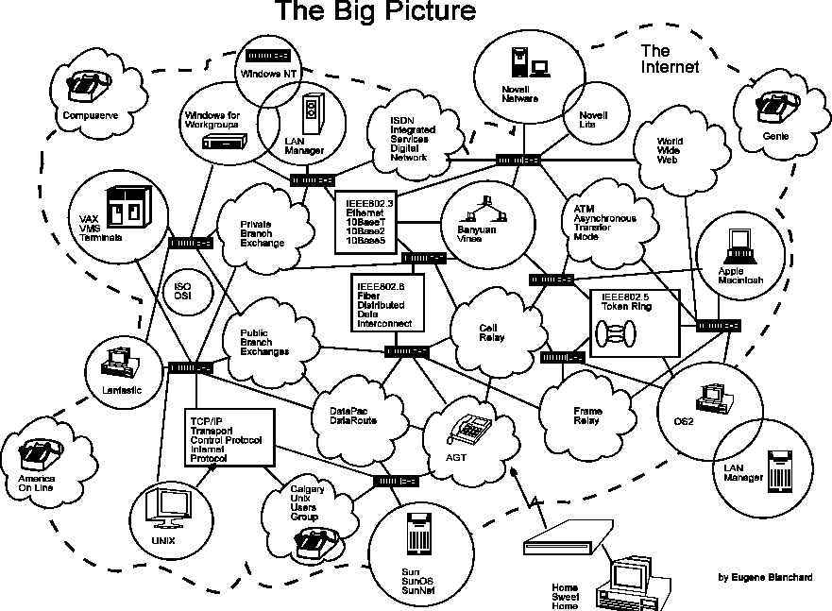

Slide 24
Breaking the big picture
Local loops
LANs
MANs
WANs

Slide 25
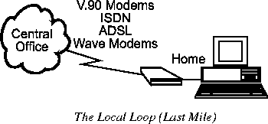
Local loops
The Local Loop is often called "the last mile"
It refers to the last mile of analog phone line that goes from the telephone company's central office (CO) to your house.

Slide 26
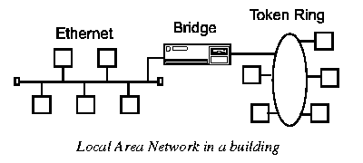
Local Area Networks (LANs)
LANs (local area networks) are networks that connect computers and resources together in a building or buildings that are close together.
The components used by LANs can be divided into cabling standards, hardware, and protocols.

Slide 27
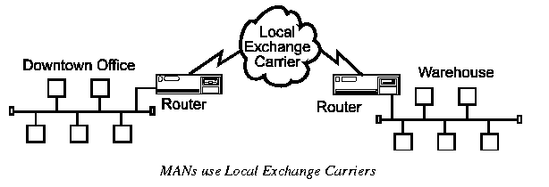
Metropolitan Area Networks(MANs)
Metropolitan Area Networks (MANs) are networks that connect LANs together within a city.
The main criterion for a MAN is that the connection between LANs is through a local exchange carrier (the local phone company).

Slide 28
Wide Area Networks(WANs)
Wide Area Networks (WANs) connect LANs together between cities.
The main difference between a MAN and a WAN is that the WAN uses Long Distance Carriers. Otherwise the same protocols and
equipment are used as a MAN.

Slide 29
Network Topology
What is a Topology?
The physical topology of a network refers to the configuration of cables, computers, and other peripherals.
Main types of physical topologies
Linear Bus
Star
Star-wired ring
4. Tree
29

Slide 30
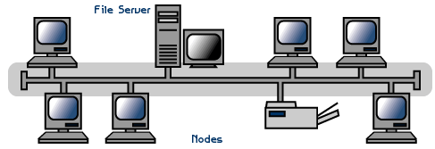
Linear Bus
A linear bus topology consists of a main run of cable with a terminator at each end (See figure). All nodes (file server, workstations, and peripherals) are connected to the linear cable. Ethernet and local talk networks use a linear bus topology.
30

Slide 31
Linear Bus
Advantages of linear bus
Easy to connect a computer or peripheral to a linear bus.
Requires less cable length than a star topology.
Disadvantages of linear bus
Entire network shuts down if there is a break
in the main cable.
Terminators are required at both ends of the backbone cable.
Difficult to identify the problem if the entire network shuts down.
31

Slide 32
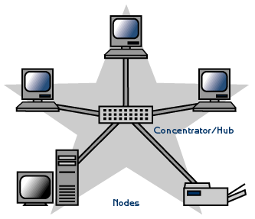
Star
A star topology is designed with each node (file server, workstations, and peripherals) connected directly to a central network hub or concentrator (See figure).
Data on a star network passes through the hub or concentrator before continuing to its
destination.
32

Slide 33
Star
Advantages of star
Easy to install and wire.
No disruptions to the network then connecting or removing devices.
Easy to detect faults and to remove parts.
Disadvantages of star
Requires more cable length than a linear topology.
If the hub or concentrator fails, nodes
attached are disabled.
More expensive than linear bus topologies because of the cost of the concentrators.
33

Slide 34
Star-Wired Ring
A star-wired ring topology may appear
(externally) to be the same as a star topology.
Internally, the MAU (multistation access unit) of a star-wired ring contains wiring that allows information to pass from one device to
another in a circle or ring

Slide 35
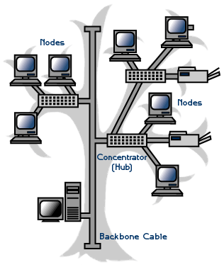
Tree
A tree topology combines characteristics of linear bus
and star topologies.
It consists of groups of star-configured workstations connected to a linear bus backbone cable
Tree topologies allow for the expansion of an existing
network, and enable schools to configure a network to
meet their needs.

Slide 36
Tree
Advantages
Point-to-point wiring for individual segments.
Supported by several hardware and software vendors.
Disadvantages
Overall length of each segment is limited by the type of cabling used.
If the backbone line breaks, the entire segment goes down.
More difficult to configure and wire than other
topologies.

Slide 37
Considerations When Choosing a Topology:
Money. A linear bus network may be the least expensive way to install a network; you do not have to purchase concentrators.
Length of cable needed. The linear bus network uses shorter lengths of cable.
Future growth. With a star topology, expanding a network is easily done by adding another concentrator.
Cable type. The most common cable in schools is unshielded twisted pair, which is
most often used with star topologies.

Slide 38
Summary Chart
Physical Topology | Common Cable | Common Protocol
Linear Bus | Twisted Pair coaxial Fiber | Ethernet LocalTalk
Star | Twisted Pair Fiber | Ethernet LocalTalk
Star-Wired Ring | Twisted Pair | Token Ring
Tree | Twisted Pair Coaxial Fiber | Ethernet

Slide 39
Introduction to the ISO - OSI Model
The ISO (International Standards Organization) has created a layered model, called the OSI (Open Systems Interconnect) model.
The purpose of the layers is to provide clearly defined functions that can improve Internetwork connectivity between "computer" manufacturing companies.
Each layer has a standard defined input and a standard defined output.

Slide 40
7 layers of the OSI Model
7. Application Layer (Top Layer)
6. Presentation Layer
5. Session Layer
4. Transport Layer
3. Network Layer
2. Data Link Layer
1. Physical Layer (Bottom Layer)

Slide 41
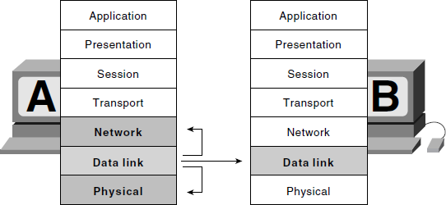
7 layers of the OSI Model

Slide 42
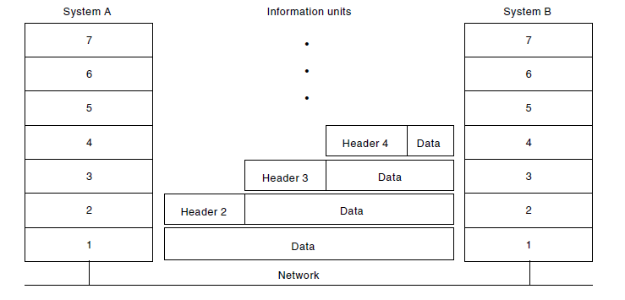
Information Exchange Process

Slide 44
Data Communication Network
The major criteria that a data communication network must meet are:
– Performance
– Consistency
– Reliability
– Recovery
– Security

Slide 45
Performance
Performance is the defined as the rate of transference of error-free data.
It is measured by the response time.
Response time is the elapsed time between the end of an inquiry and the beginning of a response
Example requesting a file transfer and starting the file transfer.
Factors that affect response time are:
Number of Users:
Transmission Speed:
Hardware Type:
–
^{Software program}

Slide 46
Consistency
Consistency is the predictability of response time and accuracy of data.
– For example, if the "normal" response time is 3 seconds for printing to a network printer but a response time of over 30 seconds occurs, we know that there is a problem in the system!

Slide 47
Reliability
Reliability is the measure of how often a network is usable.
MTBF (Mean Time Between Failures) is a measure of the average time a component is expected to operate between failures, and is normally provided by the manufacturer.
A network failure can be caused by a problem
with the hardware, the data carrying medium,
or the Network Operating System.

Slide 48
Recovery
Recovery is the network's ability to return to a prescribed level of operation after a network failure.
This level is where the amount of lost data is nonexistent or at a minimum. Recovery is
based on having back-up files.

Slide 49
Security
Security is the protection of hardware, software and data from unauthorized access.
Restricted physical access to computers, password protection, limiting user privileges and data encryption are common security methods.
Anti-virus monitoring programs to defend
against computer viruses are also a security
measure.

Slide 50
Application
Electronic Mail (e-mail or Email)
Teleconferencing allows people in different regions to "attend" meetings using telephone lines.
Automated Banking Machines allow banking transactions to be performed everywhere
Groupware is the latest network application. It allows user groups to share documents, schedules databases, etc. (ex. Lotus Notes)

Slide 51
Physical Connection
The physical connection determines how many bits (1's or 0's) can be transmitted in a single instance of time.
If only 1 bit of information can be transmitted over the data transmission medium at a time then it is considered a serial communication.
If more than 1 bit of information is transmitted over the data transmission medium at a time then it is considered a parallel communication.

Slide 53
Communications
Advantages
Parallel : faster transfer rates
Serial : long distances
Disadvantages
Parallel: short distance only
Serial : slow transfer rates

Slide 54
Transmission Media- Guided
There are 2 basic categories of transmission
media: guided and unguided.
Guided transmission media uses a cabling system that guides the data signals along a specific path.
Unguided transmission media consists of a means for the data signals to travel but
nothing to guide them along a specific path.

Slide 55
Transmission Media- Guided
There 4 basic types of guided media:
Open Wire
Twisted Pair
Coaxial Cable
Optical Fiber

Slide 56
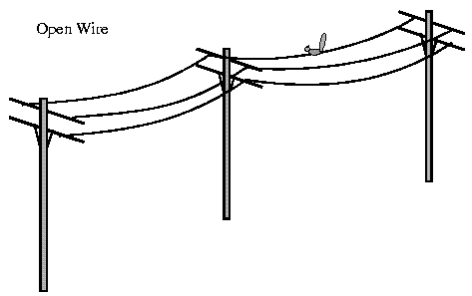
Open wire
Open wire is traditionally used to describe the electrical wire strung along power poles.
There is a single wire strung between poles.
No shielding or protection from noise interference is used.

Slide 57
Twisted Pair
The wires in twisted pair cabling are twisted together in pairs.
Each pair consists of a wire used for the +ve data signal and a wire used for the -ve data signal.
Any noise that appears on 1 wire of the pair will also occur on the other wire.
When the noise appears on both wires, it cancels or nulls itself out at the receiving end.

Slide 58
Unshielded Twisted Pair
The degree of reduction in noise interference is determined specifically by the number of turns per foot.
Increasing the number of turns per foot reduces the
noise interference.
To further improve noise rejection, a foil or wire braid "shield" is woven around the twisted pairs.
Cables with a shield are called shielded twisted pair and
are commonly abbreviated STP.
Cables without a shield are called unshielded twisted pair or UTP.

Slide 59
Coaxial cable
Coaxial cable consists of two conductors.
The inner conductor is held inside an insulator with the other conductor woven around it providing a shield.
An insulating protective coating called a jacket covers the outer conductor.

Slide 60
Coaxial cable
The outer shield protects the inner conductor from outside electrical signals.
The distance between the outer conductor (shield) and inner conductor plus the type of material used for insulating the inner conductor determine the cable properties or impedance.
Typical impedances for coaxial cables are 75 ohms for Cable TV, 50 ohms for Ethernet Thinnet and Thicknet.

Slide 61
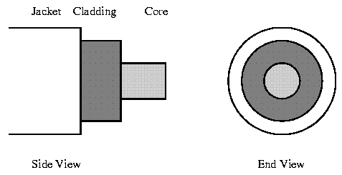
Optical fiber
Optical fiber consists of thin glass fibers that can carry information at frequencies in the visible light spectrum and beyond.
The typical optical fiber consists of a very narrow strand of glass called the core.
Around the core is a concentric layer of glass called the cladding.
Coating the cladding is a protective coating consisting of
plastic, it is called the Jacket.

Slide 62
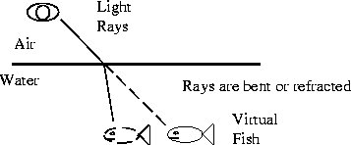
Optical fiber
An important characteristic of fiber optics is refraction.
Refraction is the characteristic of a material to either pass or reflect light.
When light passes through a medium, it "bends" as it
passes from one medium to the other.
An example of this is when we look into a pond of water.

Slide 63
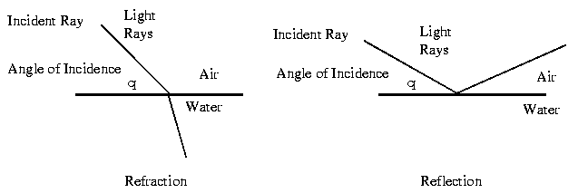
Optical fiber
If the angle of incidence is small, the light rays are reflected and do not pass into the water.
If the angle of incident is great, light passes through the media but is bent or refracted.

Slide 64
Advantages of Optical fiber
Noise immunity: RFI and EMI immune (RFI - Radio Frequency Interference, EMI -Electromagnetic Interference)
Security: cannot tap into cable.
Large Capacity due to BW (bandwidth)
No corrosion (destroy metal)
Longer distances than copper wire
Smaller and lighter than copper wire
Faster transmission rate

Slide 65
Disadvantages of Optical fiber
Physical vibration will show up as signal noise!
Limited physical arc of cable. Bend it too much and it will break!
Difficult to splice (to join)

Slide 66
Comparison
The following compares the usable bandwidth
of the different guided transmission media.
Cable Type Open Cable Twisted Pair Coaxial Cable Optical Fiber
Bandwidth
0 - 5 MHz
0 - 100 MHz
0 - 600 MHz
0 - 1 GHz

Slide 67
Transmission Media - Unguided
Unguided transmission media is data signals
that flow through the air.
They are not guided or bound to a channel to follow.
They are classified by the type of wave propagation.
RF (Radio Frequency) Propagation
Microwave Propagation
Satellite Propagation

Slide 68
RF Propagation
There are three types of RF (radio frequency)
propagation:
Ground Wave
Ionospheric
Line of Sight (LOS)

Slide 69
Groundwave propagation
Ground wave propagation follows the curvature of the Earth.
Ground waves have carrier frequencies up to 2
MHz. AM Radio is an example of ground wave
propagation.

Slide 70
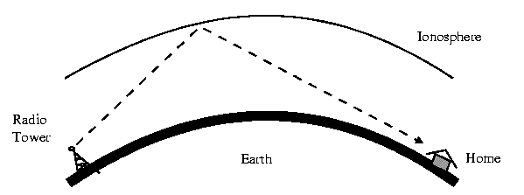
Ionospheric propagation
Ionospheric propagation bounces off of the Earth's ionospheric layer in the upper atmosphere.
It operates in the frequency range of 30 - 85
MHz.
Because it depends on the Earth's ionosphere, it changes with the weather and time of day.
Ham radios operate in this range.

Slide 71
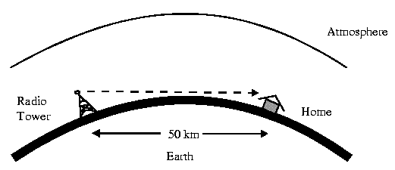
Line of sight propagation
Line of sight propagation transmits exactly in the line of sight.
The receive station must be in the view of the transmit station.
It is limited by the curvature of the Earth for ground-based stations (100 km, from horizon to horizon).
Examples of line of sight propagation are: FM radio, microwave and satellite.

Slide 72
Microwave
Microwave transmission is line of sight transmission.
The transmit station must be in visible contact with the receive station.
Typically the line of sight due to the Earth's curvature is only 50 km to the horizon! Repeater stations must be placed so the data signal can hop, skip and jump across the
country.

Slide 73
Microwave
Microwaves operate at high operating frequencies of 3 to 10 GHz.
This allows them to carry large quantities of data due to their large bandwidth.
Advantages:
They can carry high quantities of information due to their high operating frequencies.
Low cost land purchase: each tower occupies only a small area.
High frequency/short wavelength signals require small antennae.

Slide 74
Microwave
Disadvantages
Attenuation by solid objects: birds, rain, snow and fog.
Reflected from flat surfaces like water and metal.
Diffracted (split) around solid objects.
Refracted by atmosphere, thus causing beam to be
projected away from receiver.

Slide 75
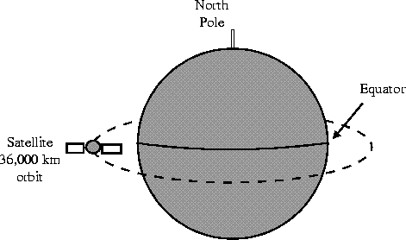
Satellite
Satellites are transponders (units that receive on one frequency and retransmit on another) that are set in geostationary orbits directly over the equator.

Slide 76
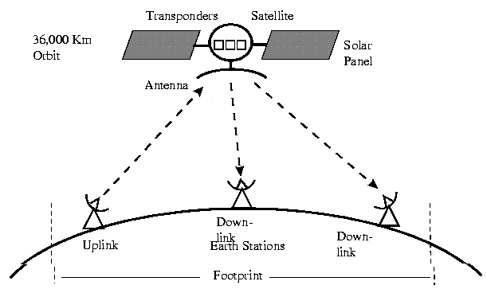
Satellite
These geostationary orbits are 36,000 km from the Earth's surface.
At this point, the gravitational pull of the Earth and the centrifugal force of Earth's rotation are balanced and cancel each other out.

Slide 77
Satellite
The uplink is the transmitter of data to the satellite.
The downlink is the receiver of data.
Uplinks and downlinks are also called Earth stations because they are located on the Earth.
The footprint is the "shadow" that the satellite can transmit to, the shadow being the area that can receive the satellite's transmitted
signal.

Slide 78
Networking Devices
Repeaters:Repeaters are physical hardware devices: they have a primary function to regenerate the electrical signal
The purpose of a repeater is to extend the LAN Segment
beyond its physical limits
Typically, repeaters are used to connect two physically close buildings together (when they are too far apart to just extend the segment).
They can be used to connect floors of a building that would normally surpass the maximum allowable segment length.
For large extensions two Repeaters are required but for shorter extensions, only one Repeater may be required.

Slide 79
Networking Devices
Repeaters:

Slide 80
Networking Devices
Repeaters operate at the OSI Model

Slide 81
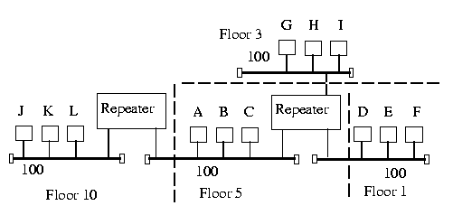
Networking Devices
Multiport Repeaters

Slide 82
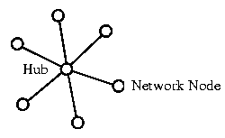
Networking Devices
Hubs:Hubs are used to provide a Physical Star Topology.
At the center of the star is the Hub, with the
network nodes located on the tips of the star.
The Hub is installed in a central wiring closet, with all the cables extending out to the network nodes.

Slide 83
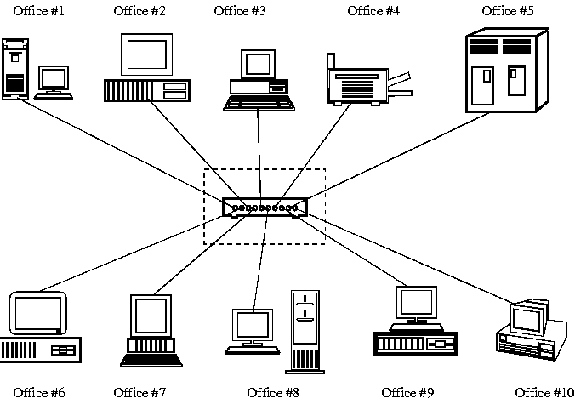
Networking Devices
Hubs:

Slide 84
Networking Devices
Bridges: Bridges are both hardware and software devices.

Slide 85
Networking Devices
Purpose of a Bridge
The purposes of a Bridge are the following:
Isolates networks by MAC addresses
Manages network traffic by filtering packets
Translates from one protocol to another

Slide 86
Networking Devices
Isolates networks by MAC addresses

Slide 87
Networking Devices
Manages network traffic by filtering packets
Bridges listen to the network traffic, and build an image of the network on each side of the bridge.
This image of the network indicates the location of each node
With this information, a bridge can make a decision whether to forward the packet across the bridge
This process of deciding whether or not to
forward a packet is termed "filtering packets."

Slide 88
Networking Devices
Translates from one protocol to another
Bridges are store and forward devices.
They receive a packet on the local segment,
store it, and wait for the remote segments to
be clear before forwarding the packet.

Slide 89
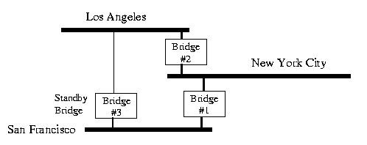
Networking Devices
Reasons to use a Bridge
Bandwidth: Reduce traffic by segmentation
Reliability: If 1 segment goes down, it does
not take down the complete LAN
Translation: Translate different Data Link protocols

Slide 90
Networking Devices
Gateways
A Gateway is the Hardware/Software device that is used to interconnect LANs & WANs using mainframe computers
Example: DECnet and IBM's SNA
Often, the router that is used to connect a LAN to the Internet will be called a gateway.
It will have added capability to direct and filter higher layer protocols (layer 4 and up) to specific devices (such as web servers, ftp
servers and e-mail servers).

Slide 91
Protocol IEEE-802.3
The IEEE-802.3 Protocol is based on the Xerox Network Standard (XNS) called Ethernet
These are the four versions of the Ethernet
frame
Ethernet_802.2
Ethernet_802.3
Ethernet_II
Ethernet_SNAP
NOTE: The Source and Destination must have the same Ethernet Frame type in order to
communicate.

Slide 92
Protocol IEEE-802.3
IEEE 802.3 defines five media types of IEEE 802.3 Ethernet Types shown below:
1. IEEE 802.3 - 10Base5 (Thick Coax) is used only as backbones to networks. Backbones are lines that connect buildings & network equipment together (such as Bridges, Routers, Hubs, Concentrators, Gateways, etc.).
10Base5 is now being replaced by either Thin Coax or fiber optics.

Slide 93
Protocol IEEE-802.3
IEEE 802.3a - 10Base2 is commonly used in new installations as a backbone to connect buildings and network equipment together.
10Base2 (Thin Coax) is also used to connect work stations together, but the preferred
choice is to use 10BaseT.
IEEE 802.3b - 10Broad36 is rarely used; it combines analog and digital signals together.
Broadband means that a mixture of signals can be sent on the same medium.

Slide 94
Protocol IEEE-802.3
IEEE 802.3e - 1 Base 5 StarLAN is a slow 1 Mbps standard that has been replaced by Thin Coax or Twisted Pair.
IEEE 802.3i - 10BaseT is commonly used to connect workstations to network hubs.
The network hubs can use 10BaseT (Twisted Pair) to connect to other Hubs.

Slide 95
10 Base T (Twisted Pair Cable)
10BaseT uses unshielded twisted pair (UTP) cable.
The cable is flexible and easy to work with.
The cable has a characteristic impedance of
100 ohms.
There are 2 pairs of twisted wires used with 10BaseT: separate Rx (receive) and Tx (transmit) pairs.
The lines are balanced lines to minimize noise
and there are a Rx+ & Rx- pair and a Tx+ &
Tx- pair.

Slide 96
10 Base T (Twisted Pair Cable)
The nodes are connected to a MPR (multi port repeater), also called a Concentrator, or Hub.
Maximum Nodes
For 10BaseT, the maximum allowed number of nodes is 128 (on one segment).
Maximum Distance between Nodes & Hub
The maximum distance between nodes & Hub is 100 m.

Slide 97
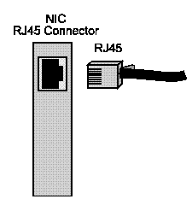
Cable Termination and Connector
The standard termination is 100 ohms.
The end connector is an "RJ45" quick disconnect connector.
The cable is internally terminated at the NIC
(Network Interface Card) and Hub.

Slide 98
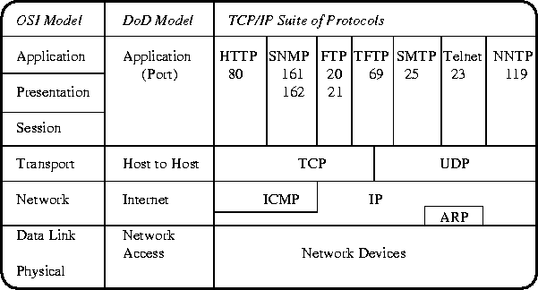
TCP/IP Protocols

Slide 99
TCP/IP Protocols
Network Devices are network interface cards (NIC) and their software drivers.
Typically, they are Ethernet cards, Token Ring cards, and WAN links (such as ISDN or Frame Relay), and they can also be modems and serial ports.
IP stands for Internet Protocol. Its main job is to find the best route--through the Internet--to the destination.
IP uses IP addresses to identify the host machine and the network.

Slide 100
TCP/IP Protocols
A typical IP address is a 32 bit number, and
looks like 142.110.237.1.
In this case, 142.110.237.0 identifies the network address, and 0.0.0.1 identifies the host machine.
ARP stands for Address Resolution Protocol and it is used to map IP addresses to MAC addresses.
ICMP stands for Internet Control Message Protocol, and is used mainly for troubleshooting TCP/IP network connections.
100

Slide 101
TCP/IP Protocols
TCP stands for Transmission Control Protocol, and is used to guarantee end to end delivery of segments of data.
TCP is used to put out of order segments in order, and to check for transmission errors.
UDP stands for User Datagram Protocol, and is
a connectionless service.
This results in a low overhead and fast transfer service (relies on the upper layer protocols to
provide error checking and delivery of data).
101

Slide 102
In the Application layer lies many hundreds of network- aware programs and services such as the following:
HTTP (80) - Hyper Text Transport Protocol, which is used for transferring web pages.
SNMP (161/162)- Simple Network Management Protocol, which is used for managing network devices.
FTP (20/21)- File Transfer Protocol, which is used for transferring files across the network.
TFTP (69)- Trivial File Transfer Protocol, which is a low overhead fast transfer FTP protocol.
SMTP (25)- Simple Mail Tranfer Protocol, which is used for transferring email across the Internet.
Telnet (23)- An application for remotely logging into a server across the network.
NNTP (119)- Network News Transfer Protocol, which is used for transferring news.
* The numbers, shown in brackets next to the protocols, are called the
102

Slide 103
Wireless Network
What is wireless networking?
A wireless network is simply two or more computers (and maybe printers) linked by radio waves.
There are various other devices that can connect to this wireless network.
This arrangement uses a protocol (method of communication) called, IEEE
802.11b, or Wi-Fi
103

Slide 104
Range & Performance
Wi-Fi is currently the fastest wireless
technology.
It can transmit through walls and floors at speeds of up to 11 Mbps.
Bandwidths available:-
11Mbps
22Mbps
54Mbps
Super G 108Mbps
104

Slide 105
Wireless adapters
Wireless network adapters can be internal (inserted in a computer) or external (housed in a separate case).
The two general types of wireless adapters are:
USB adapter: Connects through a USB cable to a USB port on your desktop computer. USB adapters are popular because they are easy to install and to swap between desktop computers as necessary.
Notebook adapter: Fits into the PCMCIA slot on your laptop or other portable computer. Notebook adapters eliminate the need for cable connections to the computer and are popular among users who value mobility.
105

Slide 106
Benefits of wireless network
Convenience: You can set up wireless connections without having to run cables or open computer cases.
Mobility: Mobility might be relatively unimportant for a desktop computer but can be an important benefit if you have a laptop or notebook computer.
106

Slide 107
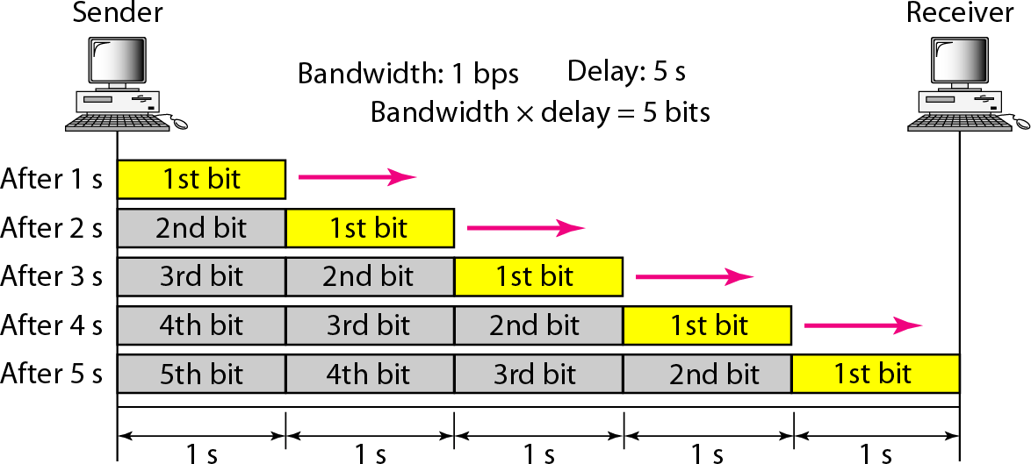
Bandwidth Case I
bandwidth in bits per second, refers to the speed of bit transmission in a channel or link
107

Slide 108
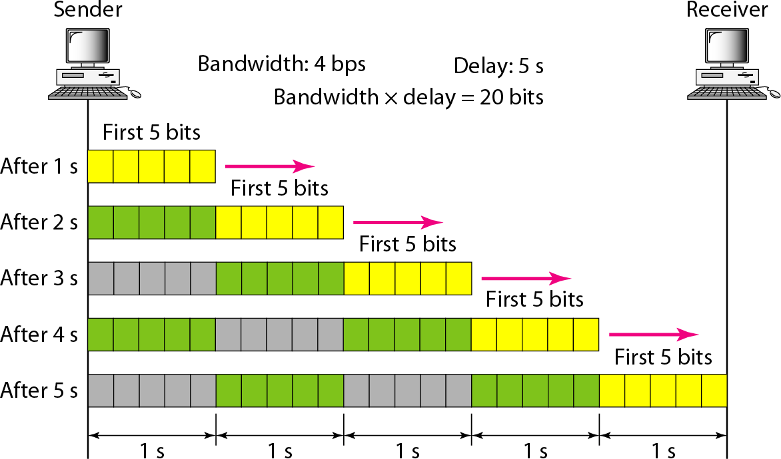
Bandwidth Case II
108

