Slide 1
INTRODUCTION
INTERNAL COMBUSTION ENGINE

Slide 2
=
Heat engine : Any engine that converts thermal energy to mechanical work output. Examples of heat engines include: steam engine, diesel engine, and gasoline (petrol) engine.
On the basis of how thermal energy is being delivered to working fluid of the heat engine, heat engine can be classified as an internal combustion engine and external combustion engine.
2

Slide 3
Internal and External Combustion Engines
In an Internal combustion engine, combustion takes place inside the engine,
  Petrol engine and diesel engine is an example of internal combustion engine, where the working fluid is a mixture of air and fuel .
In an External combustion engine, combustion take place outside the engine.
  Steam engine is an example of external combustion engine, where the working fluid is steam.

Slide 4
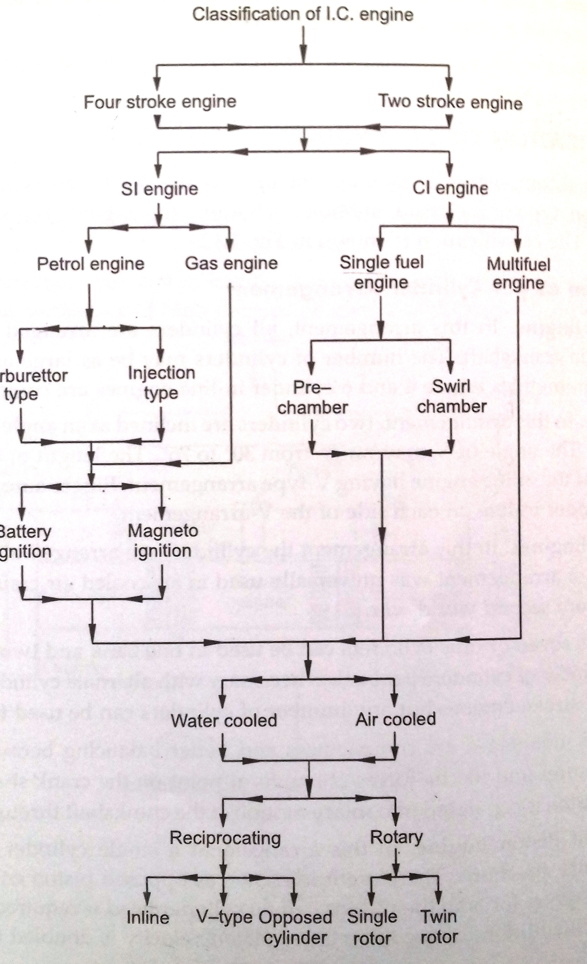
Classification of Internal Combustion Engines

Slide 5
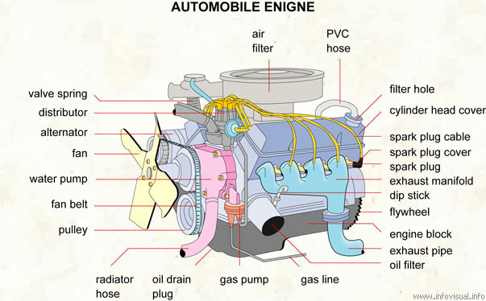
IC engine Components & Terminology

Slide 6
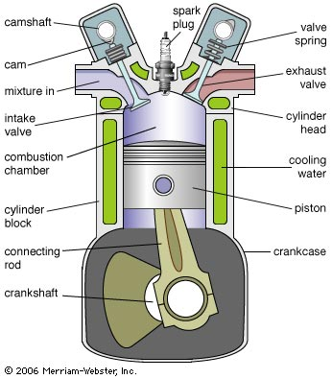

Slide 7
Block : Body of the engine containing cylinders, made of cast iron or aluminium.
Cylinder : The circular cylinders in the engine block in which the pistons reciprocate back and forth.
Head : The piece which closes the end of the cylinders, usually containing part of the clearance volume of the combustion chamber.
Combustion chamber: The end of the cylinder between the head and the piston face where combustion occurs.
  The size of combustion chamber continuously changes from minimum volume when the piston is at TDC to a maximum volume when the piston at BDC

Slide 8
Crankshaft : Rotating shaft through which engine work output is supplied to external systems.
  The crankshaft is connected to the engine block with the main bearings.
  It is rotated by the reciprocating pistons through the connecting rods connected to the crankshaft, offset from the axis of rotation. This offset is sometimes called crank throw or crank radius.
Connecting rod : Rod connecting the piston with the rotating crankshaft, usually made of steel or alloy forging in most engines but may be aluminum in some small engines.
Piston rings: Metal rings that fit into circumferential grooves around the piston and form a sliding surface against the cylinder walls.

Slide 9
Camshaft : Rotating shaft used to push open valves at the proper time in the engine cycle, either directly or through mechanical or hydraulic linkage (push rods, rocker arms, tappets) .
Push rods : The mechanical linkage between the camshaft and valves on overhead valve engines with the camshaft in the crankcase.
Crankcase : Part of the engine block surrounding the crankshaft.
  In many engines the oil pan makes up part of the crankcase housing.
Exhaust manifold : Piping system which carries exhaust gases away from the engine cylinders, usually made of cast iron .

Slide 10
Intake manifold :Piping system which delivers incoming air to the cylinders, usually made of cast metal, plastic, or composite material.
  In most SI engines, fuel is added to the air in the intake manifold system either by fuel injectors or with a carburetor.
  The individual pipe to a single cylinder is called runner.
Carburetor : A device which meters the proper amount of fuel into the air flow by means of pressure differential.
  For many decades it was the basic fuel metering system on all automobile (and other) engines.
Spark plug : Electrical device used to initiate combustion in an SI engine by creating high voltage discharge across an electrode gap.

Slide 11
Exhaust System: Flow system for removing exhaust gases from the cylinders, treating them, and exhausting them to the surroundings.
  It consists of an exhaust manifold which carries the exhaust gases away from the engine, a thermal or catalytic converter to reduce emissions, a muffler to reduce engine noise, and a tailpipe to carry the exhaust gases away from the passenger compartment.
Flywheel : Rotating mass with a large moment of inertia connected to the crank shaft of the engine.
  The purpose of the flywheel is to store energy and furnish large angular momentum that keeps the engine rotating between power strokes and smooth out engine operation.

Slide 12
Fuel injector : A pressurized nozzle that sprays fuel into the incoming air (SI engines )or into the cylinder (CI engines).
Fuel pump : Electrically or mechanically driven pump to supply fuel from the fuel tank (reservoir) to the engine.
Glow plug : Small electrical resistance heater mounted inside the combustion chamber of many CI engines, used to preheat the chamber enough so that combustion will occur when first starting a cold engine.
  The glow plug is turn off after the engine is started.
Starter : Several methods are used to start IC engines. Most are started by use of an electric motor (starter) geared to the engine flywheel. Energy is supplied from an electric battery.

Slide 13
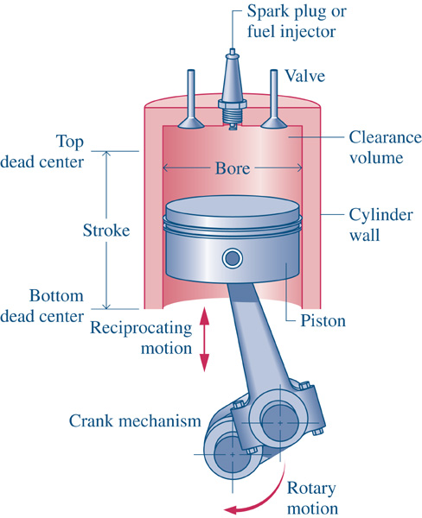
Engine terminology

Slide 15
  Top Dead Center (TDC): Position of the piston when it stops at the furthest point away from the crankshaft.
  Top because this position is at the top of the engines (not always), and dead because the piston stops as this point. Because in some engines TDC is not at the top of the engines(e.g: horizontally opposed engines, radial engines,etc,.) Some sources call this position Head End Dead Center (HEDC).
  Some source call this point TOP Center (TC).
  When the piston is at TDC, the volume in the cylinder is a minimum called the clearance volume.

Slide 16
Bottom Dead Center (BDC): Position of the piston when it stops at the point closest to the crankshaft.
  Some sources call this Crank End Dead Center (CEDC) because it is not always at the bottom of the engine.Some source call this point Bottom Center (BC).
Stroke : Distance traveled by the piston from one extreme position to the other : TDC to BDC or BDC to TDC.
Bore :It is defined as cylinder diameter or piston face diameter; piston face diameter is same as cylinder diameter( minus small clearance).
Swept volume/Displacement volume : Volume displaced by the piston as it travels through one stroke.
  Swept volume is defined as stroke times bore.
  Displacement can be given for one cylinder or entire engine (one cylinder times number of cylinders).

Slide 17
Clearance volume : It is the minimum volume of the cylinder available for the charge (air or air fuel mixture) when the piston reaches at its outermost point (top dead center or outer dead center) during compression stroke of the cycle.
  Minimum volume of combustion chamber with piston at TDC.
Compression ratio : The ratio of total volume to clearance volume of the cylinder is the compression ratio of the engine.
  Typically compression ratio for SI engines varies form 8 to 12 and for CI engines it varies from 12 to 24

Slide 18
working of four stroke cycle petrol engine
Suction stroke
Piston is at TDC
Inlet valve open and exhaust valve closed
Mixture of air and fuel enters into the cylinder due to suction created.
This continues until piston reaches BDC.
At this position, the inlet valve closes.
The downward movement of the piston is known as suction stroke and crank rotates by 180 degree during this period.

Slide 19
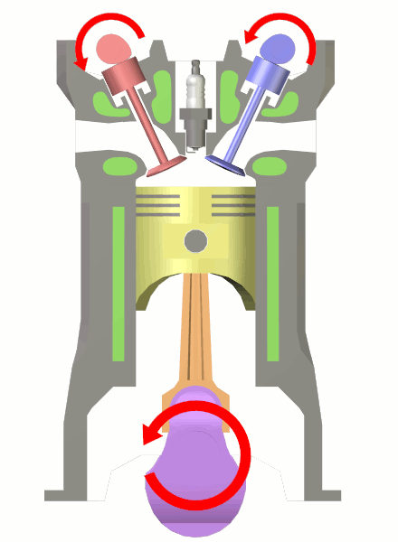
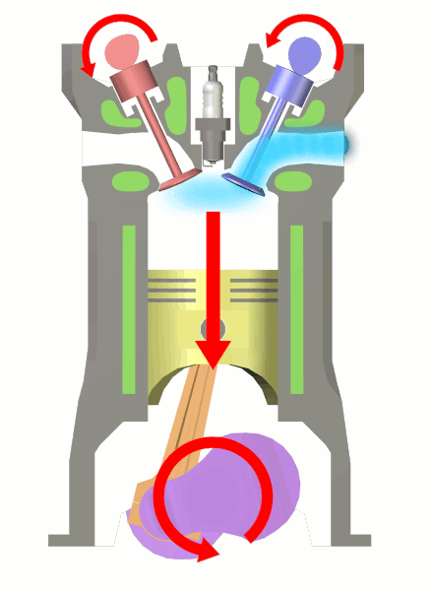
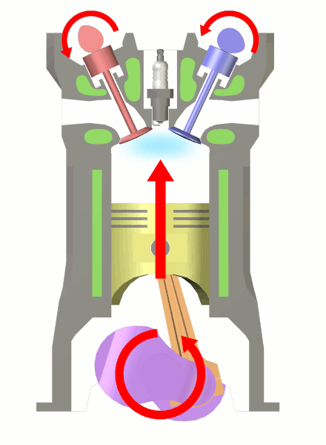
Internal Combustion Engines
– four stroke -
starting position
1. intake
2. compression
a. piston starts moving down
b. intake valve opens
c. air-fuel mixture gets in
a. piston moves up
b. both valves closed
c. air-fuel mixture gets compressed

Slide 20
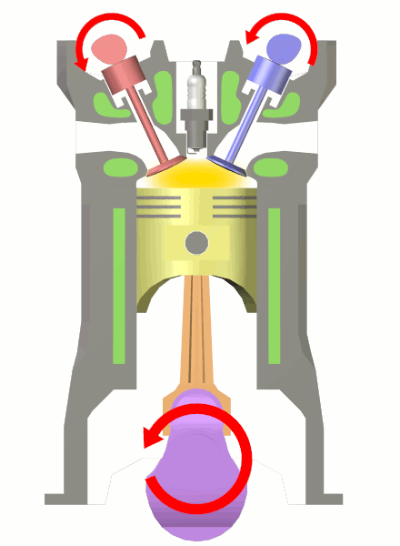
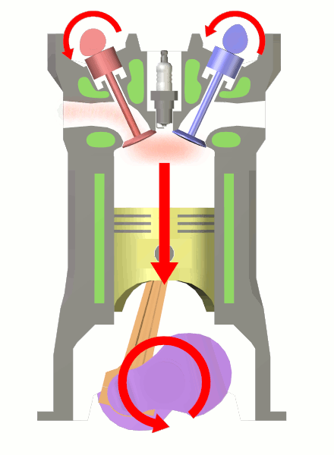
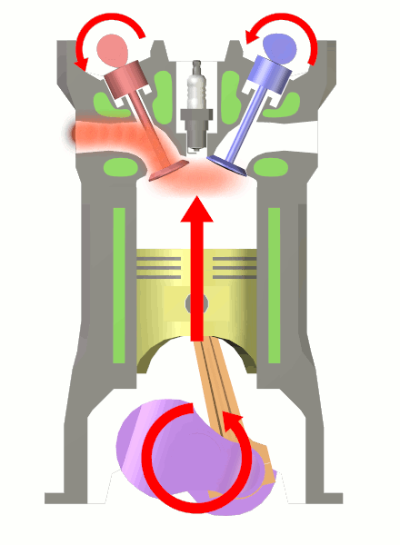
Internal Combustion Engines
– four stroke -
ignition
3. power
4. exhaust
a. air-fuel mixture explodes driving the piston down
a. piston moves up
b. exhaust valve opens c. exhaust leaves the cylinder

Slide 21
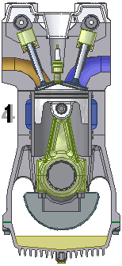
Internal Combustion Engines
– four stroke -
Advantages:
dedicated lubrication system makes to engine more wear resistant
better efficiency that 2-stroke engine
no oil in the fuel – less pollution
Drawbacks:
complicated constriction
should work in horizontal position due to lubrication

Slide 22
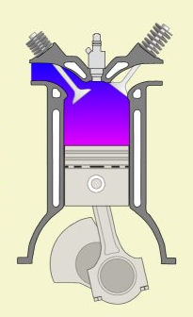
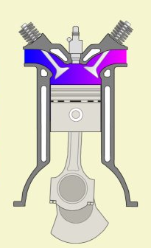
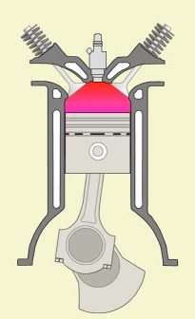
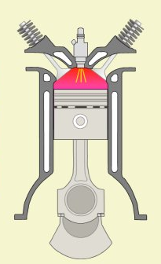
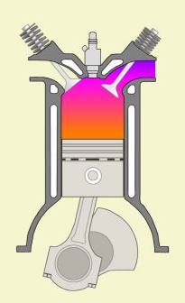
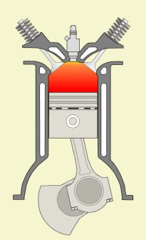
Internal Combustion Engines
– Diesel -
air intake
exhaust /intake
compression
fuel injection
exhaust
combustion

Slide 23
Introduction
working of four stroke cycle petrol engine
Compression stroke
Both valves are closed
Piston moves upward and compresses the charge in the cylinder.
The pressure and temperature of the mixture increases continuously during this process.
As the piston reaches the TDC, the mixture is ignited by electric spark.
Pressure and temperature of the gases increase while volume remains constant.

Slide 24
Introduction
working of four stroke cycle petrol engine
Power stroke or Expansion stroke
The increased pressure of the mixture exerts a large force and pushes the piston down.
During power stroke, both valves remain closed.
The high pressure and high temperature gases push the piston downwards and the gas pressure gradually decreases.
Piston moves from TDC to BDC.
Work is done during this stroke.
The exhaust valve opens as the piston reaches BDC position and pressure falls suddenly to atmospheric pressure at constant volume.

Slide 25
Introduction
working of four stroke cycle petrol engine
Exhaust stroke
During upward motion of the piston, the exhaust valve is open and inlet valve is closed.
The piston moves up in cylinder pushing out the burnt gases through the exhaust valve.
As the piston reaches the TDC, again inlet valve opens and fresh charge is taken in during next downward movement of the piston and the cycle is repeated.

Slide 26
Introduction
working of four stroke cycle Diesel engine
suction stroke
Air is come in during this stroke. It is similar as petrol engine.
Compression stroke
Compression is also similar , but near the end of compression, pressure and temperature of the air is about 60 bar and 600 C.
Expansion stroke
During this stroke, the inlet and exhaust valves are closed and fuel valve opens just before the beginning of the third stroke.
The supply of fuel is continued during a small part of the expansion stroke.
The temperature of the air at the end of compression stroke is sufficient to ignite the fuel.

Slide 27
Introduction
the combustion of fuel is continued at constant pressure as long as the fuel valve is open.
The high pressure and high temperature gases push the piston down even after the fuel valve is closed.
The exhaust valve opens when the piston reaches BDC.
Exhaust stroke
During this stroke, the inlet and fuel valves remain closed and exhaust valve remain open.
The piston moves up in the cylinder and pushes out the burned gases.
The piston reaches the TDC and completes the exhaust stroke and becomes ready for the next cycle.

Slide 28
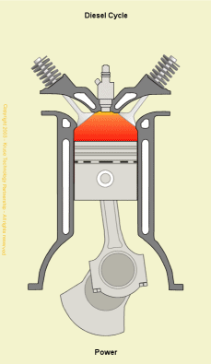
Internal Combustion Engines
– Diesel -
Advantages:
self ignition (without electrical spark plug)
better efficiency
reliability
higher durability
supplied with worse fuels
Drawbacks:
more NO_{x} production
more expensive production
more weight
louder
lower revolutions

Slide 29
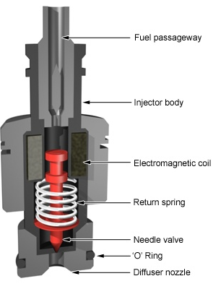
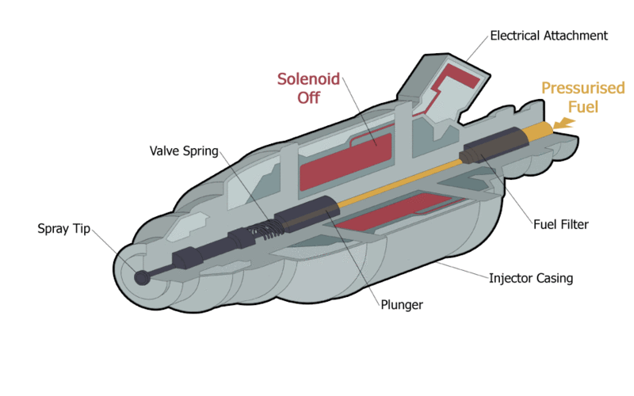
Internal Combustion Engines
– Diesel -
fuel injector

Slide 30
SI and CI Engines
Spark ignition (SI):
  combustion is initiated by spark
  air and fuel can be added together
Compression ignition (CI):
  combustion is initiated by auto ignition
  requires fuel injection to control ignition

Slide 31
Fuel-Air Mixing
In spark ignition engines, air and fuel are usually mixed prior to entry into the cylinder.
The ratio of mass flow of air to the mass flow of fuel must be held roughly constant at about 15 for proper combustion.
Conventionally, a mechanical device known as a carburetor is used to mix fuel and air. Most modern cars use electronic fuel-injection systems.
With diesel engines, fuel is sprayed directly into the cylinders, and power is varied by metering the amount of fuel added (no throttle).

Slide 32
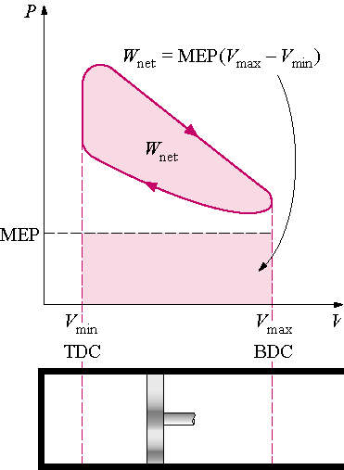
The Net Work Output of a Cycle
8-5
The net work
output of a cycle is equivalent to the product of the mean effect pressure and the displacement volume

Slide 33
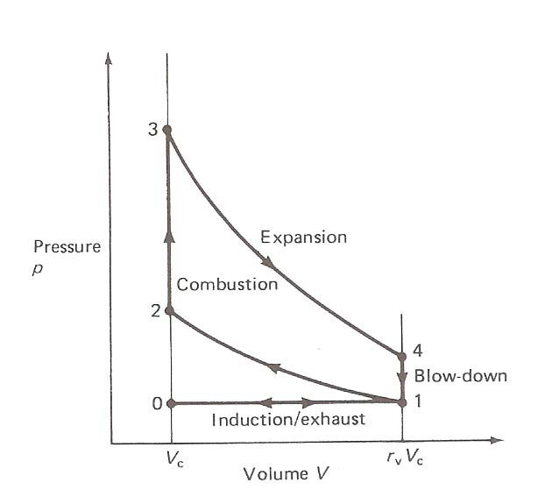
Background on the Otto Cycle
  The Otto Cycle has four basic steps or strokes:
  An intake stroke that draws a combustible mixture of fuel and air into the cylinder.
  A compression stroke with the valves closed which raises the temperature of the mixture. A spark ignites the mixture towards the end of this stroke.
– An expansion or
power from
stroke, resulting
combustion.
An idealized representation of the Otto cycle on a PV diagram.
– An Exhaust stroke the pushes the burned contents out of the cylinder.

Slide 34
Assumption
Suction and exhaust take place at atm. Pressure
Suction and exhaust take place at through 180º rotation of crank.
Compression and expansion take place through 180º rotation of crank.
Compression and expansion are isentropic
The combustion take place instantaneously at constant volume at the end of compression stroke
Pressure suddenly falls to the Atmospheric pressure at the end of expansion stroke

Slide 35
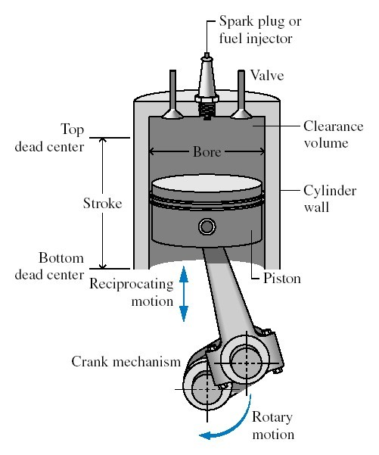
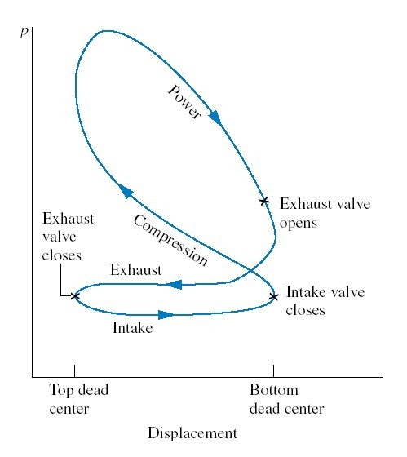
Internal Combustion Engine

Slide 36
Actual cycle
The suction of mixture in the cylinder is possible only if the pressure inside the cylinder is below atmospheric Pr.
The burnt gases can be pushed out into the atm. Only if the pr. Of the exhaust gases is above atmospheric pressure.
The comp. and Exp. do not follow the isentropic law, there will be heat exchange during these processes.
Suddenly pressure rise is not possible after the ignition and actual pressure rise is less than theoretical considered. The pressure increase take place through some crank rotation or increase in volume.
Suddenly pressure release after the opening of expansion valve is not possible and it also take place through some crank rotation

Slide 37
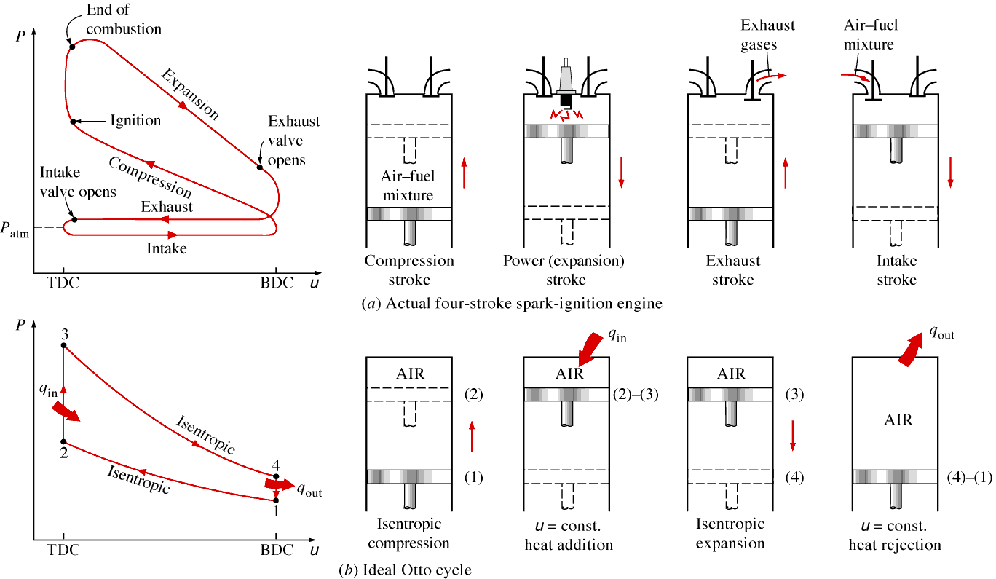
Actual and Ideal Spark Ignition Engine And Their P-v Diagram
8-6

Slide 38
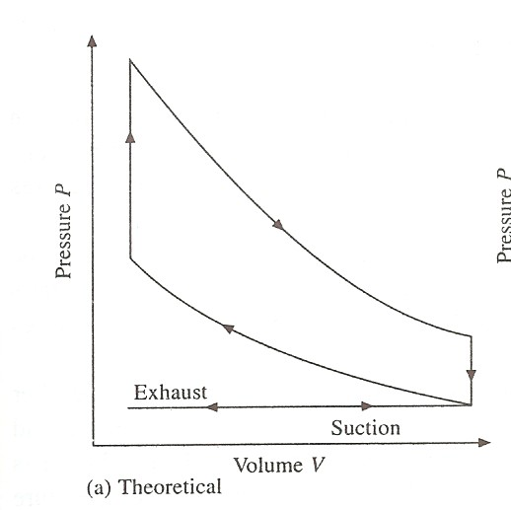
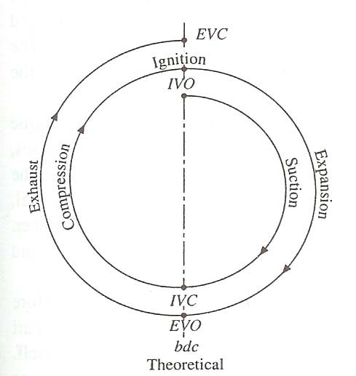
Typical Theoretical P-V and Valve Timing Diagrams of a Four-Stroke Spark Ignition Engine
Observations:
Q P-V diagram shows sharp edges
i.e., valves open/close instantaneously at dead centres

Slide 39
Actual Case

Slide 40
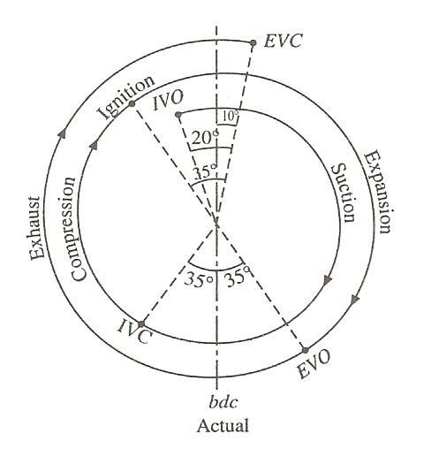
IV opens 20⁰ before TDC.
IV closes 35⁰ after BDC to take the advantage of momentum of rapidly moving gases (Ram Effect).
Ignition occurs 35⁰ before TDC; this is to allow the time delay between the spark and commencement of combustion.
EV opens at 35⁰ before BDC; else pressure will rise enormously, and the work required to expel the gas will increase.
Actual Valve Timing Diagram of a Four-Stroke Spark Ignition Engine
EV closes at 10⁰ after TDC; this is to increase the volumetric efficiency.

Slide 41
Valve Overlap: The time during which both the valves (inlet and exhaust) remain open at the same instant.
Remark
The values quoted in the actual valve timing diagrams are the typical values, and may vary from engine to engine.
For HIGH SPEED engines, higher values of angles are desirable to take into account the short time interval.

Slide 42
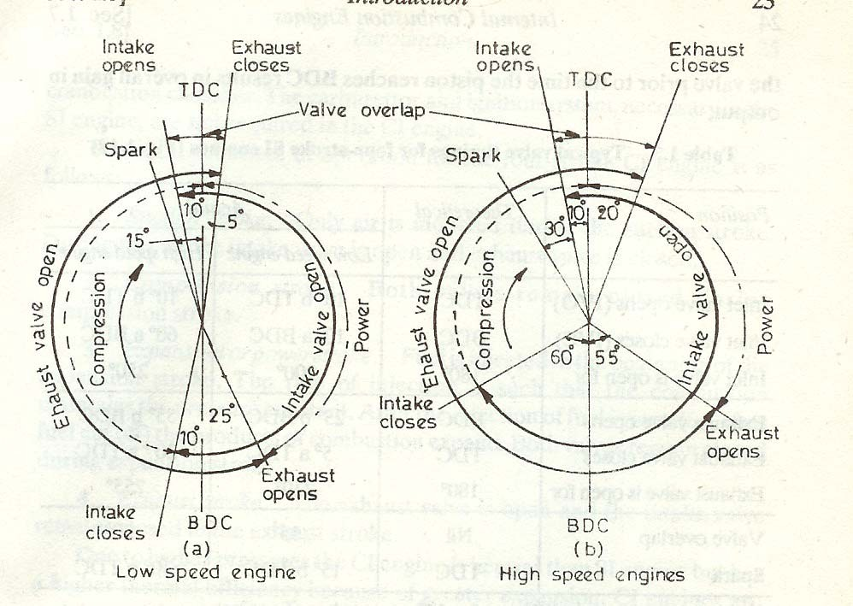
Valve Timing for Low and High Speed Four-Stroke Spark Ignition Engines

Slide 43
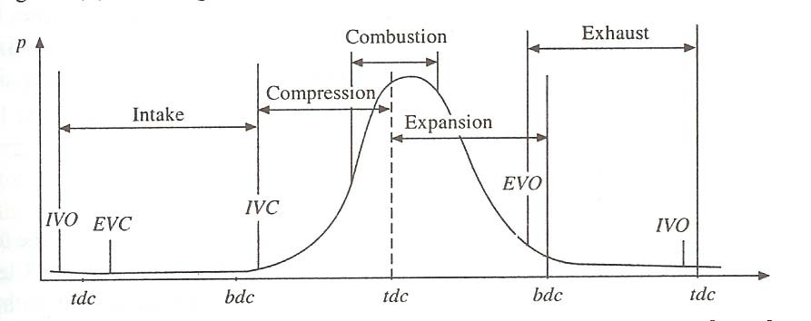
Sequence of Events in a Four-Stroke Spark Ignition Engine – Pressure vs. Crank Angle

Slide 44
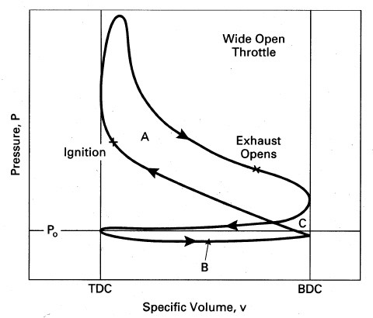
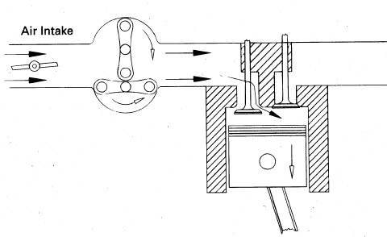
p-V diagram of a Four Stroke SI Engine at Wide open throttle
The pressure at the intake port is just below atmospheric pressure
P_{o}
^{P}intake
^{P}intake
The upper loop consists of compression and power strokes and the area represents positive indicated work. The lower loop indicates negative work of the intake and exhaust stroke. This is called indicated pumping work.

Slide 45
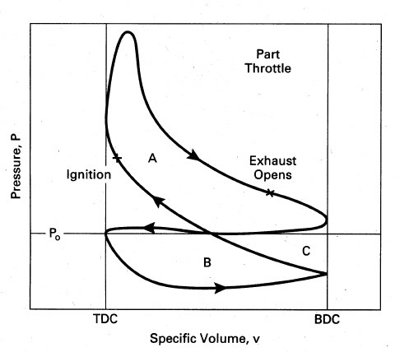
p-V diagram of a Four Stroke SI Engine at Part-Throttle
The pressure at the intake port is significantly lower than atmospheric pressure
^{P}intake
The upper loop consists of compression and power strokes and the area represents positive indicated work. The lower loop indicates negative work of the intake and exhaust strokes. This is called indicated pumping work.

Slide 46
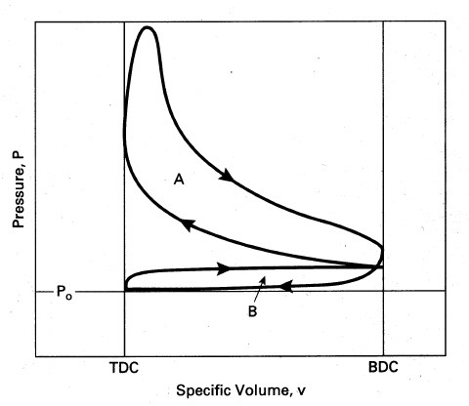
p-V diagram of a Four Stroke SI Engine with Supercharger
Compressor
^{P}intake
The engines with superchargers or turbochargers have intake pressures greater than the exhaust pressure, yielding a positive pump work.

Slide 47
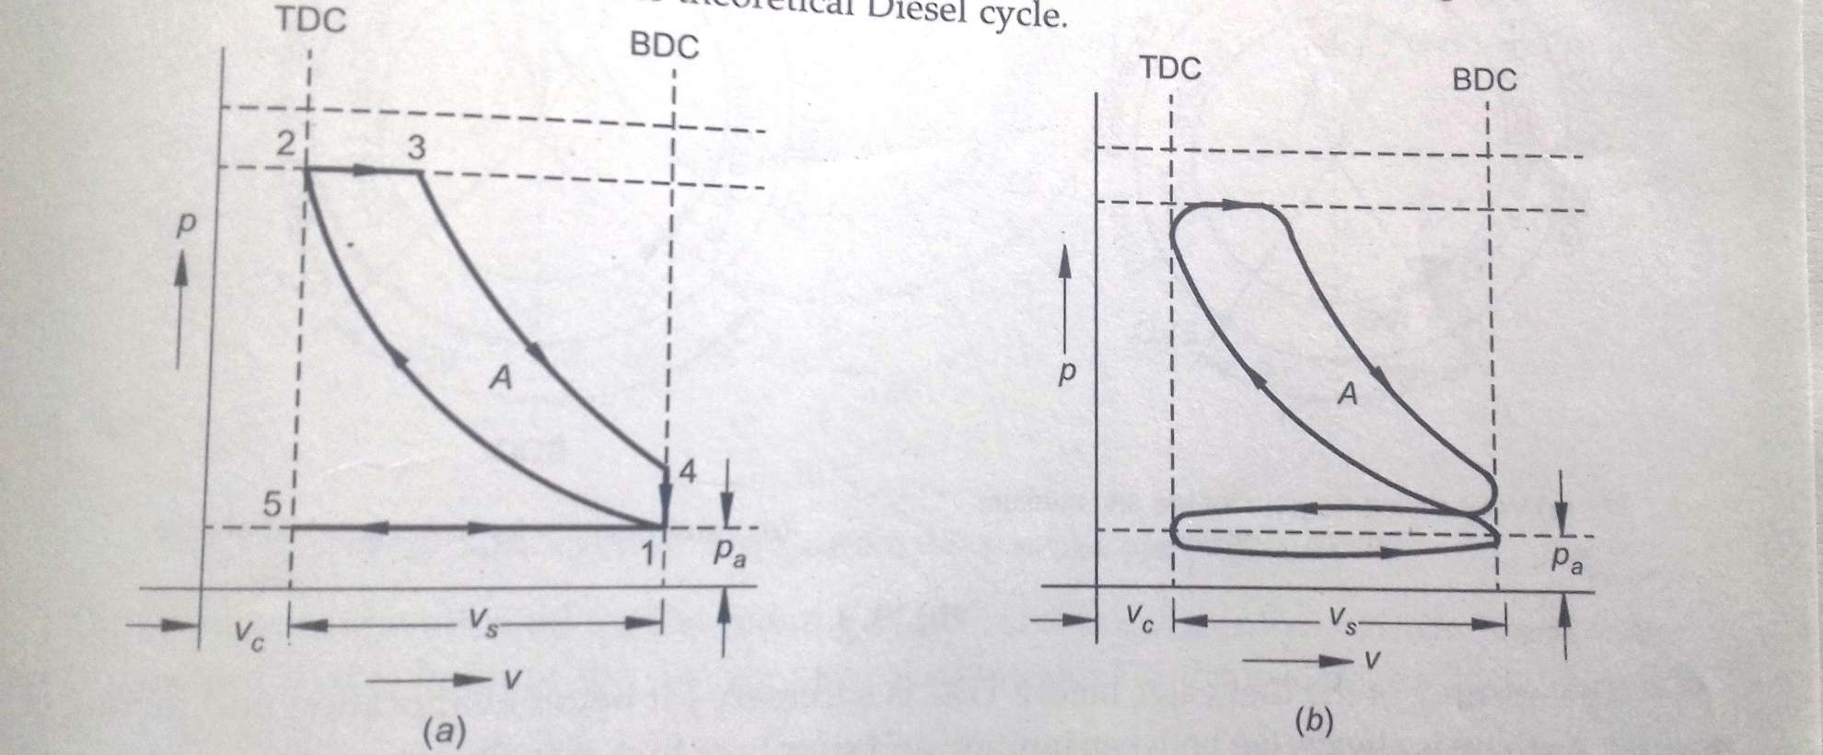
Typical Theoretical and Actual p-V Diagrams of a Four-Stroke Compression Ignition Engine

Slide 48
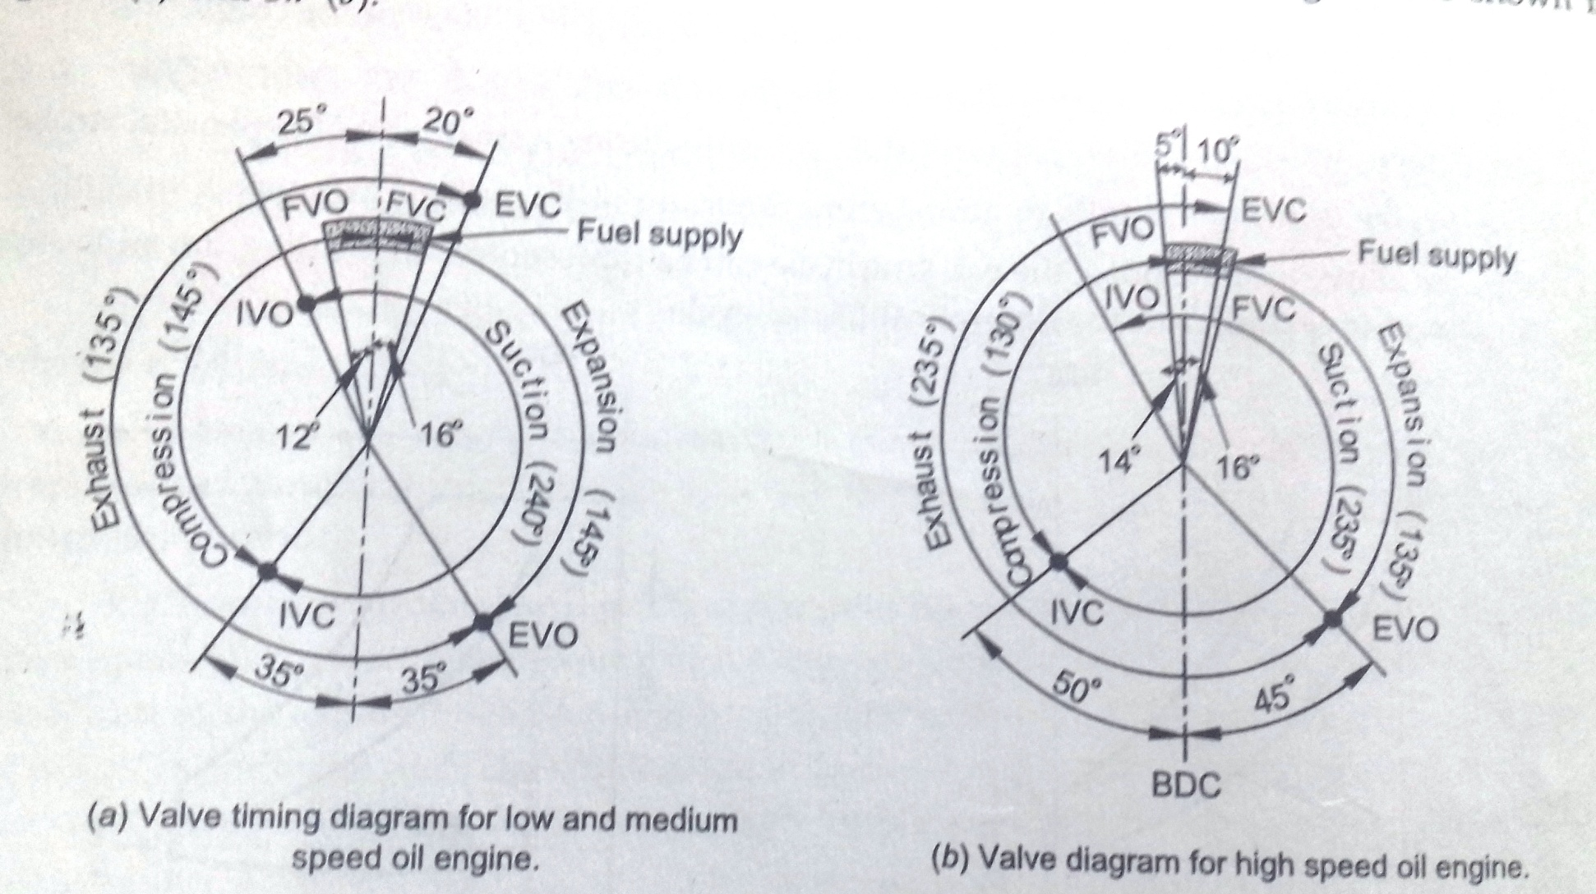
Valve Timing for Low and High Speed Four-Stroke Compression Ignition Engines

Slide 49
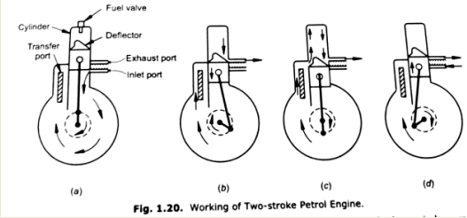
working of Two stroke petrol engine

Slide 50
Introduction
working of Two stroke petrol engine
The position of the piston at the end of compression is shown in fig.a
The spark is produced by the spark plug as the piston reaches the TDC.
The pressure and temperature of the gases increase and the gases push piston downward producing power stroke.
When the piston uncovers the exhaust port, during the downward stroke, the expanded burnt gases leave the cylinder through the exhaust port.
A little later, the piston uncovers the transfer ports.
In this position, the crank-case is directly connected to the cylinder through transfer port.

Slide 51
Introduction
during the downward stroke of the piston, the charge in the crank-case is compressed by the underside of the piston to a pressure of 1.4 bar.
As this position , the compressed charge (fuel+air) is transferred through the transfer port to the upper part of the cylinder.
The exhaust gases are swept out with the help of fresh charge.
The action of sweeping out the exhaust gases with the help of fresh charge is known as “scavenging”.
The scavenging helps to remove the burnt gases from the cylinder.
During this stroke of the piston (downward stroke) the following processes are completed.
A) power is developed by the downward movement of the piston caused by the high pressure gases.

Slide 52
Introduction
B) the exhaust gases are removed completely from the cylinder by scavenging.
C) the charge is compressed in the crank-case with the help of the piston.

Slide 53
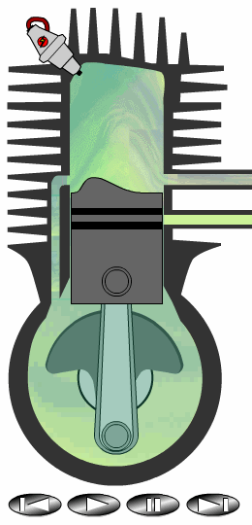
Internal Combustion Engines
– two stroke -
1. Power / Exhaust
ignition
piston moves downward compressing fuel-air mixture in the crankcase
exhaust port opens
2. Intake / Compression
inlet port opens
compressed fuel-air mixture rushes into the cylinder
piston upward movement provides further compression

Slide 54
Internal Combustion Engines
– two stroke -
Advantages:
lack of valves, which simplifies construction and lowers weight
fire once every revolution, which gives a significant power boost
can work in any orientation
good power to weight ratio
Drawbacks:
lack of a dedicated lubrication system makes the engine to wear faster.
necessity of oil addition into the fuel
low efficiency
produce a lot of pollution

Slide 55
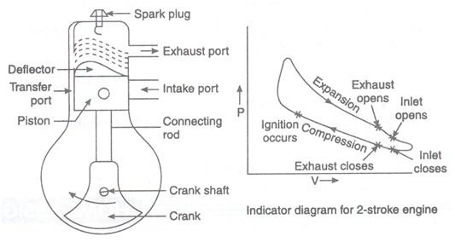
Two stroke SI Engine

Slide 56
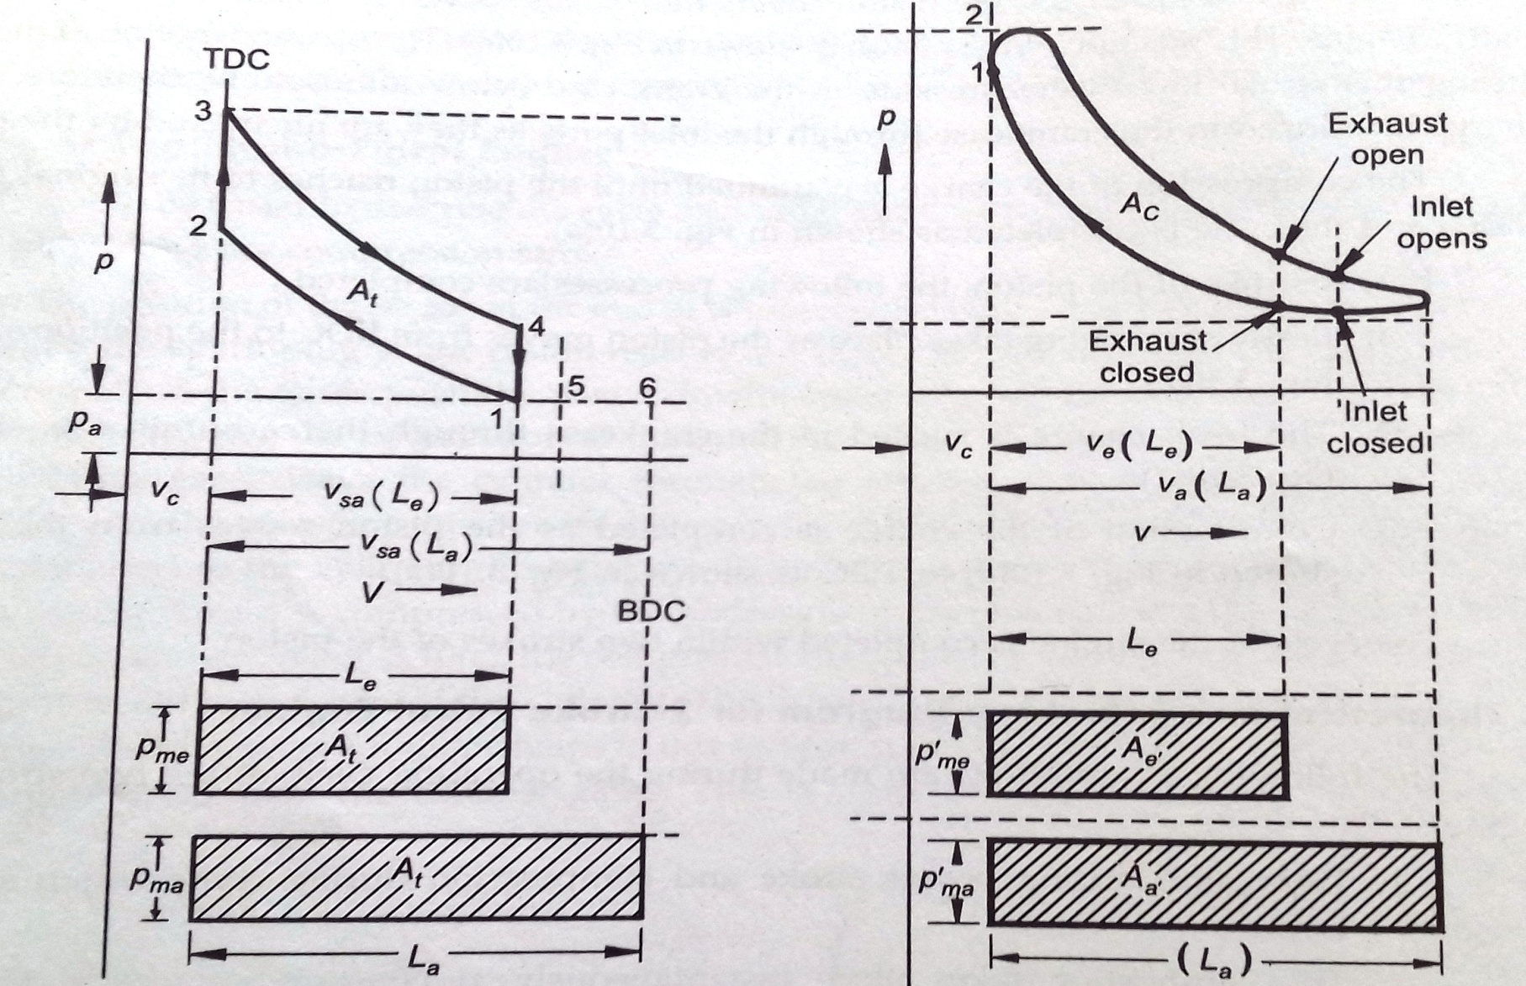
Ideal VS Actual P-V Diagram Of Two-Stroke SI Engine

Slide 57
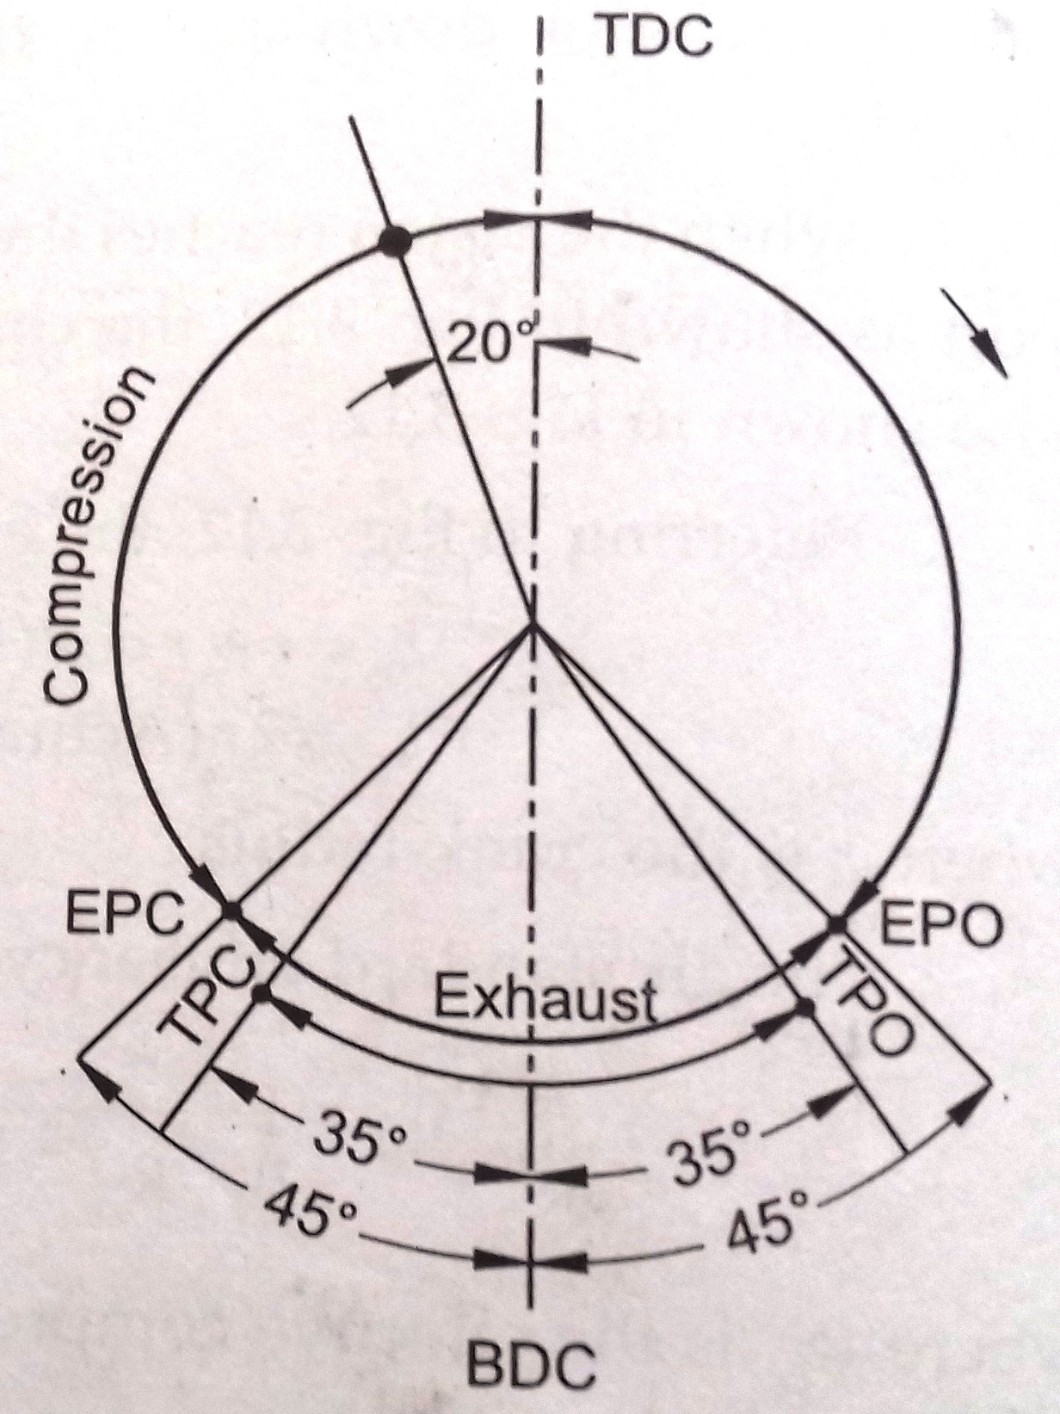
Port Timing Diagram Of Two-Stroke SI Engine

Slide 58
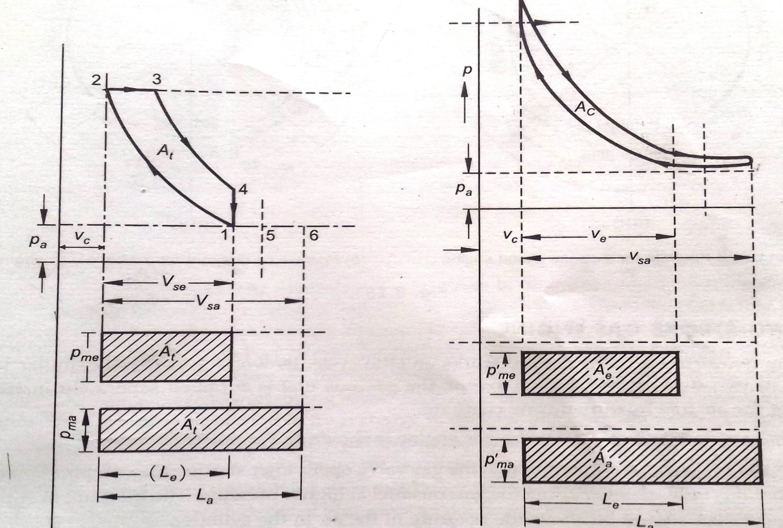
Actual Vs Ideal P-V Diagram Of Two-Stroke CI Engine

Slide 59
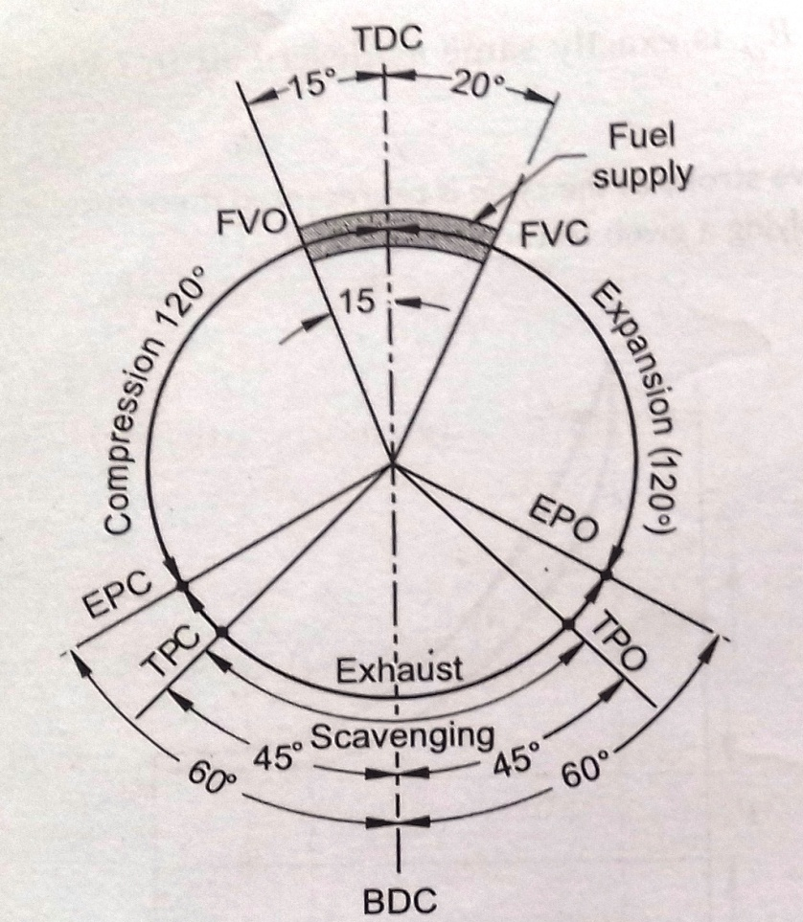
Port Timing Diagram Of Two-Stroke CI

Slide 60
Introduction
Application of I.C.Engine
1. use of 2 stroke petrol engine
Used for scooters, mopeds and lawn movers n the capacity of 1.5 to 5 KW at 2000 to 5000 RPM.
Mopeds (50 cc) with 1,5 kw at 5000 rpm
Scooters (100 cc) with 3.5 kw at 5000 rpm
Scooters (150 cc) with 5 kw at 5300 rpm
Motor cycle (250 cc) with 9 kw at 4500 rpm
2. use of 4 stroke petrol engine
Used in cars, jeeps, buses and trucks.
Pumping sets, mobile electric generating sets.
Fiat car (1089 cc) 4cylinder, 32 kw at 5000 rpm
American car (6 cylinder) 185 kw at 5000 rpm
Jeeps (4000 cc) 6 cylinder 90 kw

Slide 61
Application of I.C.Engine
3 use of 4 stroke diesel engine
Most commonly used in prime mover because of low running cost.
Speed vary from 100 to 4500 rpm an power capacity varies from 1kw to 100 kw per cylinder.
Small capacity engine used for pumping sets, construction machinery, drilling rigs, air compressors.
In middle range capacity , jeeps 40 kw, tractors 60-80 kw, buses and trucks 90 kw.
Higher capacity engines used in railways 2000 kw , ships 3000 kw.
4. use of 2 stroke diesel engine
These engines in high capacity range are generally preferred for ship propulsion as the weight of the engine is one of the major consideration in the design of ship.

Slide 62
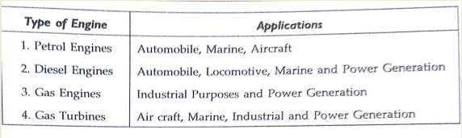
Introduction
theoretically, the weight of the 2 stroke engine is 50 % of four stroke engine when both are running at same speed and developing same power.
Generally all engines above 60 cm bore are 2 stroke engine.

Slide 63
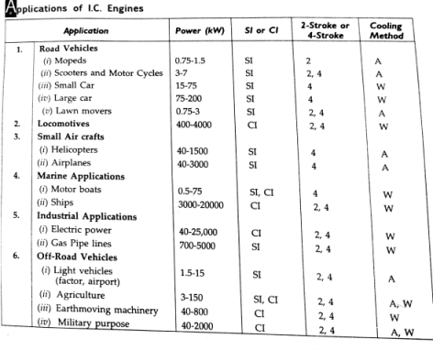
Introduction

