Slide 1
Gas Dynamics, UNIT 2

Slide 2
Overview
What will we treat during this course?
Basic equations of gas dynamics
Equation of motion
Mass conservation
Equation of state
Fundamental processes in a gas
Steady Flows
Self-gravitating gas
Wave phenomena
Shocks and Explosions
Instabilities: Jeans’ Instability

Slide 3
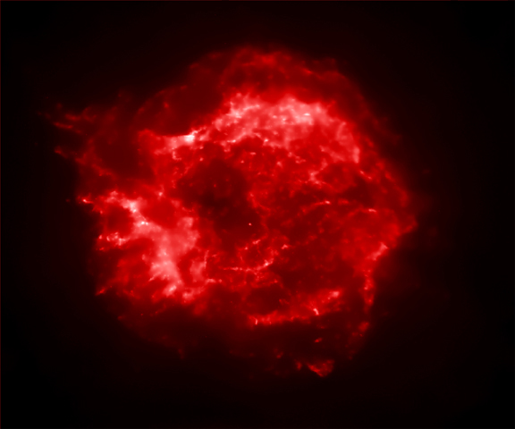
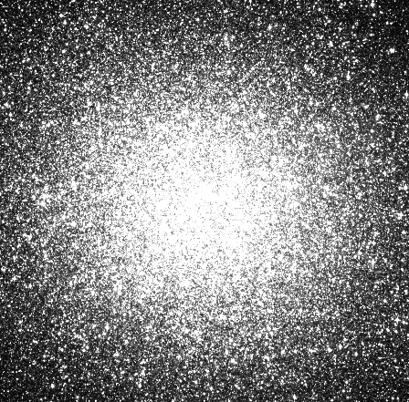
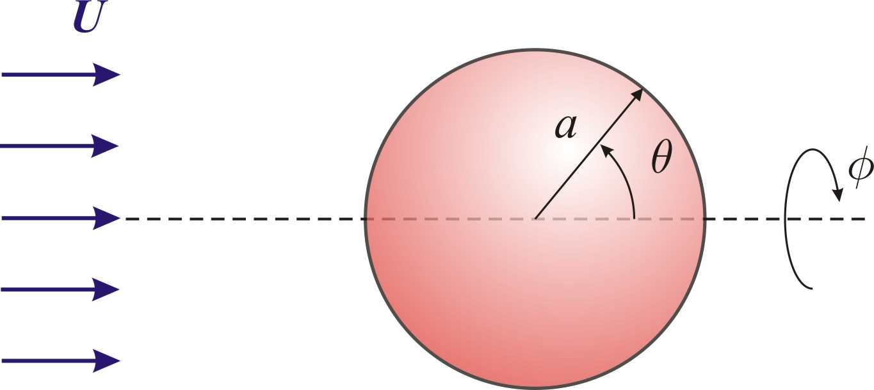
Applications
Isothermal sphere &
Globular Clusters
Special flows and drag forces
Solar & Stellar Winds
Sound waves and surface waves on water
Shocks
Point Explosions,
Blast waves &
Supernova Remnants

Slide 4
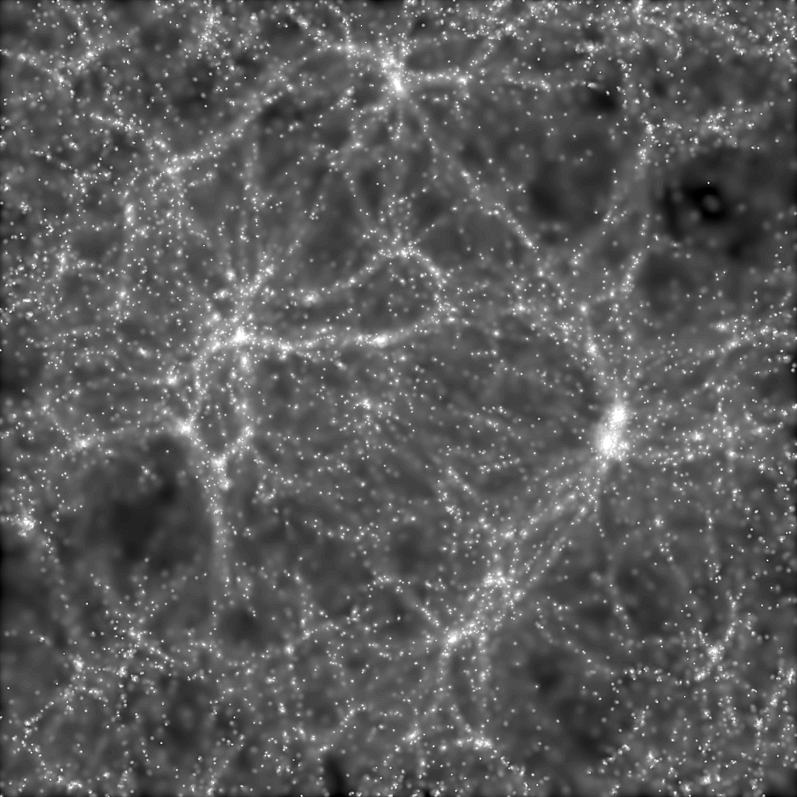
LARGE
SCALE
STRUCTURE

Slide 5
Classical Mechanics vs. Fluid Mechanics
Single-particle (classical) Mechanics | Fluid Mechanics
Deals with single particles with a fixed mass | Deals with a continuum with a variable mass-density
Calculates a single particle trajectory | Calculates a collection of flow lines (flow field) in space
Uses a position vector and velocity vector | Uses a fields : Mass density, velocity field....
Deals only with externally applied forces (e.g. gravity, friction etc) | Deals with internal AND external forces
Is formally linear (so: there is a superposition principle for solutions) | Is intrinsically non-linear No superposition principle in general!

Slide 6
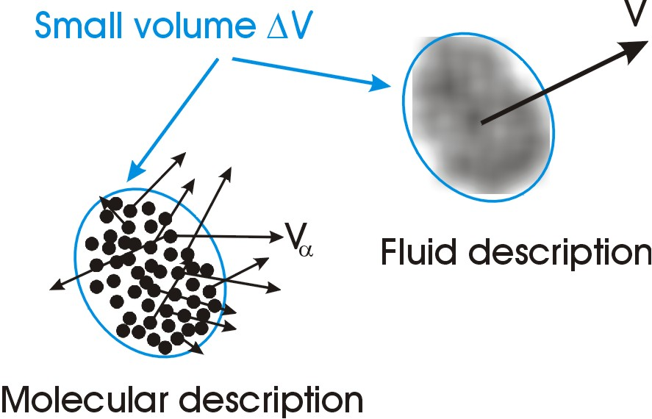
Basic Definitions

Slide 7
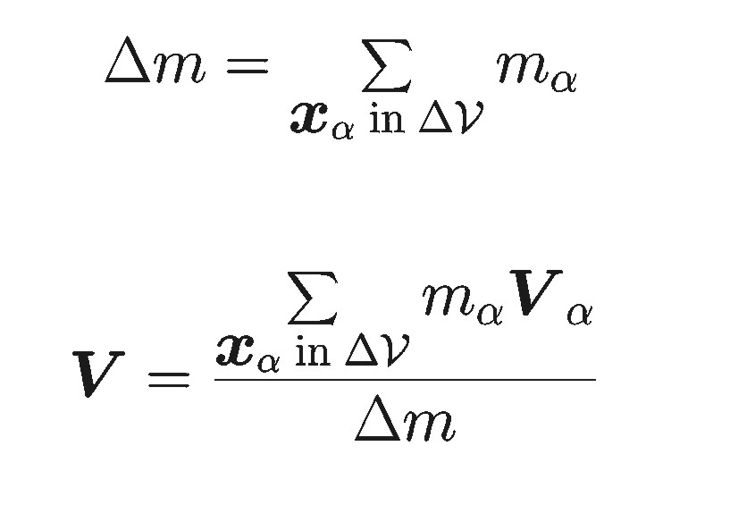
Mass, mass-density and velocity
Mass density ρ:
Mass Δm in volume ΔV
Mean velocity V(x , t) is defined as:

Slide 8
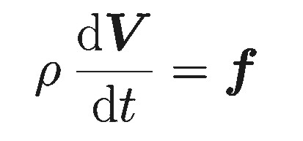
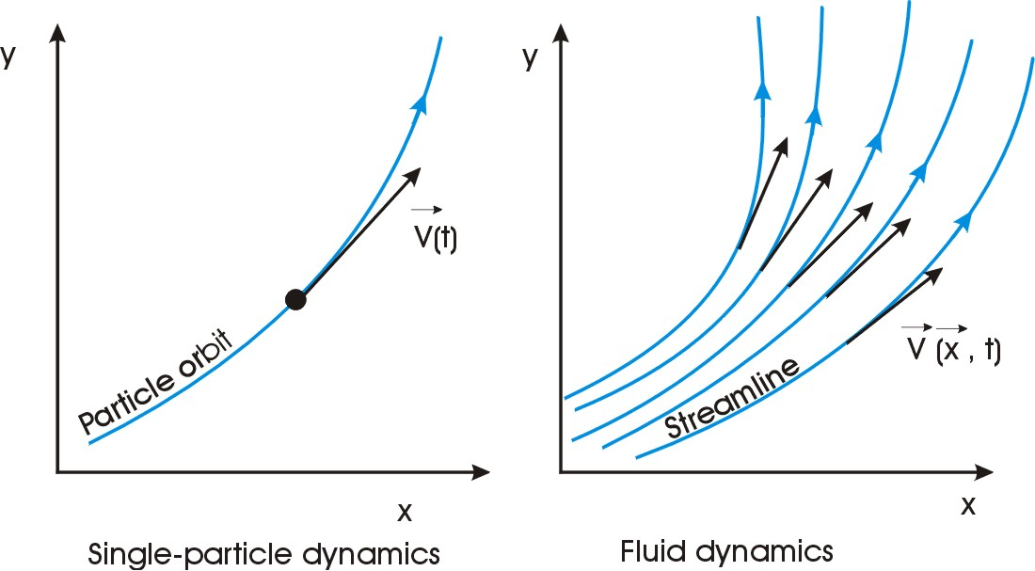
Equation of Motion: from Newton to Navier-Stokes/Euler
Particle α

Slide 9
Equation of Motion: from Newton to Navier-Stokes/Euler
You have to work with a
velocity field that depends
on position and time!
Particle α

Slide 10
Derivatives, derivatives…
Eulerian change:
fixed position

Slide 11
Derivatives, derivatives…
Eulerian change:
evaluated at a
fixed position
Lagrangian change:
evaluated at a
shifting position
Shift along
streamline:

Slide 12
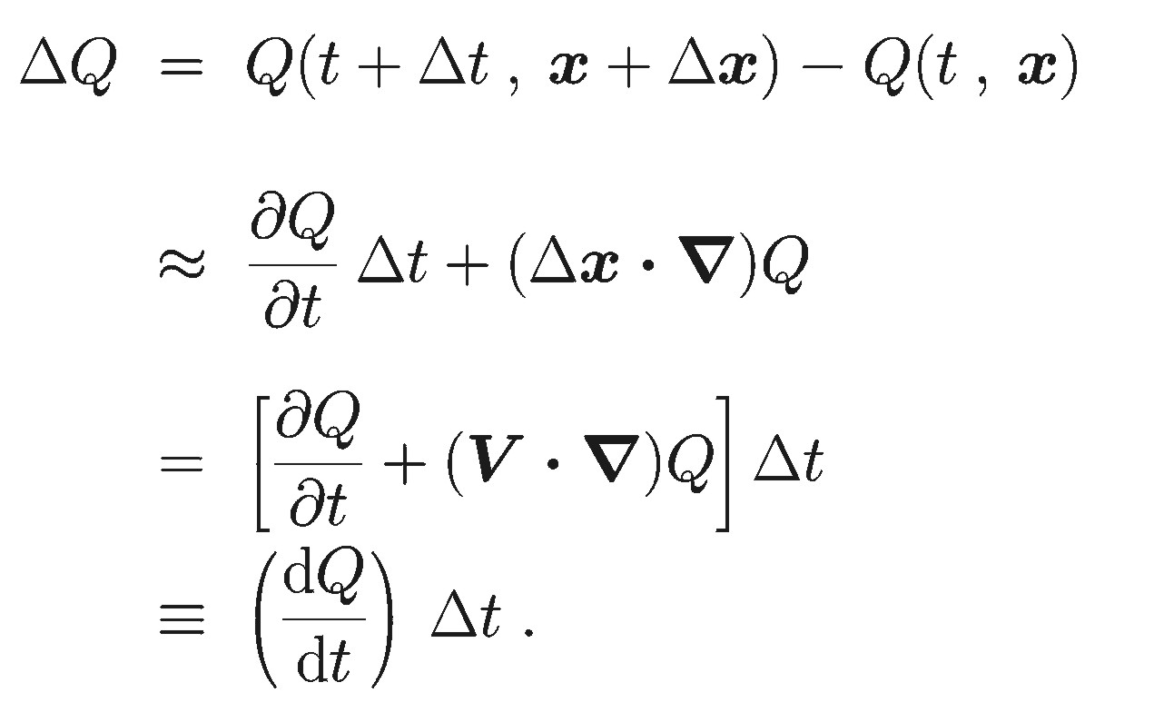
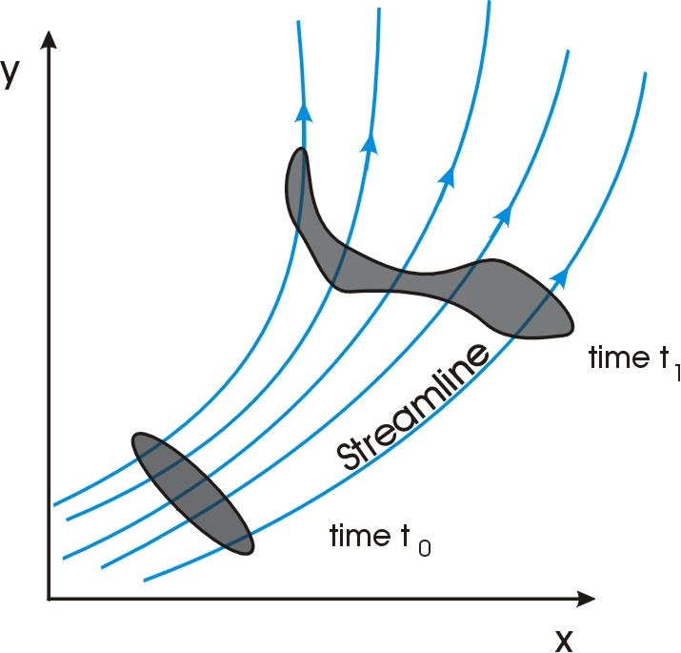
Comoving derivative d/dt

Slide 13
z
y
x

Slide 14
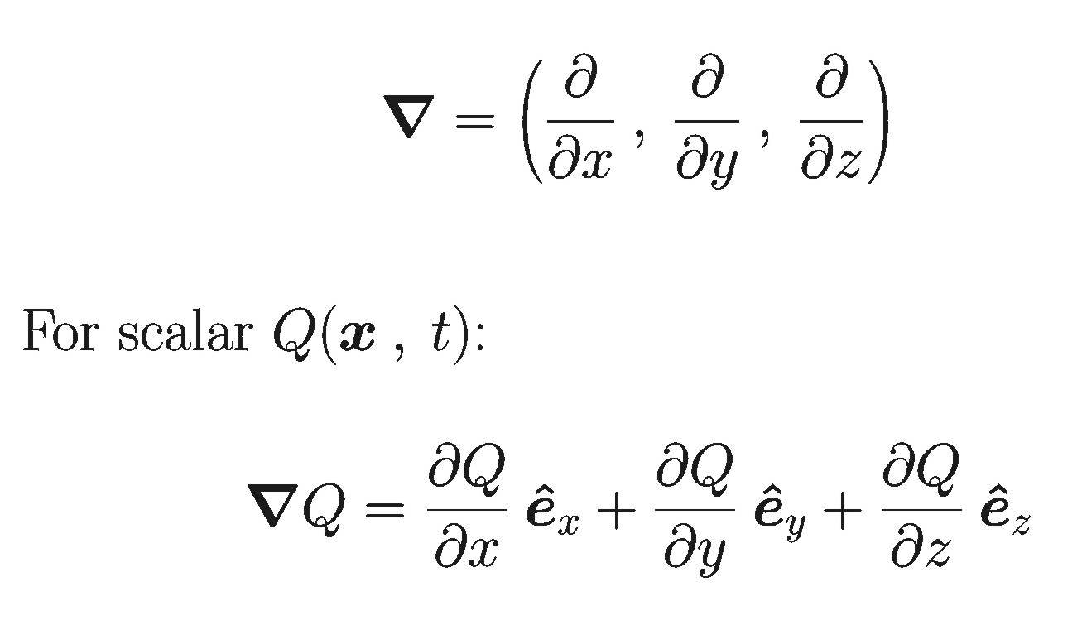
Notation: working with the gradient operator
Gradient operator is a
‘machine’ that converts
a scalar into a vector:
Related operators:
turn scalar into scalar,
vector into vector….

Slide 15
GRADIENT OPERATOR AND VECTOR ANALYSIS (See Appendix A)

Slide 16
Program for uncovering the basic equations:
1. Define the fluid acceleration and formulate the equation of motion by analogy with single particle dynamics;
2. Identify the forces, such as pressure force;
3. Find equations that describe the response of the other fluid properties (such as: density , pressure P, temperature T) to the flow.

Slide 17
Equation of motion for a fluid:

Slide 18
Equation of motion for a fluid:
The acceleration of a fluid element
is defined as:

Slide 19
Equation of motion for a fluid:
This equation states:
mass density × acceleration = force density
note: GENERALLY THERE IS NO
FIXED MASS IN FLUID MECHANICS!

Slide 20
Equation of motion for a fluid:
Non-linear term!
Makes it much more difficult
To find ‘simple’ solutions.
Prize you pay for working with
a velocity-field

Slide 21
Equation of motion for a fluid:
Non-linear term!
Makes it much more difficult
To find ‘simple’ solutions.
Prize you pay for working with
a velocity-field
Force-density
This force densitycan be:
internal:
pressure force
viscosity (friction)
self-gravity
external
For instance: external
gravitational force

Slide 22
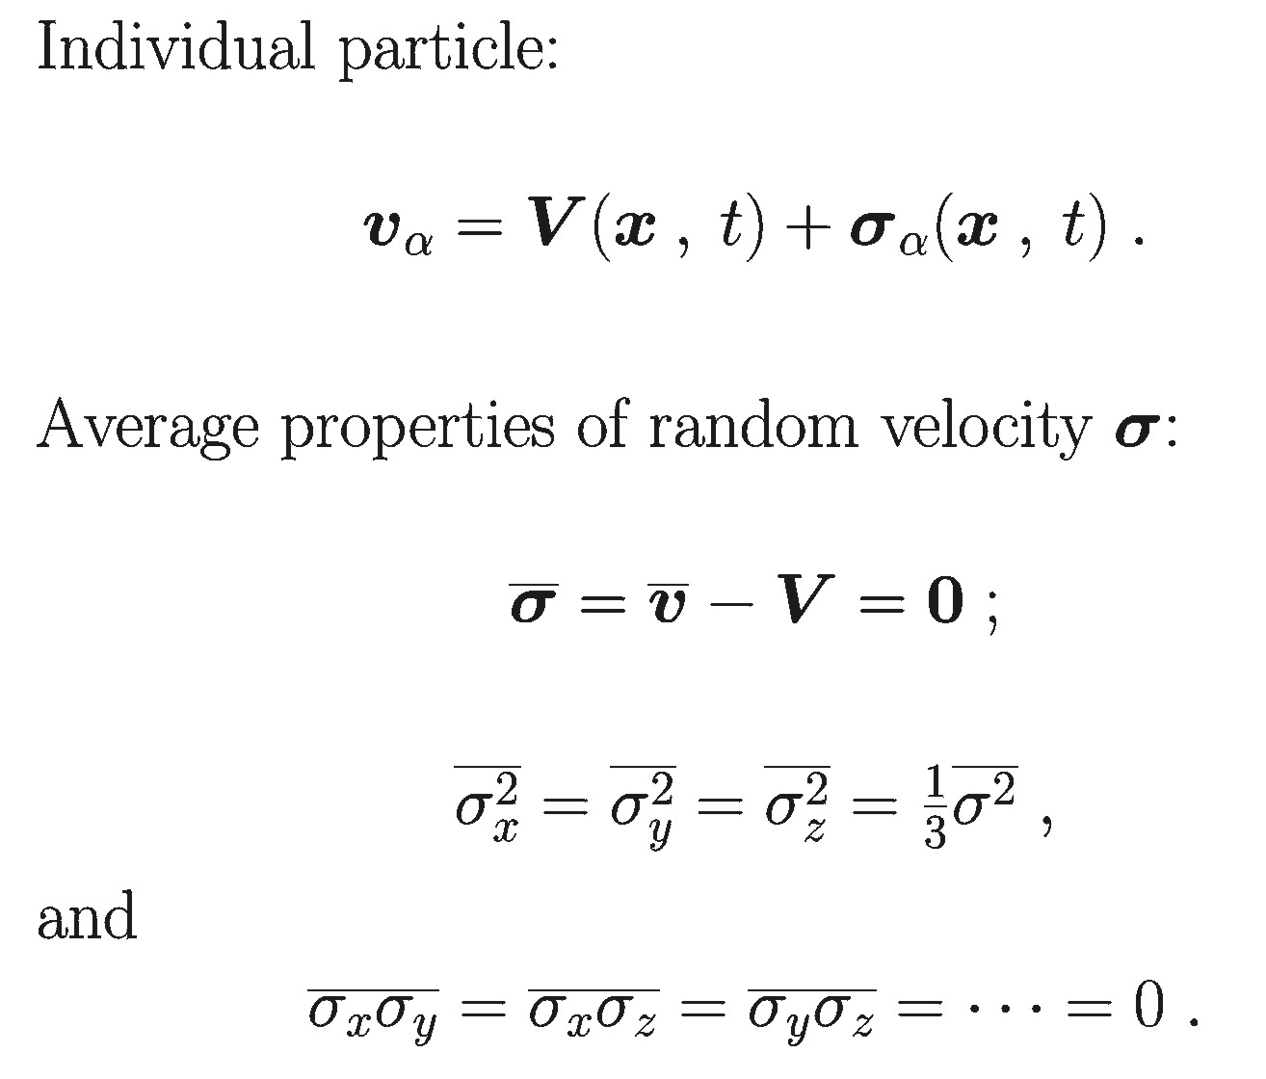
Pressure force and thermal motions
Split velocities into the
average velocity
V(x, t),
and an
isotropically distributed
deviation from average, the
random velocity:
σ(x, t)

Slide 23
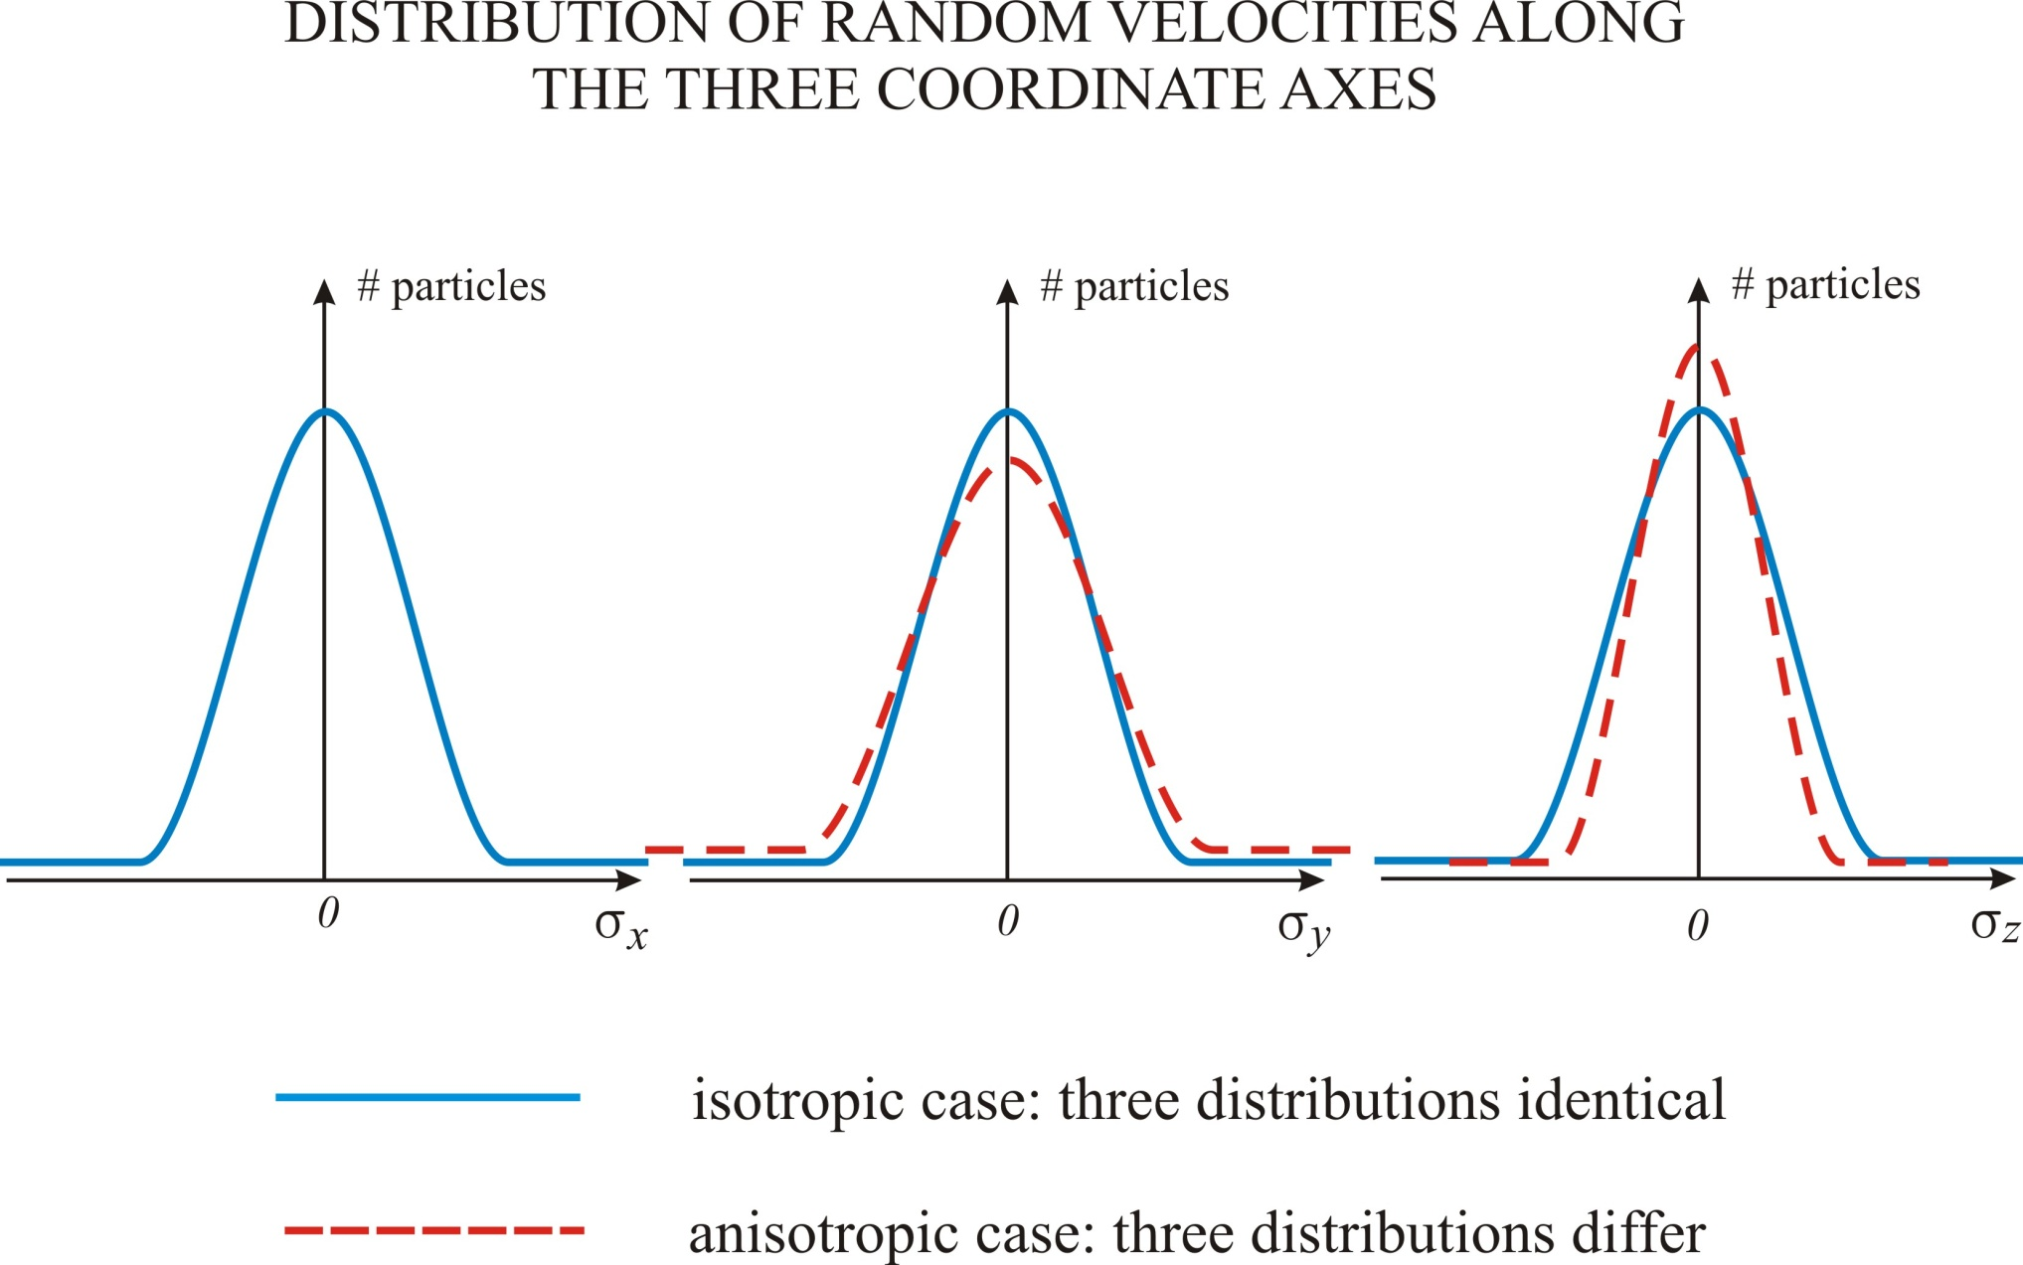

Slide 24
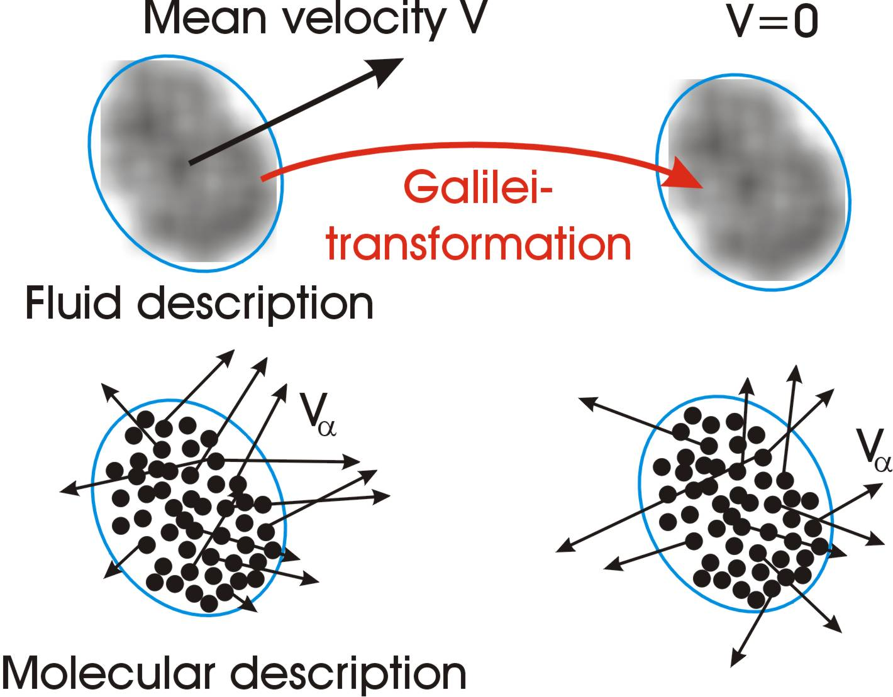

Slide 25
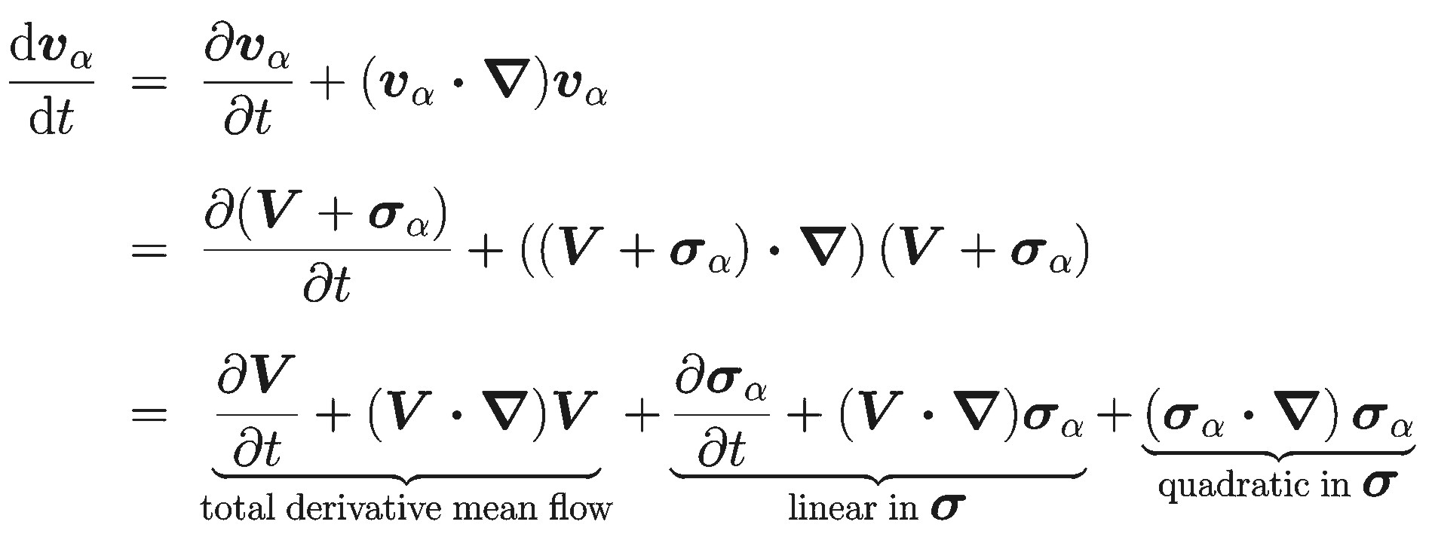
Acceleration of particle α

Slide 26
Acceleration of particle α (II)
Effect of average over many particles in small volume:

Slide 27
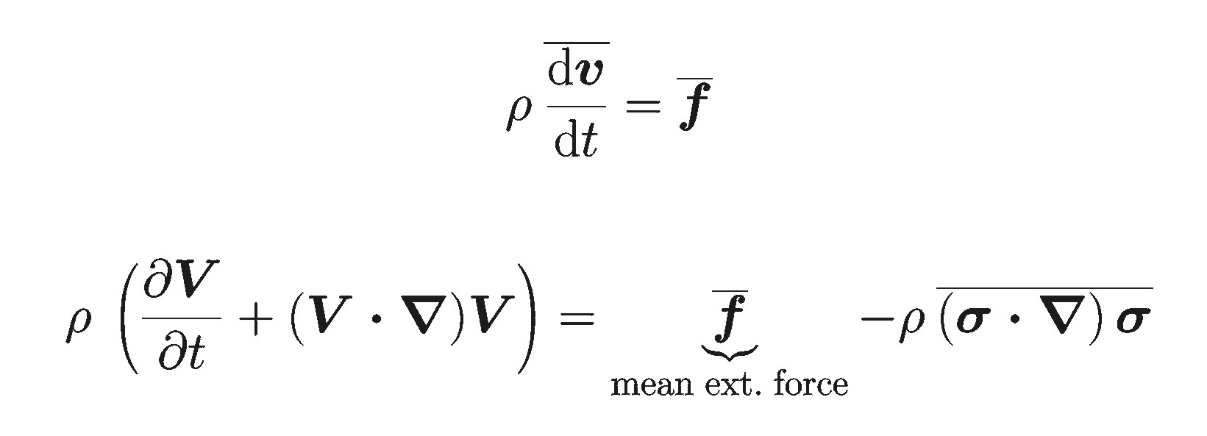
Average equation of motion:
For isotropic fluid:

Slide 28
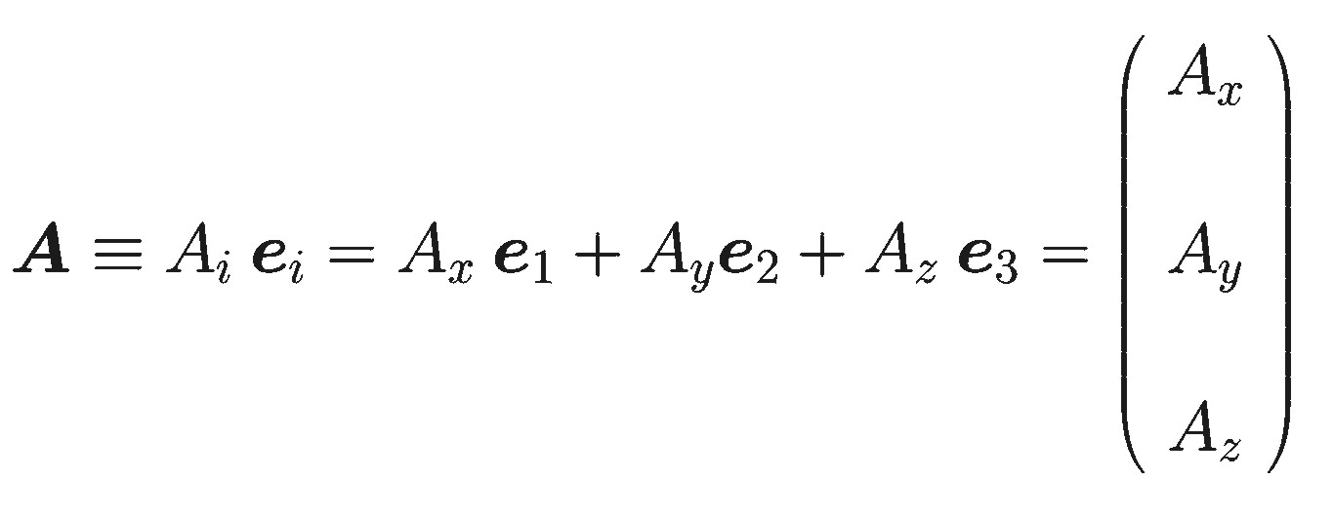
Some tensor algebra:
Vector
Three notations for the same animal!

Slide 29
Some tensor algebra: the divergence of a vector in cartesian (x, y, z) coordinates
Vector
Scalar

Slide 30
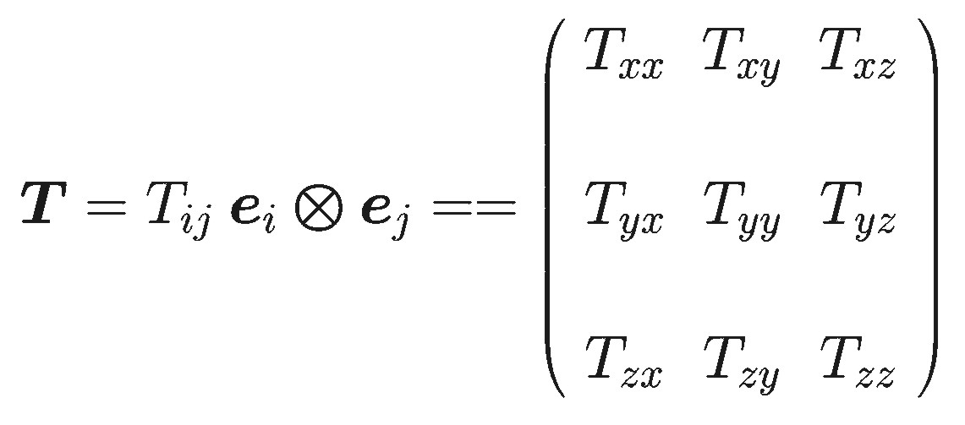
Rank 2 Tensor
Rank 2
tensor

Slide 31
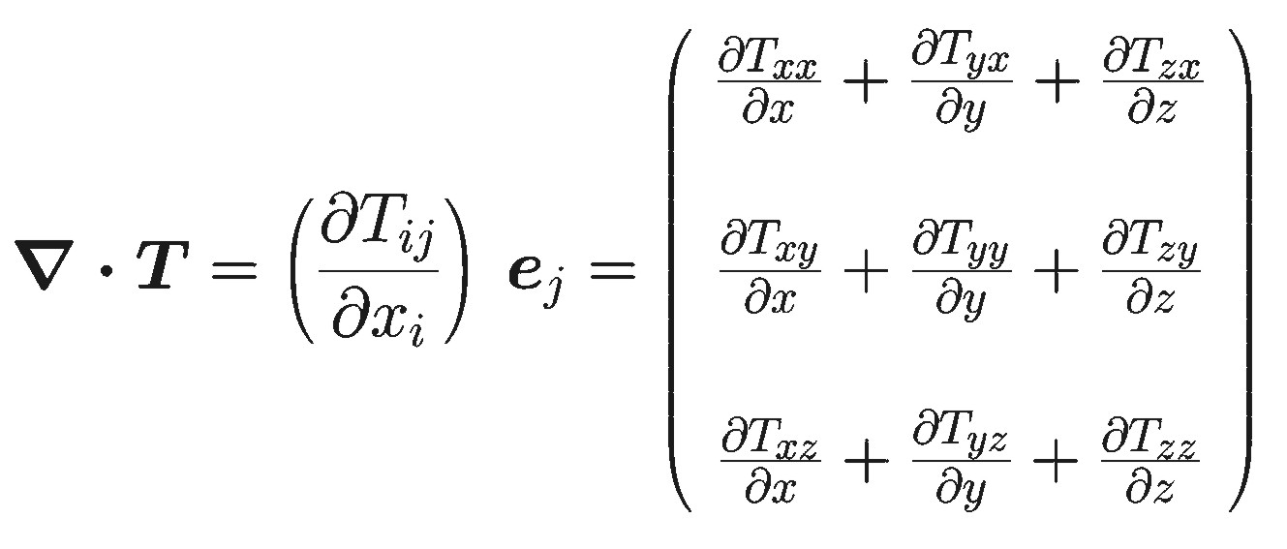
Rank 2 Tensor and Tensor Divergence
Rank 2
tensor T
Vector

Slide 32
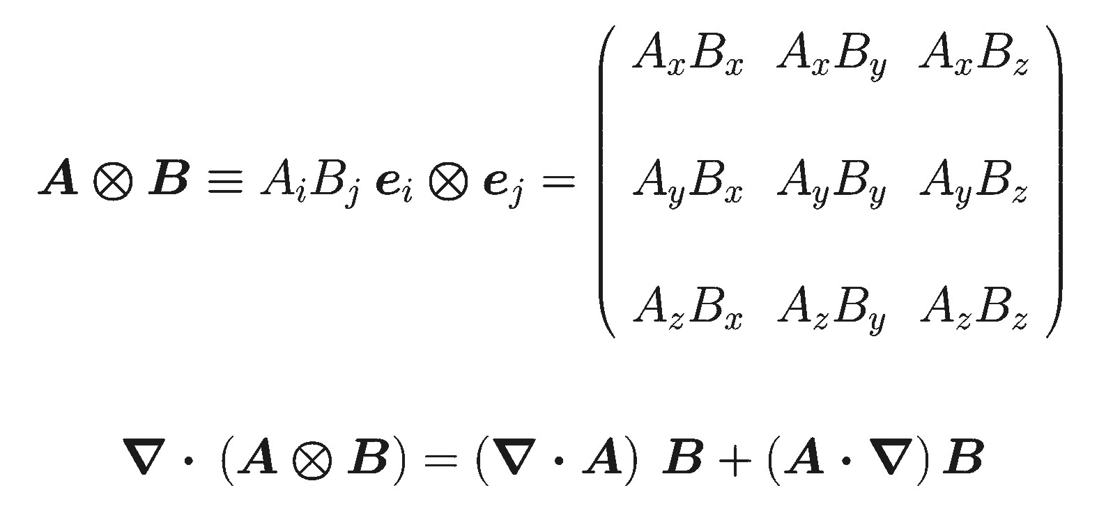
Special case: Dyadic Tensor = Direct Product of two Vectors
This is the product rule for differentiation!

Slide 33
Application: Pressure Force (I)
Tensor
divergence:
Isotropy of the
random velocities:
Second term = scalar x vector!
This must vanish upon averaging!!

Slide 34
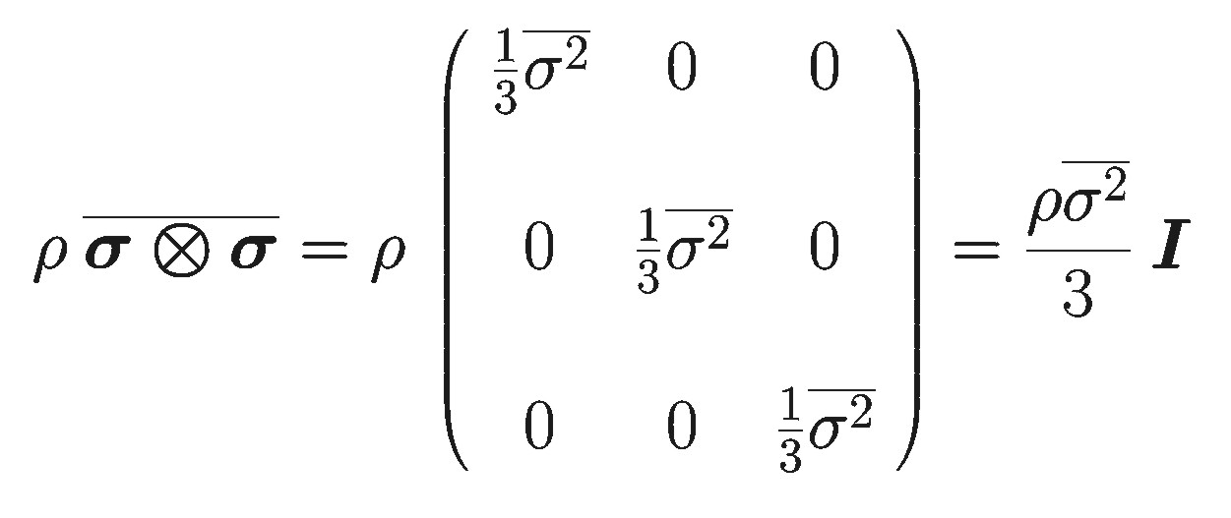
Application: Pressure Force (II)
Isotropy of the
random velocities
Diagonal Pressure Tensor

Slide 35
Pressure force, conclusion:
Equation of motion for frictionless (‘ideal’) fluid:

Slide 36
Summary:
We know how to interpret the time-derivative d/dt;
We know what the equation of motion looks like;
We know where the pressure force comes from
(thermal motions), and how it looks: f = - P .
We still need:
- A way to link the pressure to density and
temperature: P = P(, T);
- A way to calculate how the density  of the
fluid changes.

