Slide 1
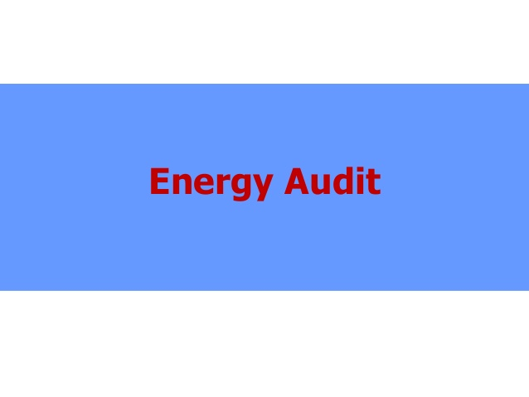
ENERGY AUDIT

Slide 51
THANK YOU

