Slide 1
Computer Engineering Department
Advanced Python Programming(CE0620)
Regular Expression
By
Prof. Bhumi Shah

Slide 2
Regular Expression
A regular expression is a special sequence of characters that helps to match or find other strings or sets of strings, using a specialized syntax held in a pattern.
Also called “regex”.
re module - provides regular expressions in Python.
so we need to import it using following syntax,
import re
RegEx can be used to check if a string contains the specified search pattern.
For Example, ^a...s$
The pattern is: any five letter string starting with a and ending with s.

Slide 3
Regular Expression
Regular expressions use the backslash character ('\') to indicate special forms or to allow special characters to be used without invoking their special meaning.
For Exa, str=”this is normal \n String” #Here,\n = new line character
but in regex,\n is not a new line ,so we need to take it as raw string by mentioning r as prefix in string
i.e, str=r”this is raw \n String”
If we dont want to write RE as raw string,then use another backslash before such characters.
str= ”this is raw \\n String”

Slide 4
First Regular Expression
reg=r’m\w\w’
meaning: Words or strings having three characters and with ‘m’ as first character.
Note: \w means any character,in A to Z,a to z or 0 to 9.
import re
prog=re.compile(r'm\w\w')
s1="cat bat mat mah"
res=prog.search(s1)
print(res.groups())
or
import re
res=re.search(r'm\w\w',s1) #single step to compile and run the RE
print(res.groups())

Slide 5
Continue..
Using findall() method --- it returns result as a list
import re
#prog=re.compile(r'm\w\w')
s1="cat bat mat man mah"
res=re.findall(r'm\w\w', s1)
print(res)

Slide 6
regular expression methods
re.match()-search the regular expression pattern and return the first occurrence.
checks for a match only at the beginning of the string.
if a match is found in the first line, it returns the match object.
If a match is found in some other line, the Python RegEx Match function returns null.
re.search()- search the regular expression pattern and return the first occurrence.
It checks all lines of the input string.
It returns a match object when the pattern is found and “null” if the pattern is not found

Slide 7
regular expression methods
re.findall() - search for “all” occurrences that match a given pattern.
findall() will iterate over all the lines of the file and will return all non-overlapping matches of pattern in a single step.
List
re.split() - splits the string according to RE and the resultanat pieces are returned as list.
It returns empty list if there are no string pieces.
re.sub() - it substitutes new strings in the place of existing strings.
After substitution,the main string is returned by this method.

Slide 8
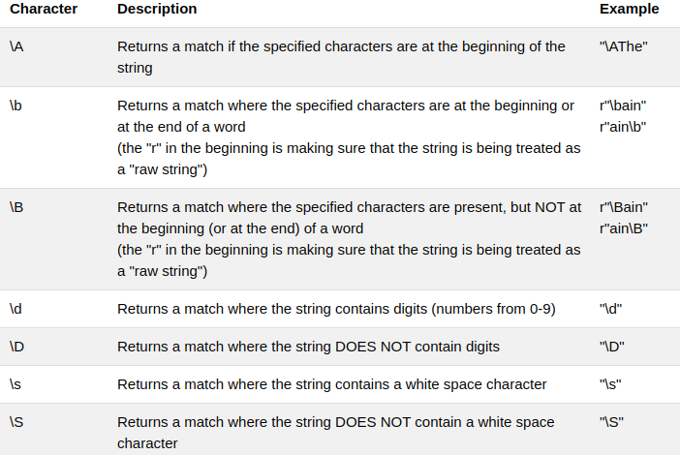
Sequence Characters
A special sequence is a \ followed by one of the characters in the list below,
It matches onlyone character in the string

Slide 9
Sequence Characters

Slide 10
Sequence Characters Example
Write a regular expression to retrive all words starting with “a”.
r’a[\w]*’
Here, “a”- the word should start with ‘a’
[\w]* - repetition of any alphanumeric characters.
Note: * is used for 0 or more repetitions.

Slide 11
Sequence Characters Example
Write a regular expression to retrive all words starting with “a”.
import re
s1=’ An apple a day keeps the doctor away’
res=re.findall(r’a[\w]*’,s1)
for word in res:
print(word)
Note:to get only word use “res=re.findall(r'\ba[\w]*\b',s1)”

Slide 12
Example
Write a regular expression to retrive all words starting with a numeric digit
import re
s1=’ The exam is scheduled during 15th to 26th February’
res=re.findall(r’\d[\w]*’,s1)
for word in res:
print(word)

Slide 13
Example
Write a regular expression to retrive all words having 5 character length.
import re
s1=' The exams are scheduled during 15th to 26th February'
#res=re.findall(r'\d[\w]*',s1)
res=re.findall(r'\b\w{5}\b',s1)
for word in res:
print(word)

Slide 14
Example
Write a regular expression to retrive all words which are at least 5 character length.
import re
s1=’ The exam is scheduled during 15th to 26th February’
res=re.findall(r’\b\w{5,}\b’,s1)
for word in res:
print(word)

Slide 15
Exercises
Write a regular expression to retrive all words with 3,4 or 5 character length.
Write a regular expression to retrive all single digits from string.
Write a regular expression to retrive last word from the string

Slide 16
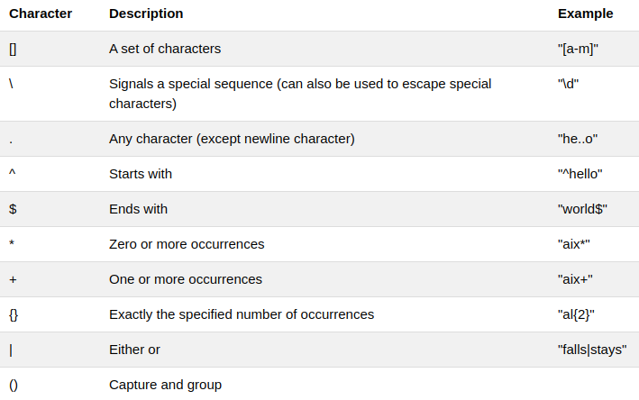
Quantifiers / Metacharacters
These are characters with a special meaning.
For example . ^ $ * + ? {} () \ |

Slide 17
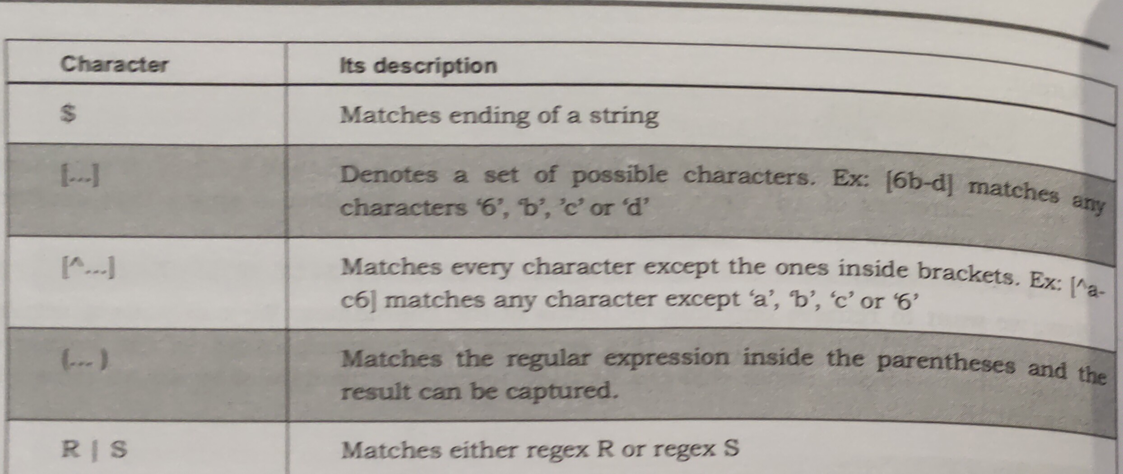
Quantifiers / Metacharacters

Slide 18
Example
Write a regular expression to retrive only name
import re
s1="Ajay Shah: 7145126931"
res=re.search(r'\D+', s1)
print(res.group())

Slide 19
Example
Write a regular expression to retrive phone numer from string
import re
s1="Ajay Shah: 7145126931"
res=re.search(r'\d+', s1)
print(res.group())

Slide 20
Example
regular expression to retrive all words starting with ‘an’ or ‘ok’
res=re.findall(r’a[nk][\w]*’,s1)
regular expression to retrive DOB from string
res=re.findall(r’\d{1,2}-\d{1,2}-\d{4}’,s1)
regular expression to check that given string start with “she” or not
res=re.search(r”^she”,str)
use(if)

Slide 21
Example
regular expression to search for a word at the ending a string.
import re
s1="Hello Students"
res=re.search(r"students$",s1)
res=re.search(r"students$",s1,re.IGNORECASE)
if res:
print("String ends with 'Students'")
else:
print("String Does not end with 'Students'")

Slide 22
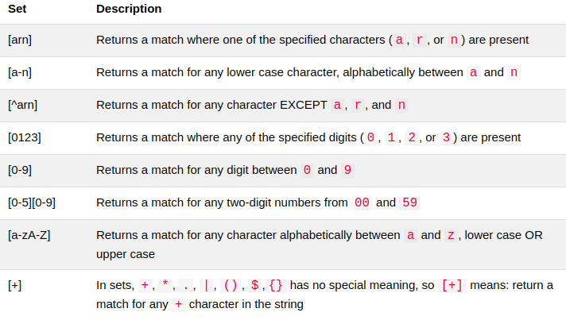
Sets
A set is a set of characters inside a pair of square brackets [] with a special meaning:

