Slide 1
GANDHINAGAR INSTITUTE OF TECHNOLGY
Computer Engineering Department
Python Programming (2180711)
Visualization
By
Prof. Margil Shah

Slide 2
Graphical displays should:
Show the data
Induce the viewer to think about substance, not
Methodology
Design
Technology
Tell the truth
Make the complex simple
Serve a clear purpose
Reveal the data

Slide 3
Data

Slide 4
Visualization

Slide 5
Fate of Napoleon’s Army
Advance
Retreat
Temperature

Slide 6
Principles of Graphics Excellence
Matter of substance, statistics, and design
Communicate complex ideas with clarity, precision, and efficiency
Give viewer the greatest number of ideas in the shortest time, with the least ink, in the smallest space

Slide 7
Data

Slide 8
Samples and Populations
Law of Large Numbers:
The more observations we have, the greater the understanding we have of the true behavior of a system
Sample: set of observations
Population: all possible observations

Slide 9
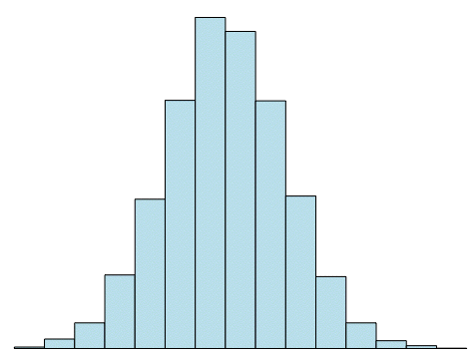
Distribution
Arrangement of the set of possible solutions along a number line

Slide 10
Statistical Properties of Data
Mean: average of all the values (expected value)
Median: middle value
Mode: value that occurs most often
Variance: spread away from the mean
Standard Deviation: square root of the variance
Min
Max

Slide 11
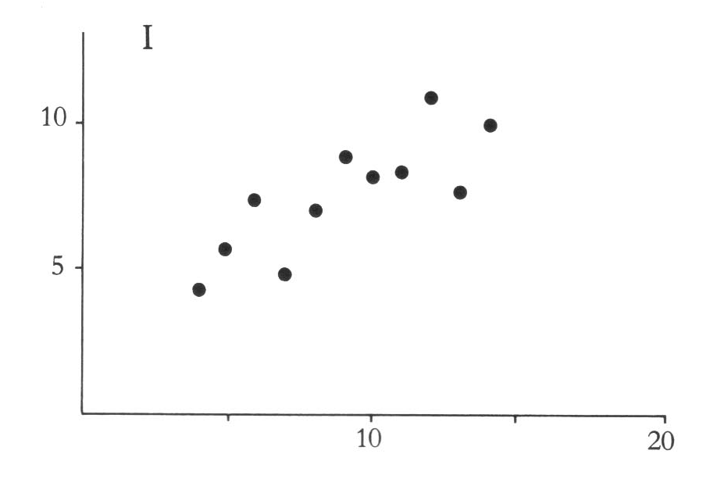
Relational Statistics
Covariance: spread of values in multiple dimensions
Correlation: how well one measure predicts another

Slide 12
Pylab and Python Statistics
mean(<DATA>)
median(<DATA>)
var(<DATA>)
std(<DATA>)
correlate(<DATA>)
corrcoeff(<DATA>)
cov(<DATA>)

Slide 13
Blocks of code
>>> def plotData():
plot(Year, Marijuana)
show()
xlabel('Year')
ylabel('Percentage')
title('Marijuana Drug Use')
Function: a block of related code that performs a single task
def
plotData: a user-defined “keyword”

Slide 14
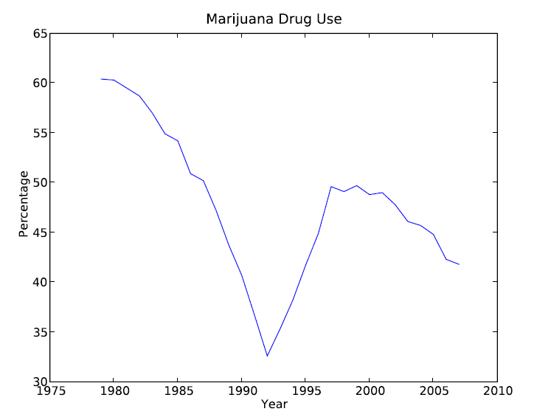
Running a Function
>>> plotData()

Slide 15
Parameters
>>> def plotData():
plot(Year, Marijuana)
show()
xlabel('Year')
ylabel('Percentage')
title('Marijuana Drug Use')
>>> def plotData2():
plot(Year, Heroin)
show()
xlabel('Year')
ylabel('Percentage')
title('Heroin Drug Use')

Slide 16
Parameters
Input
Flexibility
>>> def plotData():
plot(Year, Marijuana)
show()
xlabel('Year')
ylabel('Percentage')
title('Marijuana Drug Use')
>>> def plotData(data, name):
plot(Year, data)
show()
xlabel('Year')
ylabel('Percentage')
title(name + ' Drug Use')

Slide 17
Parameters
>>> plotData(Marijuana, 'Marijuana')

Slide 18
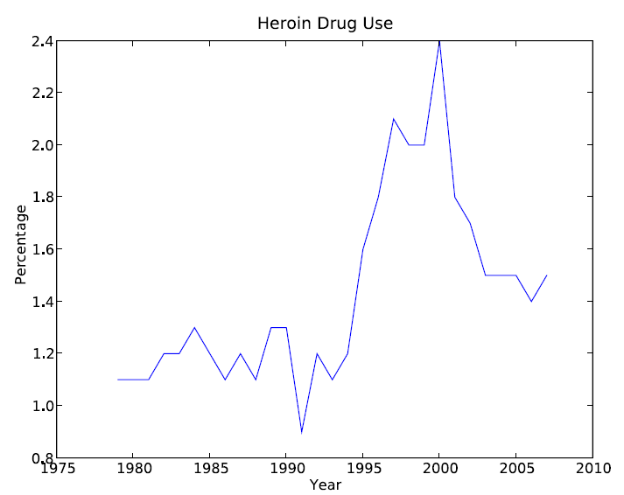
Parameters
>>> plotData(Heroin, 'Heroin')

Slide 19
Functions
def <FUNCTION NAME> (<PARAMTERS>):
<SOMETHING>
:
<SOMETHING>

Slide 20
Running a Function
Traceback (most recent call last):
File "<pyshell#5>", line 1, in <module>
plotData()
NameError: name 'plotData' is not defined
>>> plotData()

Slide 21
Modules
Type the function definition in a text file
Save
→ SOURCE CODE

Slide 22
Modules
Type the function definition in a text file
Save
→ SOURCE CODE
# File: plotdata.py
# Purpose: A useful plotting function
# Author: Me
# Import Pylab
from pylab import *
# Import Data
from DrugData import *
# Define the function
def plotData(data, name):
plot(Year, data)
show()
xlabel('Year')
ylabel('Percentage')
title(name + ' Drug Use')

Slide 23
Comments
Annotate
Explain
Identify
# File: plotdata.py
# Purpose: A useful plotting function
# Author: Me

Slide 24
Import Statement
Load modules into interpreter memory
from <MODULE> import <SOMETHING>
from DrugData import Marijuana
# Import Pylab
from pylab import *
# Import Data
from DrugData import *

Slide 25
Strings
A list of characters
Indicated by '<SOMETHING>'
String concatenation: 'a' + 'b' → 'ab'
title(name + ' Drug Use')

Slide 26
Function Definition
You can define more than function in a module
# Define the function
def plotData(data, name):
plot(Year, data)
show()
xlabel('Year')
ylabel('Percentage')
title(name + ' Drug Use')

Slide 27
Running a Function from a Module
>>> from plotData import *
>>> plotData(Heroin, 'Heroin')

Slide 28
Return Values
Output
return <SOMETHING>
Function exits immediately after executing
>>> def average(data):
# function uses “average”
# instead of “mean”
return mean(data)

Slide 29
Module Syntax: Indentation
>>> def plotData():
plot(Year, Marijuana)
show()
xlabel('Year')
ylabel('Percentage')
title('Marijuana Drug Use')
File "<pyshell#7>", line 3
show()
^
IndentationError: unexpected indent

Slide 30
Thank You

