Slide 1
Solar Thermal System
Solar Thermal Collector

Slide 2
Introduction
Solar Thermal
Solar Photovoltaic
In cold climate large amount of low grade thermal energy is used.
24% of all industrial application consumed for heating fluid to a moderate temperature
Solar energy for preheating up to 180˚C

Slide 3
Solar Thermal Collector
Low density per unit area (1kW/m² – 0.1kW/m²)
Collected by covering large area
Solar energy as heat
Transfer to heat transport fluid
Thermal storage tank/boiler/heat exchanger

Slide 4
Comparison of energy absorbed for various modes of tracking
Tracking mode | Solar energy (kWh/m²) |  |  | Percent to full tracking
 | E | SS | WS | E | SS | WS
Full tracking | 8.43 | 10.60 | 5.70 | 100.0 | 100.0 | 100.0
E-W Polar | 8.43 | 9.73 | 5.23 | 100.0 | 91.7 | 91.7
N-S Horizontal | 6.22 | 7.85 | 4.91 | 73.8 | 74.0 | 86.2
E-W Horizontal | 7.51 | 10.36 | 4.47 | 89.1 | 97.7 | 60.9
Note: E - Equinoxes, SS - Summer Solstice, WS - Winter Solstice

Slide 5
Classifications
Solar Collectors
Non – concentrating type
Concentrating type
Liquid flat-plate collector
Flat-plate air-heating collector

Slide 6
 |  | Concentrating Type
Focus Type |  |  |  | Point Focus |  |  | Non-Focus
Cylindrical parabolic concentrator
Fixed mirror solar concentrator
Linear Fresnel lens collector
Parabolic dish collector
Hemispherical bowl mirror concentrator
Circular Fresnel lens collector
Central Tower receiver
Modified flat plate collector
Compound parabolic concentrating type

Slide 7
Non-concentrating type
Absorb radiation received on surface
Both beam &diffused radiation
No optical concentration method
No need of solar tracking
Simple and compact construction
Fixed on rigid platform- maintanence free
High temp cannot be achieved

Slide 8
Concentrating type
Converging solar radiation from large area to small area
Beam radiation utilized
Optical methods( reflection,refraction)
Solar tracking required
Diffused radiation cannot be concentrated
High temp attained.
Flexible construction

Slide 9
Flat Plate Collector
Less than 100˚C
Both beam and diffused radiation

Slide 10
Flat-plate collector

Slide 13
Flat-plate Collectors

Slide 14
Types of flat-plate collectors Water systems
Glazing
Riser
Absorbing plate
Glazing
Riser
Absorbing plate
A
C
Insulation
Insulation
Glazing
Riser
Absorbing plate
B
Glazing
Riser
Absorbing plate
D
Insulation
Insulation

Slide 15
Types of flat-plate collectors Air systems
Glazing
Air passage
E
Glazing
Corrugated sheet
G
Insulation
Glazing
Air flow
Metal matrix
F
Insulation
Insulation

Slide 16
Schematic diagram of an evacuated tube collector

Slide 20
Flat plate collector with flat reflectors
Sun rays
Flat plate collector
Flat reflector

Slide 21
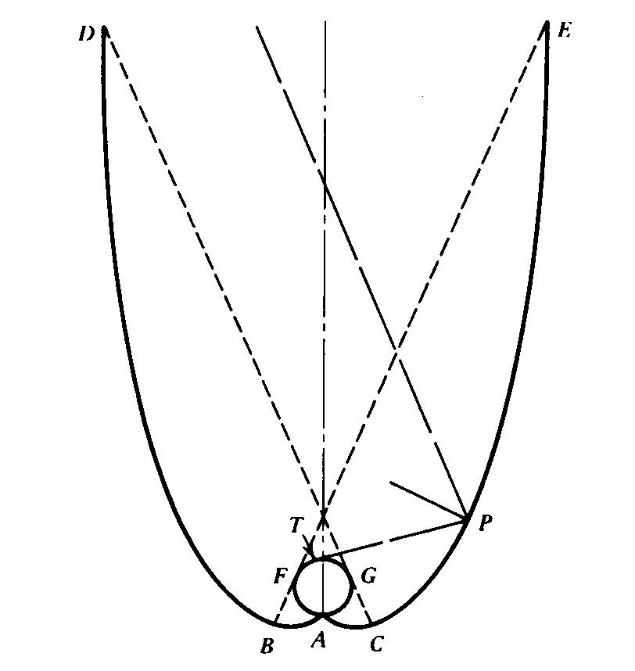
Schematic diagram of a CPC collector
θc

Slide 22
Modified Flat Plate Collector
Incident Rays
Reflector
Flat absorber

Slide 23
Compound Parabolic Concentrator
Optical Axis
Aperture
Section of Parabola B
Focus of Parabola B
Section of Parabola A
Focus of Parabola A
Flat Receiver (Absorber)

Slide 24
Concentrating Collectors
Parabolic Trough Concentrator
Central Receiver with Heliostat Field
Parabolic Disc Concentrator
Fresnel Lens Concentrator

Slide 25
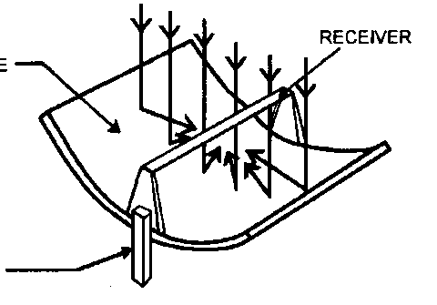
Cylindrical Parabolic Concentrator
Sun rays
Receiver detail
Parabola
Receiver
Glass cover
Tracking mechanism
Receiver tube

Slide 26
Parabolic trough collectors

Slide 27
Linear Fresnel Reflector (LFR)
Receiver
Sun rays
Tower
Mirrors

Slide 28
Schematic diagram showing interleaving of mirrors in a CLFR with reduced shading between mirrors
Receiver
Receiver
Sun rays
Tower
Tower
Mirrors

Slide 29
Fixed Mirror Solar Concentrator

Slide 30
Linear Fresnel Lens Collector

Slide 31
Schematic of a parabolic dish collector
Sun rays
Receiver
Parabola
Two-axes tracking mechanism

Slide 32
Parabolic Dish Collector

Slide 33
Schematic of central receiver system

Slide 34
Central Tower Receiver

Slide 35
Types of solar collectors
Motion | Collector type | Absorber type | Concentration ratio | Indicative temperature range (°C)
Stationary | Flat plate collector (FPC) | Flat | 1 | 30-80
 | Evacuated tube collector (ETC) | Flat | 1 | 50-200
 | Compound parabolic collector (CPC) | Tubular | 1-5 | 60-240
Single-axis tracking |  |  | 5-15 | 60-300
 | Linear Fresnel reflector (LFR) | Tubular | 10-40 | 60-250
 | Parabolic trough collector (PTC) | Tubular | 15-45 | 60-300
 | Cylindrical trough collector (CTC) | Tubular | 10-50 | 60-300
Two-axes tracking | Parabolic dish reflector (PDR) | Point | 100-1000 | 100-500
 | Heliostat field collector (HFC) | Point | 100-1500 | 150-2000
Note: Concentration ratio is defined as the aperture area divided by the receiver/absorber area of the collector.

Slide 36
Performance Indices
Collector efficiency: Ratio of the energy actually absorbed and transferred to the heat-transport fluid by the collector (useful energy) to the energy incident on the collector.
Concentration ratio: ratio of the area of aperture of the system to the area of the receiver. Aperture of the system is the projected area of the collector facing the beam.
Temperature range: range of temperature to which the heat-transport fluid is heated up by the collector.

Slide 38
Performance Evaluation of Flat Plate Collector
The useful heat output of a flat-plate solar collector is given by
Watt

Slide 39
Efficiency of the Solar Collector

Slide 40
The Outlet Temperature of the Fluid from the Collector

Slide 41
The Stagnating Temperature

Slide 42
A flat plate collector is working under the following conditions:
The intensity of solar radiation of the collector surface = 760W/m²
Inlet temperature of the fluid = 43 ˚C
Ambient Temperature = 26 ˚C 4.Effecvtive optical efficiency = 0.82
Effective heat loss coefficient = 2.1
Mass flow rate of water = 0.017 kg/s/m²d
C_{p} of the water = 4187 J/kg
Calculate outlet temperature of water, stagnation temperature and useful heat output

Slide 43
Performance Evaluation of Concentrating Collector

Slide 44
Optical efficiency

Slide 45
Efficiency of the Collector

Slide 46
Comparison of performance of different collectors
S.N. | Type | Effective Opt. Eff. | Eff. Heat loss coef. | Operating Temp | Cost $/m²
1 | Flat plate collector with no cover | 0.9 | 15-20 | 30 | 120-170
2 | Flat plate collector with single cover | 0.8 | 35-40 | <100 | 300-500
3 | Evacuated tube collector | 0.7 | 1.5-1.8 | <250 | 700-1000
4 | Parabolic trough collector | 0.8 | 0.2-0.7 | 400 | 700

Slide 47
Solar Water Heater
Swimming pool 23 -28˚C Domestic hot water 45-60 ˚C Space heating 30-90 ˚C

Slide 49
Compact Systems (Passive Systems)
A compact system can save up to 4.5 tonnes
Some systems can work for up to 25 years with minimum maintenance
These kinds of systems can be redeemed in six years, and achieve a positive balance of energy (energy they save minus energy used to build them) of 1.5 years
Most part of the year, when the electric heating element is not working, these systems do not use any external source for power

Slide 50
Solar Water Heater Design:
The heat quantity of hot water per month is

Slide 51
Heat required for space heating per month

Slide 52
Surface Area of the collector required

Slide 53
Surface Area of the collector required

Slide 54
The following data may be used for the design of solar water heater
Solar radiation = 5 kW/m²/day
Hot water required = 1000 kg/day
Hot water temperature = 45 deg. C
Cold water temperature = 14 deg. C
C_{pw} = 1.163 Wh/kg-K
Mean Efficiency of the water heater = 48%
Piping and storage heat loss may be neglected. If a single plant has an area of 2.2m², find out the total area required and number of solar collector module.

Slide 55
Pumped Systems (Active Systems)
electricity to circulate the fluid
through the collector
The electronic controllers used by some systems permit a wide range of functionality such as measurement of the energy produced; more sophisticated safety functions; thermostatic and time-clock control of auxiliary heat, hot water circulation loops, or others; display or transfer of error messages or alarms; remote display panels; and remote or local datalogging.

Slide 57
Heating Water: Active System
Active System uses antifreeze so that the liquid does not freeze if outside temp. drops below freezing.

Slide 58
Heating Water—Last Thoughts
Efficiency of solar heating system is always less than 100% because:
% transmitted depends on angle of incidence,
Number of glass sheets (single glass sheet transmits 90-95%), and
Composition of the glass
Solar water heating saves approx. 1000 megawatts of energy a yr, equivalent to eliminating the emissions from two medium sized coal burning power plants.
By using solar water heating over gas water heater, a family will save 1200 pounds of pollution each year.
Market for flat plate collectors grew in 1980s because of increasing fossil fuels prices and federal tax credits. But by 1985, when these credits were removed and fossil fuel prices were low, the demand for flat plate collectors shrunk quickly.
While solar water heating is relatively low in the US, in other parts of the world such as Cyprus (90%) and Israel (65%), it proves to be the predominate form of water heating.

Slide 59
Heating Living Spaces
Best design of a building is for it to act as a solar collector and storage unit. This is achieved through three elements: insulation, collection, and storage.
Efficient heating starts with proper insulation on external walls, roof, and the floors. The doors, windows, and vents must be designed to minimize heat loss.
Collection: south-facing windows and appropriate landscaping.
Storage: Thermal mass—holds heat.
Water= 62 BTU per cubic foot per degree F.
Iron=54, Wood (oak) =29, Brick=25, concrete=22, and loose stone=20

Slide 60
Heating Living Spaces
Passive Solar
Trombe Wall
Passively heated home in Colorado

Slide 61
Air

Slide 62
Heating Living Spaces
A passively heated home uses about 60-75% of the solar energy that hits its walls and windows.
The Center for Renewable Resources estimates that in almost any climate, a well-designed passive solar home can reduce energy bills by 75% with an added construction cost of only 5-10%.
About 25% of energy is used for water and space heating.
Major factor discouraging solar heating is low energy prices.

Slide 63
Pool or unglazed

Slide 64
Solar-Thermal Electricity: Power Towers
General idea is to collect the light from many reflectors spread over a large area at one central point to achieve high temperature.
Example is the 10-MW solar power plant in Barstow, CA.
1900 heliostats, each 20 ft by 20 ft
a central 295 ft tower
An energy storage system allows it to generate 7 MW of electric power without sunlight.
Capital cost is greater than coal fired power plant, despite the no cost for fuel, ash disposal, and stack emissions.
Capital costs are expected to decline as more and more power towers are built with greater technological advances.
One way to reduce cost is to use the waste steam from the turbine for space heating or other industrial processes.

Slide 65
Power Towers
Power tower in Barstow, California.

Slide 66
Solar oven or Solar cooker
A solar oven or solar cooker is a device which uses sunlight as its energy source. Because they use no fuel and they cost nothing to run, many organizations are promoting their use worldwide to help slow deforestation and desertification, caused by using wood as fuel for cooking.

Slide 68
Solar cookers at the Iridimi camp for refugees
from the Darfur region of Sudan

Slide 69
Types
There are a variety of types of solar cookers: over 65 major designs and hundreds of variations of them.
Concentrating sunlight
Converting light to heat
Trapping heat
Box Cooker
Panel cooker
Solar kettles

Slide 70
Concentrating sunlight
Some device, usually a mirror or some type of reflective metal, is used to concentrate light and heat from the sun into a small cooking area, making the energy more concentrated and therefore more potent.

Slide 71
Parabolic Dishes and Troughs
Collectors in southern CA.
Because they work best under direct sunlight, parabolic dishes and troughs must be steered throughout the day in the direction of the sun.

Slide 72
Concentrating sunlight

Slide 73
Parabolic trough cooker

Slide 74
Parabolic dish cooker

Slide 75
Converting light to heat
Any black on the inside of a solar cooker, as well as certain materials for pots, will improve the effectiveness of turning light into heat. A black pan will absorb almost all of the sun's light and turn it into heat, substantially improving the effectiveness of the cooker. Also, the better a pan conducts heat, the faster the oven will work.

Slide 76
Trapping heat
Isolating the air inside the cooker from the air outside the cooker makes an important difference. Using a clear solid, like a plastic bag or a glass cover, will allow light to enter, but once the light is absorbed and converted to heat, a plastic bag or glass cover will trap the heat inside. This makes it possible to reach similar temperatures on cold and windy days as on hot days.

Slide 77
Box Cooker

Slide 78
Box Cooker

Slide 79
Panel cooker

Slide 80
Panel cooker

Slide 81
Solar kettles
Solar
kettles
are solar thermal
devices that can heat water to boiling point through the reliance on solar energy alone. Typically they use evacuated solar glass tube technology to capture, accumulate and store solar energy needed to power the kettle. Besides heating liquids, since the stagnating temperature of solar vacuum glass tubes is a high 220 °C (425 °F), solar kettles can also deliver dry heat and function as ovens and autoclaves.

Slide 82
Hybrid cookers

Slide 83
Solar Panels in Use
Because of their current costs, only rural and other customers far away from power lines use solar panels because it is more cost effective than extending power lines.
Note that utility companies are already purchasing, installing, and maintaining PV-home systems (Idaho Power Co.).
Largest solar plant in US, sponsored by the DOE, served the Sacramento area, producing 2195 MWh of electric energy, making it cost competitive with fossil fuel plants.

Slide 84
Efficiency and Disadvantages
Efficiency is far lass than the 77% of solar spectrum with usable wavelengths.
43% of photon energy is used to warm the crystal.
Efficiency drops as temperature increases (from 24% at 0°C to 14% at 100°C.)
Light is reflected off the front face and internal electrical resistance are other factors.
Overall, the efficiency is about 10-14%.
Cost of electricity from coal-burning plants is anywhere b/w 8-20 cents/kWh, while photovoltaic power generation is anywhere b/w $0.50-1/kWh.
Does not reflect the true costs of burning coal and its emissions to the nonpolluting method of the latter.
Underlying problem is weighing efficiency against cost.
Crystalline silicon-more efficient, more expensive to manufacture
Amorphous silicon-half as efficient, less expensive to produce.

Slide 85
Summary
Solar Thermal System
Introduction
Classifications
Non – concentrating type
Concentrating type
Performance Evaluation of Flat Plate Collector
Performance Evaluation of Concentrating Collector
Comparison of performance of different collectors
Solar Water Heater
Solar oven or Solar cooker

Slide 87
Thank you

