Slide 1
Brakes

Slide 2
Functions of Brakes
To slow down or to stop the vehicle as and when required.
To control the vehicle when the vehicle is rolling down on a slope road down ward.
To travel smoothly and safely even in heavy flow of traffic by controlling the movement of the vehicle.
Requirement of Automobile Brakes
The brakes must stop the vehicle within shortest possible distance.
These must be released suddenly after releasing them
Total control of the vehicle should be there.

Slide 3
Weight transfer During Braking

Slide 4
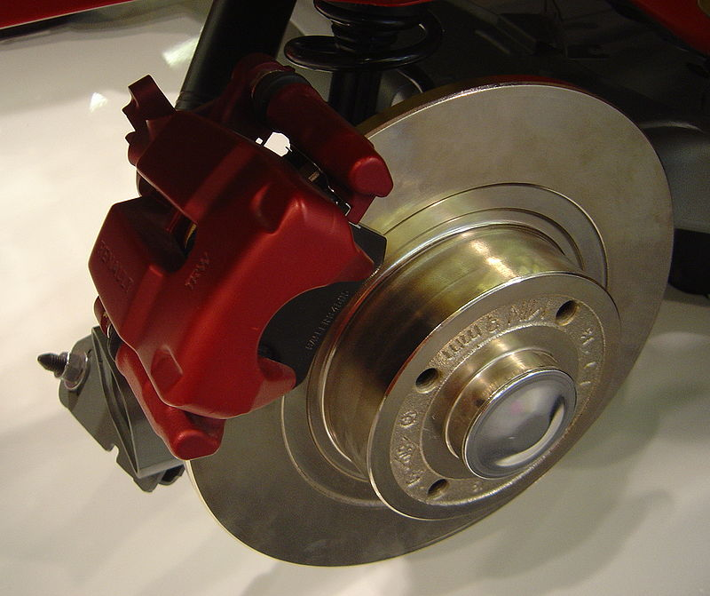
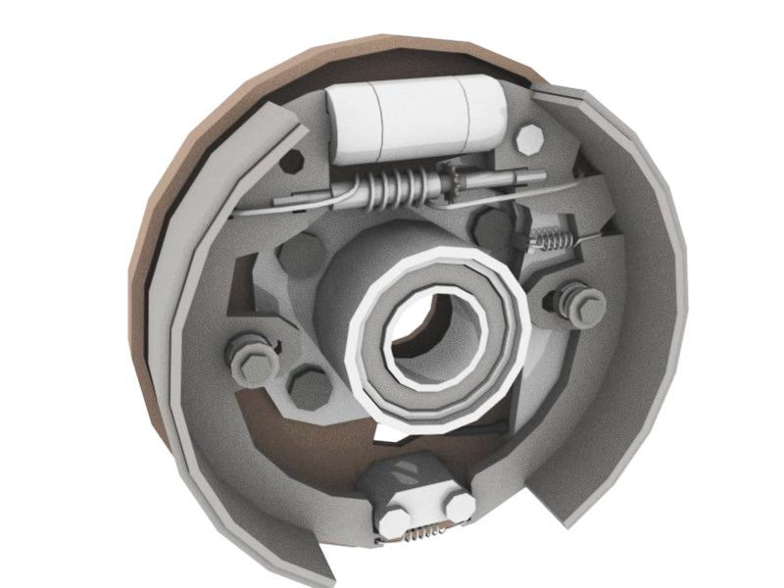
Types of Brakes
According method of Actuation
Mechanical brakes
Hydraulic brakes
Vacuum brakes
Air brakes
According to Construction
Drum brakes
Disc brakes
According to purpose
Service brake
Parking brake
According to extra braking effort
Servo or Power-operated brakes

Slide 5
Drum Brakes
Brake drum attached to axle hub.
Back plate is attached on axle casing. It provides support for expander, anchor and brake shoes. It also protect the drum & shoe from mud & dust.
Moreover it also absorb the torque reaction of shoe – torque plate.
Friction lining is mounted on brake shoe.
One or two retracting spring is used to keep brake shoe away from drum when brake is not applied.

Slide 6
Drum Brakes
Brake shoe are anchored at one end and on other end Force F is applied by means of actuating mechanism.
Adjuster is provided to compensate for wear of friction lining.
Fixed expander / Floating expander.
Fixed anchor / Floating anchor.

Slide 7
Disc Brakes
It consists of disc of cast iron is bolted to wheel hub & stationary housing called caliper.
Caliper is casted in two parts each containing piston.
Friction pad is provided between each piston and disc.
Passages are provided in caliper for fluid to enter or leave each housing.
These passage is also connected to another for bleeding.

Slide 9
Hydraulic Brakes

Slide 10
Hydraulic Brakes

Slide 11
Master Cylinder
It is the most important part of hydraulic braking system . It contains
Two main chambers .
Fluid reservoir – which stores the brake fluid in it
Barrel-which is compressor and develops pressure in brake fluid.

Slide 12
Master cylinder
(a) Primary cup (b) Piston (c) Secondary cup (d) Return spring (d) Return spring (e) Check valve .

Slide 13
Bleeding of Brakes in Hydraulic brakes.

Slide 14
Bleeding of Brakes in Hydraulic brakes.
At first check all the pipe lines and junction boxes from master cylinder to wheel cylinder. Whether there is any leak among them.
Ask one person to pump the brake pedal and keep it in pressing position
The second person should loosen the bleeding screw at the back plate of the wheel cylinder position.
Keep the bleeding screw in open until the air bubbles disappear and the brake fluid comes out with a force . Collect the brake fluid in a glass tumbler.
Then tighten the bleeding screw.
Repeat this process in all the wheel cylinders starting from the farthest wheel to the master cylinder and ending with the nearest wheel.
Make sure that the level of brake fluid in master cylinder is ¼ less than the top covers while filling it.

Slide 15
Air Brake

Slide 17
Vacuum Brake
First Type :
Release condition piston are exposed to atmosphere.
Applying brake one side of piston is subjected to vacuum of engine which cause the differential pressure & operates the linkage mechanism.
Second type:
Release condition both side of piston is subjected to vacuum.
To apply brake one side of piston will be exposed to atmosphere which provides desired force on the piston.

