Slide 1
Drives

Slide 2
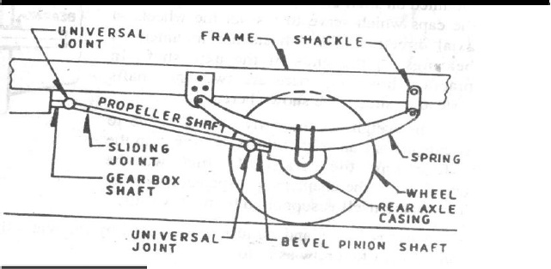
Hotchkiss drive

Slide 3
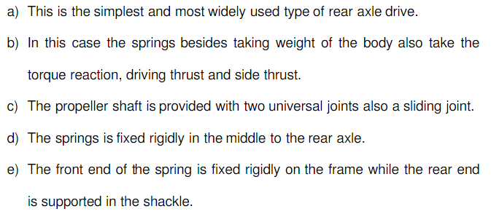
Hotchkiss drive

Slide 4
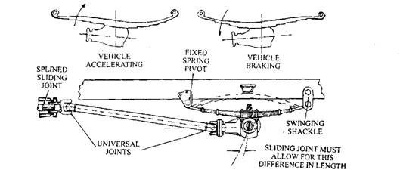
Hotchkiss drive

Slide 5
Torque-tube Drive
A tubular member called torque-tube, encloses the propeller shaft and is bolted rigidly to the axle casing.
The torque-tube is positioned at the front by a ball and socket joint, which is located at the rear of the gearbox or cross-member of the frame.
Bracing rods are introduced between the axle casing and the torque tube to strengthen the arrangement.
A small-diameter propeller shaft is installed inside the torque tube and splined to the final-drive pinion.
torque reaction and driving thrust are taken up by the torque tube
forward thrust from the ball is taken on the rear housing

Slide 6
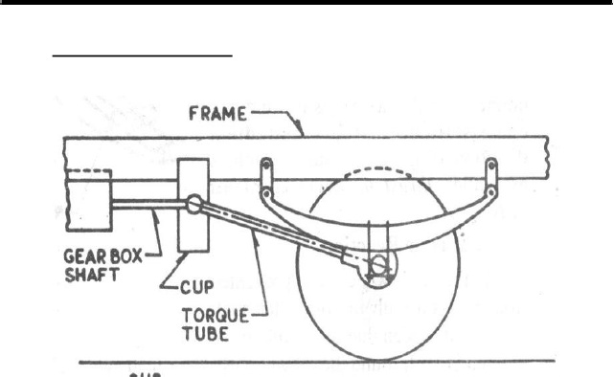
Torque-tube Drive

Slide 7
