Slide 1
GEARBOXES IN AUTOMOBILES

Slide 2
Introduction
Gearbox is speed and torque changing device between engine and driving wheels.
Gearbox exchanges engine power for greater torque to drive the vehicle under different operating condition.
Gearbox disconnect the clutch shaft from driving wheel during gear in neutral position.
Gearbox changes direction of rotation of driving wheels when gear is meshed in reverse position and provides backward movement of vehicle.

Slide 3
Types of Gearboxes
Sliding Mesh Gear box
Constant Mesh Gear Box
Synchromesh Gear Box
Transaxle Gear Box
Sequential gear box
Automatic Gear Box

Slide 4
Sliding Mesh Gearbox
Natural Gear Position : Gears of main shaft are not in contact hence no power is transmitted from clutch shaft to main shaft.

Slide 5
Sliding Mesh Gearbox
First Gear Position
Gear shift lever is applied such that Gear-6 slides on splines of main shaft and meshes with Gea-5.
Gear-1 is smaller than Gear-2 and Gear-5 is smaller than Gear-6. as a result of this speed of main shaft is very much reduced and torque is increased during first gear position.

Slide 6
Sliding Mesh Gearbox
Second gear position
Second Gear Position
Gear shift lever is applied such that Gear-4 slides on splines of main shaft and meshes with Gea-3.
Size of Gear-3 and Gear-4 is selected such that it gives high speed and less torque as compared to first gear.

Slide 7
Sliding Mesh Gearbox
Second gear position
Third gear position
Gear-4 with dog clutch slides towards Gear-1, main shaft is directly couples with clutch shaft.
Therefore main shaft rotates with same speed as clutch. This position of gear is called TOP GEAR.

Slide 8
Sliding Mesh Gearbox
Second gear position
Reverse Gear Position
Gear-6 mesh with intermediate (Idler) Gear-8.
Gear-8 is permanently mesh with Gear-7.
Speed reduction in reverse gear is same as that of first gear.

Slide 9
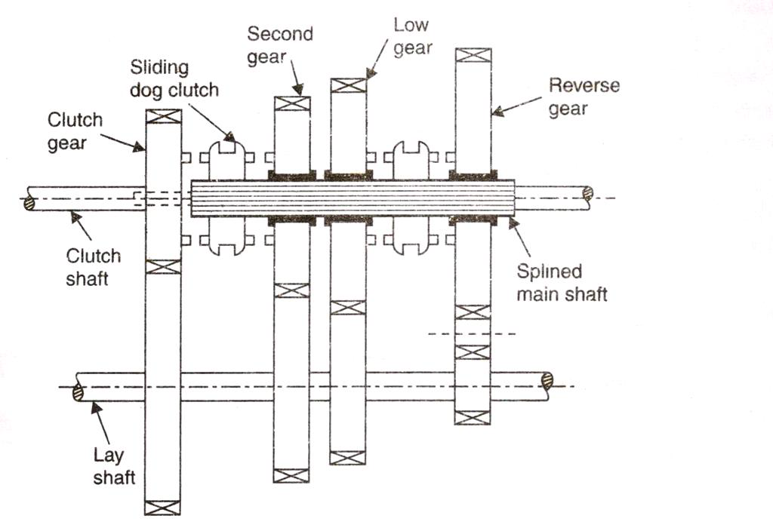
Constant Mesh Gearbox

Slide 10
Constant Mesh Gearbox
All the gears are always in mesh
Gears on counter shaft are fixed to it
Gears on main shaft are free to rotate on bearing.
Dog clutches can slide on the main shaft and rotate with it.
Dog clutches engage with gears on the main shaft to obtain desired speed
Advantages over Sliding mesh Gearbox:
Since the gears are engaged by dog clutches, if any damage occurs while engaging the gears, the dog unit members get damaged and not the gear wheels.

Slide 11
Herringbone Gears
Constant Mesh Gearbox
Helical and herringbone gear can be used in these gearboxes and therefore, constant mesh gearboxes are quieter.

Slide 12
Synchromesh Gearbox
Disadvantage of Constant Mesh
Type Gearbox
It requires Double Declutching.
Necessary to wait until gears to be meshed are rotating with same speed before actual meshing takes place, otherwise it leads to failure of gear teeth.
Gear shifting operation is requires considerable skill.

Slide 13
Synchromesh Gearbox

Slide 14
Synchromesh Gearbox
I speed gear
II speed gear
main shaft
III speed gear
5. top and III speed engaging dogs
6. top gear
7. primary shaft or main drive gear
8. counter shaft/cluster gear

Slide 15
Synchromesh Gearbox

Slide 16
Synchromesh Gearbox

Slide 17
Comparison Between Sliding Mesh, Constant Mesh and Synchromesh type Gearbox
Sliding Mesh | Constant Mesh | Synchromesh
Simplest design of gearbox | Better design as compared to Sliding Mesh | Advanced design gearbox
Gear shifting is takes place by sliding of gears on splined main shaft. | Gears of counter shaft are in constant mesh with gears on main shaft. Gears on main shaft are free to rotate and is locked with main shaft with the help of dog clutch. | All the gears are also mesh with corresponding gears and locking with main shaft takes place gradually with synchronizer provided on main shaft.
Spur Gears are used | Helical Gears are used | Helical Gears are used
Gear changing is not smooth and easy. It produce noise due to spur gears. More chance to damage the gear teeth during meshing. | Less chance of damage to gear teeth during meshing because dog clutch is used. | synchronizer unit makes gear changing easy, smooth and silent coupling. It also reduces the wear of gear.

Slide 18
Comparison Between Sliding Mesh, Constant Mesh and Synchromesh type Gearbox
Sliding Mesh | Constant Mesh | Synchromesh
Meshing gear must be rotating with same speed otherwise gear will clash and not mesh easily. Therefore double declutching is require to change the gear without damaging gear teeth. | Disadvantage of clashing are solved to certain extent. Driver has to match speed of gears to be engaged by double declutching. | Due to synchronizer unit gear meshing done through rotation coincides by frictional force so that their speed make them easier to mesh. Hence allow smooth and quick shifting of gears without damage to gear, noise and double declutching.
Due to above disadvantage it is not used in automobile. | It has been used in several two and three wheelers. | Most advance and has been adopted in most cars and other vehicles.

Slide 19
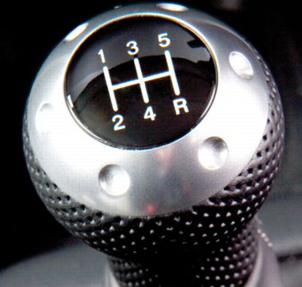
Gear Selector Mechanism

Slide 20
Gear Selector Mechanism
Operation of Interlocking Mechanism
Selector rods 1 and 3 locked & only rod 2 can be moved.
Selector rods 2 and 3 locked & only rod 1can be moved.
Selector rods 1 and 2 locked & only rod 3 can be moved.

Slide 21
Interlocking Grooves on Selector rod

Slide 25
Gear Selector Mechanism
Interlocking Mechanism to prevent two gears engagement at the same time.

Slide 26
Gearbox Trouble Shooting
Problem | Cause
Noisy Operation (When Vehicle is stationary) | Bearings may be worn out
 | Countershaft may be worn or bent
 | Countershaft gears may be worn out
 | Shortage or incorrect grade of lubricant
Noisy Operation (When Vehicle is Moving) | Gears may be worn out
 | Loose gear fitting on main shaft due to worn out splines
 | Worn-out bearings
 | Mounting bolts may be loose
 | Insufficient lubricant

Slide 27
Gearbox Trouble Shooting
Problem | Cause
Hard Gear Shifting | Incorrect clutch adjustment
 | Misalignment of clutch & gear box shaft
 | Gears tight on splines
 | Synchromesh unit may be jammed or damaged
 | Gear ball lever joint may be binding
 | Gear shifting mechanism may not be adjusted or lubricated properly

Slide 28
Gearbox Trouble Shooting
Problem | Cause
Gear Clash While Shifting | Incorrect clutch adjustment
 | Clutch linkage may be binding
 | Synchronizer assemblies may be worn or damaged
 | Low lubricant level (check for leakage)
Gear locked in one gear | Selector rod/lever/fork may be bent, worn or broken
 | Teeth on any gear may be broken
 | Other parts of gear-train assembly worn out

Slide 29
Gearbox Trouble Shooting
Problem | Cause
Gear Slipping | Loose gear on main shaft
 | Gear teeth or dog clutch may be worn out
 | Worn out bearings
 | Damaged clutch shaft
 | Misalignment of clutch housing
Leakage of Gearbox Oil | Damaged oil seals/gaskets
 | Damaged drain plug or gearbox case
 | Loose bolts on gearbox cover
 | Oil used is thinner then specified
 | Bent hole at the top may be blocked

